Slide 1
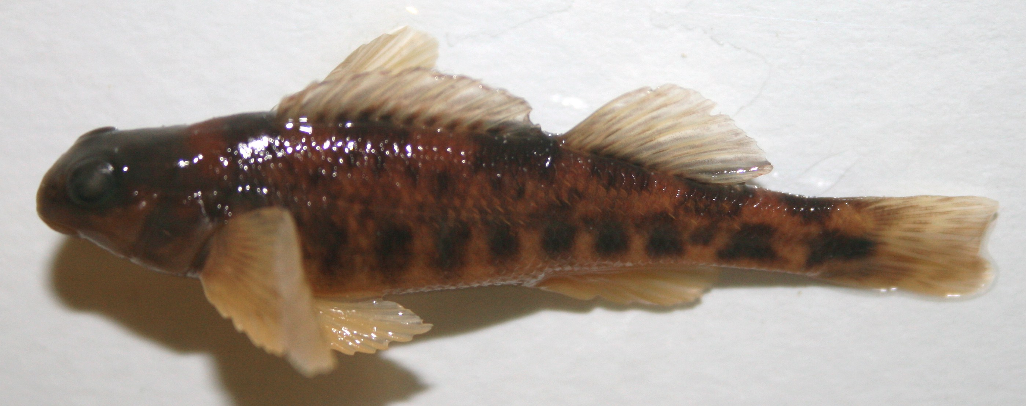
Use of Subimages in Fish Species Identification: A Qualitative Study
15 June 2011
JCDL Ottawa
http://umurthy.com/research/superidr
Uma Murthy
Eric Hallerman
Edward Fox
Manuel Perez-Quinones
Lin Tzy Li Ricardo Torres
Lois Delcambre
Notes:
INTRODUCE YOURSELF
Say title
Part of Uma Murthy’s dissertation work
Acknowledge Dr. Fox’s presence
>

Slide 2
Talk overview
A user study about use of subimages and of a prototype digital library in fish species identification
Findings and implications
Notes:
Overview of talk – In this talk, I will describe a user study where we explored the use of parts of images and of a prototype DL that enables working with parts of images in fish species identification. We’ll discuss the findings and what implications those have on the design of future digital libraries.

Slide 3
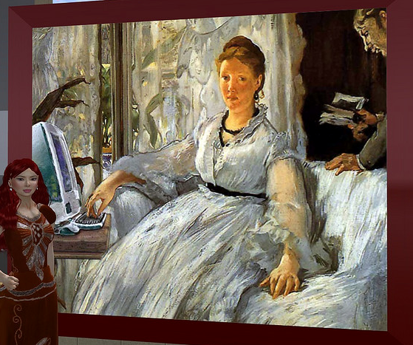
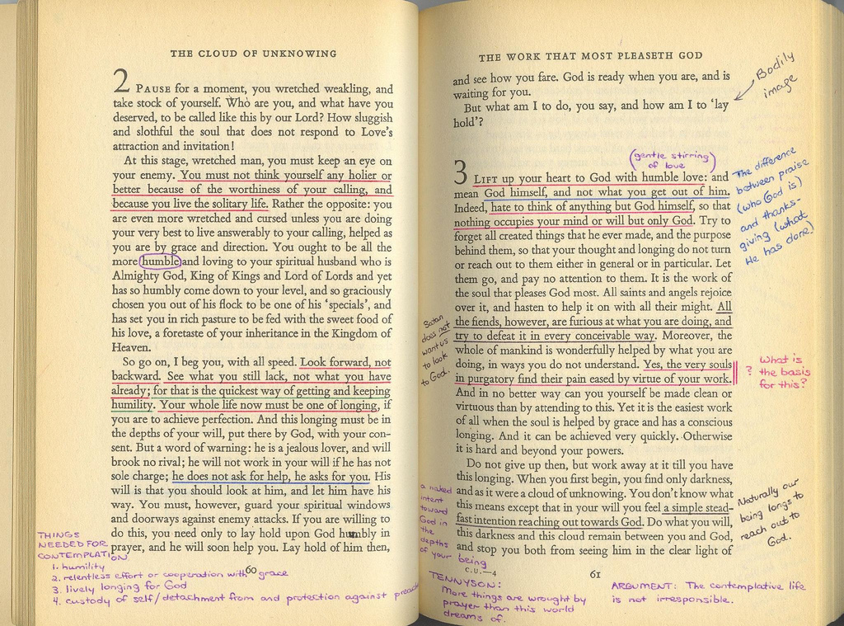
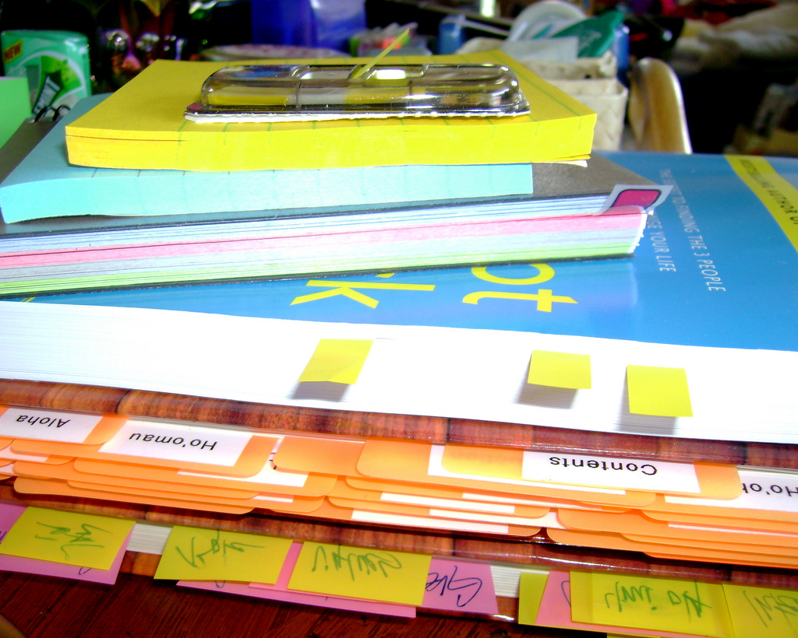
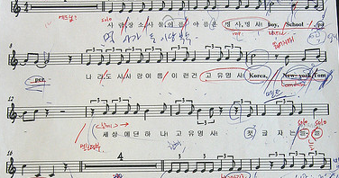
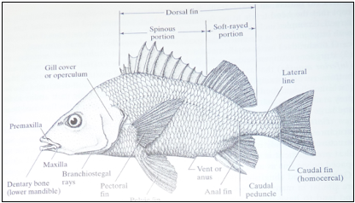
Motivation: many scholarly tasks involve working with subdocuments
Notes:
1. Main motivation: many scholarly tasks involve working with parts of documents, or subdocuments.
2. For example: an art history student studying an art style while marking up interesting parts of a painting and describing them. Or a teacher preparing notes and marking up textbooks, articles, and other various sources to prepare for a class. (mark up interesting and compare to others parts of other painting- slow)

Slide 4
Problems
Information is heterogeneous, voluminous, distributed across locations, and it is challenging to manage, organize, access, retrieve, and use.
Tools/methods (including paper-based and digital) are not well-integrated.
Ineffective and inefficient task execution
Notes:
People use various methods to accomplish these tasks, including paper-based approaches and digital tools.
However, when information becomes voluminous and distributed across locations, managing these information and these subdocuments, accessing them, and working with them becomes difficult. One reason is that the tools and methods to work this information are not well integrated.
All this can lead to inefficient and ineffective task execution.

Slide 5
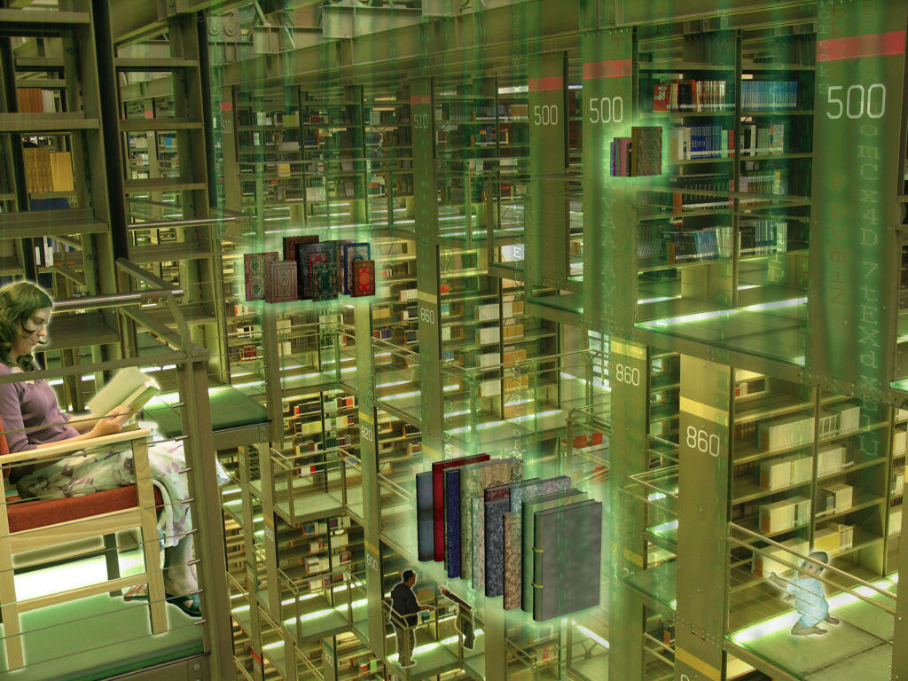
A digital library (DL) includes a repository of collections and metadata + services
Notes:
Now, a digital library helps us manage information and metadata through services.
However, DLs typically do that at level of a whole document and do not provide adequate support to work with subdocuments. – a whole picture, a whole video
In the following scenario, I will give an example of the kind of support that is required to work with subdocuments.

Slide 6
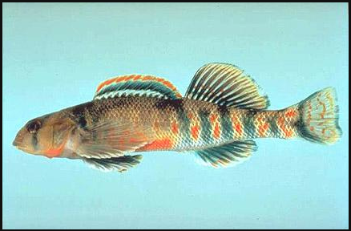
Scenario
While learning how to identify fish, a student might make use of an advanced query that involves searching for subimages, in context of other information, incl. other subimages:
Find me species that are darters that have a dorsal fin that looks like this, which is connected to another dorsal fin that looks like this, which might has an orange-colored edge
Notes:
Consider a scenario where a student is making use of an advanced query to search for a species.
She makes use of images and text to describe her query.
In this scenario, she is looking for a species of the darter family and one that has a dorsal fin <CLICK> connected to another dorsal fin <CLICK>, which has an orange-colored edge <CLICK>.
Thus she is looking for a species from a specific family of fishes and which has three parts that are connected as described.

Slide 7
Searching for such fine-grain contextual information is not supported by current DLs
Darter
Find me species that are darters that have a dorsal fin that looks like this, which is connected to another dorsal fin that looks like this, which might have an orange hue on its edge
Two dorsal fins connected
Orange edge
Notes:
Such searching is not currently supported by DLs.
The student is looking for an digital object with some metadata property, which is the family of darters and which in turn contains other objects (images), which in turn contain the specific parts and are associated that need to be present together. i.e. she is looking for a species that has two dorsal fins connected that look like the subimages shown. with textual descriptions as described.
Since subdocuments are not described and stored separately, they are not indexed and cannot be explicitly searched for.

Slide 8
Superimposed information (SI) enables working with contextualized subdocuments
superimposed (new) information
base (existing) information
Notes:
To help work with subdocuments in a DL, we bring in the notion of superimposed information.
Superimposed information enables working with parts of documents, while retaining the original information context of that subdocument/part. So we can work with the tail fin of a fish in the context of the whole fish image.

Slide 9
Hypothesis
enhanced
support to
scholarly
tasks with subdocuments
=
+
SI-DL
Notes:
Thus, our hypothesis is that combining this notion of superimposed information with traditional digital library concepts such as digital objects and metadata and services will provide enhanced support to scholarly tasks that involve working with subdocuments.

Slide 10
SuperIDR – a prototype personal SI-DL
Enables marking and annotating images
Combines text- and content-based image description, retrieval, and browsing, including for subimages
Notes:
We developed a prototype of an SI-DL, SuperIDR that enables working with parts of images.
It allows a user to mark-up and annotate parts of images and later retrieve information, including subimages, in multiple ways, including text- and content-based image retrieval.

Slide 11
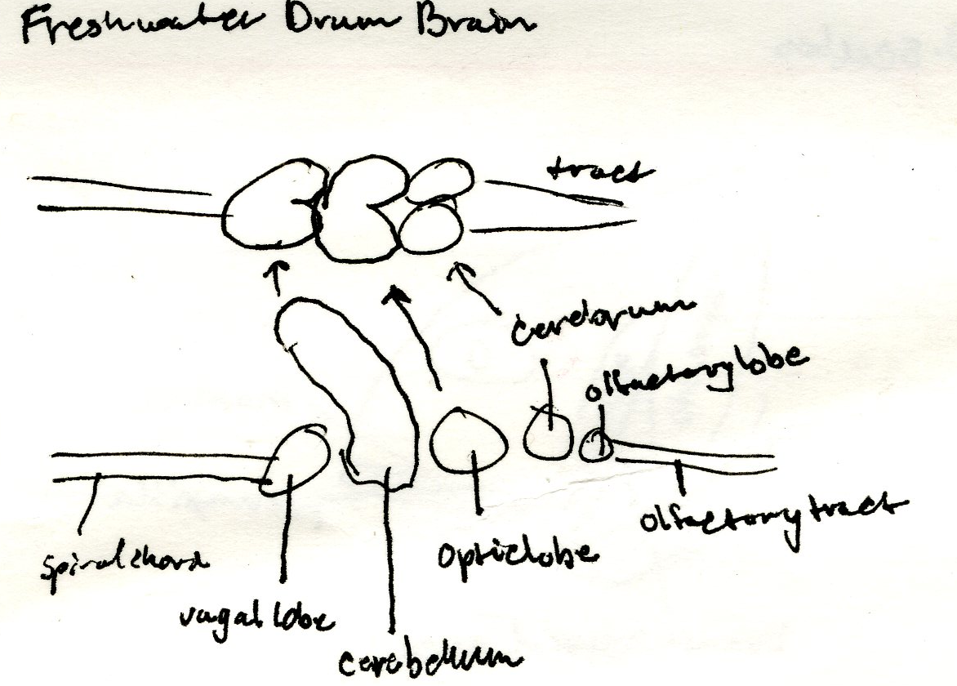
Task: fish species identification
Involves working with parts of fishes and fish images
1a Paired fins absent; jaws absent, mouth in an oral
disk (the disk mostly surrounded by a fleshy hood
in larvae); 7 external gill openings present in row
behind eye .......... Lampreys - Petromyzontidae p. ooo
1b Paired fins present (at least 1 set); jaws present;
1 external gill opening per side ................................... 2
2a Caudal fin heterocercal or abbreviate heterocercal
(Figure 5) ............................................................ 3
2b Caudal fin protocercal (Figure 13, Part 2, upper left)
or homocercal (Figure 5) ............................................ 6
Dichotomous keys
Personal Notes
Notes:
Test the SuperIDR-> choose fish
“specimen”
Our next step was to test SuperIDR, our prototype SI-DL in a scholarly task and how SuperIDR would support that scholarly task
Chose fish species identification as it inherently involves working with parts of fishes and fish images.
In fish identification, one is given an unknown fish specimen (TOP). Various fish ID materials such as a dichotomous key, text books, annotated pictures, and personal notes are used to identify the species of the unknown fish specimen. In most cases, a combination of these materials are used.
IF TIME PERMITS OR SOMEONE ASKS
There are various fish ID methods, but typically focus on distinguishing characteristics, dealing with descriptions of parts of the fish.
Dichotomous keys are akin to decision trees, where at each node a question is asked and depending on the answer, further questions are asked till one arrives at the species. Students might make notecards to study about species, which they might later use to identify the species.

Slide 12
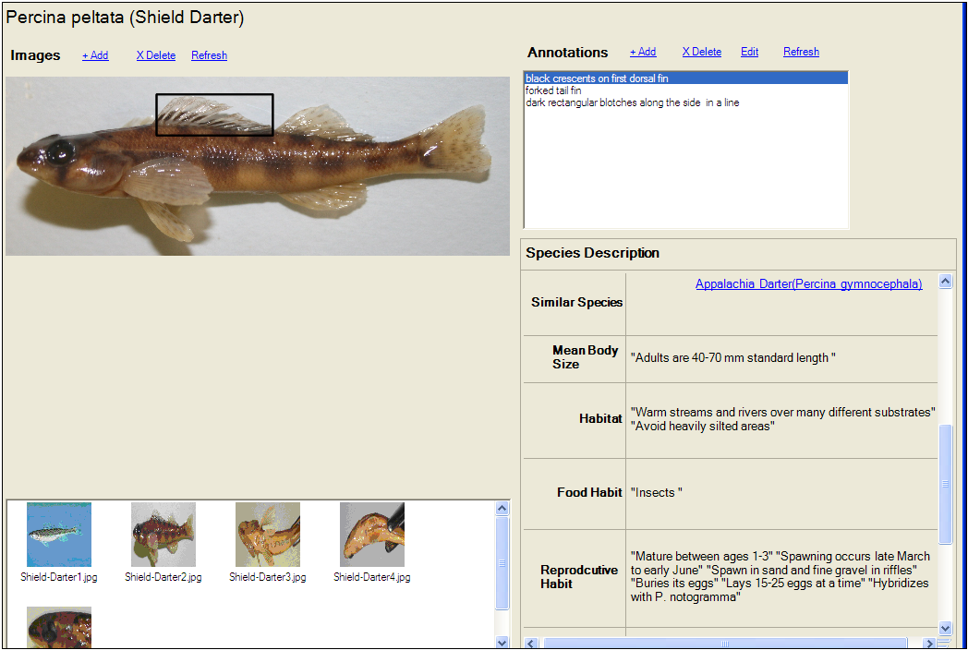
SuperIDR: species details interface
Notes:
1. Customized SuperIDR to work with fish data and images.
2. Slide shows the details of a species, with a description of the species, all its images, subimages on each image and associated annotations.

Slide 13
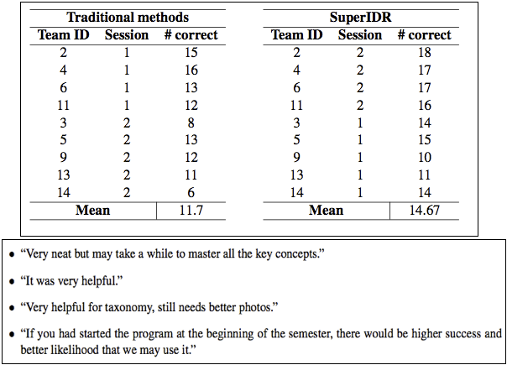
Results of a classroom-based user study of SuperIDR
Notes:
We did a series of user studies on SuperIDR, including one where we compared the use of SuperIDR with traditional fish identification methods in an Ichthyology classroom
<CLICK>We found that students had a higher likelihood of identifying species correctly with SuperIDR than with traditional methods with less than a week of using.
However, we did not gain any insights into how they used SuperIDR or details of how they use subimages in species identification.

Slide 14
A qualitative study of subimage and SuperIDR use
How do people use subimages in fish identification?
Characteristics of subimages and related information
Contexts and strategies of working with subimages in fish identification
How does SuperIDR support that use?
Notes:
Which brings us to the topic of this talk. We conducted this qualitative user study, where we looked use of subimages in species identification. We had two main questions in mind:
How do people use subimages in fish ID? Specifically, what does it mean to be a subimage?what its characteristics are? And, What are the waysand contexts in which subimages are used in fish ID?
How do people use subimages in SuperIDR and does SuperIDR support their use of subimages?

Slide 15
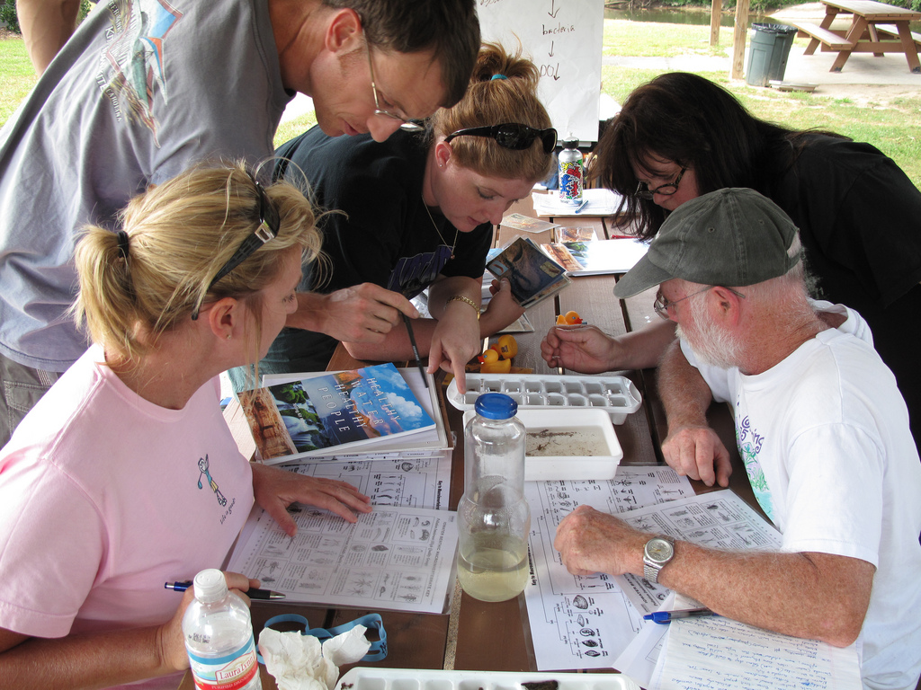
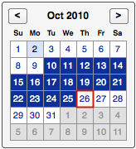
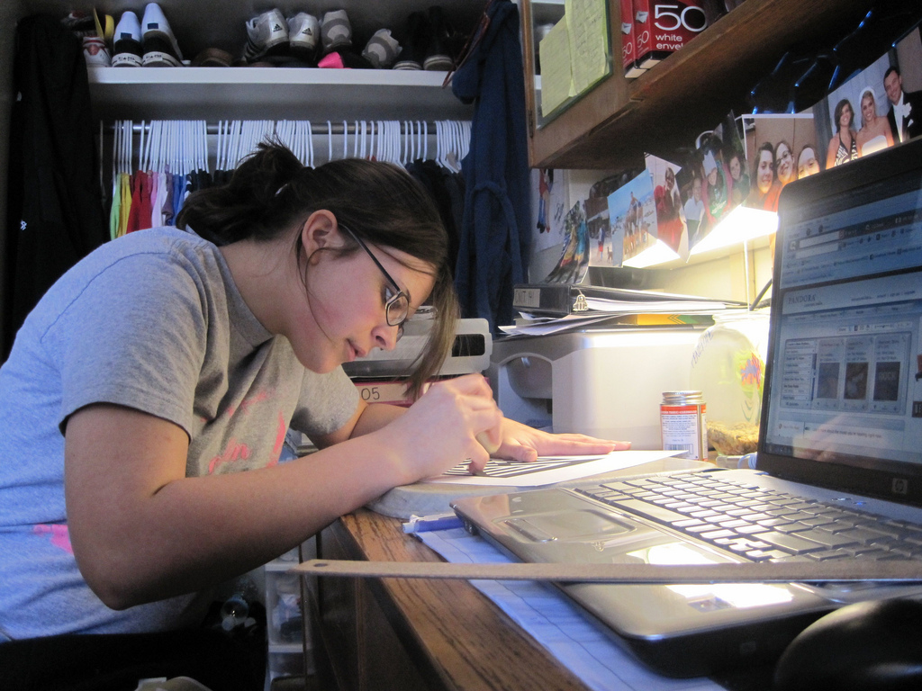
Study design criteria
Maximize use of SuperIDR
Participants with interest in fish ID
Use for a long duration
In natural setting and targeted tasks
Collect data, in multiple ways and from multiple sources, on subimage and SuperIDR use in fish ID
Notes:
Rationale for the design of the study was to:
Maximize the use of SuperIDR – we did that :
By recruiting people who are interested in fish ID and are involved in it as part of their work or study
BY having them use it for a long period of time (than a controlled lab setting)– in this case three weeks.
By having them use SuperIDR on their own in day-to-day activities -- where they had uninterrupted use, and in targeted tasks -- so we have data on use that relates to task execution, i.e. fish ID, and have an opportunity to observe that use.
Then, we collected data from multiple sources and in multiple ways so, we ended up having plenty of data to analyze on subimage and SuperIDR use.

Slide 16
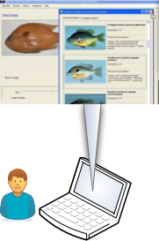
Qualitative study procedures
- Study overview
- Informed consent
- SuperIDR setup
- SuperIDR training
- Pre-study interview
SuperIDR use in work/study (diary)
Unknown specimen identification tasks
SuperIDR use in work/study (diary)
Unknown specimen identification tasks
SuperIDR use in work/study (diary)
Post-study interview
Notes:
Our study spanned over three weeks.
At the beginning of the study, for each participant, we provided an overview of study, got their consent, setup SuperIDR on their personal computers <CLICK> and trained them to use it, including having them complete a set of training tasks.
Then, we conducted a pre-study interview, asking participants about their fish ID practices and their fish ID background and experience.

Slide 17
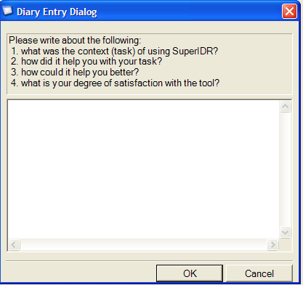
- Study overview
- Informed consent
- SuperIDR setup
- SuperIDR training
- Pre-study interview
Qualitative study procedures
SuperIDR use in work/study (diary)
Unknown specimen identification tasks
SuperIDR use in work/study (diary)
Unknown specimen identification tasks
SuperIDR use in work/study (diary)
Post-study interview
Notes:
Over the next three weeks, they used SuperIDR in their work/study environment.
At the end of each use, the tool prompted them to complete a diary <CLICK> on their experience with SuperIDR, asking about the task they were working on and how SuperIDR supported that task.

Slide 18
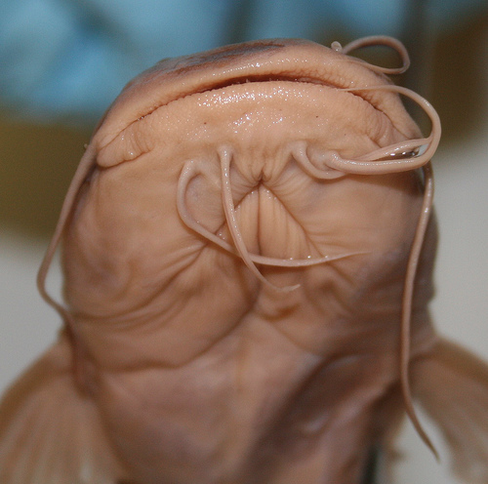
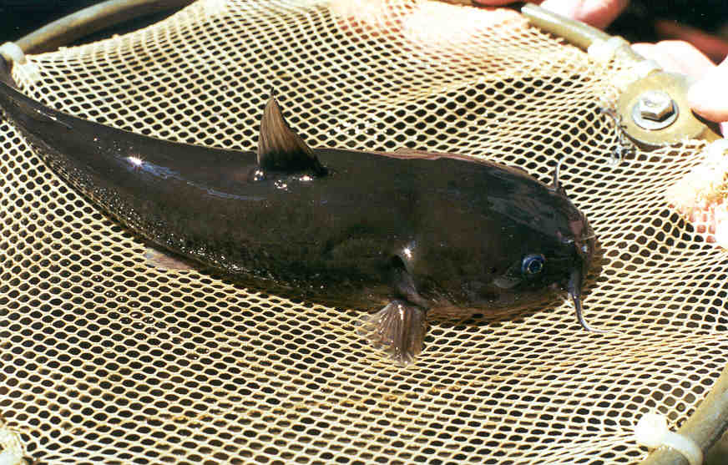
Qualitative study procedures
- Study overview
- Informed consent
- SuperIDR setup
- SuperIDR training
- Pre-study interview
SuperIDR use in work/study (diary)
Unknown specimen identification tasks
SuperIDR use in work/study (diary)
Unknown specimen identification tasks
SuperIDR use in work/study (diary)
Post-study interview
Notes:
After the 1st and 2nd week, we met with participants individually, and gave them unknown specimens <CLICK> to identify using SUperIDR.
We observed that use and recorded their screen interactions.

Slide 19
Qualitative study procedures
- Study overview
- Informed consent
- SuperIDR setup
- SuperIDR training
- Pre-study interview
SuperIDR use in work/study (diary)
Unknown specimen identification tasks
SuperIDR use in work/study (diary)
Unknown specimen identification tasks
SuperIDR use in work/study (diary)
Post-study interview
Notes:
At the end of the three weeks, we had a post-study interview asking details about their subimage and SUperIDR use.

Slide 20
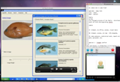
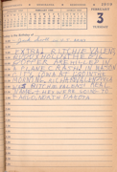
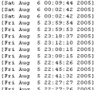
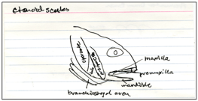
Data analysis was informed by Grounded Theory
Interview responses
Screen captures & spoken thoughts
Diary entries
SuperIDR logs
Species ID responses
Species ID materials
Database image
Notes:
Throughout the study, we collected various data, including the interview responses, screen captures and spoken thoughts during the targeted species identification task, diary entries, and logs of interaction with SUperIDR and other data. We used this data in the post-study interview to ask specific usage questions.
For the major part, our data analysis was informed by the Grounded Theory approach.

Slide 21
6 participants: 3 groups
Analyzed participants based on fisheries and fish identification experience, current projects and fish identification practices
P2 (male), P6 (male): 1-2 years of experience, undergraduates (UG) or recent UG
P1 (male), P5 (female): 2-5 years of experience, Master’s students, working on theses and/or teaching/research
P3 (male), P4 (female): 8-10 years of experience, PhD students, working on research projects
Notes:
6 participants.
We had six participants whom we analyzed based on fish ID experience and classified them into 3 groups - first were less expereinces undergraduates, then moderately experienced Master's students, and finally highly experienced Ph.D. students
Undergraduates – P2 and P6, recently taken Ichthyology, freshwater species knowledge relatively fresh in mind, transitioning from using/referring to several sources to internalizing that species id knowledge, species id in the classroom, assisted senior students in 1-2 projects on field
Master’s students – P1 and P5 (recently took Ichthyology) work with a few species, just started on research projects, generally use memory or refer to a few books/websites/etc.
PhD students – P3 and P5 have many years of experience, have done a lot of species id in the field and lab, work on select species, have almost internalized species id process. Still need to refer to information for fishes outside the ones that they work. Have developed their own styles of species id. For the most part, use these references to confirm fish identification
(highly experiment)

Slide 22
A qualitative study of subimage and SuperIDR use
How do people use subimages in fish identification?
Characteristics of subimages and related information
Contexts and strategies of working with subimages in fish identification
How does SuperIDR support that use?
Notes:
Going back to the initial questions of the study - we will now present findings considering the the characteristics of subimages and related information.

Slide 23
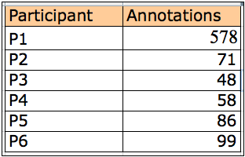
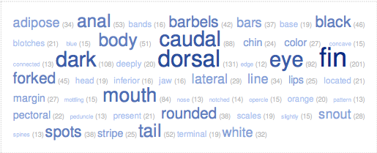
Subimage/annotation characteristics
940 subimages/ annotations
13 recurring types
Notes:
In the study, we collected 940 subimages and associated annotations. The table shows the distribution of subimages/annotations. We can see that one participant created significantly more number of subimages than the others.
We analyzed the annotations, looking for the most frequently used keywords, which is shown in this word cloud <BOTTOM>. We see that the most frequent keywords indicate parts of fishes, which suggests use of parts of fish images
We also analyzed the subimages/annotations for recurring types and patterns and found 13 different types of subimages/annotations. In the following slides, I will show you examples.

Slide 24
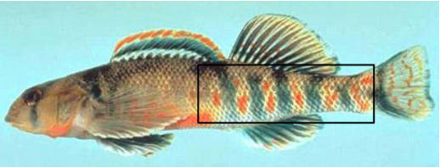
Color:
Red spots or bars, some blue bars
Location:
Eyes almost on top of head
Notes:
Top-right: has to do with color of the part
Bottom-left: describes the location of a part

Slide 25
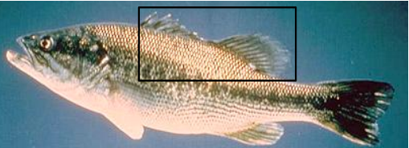
Morphological comparison:
Tail fins with pointed lobes about equal in length
Connection/relationship:
Dorsal fins connected
Notes:
Both these are examples of description of multiple parts:
Top-right: In these kinds of subimages, comparison of size of a part or a ratio
Bottom-left: Subimage/annotation shows a connection between two parts

Slide 26
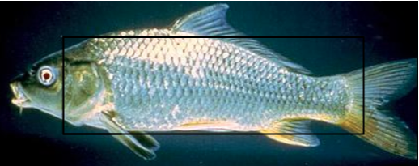
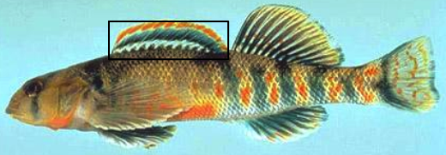
Comparison with other information objects (species):
Body similar to cyprinella
Combination (color and count):
One orange and one blue band on first dorsal fin
Notes:
Top-right: compare a subimage with the same body part in another species.
Bottom-left: combination of aforementioned types. In this case, of color and count

Slide 27
A qualitative study of subimage and SuperIDR use
How do people use subimages in fish identification?
Characteristics of subimages and related information
Contexts and strategies of working with subimages in fish identification
How does SuperIDR support that use?
Notes:
Now we will look at the contexts and ways in which the participants worked with subimages in fish ID and with SUperIDR

Slide 28
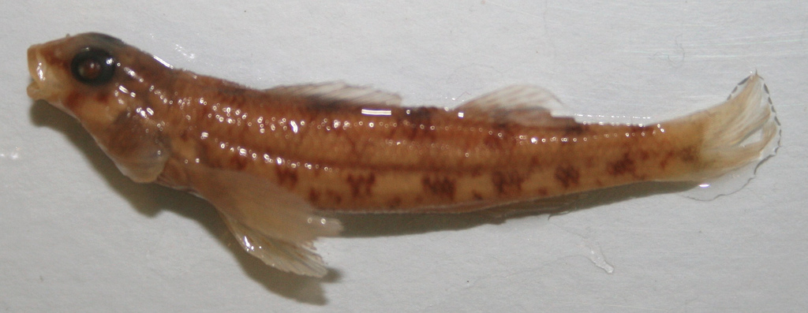
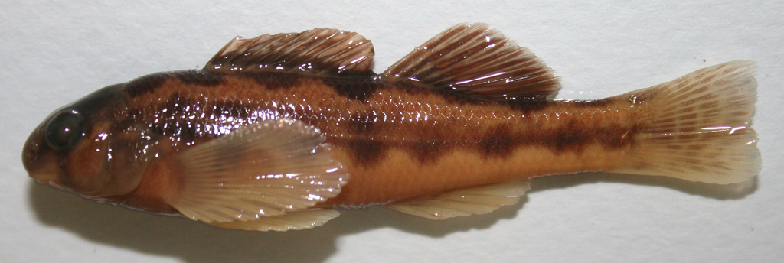
Strategies and contexts of subimage use in fish identification
Subimages are necessary in fish identification
In learning about a species
In identifying species
(top-down approach, compare similar species)
Percina
Etheostoma
Perca
Ammocrypta
…..
Family
Genera
Species
Notes:
Use of subimages is necessary in fish identification
Fish identification activities – learning/teaching and identifying species
Fishes might follow a taxonomical classification. There are many families of fishes. Each family has many genera. Each genus has many species. Typically, people can identify the family by glancing at the specimen – by its shape or some really distinct characteristic. However, as we go down the taxonomy, it is harder to distinguish the similarities and differences and that is where subimages are used a lot. Subimages at genus/species level are used to compare and contrast among very similar species, helping us eliminate choices and then arriving at the correct species.
Subimages help identify fishes quickly. Most people identify in the field (except while taking a class, wherea lot of id is in class using jarred/specimens), need to quickly id fish in order to release them alive rather than taking them back to the lab. This is another reason why distinguishing characteristics, in many cases subimages are used.
<CLICK> I’ll show you examples of subimages in fish ID materials.

Slide 29
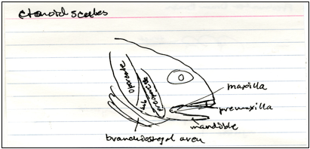
Subimages in species learning methods
Fish drawing in a book
Notecard
Printed list with notes
Table with species information
Notes:
Example of material used on learning.
Learning methods vary, such as notecards, textbooks, identification key, notes, printed lists, lists of images in digital documents, websites, etc. Focus on location, habitat, species general physical appearance, distinguishing characteristics → subimages.

Slide 30
Subimage use in SuperIDR
Marking and annotation
(940 subimages and annotations)
Browse
(subimages in species details, comparison, and search results)
Search
(subimages in text, image, and combined search, and in complex objects as queries)
Notes:
We found subimage use quite prominent with SuperIDR as well. We saw some evidence of the use while analyzing the 940 subimages/annotations
Participants also used subimages in browsing and search features of SuperIDR. We will present examples of use:
In the comparison browse <CLICK>
In use of the combined search. <CLICK>

Slide 31
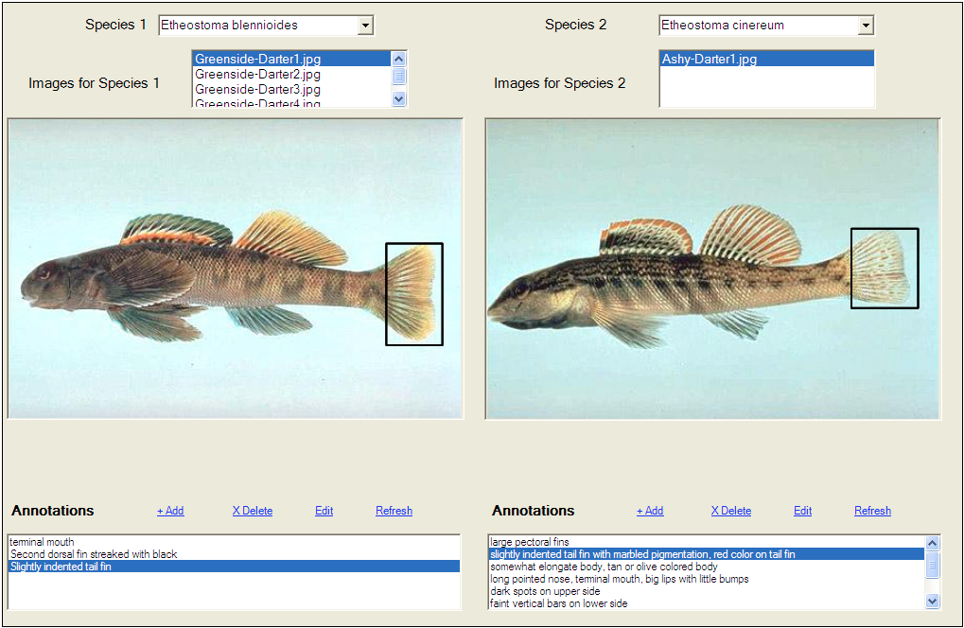
Comparing similar species (manual inspection)
Notes:
SuperIDR has a comparison feature, which allows a user to pull up two images side by side and browse through their subiamges and associated annotations.
This was especially useful because all participants wanted to manually inspect and analyze images/subimages.
Even if the search result returned the correct species as the topmost one, they would still want to browse through similar species just to make sure they had got it right. They would analyze and look at similarities and differences – for example in this case, one tail is forked whereas another has a slightly forked edge, etc.

Slide 32
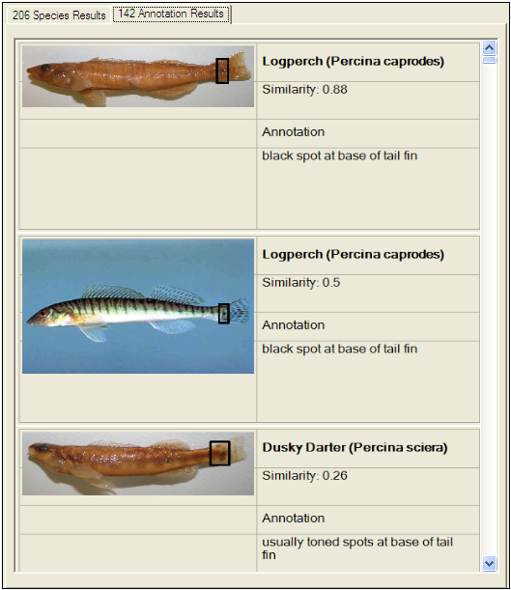
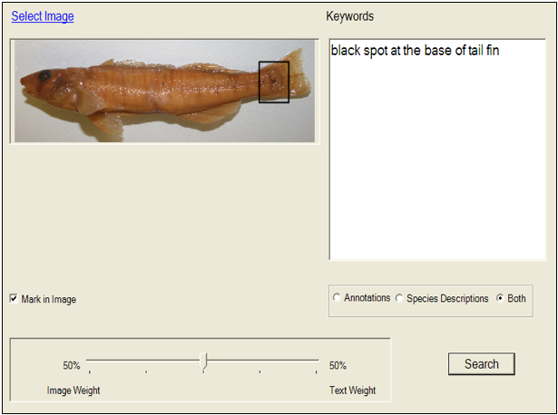
SuperIDR: combined search
Query interface
Search results
Notes:
Before showing an example of how subimages were used in the query interface, I will describe the combined search function in SuperIDR
In this search interface, a user might specify a query using images and text. Further, they can mark-up part of the image and use that subimage as the query.
In the text part they can give keywords and search on annotations, descriptions of species, or both.
Search results are organized by images and by subimages/annotations.

Slide 33
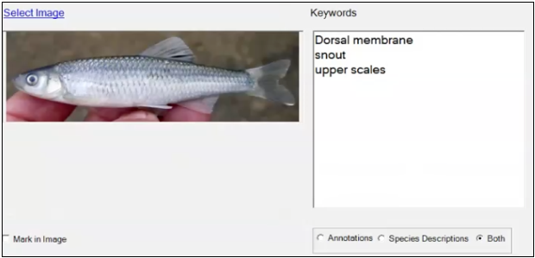
Complex object as a query
Notes:
The participants used the query interface in an interesting new way.
The interface allowed them to enter only one subimage as the query, but they were trying to enter multiple subimages. In addition, the keywords in the text part of the query indicated multiple annotations, in many cases to match the marked-up subimage.
When asked to explain what they were trying to do and what behavior they expected from SuperIDR, here is what the participants said:
They were searching for a species with images that had all parts that looked like the mark-ed up parts associated with multiple annotations that matched the keywords.
Thus, in some sense the query they framed was a complex object – a species, with images that had all the parts as specified in the query, including the subimages and the associated annotations.
This is a new way to querying multimodal information and opens up possibilities of interfaces that can be designed for such multimodal queries.
Five out of the six users used the combined search interface to frame a complex object query.

Slide 34
Context
“... It would not work if you said that this fish has dark spots. You know you get hundreds of species with dark spots. But, if you got down to a few species and you need to know how many they have ..." [P1 interview]
Manually working with information
It depends on how distinct that species [is] and how many other species are similar to that species, I guess … I would never trust the result, I guess, 100\% …you know, based on just one picture and a little bit of written text. I would always want to pull up other species that are somewhat similar and just do a visual inspection myself to be sure that it just was not some bad [query] image that I used or a bad search term." [P3 interview]
Notes:
Here are select comments supporting our findings.
Context - The first relates to context and how working with subimages is important and useful in the context of other information, such as in this case, the family. So, maintaining those links to contextual information is very important.
Manual - The second comment relates to support for manually browsing through information. In almost all cases, even if the search returned the correct species, participants would browse and compare similar species (as show earlier) to verify that the identified species is correct.

Slide 35
SI-DL
“It [SuperIDR] is pulling together different ways of getting to information ... So, not only do I have a taxonomy [and] dichotomous key, but it is also supported by images, many images that I have loaded in myself, that I can compare and contrast right there in the program [SuperIDR]. I can annotate the images, so I know that I kind of looking somewhat into their future [use]. And it kind of just pulls all those tools together, more so than [pulling together] information. It gives me many ways of accessing the same information. The more ways you can come to that information, the better [it is]. Because it is always going to make you more confident about the decision that you are making." [P1 interview]
Notes:
We received feedback on subimage use and participants felt that SuperIDR supported that use, especially in teaching/learning to identify species.
Here is a comment by a participant completely validating our hypothesis – about how SuperIDR brings all tools together to work with subimages

Slide 36
Recommendations for design of an SI-DL
Subdocuments as first-class digital objects in a DL
Store, index, access, retrieve, and reuse
Preserving and using context
Stored in metadata/digital objects/links
Co-presence of multiple subimages
Along with other criteria (e.g. family and location)
Notes:
Based on our findings, we came up with recommendations for the design of future digital libraries that provide support for working with subdocuments:
First and foremost, such DLs should include subdocuments as first-class objects, rather than as metadata for other objects and such. This will enable subdocuments to be described, stored, indexed, and hence, accessed, browsed, searched, and reused.
Secondly, contextual information should be preserved - either in the metadata of subdocuments or in other digital objects or via links. This will enable searches, browsing, and visualization where you can consider this contextual information.

Slide 37
Recommendations for design of an SI-DL
Multiple ways to describe, access, browse, search, and visualize subdocuments
Search: text retrieval, CBIR, combined search, complex objects as queries
Support for manually working with as well as automatically processing subdocuments
Subimage annotation
Auto-complete, and search refinement (e.g. using an ontology)
Notes:
3. Third, the DL should provide multiple ways to get to information – search, browse, visualize. And, hence, support for multiple ways to describe and store information. In the study, we saw that various ways of searching and browsing were useful. Through complex object as queries, we discovered new ways of framing a multimodal query.
4. We saw how support for manually working with subimages is useful. In addition, as indicated in the feedback from the participants - batch processing and automatic processing of subdocuments should also be supported, which can also be very useful. For example, automatically identifying and annotating forked tail fins in a family of fishes.

Slide 38
Conclusions
Working with subimages is important and necessary in fish species identification
An SI-DL provides enhanced support to such scholarly tasks
Integrated functionality
Subdocuments as first-class objects in a DL
Future work: Develop web interface to leverage online collections (Flickr) to study applicability in other domains
Notes:
In conclusion, we showed that subimages are an important and necessary part of fish identification.
An SI-DL brings together functionality to provide enhanced support to such scholarly tasks – most importantly by treating subdocuments as first-class objects.
In future work, we are working on a web-based version for SuperIDR, mainly to leverage existing collections, such as those in Flickr, to examine how an SI-DL, specifically search and browsing of subimages, might be applicable in other domains, such as art history, study of trees, flowers, architecture, etc.

Slide 39
Resources and pointers
http://umurthy.com/research/superidr
SuperIDR information and papers
Uma Murthy’s Ph.D. dissertation
“Digital libraries with superimposed information – supporting scholarly tasks that involve fine-grained information”
Includes SuperIDR source code
Upcoming panel in GHC 2011 on conducting user studies remotely
Notes:
All information and papers related to SuperIDR, including these slides is available at the given link.
Uma Murthy’s dissertation has more details about the user study as well as other studies and work relating to incorporating subdocuments in a digital library.
We have an upcoming panel in the Grace Hopper conference to talk about conducting user studies remotely.

Slide 40
Acknowledgments
Participants
Dr. Naren Ramakrishnan, Yinlin Chen, Nadia Kozievitch, Evandro Ramos, Tiago Falcao, Seungwon Yang, Ricardo Quintana-Castillo, Monika Akbar, Laurian Vega, Stacy Branham, Tejinder Judge
Microsoft tablet PC grant, NSF (DUE-0435059 and 0840668), CAPES (BEX 1385/10-0), and CPqD Foundation
Notes:
Many people and organizations helped in this study and we would like to thank them.

Slide 41
Thank you
?
Contact:
Uma Murthy (umurthy@vt.edu)
Lin Tzy Li (lintzyli@ic.unicamp.br)
Edward A. Fox (fox@vt.edu)
Web:
http://umurthy.com/research/superidr
?

Slide 42
Appendix

Slide 43
Photo attributions (Flickr)
A digital library by HacksHaven
Art History With Chris And Mac 6/9: Manet: Lecture (Mme Manet and Leon) by moonflowerdragon
Korean music by Homies In Heaven
Old annotations by Lorianne DiSabato
Reading Annotation by Rosa Say

Slide 44
Photo attributions (Flickr)
Everyone getting in on macroinvertebrate identification by USFWS/Southeast
studying by English106
My 1959 diary entry for “the day the music died” by Snap Man
database 2 by Tim Morgan

Slide 45
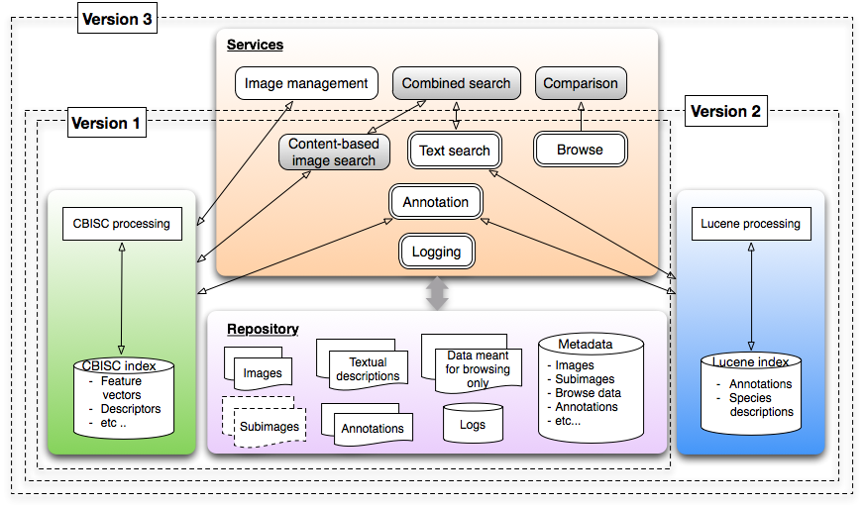
SuperIDR architecture

Slide 46
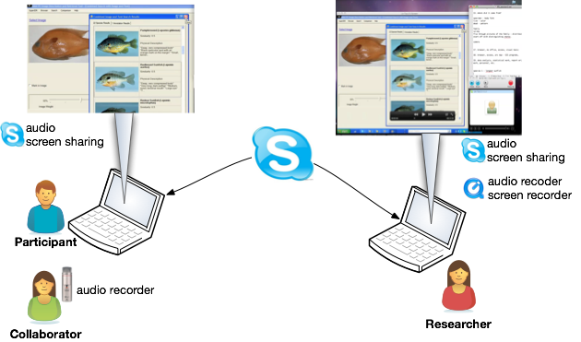
Study setup

Slide 47
Summary of findings of qualitative study
13 types of subimages/annotations from 940 subimages/annotations
Subimages are important and necessary in fish identification
Identification top down way
Learning using multiple methods
Context is important
Combined search and using a complex object as a query
SI-DL – bringing together capabilities

