Slide 1
SimDL: A Model Ontology Driven Digital Library for Simulation Systems
Jonathan Leidig - leidig@vt.edu
Edward A. Fox
Kevin Hall
Madhav Marathe
Henning Mortveit
JCDL: June 13-17, 2011, Ottawa, Canada
Network Dynamics and Simulation Science Laboratory
Digital Library Research Laboratory (DLRL) @ Virginia Tech

Slide 2
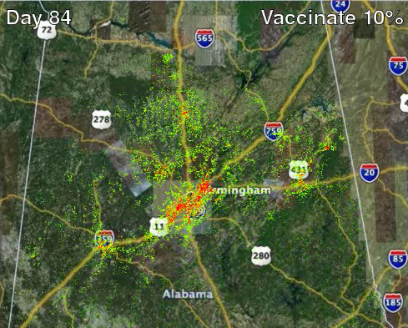
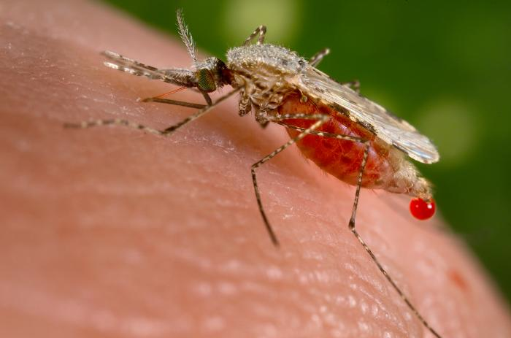
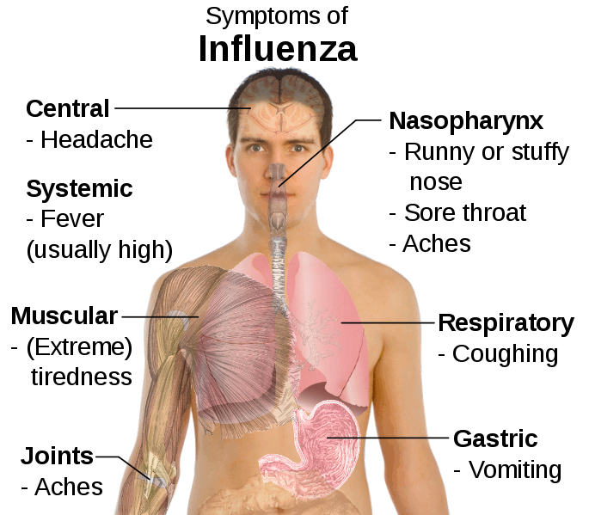
Domain: Computational Epidemiology
NIH: infectious diseases
Gates Foundation: malaria modeling
Model diseases and populations
Study of the health of a population - simulate epidemics
Test public policies, interventions, adaptive behavior, & economics
Network Dynamics and Simulation Science Laboratory
Digital Library Research Laboratory (DLRL) @ Virginia Tech

Slide 3
Institutional “Collaboration” Map
Malaria research groups – 5 groups
Infectious disease research – 35 groups
Network Dynamics and Simulation Science Laboratory
Digital Library Research Laboratory (DLRL) @ Virginia Tech

Slide 4
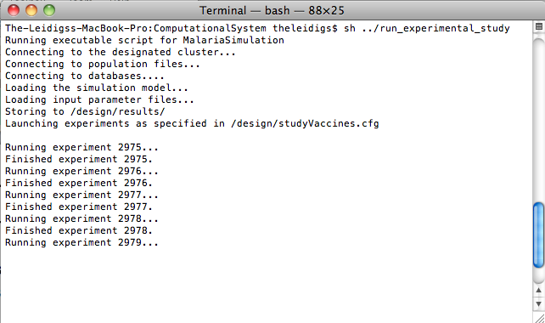
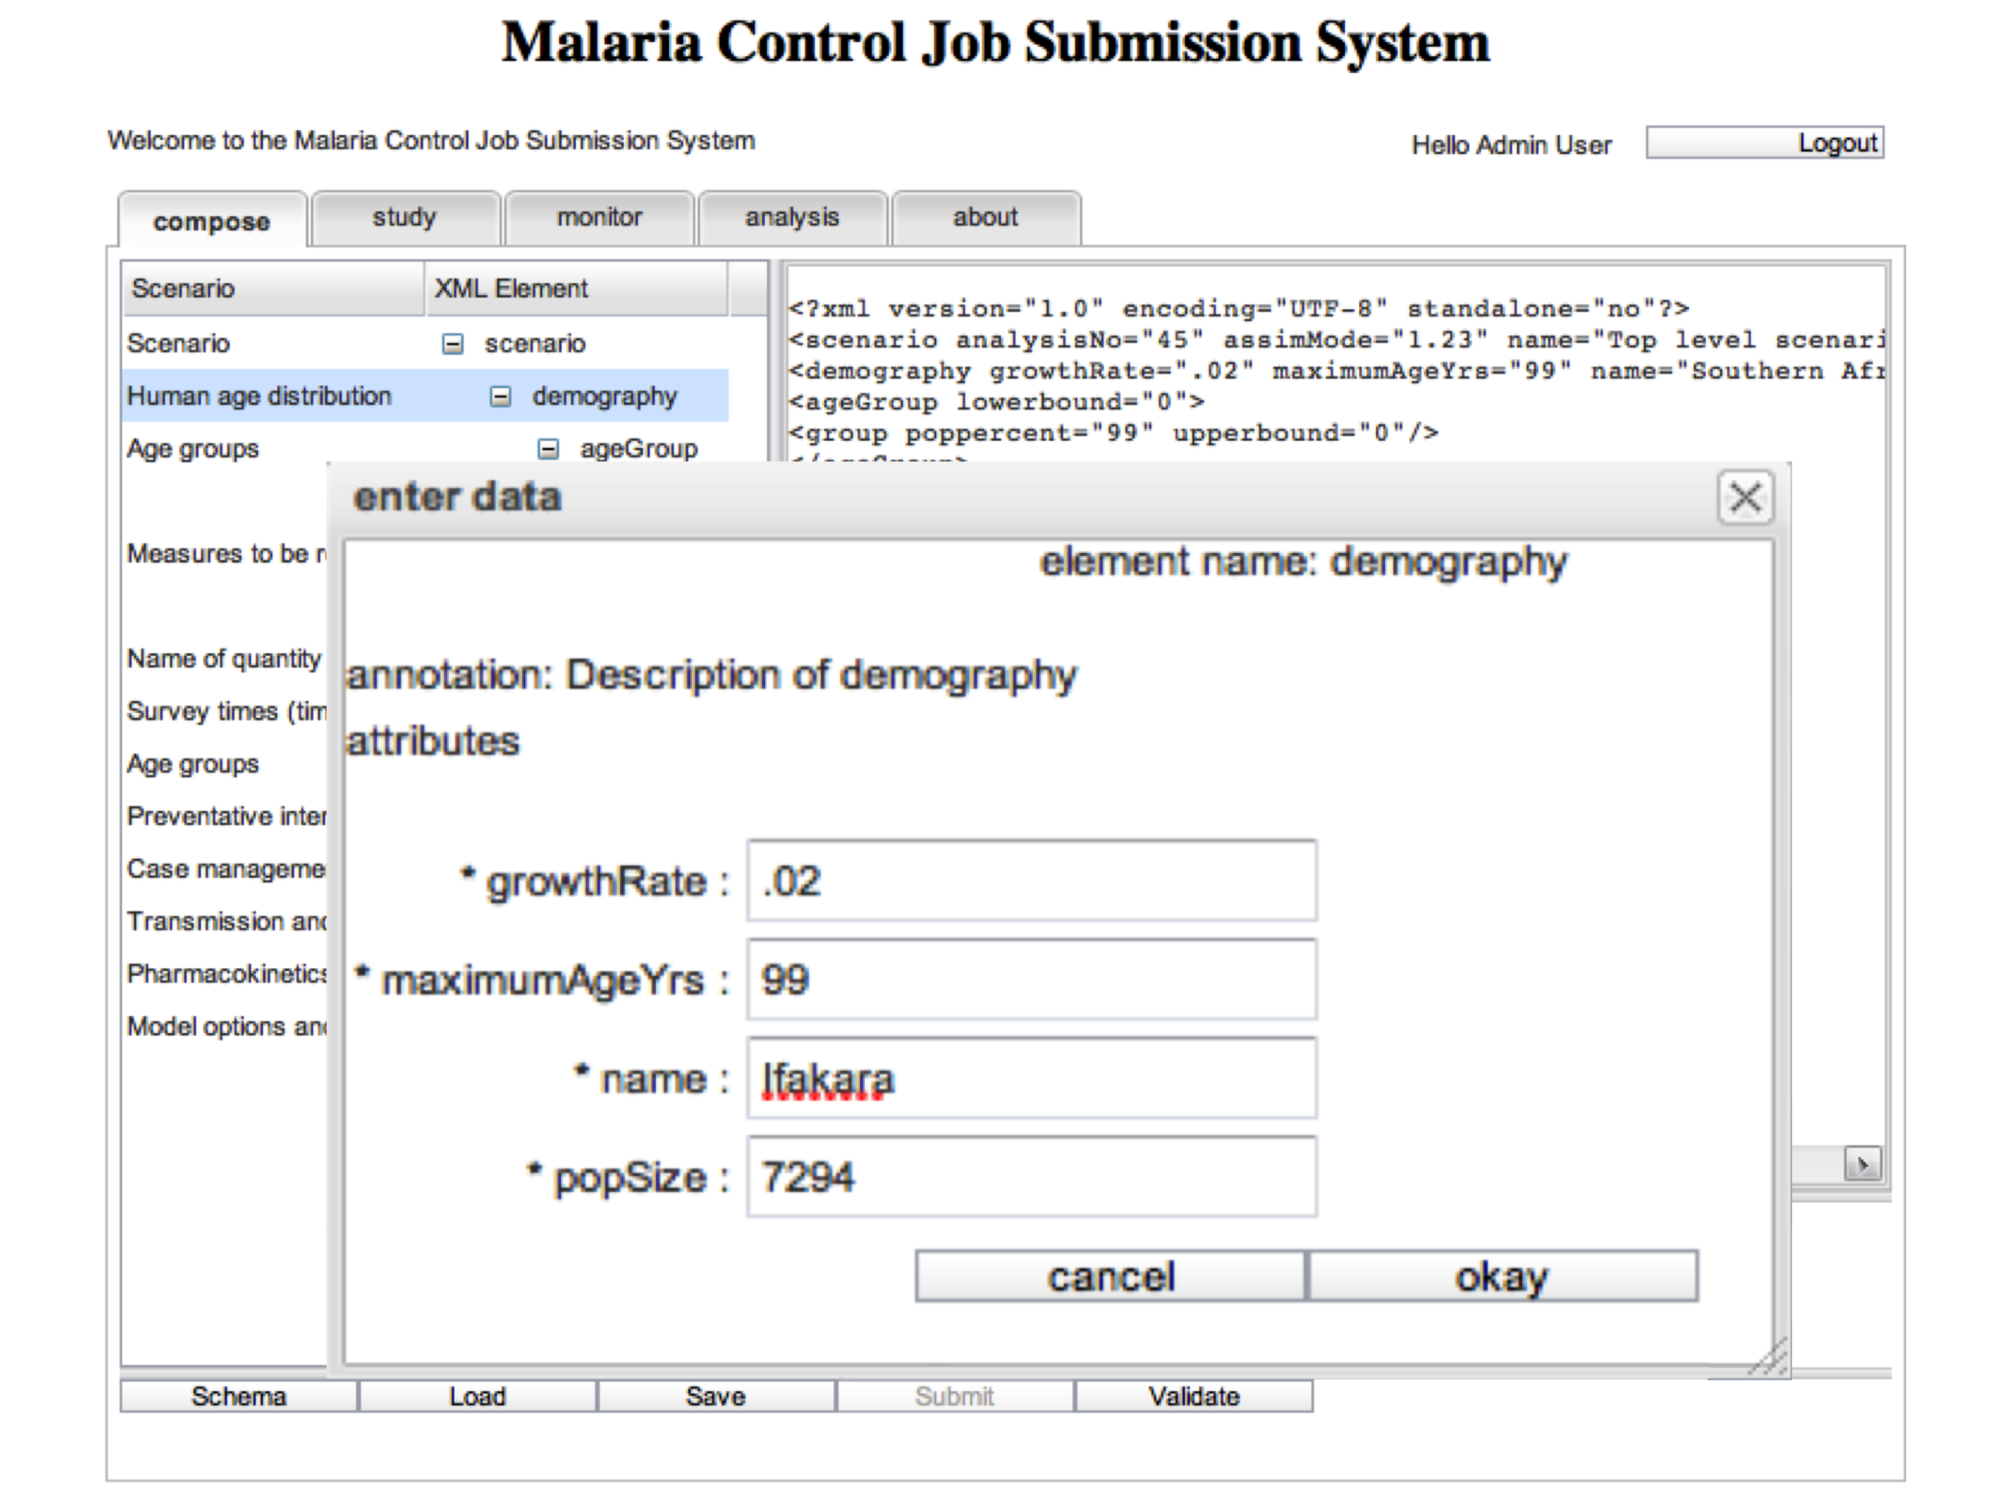
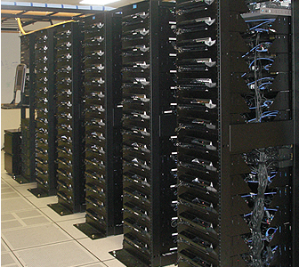
Simulation Community Goals
Integrate isolated models
Manage and expose simulation content
Link and workflow models and content
Minimize domain-expert contributions
Network Dynamics and Simulation Science Laboratory
Digital Library Research Laboratory (DLRL) @ Virginia Tech

Slide 5
Simulation Digital Library (SimDL)
Develop model ontologies
Use ontologies to:
Encapsulate domain knowledge
Manage simulation collections
Compose models into scientific workflows
Build metadata description sets
Capture provenance information
Customize domain-specific services
Network Dynamics and Simulation Science Laboratory
Digital Library Research Laboratory (DLRL) @ Virginia Tech

Slide 6
Ontology Levels
Network Dynamics and Simulation Science Laboratory
Digital Library Research Laboratory (DLRL) @ Virginia Tech

Slide 7
Ontology-Based Organization
Simulation model ontologies:
Collection metadata schemas
Federated services
Model workflows and compositions
Domain ontologies:
Linked-models
Multi-systems and institutions
Network Dynamics and Simulation Science Laboratory
Digital Library Research Laboratory (DLRL) @ Virginia Tech

Slide 8
Ontology-Based User Interactions
Support for user tasks:
Automate workflows
User interfaces
Experiment design
Network Dynamics and Simulation Science Laboratory
Digital Library Research Laboratory (DLRL) @ Virginia Tech

Slide 9
Ontology-Based Discovery
?
Functionality:
High-granularity in browsing
Data profiling – integration
Domain-specific searching
Scientific data ranking
Network Dynamics and Simulation Science Laboratory
Digital Library Research Laboratory (DLRL) @ Virginia Tech

Slide 10
Prototypes
Swiss Tropical Institute
Malaria simulation models
Virginia Bioinformatics Institute
Disease and network models
Network science cyberinfrastructure
Network simulation & analysis
Cyberinfrastructure
Communication
SimDL
Simulation
Models
Analyses
Computational
Platforms
Interfaces
Network Dynamics and Simulation Science Laboratory
Digital Library Research Laboratory (DLRL) @ Virginia Tech

Slide 11
Conclusion, Future Work, and Challenges
Contribution:
Multiple simulation model ontologies
Generic service implementations using model ontologies
Semi-automated model ontology generation
Initial work in linking ontologies
Current tasks:
Human-intensive collaboration tasks (vocabularies and ontologies)
Meta-ontology for epidemiology
Network Dynamics and Simulation Science Laboratory
Digital Library Research Laboratory (DLRL) @ Virginia Tech

Slide 12
Jonathan Leidig - leidig@vt.edu - Acknowledgments
This work has been partially supported by:
Swiss Tropic and Public Health Institute: OpenMalaria subcontract
National Institutes of Health: MIDAS project 2U01GM070694-7
Department of Defense:
DTRA CNIMS Grant HDTRA1-07-C-0113
DTRA R&D Grant HDTRA1-0901-0017
National Science Foundation
HSD Grant SES-0729441
PetaApps Grant OCI-0904844
SDCI Grant OCI-1032677
Special thanks to:
Drs. Fox, Marathe, and Mortviet
NDSSL and DLRL members
Network Dynamics and Simulation Science Laboratory
Digital Library Research Laboratory (DLRL) @ Virginia Tech

