Slide 1
VT Task Force on
Instructional Technology
28 January 2010
“Computing and
Instructional Technology” by Edward A. Fox
fox@vt.edu http://fox.cs.vt.edu
Dept. of Computer Science, Virginia Tech
Blacksburg, VA 24061 USA

Slide 2
Point 1: Computing is Fundamental
All of the technologies considered are based on, or depend upon, computing.
=> Faculty, students, staff should be proficient at computational thinking.
=> VT should ensure this, preparing the community for Living In the KnowlEdge Society (LIKES):
http://www.livingknowledgesociety.org

Slide 3
Engineering Grand Challenges http://www.engineeringchallenges.org/cms/challenges.aspx
Those that relate to computing include:
Restore and improve urban infrastructure
Advance health informatics
Engineer better medicines
Reverse-engineer the brain
Secure cyberspace
Enhance virtual reality
Advance personalized learning
Engineer the tools of scientific discovery

Slide 4
Computing Research for 21st Century http://www.cra.org/ccc/initiatives
Data to knowledge to action
Evidence-based healthcare, new biology/med.
Discovery in science and engineering
Advanced intelligence and decision making for America’s security; New transportation
Energy future; Smart grid; Quality of life
Robotics; Ocean observatories; eScience
Emergency informatics
Personalized education, eLearning

Slide 5

CTR stakeholders
Crisis, Tragedy & Recovery net
www.ctrnet.net
Notes:
Help affected communities to recover more quickly and effectively
Provide global network with relevant information and resources
Support the research community, emergency personnel, decision makers, and the public in reacting to and recovering from crises

Slide 6
LIKES and 4 Needs of Others
Processes
  Programs, algorithms, workflows, business processes, packages/toolkits, problem solving
Modeling, simulation
  Analyze, abstract, connect, validate, predict, refine
Managing information
  Data, information, and knowledge
  PIM, create/represent/search/retrieve/reuse/…
Sensory connection, interaction
  HCI, games, visualization, collaboration

Slide 7
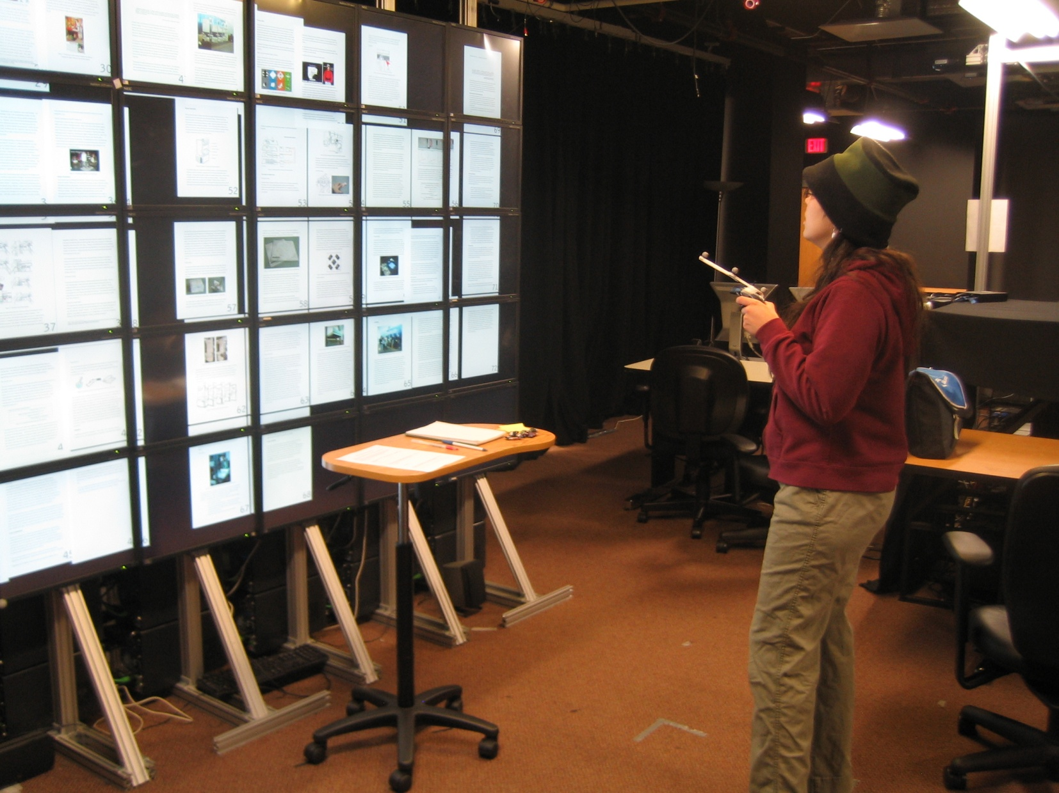
Gigapixel
5 x 10 monitors
All pages shown, grouped by chapter
A handheld device to move pages
Notepad, Post-It on a rolling desk
Notes:
All the pages of a thesis were shown on a Gigapixel display, which consisted of 5 x 10 monitors (vertical x horizontal).
Pages were grouped by the chapter.
A handheld device was used to move pages like a mouse.
Participants had access to a notepad and Post-it notes on a rolling desk.

Slide 8
Computational Thinking (Wing)
Fundamental skill, conceptualizing
Mental tools that reflect breadth of CS
Solving problems, designing systems, understanding human behavior
Thinking recursively, parallel processing
Abstraction, decomposition, representation, modeling, using invariants, heuristics, ideas, planning, learning, uncertainty, search
Applying in (all) other disciplines

Slide 9
AP CS Principles: Big Ideas
Computing is a creative human activity that engenders innovation and promotes exploration.
Abstraction reduces information and detail to focus on concepts relevant to understanding and solving problems.
Data and information facilitate the creation of knowledge.
Algorithms are tools for developing and expressing solutions to computational problems.

Slide 10
AP CS Principles: Big Ideas (2)
Programming is a creative process that produces computational artifacts.
Digital devices, systems, and the networks that interconnect them enable and foster computational approaches to solving problems.
Computing enables innovation in other fields including science, social science, humanities, arts, medicine, engineering, and business.

Slide 11
CC2001 Computer Science volume
DS. Discrete Structures
PF. Programming Fundamentals
AL. Algorithms and Complexity
AR. Architecture and Organization
OS. Operating Systems
NC. Net-Centric Computing
PL. Programming Languages
HC. Human-Computer Interaction
GV. Graphics and Visual Computing
IS. Intelligent Systems
IM. Information Management
SP. Social and Professional Issues
SE. Software Engineering
CN. Computational Science

Slide 12
CC2001 Information Management Areas
IM1. Information models and systems* | IM8. Distributed DBs
IM2. Database systems* | IM9. Physical DB design
IM3. Data modeling* | IM10. Data mining
IM4. Relational DBs | IM11. Information storage and retrieval
IM5. Database query languages | IM12. Hypertext and hypermedia
IM6. Relational DB design | IM13. Multimedia information & systems
IM7. Transaction processing | IM14. Digital libraries
* Core components

Slide 13
DL Curriculum Framework

Slide 14
Point 2: Vision: Develop, Move To
What is our vision?
Who are the stakeholders?
How do they interact?
How will each advance maximally?
  Optimization Goal: Learning
  Everything else open for innovation
  But aware of real constraints, e.g.:
Continuous, sustainable, focused change

Slide 15
Vision: Student Abilities
Effective learners
Effective teamworkers
Skilled in research, discovery, & innovation
Mentees and tutors
Multidisciplinary scholars
Citizens in the knowledge society
Problem solvers and problem posers
Information managers

Slide 16
Vision: Education <-> Research
Embrace VT’s other missions, including research and service
Research: understanding reality, discovering, questioning, solving challenges/problems, creating opportunities
Service: awareness, compassion, engagement
Students at all levels: researching, serving

Slide 17
Vision: Support
Institutionalization of innovation in all aspects of teaching and learning
Distinguished innovator speaker series
VP for Innovation
All the campus groups focused on teaching and learning working together
  Revisiting all assumptions (lectures, courses, …)
  Funding, processes, rewards – reshaped
  Deconstruct => flexible/dynamic synthesis
  Repackage, e.g., college->dept.->program

Slide 18
Point 3: Ongoing: R&D -> Practice
Learning
  Brain, cognitive science, communication
Research
  Novel research today is the foundation for practice in 10-30 years.
Computing
  Ubiquitous/pervasive, usable, effective, efficient
  CS -> IT -> English/Engineering/… -> Practice

Slide 19
Carl E. Wieman
Associate Director for Science in the White House Office of Sci. & Technology Policy
Director of the Carl Wieman Science Education Initiative and Professor of Physics (2001 Nobel Prize Winner), U. British Columbia, www.cwsei.ubc.ca
“Science Education for the 21st Century: Using the Insights of Science to Teach/Learn Science” (SIGCSE 2010)
E.g., Brain-Based Learning/Education

Slide 20
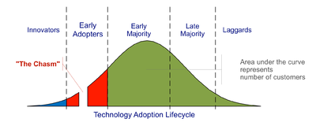
Crossing the Chasm
(Geoffrey A. Moore, 1999)
Diffusion of innovation
Technology adoption lifecycle
Early adopters
CHASM
Early majority

Slide 21
Point 4: Illustrate with Examples
Personalization
  PCs: Personal Computers
  PIM: Personal Information Management
  User modeling, intelligent tutoring systems
    Tutors are roughly 3 times more effective
  Adaptive hypermedia, variable granularity
Digital Libraries of Educational Resources

Slide 22
Locating Digital Libraries in Computing and
Communications Technology Space
Digital Libraries technology
trajectory: intellectual
access to globally distributed information
Communications
(bandwidth, connectivity)
Computing (flops)
Digital content
Note: we should consider 4 dimensions: computing, communications,
content, and community (people)
less
more

Slide 23
Synchronous
Scholarly Communication
Same time, Same or different place

Slide 24

Asynchronous, Digital Library Mediated Scholarly Communication
Different time and/or place

Slide 25
Information Life Cycle
Creation
Active
Authoring
Modifying
Social Context
Using
Creating
Organizing
Indexing
Retention
/ Mining
Accessing
Filtering
Storing
Retrieving
Semi-
Active
Utilization
Distributing
Networking
Inactive
Searching
Notes:
This is a simplification of the previous slide.

Slide 26
Quality and the Information Life Cycle

Slide 27
Digital Libraries
Shorten the Chain from
Author
Editor
Reviewer
Publisher
A&I
Consolidator
Library
Reader

Slide 28
DLs Shorten the Chain to
Roles
Digital
Library
Author
Teacher
User
Reader
Editor
Learner
Reviewer
Librarian

Slide 29
Informal 5S & DL Definitions
DLs are complex systems that
help satisfy info needs of users (societies)
provide info services (scenarios)
organize info in usable ways (structures)
present info in usable ways (spaces)
communicate info with users (streams)

Slide 30
Degree of Structure
Web
DLs
DBs
Chaotic
Organized
Structured

Slide 31
Digital Objects (DOs)
Born digital
Digitized version of “real” object
  Is the DO version the same, better, or worse?
  Separation of structure, meaning, use
    Rendered on paper, laptop, handheld – or CAVE
    Semantic Web (human or machine processing)
Surrogate for “real” object
  Hybrid systems with real and digital objects
  Data, documents, subdocuments, metadata

Slide 32
The World According to OAI
Service Providers
Discovery
Current
Awareness
Preservation
Metadata
harvesting
Data Providers

Slide 33
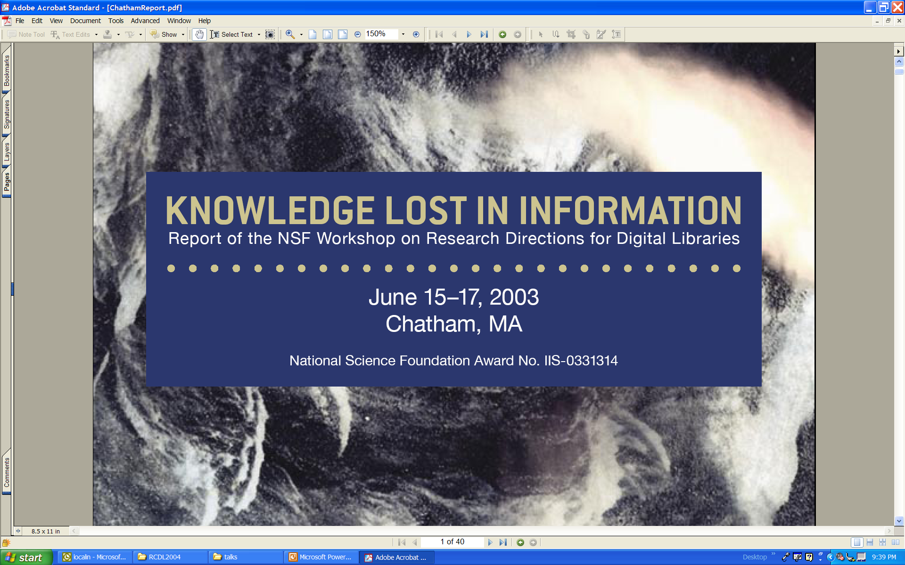

Slide 34


Slide 35
Educational Repositories Connect:
Users: students, educators, life-long learners
Content: structured learning materials; large real-time or archived datasets; audio, images, animations; primary sources; digital learning objects (e.g. applets); interactive (virtual, remote) laboratories; ...
Tools: search; refer; validate; integrate; create; customize; publish; share; notify; collaborate; ...

Slide 36
Collections
Discovery of content
Classification and cataloguing
Acquisition and/or linking; referencing
Disciplinary-based themes define a natural body of content, but other possibilities are also encouraged
Access to massive real-time or archived datasets
Software tool suites for analysis, modeling, simulation, or visualization
Reviewed commentary on learning materials and pedagogy

Slide 37
Services
Help services, frequently asked questions, etc.
Synchronous/asynchronous collaborative learning environments using shared resources
Mechanisms for building personal annotated digital information spaces
Reliability testing for applets or other digital learning objects
Audio, image, and video search capability
Metadata system translation
Community feedback mechanisms

Slide 38
NSDL Information Architecture
Essentially as developed by the Technical Infrastructure Workgroup
Portals &
Clients
Portals &
Clients
User Interfaces
Portals &
Clients
NSDL
Services
NSDL
Services
Other NSDL
Services
NSDL
Collections
Core
NSDL
“Bus”
NSDL
Collections
NSDL
Collections
Usage Enhancement
Collection
Building
Core Services:
information retrieval
CI Services
browsing
CI Services
authentication
referenced
items &
collections
Core Services:
metadata gathering
CI Services
personalization
referenced
items &
collections
Special
Databases
Core Collection-
Building Services
protocols
CI Services
discussion
Core Collection-
Building Services
harvesting
CI Services
annotation

Slide 39
Digital Libraries in Education
Analytical Survey, ed. Leonid Kalinichenko
© 2003, www.iite-unesco.org, info@iite.ru
Transforming the Way to Learn
DLs of Educational Resources & Services
Integrated/Virtual Learning Environment
Educational Metadata
Current DLEs: US (NSDL, DLESE, CITIDEL, NDLTD), Europe (Scholnet, Cyclades), UK (Distributed National Electronic Resource)

Slide 40
DLEs: Guiding Principles (p. 12)
Driven by educational and science needs
Facilitating educational innovation
Stable, reliable, permanent
Accessible to all
Leverage prior research: DL, courseware, …
Adaptable to new technologies
Supporting decentralized services
Resource integration thru tools/organization

Slide 41
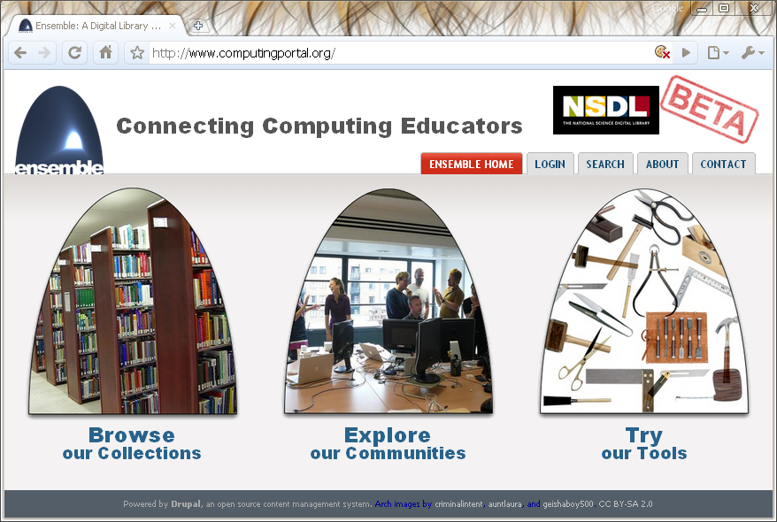





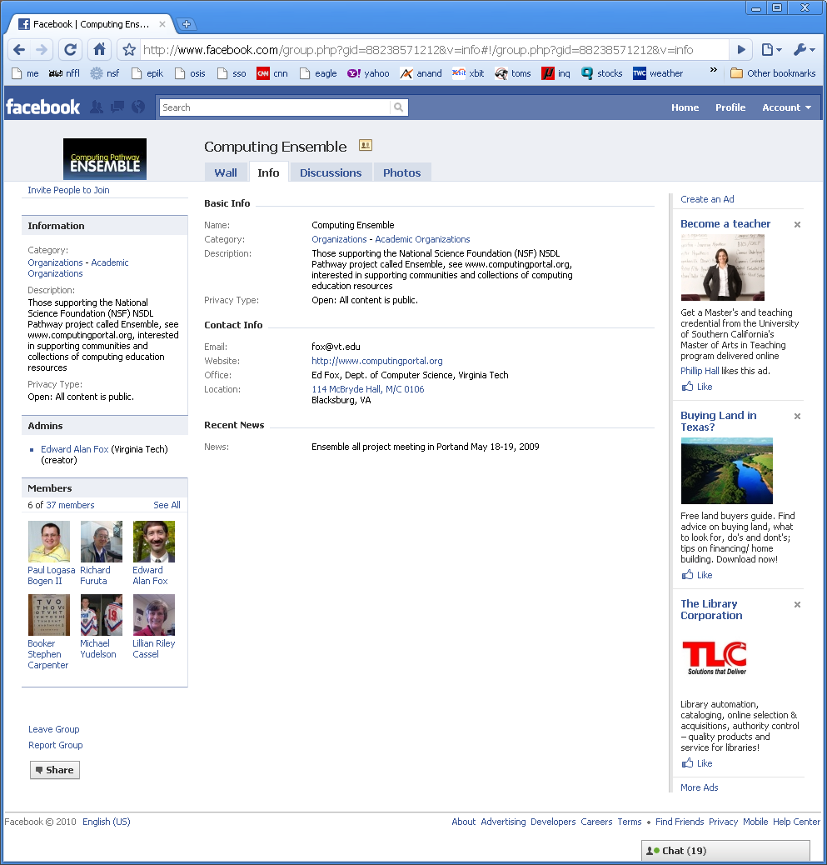
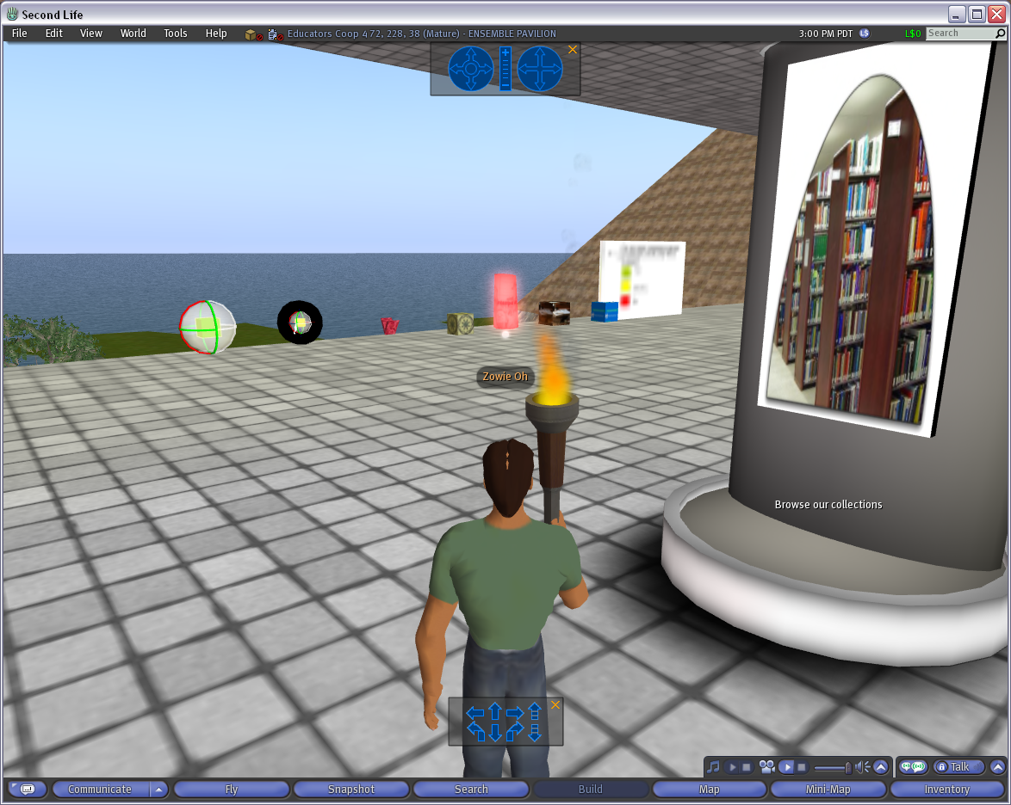
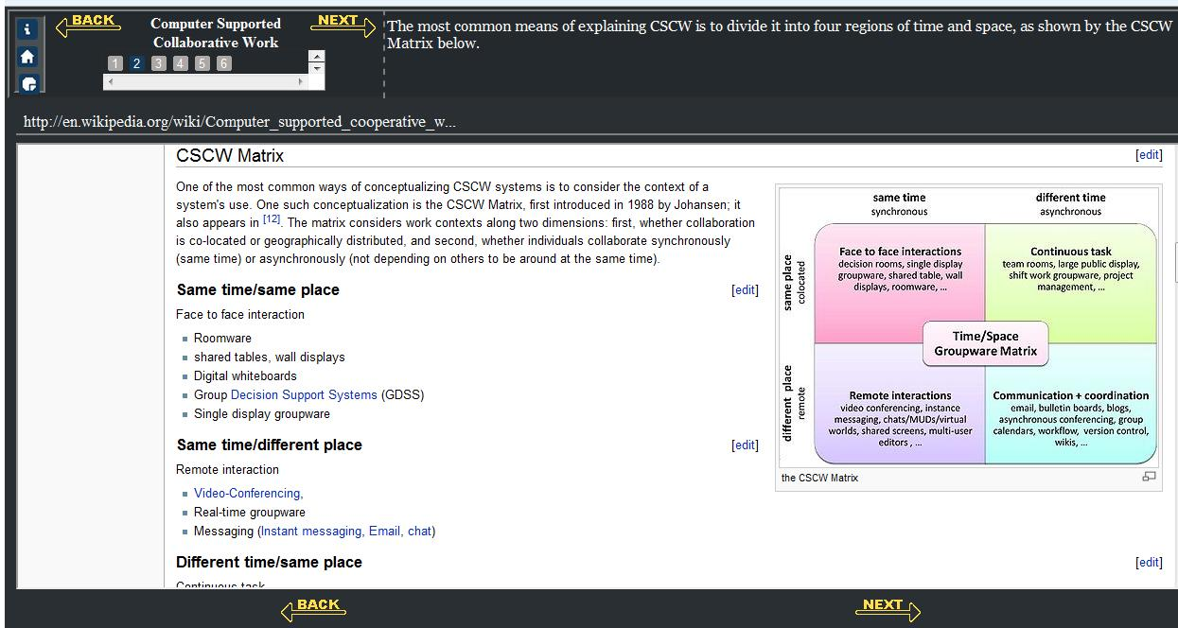
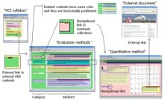



The Ensemble Computing Portal
Many-to-Many Information Connections in a Distributed Digital Library Portal
Collections
Communities
ACM
CS1
FOCES
TECH Developers
Ensemble
LIKES
AP CS
Services
Search
Distributed DL Portal
Forum
Group
Blog
Browse
Notification
Tools
A collaborative research project to build a distributed portal with up-to-date contents for all computing communities.
http://www.computingportal.org/

Slide 42
As data, information, and knowledge play increasingly central roles … digital library research should focus on:
Increasing the scope and scale of information resources and services;
Employing context at the individual, community, and societal levels to improve performance;
Developing algorithms and strategies for transforming data into actionable information;
Demonstrating the integration of information spaces into everyday life; and
Improving availability, accessibility, and, thereby, productivity.

Slide 43
An appropriate infrastructure program will provide sustainability of digital knowledge resources among five dimensions:
Acquisition of new information resources;
Effective access mechanisms that span media type, mode, and language;
Facilities to leverage the utilization of humankind’s knowledge resources;
Assured stewardship over humanity’s scholarly and cultural legacy; and
Efficient and accountable management of systems, services, and resources.

Slide 44
Questions?
Discussion?
Thank You!

