Slide 1
Georgetown University
29 April 2011
“A Formal Approach to Digital Libraries -
The 5S Framework: Societies, Scenarios, Spaces, Structures, Streams” by Edward A. Fox
fox@vt.edu http://fox.cs.vt.edu
Dept. of Computer Science, Virginia Tech
Blacksburg, VA 24061 USA

Slide 2
Ed Fox, Director, Virginia Tech Digital Library Research Laboratory
Executive Director, Networked Digital Library of Theses & Dissertations
Chair, Steering Committee, ACM/IEEE Jt. Conf. on Digital Libraries
Member, Board of Directors, Computing Research Association
Digital | Information | Libraries | Retrieval
Chair | Committee | Conference | Workshop
Education | Electronic | Dissertations | Theses
Research | Science | Systems | Technology
Open | Initiative | International | Multimedia
Access | Archive | Intelligent | Interactive
Knowledge | Learning | SIGIR | Tutorial

Slide 3
Acknowledgements
Mentors (Licklider, Kessler, Salton)
Virginia Tech, CS, Digital Library Research Laboratory
NSF and other sponsors
Students, colleagues, co-investigators:
Monika Akbar, Yinlin Chen, Spencer Lee, Venkat Srinivasan, Seungwon Yang, …
Boots Cassel, Gary Marchionini, Jeffrey Pomerantz, Barbara Wildemuth, Andrea Kavanaugh, Naren Ramakrishnan, Steve Sheetz, Don Shoemaker, …

Slide 4
Selected DL Projects
Digital Library Curricular Resources
  NSF IIS-0535057 & 0535060
CTRnet (Crisis, Tragedy & Recovery Net)
  NSF IIS-0916733
Ensemble (Computer Science Education)
  NSF DUE-0840719
Digital Preserve
  NSF IIS-0910183 & 0910465
  http://slurl.com/secondlife/Digital%20Preserve/140/126/29

Slide 5
Outline
An informal overview of digital libraries
An informal view of 5S
A formal perspective of 5S
What has been done with 5S
Future plans

Slide 6
Synchronous
Scholarly Communication
Same time, Same or different place

Slide 7

Asynchronous, Digital Library Mediated Scholarly Communication
Different time and/or place

Slide 8
Information Life Cycle
Creation
Active
Authoring
Modifying
Social Context
Using
Creating
Organizing
Indexing
Retention
/ Mining
Accessing
Filtering
Storing
Retrieving
Semi-
Active
Utilization
Distributing
Networking
Inactive
Searching
Notes:
This is a simplification of the previous slide.

Slide 9
Quality and the Information Life Cycle

Slide 10
Digital Libraries
Shorten the Chain from
Author
Editor
Reviewer
Publisher
A&I
Consolidator
Library
Reader

Slide 11
DLs Shorten the Chain to
Roles
Digital
Library
Author
Teacher
User
Reader
Editor
Learner
Reviewer
Librarian

Slide 12
Degree of Structure
Web
DLs
DBs
Chaotic
Organized
Structured

Slide 13
Locating Digital Libraries in Computing and
Communications Technology Space
Digital Libraries technology
trajectory: intellectual
access to globally distributed information
Communications
(bandwidth, connectivity)
Computing (flops)
Digital content
Note: we should consider 4 dimensions: computing, communications,
content, and community (people)
less
more

Slide 14
Digital Objects (DOs)
Born digital
Digitized version of “real” object
  Is the DO version the same, better, or worse?
  Separation of structure, meaning, use
    Rendered on paper, laptop, handheld – or CAVE
    Semantic Web (human or machine processing)
Surrogate for “real” object
  Hybrid systems with real and digital objects
  Data, documents, subdocuments, metadata

Slide 15
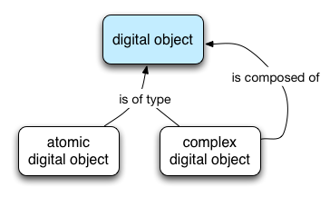
A concept map for complex object composition

Slide 16
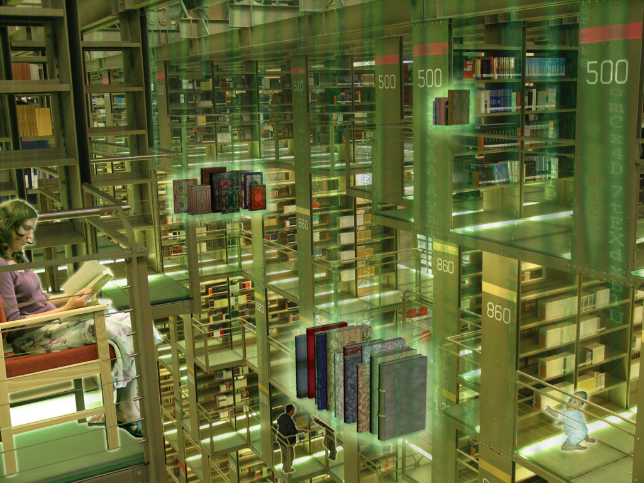
A digital library = repository of collections and metadata + services

Slide 17
The World According to the
Open Archives Initiative
Service Providers
Discovery
Current
Awareness
Preservation
Metadata
harvesting
Data Providers

Slide 18
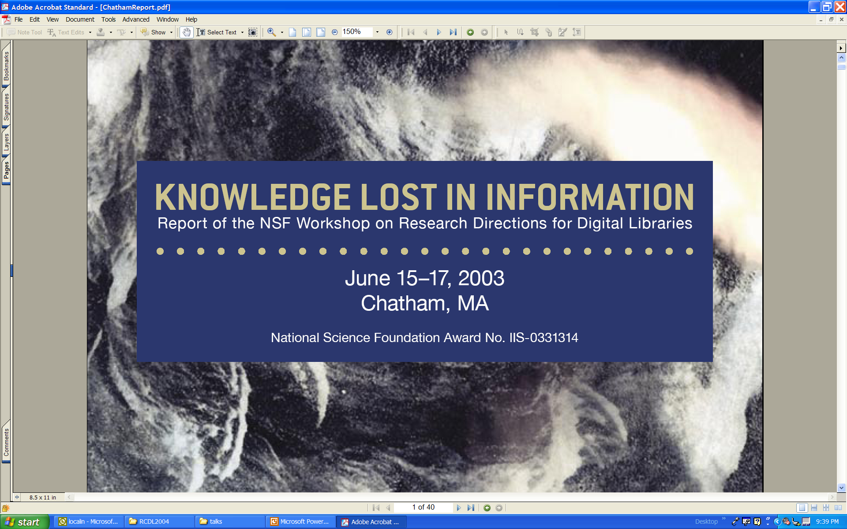

Slide 19


Slide 20
Educational Repositories Connect:
Users: students, educators, life-long learners
Content: structured learning materials; large real-time or archived datasets; audio, images, animations; primary sources; digital learning objects (e.g. applets); interactive (virtual, remote) laboratories; ...
Tools: search; refer; validate; integrate; create; customize; publish; share; notify; collaborate; ...

Slide 21
Collections
Discovery of content
Classification and cataloguing
Acquisition and/or linking; referencing
Disciplinary-based themes define a natural body of content, but other possibilities are also encouraged
Access to massive real-time or archived datasets
Software tool suites for analysis, modeling, simulation, or visualization
Reviewed commentary on learning materials and pedagogy

Slide 22
Services
Help services, frequently asked questions, etc.
Synchronous/asynchronous collaborative learning environments using shared resources
Mechanisms for building personal annotated digital information spaces
Reliability testing for applets or other digital learning objects
Audio, image, and video search capability
Metadata system translation
Community feedback mechanisms

Slide 23
NSDL Information Architecture
Essentially as developed by the Technical Infrastructure Workgroup
Portals &
Clients
Portals &
Clients
User Interfaces
Portals &
Clients
NSDL
Services
NSDL
Services
Other NSDL
Services
NSDL
Collections
Core
NSDL
“Bus”
NSDL
Collections
NSDL
Collections
Usage Enhancement
Collection
Building
Core Services:
information retrieval
CI Services
browsing
CI Services
authentication
referenced
items &
collections
Core Services:
metadata gathering
CI Services
personalization
referenced
items &
collections
Special
Databases
Core Collection-
Building Services
protocols
CI Services
discussion
Core Collection-
Building Services
harvesting
CI Services
annotation

Slide 24
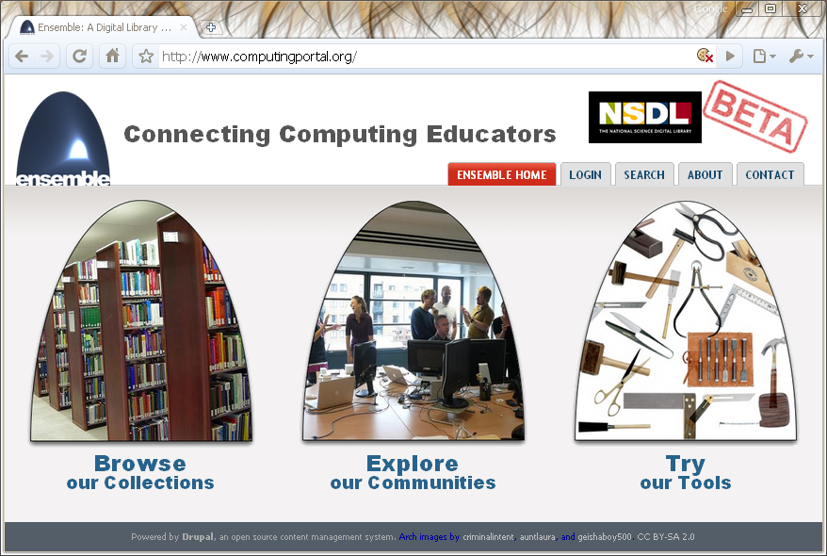
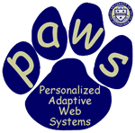




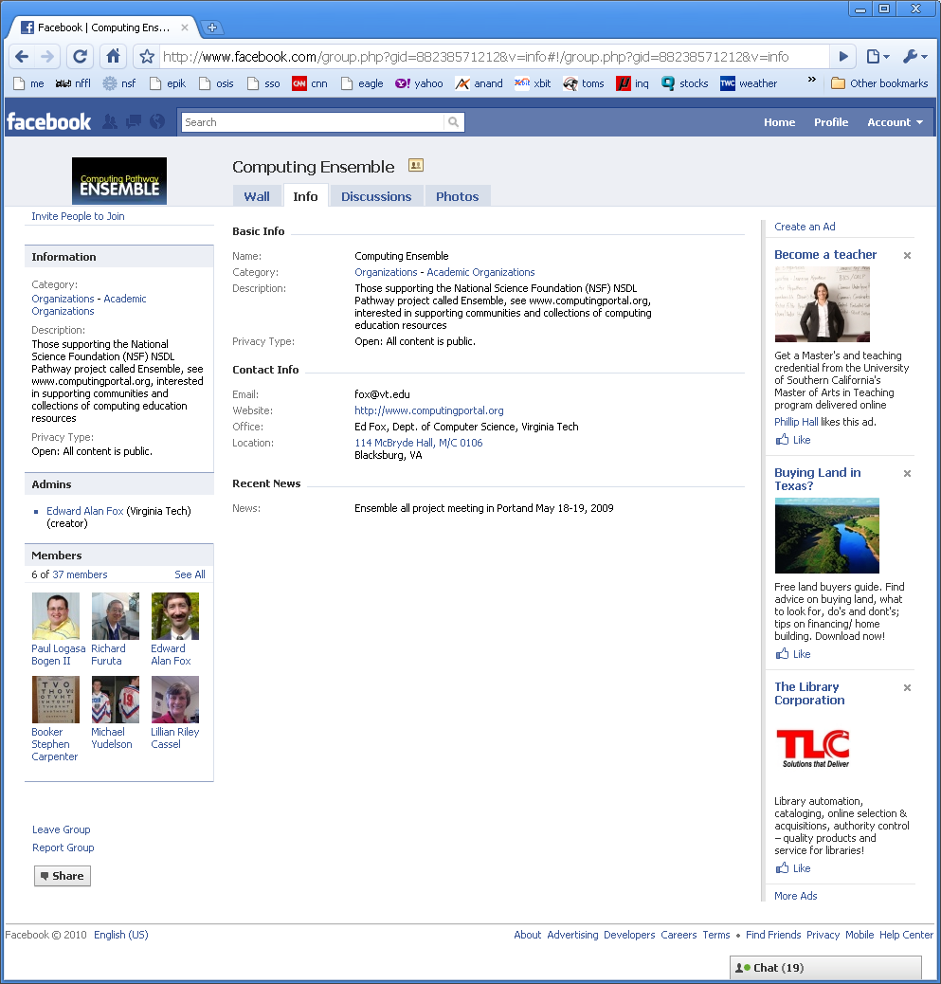
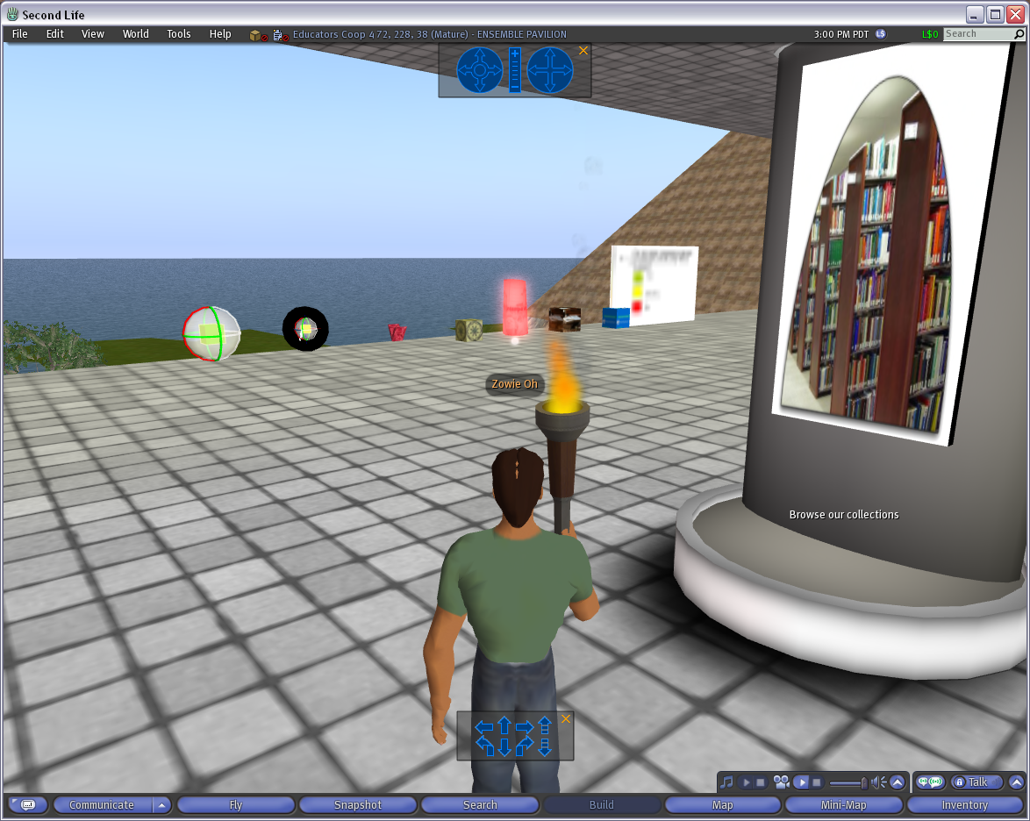
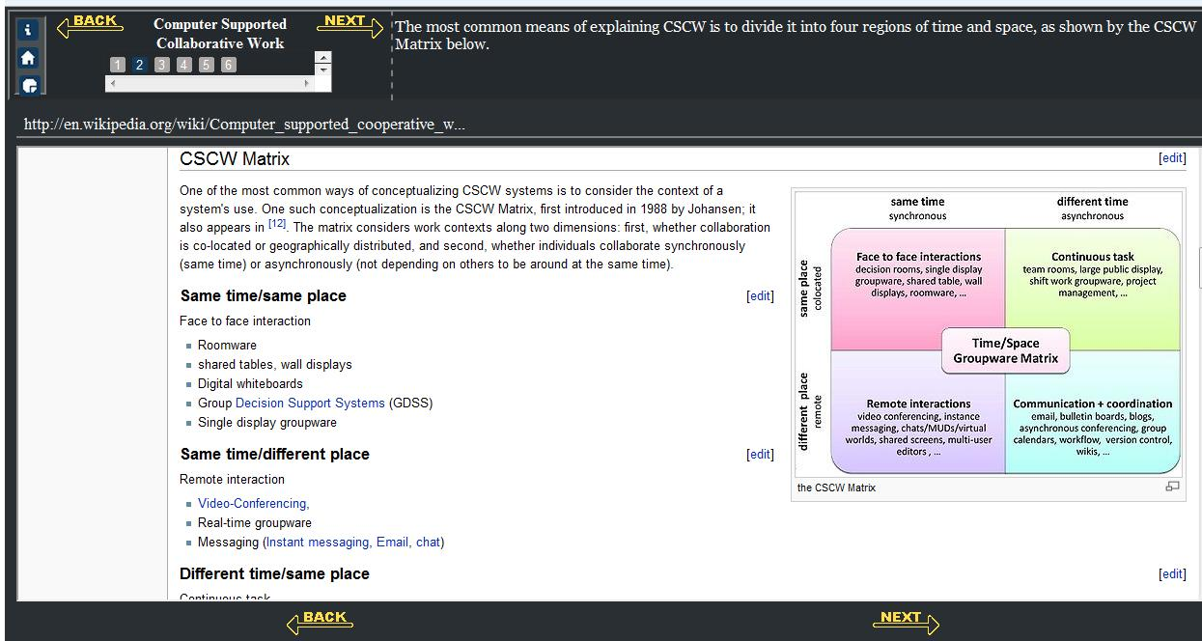
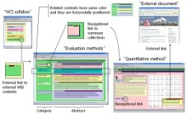



The Ensemble Computing Portal
Many-to-Many Information Connections in a Distributed Digital Library Portal
Collections
Communities
ACM
CS1
FOCES
TECH Developers
Ensemble
LIKES
AP CS
Services
Search
Distributed DL Portal
Forum
Group
Blog
Browse
Notification
Tools
A collaborative research project to build a distributed portal with up-to-date contents for all computing communities.
http://www.computingportal.org/

Slide 25
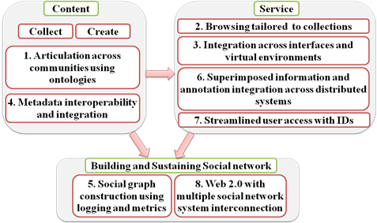
Ensemble: PDP-8 Overview
Principles
of
Distributed
Portals

Slide 26
Networked Digital Library of Theses and Dissertations: www.ndltd.org
N D Ltd or Noodle TD
Vision: Every thesis and dissertation in the world is:
  Devised to take advantage of the most helpful electronic publishing methods
  Shared globally and easily found
  Supported by a suite of digital library services to aid authors, researchers, learners, universities
  Preserved and migrated permanently

Slide 27

CTR stakeholders
Crisis, Tragedy & Recovery net
www.ctrnet.net
Notes:
Help affected communities to recover more quickly and effectively
Provide global network with relevant information and resources
Support the research community, emergency personnel, decision makers, and the public in reacting to and recovering from crises

Slide 28
CC2001 Computer Science volume
DS. Discrete Structures
PF. Programming Fundamentals
AL. Algorithms and Complexity
AR. Architecture and Organization
OS. Operating Systems
NC. Net-Centric Computing
PL. Programming Languages
HC. Human-Computer Interaction
GV. Graphics and Visual Computing
IS. Intelligent Systems
IM. Information Management
SP. Social and Professional Issues
SE. Software Engineering
CN. Computational Science

Slide 29
CC2001 Information Management Areas
IM1. Information models and systems* | IM8. Distributed DBs
IM2. Database systems* | IM9. Physical DB design
IM3. Data modeling* | IM10. Data mining
IM4. Relational DBs | IM11. Information storage and retrieval
IM5. Database query languages | IM12. Hypertext and hypermedia
IM6. Relational DB design | IM13. Multimedia information & systems
IM7. Transaction processing | IM14. Digital libraries
* Core components

Slide 30
DL Curriculum Framework

Slide 31
DL Curric. Project - 1
NSF awards to VT and UNC-CH
CS and LIS
Project server: http://curric.dlib.vt.edu/
Wikiversity: http://en.wikiversity.org/wiki/Curriculum_on_Digital_Libraries

Slide 32
DL Curric. Project - 2
Module 1-b: History of digital libraries and library automation
Module 2-c: File Formats, Transformation, and Migration
Module 3-b: Digitization
Module 4-b: Metadata
Module 5-a: Architecture overviews

Slide 33
DL Curric. Project - 2
Module 5-b: Application software
Module 5-d: Protocols
Module 6-a: Information needs/relevance
Module 6-b: Online information seeking behaviors and search strategies
Module 6-d: Interaction design and usability assessment

Slide 34
DL Curric. Project - 3
Module 7-b: Reference Services
Module 7-g: Personalization
Module 8-b: Web Archiving
Module 9-c: Digital library evaluation, user studies

Slide 35
LIKES and 4 Needs of Others
(www.LivingKnowledgeSociety.org)
Processes
  Programs, algorithms, workflows, business processes, packages/toolkits, problem solving
Modeling, simulation
  Analyze, abstract, connect, validate, predict, refine
Managing information
  Data, information, and knowledge
  PIM, create/represent/search/retrieve/reuse/…
Sensory connection, interaction
  HCI, games, visualization, collaboration

Slide 36
AP CS Principles: Big Ideas
Computing is a creative human activity that engenders innovation and promotes exploration.
Abstraction reduces information and detail to focus on concepts relevant to understanding and solving problems.
Data and information facilitate the creation of knowledge.
Algorithms are tools for developing and expressing solutions to computational problems.

Slide 37
AP CS Principles: Big Ideas (2)
Programming is a creative process that produces computational artifacts.
Digital devices, systems, and the networks that interconnect them enable and foster computational approaches to solving problems.
Computing enables innovation in other fields including science, social science, humanities, arts, medicine, engineering, and business.

Slide 38
Outline
An informal overview of digital libraries
An informal view of 5S
A formal perspective of 5S
What has been done with 5S
Future plans

Slide 39
5S Layers
Societies
Scenarios
Spaces
Structures
Streams

Slide 40
5S Contextualized
Societies/communities/users served
Scenarios/services supported
Management of physical/conceptual/ feature spaces
Use of structures/organizational devices
Streams of content and communication

Slide 41
Informal 5S & DL Definitions
DLs are complex systems that
help satisfy info needs of users (societies)
provide info services (scenarios)
organize info in usable ways (structures)
present info in usable ways (spaces)
communicate info with users (streams)

Slide 42
ETANA-DL Architecture
DigBase and DigKit
Lahav
D
A
T
A
B
A
S
E
W
R
A
P
P
E
R
S
Search
U
S
E
R
I
N
T
E
R
F
A
C
E
Browse
Nimrin
Recommend
Umayri
ETANA-DL
UNION
CATALOG
Note
Hisban
Personalize
Megiddo
Review
Jalul
Visualizations
Archaeology
Specific
…
New Sites
Work in progress

Slide 43
ETANA Societies
Historic and pre-historic societies (being studied)
Archaeologists (in academic institutes, fieldwork settings, or local and national governmental bodies)
Project directors
Technical staff (consisting of photographers, technical illustrators, and their assistants)
Field staff (responsible for the actual work of excavation)
Camp staff (e.g., camp managers, registrars, tool stewards)
General public (e.g., educators, learners, citizens)

Slide 44
ETANA Societies
Social issues
  Who owns the finds?
  Where should they be preserved?
  What nationality and ethnicity do they represent?
  Who has publication rights?
  What interactions took place between those at the site studied, and others? What theories are proposed by whom about this?

Slide 45
ETANA Scenarios
Life in the site in former times
Digital recording: the planning stage and the excavation stage
Planning stage: remote sensing, fieldwalking, field surveys, building surveys, consulting historical and other documentary sources, and managing the sites and monuments
Excavation
  Detailed information is recorded, including for each layer of soil, and for features such as pole holes, pits, and ditches.
  Data about each artifact is recorded together with information about its exact find spot.
  Numerous environmental and other samples are taken for laboratory analysis, and the location and purpose of each is carefully recorded.
  Large numbers of photographs are taken, both general views of the progress of excavation and detailed shots showing the contexts of finds.
Organization and storage of material
Analysis and hypotheses generation and testing
Publications, museum displays
Information services for the general public

Slide 46
ETANA Spaces
Geographic distribution of found artifacts
Temporal dimension (as inferred by archaeologists)
Metric or vector spaces
  used to support retrieval operations, and to calculate distance (and similarity)
  used to browse / constrain searches spatially
3D models of the past, used to reconstruct and visualize archaeological ruins
2D interfaces for human-computer interaction

Slide 47
ETANA Structures
Site Organization
  Region, site, partition, sub-partition, locus, …
Temporal orderings (ages, periods)
Taxonomies
  for bones, seeds, building materials, …
Stratigraphic relationships
  above, beneath, coexistent

Slide 48
ETANA Streams
successive photos and drawings of excavation sites, loci, unearthed artifacts
audio and video recordings of excavation activities and discussions
textual reports
3D models used to reconstruct and visualize archaeological ruins.

Slide 49
Ensemble in 5 S - Societies
What Societies must Ensemble serve?
  Teachers
  Students, perhaps
  Groups with computing education tasks
  The NSDL
  The NSF
  Partner sites (providers and harvesters)
  The developers
  Related hardware / software components

Slide 50
Ensemble in 5S - Scenarios
What Scenarios must be addressed? (a sample)
  Search, Browse
  User registration, login
  Commenting, rating, tagging
  Acquisition/de-acquisition/user contributing
  Share resources in, and collect data from, other places (CiteULike, Facebook)
  Acknowledge contributions
  Harvest and be harvested
  Join groups, participate in discussions
  Recover from failures
    Computer systems, storage

Slide 51
Ensemble in 5S - Spaces
What Spaces will matter in Ensemble?
  User interface (2D generally, 3D in Second Life)
  Education level
  Curriculum standards or recommendations
  Topic spaces
  Vector and feature spaces to support indexing, searching, and classifying

Slide 52
Ensemble in 5S - Structures
What Structures will we hold?
  Metadata
  Computing Ontology
  Database schema and tables
  Taxonomies
    Educational schema
    Computing topics (Knowledge units)
    Rating schemes

Slide 53
Ensemble in 5 S - Streams
What Streams of data will we see?
  All the document types we can imagine: text, word processor, PDF, spreadsheets, presentations, HTML, XML, …
  All the image types, all the video types
    Images (jpg, tiff, …)
    Video (avi, mov, …)
  Program code, both source code and object code
  Comments, ratings, tags
  Group membership profiles
  E-mail addresses
  User information (preferences, …)

Slide 54
Outline
An informal overview of digital libraries
An informal view of 5S
A formal perspective of 5S
What has been done with 5S
Future plans

Slide 55
5S and DL formal definitions and compositions (April 2004 TOIS)

Slide 56
A Minimal ArchDL in the 5S Framework
Streams
Structures
Spaces
Scenarios
Societies
Descriptive Metadata specification
Structured Stream
services
SpaTemOrg
StraDia
Arch Descriptive Metadata specification
indexing
browsing
searching
ArchObj
hypertext
ArchDO
Arch Metadata catalog
ArchColl
ArchDColl
ArchDR
Minimal ArchDL

Slide 57
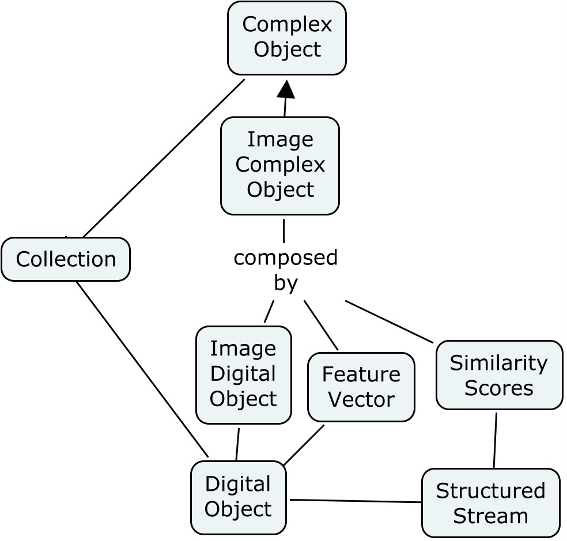
5S Extensions to Complex Object
From [Murthy et al. 2010], a Complex object is a tuple cdo=(h, SCDO=DO U SM, S), where:
h є H, where H is a set of universally unique handles (lables);
DO={do¹,do²,...,don}, where doi is a digital object;
SM={sm¹,sm²,...smn} is a set of streams;
S is a structure that composes the cdo into its parts in SCDO.

Slide 58
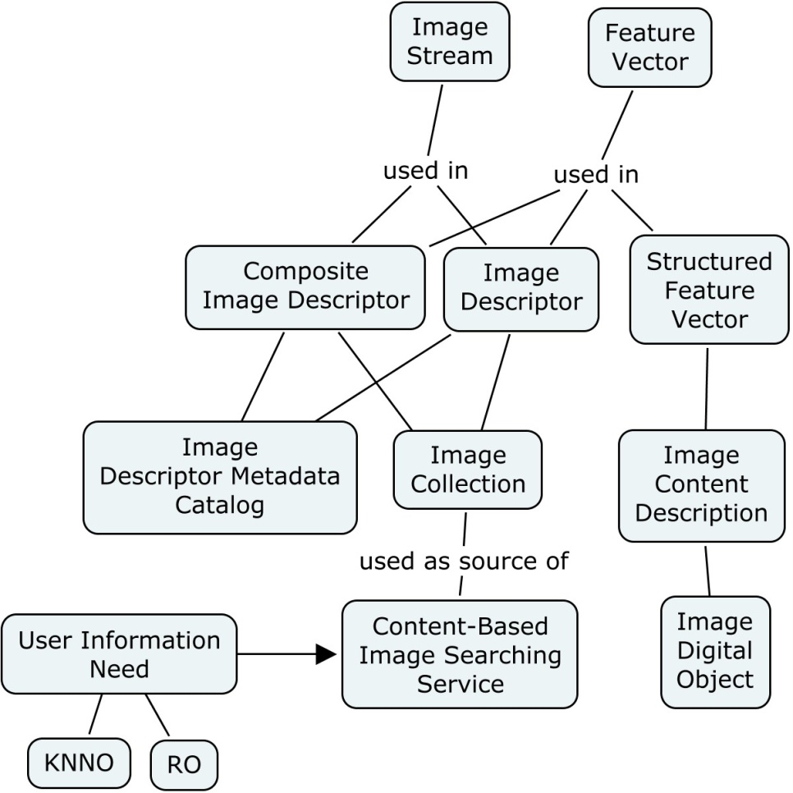
5S Extensions to CBIR

Slide 59
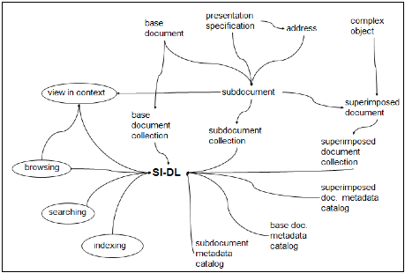
Uma Murthy’s Dissertation, esp. Ch. 8
SI-Dl metamodel - v1
5S analysis of SI Initial metamodel
SIMPEL Enhanced CMapTools
Case studies of SI use (music & fisheries) Pilot user studies
SuperIDR-v1
SuperIDR-classroom study
Fish id. – learning and identification SuperIDR improves on traditional methods Insufficient data on how SuperIDR was used
SuperIDR-v2
Lucene indexing Usability improvements
SuperIDR – formative evaluation
SuperIDR improvements Classroom study design
SuperIDR-v3
Image mgmt. Combined search Comparison Usability improvements
SI-Dl metamodel – v2
Improved metamodel Case study
SuperIDR-qualitative study
SI-DL design guidelines
Notes:
Results to date
Case studies
Superimposed applications
SuperIDR
SuperIDR evaluation – longitudinal and classroom-based
Metamodel
Was able to answer questions about what does this DL contain, how might it be realized, how it compares with traditional methods of doing a task and to some extent how subimages/SI is used in scholarly tasks
But not yet answered – how SI-DL supports use of subimages in scholarly tasks? Opportunity to analyze deeper on use of subimages in scholarly tasks

Slide 60
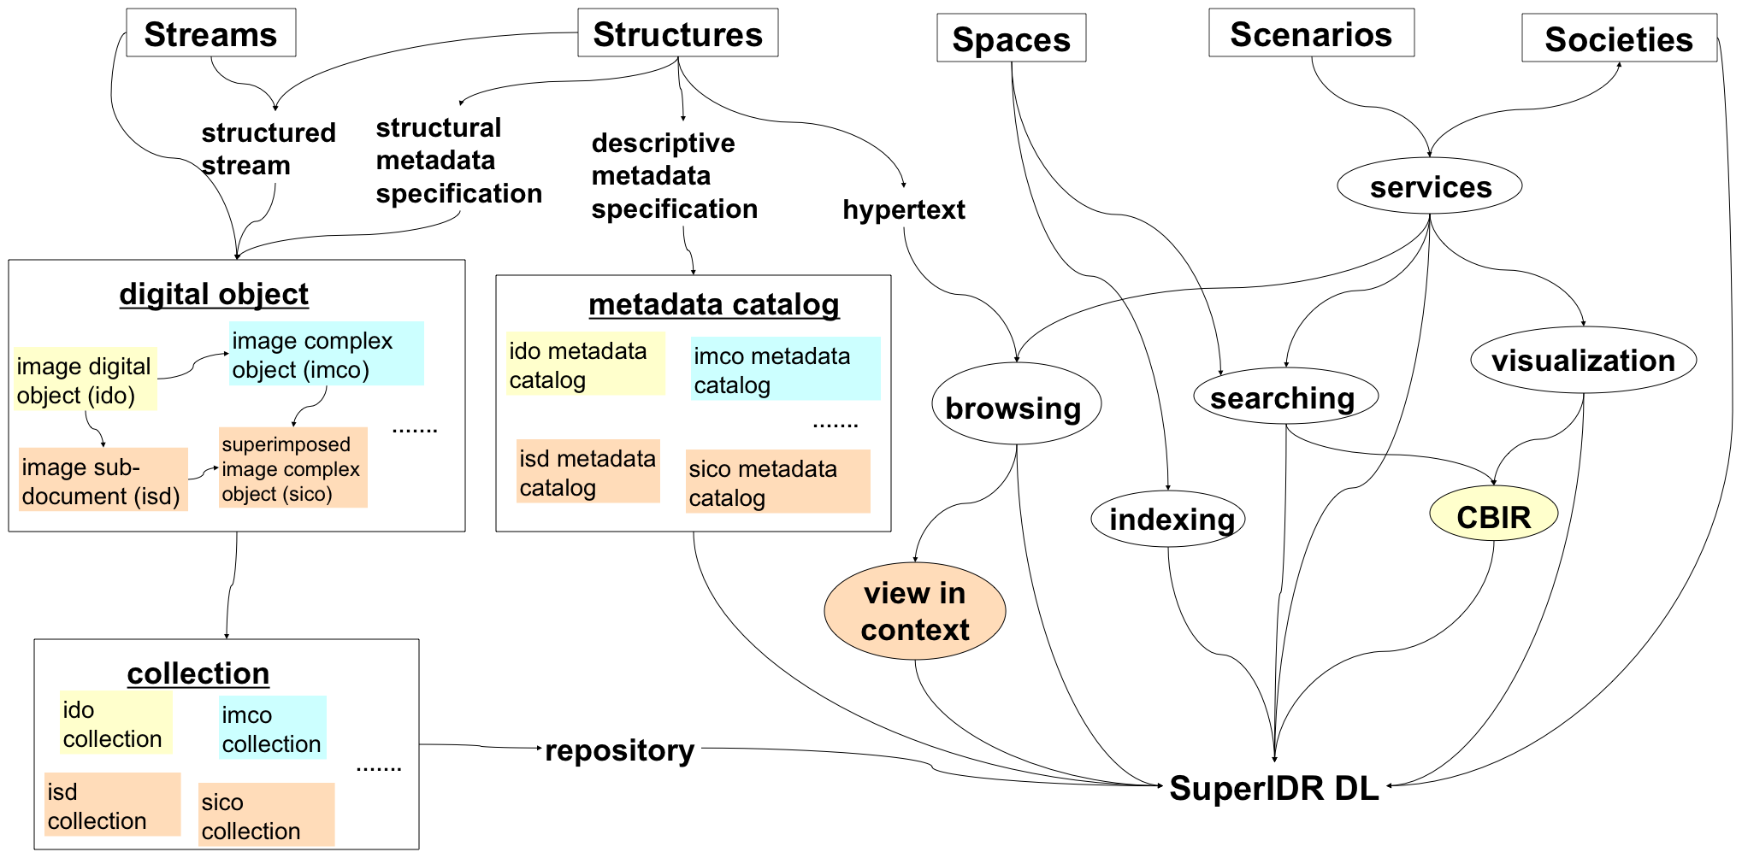
Definitional dependencies among concepts in the SuperIDR SI-DL

Slide 61
Content / People

Slide 62
Extending 5S
Higher DL Constructs
  Collections
  Catalogs
  Repositories and Archives
  Systems
  Case Studies
Specialized views and services

Slide 63
Outline
An informal overview of digital libraries
An informal view of 5S
A formal perspective of 5S
What has been done with 5S
Future plans

Slide 65
Tools/Applications

Slide 66
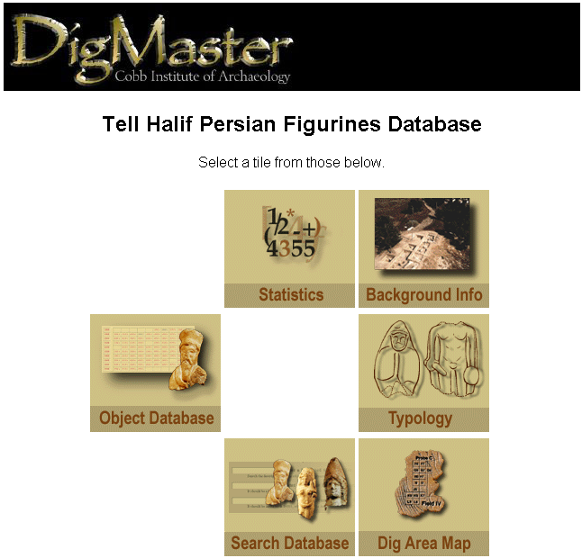
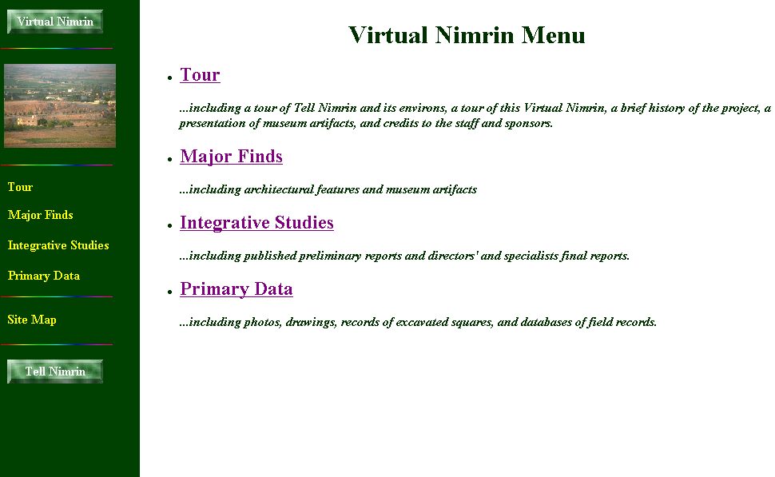
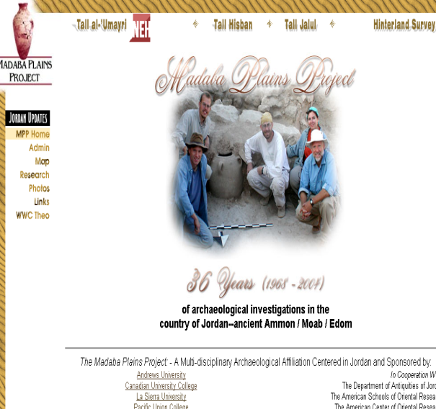
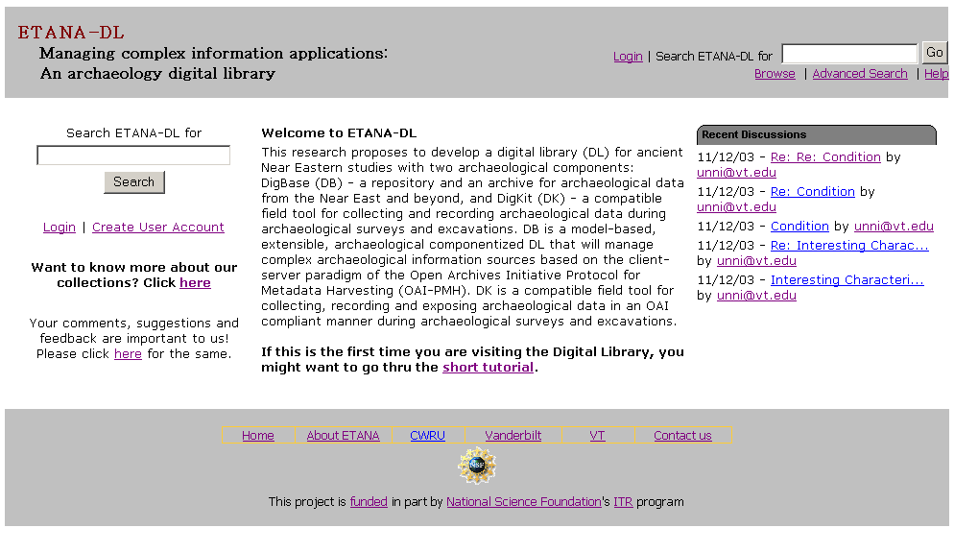
ETANA.org

Slide 67
Architecture of a Union DL (ETANA.org)
DL1
Union DL
DL2
Union Society
Society
☺ ☺ ☺ ☺
Society
☺ ☺
☺ ☺
archaeologists
Archaeologists
General Public
General Public
Union Service
Service
Service
Searching
Harvesting, Mapping,
Searching, Browsing,
Clustering, Visualization
Browsing
Catalog1
Union
Catalog
Catalog2
Union
Repository
Repository1
Repository2

Slide 68
Union Catalog Integration
Mapping
Tool
Virtual Nimrin
(VN)
VN Metadata
Format
Union ArchDL
Union
Catalog
VN
Catalog
Wrapper
Global Metadata
Format
Halif DigMaster
(HD)
HD
Catalog
Wrapper
HD Metadata
Format
Mapping
Tool

Slide 69
Outline
An informal overview of digital libraries
An informal view of 5S
A formal perspective of 5S
What has been done with 5S
Future plans

Slide 70
Digital Libraries --- Objectives
World Lit.: 24hr / 7day / from desktop
Integrated “super” information systems: 5S: Table of related areas and their coverage
Ubiquitous, Higher Quality, Lower Cost
Education, Knowledge Sharing, Discovery
Disintermediation -> Collaboration
Universities Reclaim Property
Interactive Courseware, Student Works
Scalable, Sustainable, Usable, Useful

Slide 71
DL Overview
Why of Global Interest?
National projects can preserve antiquities and heritage: cultural, historical, linguistic, scholarly
Knowledge and information are essential to economic and technological growth, education
DL - a domain for international collaboration
  wherein all can contribute and benefit
  which leverages investment in networking
  which provides useful content on Internet & WWW
  which will tie nations and peoples together more strongly and through deeper understanding
Notes:
3
3

Slide 72
As data, information, and knowledge play increasingly central roles … digital library research should focus on:
Increasing the scope and scale of information resources and services;
Employing context at the individual, community, and societal levels to improve performance;
Developing algorithms and strategies for transforming data into actionable information;
Demonstrating the integration of information spaces into everyday life; and
Improving availability, accessibility, and, thereby, productivity. (Chatham Workshop)

Slide 73
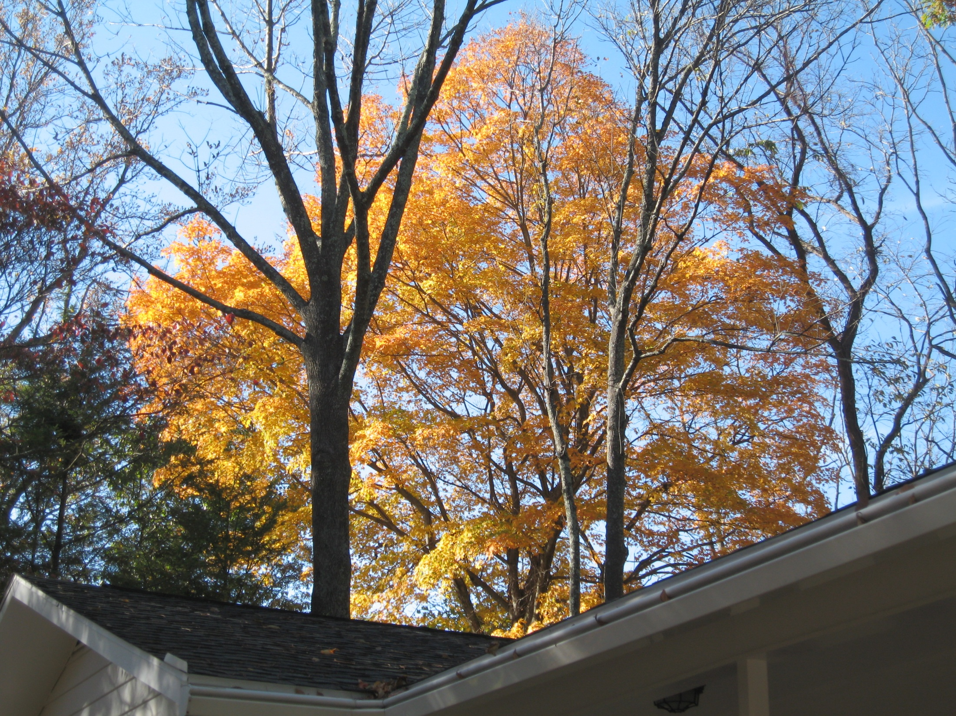
Questions?
Ask: fox@vt.edu. Feel free to visit Blacksburg, VA

