Slide 1
Digital Libraries in Higher Education:
Scientific Experiences
(Riyadh, Saudi Arabia– 30-31 October)
“Digital Library Support for
1) Graduate Education and
2) Computing-related Education” by Edward A. Fox
fox@vt.edu http://fox.cs.vt.edu (/talks)
Dept. of Computer Science, Virginia Tech
Blacksburg, VA 24061 USA

Slide 2
Ed Fox, Director, Virginia Tech Digital Library Research Laboratory
Executive Director, Networked Digital Library of Theses & Dissertations
Chair, Steering Committee, ACM/IEEE Jt. Conf. on Digital Libraries
Member, Board of Directors, Computing Research Association
Digital | Information | Libraries | Retrieval
Chair | Committee | Conference | Workshop
Education | Electronic | Dissertations | Theses
Research | Science | Systems | Technology
Open | Initiative | International | Multimedia
Access | Archive | Intelligent | Interactive
Knowledge | Learning | SIGIR | Tutorial

Slide 3
Philosophy, Message
Collaboration Local National Regional, Global | Empowerment Uploading Sharing Open Access
Research Board, CRA Over 110 grants: Epub, IR, DL, MM | Education DL curriculum Graduate: ETDs Ugrad: Ensemble

Slide 4
Outline
Acknowledgements
NDLTD
Digital Library Curriculum Project
Ensemble (Pathway in NSDL)
Extra Slides
  Digital Libraries
  Crisis, Tragedy & Recovery Network (CTRnet)
  Digital Preserve in Second Life

Slide 5
Acknowledgements
Mentors (Licklider & Kessler 1967-71 MIT, Salton 1978-1983 Cornell)
NSF and other sponsors
Students, colleagues, co-investigators
Virginia Tech, CS, Digital Library Research Lab
Collaborators: Dlcurric, Ensemble, CTRnet, …
NDLTD Board, Members
ETD supporters: conference/regional/local

Slide 6
Acknowledgments (2)
NSF-funded DL Projects
Digital Library Curricular Resources
  NSF IIS-0535057 & 0535060
Ensemble (Computer Science Education)
  NSF DUE-0840719
CTRnet (Crisis, Tragedy & Recovery Net)
  NSF IIS-0916733
Digital Preserve
  NSF IIS-0910183 & 0910465
  http://slurl.com/secondlife/Digital%20Preserve/140/126/29

Slide 7
Outline
Acknowledgements
NDLTD
Digital Library Curriculum Project
Ensemble (Pathway in NSDL)
Extra Slides
  Digital Libraries
  Crisis, Tragedy & Recovery Network (CTRnet)
  Digital Preserve in Second Life

Slide 8
A Digital Library Case Study
Domain: graduate education, research
Genre:ETDs=electronic theses & dissertations
Submission: e.g., http://etd.vt.edu
Collection: Union Catalog run by OCLC, with access through OAI-PMH, SRU
Project:
Networked Digital
Library of Theses
& Dissertations
(NDLTD)
http://www.ndltd.org

Slide 9
ETD Conferences
1987 mtg in Ann Arbor: UMI, VT, … | 2002 – 5th symposium – BYU, Provo, Utah
1992 mtg in Washington: CNI, CGS, UMI, VT and 10 universities | 2003 – 6th symposium – Berlin (215)
1993 mtg in Atlanta to start Monticello Electronic Library | 2004 – 7th symposium – U. Kentucky
1994 mtg at VT: std: PDF + SGML + multimedia objects | 2005 – 8th symposium – Sydney, Australia
1996 mtg w. funding by SURA, US Dept. of Education(FIPSE) | 2006 – 9th symposium – Quebec City, Canada
1997 meetings in UK, Germany, ... ================================== | 2007 – 10th symposium – Uppsala, Sweden
1998 – 1st symposium – Memphis (20) | 2008 – 11th symposium – Aberdeen, Scotland
1999 – 2nd symposium – Blacksburg (70) | 2009 – 12th symposium – Pittsburgh, PA
2000 – 3rd symp – St. Petersburg, FL (225) | 2010 – 13th symposium – Austin, TX
2001 – 4th symposium – Caltech (200) | 2011 – 14th symposium – Cape Town,S. Africa September 13-17

Slide 10
NDLTD: www.ndltd.org
N D Ltd or Noodle TD
Vision: Every thesis and dissertation in the world is:
  Devised to take advantage of the most helpful electronic publishing methods
  Shared globally and easily found
  Supported by a suite of digital library services to aid authors, researchers, learners, universities
  Preserved and migrated permanently

Slide 11
What are we doing?
Aiding universities and nations to enhance graduate education, publishing, preservation (data sets next!), and Intellectual Property Rights efforts
Helping improve the availability and content of theses and dissertations
Educating ALL future scholars so they can publish electronically and effectively use digital libraries (i.e., are Information Literate and can be more expressive)
Notes:
4
4
4
3
2

Slide 12
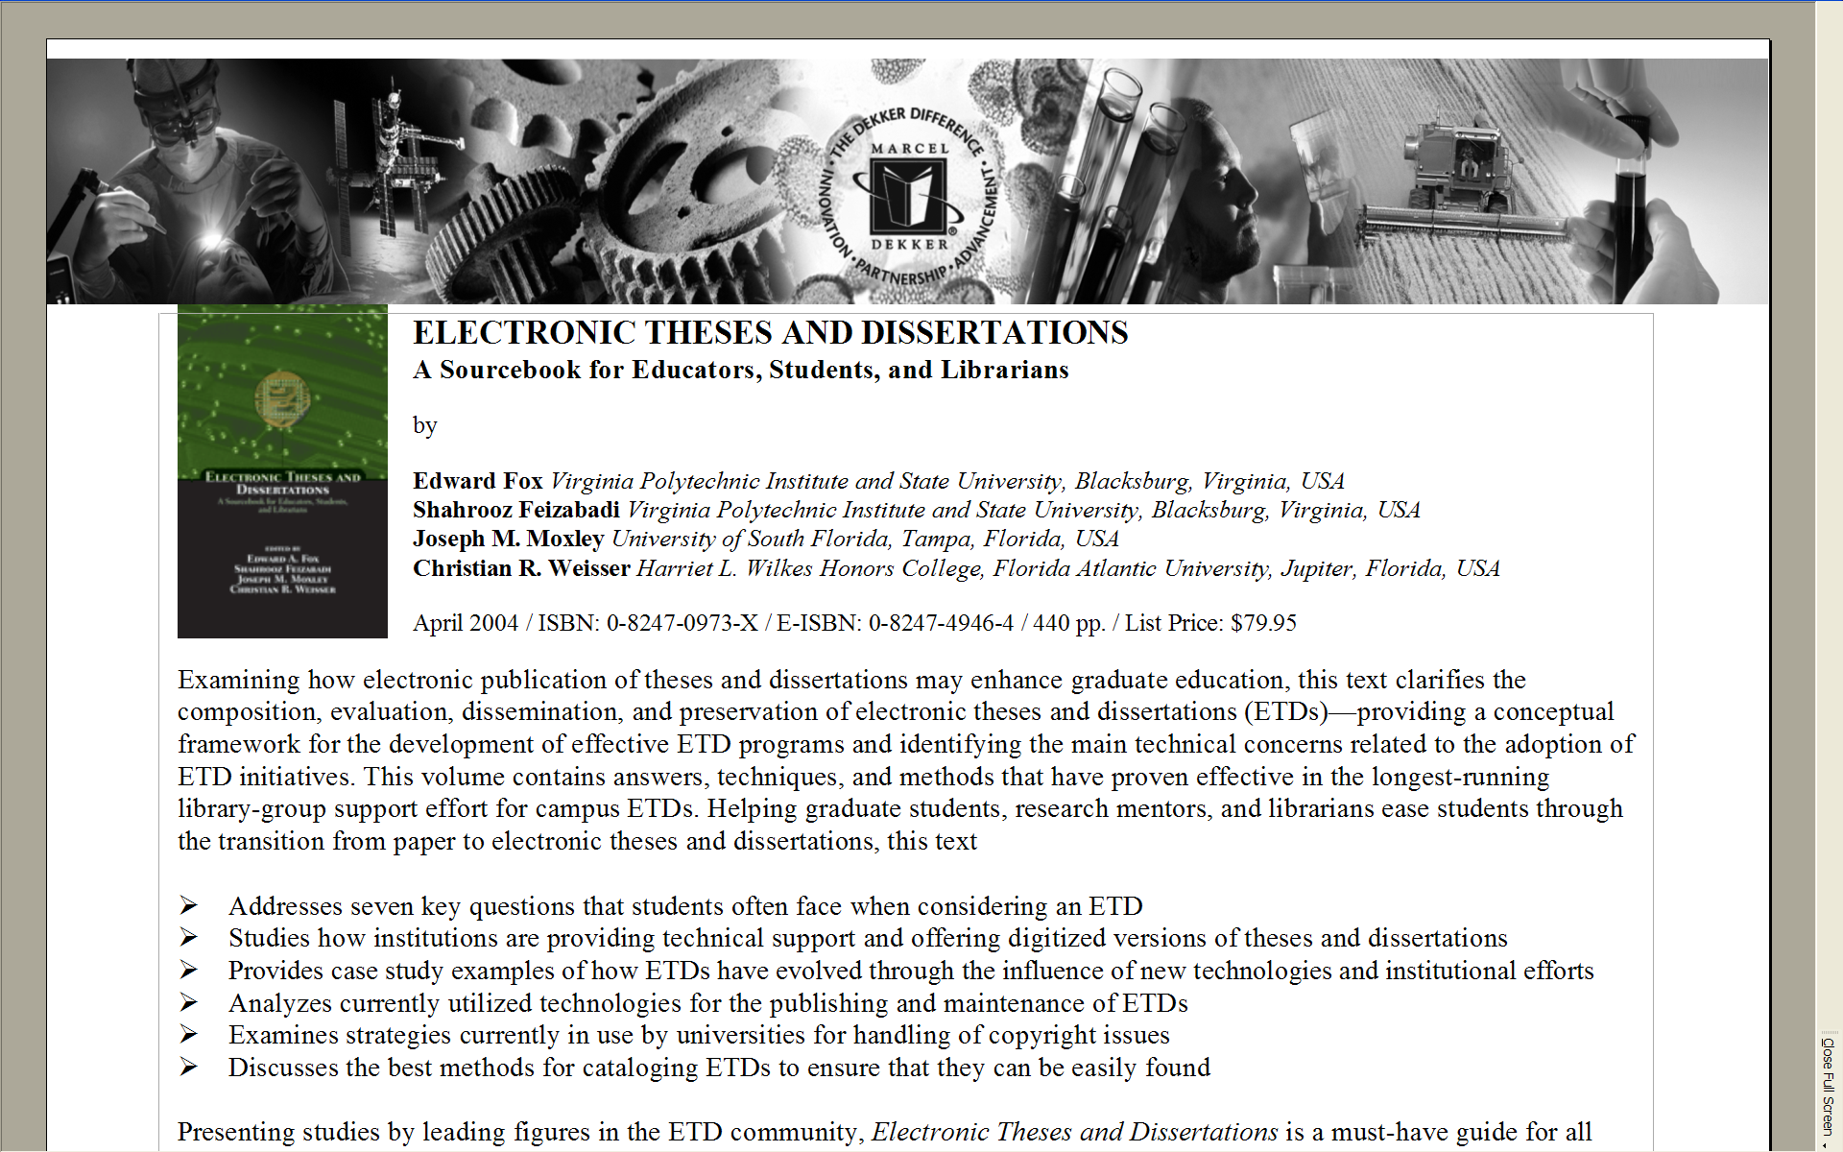

Slide 13
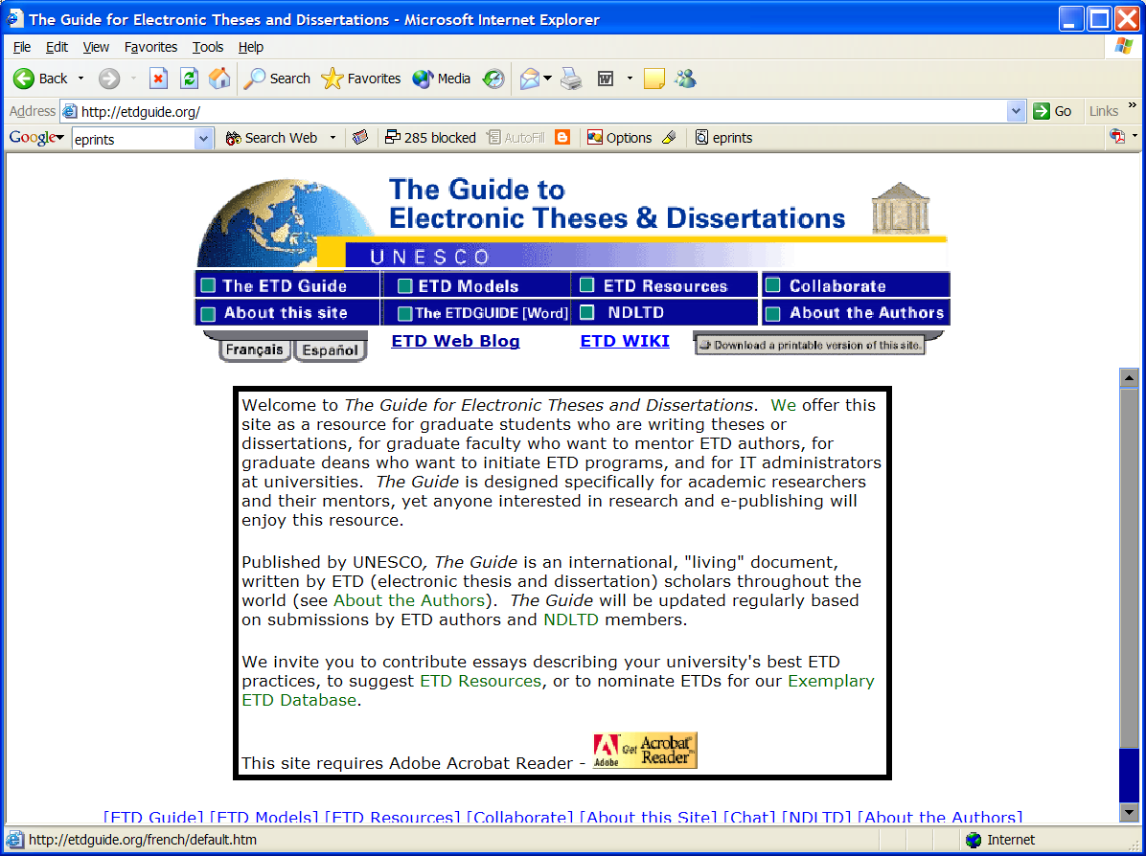
http:// curric.dlib.vt.edu/wiki/index.php/ETD_Guide

Slide 14
ETDs: Library Goals
Improve library services
  Better turn-around time
  Always available
Reduce work
  catalog from e-text
  eliminate handling: mailing to ProQuest, bindery prep, check-out, check-in, reshelving, etc.
Save space
Notes:
ETDs give libraries an avenue to demonstrate Information Age goals

Slide 15
NDLTD: How can a university proceed?
Select planning/implementation team
  Library
  Graduate School
  Computing / Information Technology
  Institutional Research / Educ. Tech.
Join online, give us contact names
  www.ndltd.org/join
Adapt Virginia Tech or other proven approach
  Build interest and consensus
  Start trial / allow optional submission / start requirement
  ETDdb, DSpace, EPrints, other institutional repositories
Notes:
22
17
16
17
17

Slide 16
Student Gets Committee
Signatures and Submits ETD
Approval
form
Signed
Grad School
Notes:
10

Slide 17
Library Catalogs ETD, Access is
Opened to the New Research
WWW
NDLTD
Digital library access control
Notes:
12

Slide 18
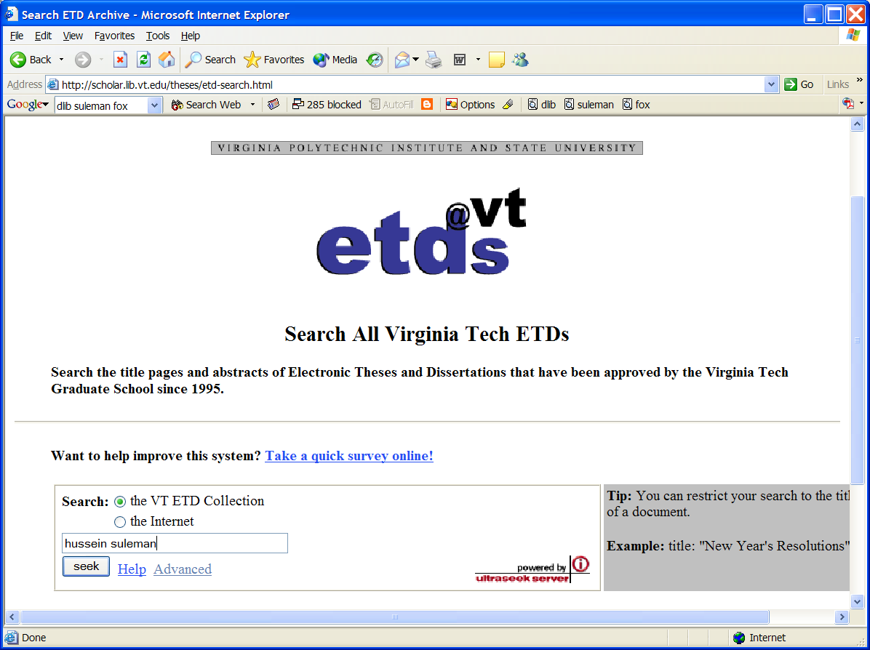

Slide 19
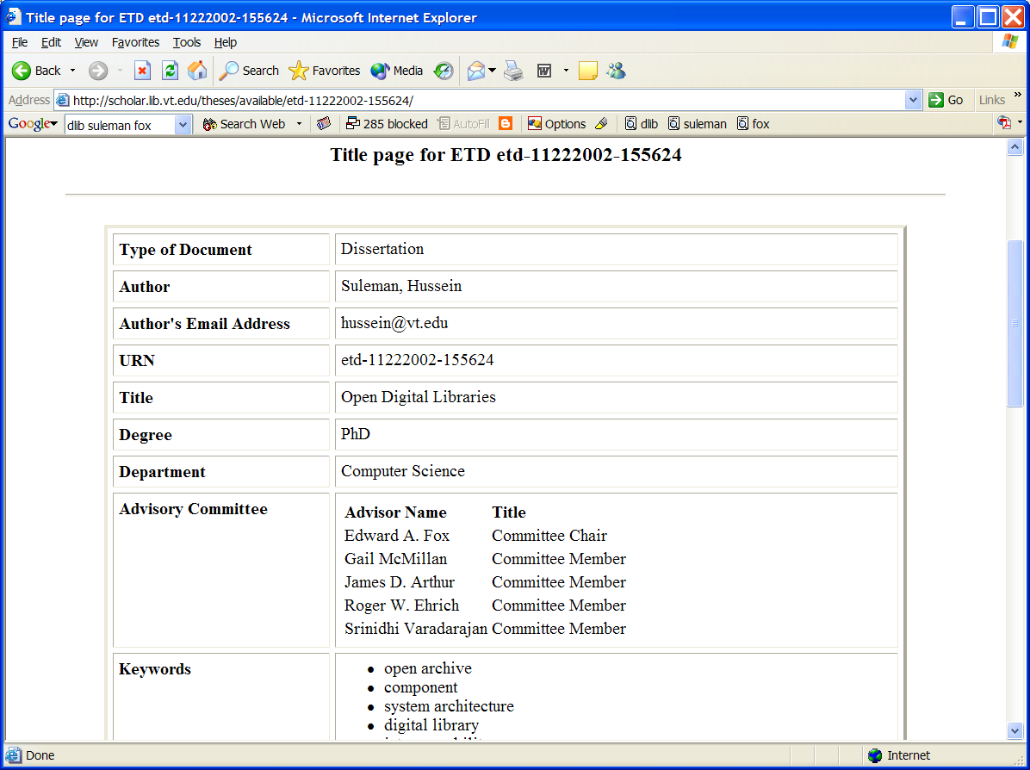

Slide 20
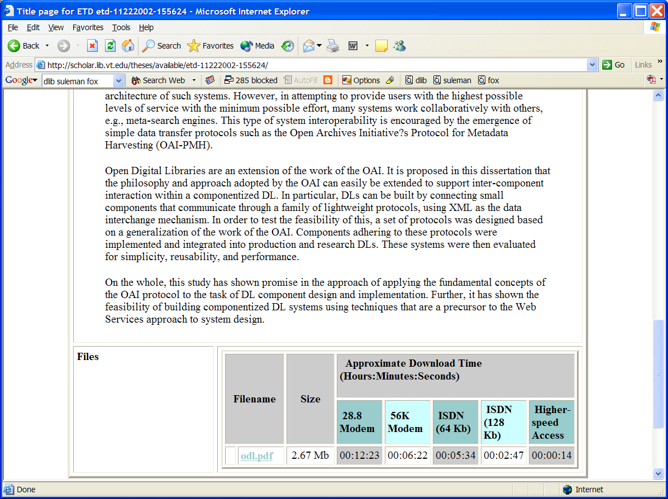

Slide 21
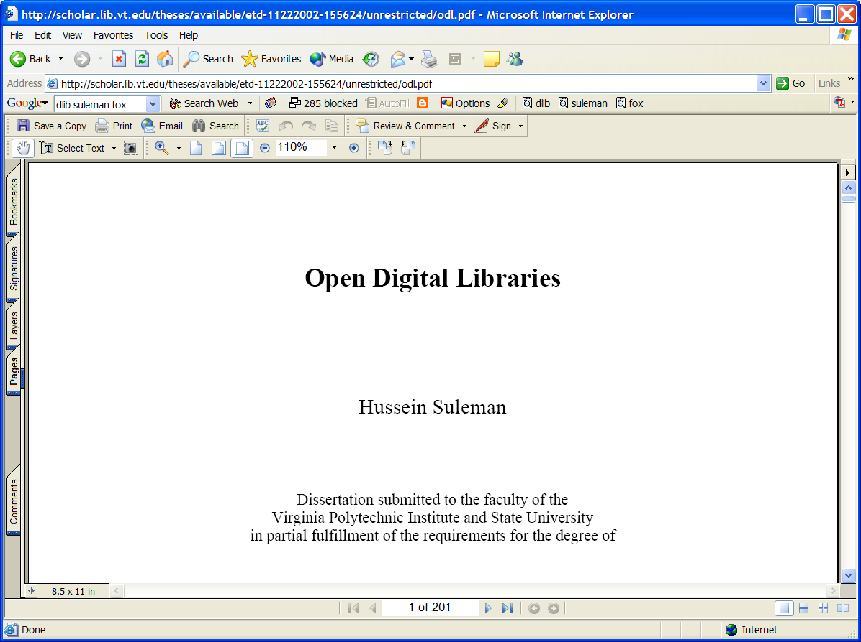

Slide 22
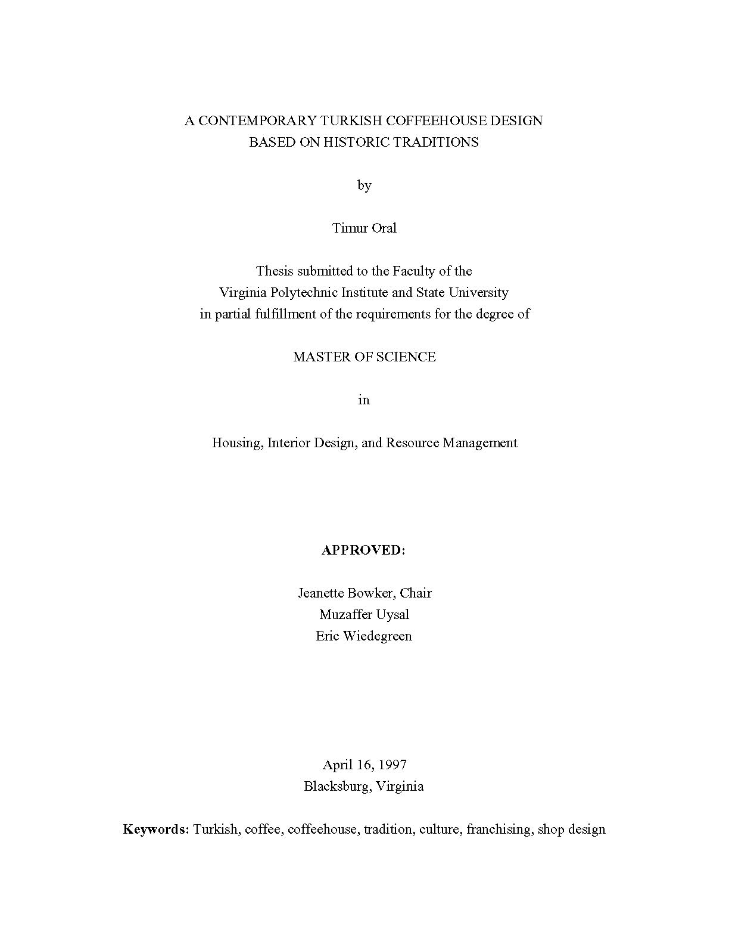

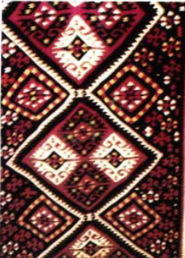
http://scholar.lib.vt.edu/theses/available/etd-2227102539751141/
Notes:
http://scholar.lib.vt.edu/theses/available/etd-2227102539751141/
What is an ETD? What it can look like:
It can have the appearance of a paper document.
It can contain a video clip.
It can contain sound.
It can contain thumbnail pages and links to aid navigation.
It can have a unique layout.
It can have photomicrographs.
It can contain a simulation.
The library resources used in an ETD initiative can include

Slide 23
Union catalog: OCLC
Is getting data from WorldCat (so, from many sites).
Need DC and either ETD-MS or MARC.
Will harvest from all others who contact them.
Has a set for ETDs, using Open Archives Initiative Protocol for Metadata Harvesting (OAI-PMH)

Slide 24
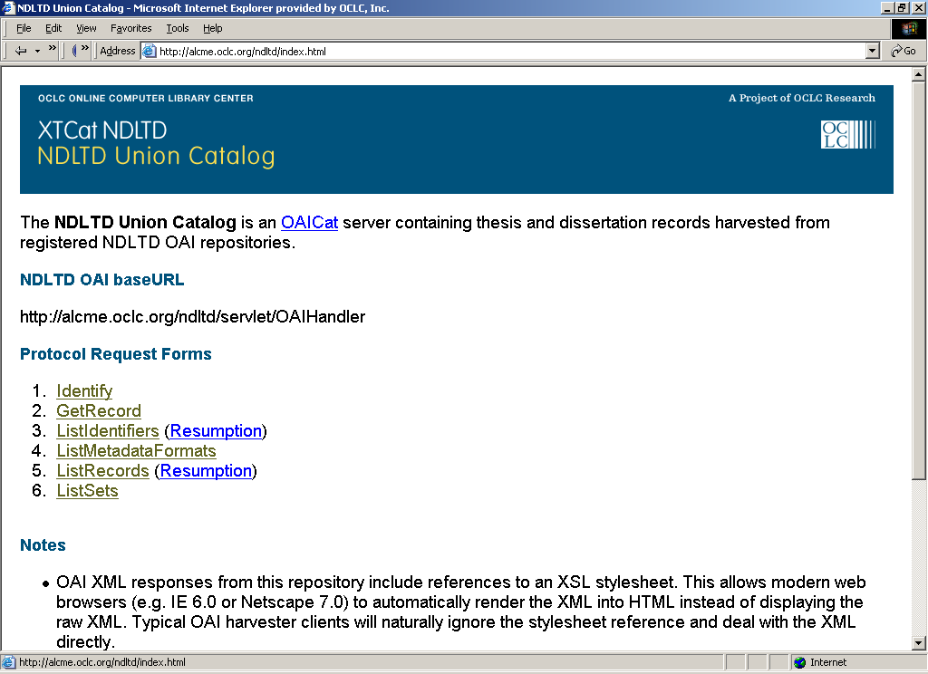

Slide 25
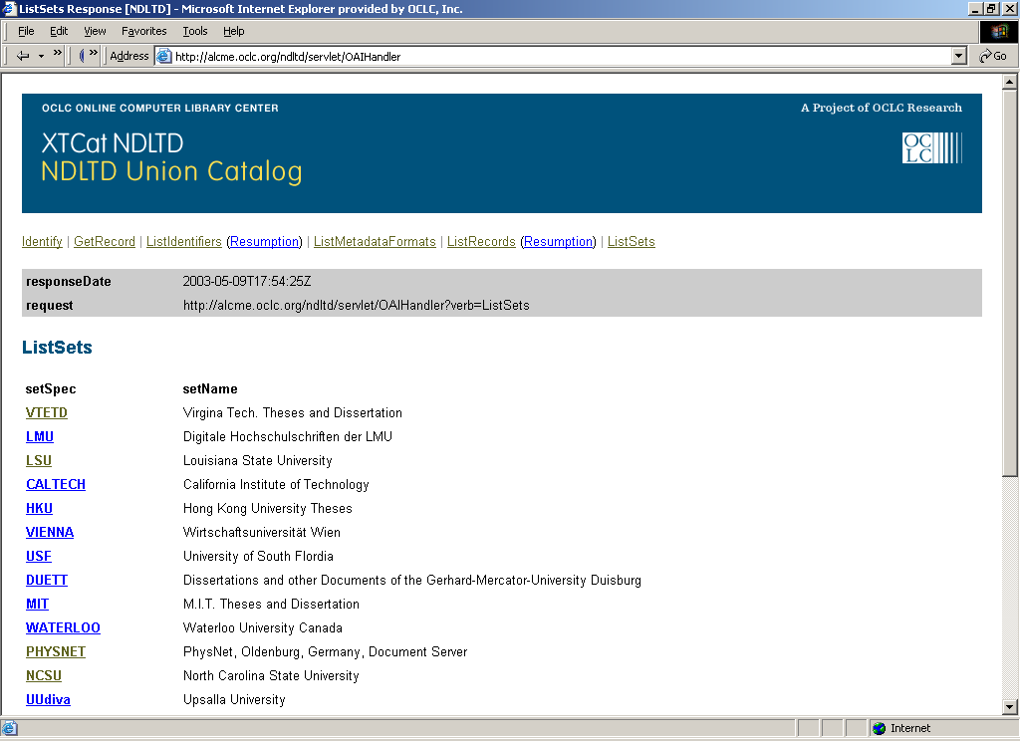

Slide 26
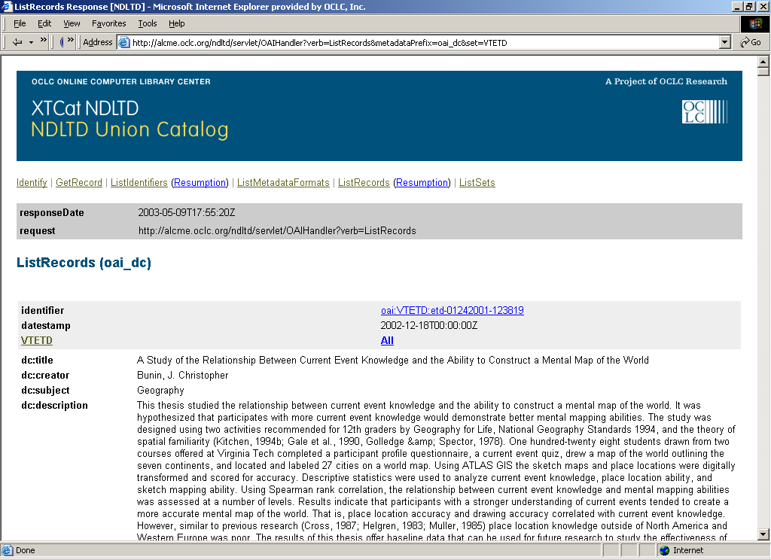

Slide 27
OCLC SRU Interface

Slide 28
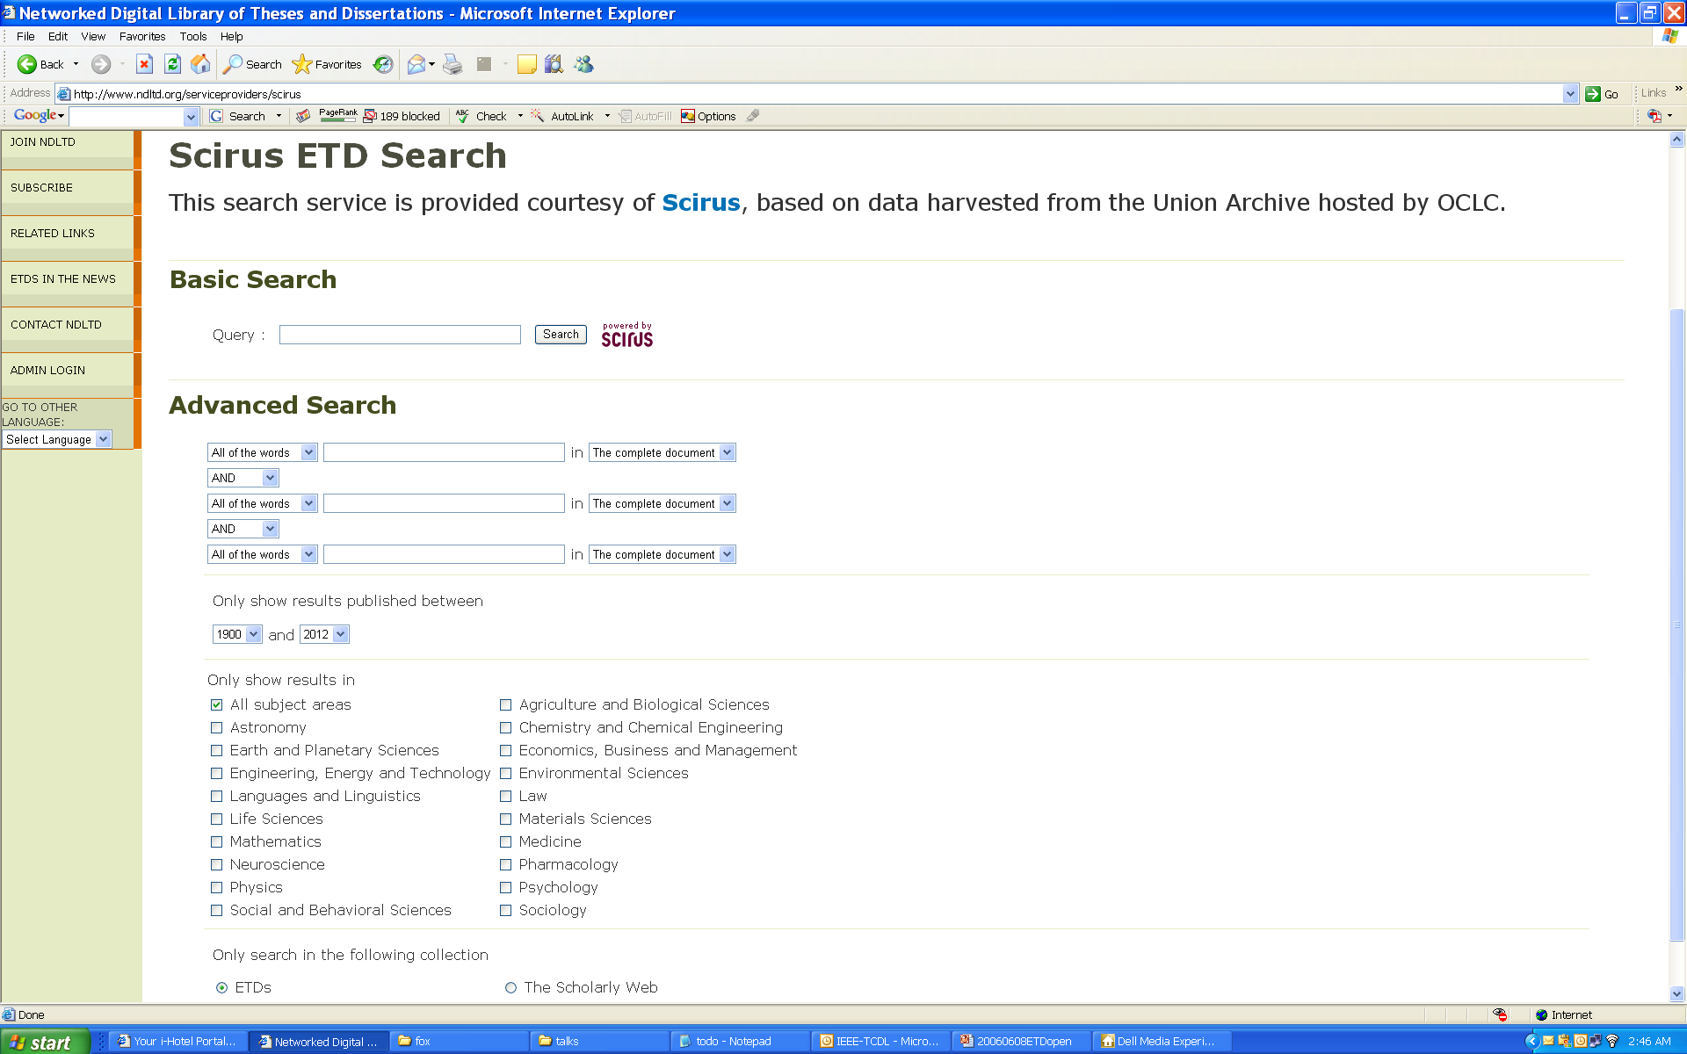

Slide 29
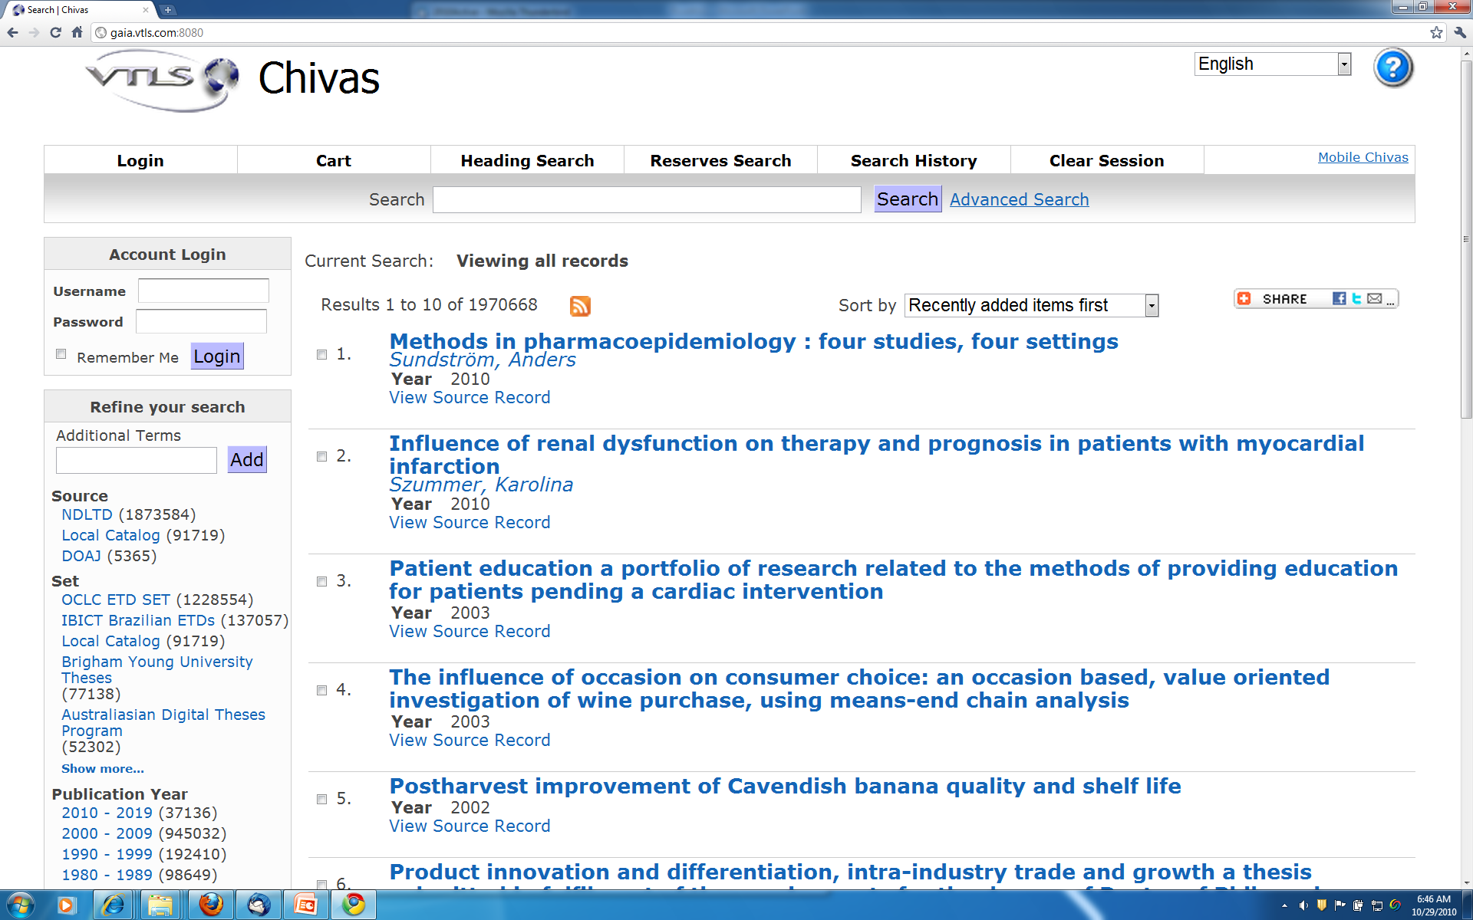
VTLS Visualizer Service -> Chivas
Other facets: Format, Language, Subject, Genre, Author

Slide 30
ETD Classification Research:
Algorithm Pipeline
(Venkat Srinivasan dissertation)
ETDs categorized into a node of the category tree (after classification)
LCSH
Category
Tree
ETD Collection
Category label for each node used as query
ETD metadata used for categorization
Categorized
ETDs
OCLC Dataset
Classifiers
Level-wise categorization
Top entries (for each node in the tree)
Training
Browsing
Web
Interface
Document
Sets
Training
Sets
Cleanup
(stemming,
stopword removal,
etc.)

Slide 31
Why ETD? Short Answer
For Students:
  Gain knowledge and skills for the Information Age
  Richer communication (digital information, multimedia, …)
For Universities:
  Easy way to enter the digital library field and benefit thereby
For the World:
  Global digital library – large, useful, many services
General:
  Save time and money
  Increased visibility for all associated with research results

Slide 32
Outline
Acknowledgements
NDLTD
Digital Library Curriculum Project
Ensemble (Pathway in NSDL)
Extra Slides
  Digital Libraries
  Crisis, Tragedy & Recovery Network (CTRnet)
  Digital Preserve in Second Life

Slide 33
DL Curriculum Framework

Slide 34
1. Module name
2. Scope
3. Learning objectives
4. 5S characteristics of the module (streams, structures, spaces, scenarios, society)
5. Level of effort required (in-class and out-of-class time required for students)
6. Relationships with other modules (flow between modules)
7. Prerequisite knowledge/skills required (what the students need to know prior
to beginning the module; completion optional; complete only if prerequisite
knowledge/skills are not included in other modules)
8. Introductory remedial instruction (the body of knowledge to be taught for the
prerequisite knowledge/skills required; completion optional)
9. Body of knowledge (theory + practice; an outline that could be used as the
basis for class lectures)
10. Resources (required readings for students; additional suggested readings
for instructor and students)
11. Exercises / Learning activities
12. Evaluation of learning objective achievement (graded exercises or
assignments)
13. Glossary
14. Additional useful links
15. Contributors (authors of module, reviewers of module)

Slide 35
DL Curric. Project - 1
NSF awards to VT and UNC-CH
CS and LIS
Project server: http://curric.dlib.vt.edu/
Wikiversity: http://en.wikiversity.org/wiki/Curriculum_on_Digital_Libraries

Slide 36
DL Curric. Project - 2
Module 1-b: History of digital libraries and library automation
Module 2-c: File Formats, Transformation, and Migration
Module 3-b: Digitization
Module 3-e (7-e): Web Publishing
Module 3-f (7-f): Crawling
Module 4-b: Metadata
Module 5-a: Architecture overview

Slide 37
DL Curric. Project - 2
Module 5-b: Application software
Module 5-d: Protocols
Module 6-a: Information needs/relevance
Module 6-b: Online information seeking behaviors and search strategies
Module 6-d: Interaction design and usability assessment
Module 7-a: Indexing and searching
Module 7-a(1): Image retrieval

Slide 38
DL Curric. Project - 3
Module 7-b: Reference services
Module 7-c: Recommender systems
Module 7-d: Routing
Module 7-g: Personalization
Module 8-a: Preservation
Module 8-b: Web archiving
Module 9-c: Digital library evaluation, user studies
Plus others in process, and 10 under development by VT’s CS5604Fall 2010 students

Slide 39
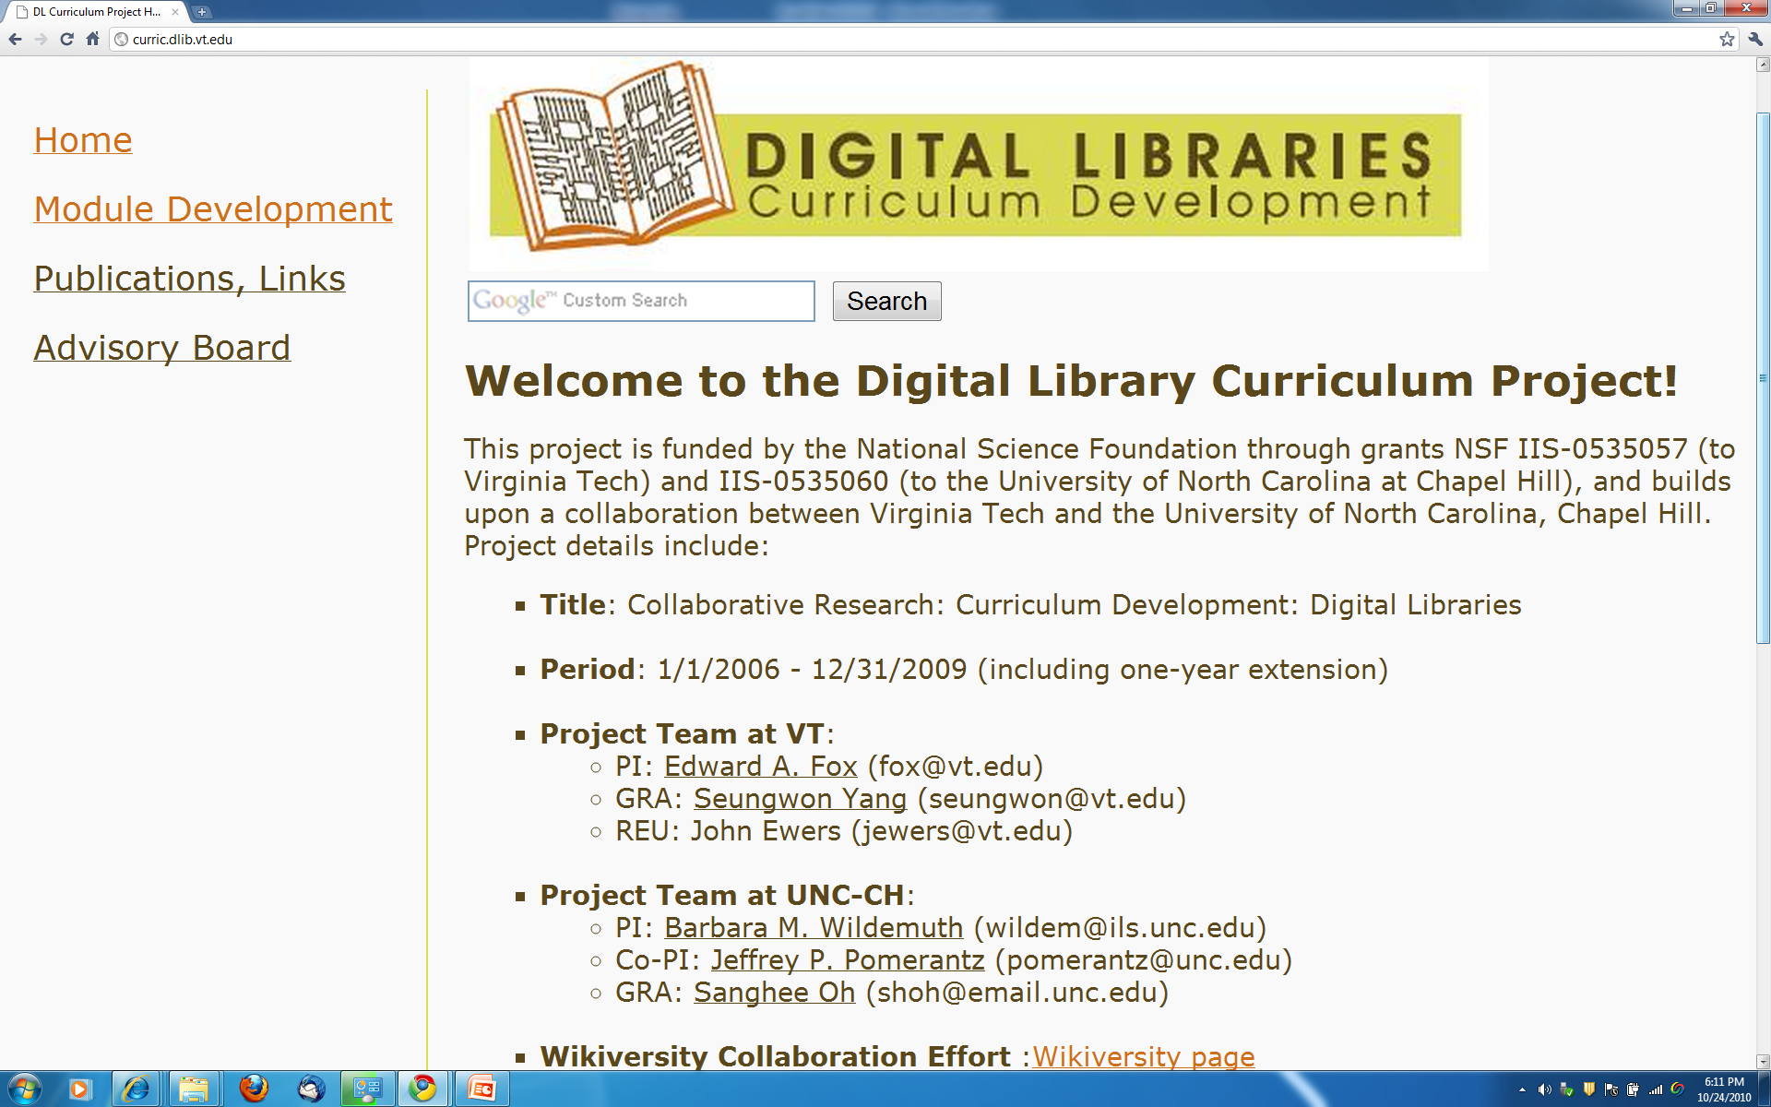

Slide 40
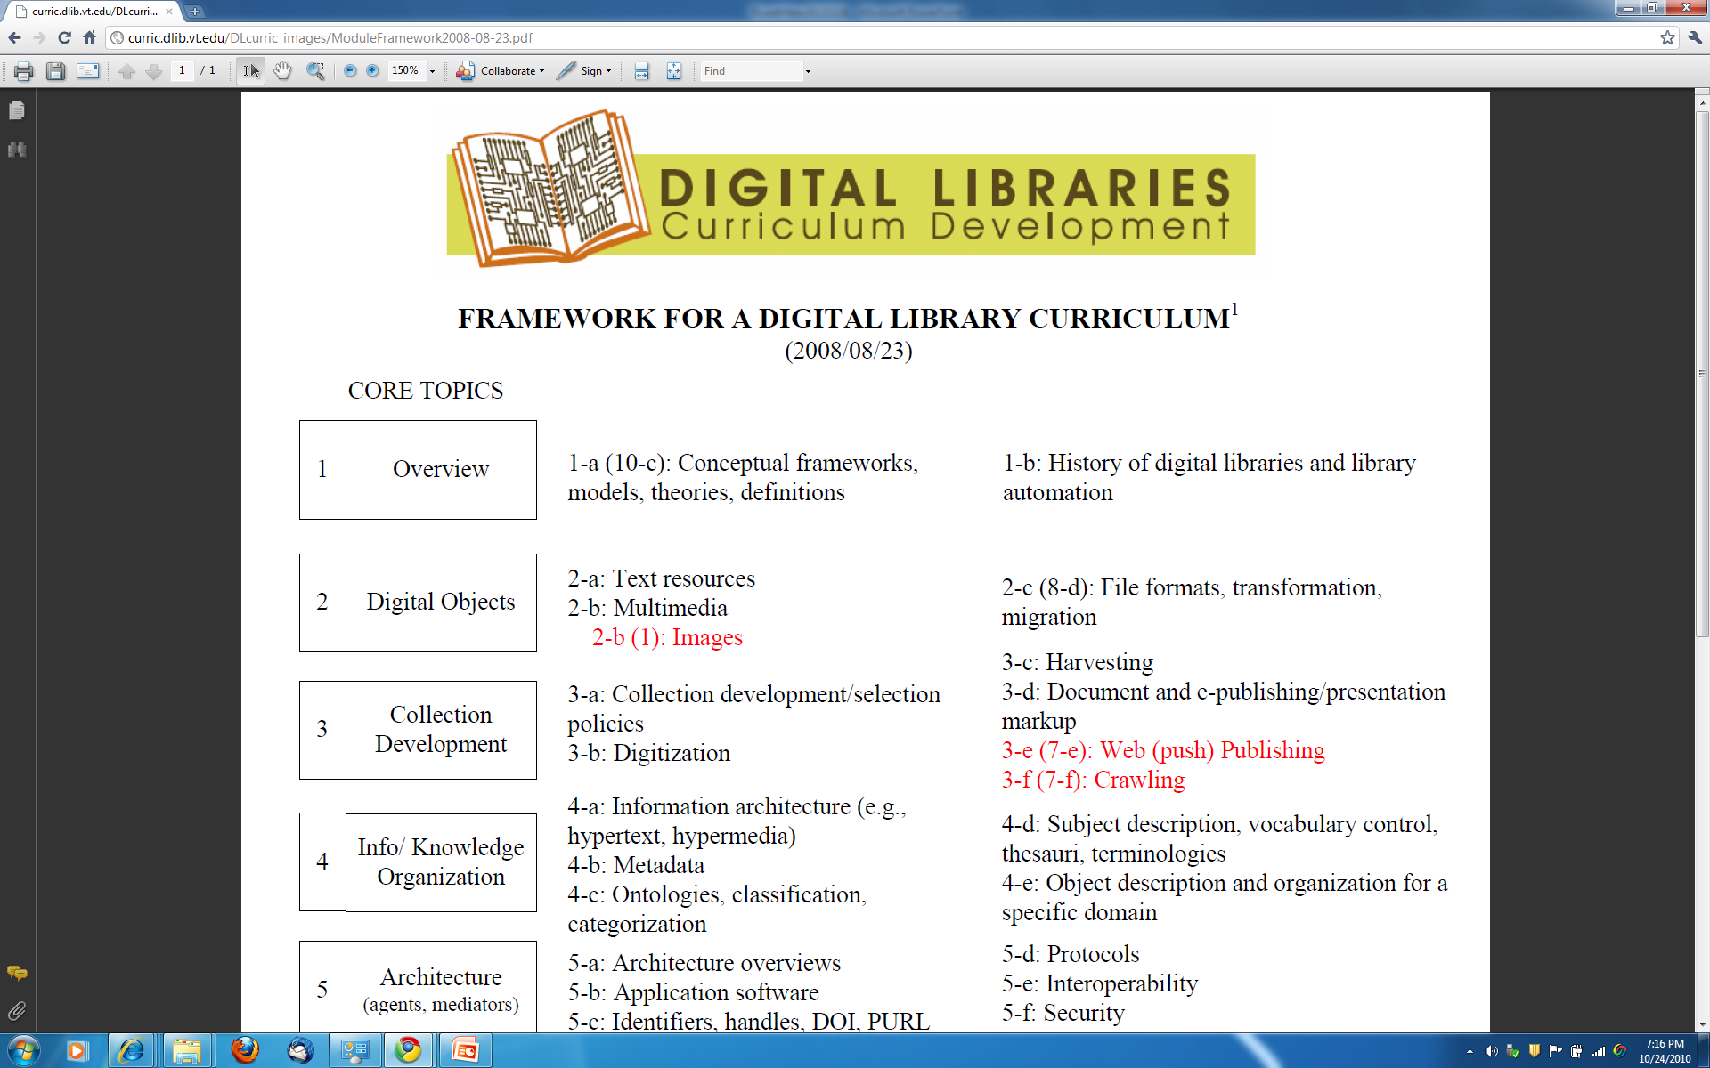

Slide 41
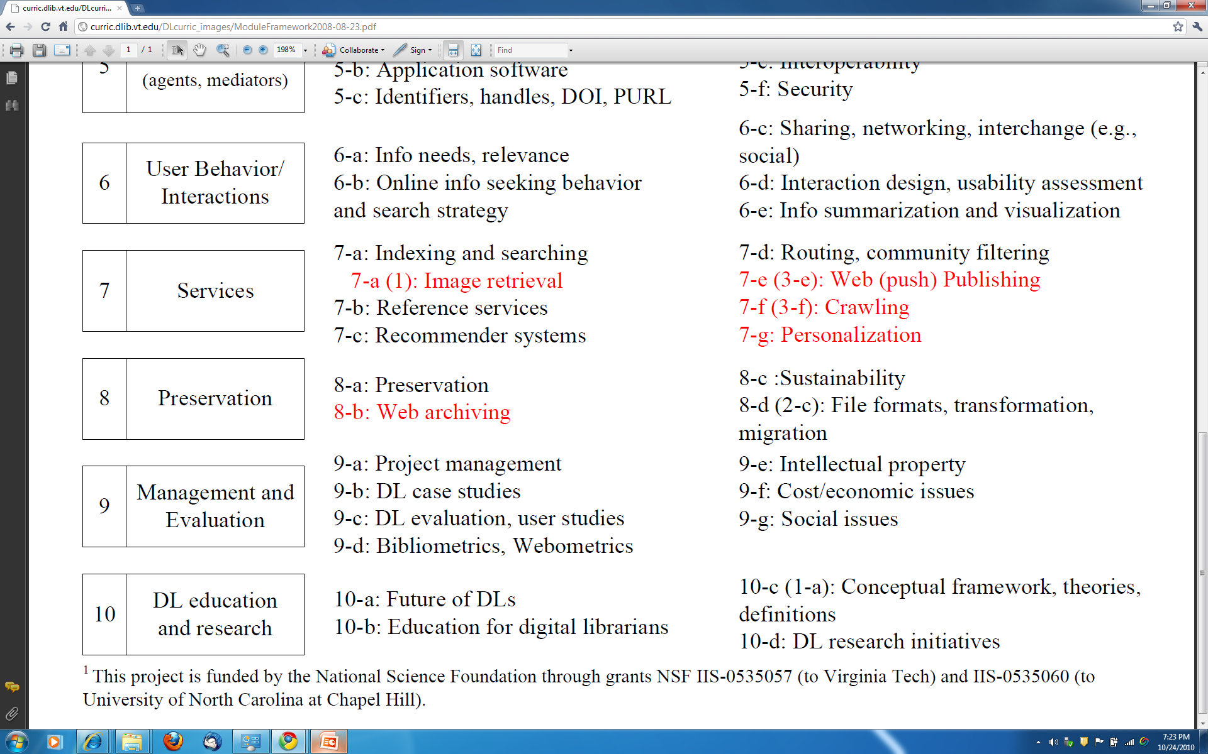
Modules for 5 more packages just completed: CLUTO, NLTK, SOLR, TRECeval, and WordNet. 5 more will be completed in December: Hadoop, Lemur, R, Weka, and an XMLdatabase (on IBM Cloud).

Slide 42
How to organize a DL course?
Various frameworks
  What, Why, How
  History, Current status, Future (research)
  Economics: open source, sustainability
  Social: users/patrons, management
  Technical: HCI, HT, IR, LIS, Web
Suggest that concept maps be drawn by readers to help in working with this book
Instructors can access “expert” maps with IHMC tools

Slide 43
Outline
Acknowledgements
NDLTD
Digital Library Curriculum Project
Ensemble (Pathway in NSDL)
Extra Slides
  Digital Libraries
  Crisis, Tragedy & Recovery Network (CTRnet)
  Digital Preserve in Second Life

Slide 44
Ensemble, Pathway in NSDL
National STEM (science, technology, engineering, and mathematics) education Digital Library – NSDL
National Science Digital Library
www.nsdl.org
Many projects, largest now called Pathways
Notes:
3
3

Slide 45
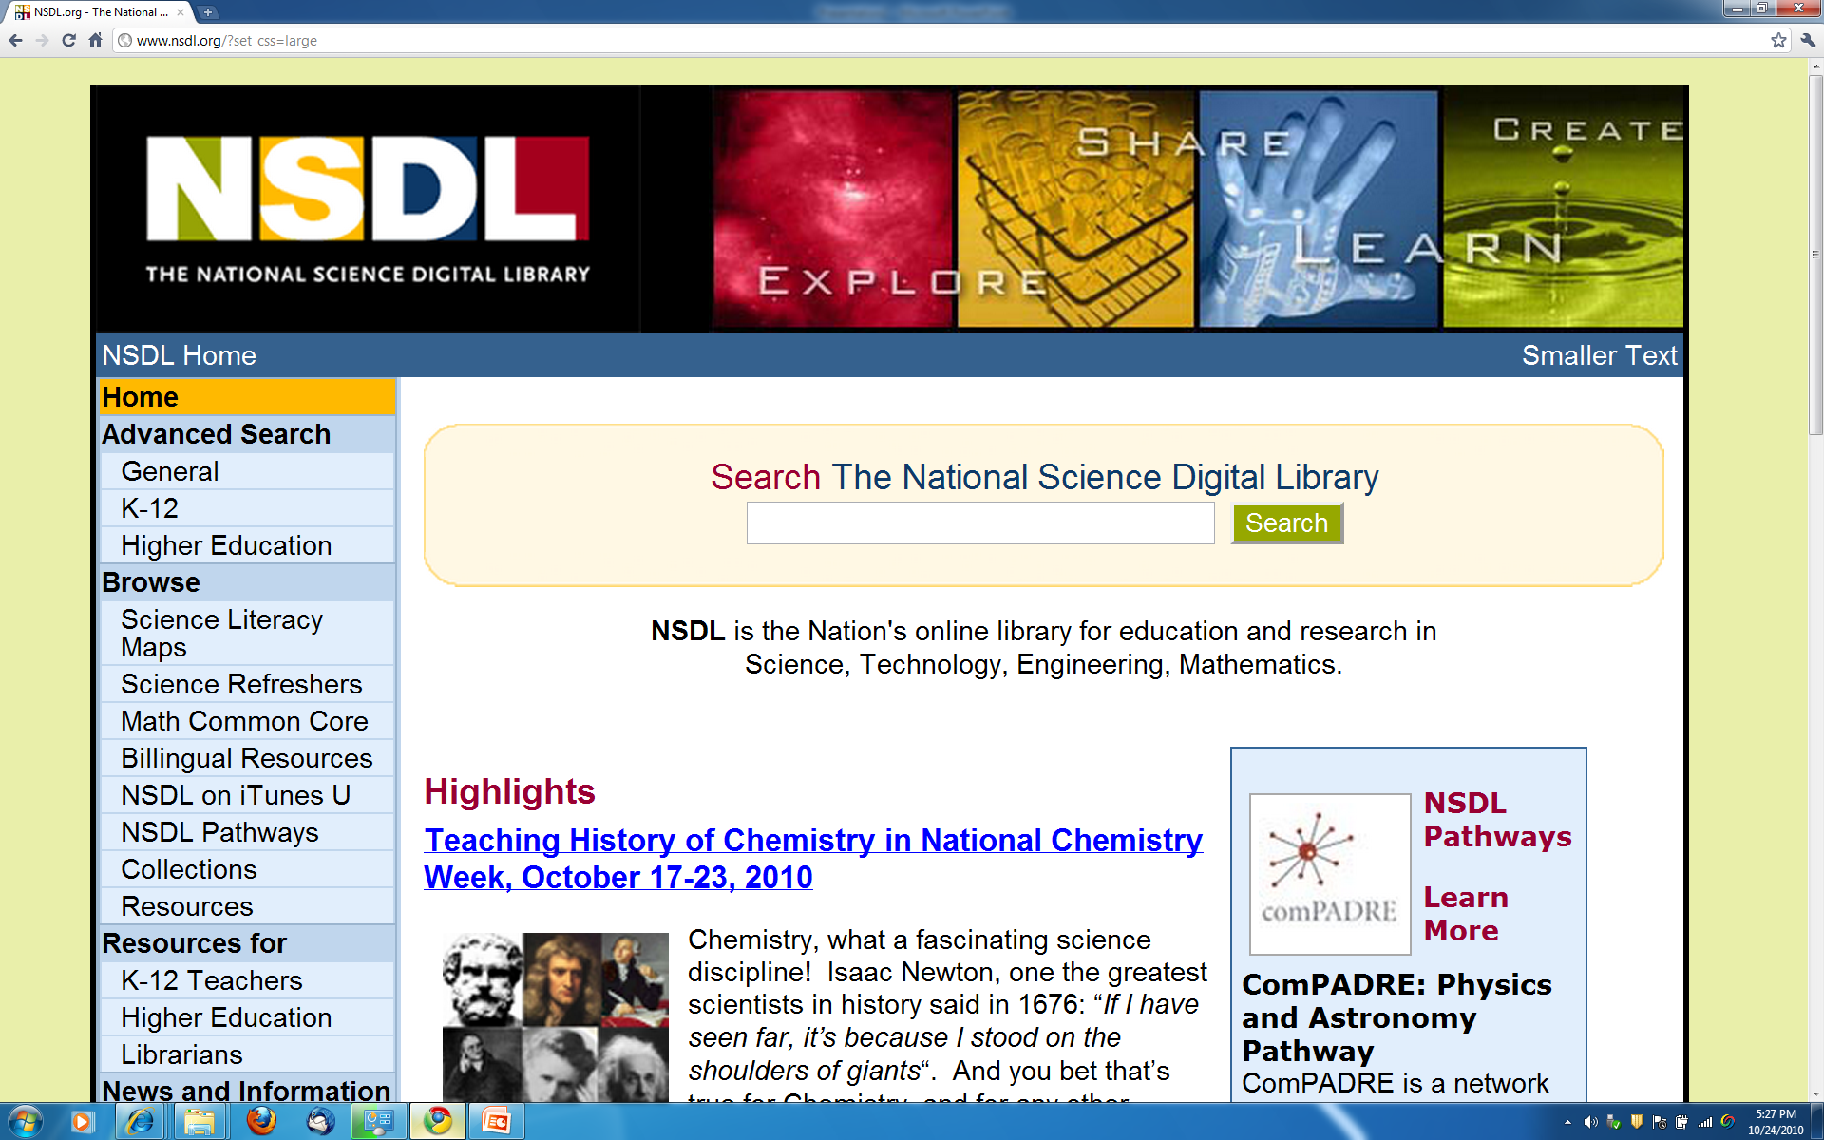
www.nsdl.org

Slide 46
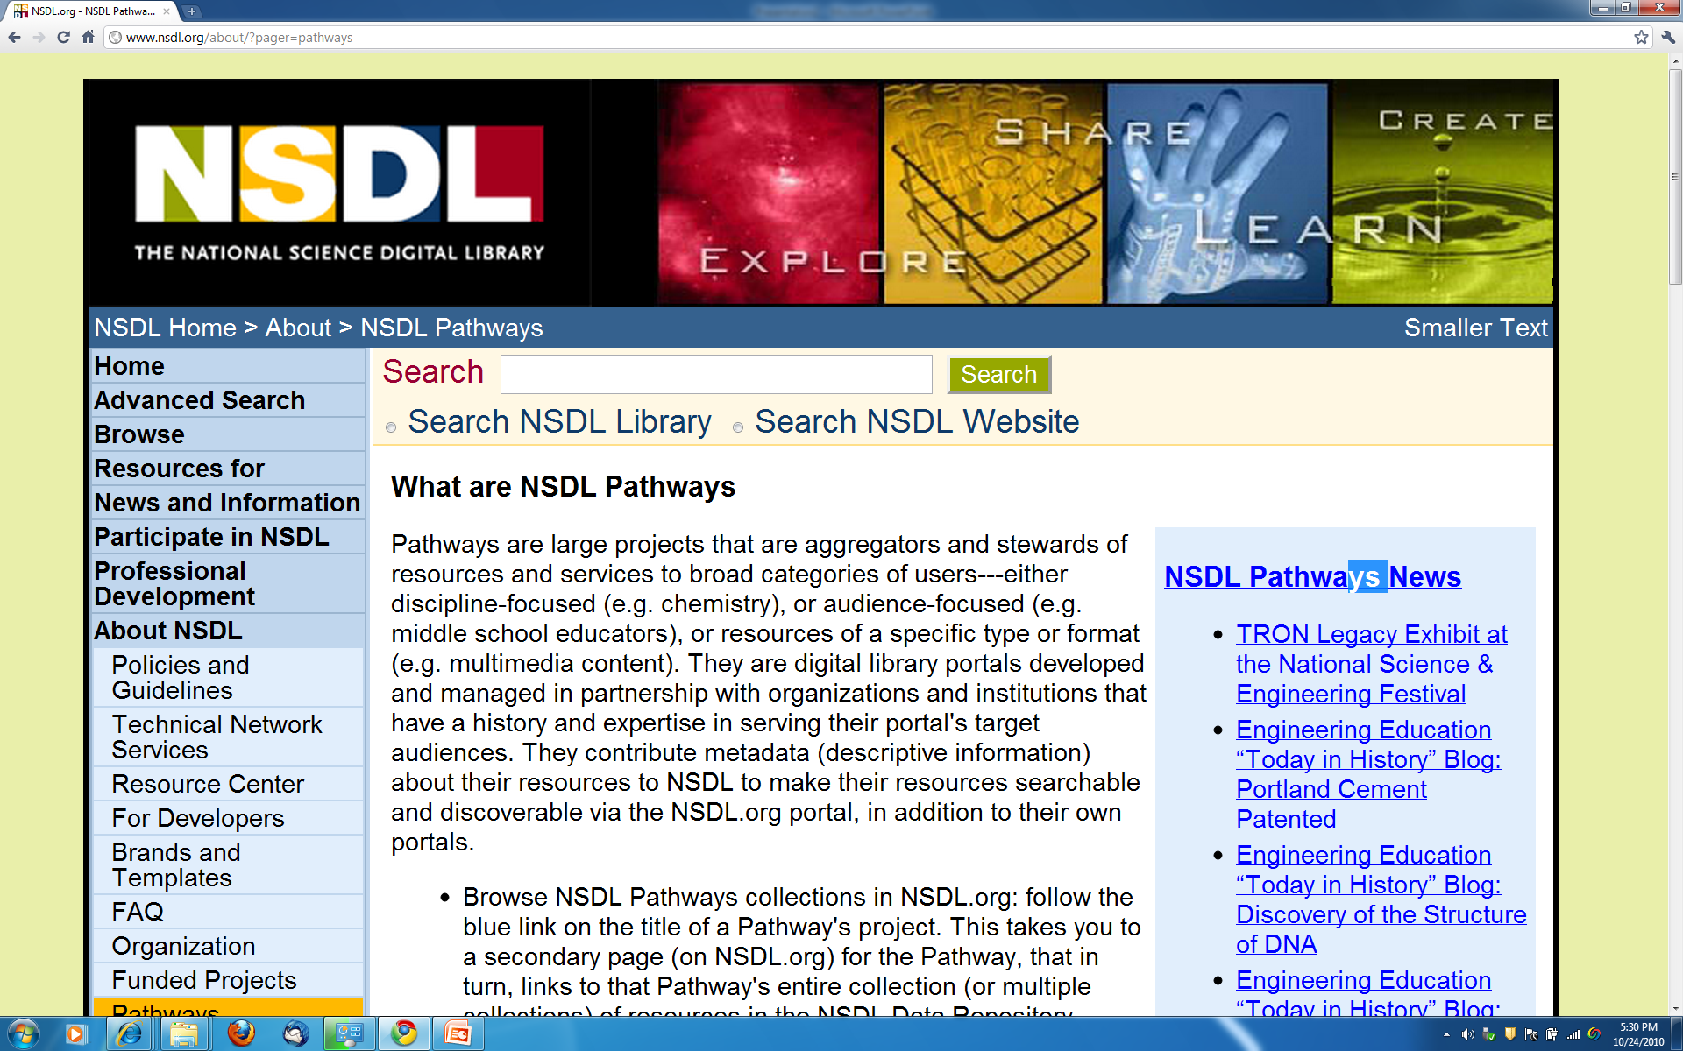
NSDL Pathways

Slide 47
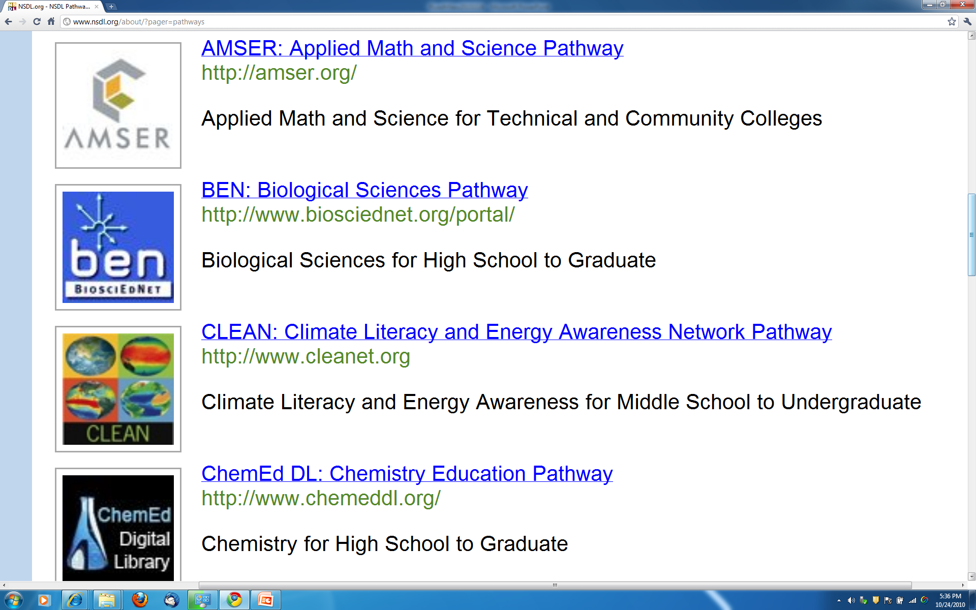

Slide 48
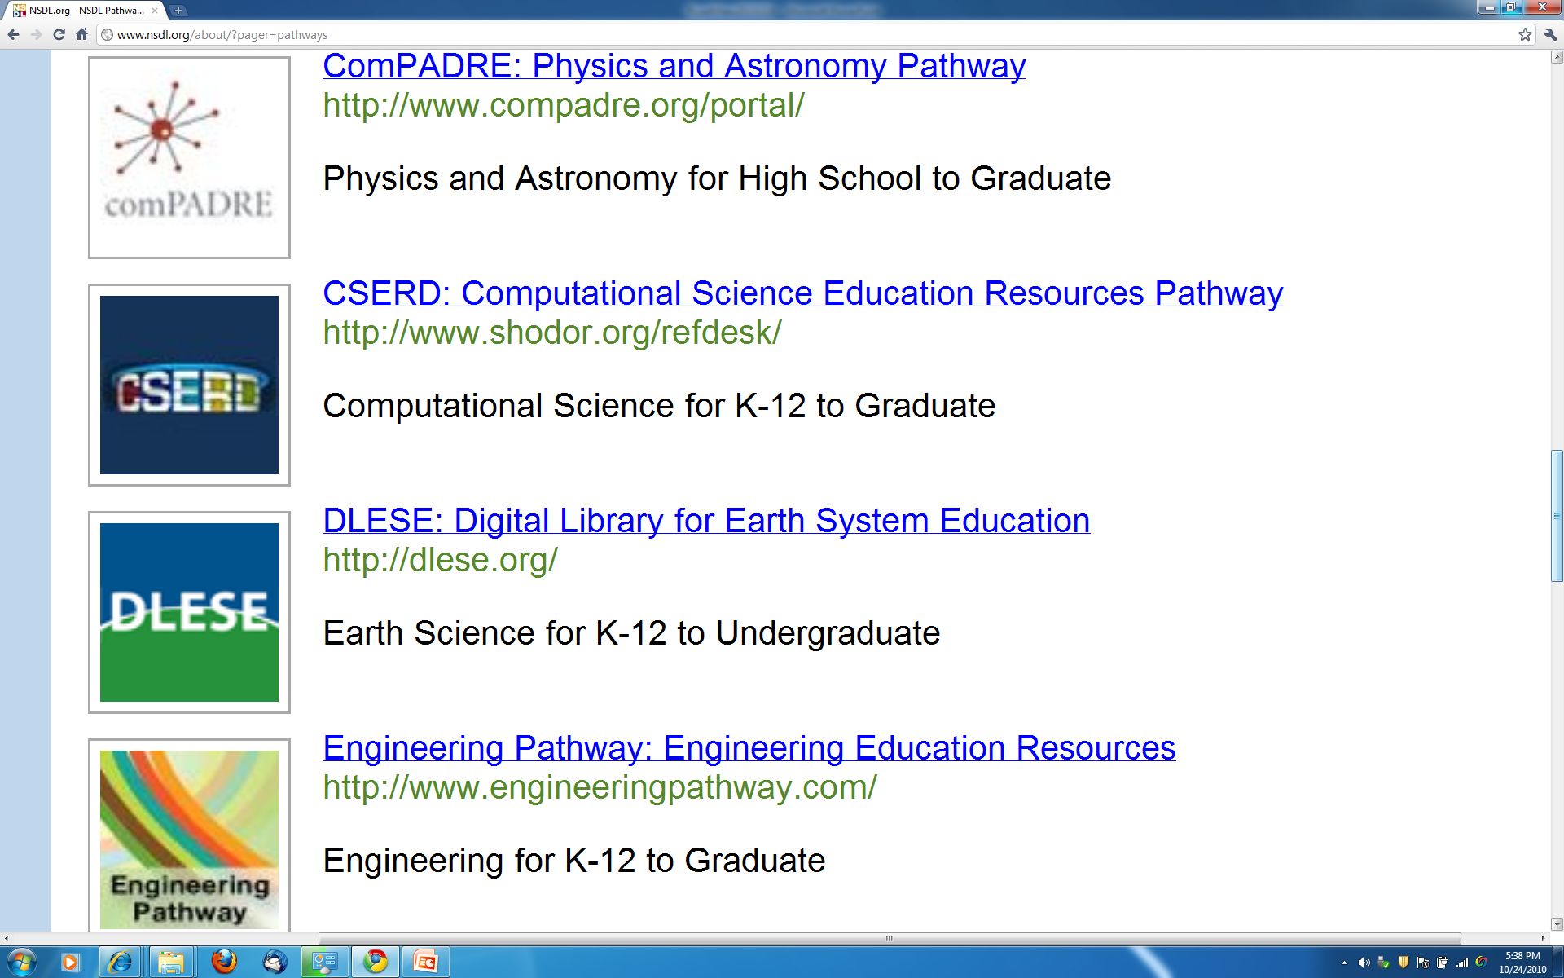

Slide 49
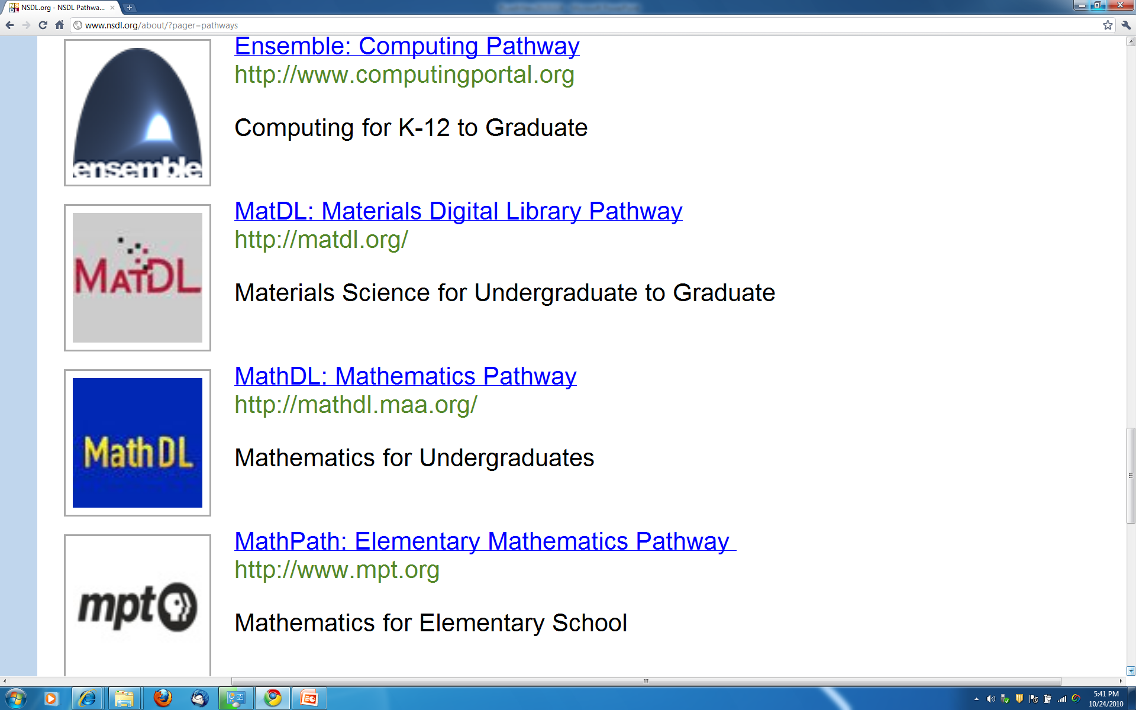

Slide 50
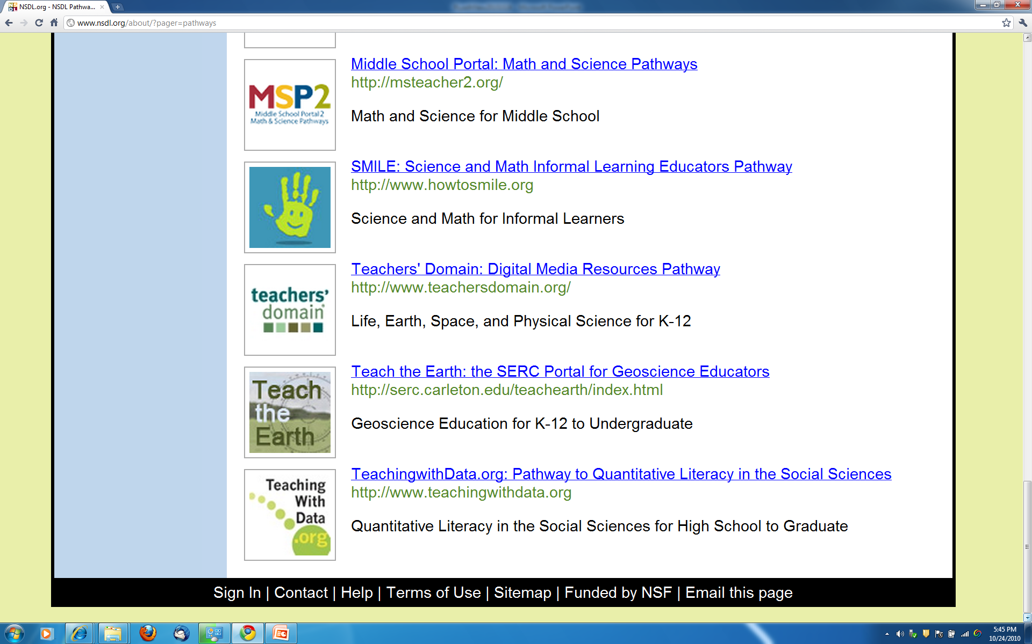

Slide 51
NSDL Connects:
These 3 slides
from Lee Zia
Users: students, educators, life-long learners
Content: structured learning materials;
large real-time or archived datasets;
audio, images, animations;
primary sources;
digital learning objects (e.g. applets);
interactive (virtual, remote) laboratories; ...
Tools: search; refer; validate; integrate; create; customize; publish; share; notify; collaborate; ...

Slide 52
Collections
Discovery of content
Classification and cataloguing
Acquisition and/or linking; referencing
Disciplinary-based themes define a natural body of content, but other possibilities are also encouraged
Access to massive real-time or archived datasets
Software tool suites for analysis, modeling, simulation, or visualization
Reviewed commentary on learning materials and pedagogy

Slide 53
Services
Help services, frequently asked questions, etc.
Synchronous/asynchronous collaborative learning environments using shared resources
Mechanisms for building personal annotated digital information spaces
Reliability testing for applets or other digital learning objects
Audio, image, and video search capability
Metadata system translation
Community feedback mechanisms

Slide 54
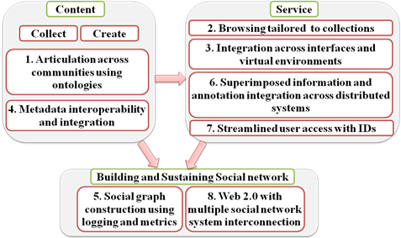
Ensemble: PDP-8 Overview
Principles
of
Distributed
Portals

Slide 55
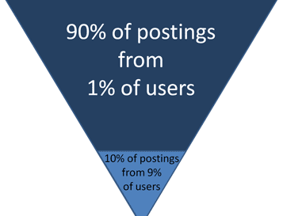
Overcoming 90-9-1 Behavior
Source: www.useit.com/alertbox/participation_inequality.html
Make it easier to contribute
  Clicking stars for a rating vs. writing a natural language review
Promote quality contributions
  Reputation rankings
Reward participants
  Badges for roles
Creators
Editors
Lurkers
No postings from 90% of users

Slide 56
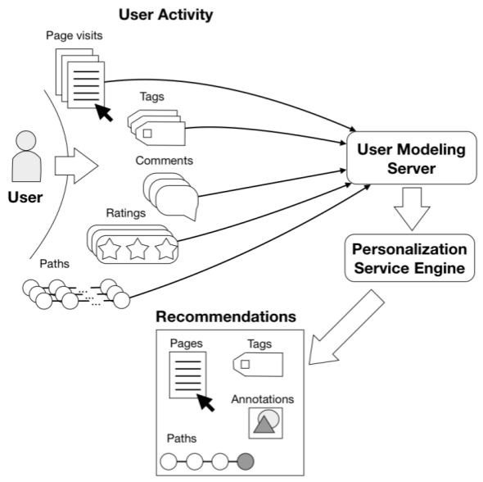
Ensemble, U. Pittsburgh, PERSEUS: Collecting Social Wisdom
Notes:
Ensemble portal tacks both low-level actions (page visit, rating, tagging) and hi-level level user actions (writing/editing a comment).
All these actions are an input to an intelligent analysis charged with making recommendations to the user.

Slide 57
Ensemble in 5 S - Societies
What Societies must Ensemble serve?
  Teachers
  Students, perhaps
  Groups with computing education tasks
  The NSDL
  The NSF
  Partner sites (providers and harvesters)
  The developers
  Related hardware / software components

Slide 58
Ensemble in 5S - Scenarios
What Scenarios must be addressed? (a sample)
  Search, Browse
  User registration, login
  Commenting, rating, tagging
  Acquisition/de-acquisition/user contributing
  Share resources in, and collect data from, other places (CiteULike, Facebook)
  Acknowledge contributions
  Harvest and be harvested
  Join groups, participate in discussions
  Recover from failures
    Computer systems, storage

Slide 59
Ensemble in 5S - Spaces
What Spaces will matter in Ensemble?
  User interface (2D generally, 3D in Second Life)
  Education level
  Curriculum standards or recommendations
  Topic spaces
  Vector and feature spaces to support indexing, searching, and classifying

Slide 60
Ensemble in 5S - Structures
What Structures will we hold?
  Metadata
  Computing Ontology
  Database schema and tables
  Taxonomies
    Educational schema
    Computing topics (Knowledge units)
    Rating schemes

Slide 61
Ensemble in 5 S - Streams
What Streams of data will we see?
  All the document types we can imagine: text, word processor, PDF, spreadsheets, presentations, HTML, XML, …
  All the image types, all the video types
    Images (jpg, tiff, …)
    Video (avi, mov, …)
  Program code, both source code and object code
  Comments, ratings, tags
  Group membership profiles
  E-mail addresses
  User information (preferences, …)

Slide 62
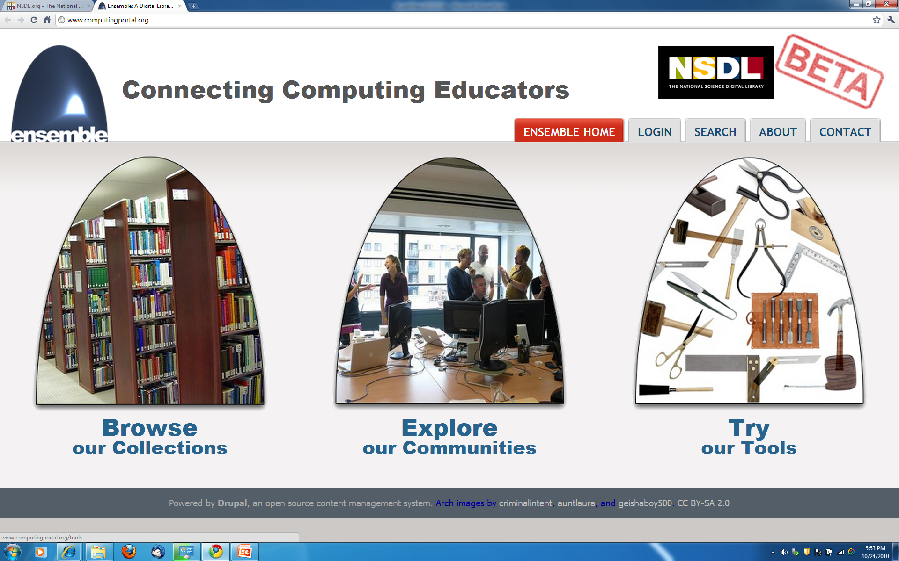
Ensemble: www.computing portal.org

Slide 63
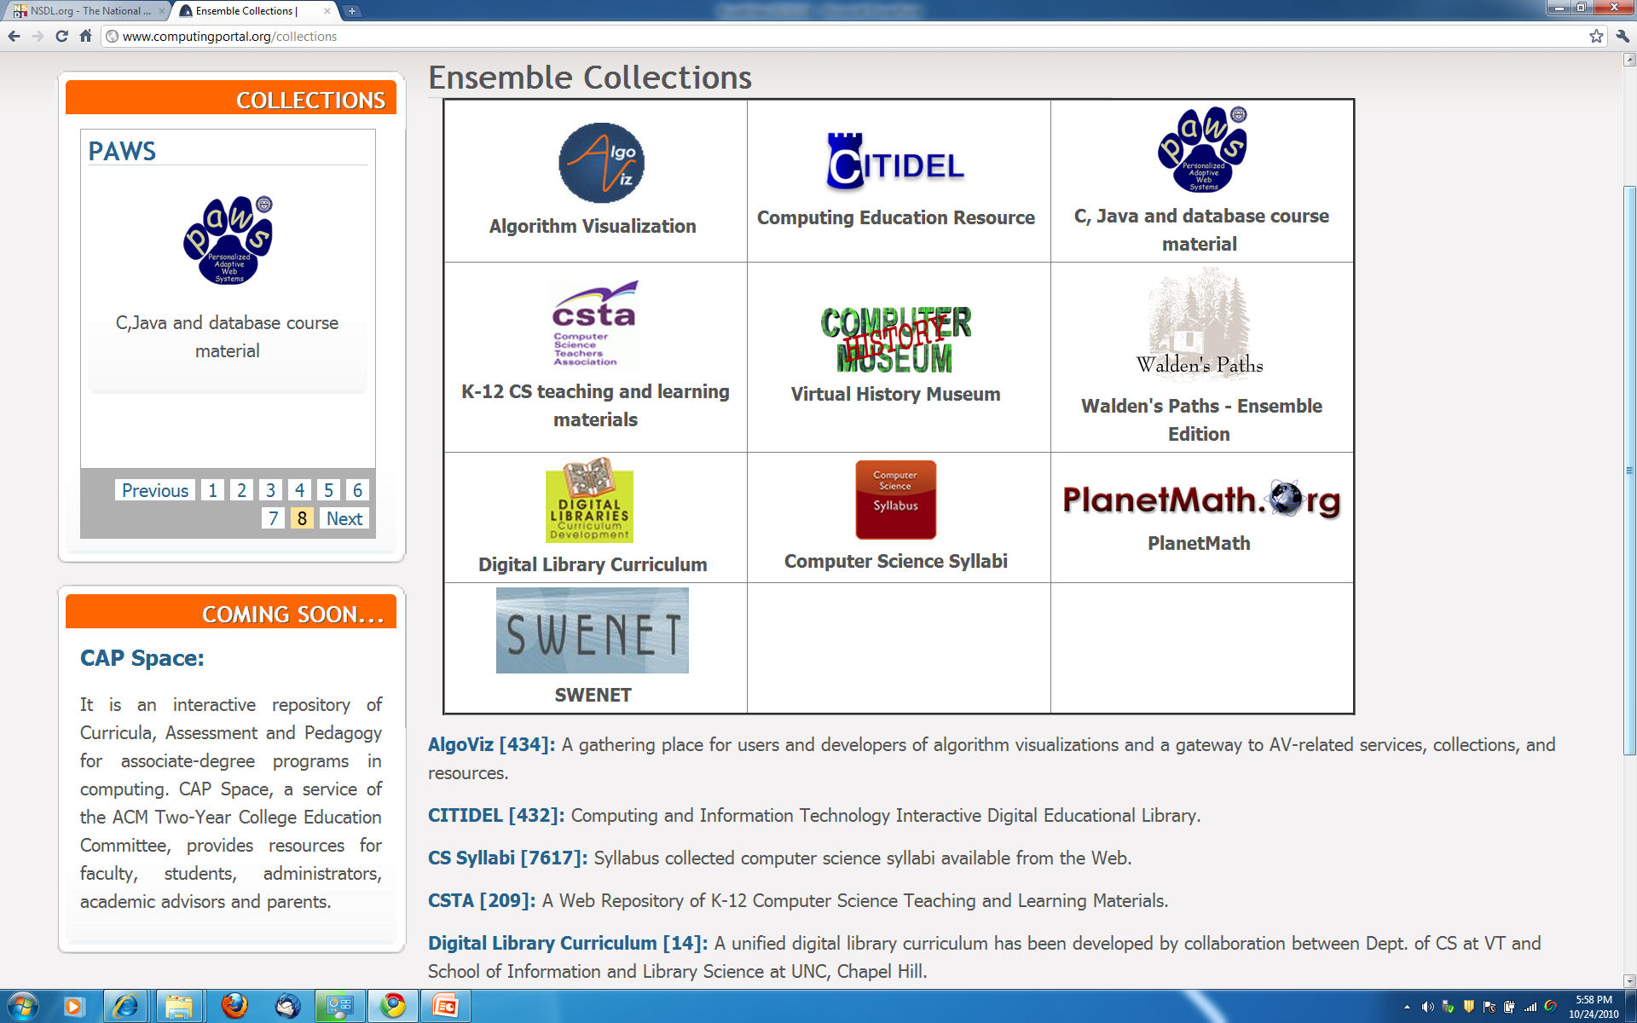

Slide 64
Summary
Acknowledgements
NDLTD
Digital Library Curriculum Project
Ensemble (Pathway in NSDL)
Extra Slides
  Digital Libraries
  Crisis, Tragedy & Recovery Network (CTRnet)
  Digital Preserve in Second Life

Slide 65
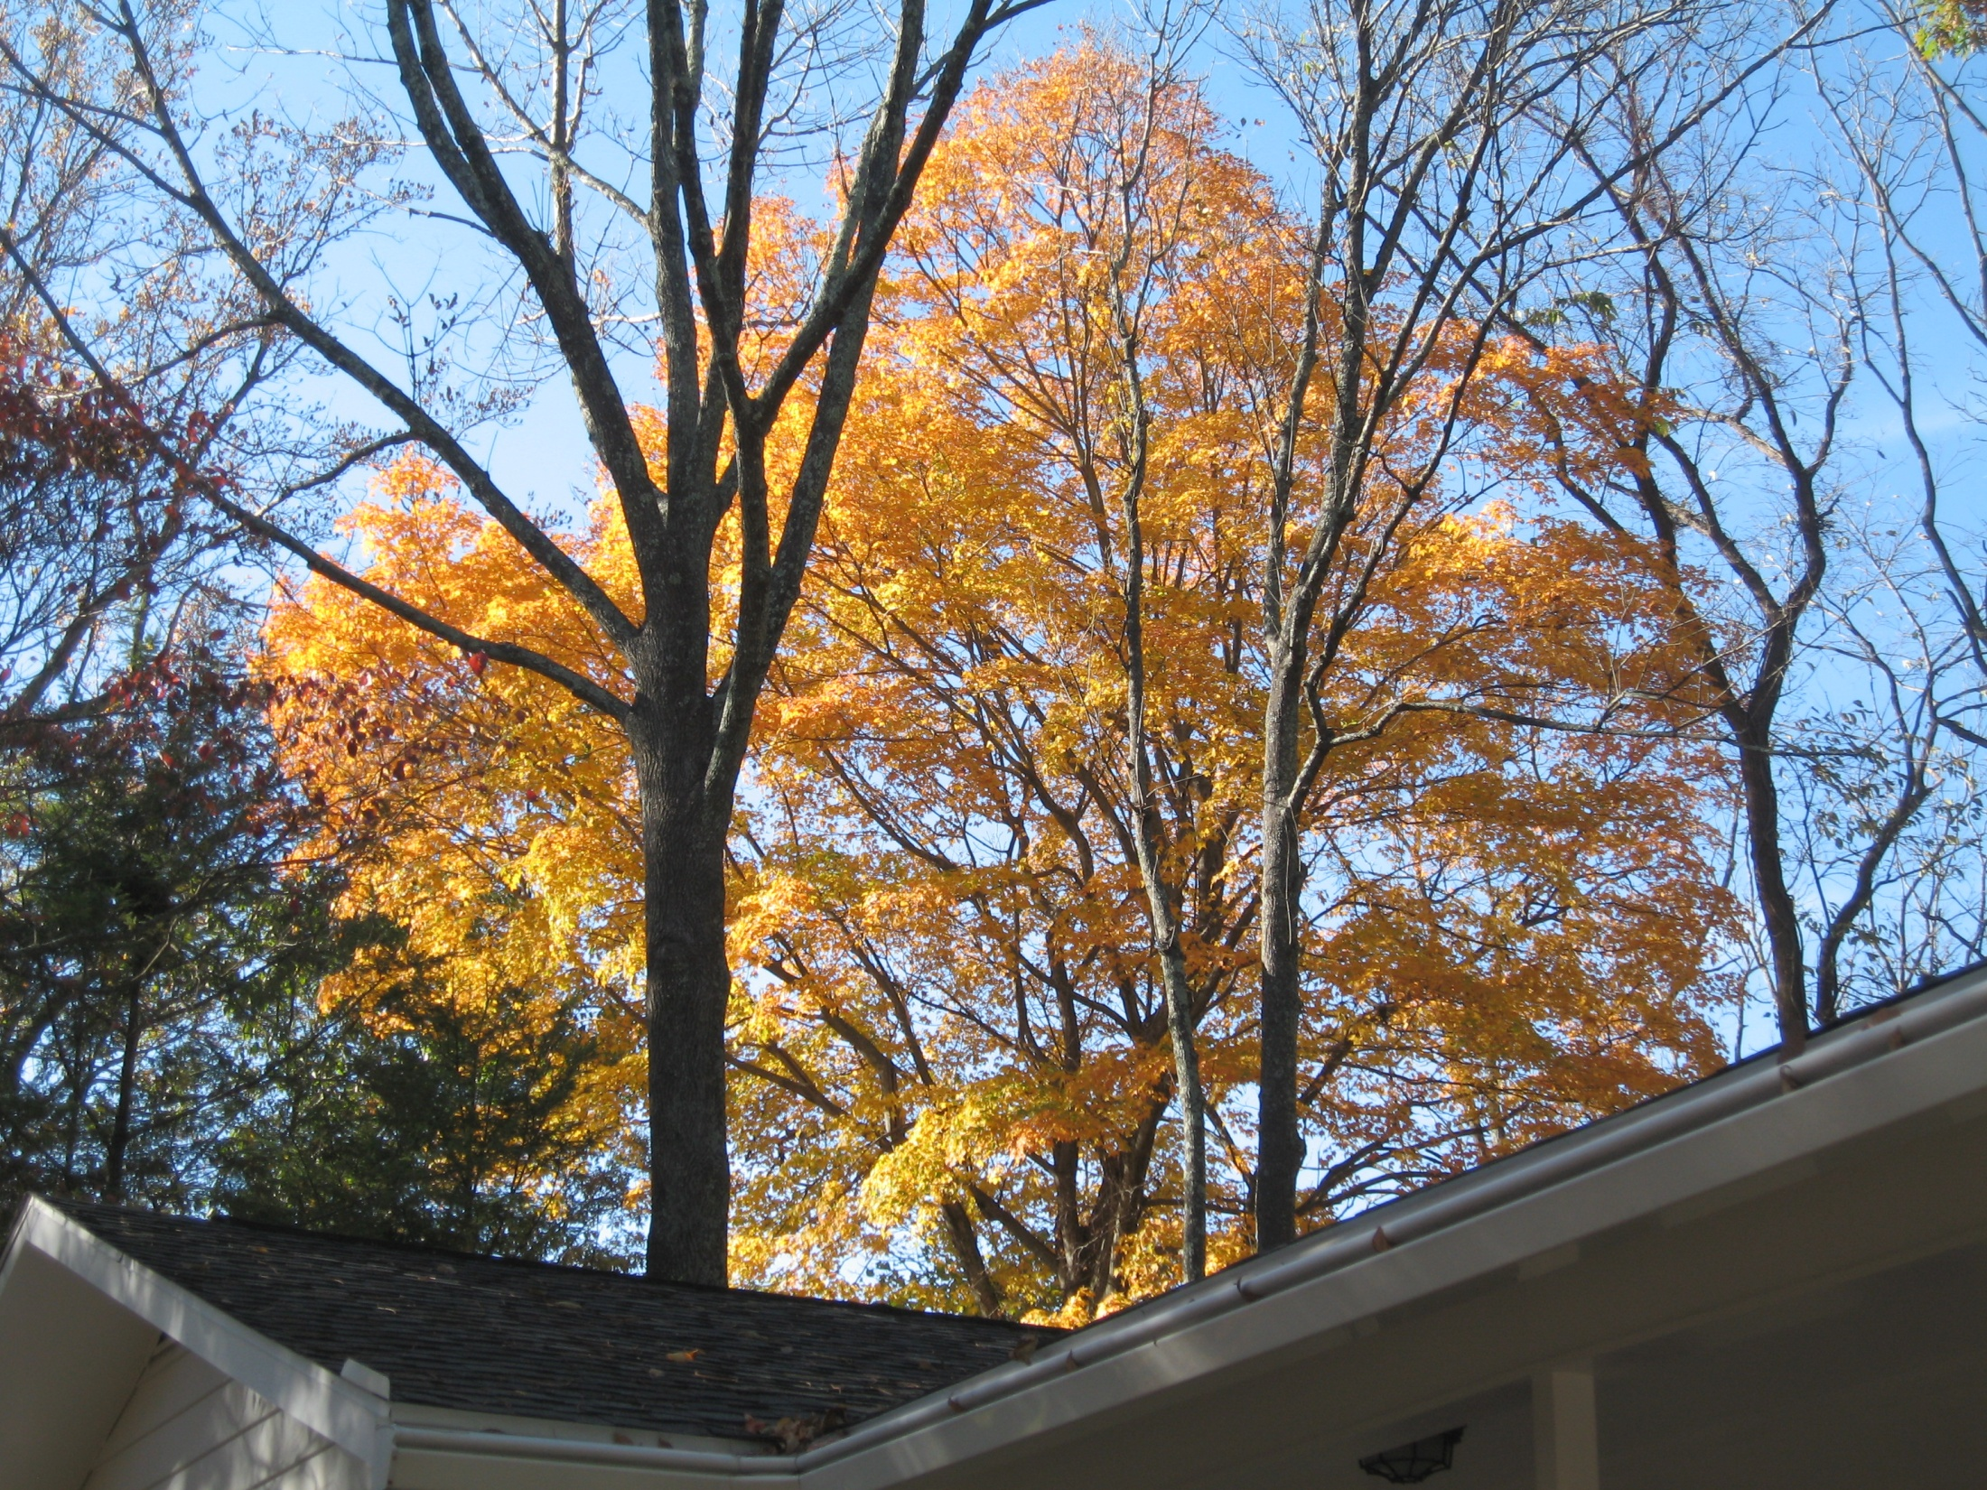
Questions?
Ask: fox@vt.edu. Feel free to visit Blacksburg, Virginia, USA

Slide 66
Extra Slides
Digital Libraries
Crisis, Tragedy & Recovery Network (CTRnet)
Digital Preserve in Second Life

Slide 67
Digital Libraries --- Objectives
World Lit.: 24hr / 7day / from desktop
Integrated “super” information systems: 5S: Table of related areas and their coverage
Ubiquitous, Higher Quality, Lower Cost
Education, Knowledge Sharing, Discovery
Disintermediation -> Collaboration
Universities Reclaim Property
Interactive Courseware, Student Works
Scalable, Sustainable, Usable, Useful

Slide 68
DL Overview
Why of Global Interest?
National projects can preserve antiquities and heritage: cultural, historical, linguistic, scholarly
Knowledge and information are essential to economic and technological growth, education
DL - a domain for international collaboration
  wherein all can contribute and benefit
  which leverages investment in networking
  which provides useful content on Internet & WWW
  which will tie nations and peoples together more strongly and through deeper understanding
Notes:
3
3

Slide 69
DL Challenges
Preservation - so people will trust DLs
Supporting infrastructure - networks, ...
Scalability, sustainability, interoperability
DL industry - critical mass by covering libraries, archives, museums, corporate info, govt info, personal info - “quality WWW” integrating IR, HT, MM, ...
  Need tools & methods to make them easier to build

Slide 70
DL Challenges – 2: Terminology
Digital / electronic / virtual library
Born digital, hybrid (digital/physical)
Universal access (all people/places/times)
  Accommodate disabilities (color, visual, auditory)
  Mobile (office, home, laptop, PDA, mobile)
Archiving, self-archiving
Open (source, standards, archives)

Slide 71
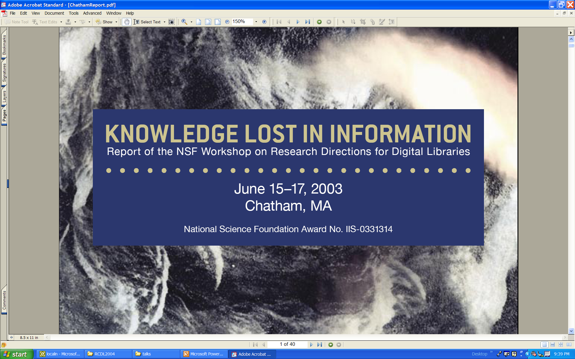

Slide 72
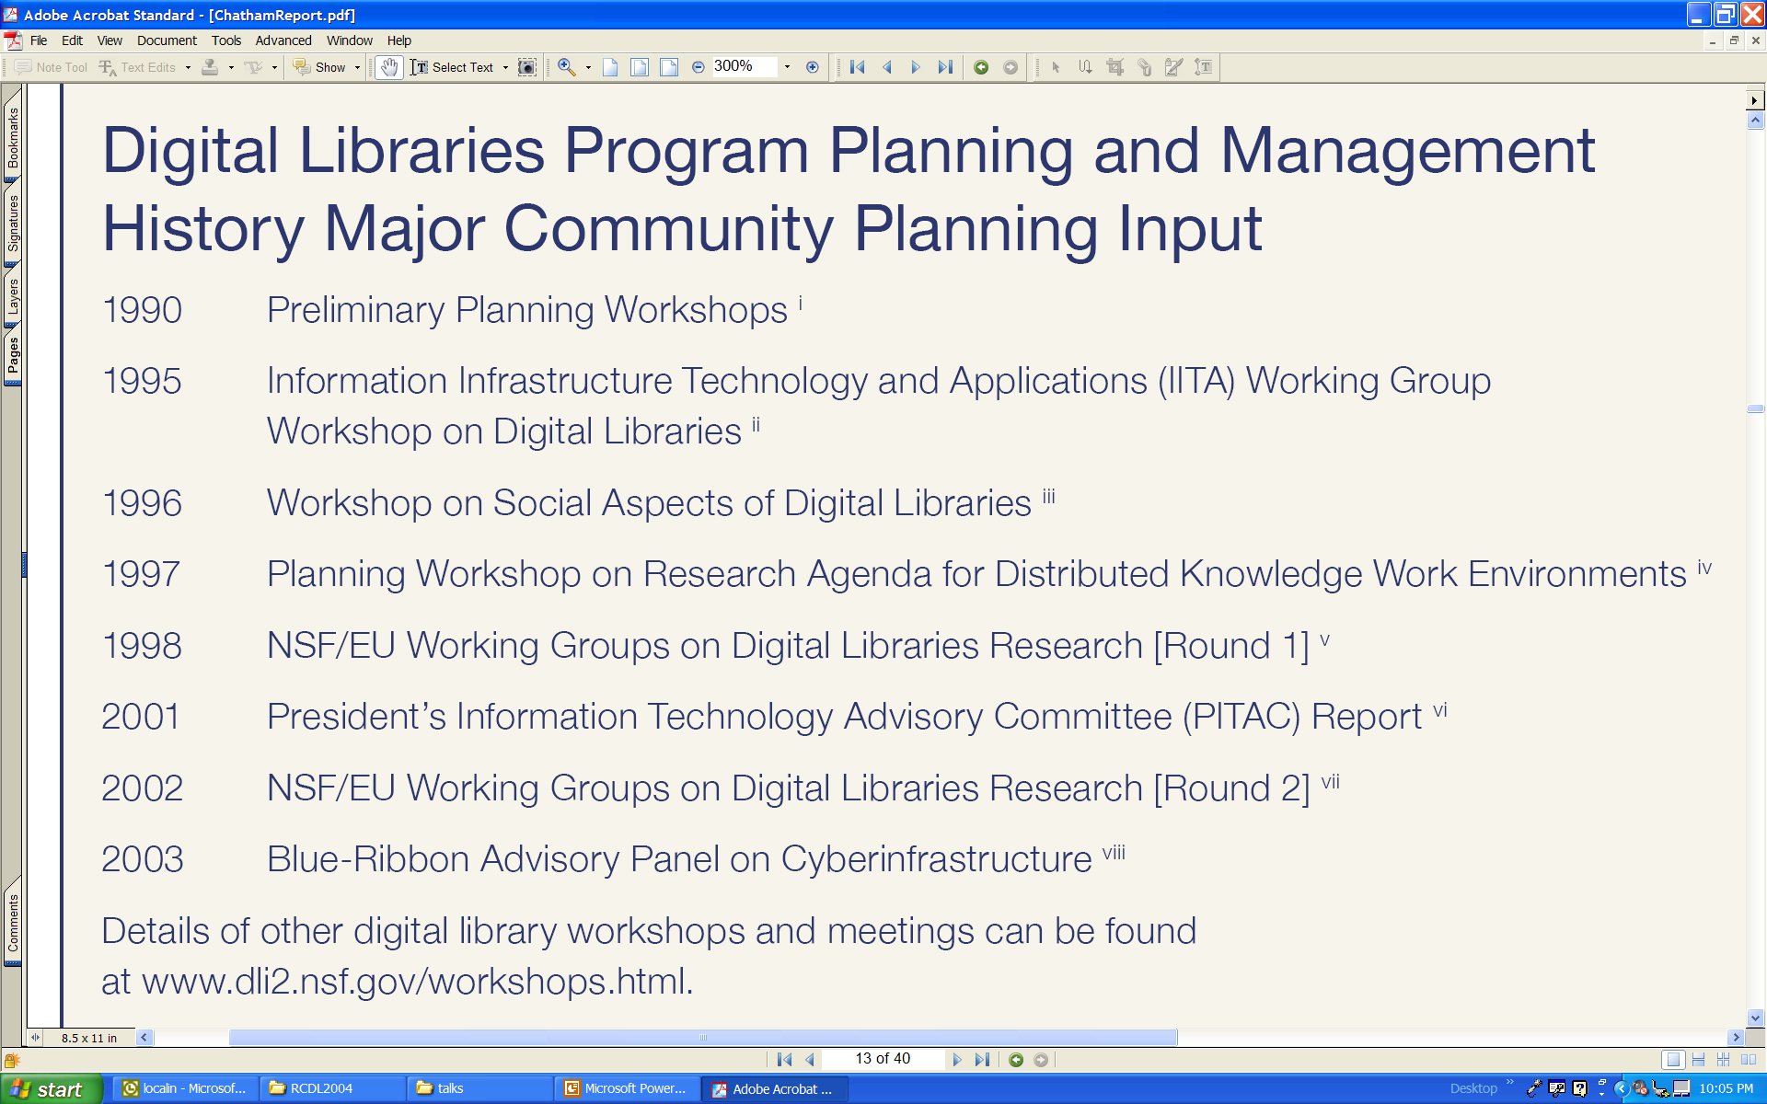

Slide 73


Slide 74
Synchronous
Scholarly Communication
Same time, Same or different place

Slide 75

Asynchronous, Digital Library Mediated Scholarly Communication
Different time and/or place

Slide 76
Libraries of the Future
JCR Licklider, 1965, MIT Press
World
Nation
State
City
Community

Slide 77
Locating Digital Libraries in Computing and
Communications Technology Space
Digital Libraries technology
trajectory: intellectual
access to globally distributed information
Communications
(bandwidth, connectivity)
Computing (flops)
Digital content
Note: we should consider 4 dimensions: computing, communications,
content, and community (people)
less
more

Slide 78
Information Life Cycle
Creation
Active
Authoring
Modifying
Social Context
Using
Creating
Organizing
Indexing
Retention
/ Mining
Accessing
Filtering
Storing
Retrieving
Semi-
Active
Utilization
Distributing
Networking
Inactive
Searching
Notes:
This is a simplification of the previous slide.

Slide 79
Digital Libraries
Shorten the Chain from
Author
Editor
Reviewer
Publisher
A&I
Consolidator
Library
Reader

Slide 80
DLs Shorten the Chain to
Roles
Digital
Library
Author
Teacher
User
Reader
Editor
Learner
Reviewer
Librarian

Slide 81
Institutional Repositories
“Institutional repositories are digital collections that capture and preserve the intellectual output of a single university or a multiple institution community of colleges and universities.”
Crow, R. “Institutional repository checklist and resource guide”, SPARC, Washington, D.C., USA
www.arl.org/sparc/

Slide 82
The World According to OAI
Service Providers
Discovery
Current
Awareness
Preservation
Metadata
harvesting
Data Providers

Slide 83
OAI – Black Box Perspective
OA 7
OA 4
OA 2
OA 3
OA 1
OA 6
OA 5

Slide 84
OAI – Repository Perspective
Required: Protocol
Set Structure
URI Scheme
MDO
MDO
MDO
MDO
Required: DC
MDO
MDO
MDO
MDO
DO
DO
DO
DO

Slide 86
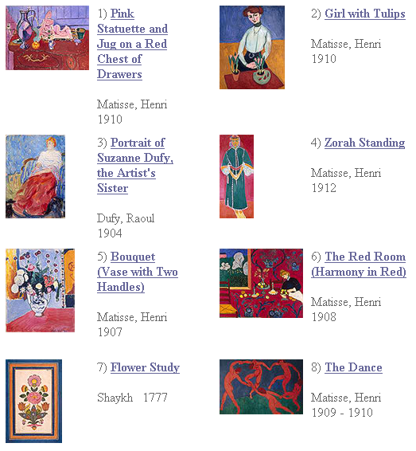
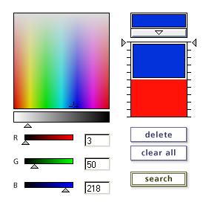
Content Based
Information
Retrieval

Slide 87
Digital Objects (DOs)
Born digital
Digitized version of “real” object
  Is the DO version the same, better, or worse?
  Decision for ETDs: structured + rendered
Surrogate for “real” object
  Not covered explicitly in metamodel for a minimal DL
  Crucial in metamodel for archaeology DL

Slide 88
Informal 5S & DL Definitions
DLs are complex systems that
help satisfy info needs of users (societies)
provide info services (scenarios)
organize info in usable ways (structures)
present info in usable ways (spaces)
communicate info with users (streams)

Slide 89
5S Layers
Societies
Scenarios
Spaces
Structures
Streams

Slide 90
5Ss
Ss | Examples | Objectives
Streams | Text; video; audio; image | Describes properties of the DL content such as encoding and language for textual material or particular forms of multimedia data
Structures | Collection; catalog; hypertext; document; metadata | Specifies organizational aspects of the DL content
Spaces | Measure; measurable, topological, vector, probabilistic | Defines logical and presentational views of several DL components
Scenarios | Searching, browsing, recommending | Details the behavior of DL services
Societies | Service managers, learners, teachers, etc. | Defines managers, responsible for running DL services; actors, that use those services; and relationships among them

Slide 91
5S and DL formal definitions and compositions (April 2004 TOIS)

Slide 93
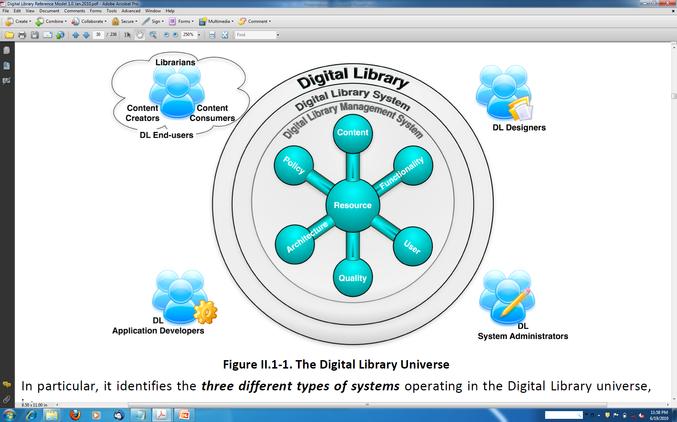
Digital Library Reference Model 1.0 p. 30 of 234

Slide 94
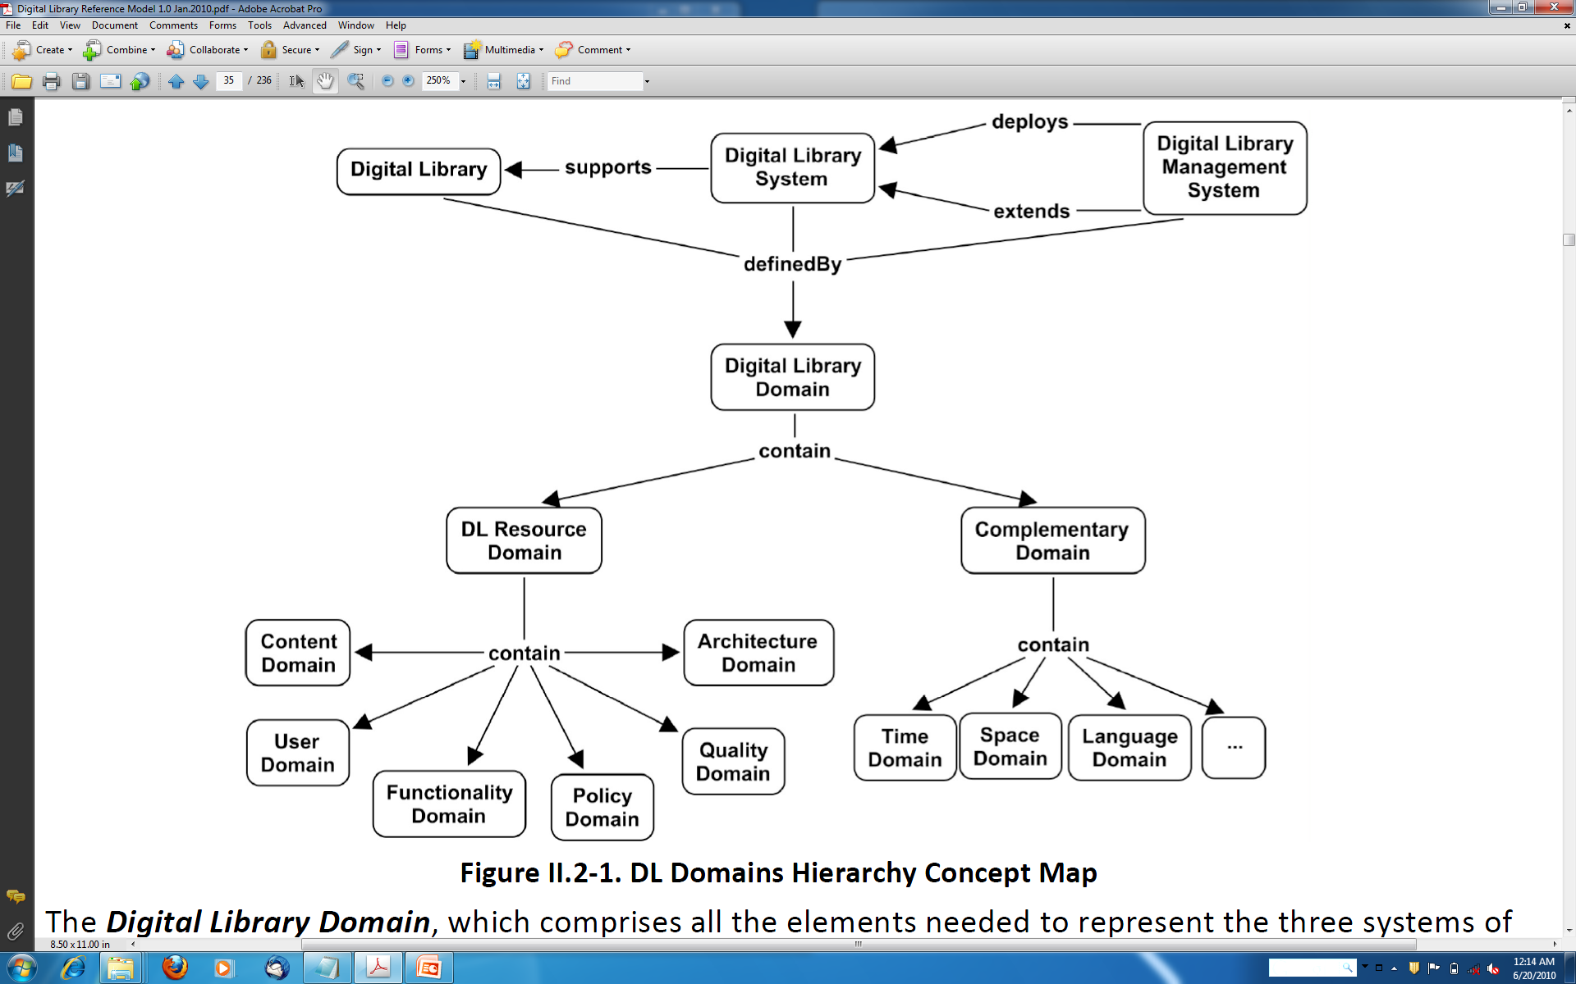
Digital Library Reference Model 1.0 p. 35 of 234

Slide 95
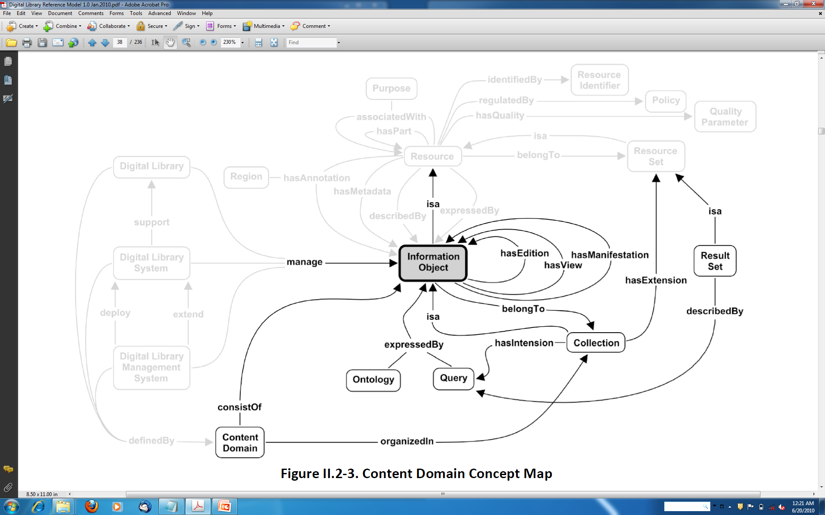
Digital Library Reference Model 1.0 p. 38 of 234

Slide 96
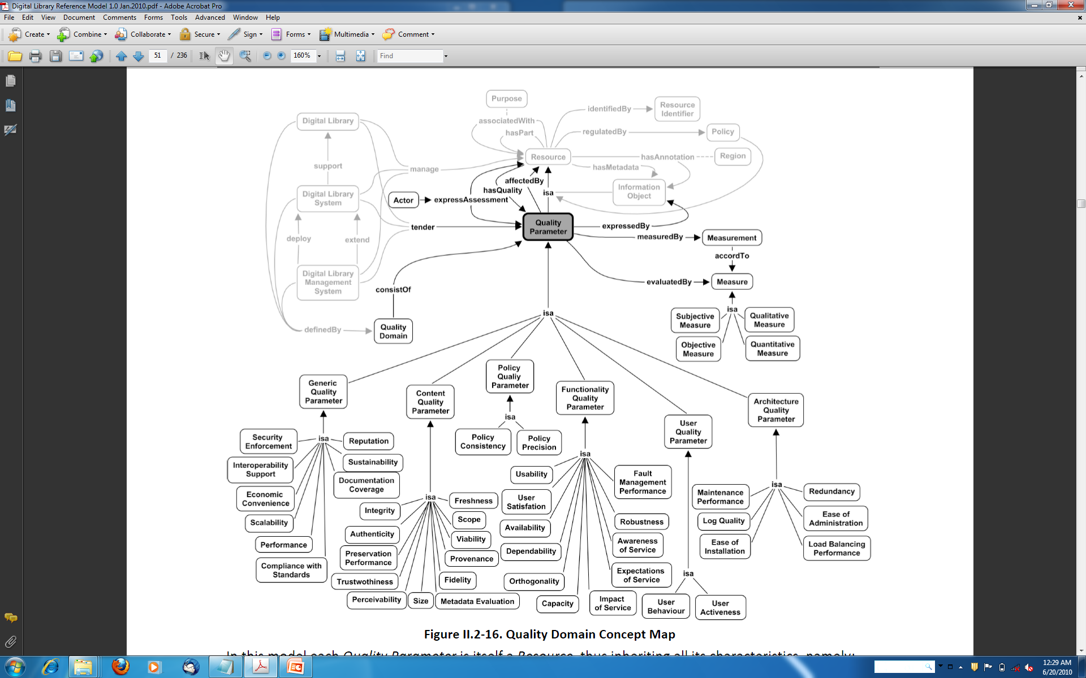
Digital Library Reference Model 1.0 p. 51 of 234

Slide 97
For More Information
Magazine: www.dlib.org
Books: http://fox.cs.vt.edu/DLSB.html (1994)
  MIT Press: Arms, plus by Borgman, Licklider (1965)
  Morgan Kaufmann: Witten... (several), Lesk (2nd edition)
Conferences
  ECDL/TPDL: www.tpdl2011.org/
  ICADL: www.icadl.org
  JCDL: www.jcdl.org
Associations
  ASIS&T DL SIG
  IEEE TCDL: www.ieee-tcdl.org (student awards, …)
NSF: http://www.nsf.gov/pubs/1998/nsf9863/nsf9863.htm
Labs: VT: www.dlib.vt.edu

Slide 98
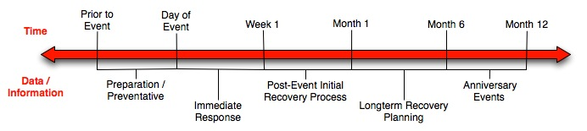
Crisis, Tragedy, and Recovery
Human tragedies that result from man-made and natural events affect humans and communities significantly.
During and after a tragic event, there are a series of needs that have to be addressed.
  Compounded by communication failures and a confusing plethora of data and information

Slide 99
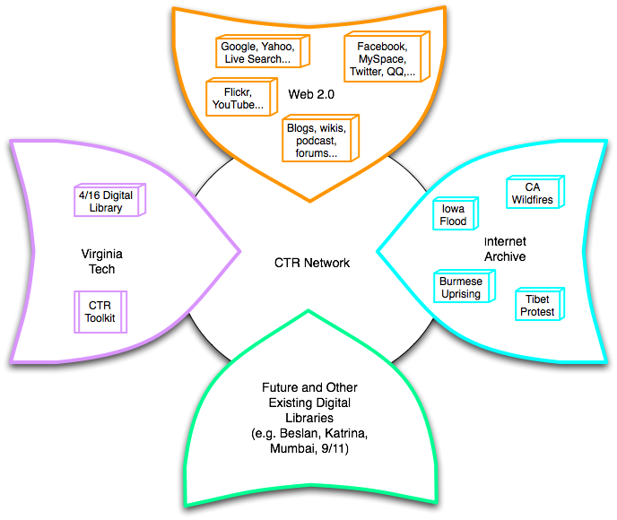
Build a networked digital library relating to CTR
www.citeulike.org group ctrnet
Citations
Papers, …
Integrate community, content, and services relating to CTR, making it accessible, and preserving it for long-term reuse
Support information exploration
Aided by an ontology
www.ctrnet.net

Slide 100

CTR stakeholders
Notes:
Help affected communities to recover more quickly and effectively
Provide global network with relevant information and resources
Support the research community, emergency personnel, decision makers, and the public in reacting to and recovering from crises

Slide 101
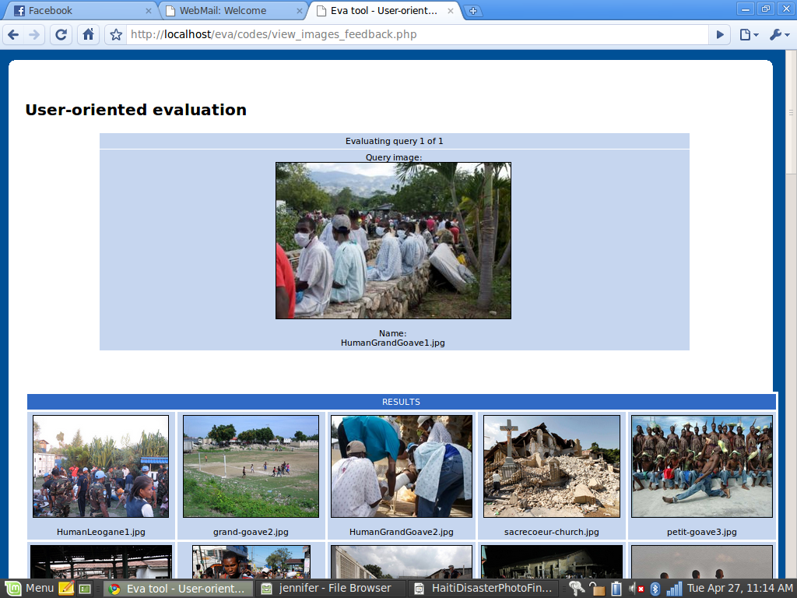
Haiti Photographs, Content Based Image Retrieval Evaluation

Slide 102
CTR Ontology
An ontology is
  Collection of words and phrases
  Graph of relationships, sometimes mostly hierarchical as in a taxonomy
  Covering the key concepts and terms in the discipline
  Supporting differing views on the field
Purposes
  Describes documents
    As tags, descriptors, keywords
  Supports navigation, learning, and research

Slide 103





Goals for Ontology for CTR
CTR literature
Browsing
sources
Searching
  Query
  expansion
Focus groups
CTR Ontology
Individual
Organizational
Community
Political
…
Tagging
Websites,
Internet Archive
Recommending
Social network
applications
Summarizing
uses
Multicultural/ linguistic input
Visualizing

Slide 104
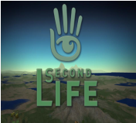
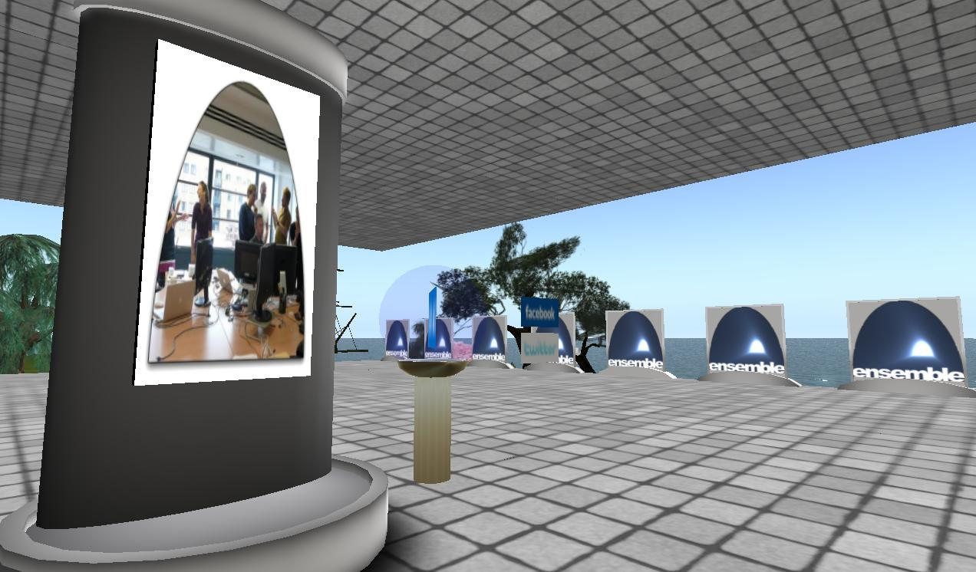
Second Life:
Ensemble, Digital Preserve
The Ensemble Pavilion offers:
• teleports to other computing sites in Second Life like the Digital Preserve
• hyperlinks to related computing websites
• RSS readers with feeds from computing and computing education blogs
• membership in the Ensemble Computing group in Second Life, Facebook, and Twitter

Slide 105
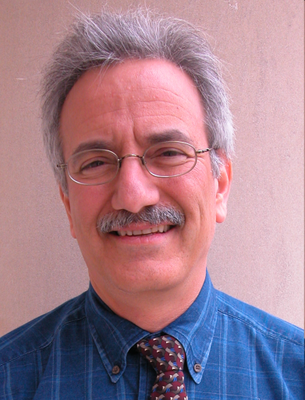
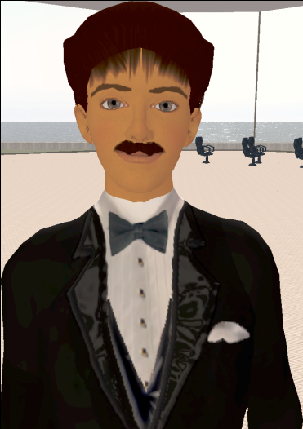
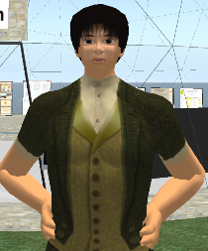
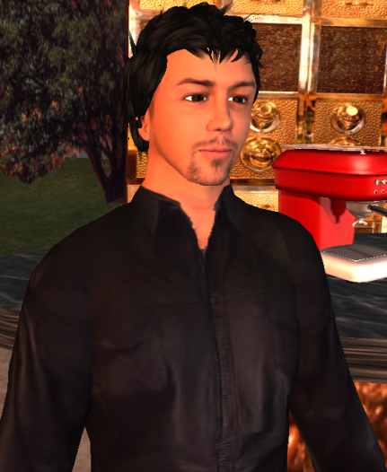
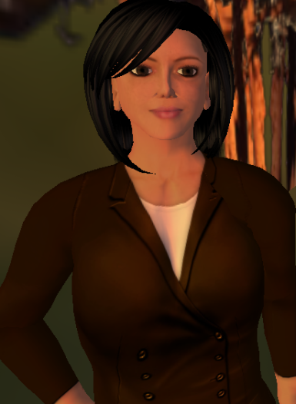
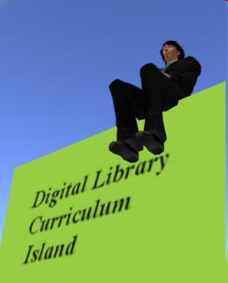
Selected Digital Preserve Personnel
Gary Octagon
Gary Marchionini
EdFox Rieko
Edward Fox
zamfir Paule
Spencer Lee
Uma Aldrin
Uma Murthy
Krad Proto
Seungwon Yang
mantruc Martian
Javier Velasco-Martin

Slide 106
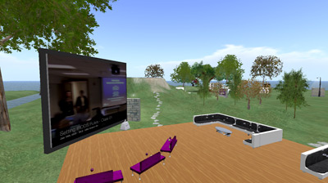
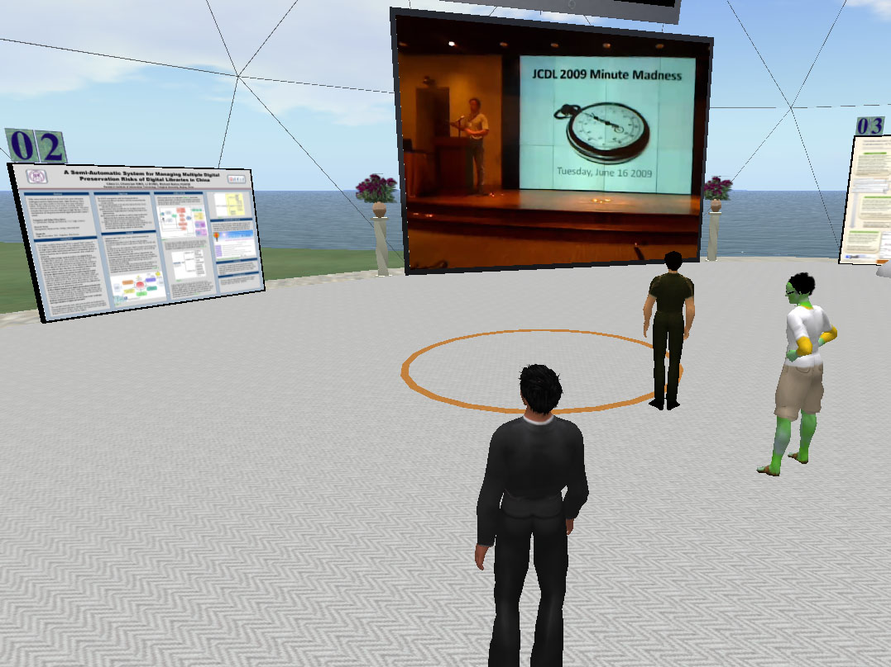
DP areas
Poster Buildings
Posters on display
Poster view tips
Video screens
Cafe
Beverages
Screens
Discussion areas

Slide 107
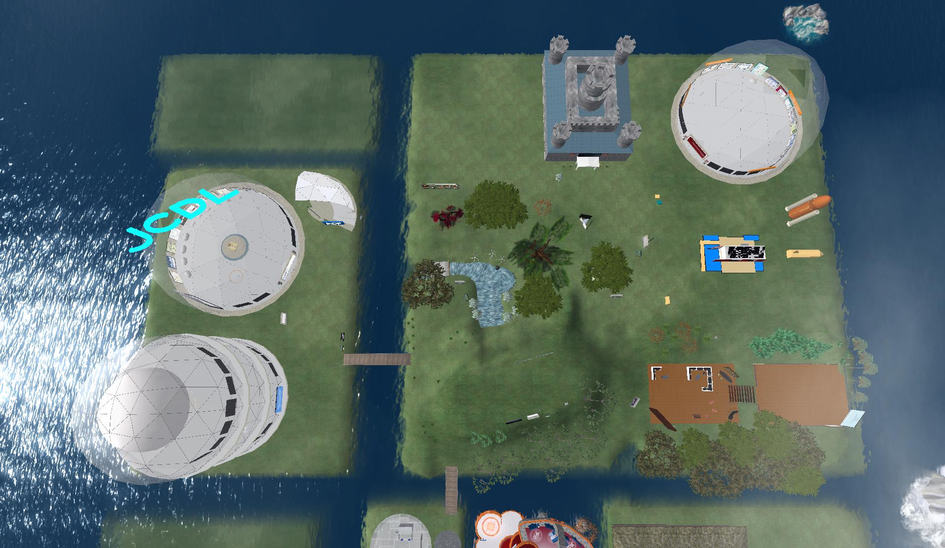
Digital Preserve Layout
Entertainment museum
VT CS REU poster building
Work area in the sky (reflection)
Independent
study area
InDP presentation building
JCDL poster
building
Poster garden
Main land
Lumenhaus
Poster island
The Main Poster building
Welcome area
Meeting area
Subproject Area (see the next figure)

