Slide 1
JCDL/ICADL 2010 (Gold Coast, Australia – June 24) “Ensemble PDP-8: Eight Principles for Distributed Portals” Edward A. Fox, Yinlin Chen, Monika Akbar, Clifford A. Shaffer, Stephen H. Edwards, Peter Brusilovsky, Dan Garcia, Lois Delcambre, Felicia Decker, David Archer, Richard Furuta, Frank Shipman, Stephen Carpenter, Lillian (Boots) Cassel
fox@vt.edu http://fox.cs.vt.edu/talks/2010/ …
Dept. of Computer Science, Virginia Tech
Blacksburg, VA 24061 USA

Slide 2
Acknowledgements
US National Science Foundation Grants: IIS-0534762, and DUE-0840713, 0840719, 0840721, 0840668, 0840597, 0840715,0511050, 0836940, and 0937863
NSDL 2008 Pathways project “Collaborative Research: Ensemble: Enriching Communities and Collections to Support Education in Computing

Slide 3
Outline
Origins
Ensemble from 4 different viewpoints
PDP-8: Clusters, 8 principles

Slide 4
A. Origins
Ensemble is part of USA NSF’s National Science Digital Library.
It arose in part as a result of NSF funded DL efforts dating back to 1991.
More directly, it arose as a computing education related DL effort, in the line of CSTC and CITIDEL. (See next 4 slides …)
Then, in part B, we can consider Ensemble from five different viewpoints.

Slide 5
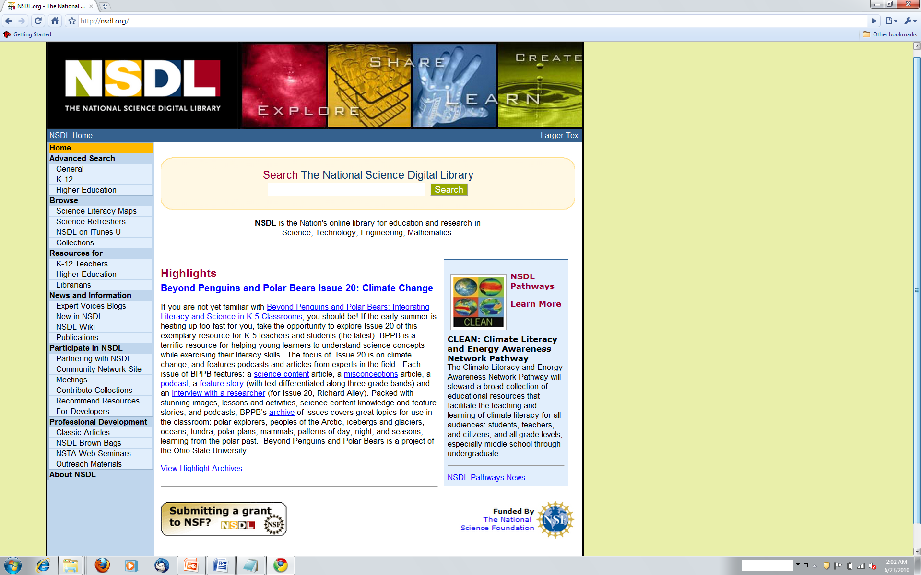
www.nsdl.org

Slide 6
CS Teaching Center (CSTC, 1998, D. Knox et al.)
Instead of building large, expensive multimedia packages, that become obsolete and are difficult to re-use, concentrate on small knowledge units.
Learners benefit from having well-crafted modules that have been reviewed and tested.
Use digital libraries to build a powerful base of support for learners, upon which a variety of courses, self-study tutorials & reference resources can be built.
ACM support led to Journal of Educational Resources in Computing (JERIC), now a Transactions
Notes:
3
3

Slide 7
www.CITIDEL.org
2001, led by Virginia Tech, with co-PIs:
Fox (DL systems)
Lee (history)
Perez (user interface, Spanish support)
Partners
College of New Jersey (Knox)
Hofstra (Impagliazzo)
Villanova (Cassel) – sustained by Library
Penn State (Giles)
Notes:
3
3

Slide 8
Computing and Information Technology Interactive Digital Educational Library (CITIDEL)
Domain: computing / information technology
Genre: one-stop-shopping for teachers & learners: courseware (CSTC, JERIC), leading DLs (ACM, IEEE-CS, DB&LP, CiteSeer), PlanetMath.org, NCSTRL (technical reports), …
Submission & Collection: sub/partner collections ➔ www.citidel.org

Slide 9
B. Ensemble from 5 different viewpoints
Interface (Drupal homepage)
Architecture
Poster: Many-to-Many Information Connections in a Distributed DL Portal
Three different interpretations
Data: Info coll. distributed in location, ownership
Info: Different topic domains (stakeholder views)
Users: Varied preferred environments
8 principles, in 3 clusters

Slide 10
Ensemble Portal
Edward A. Fox, Yinlin Chen, Monika Akbar
Virginia Tech
www.computingportal.org

Slide 11
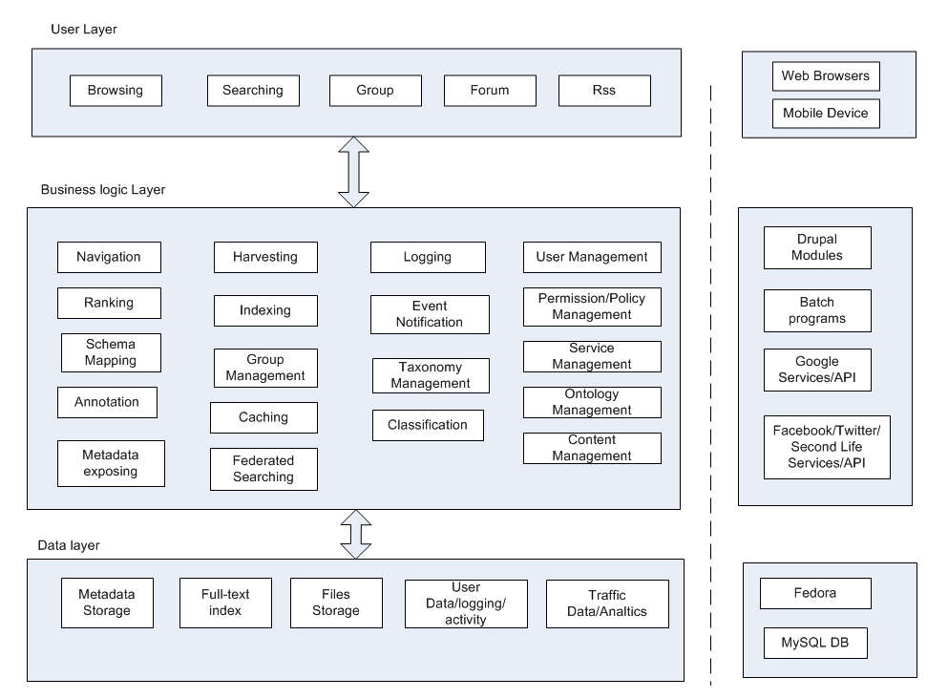
Ensemble Portal Architecture

Slide 12
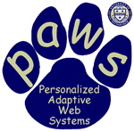
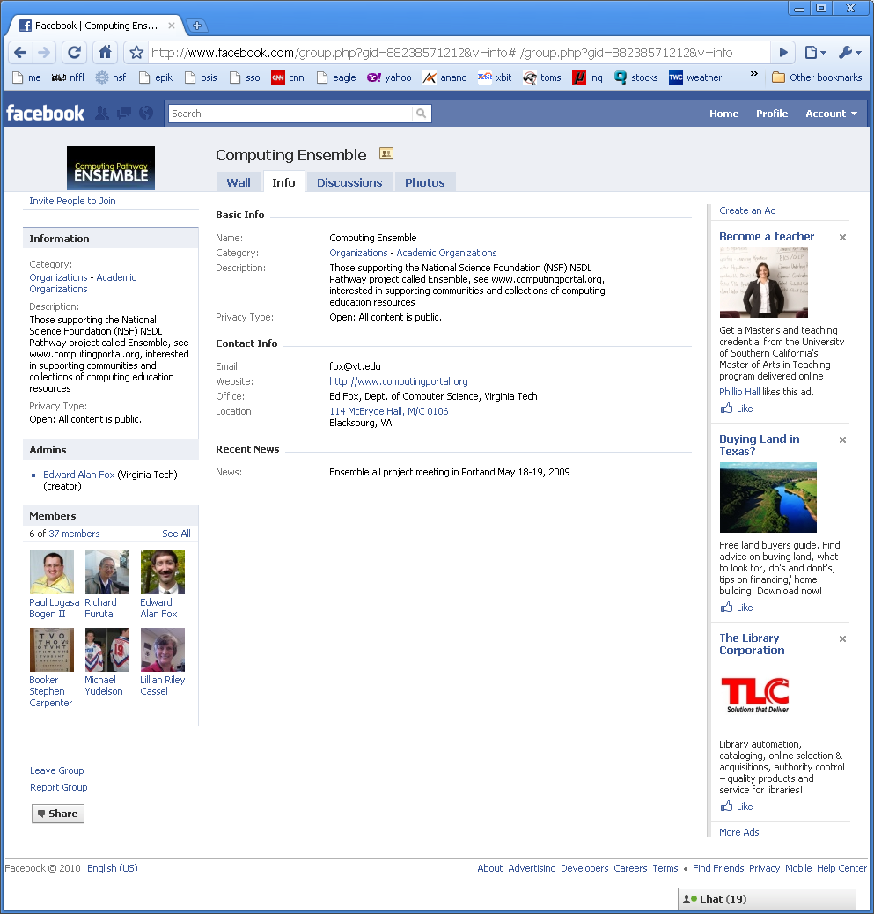
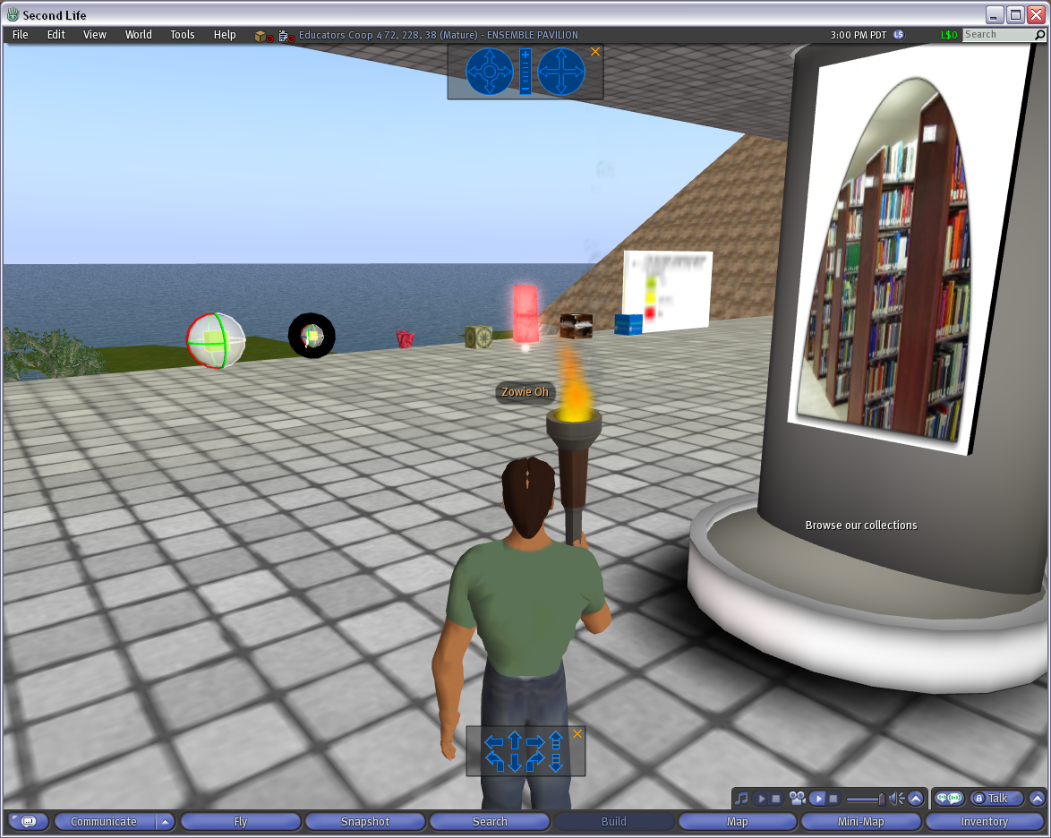
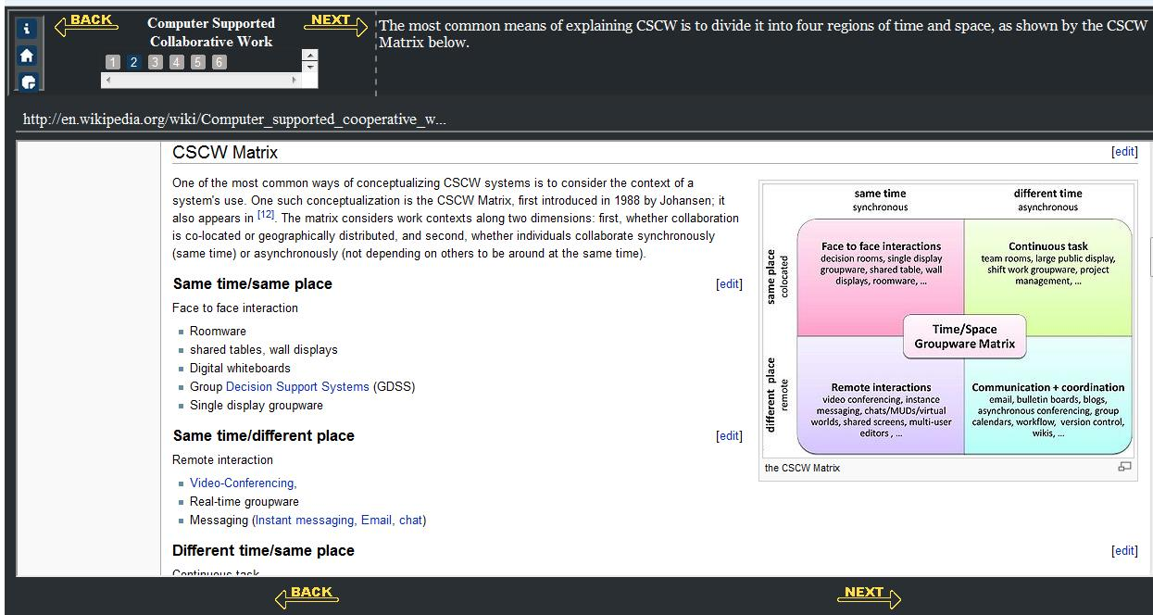
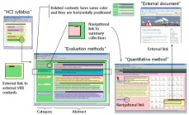
The Ensemble Computing Portal
Many-to-Many Information Connections in a Distributed Digital Library Portal
Collections
Communities
ACM
CS1
FOCES
TECH Developers
Ensemble
LIKES
AP CS
Services
Search
Distributed DL Portal
Forum
Group
Blog
Browse
Notification
Tools
A collaborative research project to build a distributed portal with up-to-date contents for all computing communities.
http://www.computingportal.org/

Slide 13
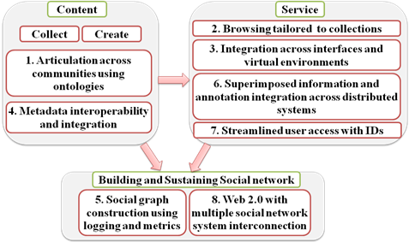
C. PDP-8 Overview

Slide 14
C1. Articulation Across Communities using Ontologies
Drupal support of focused groups (each with different terminology) -> articulation
ACM category system -> http://what.csc.villanova.edu/twiki/bin/Main/ OntologyProject
Plus U. Pittsburgh focused ontologies:
For educational programs on: C, Java, SQL
Plus Ramapo College, U. Canterbury, …
Exploration of ontology applied to syllabi

Slide 15
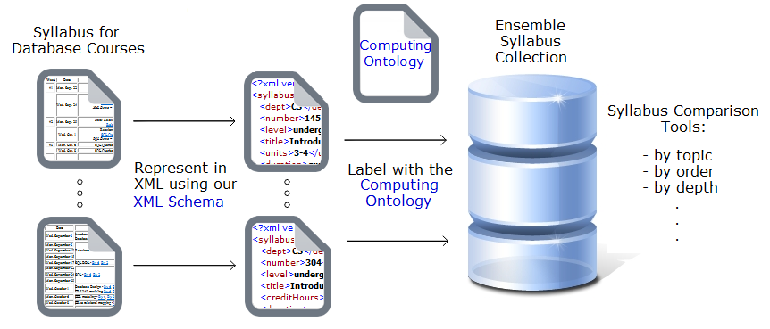
PSU Syllabus Comparison with Ontology

Slide 16
C2. Browsing Tailored to Collections
Each collection’s stakeholder community wants Ensemble to do as least as well as it already does in supporting browsing:
CSTA wants to see its hierarchy of content
AlgoViz wants algorithm visualizations to match its category scheme for algorithms.
…

Slide 17
C4. Metadata Interoperability and Integration
Such browsing support depends on:
Metadata schema for each type of browsing
OAI-PMH delivering that type of metadata
XSLT stylesheets for that metadata to organize it to support tailored browsing

Slide 18
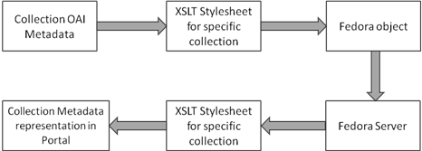
Metadata and Stylesheets

Slide 19
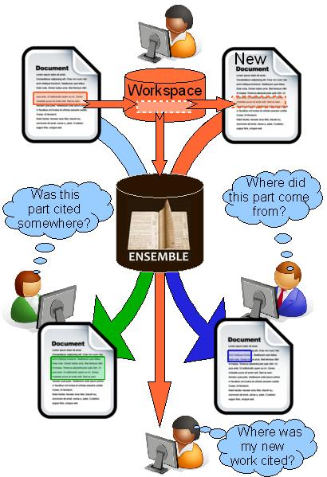
C6. Superimposed Information and Annotation Across Distributed Systems

Slide 20
C3. Integration Across Interfaces and Virtual Environments
Fedora as common backend, supporting
Multiple front-end interfaces, initially:
1. Drupal
2. Second Life Ensemble Pavillion
3. Facebook application: CATspace

Slide 21
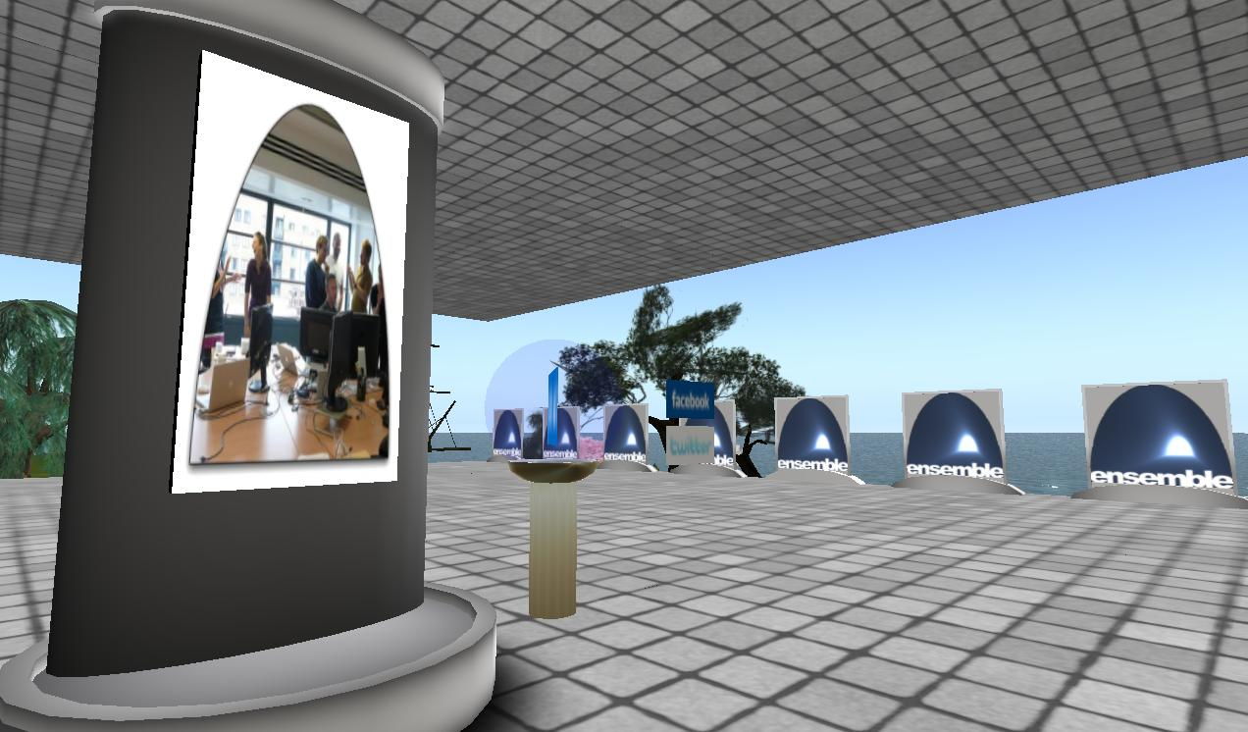
Ensemble in Second Life
http://slurl.com/secondlife/Educators%20Coop%204/66/236/28
The Ensemble Pavilion offers:
• teleports to other computing sites in Second Life like the Digital Preserve
• hyperlinks to related computing websites
• RSS readers with feeds from computing and computing education blogs
• membership in the Ensemble Computing group in Second Life, Facebook, and Twitter

Slide 22
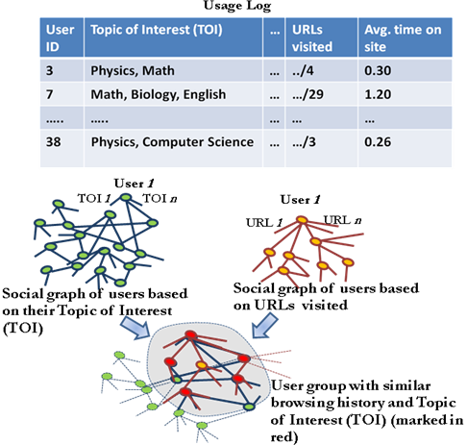
C5. Social Graph Construction using Logging and Metrics
(top) sample log
data;
(middle) 2 social
graphs based on
Topics of Interest
(TOI) and URLs
visited;
(bottom) overlap
revealing groups
with special
interests

Slide 23
C7. Streamlined User Access with IDs
Multiple partner sites, each with own Internet identities (IDs)
Web 2.0 sites, where users login
OpenID
Eventually, an integrated social network graph with integrated user profiles

Slide 24
C8. Web 2.0 with Multiple Social Network System Interconnection
Build and identify a user base with:
Twitter
Facebook, …
Start w. Drupal “rewards” plug-in modules
User Points: manage user points for actions
User Points Top Contributors: over the user lifetime, or over a defined time period
User Badges: triggered by point totals
Towards benefits of stackoverflow.com

Slide 25
Questions? Discussion?
Thank You!

