Slide 1
JCDL/ICADL 2010 Tutorial
(Gold Coast, Australia – June 21)
“Introduction to
Teaching (Learning about):
Digital Libraries” by Edward A. Fox
fox@vt.edu http://fox.cs.vt.edu
Dept. of Computer Science, Virginia Tech
Blacksburg, VA 24061 USA

Slide 2
Acknowledgements
Mentors (Licklider, Kessler, Salton)
Virginia Tech, CS, Digital Library Research Lab
NSF and other sponsors
Students, colleagues, co-investigators
Monika Akbar, Yinlin Chen, Marcos André Gonçalves, Doug Gorton, Nadia Kozievitch, Spencer Lee, Jonathan Leidig, Yi Ma, Uma Murthy, Sung Hee Park, Rao Shen, Venkat Srinivasan, Ricardo Torres, Xiaoyan Yu, ...
Barbara Wildemuth, Jeffrey Pomerantz, Sanghee Oh, Seungwon Yang

Slide 3
Selected DL Projects
Digital Library Curricular Resources
  NSF IIS-0535057 & 0535060
CTRnet (Crisis, Tragedy & Recovery Net)
  NSF IIS-0916733
Ensemble (Computer Science Education)
  NSF DUE-0840719
Digital Preserve
  NSF IIS-0910183 & 0910465
  http://slurl.com/secondlife/Digital%20Preserve/140/126/29

Slide 4
DL Curric. Project - 1
NSF awards to VT and UNC-CH
CS and LIS
Project server: http://curric.dlib.vt.edu/
Wikiversity: http://en.wikiversity.org/wiki/Curriculum_on_Digital_Libraries

Slide 5
DL Curric. Project - 2
Module 1-b: History of digital libraries and library automation
Module 2-c: File Formats, Transformation, and Migration
Module 3-b: Digitization
Module 4-b: Metadata
Module 5-a: Architecture overviews

Slide 6
DL Curric. Project - 2
Module 5-b: Application software
Module 5-d: Protocols
Module 6-a: Information needs/relevance
Module 6-b: Online information seeking behaviors and search strategies
Module 6-d: Interaction design and usability assessment

Slide 7
DL Curric. Project - 3
Module 7-b: Reference Services
Module 7-g: Personalization
Module 8-b: Web Archiving
Module 9-c: Digital library evaluation, user studies

Slide 8
Introductions
Country, City, Languages you speak
Main discipline of training
# of digital libraries (DLs) used: list
# of DL conferences attended? JCDLs?
Other activities at conference
Why taking this course
Goals for today

Slide 9
For More Information
Magazine: www.dlib.org
Books: http://fox.cs.vt.edu/DLSB.html (1994)
  MIT Press: Arms, plus by Borgman, Licklider (1965)
  Morgan Kaufmann: Witten... (several), Lesk (2nd edition)
Conferences
  ECDL: www.ecdl2010.eu
  ICADL: www.icadl.org
  JCDL: www.jcdl2010.org
Associations
  ASIS&T DL SIG
  IEEE TCDL: www.ieee-tcdl.org (student awards, …)
NSF:http://web.archive.org/web/20080130072311/, http://www.dli2.nsf.gov/
Labs: VT: www.dlib.vt.edu, http://ei.cs.vt.edu/~dlib/ (old)

Slide 10
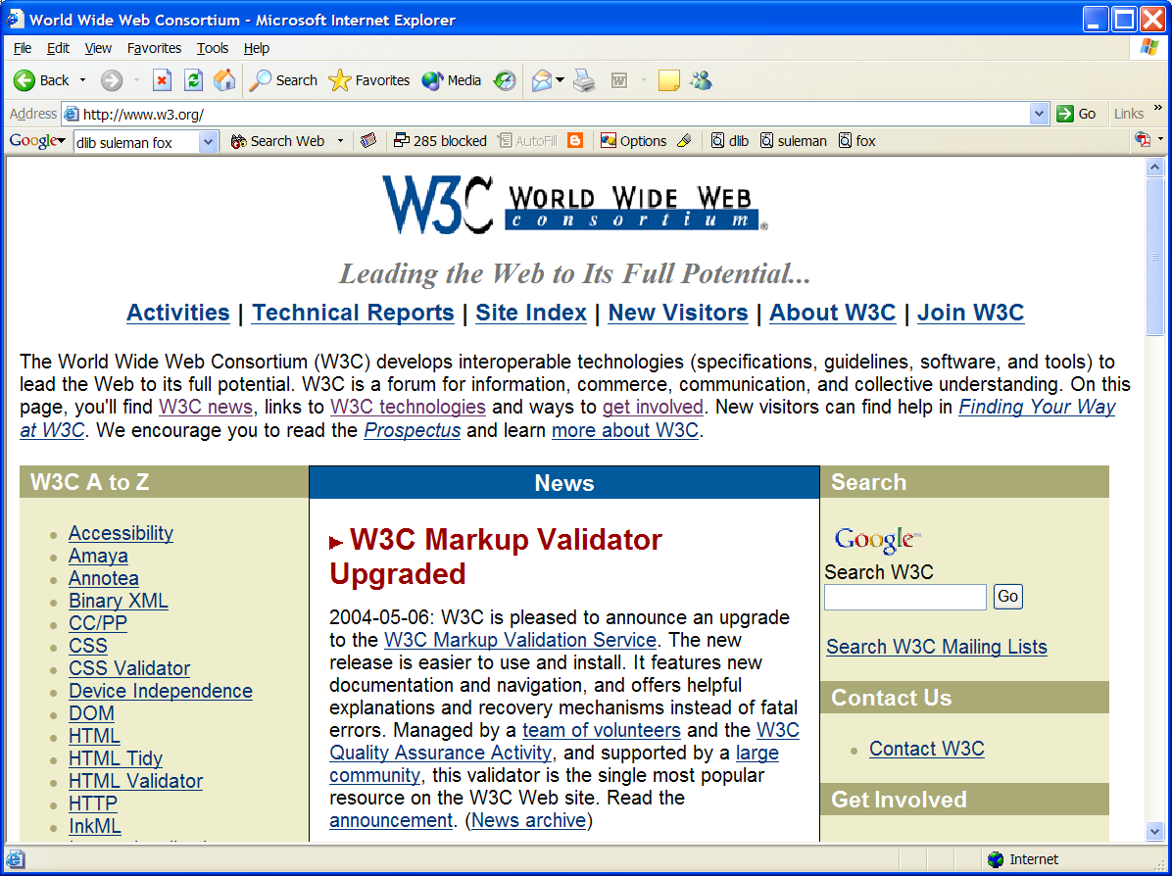

Slide 11
DL Challenges
Preservation - so people will trust DLs
Supporting infrastructure - networks, ...
Scalability, sustainability, interoperability
DL industry - critical mass by covering libraries, archives, museums, corporate info, govt info, personal info - “quality WWW” integrating IR, HT, MM, ...
  Need tools & methods to make them easier to build

Slide 12
DL Challenges – 2: Terminology
Digital / electronic / virtual library
Born digital, hybrid (digital/physical)
Universal access (all people/places/times)
  Accommodate disabilities (color, visual, auditory)
  Mobile (office, home, laptop, PDA, mobile)
Archiving, self-archiving
Open (source, standards, archives)

Slide 13
How to organize a DL course?
Various frameworks
  What, Why, How
  History, Current status, Future (research)
  Economics: open source, sustainability
  Social: users/patrons, management
  Technical: HCI, HT, IR, LIS, Web
Suggest that concept maps be drawn by readers to help in working with this book
Instructors can access “expert” maps with IHMC tools

Slide 14
CC2001 Information Management Areas
IM1. Information models and systems* | IM8. Distributed DBs
IM2. Database systems* | IM9. Physical DB design
IM3. Data modeling* | IM10. Data mining
IM4. Relational DBs | IM11. Information storage and retrieval
IM5. Database query languages | IM12. Hypertext and hypermedia
IM6. Relational DB design | IM13. Multimedia information & systems
IM7. Transaction processing | IM14. Digital libraries
* Core components

Slide 15
DL Curriculum Framework

Slide 16
Book Parts
Ch. 1. Introduction (Motivation, Synopsis)
Part 1 – The “Ss”
Part 2 – Higher DL Constructs
Part 3 – Advanced Topics
Appendix

Slide 17
Book Parts and Chapters - 1
Ch. 1. Introduction (Motivation, Synopsis)
Part 1 – The “Ss”
  Ch. 2: Streams
  Ch. 3: Structures
  Ch. 4: Spaces
  Ch. 5: Scenarios
  Ch. 6: Societies

Slide 18
Book Parts and Chapters - 2
Part 2 – Higher DL Constructs
  Ch. 7: Collections
  Ch. 8: Catalogs
  Ch. 9: Repositories and Archives
  Ch. 10: Services
  Ch. 11: Systems
  Ch. 12: Case Studies

Slide 19
Book Parts and Chapters - 3
Part 3 – Advanced Topics
  Ch. 13: Quality
  Ch. 14: Integration
  Ch. 15: How to build a digital library
  Ch. 16: Research Challenges, Future Perspectives
Appendix
  A: Mathematical preliminaries
  B: Formal Definitions: Ss
  C: Formal Definitions: DL terms, Minimal DL
  D: Formal Definitions: Archeological DL
  E: Glossary of terms, mappings

Slide 20
Chapter 1 Overview
Why do we need this book?
What are digital libraries (DLs)?
Why is 5S helpful in a DL book?
How do digital libraries work?
History: Memex, 1990s, proliferation
Related areas: LIS, linguistics, IR, AI, DBs, knowledge management, content management, probability/statistics

Slide 21
Synchronous
Scholarly Communication
Same time, Same or different place

Slide 22

Asynchronous, Digital Library Mediated Scholarly Communication
Different time and/or place

Slide 23
DL Overview
Why of Global Interest?
National projects can preserve antiquities and heritage: cultural, historical, linguistic, scholarly
Knowledge and information are essential to economic and technological growth, education
DL - a domain for international collaboration
  wherein all can contribute and benefit
  which leverages investment in networking
  which provides useful content on Internet & WWW
  which will tie nations and peoples together more strongly and through deeper understanding
Notes:
3
3

Slide 24
Digital Libraries --- Objectives
World Lit.: 24hr / 7day / from desktop
Integrated “super” information systems: 5S: Table of related areas and their coverage
Ubiquitous, Higher Quality, Lower Cost
Education, Knowledge Sharing, Discovery
Disintermediation -> Collaboration
Universities Reclaim Property
Interactive Courseware, Student Works
Scalable, Sustainable, Usable, Useful

Slide 25
Libraries of the Future
JCR Licklider, 1965, MIT Press
World
Nation
State
City
Community

Slide 26
Locating Digital Libraries in Computing and
Communications Technology Space
Digital Libraries technology
trajectory: intellectual
access to globally distributed information
Communications
(bandwidth, connectivity)
Computing (flops)
Digital content
Note: we should consider 4 dimensions: computing, communications,
content, and community (people)
less
more

Slide 27
AmericanSouth.Org – Roles, Content
SOLINET | Libraries (Data Providers) | Scholars
Intellectual Organization Controlled vocabulary Metadata extension development | Collection Decisions Selection Criteria | Selection Criteria Controlled vocabulary
Central Server Maintenance | Local Server Maintenance | Provision of Context
Metadata Repository | Metadata Creation/Maintenance | Organizational Structure and Annotation Tools
Central Interface Design/Maintenance | Local Interface Design/Maintenance | Selection of Other Annotation Tools
Central Indices Creation/Maintenance | Local Indices | Selection of Thesauri
Coordination of Metadata Gateway Development | Gateway Implementation | Concept Mapping
 | Digital Objects

Slide 28
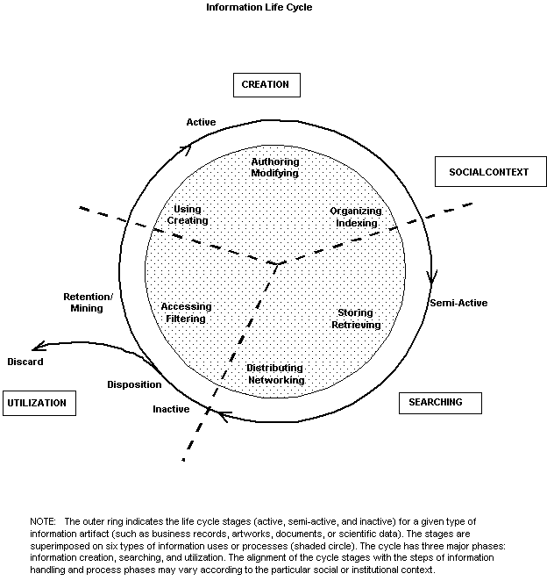
Information
Life
Cycle
Borgman et al.:
Workshop Report on
Social Aspects of
Digital Libraries:
http://www-lis.gseis.
ucla.edu/DL/
Notes:
Thanks to Christine Borgman and others at this workshop.

Slide 29
Information Life Cycle
Creation
Active
Authoring
Modifying
Social Context
Using
Creating
Organizing
Indexing
Retention
/ Mining
Accessing
Filtering
Storing
Retrieving
Semi-
Active
Utilization
Distributing
Networking
Inactive
Searching
Notes:
This is a simplification of the previous slide.

Slide 30
Digital Libraries
Shorten the Chain from
Author
Editor
Reviewer
Publisher
A&I
Consolidator
Library
Reader

Slide 31
DLs Shorten the Chain to
Roles
Digital
Library
Author
Teacher
User
Reader
Editor
Learner
Reviewer
Librarian

Slide 32
Application Domain | Related Institutions | Examples |  | Technical Challenges | Benefit / Impact
Publishing | Publishers, Eprint archives | OAI |  | Quality control, openness | Aggregation, organization
Education | Schools, colleges, universities | NSDL, NCSTRL |  | Knowledge management, reuseability | Access to data
Art, Culture | Museum | AMICO, PRDLA |  | Digitization, describing, cataloging | Global understanding
Science | Government, Academia, Commerce | NVO, PDG, SwissProt, UK eScience,European Union Commission |  | Data models | reproducibility, faster reuse, faster advance
(e) Government | Government Agencies (all levels) | Census |  | Intellectual property rights, privacy, multi-national | Accountability, homeland security
(e) Commerce, (e) Industry | Legal institutions | Court cases, patents |  | Developing standards | Standardization, economic development
History, Heritage | Foundations | American Memory |  | Content, context, interpretation | Long term view, perspective, documentation, recording, facilitating, interpretation, understanding
Cross-cutting | Library, Archive | Web, personal collections |  | Multi-language, preservation, scalability, interoperability, dynamic behavior, workflow, sustainability, ontologies, distributed data, infrastructure | Reduced cost, increased access, pereservation, democratization, leveling, peace, competitiveness
Reagan Moore
Ed Fox
June
2002
for
NSF

Slide 33
Running Examples
  Institutional repositories linked worldwide
    Building from partial vs. complete coverage
    Partial1: ETDs -> NDLTD
    Partial2: Courseware -> NSDL -> DLEs
  Archaeological information worldwide
    Sites -> ETANA -> …

Slide 34
Motivation
Digital Libraries (DLs): what are they??
  No definitional consensus
  Conflicting views
  Makes interoperability a hard problem
DLs are not benefiting from formal theories as are other CS fields: DB, IR, PL, etc.
DL construction: difficult, ad-hoc, lack of support for tailoring/customization
Conceptual modeling, requirements analysis, and methodological approaches are rarely supported in DL development.
  Lack of specific DL models, formalisms, languages

Slide 35
DL Definitions - 1
“A digital library is an organized and focused collection of digital objects, including text, images, video, and audio, along with methods of access and retrieval, and for selection, creation, organization, maintenance, and sharing of the collection.”
Witten & Bainbridge – “How to Build a Digital Library” – Morgan Kaufmann 2003

Slide 36
DL Definitions - 2
“Digital libraries are organizations that provide the resources, including the specialized staff, to select, structure, offer intellectual access to, interpret, distribute, preserve the integrity of, and ensure the persistence over time of collections of digital works so that they are readily and economically available for use by a defined community or set of communities”
Waters,D.J. CLIR Issues, July/August 1998
www.clir.org/pubs/issues/issues04.html

Slide 37
DL Definitions - 3
Issues and Spectra
  Collection vs. Institution
  Content vs. System
  Access vs. Preservation
  “Free” vs. Quality
  Managed vs. Comprehensive
  Centralized vs. Distributed

Slide 38
DL Definitions - 4
NOT a “digitized library”
NOT a “deconstruction” of existing systems and institutions, moving them to an electronic box in a Library
IS a new way to deal with knowledge
  Authoring, Self-archiving, Collecting,
  Organizing, Preserving,
  Accessing, Propagating, Re-using

Slide 40
Content Area Description | Audio | Digital | Finding Aid | MSS | Other | Photo | Video | MF | Print | Total
African-American cultural life | 6 | 4 | 6 | 9 | 4 | 12 | 3 | 10 | 18 | 72
Agricultural crisis of late 19th century | 1 |  | 1 | 3 | 1 | 1 |  | 4 | 8 | 19
Codification of segregation laws | 1 |  | 3 | 2 | 1 |  | 1 |  | 8 | 16
Configuration of white supremacy | 1 |  | 3 | 3 |  | 3 |  | 1 | 9 | 20
Cultural values and activities | 3 | 1 | 5 | 17 | 4 | 15 | 1 | 5 | 20 | 71
Disenfranchising movements | 1 |  | 2 | 2 | 1 | 2 | 1 |  | 6 | 15
Educational movements | 6 | 1 | 1 | 18 | 6 | 21 | 3 | 5 | 27 | 98
Emergence of Holiness & Pentecostal Groups |  |  | 1 | 1 |  | 1 |  |  | 7 | 10
Emergence of new musical forms | 3 | 1 |  |  |  | 1 |  | 1 | 2 | 8
Emergence of organized groups expressing farmers concerns |  |  |  | 2 |  | 2 |  | 1 | 8 | 13
… | … | … | … | … | … | … | … | … | … | …
Total Each Format | 41 | 14 | 51 | 161 | 38 | 133 | 13 | 79 | 301 | 831

Slide 41
Outline
Ch. 1. Introduction (Motivation, Synopsis)
Part 1 – The “Ss”
  Ch. 2: Streams
  Ch. 3: Structures
  Ch. 4: Spaces
  Ch. 5: Scenarios
  Ch. 6: Societies

Slide 42
Informal 5S & DL Definitions
DLs are complex systems that
help satisfy info needs of users (societies)
provide info services (scenarios)
organize info in usable ways (structures)
present info in usable ways (spaces)
communicate info with users (streams)

Slide 43
5S Layers
Societies
Scenarios
Spaces
Structures
Streams

Slide 44
Hypotheses
A formal theory for DLs can be built based on 5S.
The formalization can serve as a basis for modeling and building high-quality DLs.

Slide 45
Research Questions
1. Can we formally elaborate 5S?
2. How can we use 5S to formally describe digital libraries?
3. What are the fundamental relationships among the Ss and high-level DL concepts?
4. How can we allow digital librarians to easily express those relationships?
5. Which are the fundamental quality properties of a DL? Can we use the formalized DL framework to characterize those properties?
6. Where in the life cycle of digital libraries can key aspects of quality be measured and how?

Slide 46
5Ss
Ss | Examples | Objectives
Streams | Text; video; audio; image | Describes properties of the DL content such as encoding and language for textual material or particular forms of multimedia data
Structures | Collection; catalog; hypertext; document; metadata | Specifies organizational aspects of the DL content
Spaces | Measure; measurable, topological, vector, probabilistic | Defines logical and presentational views of several DL components
Scenarios | Searching, browsing, recommending | Details the behavior of DL services
Societies | Service managers, learners, teachers, etc. | Defines managers, responsible for running DL services; actors, that use those services; and relationships among them

Slide 47
5S and DL formal definitions and compositions (April 2004 TOIS)

Slide 48
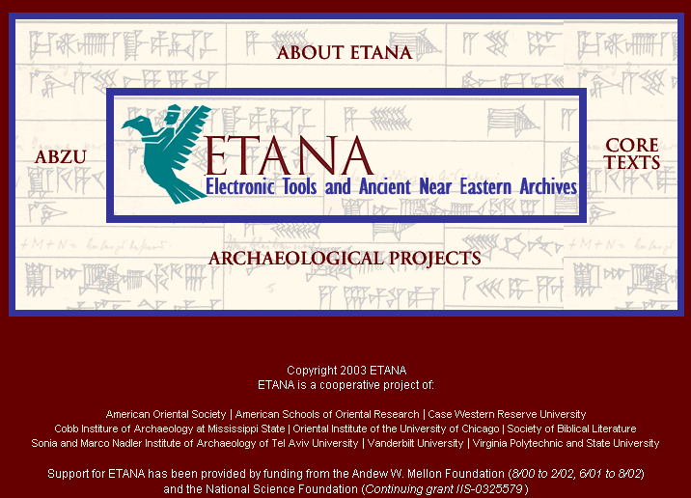

Slide 49
ETANA-DL
Archaeological DL
Integrated DL
  Heterogeneous data handling
Applies and extends the OAI-PMH
  Open Archives Initiative Protocol for Metadata Handling
Design considerations
  Componentized
  Extensible
  Portable

Slide 50
ETANA-DL Architecture
DigBase and DigKit
Lahav
D
A
T
A
B
A
S
E
W
R
A
P
P
E
R
S
Search
U
S
E
R
I
N
T
E
R
F
A
C
E
Browse
Nimrin
Recommend
Umayri
ETANA-DL
UNION
CATALOG
Note
Hisban
Personalize
Megiddo
Review
Jalul
Visualizations
Archaeology
Specific
…
New Sites
Work in progress

Slide 51
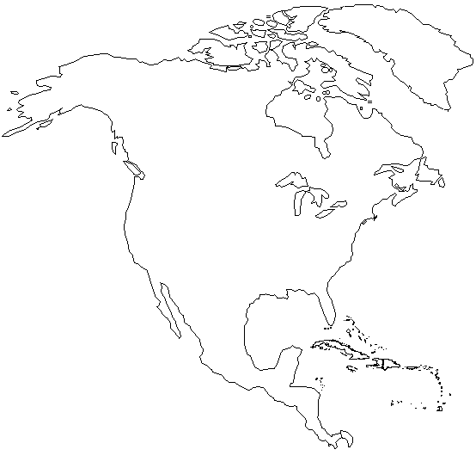
Initial ETANA-DL Member Locations
Canadian University College
Andrews University
CWRU
Walla Walla College
Willamette University
Virginia Tech
Vanderbilt University
Mississippi State University
Map courtesy: www.enchantedlearning.com

Slide 52
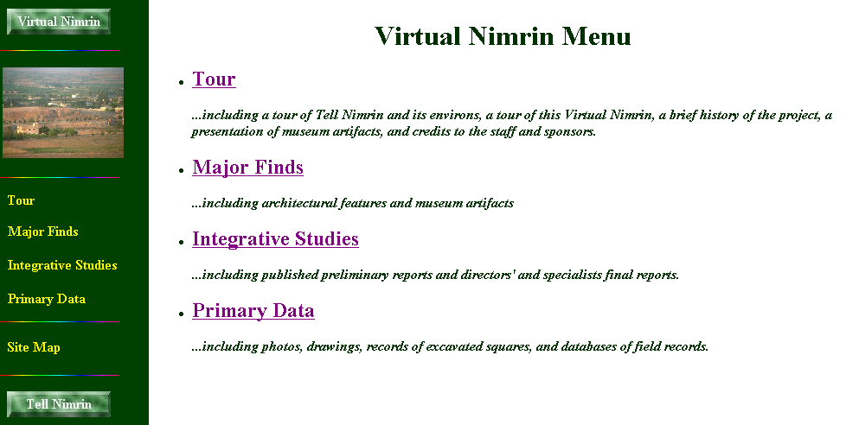

Slide 53
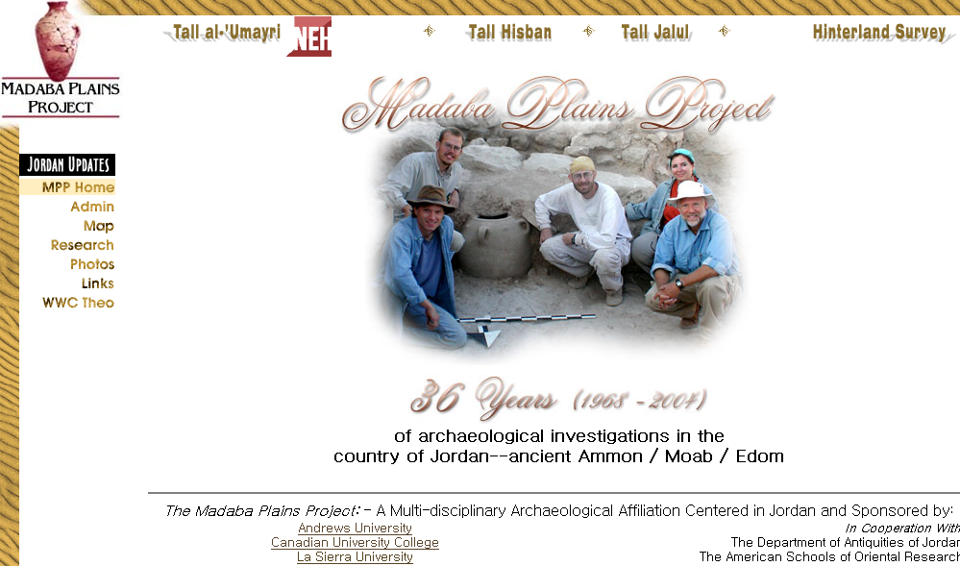

Slide 54
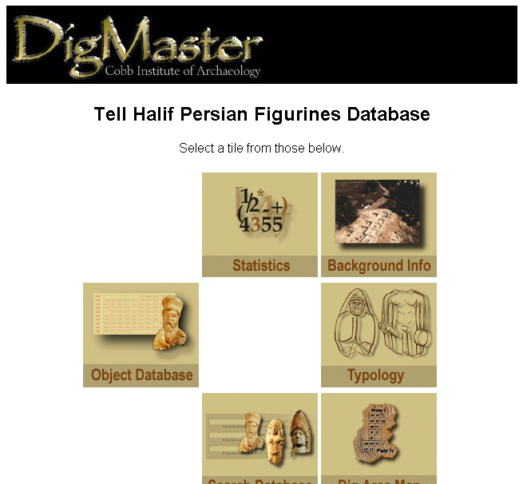
Lahav Website

Slide 55
Megiddo Opening Screen

Slide 56
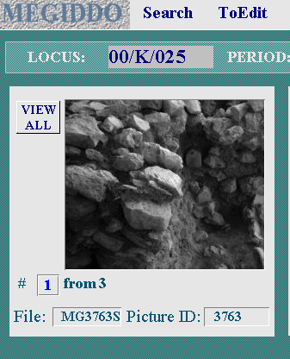
Locus Screen: Pictures
View all

Slide 57
Area Screen

Slide 58
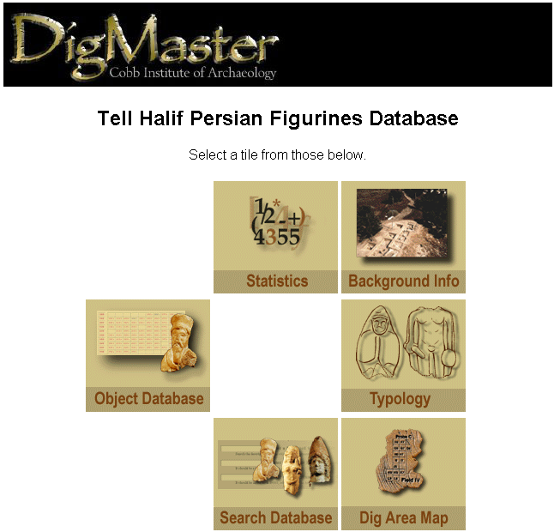
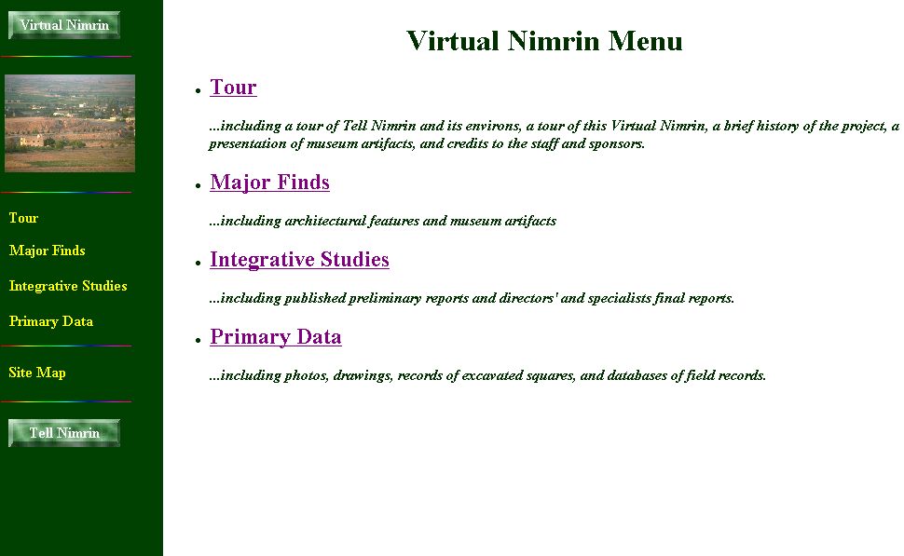
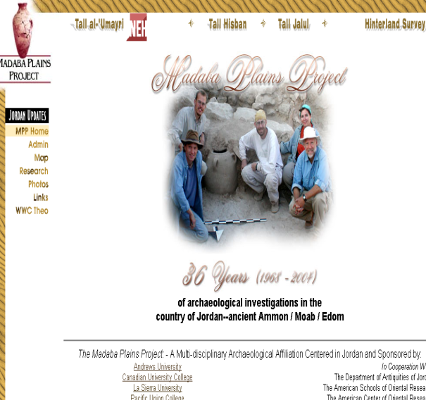
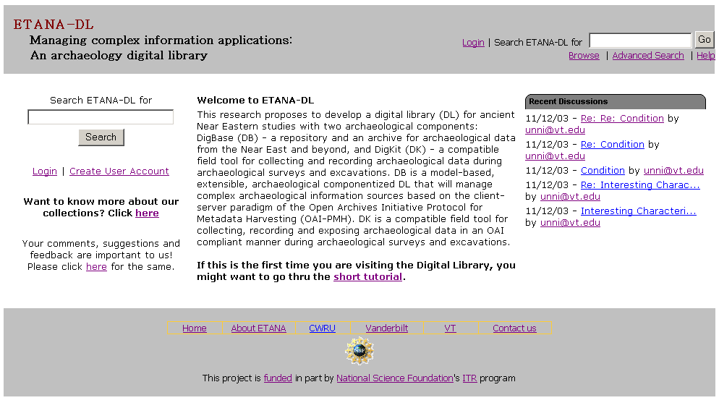

Slide 59
ETANA-DL Approach
Applying and extending Digital Library (DL) techniques to solve key problems: making primary data available, data preservation, and interoperability
Modeling archaeological information systems using 5S to better understand the domain and design the system and the supporting services
Rapidly prototyping DLs that handle heterogeneous archaeological data using componentized frameworks:
  eliciting requirements
  refining metamodel and union schema
  modeling sites
  mapping
  harvesting
  providing useful services

Slide 60
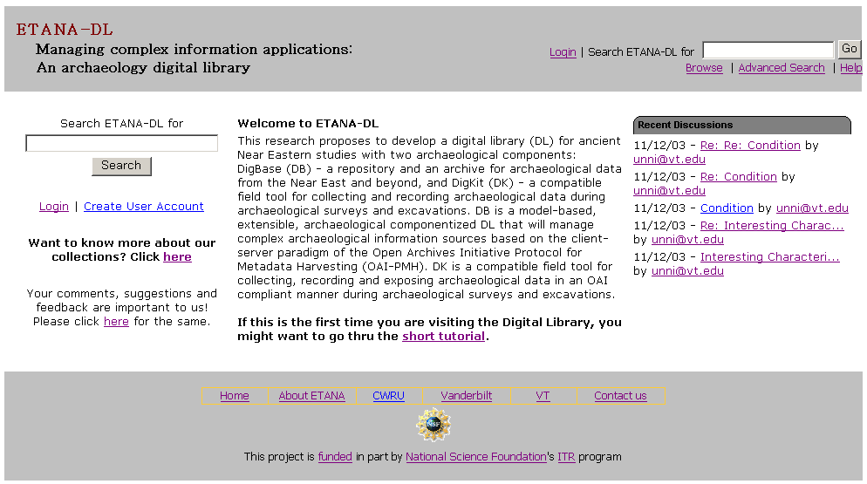
ETANA-DL Website

Slide 61
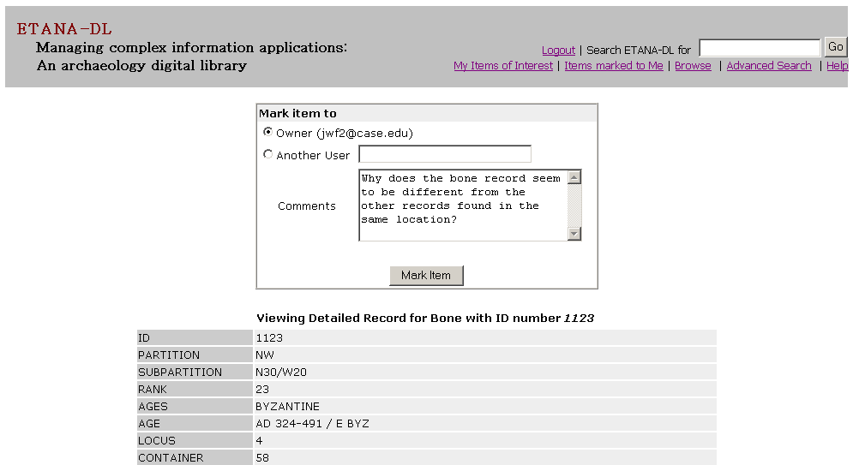
Marking – writing
notes for
a specific user
Marking Items

Slide 62
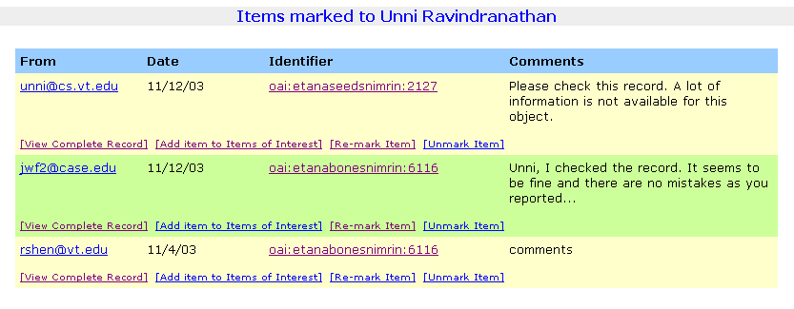
Sender, Date,
Object OAI ID
Sender
Comments
Options:
View Record,
Add record to Items Of Interest,
Re-mark item (Redirect),
Unmark item (Remove item from list)
Marked Items Display

Slide 63
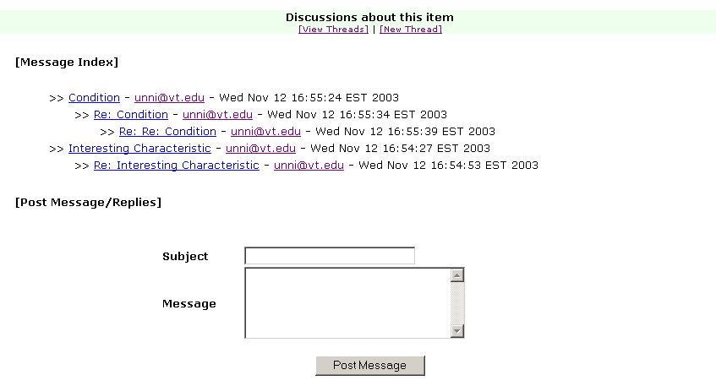
Discussions
about an
object
View/Post
messages,
create new
threads
Discussions Page

Slide 64
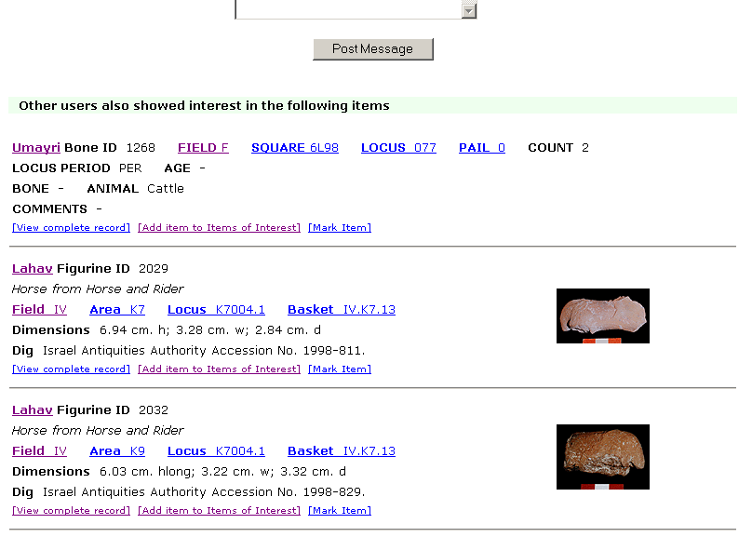
Items recommended
on the basis of
similar interests
Recommendations

Slide 65
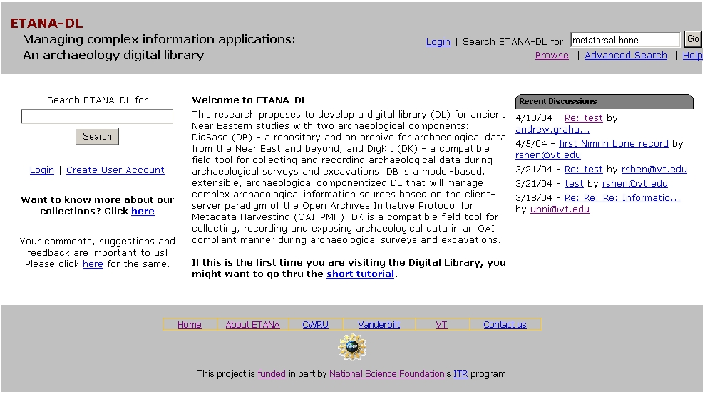
ETANA-DL Searching Service
Search

Slide 66
ETANA-DL Multi-dimensional Browsing
3 new sites
2 new types of artifacts

Slide 67
ETANA-DL Visual Browsing Service
Visual Browse
By site

Slide 68
Visual Browsing Nimrin:
Topographical Drawings
Square:
N40/W20
Full site
North west quadrant

Slide 69
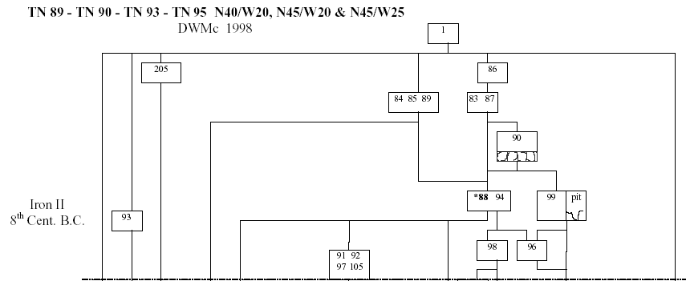
Visual Browsing Nimrin : Square information
Square:
N40/W20
Locus: 86
Loci layout

Slide 70
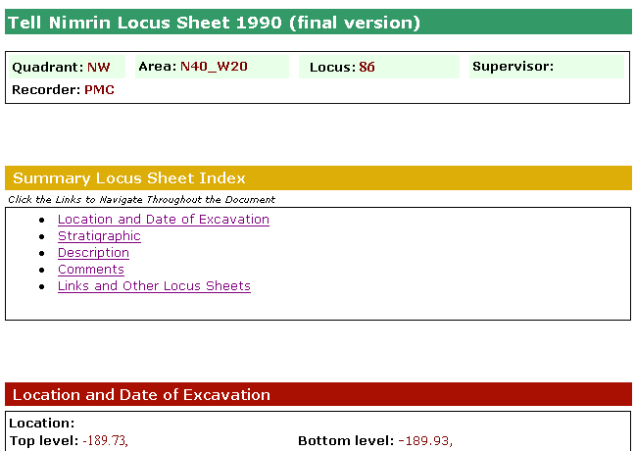
Visual Browsing Nimrin : locus sheet

Slide 71
Visual Browsing
Bab edh-Dhra'
Cemetery
Pottery # 25

Slide 72
Visual Browsing
Bab edh-Dhra'
Cemetery
Pottery # 25

Slide 73
ETANA Societies
Historic and pre-historic societies (being studied)
Archaeologists (in academic institutes, fieldwork settings, or local and national governmental bodies)
Project directors
Technical staff (consisting of photographers, technical illustrators, and their assistants)
Field staff (responsible for the actual work of excavation)
Camp staff (e.g., camp managers, registrars, tool stewards)
General public (e.g., educators, learners, citizens)

Slide 74
ETANA Societies
Social issues
  Who owns the finds?
  Where should they be preserved?
  What nationality and ethnicity do they represent?
  Who has publication rights?
  What interactions took place between those at the site studied, and others? What theories are proposed by whom about this?

Slide 75
ETANA Scenarios
Life in the site in former times
Digital recording: the planning stage and the excavation stage
Planning stage: remote sensing, fieldwalking, field surveys, building surveys, consulting historical and other documentary sources, and managing the sites and monuments
Excavation
  Detailed information is recorded, including for each layer of soil, and for features such as pole holes, pits, and ditches.
  Data about each artifact is recorded together with information about its exact find spot.
  Numerous environmental and other samples are taken for laboratory analysis, and the location and purpose of each is carefully recorded.
  Large numbers of photographs are taken, both general views of the progress of excavation and detailed shots showing the contexts of finds.
Organization and storage of material
Analysis and hypotheses generation and testing
Publications, museum displays
Information services for the general public

Slide 76
ETANA Spaces
Geographic distribution of found artifacts
Temporal dimension (as inferred by archaeologists)
Metric or vector spaces
  used to support retrieval operations, and to calculate distance (and similarity)
  used to browse / constrain searches spatially
3D models of the past, used to reconstruct and visualize archaeological ruins
2D interfaces for human-computer interaction

Slide 77
ETANA Structures
Site Organization
  Region, site, partition, sub-partition, locus, …
Temporal orderings (ages, periods)
Taxonomies
  for bones, seeds, building materials, …
Stratigraphic relationships
  above, beneath, coexistent

Slide 78
ETANA Streams
successive photos and drawings of excavation sites, loci, unearthed artifacts
audio and video recordings of excavation activities and discussions
textual reports
3D models used to reconstruct and visualize archaeological ruins.

Slide 79
Exercise 1
Forms groups of 2.
Select a digital library you wish to build, improve, or study.
As was done for ETANA, discuss it using the 5S perspective.
Present a summary to the class and lead a discussion.

Slide 80
Outline
Ch. 1. Introduction (Motivation, Synopsis)
Part 1 – The “Ss”
  Ch. 2: Streams
  Ch. 3: Structures
  Ch. 4: Spaces
  Ch. 5: Scenarios
  Ch. 6: Societies

Slide 81
Chapter 2 Overview
Multiple media types and representation
  See ch. 4 for IR (except some here for non-text)
  Standards for each, and for some combinations
Text
  Character strings, encoding (Unicode)
  Morphology -> Stemming
  Syntax, semantics -> stop words
  ** POS tagging, phrases
Images, Audio, Video, Graphics, Animation
  Capture, digitization, representation
  CBIR for each
** Compression, processing, analysis
**Synchronization, rendering, presentation, interchange
  RealVideo, SMIL, QoS

Slide 82

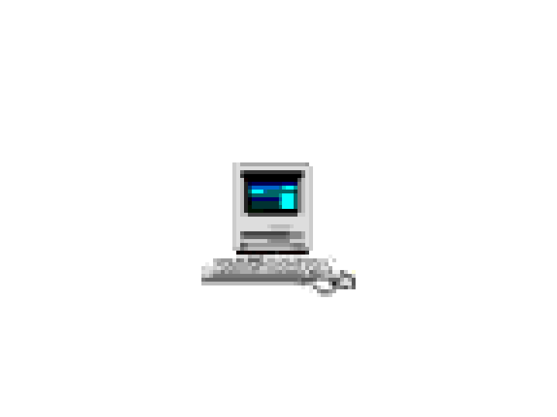

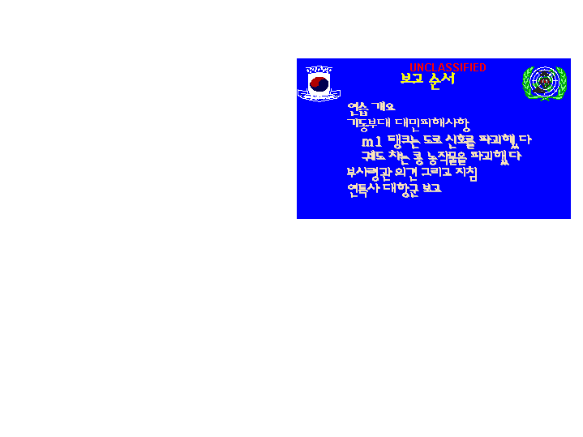
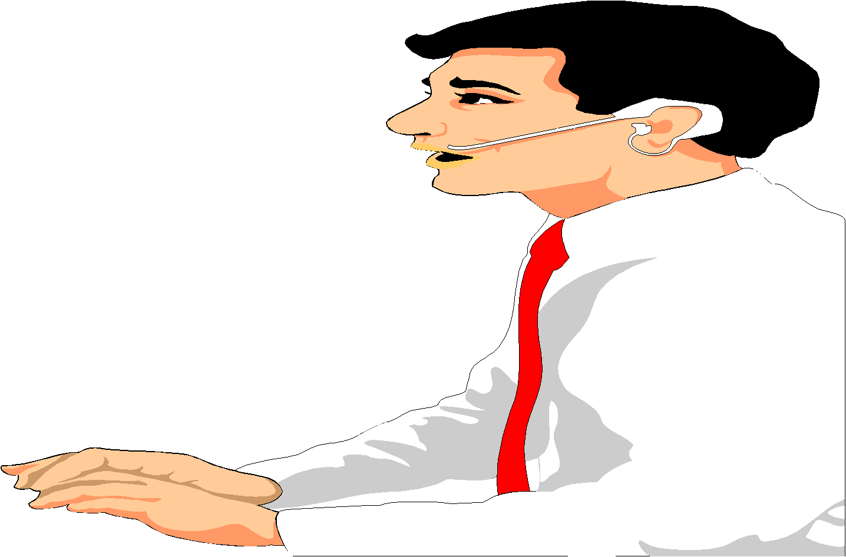

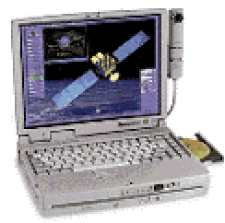
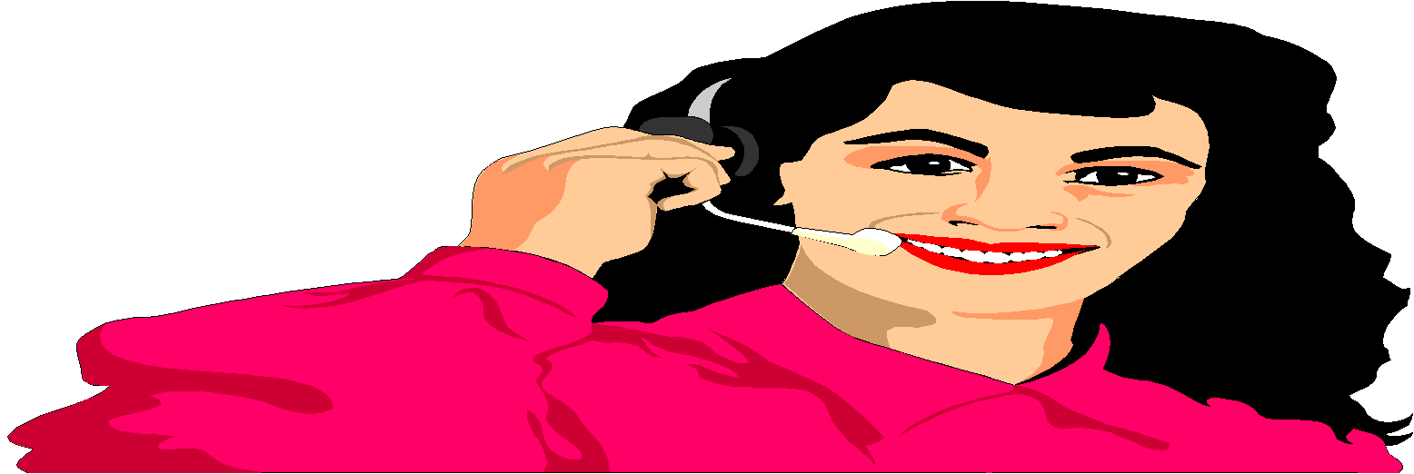
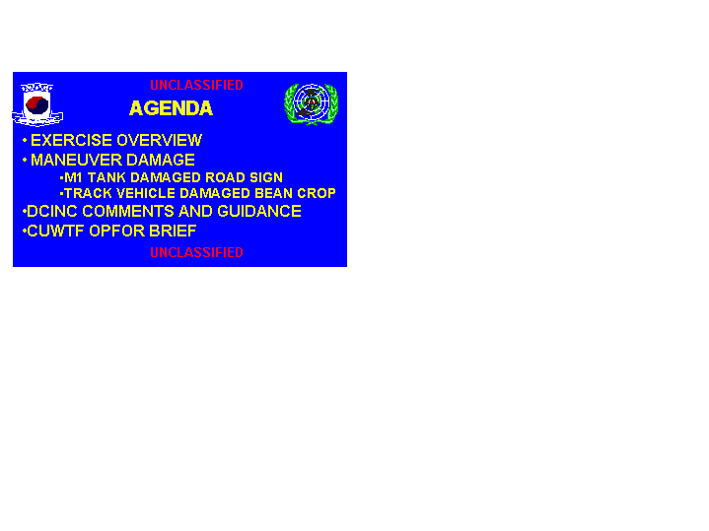
Integrated CCLINC
Translingual Information System
DARPA
CCLINC
SERVER
BugHanI IlBonE Ddo MiSaIlEul
BalSaHan Deus HaDa
Info Detection
2-way
Speech Transation
Extraction
What is the north korean
movement in the front line?
What is the status of nk
missile launch against japan?
Summarization
It seems that North Korea launch a missile again
After North Korea launched a Daipodong missile
last month, NK is perceived to proceed to an additional
test launch. Korea, US and Japan enter into an alert
state, and prepare for a joint response policy. Korea
estimates that the additional launch will be on 09/05.
Japan estimates that NK’s missile range is short. US
information says that there is no sign of launch yet.
Translation

Slide 83
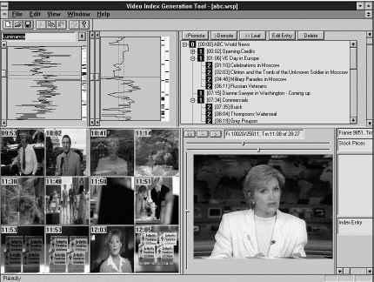
Structured Video Browser
(making video into hypermedia) www.learn.umd.edu
IBrowse
Expository multimedia
Narrative Structures

Slide 84
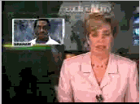
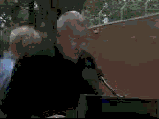
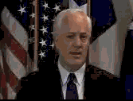

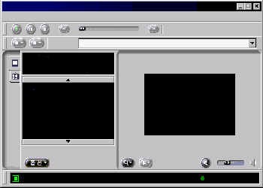
MPEG-7 Video Library Systems Tech.
MPEG-7 Video Library Systems Tech.
Architecture
Video Data
Description
Scheme
Description Schemes
Design Tool
Description Generator
Meta
Database
Video
Database
Presentation Module
Player
Retrieval Server
Module
ICU
Information and Communication
University

Slide 85






Tides in Early Texas History – Stephen F. Austin University

Slide 86

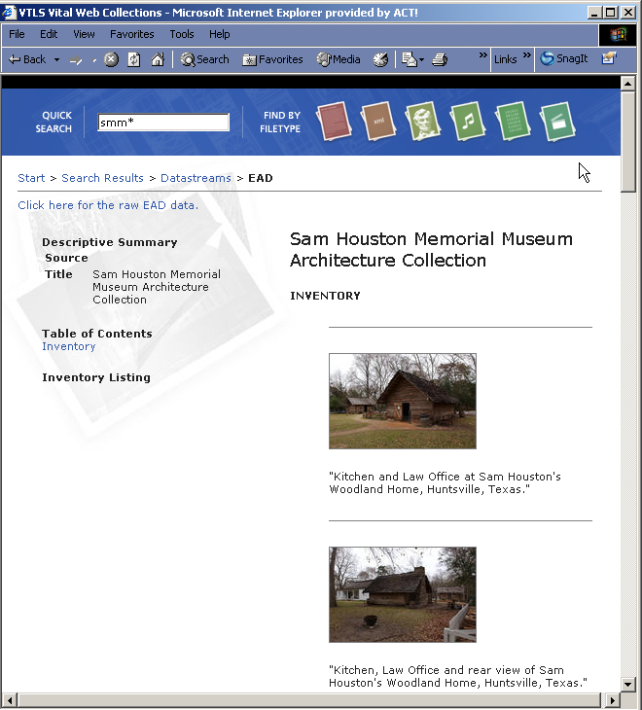
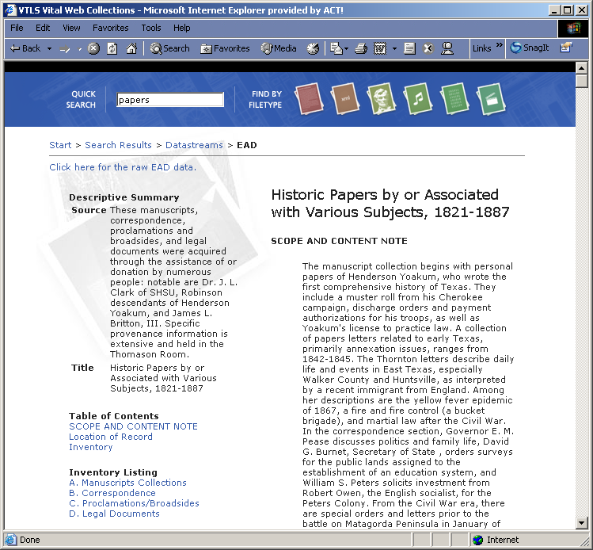
VITAL Web Portal
Clicking on the thumbnail image from this screen will launch the VITAL Hi-Res Image Navigator – a tool which provides for detailed examination of these wavelet compressed image files
Institutions have considerable flexibility in the way they present their collections – the examples here show two different approaches to presenting EAD (Encoded Archival Description) metadata objects

Slide 87
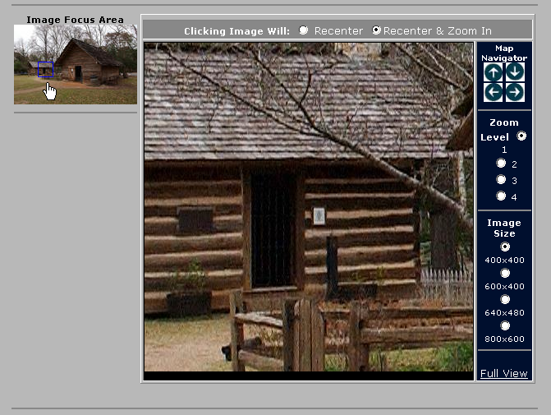
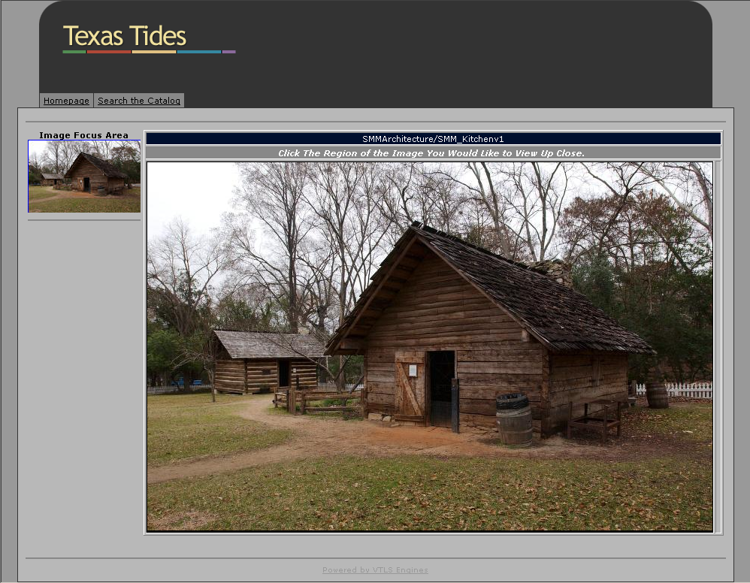
VITAL Web Portal
MrSID and JPEG2000 wavelet compressed images can be stored in the repository and displayed to the user via the integrated VITAL Hi-Res Image Navigator

Slide 88
The AMICO Library™

Slide 89
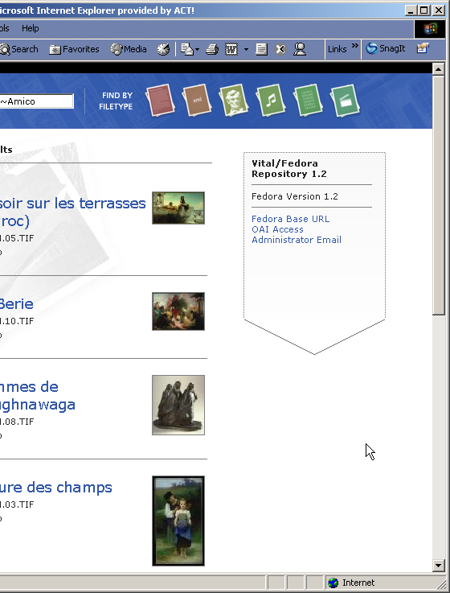
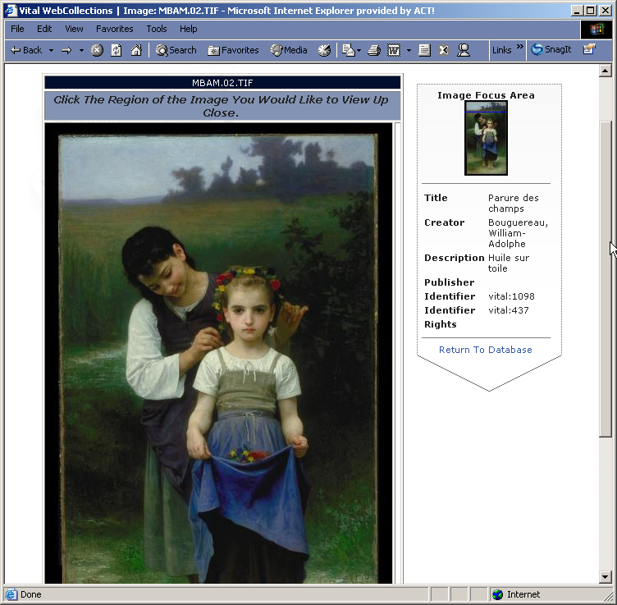
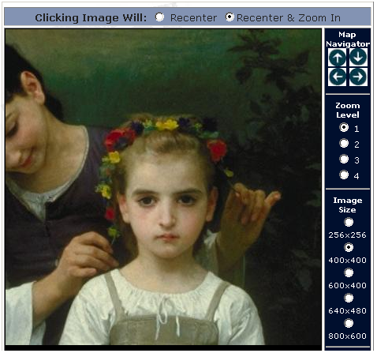
VITAL Web Portal
The AMICO Library in VITAL

Slide 90
Implementation Options
The Fedora™ package
  Fedora™ open source software (free)
  VTLS installation, training, and support

Slide 91
Collaborative Research: Torres
Torres at UNICAMP, Brazil
Hallerman in Fisheries at VT
Funding by Microsoft Research
Search in collections of fish images
using combination of
image properties (CBIR) and
textual descriptions
With superimposed information (Murthy, Delcambre, Cassel, …)

Slide 92
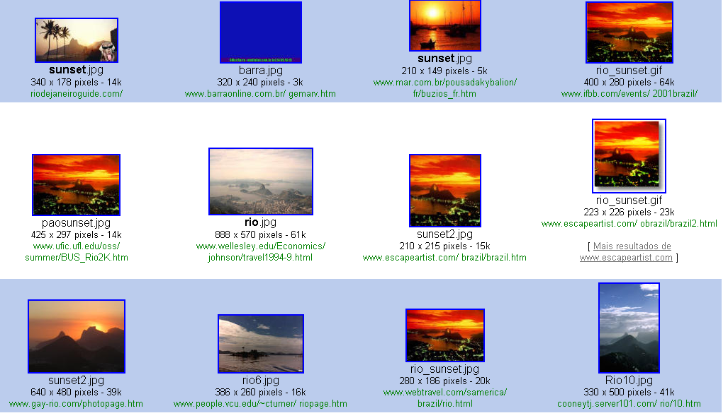
Textual information retrieval
Query on Google using Sunset and Rio de Janeiro
Query result

Slide 93
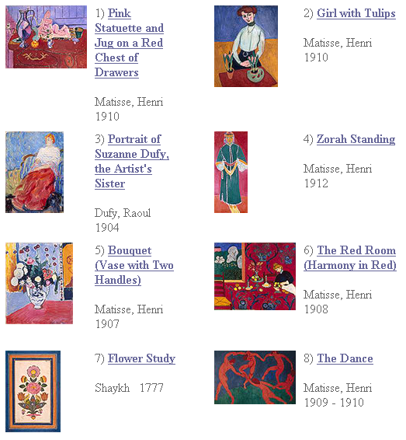
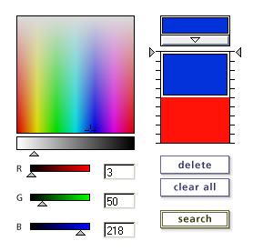
Content Based
Information
Retrieval

Slide 94
Outline
Ch. 1. Introduction (Motivation, Synopsis)
Part 1 – The “Ss”
  Ch. 2: Streams
  Ch. 3: Structures
  Ch. 4: Spaces
  Ch. 5: Scenarios
  Ch. 6: Societies

Slide 95
Chapter 3 Overview
Digital Objects
  Documents, digitization, packaging (METS, ORE, DCC), interchange, standards, format conversion
  Genre: plays, encyclopedia, dictionaries, educational resources: courses (e.g., syllabi) and lessons
  Structural organizations (books, chapters, sections), excerpts/spans (mark, superimposed info)
Metadata: standards, markup
Knowledge Structures & Representations
  Databases, Schema, Ontologies, Thesauri, Lexicons, Authority files, Concept maps, Semantic networks
Indexes
  Inverted files, signature files, R-trees, Quad trees, etc.
Clusters & Classification Schemes

Slide 96
Degree of Structure
Web
DLs
DBs
Chaotic
Organized
Structured

Slide 97
Digital Objects (DOs)
Born digital
Digitized version of “real” object
  Is the DO version the same, better, or worse?
  Decision for ETDs: structured + rendered
Surrogate for “real” object
  Not covered explicitly in metamodel for a minimal DL
  Crucial in metamodel for archaeology DL

Slide 98
Metadata Objects (MDOs)
MARC
Dublin Core
RDF
IMS
OAI (Open Archives Initiative), ORE
Crosswalks, mappings
Ontologies
Topics maps, concept maps

Slide 99
Complex to Simple
+
thesis
MARC ($50)
Dublin Core (DC)

Slide 100
Also Important: Epub, SGML, XML
5S perspective: streams, structures, scenarios
Authoring
Rendering, presenting
Tagging, Markup, DOM
Semi-structured information
Dual-publishing, eBooks
Styles (XSL, XSLT)
Structured queries

Slide 101
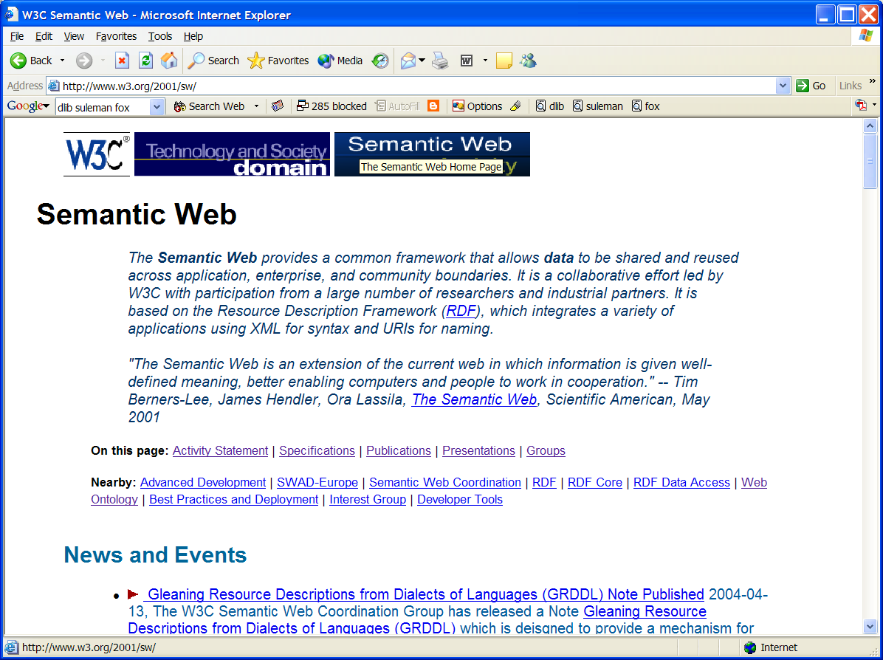

Slide 102
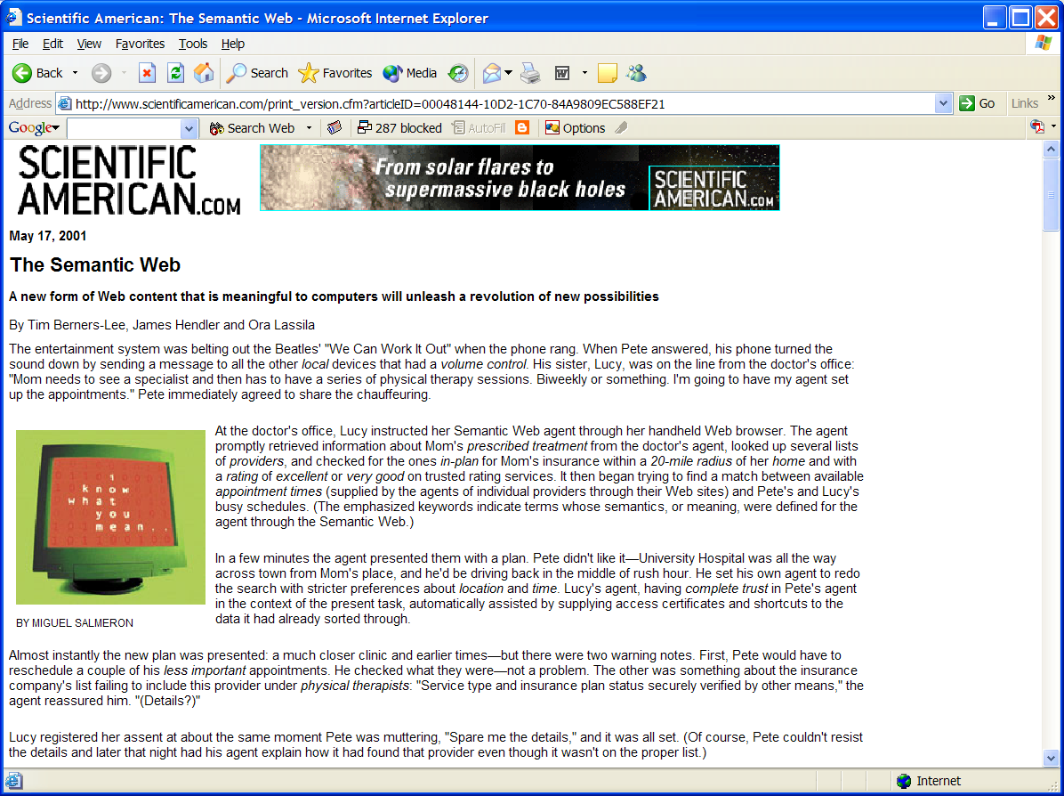

Slide 103
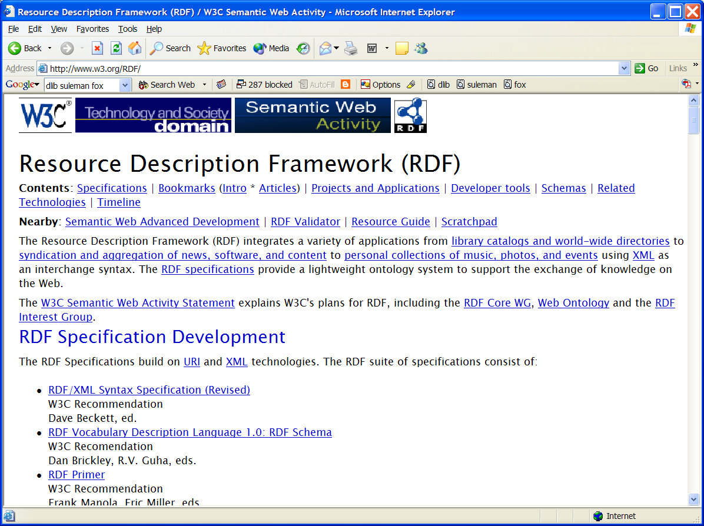

Slide 104
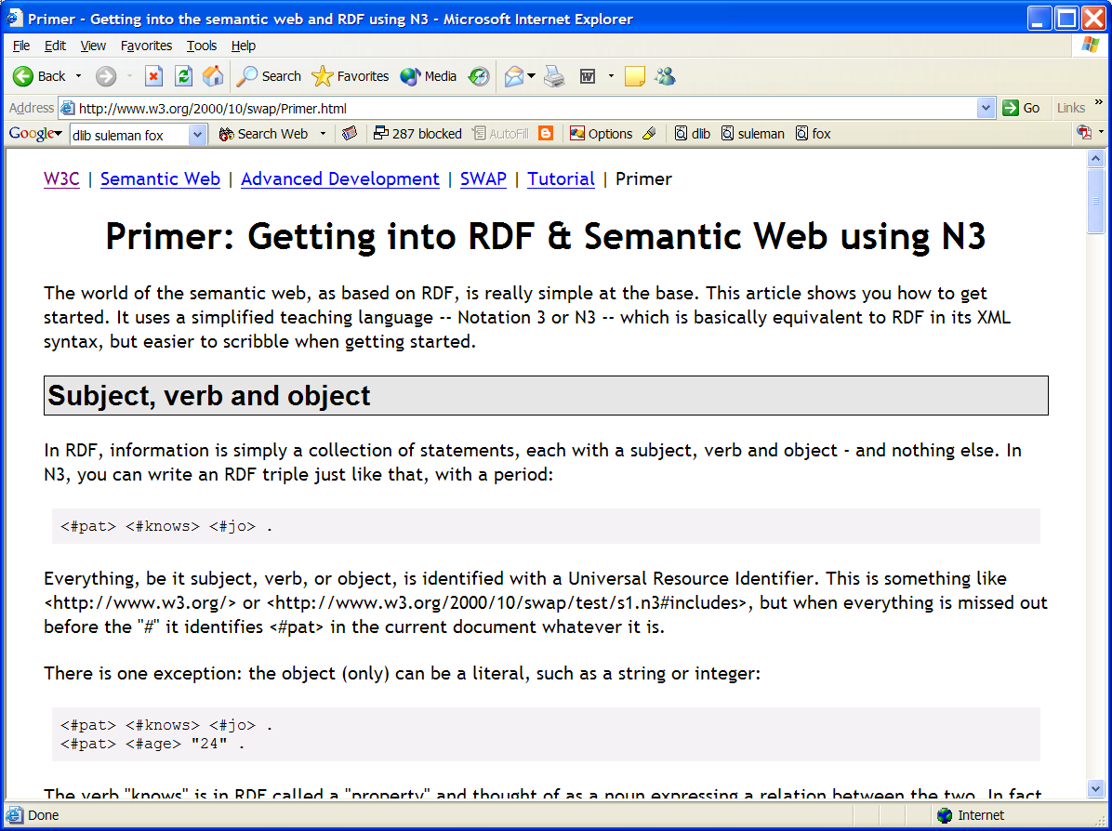

Slide 105
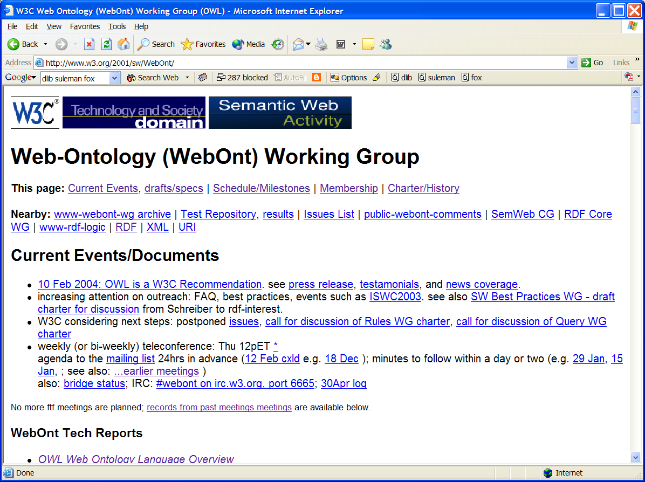

Slide 106
Databases
5S perspective: structures, streams, scenarios
Extending database technology
Structured and unstructured info
Multimedia databases
Link databases
Performance, transaction processing
Replicated storage, rollback/recovery

Slide 107
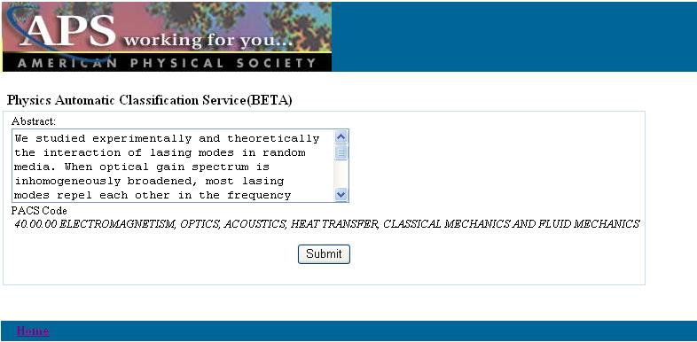
PACS Automatic Classification

Slide 108
Outline
Ch. 1. Introduction (Motivation, Synopsis)
Part 1 – The “Ss”
  Ch. 2: Streams
  Ch. 3: Structures
  Ch. 4: Spaces
  Ch. 5: Scenarios
  Ch. 6: Societies

Slide 109
Chapter 4 Overview
Retrieval models
  Boolean, extended Boolean
  Vector, LSI
  Probabilistic: classical, belief network, inference network, language models
User interfaces and visualization

Slide 110
User interfaces and visualization
2D interfaces
3D interfaces
GIS
Other paradigms
Stepping Stones and Pathways
  http://fox.cs.vt.edu/SSP/

Slide 111
Outline
Ch. 1. Introduction (Motivation, Synopsis)
Part 1 – The “Ss”
  Ch. 2: Streams
  Ch. 3: Structures
  Ch. 4: Spaces
  Ch. 5: Scenarios
  Ch. 6: Societies

Slide 112
Chapter 5 Overview
Recall OO for streams – now have objects as well as scenarios – ex interface components
Information Access
  Searching: ad hoc, filtering/routing
  Browsing: using an organization, using a visualization, using links (i.e., hypertext, hypermedia)
  Workflow: sessions, feedback, etc.
Scenario-based Design
Usability: goals, tasks, claims

Slide 113
Outline
Ch. 1. Introduction (Motivation, Synopsis)
Part 1 – The “Ss”
  Ch. 2: Streams
  Ch. 3: Structures
  Ch. 4: Spaces
  Ch. 5: Scenarios
  Ch. 6: Societies

Slide 114
Chapter 6 Overview
User communities
  Authors, editors, teachers, students, readers
  Personal(ization), group(ware), community, global
  Accessibility, universal access
Librarians: reference, acquisition, operations
Research community
  Associations, conferences, publications, labs, projects
Economics
  Copyright, intellectual property rights, digital rights management, authorization, authentication, security, privacy, self-archiving (eprints)
  Publishers, catalogers, distributors, sustainability
  Open source, commercial, hybrid

Slide 115
Outline – Part 2
Part 2 – Higher DL Constructs
  Ch. 7: Collections
  Ch. 8: Catalogs
  Ch. 9: Repositories and Archives
  Ch. 10: Services
  Ch. 11: Systems
  Ch. 12: Case Studies

Slide 116
5S and DL formal definitions and compositions (April 2004 TOIS)

Slide 117
Streams
Structures
Spaces
Scenarios
Societies
community
services
user role
structured stream
structural metadata specification
descriptive metadata specification
user model
user
digital object
metadata catalog
hypertext
indexing
searching
browsing
personalization
collection
repository
collaboration
Minimal DL
base document
superimposed document
image stream
feature vector
mark
superimposed structure
image descriptor
composite image descriptor
structured feature vector
subdocument
presentation channel
view in context
image content description
image object
image descriptor metadata catalog
image collection
image digital object
complex object structure
complex object
visualization
CBIR service

Slide 119
Outline – Part 2
Part 2 – Higher DL Constructs
  Ch. 7: Collections
  Ch. 8: Catalogs
  Ch. 9: Repositories and Archives
  Ch. 10: Services
  Ch. 11: Systems
  Ch. 12: Case Studies

Slide 120
Chapter 7 Overview
Terminology: set, “database”
Distributed: basis, efficiency/effectiveness
Parallelism: federation, harvesting
Scale: object size, compression, replication, stream splitting
Intelligence/processing granularity: object, cluster, collection, repository

Slide 121
Outline – Part 2
Part 2 – Higher DL Constructs
  Ch. 7: Collections
  Ch. 8: Catalogs
  Ch. 9: Repositories and Archives
  Ch. 10: Services
  Ch. 11: Systems
  Ch. 12: Case Studies

Slide 122
Chapter 8 Overview
OPACs
Distributed vs. centralized
Coverage, breadth
Specificity, depth
Management: versioning, works

Slide 123
Outline – Part 2
Part 2 – Higher DL Constructs
  Ch. 7: Collections
  Ch. 8: Catalogs
  Ch. 9: Repositories and Archives
  Ch. 10: Services
  Ch. 11: Systems
  Ch. 12: Case Studies

Slide 124
Chapter 9 Overview
Naming, identifiers
Architectures, interoperability
  OAI: harvesting
  SRU/SRW: federation
Preservation, archives
  LOCKSS, UVC, emulation/migration
Scalability, storage

Slide 125
LOCKSS
Lots of copies keep stuff safe
Stanford (Vicky Reich)
Initial focus on lower levels
Initial content: journals
Emory (Martin Halbert)
  Help deploy and adapt
  Help apply in other contexts
    Another registry
    Set of publisher manifests (information providers)
    Set of storage systems (archival storage)
  NDIIP: AmericanSouth, MetaArchive

Slide 126
Digitization and Preservation
Community and Activity (early)
Archivists worldwide
International collaboration
  Million book project in US, China, India (Reddy, Chen, Balakrishnan)
US Library of Congress
  Matching funds
  American Memory
  Infrastructure: NDIIP
Dutch National Library + IBM
Associations: ARL, DLF
People
  Harnad: Self-archiving movement
  Lorie: Universal virtual computer
  Gladney: technology, philosophy (http://home.pacbell.net/hgladney/ddq_3_1.htm)
  Besser, Trant, …

Slide 127
OAI - Open Archives Initiative
Advocacy for interoperability
Standard for transferring metadata among digital libraries
  Protocol for Metadata Harvesting (PMH)
    Simplicity
    Generality
    Extensibility
Support for PMH => Open Archive (OA)

Slide 128
OAI = Technical Umbrella for
Practical Interoperability…
Metadata Harvesting
Reference
Libraries
Museums
Publishers
E-Print
Archives
…that can be exploited by different communities

Slide 129
OAI – Repository Perspective
Required: Protocol
Set Structure
URI Scheme
MDO
MDO
MDO
MDO
Required: DC
MDO
MDO
MDO
MDO
DO
DO
DO
DO

Slide 130
OAI – Black Box Perspective
OA 7
OA 4
OA 2
OA 3
OA 1
OA 6
OA 5

Slide 131
Tiered Model of Interoperability
Mediator services
Metadata harvesting
Document models

Slide 132
The World According to OAI
Service Providers
Discovery
Current
Awareness
Preservation
Metadata
harvesting
Data Providers

Slide 133
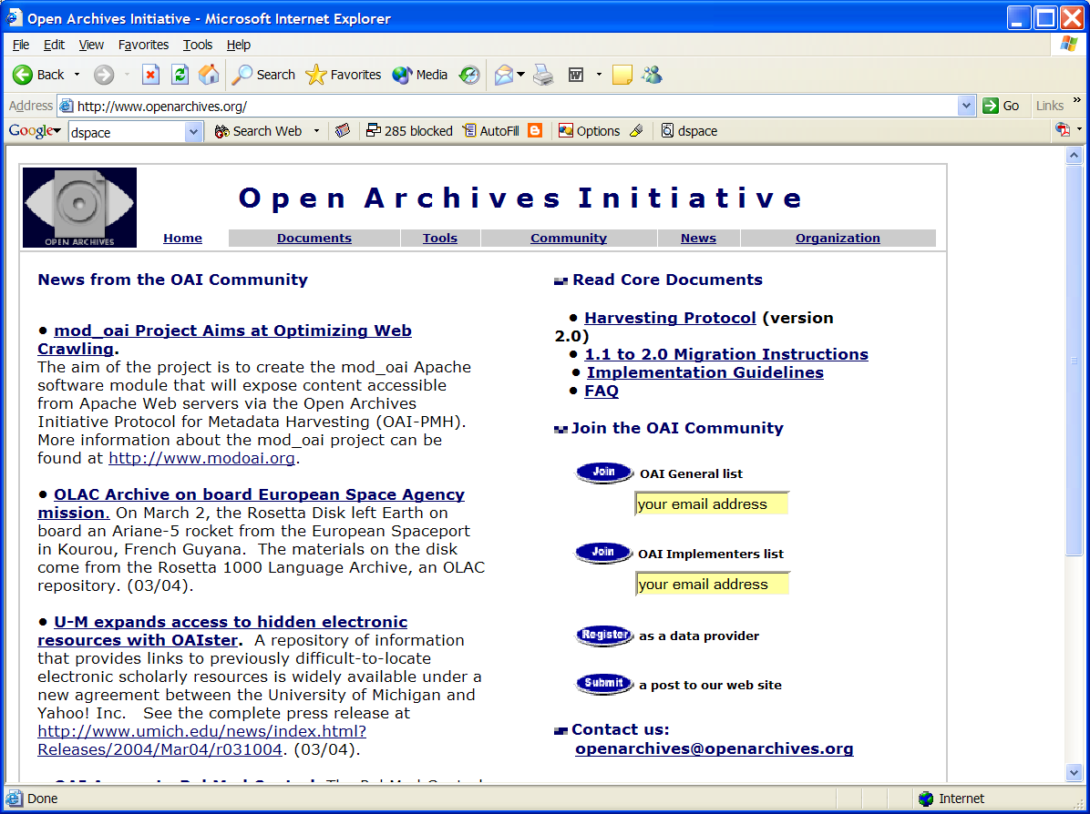

Slide 134
Institutional Repositories - 1
“Institutional repositories are digital collections that capture and preserve the intellectual output of a single university or a multiple institution community of colleges and universities.”
Crow, R. “Institutional repository checklist and resource guide”, SPARC, Washington, D.C., USA
www.arl.org/sparc/IR/IR_Guide_v1.pdf

Slide 135
Institutional Repositories - 2
“A university-based institutional repository is a set of services that a university offers to the members of its community for the management and dissemination of digital materials created by the institution and its community members. It is most essentially an organizational commitment to the stewardship of these digital materials, including long-term preservation where appropriate, as well as organization and access or distribution.”
Lynch, C.A. In ARL Bimonthly Report 226, pp. 1-7, Feb. 2003, www.arl.org/newsltr/226/ir.html

Slide 136
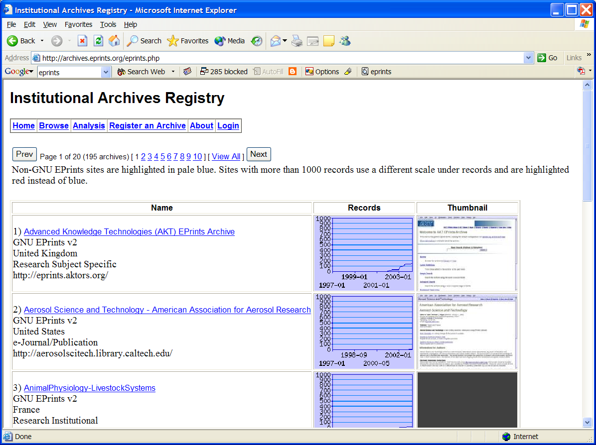

Slide 137
Goals of Institutional Repositories
(by Steven Harnad, U. Southampton)
Self Archiving of Institutional Research
  Thesis and Dissertations (VTLS NDLTD Project)
  Article preprints and post prints
  Internal documents and maps
Management of digital collections
Preservation of materials – decentralized approach
Housing of teaching materials
Electronic Publishing of journals, books, posters, maps, audio, video and other multimedia objects
Adapted from Slide by V. Chachra, VTLS

Slide 138
Outline – Part 2
Part 2 – Higher DL Constructs
  Ch. 7: Collections
  Ch. 8: Catalogs
  Ch. 9: Repositories and Archives
  Ch. 10: Services
  Ch. 11: Systems
  Ch. 12: Case Studies

Slide 139
Chapter 10 Overview
Taxonomy of services
Ontology, composition, reuse
Evaluation
Key services in-depth:
  Crawling, indexing
  Clustering, classifying
  Recommending, using social networks
  Logging

Slide 140
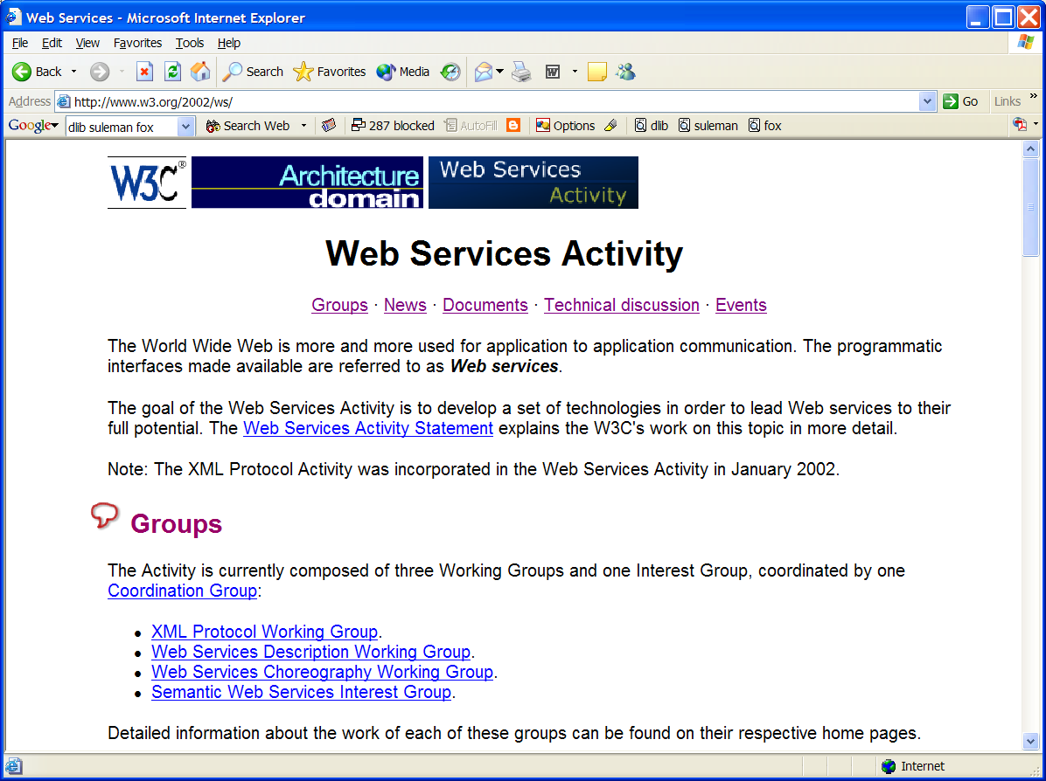

Slide 141
Ontology: Applications
Expand definition of minimal DL by characterizing
  typical DL services
  in the context of “employs” and “produces” relationships
Use characterization to:
  Reason about how DL services can be built from other DL components
  As well as be composed with other services through extension or reuse

Slide 143
Ontology: Applications

Slide 146
XML-based DL Log Standard
Log analysis
  is a source of information on:
    How patrons really use DL services
    How systems behave while supporting user information seeking activities
Used to:
  Evaluate and enhance services
  Guide allocation of resources
Common practice in the web setting
  Supported by web servers, proxy caches
DL Logging can be more detailed

Slide 147
The XML Log Format
Log
Transaction
SessionId
MachineInfo
Timestamp
Statement
Event
SessionInfo
RegisterInfo
Timestamp
Statement
StatusInfo
Action
Search
Browse
Update
StoreSysInfo
SearchBy
QueryString
Collection
Catalog
Timeout
PresentationInfo

Slide 148
Outline – Part 2
Part 2 – Higher DL Constructs
  Ch. 7: Collections
  Ch. 8: Catalogs
  Ch. 9: Repositories and Archives
  Ch. 10: Services
  Ch. 11: Systems
  Ch. 12: Case Studies

Slide 149
Chapter 11 Overview
Architectures
  Client-server, service-oriented
  P2P, Grid
System descriptions and comparisons
  Personal DLs; Institutional to global
  DSpace, Eprints, Fedora, Greenstone, Kepler
ODL
5S Suite: language, visualization, generation, logging

Slide 150
Architectural Issues
Independent system vs. part of federation
Centralized vs. distributed vs. open services
Monolithic vs. modular vs. componentized
Topologies: bus vs. star vs. hierarchical vs. network
Decompositions vary
  search engine, browser, DBMS, MM support
  repository, handle server, client
  information resources + mediators, bus or agent collection + client with workspace/environment

Slide 151


Slide 152


Slide 153

What is Fedora™?
Flexible Extensible Digital Object Repository Architecture
Slides courtesy Vinod Chachra of VTLS

Slide 154
History of Fedora™
1997-Present
  DARPA and NSF-funded research project at Cornell (Conceptual framework developed by Sandra Payette and Carl Lagoze)
  Reference implementation developed at Cornell
1999-2001
  University of Virginia digital library prototype (Thornton Staples and Ross Wayland)
2002-Present
  Andrew W. Mellon Foundation granted Virginia and Cornell $1 million to develop a production-quality Fedora system
  Fedora 1.0 released in May 2003 as Open Source under the Mozilla public license.

Slide 155
Fedora™ Terms
Metadata
Digital Objects (data)
Complex Objects (Object consisting of many objects in a complex/hierarchical relationship)
Content (Data and Metadata together)
Data-streams (are content for dissemination)
Disseminators (are services) – A dissemination is defined as a stream of data that manifests a view of the digital objects content.

Slide 156
Fedora™ Digital Object Architecture
Persistent ID (
PID
)
Globally unique persistent id
Disseminators
Public view: access methods for obtaining “disseminations” of digital object content
Internal view: metadata necessary to manage the object
System
Metadata
Datastreams
Protected view: content that makes up the “basis” of the object
EAD, TEI, DC, MARC,
VRA Core, MIX, etc.
Images, E-books, E-journals, Music, Video, etc.
The Mellon Fedora Project
Adapted from Slide by V. Chachra, VTLS

Slide 157
Fedora™
Repository
Web Service Exposure Layer
Adapted from Slide by V. Chachra, VTLS

Slide 158

VITAL / Fedora Relationship

Slide 159
Other Commercial DL Examples
IBM Digital Library
Virtua (www.vtls.com), VITAL
Some systems from NSF DLI projects
  Google

Slide 160
ODL: Open Digital Library
Document
Program
Document
Program
Document
Program
1010100101010010101010010101010101010101
1010100101010010101010010101010101010101
?
1010100101010010101010010101010101010101
1010100101010010101010010101010101010101
1010100101010010101010010101010101010101
1010100101010010101010010101010101010101
Video
Image
Video
Image
Video
Image
1010100101010010101010010101010101010101
1010100101010010101010010101010101010101
1010100101010010101010010101010101010101
1010100101010010101010010101010101010101
1010100101010010101010010101010101010101
1010100101010010101010010101010101010101
users
digital objects

Slide 161
Monolithic
and/or
Custom-built
web-based
application
?
?
Document
Program
Document
Program
Document
Program
1010100101010010101010010101010101010101
1010100101010010101010010101010101010101
1010100101010010101010010101010101010101
1010100101010010101010010101010101010101
1010100101010010101010010101010101010101
1010100101010010101010010101010101010101
Video
Image
Video
Image
Video
Image
1010100101010010101010010101010101010101
1010100101010010101010010101010101010101
1010100101010010101010010101010101010101
1010100101010010101010010101010101010101
1010100101010010101010010101010101010101
1010100101010010101010010101010101010101
digital library

Slide 162
Document
Document
Document
1010100101010010101010010101010101010101
1010100101010010101010010101010101010101
1010100101010010101010010101010101010101
?
?
?
?
?
?
Program
Program
?
Program
1010100101010010101010010101010101010101
?
1010100101010010101010010101010101010101
?
1010100101010010101010010101010101010101
?
?
?
?
?
?
Image
Image
?
Image
?
1010100101010010101010010101010101010101
1010100101010010101010010101010101010101
?
?
1010100101010010101010010101010101010101
?
?
?
Video
Video
Video
1010100101010010101010010101010101010101
1010100101010010101010010101010101010101
1010100101010010101010010101010101010101
componentized digital library

Slide 163
Document
Document
Document
1010100101010010101010010101010101010101
1010100101010010101010010101010101010101
1010100101010010101010010101010101010101
XPMH
OA
OA
XPMH
OA
PMH
Program
Program
Program
XPMH
1010100101010010101010010101010101010101
OA
1010100101010010101010010101010101010101
XPMH
1010100101010010101010010101010101010101
XPMH
OA
XPMH
OA
XPMH
XPMH
Image
Image
Image
1010100101010010101010010101010101010101
XPMH
1010100101010010101010010101010101010101
OA
OA
1010100101010010101010010101010101010101
XPMH
OA
PMH
XPMH
Video
Video
Video
1010100101010010101010010101010101010101
1010100101010010101010010101010101010101
1010100101010010101010010101010101010101
open digital library

Slide 164
Protocol for
Metadata
Harvesting
Extended OAI-PMH
Open Digital Library Protocol

Slide 165
OPEN
ARCHIVE
Extended OPEN ARCHIVE
Open Digital Library Component

Slide 166
Open Digital Library
Network of Extended Open Archives where each node acts as either a provider of data, services or both.
Component = Node
Protocol = Arc

Slide 167
Open Digital Library Components
Running now
  XML-File (data provider from file system)
  Search: simple or in-memory (Essex) or generalized
  Union, browse, recent, filter
  E-journal/review, Submit, Edit, Annotation
  Recommender, Rating; Mirroring (see JCDL’02)
  Working with NCSA: from DB, unstructured text
Others in process
  Classification/categorization
  Registry (and other connections with web services)

Slide 168
Example Open Digital Library
Document
Document
ETD-1
1010100101010010101010010101010101010101
1010100101010010101010010101010101010101
ODLRecent
1010100101010010101010010101010101010101
USER INTERFACE
Recent
ODLUnion
PMH
Program
Filter
Program
ETD-2
PMH
1010100101010010101010010101010101010101
1010100101010010101010010101010101010101
1010100101010010101010010101010101010101
ODLUnion
Browse
Union
PMH
Image
ODLBrowse
Image
ETD-3
1010100101010010101010010101010101010101
PMH
1010100101010010101010010101010101010101
ODLUnion
1010100101010010101010010101010101010101
Filter
PMH
Search
ODLSearch
Video
Video
ETD-4
1010100101010010101010010101010101010101
1010100101010010101010010101010101010101
1010100101010010101010010101010101010101
ETD DL for the Networked Digital Library of Theses and Dissertations (www.ndltd.org)
Students and
researchers
ETD collections

Slide 169
OAI, ODL, DL-in-a-box
Open Archives Initiative
  since 1999, www.openarchives.org
Open Digital Libraries
  since 2001, from www.dlib.vt.edu
  with Hussein Suleman (now U. Cape Town)
DL-in-a-box
  NSDL support since 2001
  Aimed to help new collections / services projects
  http://dlbox.nudl.org

Slide 170


Slide 171


Slide 172


Slide 173


Slide 174
5S Modeling -> Systems

Slide 175
Tools/Applications

Slide 176
5SL: a DL design language
Domain specific languages
  Address a particular class of problems by offering specific abstractions and notations for the domain at hand
  Advantages: domain-specific analysis, program management, visualization, testing, maintenance, modeling, and rapid prototyping.
XML-based realization of 5S
  Interoperability
  Use of many sub-languages (e.g., MIME types, XML Schemas, UML notations)

Slide 177
5SL – The Minimal DL Metamodel

Slide 178
Example of
Document
declaration in the
Structures Model
Example of Actors
declaration in the
Societies Model
Example of Service
declaration in the
Scenario Model
<Society>
<Actor>
<Community name='Patron‘/>
<Attribute name='name‘
type='String'/>
<Attribute name='ID‘
type='Integer'/>
</Community>
<Community name='Student'>
<Service>Converting</Service>
</Community>
<Community name='ETDReviewer'>
<Service>Reviewing</Service>
</Community>
<Community name='ETDCataloguer'>
<Service>Cataloguing</Service>
</Community>
</Actor>
………
<SERVICE name ='Searching'>
<SCENARIO name='SimpleSearching'>
<NOTE>Simple scenario for an NDLTD
site searching service</NOTE>
<EVENT>
<SENDER>Patron</SENDER>
<RECEIVER>InterfaceManager</RECEIVER>
<OPERATION name=SearchCriteria/>
<PARAMETER>collection</PARAMETER>
<PARAMETER>query</PARAMETER>
</EVENT>
<EVENT>
<SENDER>InterfaceManager</SENDER>
<RECEIVER>SearchManager</RECEIVER>
<OPERATION name='Search'/>
<PARAMETER>collection</PARAMETER>
<PARAMETER>query</PARAMETER>
</EVENT>
<EVENT>
<SENDER>SearchManager</SENDER>
<RECEIVER>InterfaceManager</RECEIVER>
<PARAMETER name='Results'>WtdSet
</PARAMETER>
</EVENT> ….
<document name=`ETD'>
<stream_enumeration>
<stream
value=`ETDText'>
<stream
value=`ETDAudio'>
...
</stream_enumeration>
<structured_stream>
%XMLSchema%
<structured_stream>
</document>

Slide 179
5SGraph: A DL Modeling Tool
Help users model their own instances of a digital library (DL) in the 5S language (5SL).
A simple modeling process which enables rapid generation of digital libraries
Features
  5SGraph loads and displays a metamodel in a structured toolbox.
  The structured editor of 5SGraph provides a top-down visual building environment for the DL designer.
  5SGraph produces syntactically correct 5SL files according to the visual model built by the designer.

Slide 180

Overview of 5SGraph
Workspace
(instance model)
Structured
toolbox
(metamodel)

Slide 183


Slide 184


Slide 185
5SGraph Evaluation: Usability Study

Slide 186
5SGen
Version 1 -- MARIAN as the target system
  Focused on rich structures: semantic networks
  Behavior attached to nodes/links
Version 2 -- Shifted for later work to componentized (ODL) approach
  Focused on scenarios/societies
  Structures/Spaces encapsulated within components (e.g., relational tables, indexes)
  Only textual streams supported
Version 3 – Practical DL (w. DSpace) – Doug Gorton

Slide 187
5SLGen – Version 2: ODL, Services, Scenarios

Slide 188
5SLGen
Proof of Concept: prototyping
  CITIDEL
  Viaduct
  NDLTD Union Catalog
  BDBComp

Slide 189
Outline – Part 2
Part 2 – Higher DL Constructs
  Ch. 7: Collections
  Ch. 8: Catalogs
  Ch. 9: Repositories and Archives
  Ch. 10: Services
  Ch. 11: Systems
  Ch. 12: Case Studies

Slide 190
CS Teaching Center (CSTC)
Instead of building large, expensive multimedia packages, that become obsolete and are difficult to re-use, concentrate on small knowledge units.
Learners benefit from having well-crafted modules that have been reviewed and tested.
Use digital libraries to build a powerful base of support for learners, upon which a variety of courses, self-study tutorials & reference resources can be built.
ACM support led to Journal of Educational Resources in Computing (JERIC), accessible from www.cstc.org
Notes:
3
3

Slide 191
Computing and Information Technology Interactive Digital Educational Library (CITIDEL)
Domain: computing / information technology
Genre: one-stop-shopping for teachers & learners: courseware (CSTC, JERIC), leading DLs (ACM, IEEE-CS, DB&LP, CiteSeer), PlanetMath.org, NCSTRL (technical reports), …
Submission & Collection: sub/partner collections ➔ www.citidel.org

Slide 192
www.CITIDEL.org
Led by Virginia Tech, with co-PIs:
  Fox (director, DL systems)
  Lee (history)
  Perez (user interface, Spanish support)
Partners
  College of New Jersey (Knox)
  Hofstra (Impagliazzo)
  Villanova (Cassel) – taken over
  Penn State (Giles)
Notes:
3
3

Slide 193
Multi-dimensional Categorization

Slide 194
Digital library architecture for local
and interoperable CITIDEL services

Slide 195


CITIDEL: Computing & Information Technology Interactive Digital Education Library

Slide 196


Slide 197
CITIDEL Technology Features
Component architecture (Open Digital Library)
  Re-use and compose re-deployable digital library components.
Built Using Open Standards & Technologies
  OAI: Used to collect DL Resources and DL Interoperability
  XSL and XML: Interface rendering with multi-lingual community based translation of screens and content (Spanish, …)
  Perl: Component Integration
  ESSEX: Search Engine Functionality
    Very fast, utilizing in-memory processing
    Includes snap-shots for persistence
Multi-scheming
  Integrates multiple classifications / views through maps, closure

Slide 198


Slide 199

Cluster NDLTD-Computing

Slide 200

CITIDEL + PIPE
Adds Interaction Personalization to CITIDEL
Automatically handles multi-modal conversion to Cell phone, PDA, Etc.
Can be adopted to any digital data set, only requires XML file of content with hierarchy maintained.

Slide 201
CITIDEL -> NSDL
A collection project in the
National STEM (science, technolgy, engineering, and mathematics) education Digital Library – NSDL
National Science Digital Library
www.nsdl.org
(Next slides courtesy Lee Zia, NSF)
Notes:
3
3

Slide 202
Connects:
Users: students, educators, life-long learners
Content: structured learning materials; large real-time or archived datasets; audio, images, animations; primary sources; digital learning objects (e.g. applets); interactive (virtual, remote) laboratories; ...
Tools: search; refer; validate; integrate; create; customize; publish; share; notify; collaborate; ...

Slide 203
Collections
Discovery of content
Classification and cataloguing
Acquisition and/or linking; referencing
Disciplinary-based themes define a natural body of content, but other possibilities are also encouraged
Access to massive real-time or archived datasets
Software tool suites for analysis, modeling, simulation, or visualization
Reviewed commentary on learning materials and pedagogy

Slide 204
Services
Help services, frequently asked questions, etc.
Synchronous/asynchronous collaborative learning environments using shared resources
Mechanisms for building personal annotated digital information spaces
Reliability testing for applets or other digital learning objects
Audio, image, and video search capability
Metadata system translation
Community feedback mechanisms

Slide 205


Slide 206


Slide 207
NSDL Information Architecture
Essentially as developed by the Technical Infrastructure Workgroup
Portals &
Clients
Portals &
Clients
User Interfaces
Portals &
Clients
NSDL
Services
NSDL
Services
Other NSDL
Services
NSDL
Collections
Core
NSDL
“Bus”
NSDL
Collections
NSDL
Collections
Usage Enhancement
Collection
Building
Core Services:
information retrieval
CI Services
browsing
CI Services
authentication
referenced
items &
collections
Core Services:
metadata gathering
CI Services
personalization
referenced
items &
collections
Special
Databases
Core Collection-
Building Services
protocols
CI Services
discussion
Core Collection-
Building Services
harvesting
CI Services
annotation

Slide 208
Digital Libraries in Education
Analytical Survey, ed. Leonid Kalinichenko
© 2003, www.iite-unesco.org, info@iite.ru
Transforming the Way to Learn
DLs of Educational Resources & Services
Integrated/Virtual Learning Environment
Educational Metadata
Current DLEs: US (NSDL, DLESE, CITIDEL, NDLTD), Europe (Scholnet, Cyclades), UK (Distributed National Electronic Resource)

Slide 209
DLEs: Guiding Principles (p. 12)
Driven by educational and science needs
Facilitating educational innovation
Stable, reliable, permanent
Accessible to all
Leverage prior research: DL, courseware, …
Adaptable to new technologies
Supporting decentralized services
Resource integration thru tools/organization

Slide 210

Ensemble Portal
Edward A. Fox, Yinlin Chen, Monika Akbar
Virginia Tech
www.computingportal.org

Slide 211













The Ensemble Computing Portal
Many-to-Many Information Connections in a Distributed Digital Library Portal
Collections
Communities
ACM
CS1
FOCES
TECH Developers
Ensemble
LIKES
AP CS
Services
Search
Distributed DL Portal
Forum
Group
Blog
Browse
Notification
Tools
A collaborative research project to build a distributed portal with up-to-date contents for all computing communities.
http://www.computingportal.org/

Slide 212

Ensemble Portal Architecture

Slide 213


Ensemble in Second Life
http://slurl.com/secondlife/Educators%20Coop%204/66/236/28
The Ensemble Pavilion offers:
• teleports to other computing sites in Second Life like the Digital Preserve
• hyperlinks to related computing websites
• RSS readers with feeds from computing and computing education blogs
• membership in the Ensemble Computing group in Second Life, Facebook, and Twitter

Slide 214






Selected Digital Preserve Personnel
Gary Octagon
Gary Marchionini
EdFox Rieko
Edward Fox
zamfir Paule
Spencer Lee
Uma Aldrin
Uma Murthy
Krad Proto
Seungwon Yang
mantruc Martian
Javier Velasco-Martin

Slide 215


DP areas
Poster Building
18 posters on display
Poster view tips
Video screen
Cafe
Beverages
Screens
Discussion areas

Slide 216
A Digital Library Case Study
Domain: graduate education, research
Genre:ETDs=electronic theses & dissertations
Submission: http://etd.vt.edu
Collection: http://www.theses.org
Project:
Networked Digital
Library of Theses
& Dissertations
(NDLTD)
http://www.ndltd.org

Slide 217
NDLTD: How can a university get involved?
Select planning/implementation team
  Graduate School
  Library
  Computing / Information Technology
  Institutional Research / Educ. Tech.
Join online, give us contact names
  www.ndltd.org/join
Adapt Virginia Tech or other proven approach
  Build interest and consensus
  Start trial / allow optional submission
Notes:
22
17
16
17
17

Slide 218
Student Gets Committee
Signatures and Submits ETD
Approval
form
Signed
Grad School
Notes:
10

Slide 219
Library Catalogs ETD, Access is
Opened to the New Research
WWW
NDLTD
Digital library access control
Notes:
12

Slide 220



http://scholar.lib.vt.edu/theses/available/etd-2227102539751141/
Notes:
http://scholar.lib.vt.edu/theses/available/etd-2227102539751141/
What is an ETD? What it can look like:
It can have the appearance of a paper document.
It can contain a video clip.
It can contain sound.
It can contain thumbnail pages and links to aid navigation.
It can have a unique layout.
It can have photomicrographs.
It can contain a simulation.
The library resources used in an ETD initiative can include

Slide 221
Union catalog: OCLC
OCLC will expand OAI data provider on TDs.
Is getting data from WorldCat (so, from many sites!).
Will harvest from all others who contact them.
Need DC and either ETD-MS or MARC.
Has a set for ETDs.

Slide 222


Slide 223


Slide 224


Slide 225
OCLC SRU Interface

Slide 226


Slide 227

VTLS Visualizer Service with NDLTD Union Catalog

Slide 228


Slide 229
ETDs: Library Goals
Improve library services
  Better turn-around time
  Always available
Reduce work
  catalog from e-text
  eliminate handling: mailing to ProQuest, bindery prep, check-out, check-in, reshelving, etc.
Save space
Notes:
ETDs give libraries an avenue to demonstrate Information Age goals

Slide 230
Why ETD? Short Answer
For Students:
  Gain knowledge and skills for the Information Age
  Richer communication (digital information, multimedia, …)
For Universities:
  Easy way to enter the digital library field and benefit thereby
For the World:
  Global digital library – large, useful, many services
General:
  Save time and money
  Increased visibility for all associated with research results

Slide 231

HTML5 Structuring Flowchart
HTML5
tag set
TXT/ HTML
ETD
structure
analyzer
Tagged TXT
PDFETD
Text/ Grammar
PDF2Text/HTML converter
HTML5
Converter
Multimedia file link extractor
Tagged TXT
HTML5ETD
TXT/ HTML
Tagged MM Source
HTML
Multimedia file source extractor

Slide 232
ETD Classification:
Algorithm Pipeline
ETDs categorized into a node of the category tree (after classification)
Category
Tree
ETD Collection
Category label for each node used as query
ETD metadata used for categorization
Categorized
ETDs
Google
Naïve Bayes Classifiers
Level-wise categorization
Top 50 webpages (for each node in the tree)
Training
Browsing
Web
Interface
Document
Sets
Training
Sets
Cleanup
(stemming,
stopword removal,
etc.)

Slide 233

Gigapixel
5 x 10 monitors
All pages shown, grouped by chapter
A handheld device to move pages
Notepad, Post-It on a rolling desk
Notes:
All the pages of a thesis were shown on a Gigapixel display, which consisted of 5 x 10 monitors (vertical x horizontal).
Pages were grouped by the chapter.
A handheld device was used to move pages like a mouse.
Participants had access to a notepad and Post-it notes on a rolling desk.

Slide 234
Scholarship
Humans/
Humanities
DL curriculum
Ensemble
Living In the KnowlEdge
Society (LIKES): Book,
Part on Humanities
Needs
Areas
Approach
Supporting
Scholarship
About Humans
Through
Content &
Services
Content
Services
Digitized
ETDs
Born digital
(digital
natives)
DLs:
CTRnet
Ensemble
ETANA
NDLTD
Flattening
(cooperation,
collaboration)
Exploring
(search, browse)
Interoperability
Integration

Slide 235

Crisis, Tragedy, and Recovery
Human tragedies that result from man-made and natural events affect humans and communities significantly.
During and after a tragic event, there are a series of needs that have to be addressed.
  Compounded by communication failures and a confusing plethora of data and information

Slide 236

Build a networked digital library relating to CTR
www.citeulike.org group ctrnet
Citations
Papers, …
Integrate community, content, and services relating to CTR, making it accessible, and preserving it for long-term reuse
Support information exploration
Aided by an ontology
www.ctrnet.net

Slide 237

CTR stakeholders
Notes:
Help affected communities to recover more quickly and effectively
Provide global network with relevant information and resources
Support the research community, emergency personnel, decision makers, and the public in reacting to and recovering from crises

Slide 238

Haiti Photographs, Content Based Image Retrieval Evaluation

Slide 239
CTR Ontology
An ontology is
  Collection of words and phrases
  Graph of relationships, sometimes mostly hierarchical as in a taxonomy
  Covering the key concepts and terms in the discipline
  Supporting differing views on the field
Purposes
  Describes documents
    As tags, descriptors, keywords
  Supports navigation, learning, and research

Slide 240





Goals for Ontology for CTR
CTR literature
Browsing
sources
Searching
  Query
  expansion
Focus groups
CTR Ontology
Individual
Organizational
Community
Political
…
Tagging
Websites,
Internet Archive
Recommending
Social network
applications
Summarizing
uses
Multicultural/ linguistic input
Visualizing

Slide 241

Categories from focus group study
Results from focus group interviews following the April 16, 2007 tragedy at Virginia Tech

Slide 242
CTR keyword pairs
Extracted top keyword pairs from ISCRAM proceedings using the N-gram statistics package
emergency response | decision support | information systems | teams participants
decision making | data models | disaster monitoring | teams maps
command teams | disaster plan | crisis management | sms text-message
flood alerts | information seeking | situational awareness | disaster registry
physical communication | human disaster | teams access | decision preference
Notes:
International Conference on Information Systems for Crisis Response and Management

Slide 243
Preliminary Web Data Analysis
Revise seeds if poor preliminary data
Crawl
Index Data
Index crawl data from Heritrix
Use NutchWax to preliminarily analyze seed quality
Pass Along
Collect Seeds
Send ARC files on for Story-telling

Slide 244
Data Cleaning, Extracting, Filtering, Storytelling
Classifying
Related files
Storytelling
Stories
Visualizing
Graph of stories
Analyzing
results
Goal: Discover relationships between tragic events.
  Examples: Shooting, study pressure, and mental disorders
formatting
Start and end docs

Slide 245
Hypothesis of school shooting
Immigration
Socially Different
Victim of Bullying
Isolation
Psychological Impact
School Impact
Out come
Keywords
Migration Geographical movement
Relocation
Keywords
Social Outsider
Social Stranger
Keywords
Homophobia Gay Taunts
Keywords
Rejection Seclusion
Keywords
Depression Frustration Anxiety Anger Aggression Stress Loneliness Low Self-esteem
Keywords
Truancy Poor Academic Performance
Low Grades School Drop-out
E.g., Any relations between
Violence and Migration?
Male
Female
Keywords
Delinquency Violence Fighting Masculinity Assault School Shooting
Keywords
Suicide Ideation Suicide Attempt Suicide

Slide 246
Outline – Part 3
Part 3 – Advanced Topics
  Ch. 13: Quality
  Ch. 14: Integration
  Ch. 15: How to build a digital library
  Ch. 16: Research Challenges, Future Perspectives
Appendix
  A: Mathematical preliminaries
  B: Formal Definitions: Ss
  C: Formal Definitions: DL terms, Minimal DL
  D: Formal Definitions: Archeological DL
  E: Glossary of terms, mappings

Slide 247
Chapter 13 Overview
Information life cycle
Dimensions, Indicators
Definitions
Examples
Evaluation

Slide 248
Describing Quality in
Digital Libraries
What’s a “good” digital Library?
  Central Concept: Quality!
  Hypotheses of this work:
    Formal theory can help to define “what’s a good digital library” by:
    New formalizations of quality indicators for DLs within our 5S framework
    Contextualizing these measures within the Information Life Cycle

Slide 249
Quality Dimensions

Slide 250
Digital Objects: Accessibility
A digital object is accessible by an DL actor or patron, if
it exists in the DL collections
is retrievable from the repository
it is not restricted from access
  by metadata on rights
  For actor or actor’s society

Slide 251
Digital Objects: Pertinence
Inf(do_{i}) = information carried by a digital object or any of its descriptions
IN(ac_{j}) = information need of an actor
Context_{jk} = an amalgam of societal factors which can impact the judgment of pertinence by ac_{j} at time k.
  Factors include time, place, the actor's history of interaction, task in hand, and factors implicit in the interaction and ambient environment.

Slide 252
Digital Objects: Pertinence
The pertinence of a digital object to a user ac_{j} is an indicator function Pertinence(do_{i}, ac_{j}): Inf(do_{i}) × IN(ac_{j}) × Context_{jk} defined as:
  1, if Inf(do_{i}) is judged by ac_{j} to be informative with regards to IN(ac_{j}) in context Context_{jk};
  0, otherwise

Slide 253
Metadata Specifications and Metadata Format: Completeness
Refers to the degree to which values are present in the description, according to a metadata standard. As far as an individual property is concerned, only two situations are possible: either a value is assigned to the property in question, or not.
Completeness(ms_{x}) = 1 - (no. of missing attributes in ms_{x}/ total attributes of the schema to which ms_{x} conforms)

Slide 254
Metadata Specifications and Metadata Format: Completeness
OCLC NDLTD Union catalog

Slide 255
Services: Efficiency / Effectiveness
Effectiveness
  Very common measures: Precision, Recall, F1, 10-precision, R-Precision
  Other services may have different measures: e.g., Recommending, etc.
Efficiency
  let t(e) be the time of an event e
  let e_{ix} and e_{fx} be the initial and the final event of service se_{x} .
  For service se_{x}, efficiency is defined as:
    Efficiency(se_{x}) = t(e_{fx}) - t(e_{ix})

Slide 256
Quality and the Information Life Cycle

Slide 257
Quality Model: Evaluation
Focus groups
  3 librarians
  Major points
    Focus on DLs not traditional libraries
    Some indicators may have more theoretical than practical use in some contexts
    Liked minimalist approach
    Interesting and potentially useful mainly for education and evaluation

Slide 258
Exercise 2
Re-form into former groups of 2.
Recall the digital library you selected earlier.
Select the most important measures of quality for that digital library (from those discussed or others you feel are needed).
Work out the details of an evaluation using those measures.
Present a summary to the class and lead a discussion.

Slide 259
Outline – Part 3
Part 3 – Advanced Topics
  Ch. 13: Quality
  Ch. 14: Integration
  Ch. 15: How to build a digital library
  Ch. 16: Research Challenges, Future Perspectives
Appendix
  A: Mathematical preliminaries
  B: Formal Definitions: Ss
  C: Formal Definitions: DL terms, Minimal DL
  D: Formal Definitions: Archeological DL
  E: Glossary of terms, mappings

Slide 260
DL Integration
What is “DL Integration”
  Hide distribution
  Hide heterogeneity
  Enable autonomy of individual component
Why Integration
  island-DLs
  inability to seamlessly and transparently access knowledge across DLs
Utilize various autonomous DLs in concert

Slide 261
Integration: Rationale
We can read any paper book (ignoring limitations of language, vision, …).
Scholarship requires access, analysis, and synthesis spanning disciplines and sources.
New theories, systems, and services build upon our past accomplishments.
Our “Small World” and the “Internet Age” demand that we, and our computers, work together and interoperate.

Slide 262
Integration: Urgency, Longevity
If we collect, capture, acquire, or produce information, will it be usable in 100 years?
NSF Digital Archiving Program
Library of Congress National Digital Information Infrastructure and Preservation Program

Slide 263
Integration: Challenges
“Semantic Web” is vision, not reality.
How can we integrate without a theory?
How can we interoperate without a common framework?
How can we have a science of DLs if we lack agreement on definitions (so we can reason and discuss) and measures of quality (so we can compare and improve)?

Slide 264
Hypothesis and Research Questions
The 5S framework provides effective solutions to DL integration.
  Formally define the DL integration problem?
  Guide integration of domain focused DLs?
    How to formally model such domain specific DLs?
    How to integrate formally defined DL models into a union DL model?
    How to use the union DL model to help design and implement high quality integrated DLs?
  Assess the integration?

Slide 265
Related Work
DL interoperability approach
Consists of
Intermediary-based
mapping-based
Interrelated with
use
use
mediator
wrapper
agent
schema mapping
used in
use
two architectures
hybrid mapper
composite mapper
Consists of
has an example
has an example
federation
Union Archiving
SemInt
LSD

Slide 266
DL integration formalization
based on
DL interoperability approach
Consists of
Intermediary-based
mapping-based
Interrelated with
use
use
mediator
wrapper
agent
schema mapping
used in
use
two architectures
hybrid mapper
composite mapper
Consists of
trained by
federation
Union Archiving
GA

Slide 267
Formal Definition of DL Integration
DL_{i}=(R_{i}, DM_{i}, Serv_{i}, Soc_{i}), 1 i n
  R_{i} is a network accessible repository
  DM_{i} is a set of metadata catalogs for all collections
  Serv_{i} is a set of services
  Soc_{i} is a society
UnionRep
UnionCat
UnionServices
UnionSociety

Slide 268
Formal Definition of DL Integration (Cont.)
DL integration problem definition:
Given n individual libraries, integrate the n DLs to create a UnionDL.

Slide 269
Union Catalog Quality Measurement
Complete
  All the catalogs to be integrated are complete.
Consistent
  All the catalogs to be integrated are consistent.
  Each descriptive metadata specification in the union catalog describes only one digital object.

Slide 270
Architecture of a Union DL
DL1
Union DL
DL2
Union Society
Society
☺ ☺ ☺ ☺
Society
☺ ☺
☺ ☺
archaeologists
Archaeologists
General Public
General Public
Union Service
Service
Service
Searching
Harvesting, Mapping,
Searching, Browsing,
Clustering, Visualization
Browsing
Catalog1
Union
Catalog
Catalog2
Union
Repository
Repository1
Repository2

Slide 271

Example of Union Service: CitiViz

Slide 272
Integration of Domain Focused DLs
Union archaeological metadata catalog generation
Modeling archaeological DLs (ArchDLs) in the 5S framework
ArchDL integration case study:
ETANA-DL

Slide 273
Union Catalog Integration
Mapping
Tool
Virtual Nimrin
(VN)
VN Metadata
Format
Union ArchDL
Union
Catalog
VN
Catalog
Wrapper
Global Metadata
Format
Halif DigMaster
(HD)
HD
Catalog
Wrapper
HD Metadata
Format
Mapping
Tool

Slide 274
ETANA-DL Schema Design
Owner
Locus
Partition
Collection
ETANA-DL
Object
Subpartition
ID
Container
Bone
Seed
Figurine
……
Animal
Name
Dimensions
Count
Species
Description
……
……
……

Slide 275
Visual Mapping Tool Architecture
Visualizing Components
Composite Mapper
Mapper1
Mapper2
Mapper3
Mapper4

Slide 276

Data Mapping (state-of-the-art)

Slide 277

local schema
global schema
Notes:
To invoke the mapping tool:
Double click the “run.bat” under the fold “schemamapper” which is extracted from schemapper.zip
File→ Open: “cemetery.xsd” under the fold “schemamapper” which is extracted from schemapper.zip
a local schema will display on the left
File→ Open: “etana1.1..xsd” under the fold “schemamapper” which is extracted from schemapper.zip
a global schema will display on the right

Slide 278

Mapping recommendation
Notes:
1. left click element “Collection” on the local schema, then the tool will recommend a mapped element displayed in different color (orange?) on the global schema

Slide 279

Mapping confirmation
Mapping history
Notes:
left click the suggested element on the global schema to confirm the mapping, then two mapped elements will display in the same color (pink?)
A mapping history will display at the bottom of the window
remove mapping: you can right click the element on the local schema, right click then click “Removing Mapping”

Slide 280
Modeling ArchDLs in the 5S Framework
Modeling archaeological information systems using the 5S theory to better understand the domain and design the system and the supported services
Minimal DL
Minimal ArchDL

Slide 281
A Minimal DL in the 5S Framework
Streams
Structures
Spaces
Scenarios
Societies
Structured Stream
Structural Metadata Specification
services
Descriptive Metadata Specification
indexing
browsing
searching
hypertext
Digital Object
Metadata Catalog
Collection
Repository
Minimal DL

Slide 282
A Minimal ArchDL in the 5S Framework
Streams
Structures
Spaces
Scenarios
Societies
Descriptive Metadata specification
Structured Stream
services
SpaTemOrg
StraDia
Arch Descriptive Metadata specification
indexing
browsing
searching
ArchObj
hypertext
ArchDO
Arch Metadata catalog
ArchColl
ArchDColl
ArchDR
Minimal ArchDL

Slide 283
Requirements (1)
Analysis (2)
5S
DL
Meta
5SGraph
Designer
DL
Model
Expert
Practitioner
5SL
Teacher
DL
Model
c
omponent
pool
Design (3)
ODLSearch,
Researcher
ODLBrowse,
Tailored
ODLRate,
5SLGen
DL
ODLReview,
…….
Services
Implementation (4)
5SSuite
5SGraph
5SGen
Mapping Tool

Slide 284
ArchDL Expert
5S Archaeology
MetaModel
ArchDL Designer
5SGraph
VN Metadata Format
HD Metadata Format
Scenario
Sub-model
ETANA-DL Metadata Format
ETANA-DL
Union Services
Descriptions
Harvesting
Mapping
Searching
Browsing
…
VN
Catalog
HD
Catalog
Mapping Tool
Wrapper4VN
Wrapper4HD
Structure
Sub-model
Inverted Files
XOAI
Search
Service
Web Interface
Index
Union
Catalog
Browse DB
Index
Browse
Service
Component
Pool
5SGen
Services DB
Other
ETANA-DL
Services
Browsing
XOAI
…

Slide 285
Outline – Part 3
Part 3 – Advanced Topics
  Ch. 13: Quality
  Ch. 14: Integration
  Ch. 15: How to build a digital library
  Ch. 16: Research Challenges, Future Perspectives
Appendix
  A: Mathematical preliminaries
  B: Formal Definitions: Ss
  C: Formal Definitions: DL terms, Minimal DL
  D: Formal Definitions: Archeological DL
  E: Glossary of terms, mappings

Slide 286
Chapter 15 Overview
  Requirements gathering
  Modeling with 5S-based approach
  Identifying good fit among existing systems or toolkits
  Adapting an existing DL to fit new needs
  Construction of new system from toolkit
  Domain specific enhancement

Slide 287
Chapter 16 Overview
Future direction workshops
Challenges

Slide 288


Slide 289


Slide 290


Slide 291
As data, information, and knowledge play increasingly central roles … digital library research should focus on:
Increasing the scope and scale of information resources and services;
Employing context at the individual, community, and societal levels to improve performance;
Developing algorithms and strategies for transforming data into actionable information;
Demonstrating the integration of information spaces into everyday life; and
Improving availability, accessibility, and, thereby, productivity.

Slide 292
An appropriate infrastructure program will provide sustainability of digital knowledge resources among five dimensions:
Acquisition of new information resources;
Effective access mechanisms that span media type, mode, and language;
Facilities to leverage the utilization of humankind’s knowledge resources;
Assured stewardship over humanity’s scholarly and cultural legacy; and
Efficient and accountable management of systems, services, and resources.

Slide 293
Conclusions
We have answered the almost 40-year-old challenge of Licklider to build a unified CS / LIS theory by
  Proposing and formalizing the first comprehensive formal framework for digital libraries
Showed how to move from theory to practice by
  Applying the framework to the problems of
  Materializing these application into languages, tools, formats, etc.
  Explaining and evaluating these applications (usability studies, focus groups, prototyping, etc.)
But see also lots of other related works!
(e.g., DELOS Reference Model, DL.org)

Slide 294

Digital Library Reference Model 1.0 p. 30 of 234

Slide 295

Digital Library Reference Model 1.0 p. 35 of 234

Slide 296

Digital Library Reference Model 1.0 p. 38 of 234

Slide 297

Digital Library Reference Model 1.0 p. 51 of 234

Slide 298
Questions?
Discussion?
Thank You!

