Slide 1
HTML5 ETDs
Edward A. Fox, Sung Hee Park, Nicholas Lynberg, Jesse Racer, Phil McElmurray
Digital Library Research Laboratory
Virginia Tech
ETD 2010, June 16-18, Austin, TX

Slide 2
Contents
Introduction
Background
Algorithm & Implementation
Discussion
Conclusion

Slide 3
Introduction
Computing & Technological Environment Changes
  Emerging Mobile Web
  HTML5 standard for mobile web
    the latest revision of HTML
    reduces the need for proprietary plug-in technologies (e.g., Adobe Flash and Microsoft Silverlight)
Preservation in DL
  Long-Term Preservation via Archiving
  Migration For Better Access to Mobile Web

Slide 4
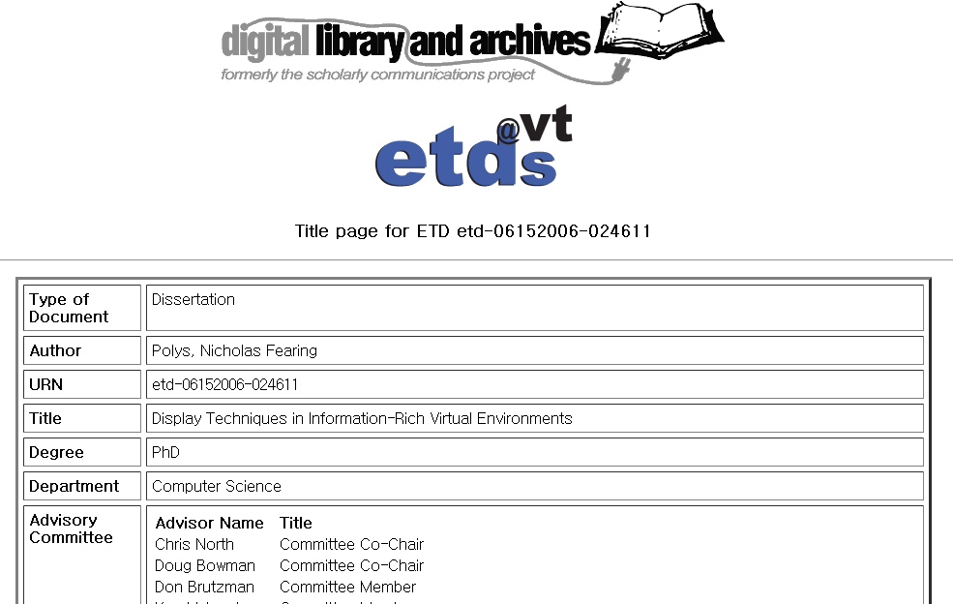
An Example of ETD Title Page

Slide 5
ETD “Splash” Page
ETD
Metadata
Type of Document
Author
…
Metadata
Files*
Filename
Size
Approximate Download Time
288 Modem
…
Metadata

Slide 6
Identifying links among files
Afront.pdf
…
Ch1.pdf
Ch1.pdf
…
Ch2.pdf
Ch3_result.mp3
Ch4.pdf
Linking
Files
Afront.pdf
Ch3.pdf
Refs.pdf
Ch4.pdf
Ch4_result.avi
Ch3_result.mp3
refs.pdf
Ch4_result.avi

Slide 7
Issues for migration strategy
How is conversion to HTML5 conducted?
Which browsers support HTML5?
Which video file formats are supported by current browsers?
Which video file format converters support conversion into different file types?
Which pdf2txt extractors are effective?
How will HTML5 ETDs work on mobile devices (e.g., Android phone, iPod, iPad)?

Slide 8

Algorithm
HTML5
tag set
TXT/ HTML
Tagged TXT
ETD
structure
analyzer
PDFETD
Text/ Grammar
PDF2Text/HTML converter
Tagged TXT
HTML5
converter
Multimedia file link extractor
HTML5ETD
TXT/ HTML
Tagged MM Source
HTML
Multimedia file source extractor

Slide 9
PDF2TXT/HTML
Convert a presentation format, e.g., PDF, into an intermediate format, plain text, or semi-presentation format, HTML,
to find some link candidates and add useful HTML5 tags (e.g., video, audio, etc.).
PDFbox (http://pdfbox.apache.org)
  An open library to parse PDF and extract text
  PDFParser class to parse the entire document
  PDFTextStripper class to extract the PDF's text
PDF2Text/HTML converter
Using PDFBOX
TXT/HTML ETD
PDF
ETD

Slide 10
ETD Structure Analyzer
Parse the ‘Table of contents' section
Analyze inter-structure between
  logical page structure (e.g., ii, iii,…, 1, 2, …)
  logical structure (e.g., Abstract, … , Chapter 1,…)
Information used to insert HTML5 tags
  header, article, section
"table of content analysis for ETD structuring"
  segmentation of headings, logical pages
  from table of contents
  using regular expressions
TXT/ HTML
ETD
structure
analyzer
Tagged TXT

Slide 11
‘Table of Contents’

Slide 12
Inter-structuring (Example)
Table of Contents
ETD
Inter-structuring
Cover
…
ETD
…
…
…
Title
…
Pages
ETD
Logical structure
…
…
…
Lines
Pages
…
Logical page structure
…
…
…
Lines
Physical page structure

Slide 13
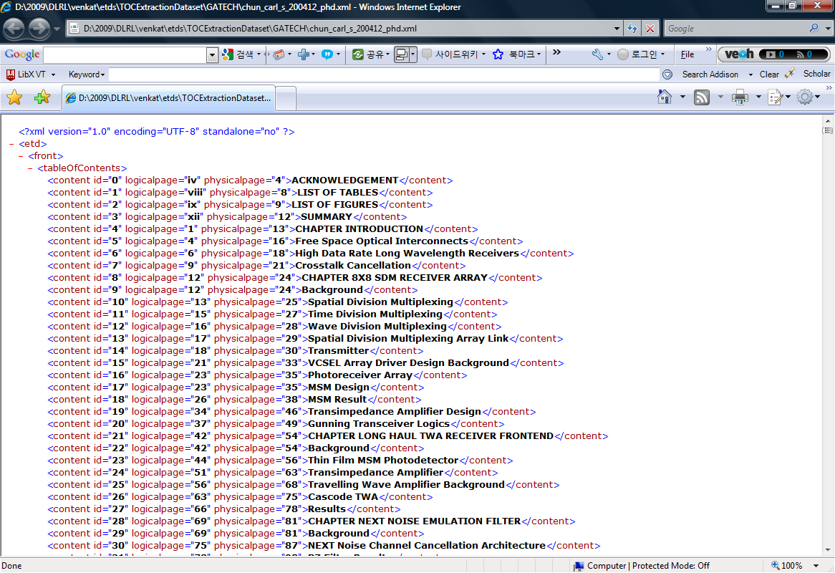
Result of Structure Analyzer (1/2)
Logical page structure
Physical page structure
Logical structure

Slide 14
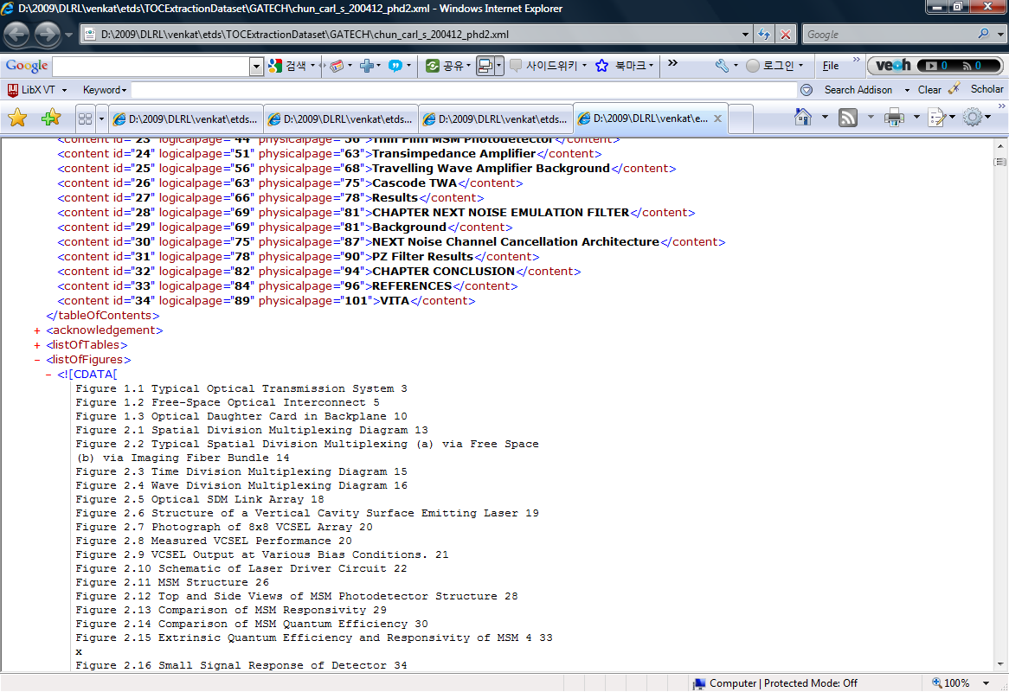
Result of Structure Analyzer (2/2)
Analyzed structure and the first 3 items of the ETD

Slide 15
Multimedia Link Source Extractor
Source information for multimedia files
  E.g., URL, file names
  'src' property in the 'video' or 'audio' tags
Algorithm in Perl script
Tagged MM Source
ETD Title Page
HTML
Multimedia file source extractor

Slide 16
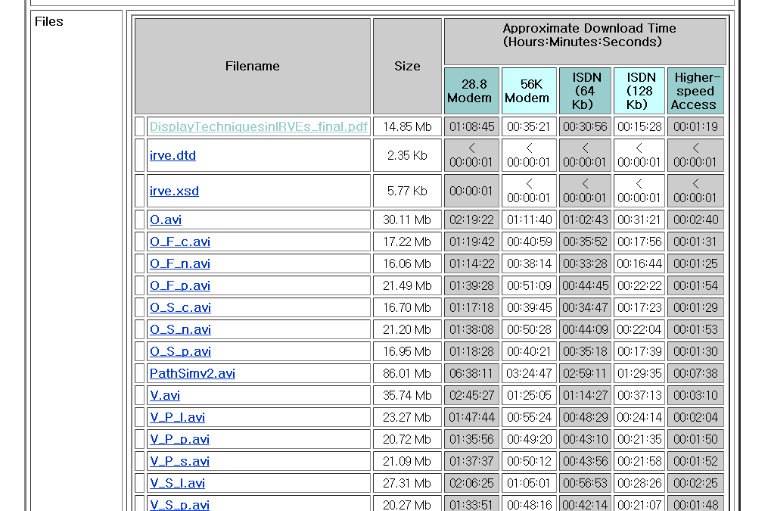
ETD Files in the ETD Title Page
(Multimedia Link Sources)
Video files
(.avi)

Slide 17
Multimedia Link Candidates Extractor (1/2)
Process
  Input: multimedia link sources
  Extract link candidates from the plain ETD text
  Finds matches in the plain text
  Output: a tagged text file with multimedia type attributes (e.g., video or audio or …)
Tagged TXT
Multimedia file link extractor
Tagged MM Source

Slide 18
Multimedia Link Candidates Extractor (2/2)
Implemented in Perl
  simple string match between multimedia link sources (e.g., list of file names), candidate links
  code integrated into the HTML5 main graphical user interface written in Java and Java SWT
Tagged TXT
Multimedia file link extractor
Tagged MM Source

Slide 19
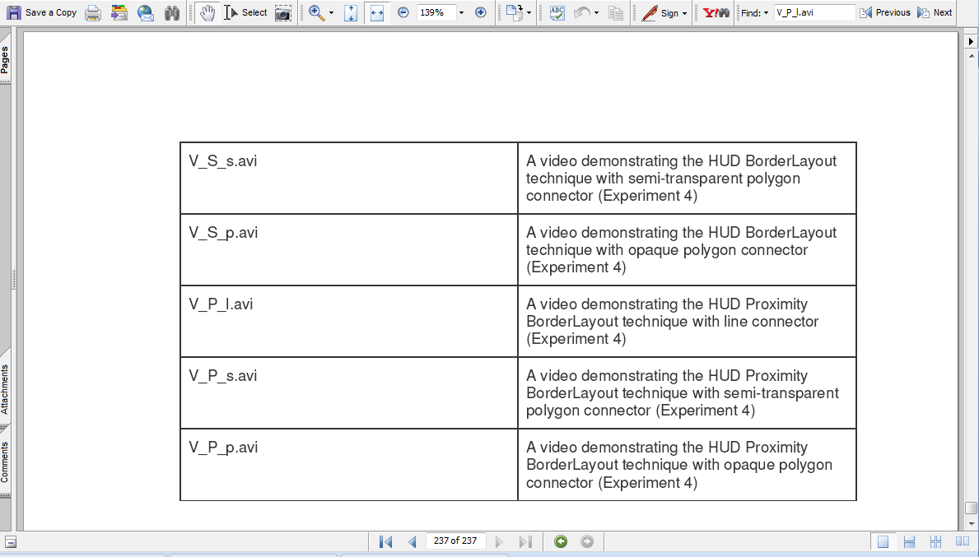
Multimedia Link Candidates in the PDF ETD
Link candidates in context:
Video file names (.avi)

Slide 20
HTML5 Conversion (1/2)
combines all information for producing an HTML5 document
  Useful HTML5 tags such as <video>, <audio>, <section>, <figure>, <table>, etc.
  a plain text ETD with link candidate tags
  link sources (e.g., file names, URL)
  structure information of ETD (e.g., header, footer, chapter, section)
HTML5
tag set
Tagged TXT
Text/ Grammar
HTML5
Converter
Tagged TXT
HTML5ETD

Slide 21
HTML5 Conversion (2/2)
key part of the conversion
  Outputting the text during the first step, PDF2TXT
sets up <!DOCTYPE HTML>,
  header, body, and other tags.
more interesting part of the conversion:
  video insertion and tagging with source information
HTML5
tag set
Tagged TXT
Text/ Grammar
HTML5
Converter
Tagged TXT
HTML5ETD

Slide 22
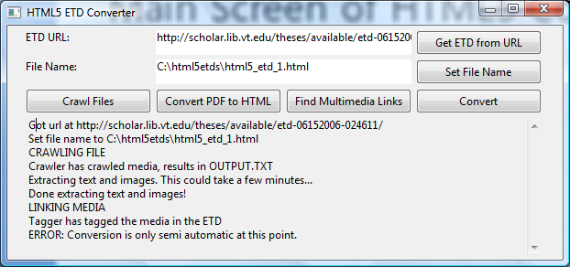
Main Screen of HTML5 Converter

Slide 23
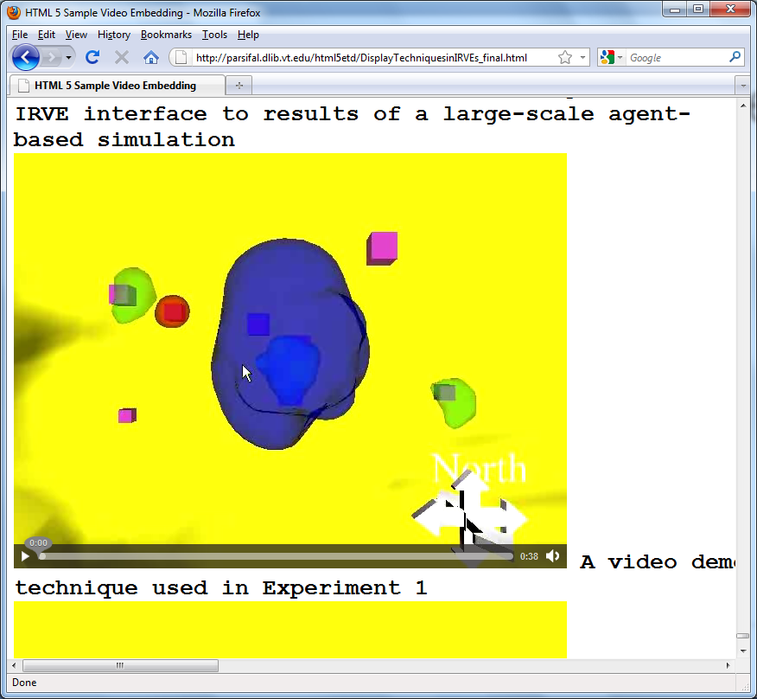
Browsing HTML5 ETD

Slide 24
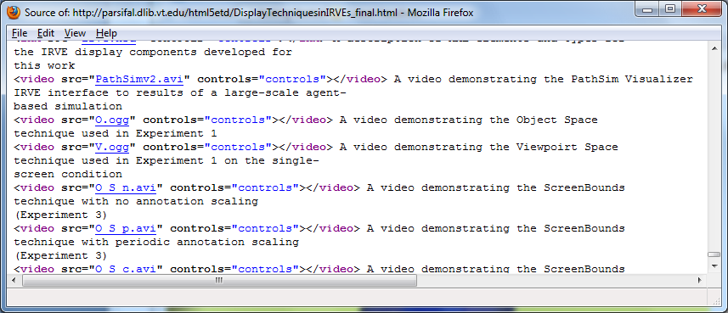
Viewing Page Source
Note: Video file extensions (.ogg) were edited manually for the purpose of demonstration.

Slide 25
Discussion – Problems (1/2)
  1. How to migrate from PDF files into HTML5 files
  2. What PDF2txt extraction tools are most effective
  3. How to avoid loss of formatting information (size, color, font, etc.) when the text comes from PDF
  4. How to avoid multiple image parts stacking (Some of the images from the PDF file, appear stacked on top of one another.)

Slide 26
Discussion – Problems (2/2)
Which browsers support HTML5, esp., video / audio?
  No: Internet Explorer, Opera
  Yes: Mozilla Firefox, Google Chrome, Safari
Which mobile devices view HTML5 video?
  No: Cell phones: Android 2.1, Blackberry
  Yes: iPod touch, iPhone, iPad

Slide 27
Discussion – Solutions
PDFBox was best for extracting from PDF
Problem with multiple parts for one image:
  no real solution yet
  something to do with the created image type
Problem with file types: convert video to ogv
Problem with the browser type:
  use a browser which supports it, or
  use HTML5 embed tag
    for a standalone media player, e.g., Windows Media Player, Flash

Slide 28
Discussion – Mobile Adaptation in Digital Libraries
ETD sustainability
Adapt structure to mobile computing environment
System-oriented adaptation to
    browsers
    small-size display
    wireless network
User-oriented adaptation to
    beginners vs. experts, handicapped
    tasks – learning, collaboration
Case of HTML5 ETDs accessed by general users through mobile web browser from wireless networks

Slide 29
Conclusion
HTML5 Converter S/W tool prototype
HTML5 ETDs converted semi-automatically
Future work
  Adapt to mobile web and semantic web
  Serve: individual human needs, mobile web browsers, small screens on mobile devices
  Adapt to semantic web to create machine readable content, using Microdata and RDFa
  Questions & Answers

