Slide 1
The Effect of Presenting Long Documents with Large High-Resolution Displays on Comprehension of Content and User Experience
Seungwon Yang, Haeyong Chung, Chris North, and Edward A. Fox
fox@vt.edu
Virginia Tech, Blacksburg, VA 24061 USA

Slide 2
Acknowledgements
Christopher Andrews for helping with devices and video compression,
Taeho Kim for helping with data analysis,
Regis Kopper for allowing us to use the handheld pointing device, and
members of Digital Library Research Lab and Info Vis Lab for their stimulating discussions and feedback.

Slide 3
Overview
Introduction
Hypotheses
Experiment
Results and Discussions
Design Implications
Conclusion and Future Work

Slide 4
Introduction
Introduction
Problem
Research Questions
Large High-Resolution Display
Hypotheses
Experiment
Results and Discussions
Design Implications
Conclusion and Future Work

Slide 5
Problem
Comprehending long documents (e.g., ETDs) :
Is time-consuming
Requires a massive amount of cognitive resources
Define ‘comprehension’ in this study:
Seeing the forest : understand overall content
Seeing the trees: find/re-find/compare/contrast information detail in the content
Notes:
Reading a long scholarly document such as theses or dissertations to understand its overall ideas or finding specific information from its multiple hundreds of pages requires massive amount of the reader’s cognitive resources.
These difficulties motivated us to explore more efficient and effective ways to comprehend ETDs.
we define ‘comprehension’ in two parts: (a) ability to understand the overall content (i.e., seeing the forest) and (b) ability to find/re-find/compare/contrast detail information in the content (i.e., seeing the trees).

Slide 6
Research Question 1
Does viewing all the pages of a long document on an LHRD improve users’ overall understanding of the content?
Notes:
* Does using an LHRD for textual information presentation help see the forest?

Slide 7
Research Question 2
Does viewing all the pages of a long document on an LHRD improve users’ information finding and comparisons?
Notes:
* Does using an LHRD for textual information presentation help see individual trees?

Slide 8
Research Question 3
Does viewing all the pages of a long document on an LHRD provide a better user experience?
Notes:
* Will the users think/feel that using LHRDs are helpful to understand long documents?

Slide 9
Large High-Resolution Displays (LHRD)
Notes:
LHRD is an effective solution to significantly increase visual scalability from its large field of view and high resolution.
LHRDs have been shown to be helpful in a variety of visual analytics and complex information tasks.
An example of LHRD is a Gigapixel display, which consists of 50 tiled monitors (5 rows, each row has 10 monitors = 5 × 10 × 1600 × 1200 = 96,000,000 pixels) driven by a PC cluster (each node displays a part of the large scene)

Slide 10
Hypotheses
Introduction
Hypotheses
Hypothesis 1
Hypothesis 2
Hypothesis 3
Hypothesis 4
Experiment
Results and Discussions
Design Implications
Conclusion and Future Work

Slide 11
Hypothesis 1
The users of the Gigapixel display will summarize a long document with better quality compared to those in the Single Monitor or Paper on Table groups.
Notes:
* Gigapixel setting provides a layout that all the pages of a thesis are displayed, grouped by the chapter. This layout gives additional ‘spatial’ information of the whole content to its readers, which potentially could enhance the accuracy of the content summary. In contrast, Single Monitor setting displays only a couple of pages on the screen at a time without a spatial layout of the thesis.

Slide 12
Hypothesis 2
The participants in the Gigapixel group will find/compare information in a long document faster than those in the Single Monitor or Paper on Table groups.
Notes:
* Gigapixel setting provides a large display area for all pages of a thesis to be viewed, which might allow quick and direct access to the content of the thesis. But in the Single Monitor setting, users have to check pages in sequential order, which could be a bit slower compared to direct access.

Slide 13
Hypothesis 3
The Gigapixel group will answer more accurately in finding/comparing information, when compared to either the Single Monitor or Paper on Table group.
Notes:
* The direct access to the content and spatial organization of it from Gigapixel’s large field of view might improve readers’ ability to find information more accurately in the Gigapixel setting compared to the other two settings.

Slide 14
Hypothesis 4
Participants in the Gigapixel group and Paper on Table group will perceive a higher level of efficiency and effectiveness for using their display medium compared to the Single Monitor group.
Notes:
* The fact that the content of a thesis is directly accessible and that there are enough working space on the display to freely reorganize pages in a way that they feel comfortable in the Gigapixel and Paper on Table settings may affect users’ perception of their performances positively.

Slide 15
Experiment
Introduction
Hypotheses
Experiment
Participants
Experimental Setting
Gigapixel ETD Viewer
Tasks and Procedure
Results and Discussions
Design Implications
Conclusion and Future Work

Slide 16
Participants (1/2)
12 grad students (5 female, 7 male)
4 people participated in each of 3 settings
Ages 22-40 years
Familiarity of resource type:
Web pages > conference proceedings > journal articles > theses & dissertations

Slide 17
Participants (2/2)
Preference for text presentation (1:least - 5:most):
Computer screen: 4.25 out of 5
Paper: 3.17 out of 5
Reasons: digital docs are easier to manage/search/store
Read texts on computer screens
More than 8 hrs/week
In ETDs, participants were interested in:
Specific info (75%)
Methodologies (75%), literature reviews (83.3%)
Overall topics (50%)
Notes:
* Specific information in ETDs: e.g., parameter values, algorithms, etc.

Slide 18
Gigapixel Experiment Video
Example video

Slide 19
Experimental Setting
A Master’s thesis, “The Design of Active Workspace,” was used
Approx. 70 pages
Easy reading, HCI-related paper
Font size of each page enlarged
3 Settings
Gigapixel
Paper on Table
Single Monitor

Slide 20
Gigapixel
5 x 10 monitors
All pages shown, grouped by chapter
A handheld device to move pages
Notepad, Post-It on a rolling desk
Notes:
All the pages of a thesis were shown on a Gigapixel display, which consisted of 5 x 10 monitors (vertical x horizontal).
Pages were grouped by the chapter.
A handheld device was used to move pages like a mouse.
Participants had access to a notepad and Post-it notes on a rolling desk.

Slide 21
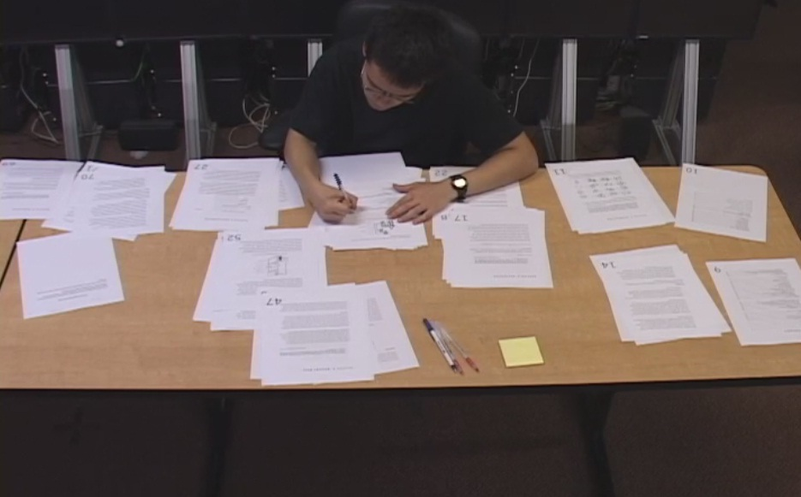
Paper on Table
Pages are grouped by chapter, on a large table
Notepad, Post-It notes are provided
Notes:
Paper thesis was put on a desk, organized by the chapters.
Participants were allowed to freely move pages, use a notepad and post-it notes.

Slide 22
Single Monitor
Display a thesis with Adobe PDF Reader
Page thumbnails
Notepad, Post-It provided
Notes:
Adobe’s PDF viewer with searching feature disabled to be consistent with the other two settings.
To help navigation, a document thumbnail view was provided on the left side of the screen.

Slide 23
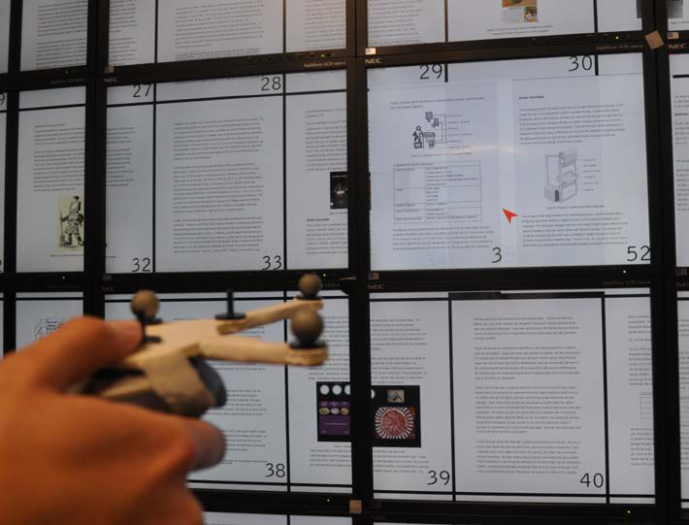
Gigapixel ETD Viewer
Red pointer from the handheld interface
Drag-and-drop pages using the trigger to compare figures
Notes:
Gigapixel ETD Viewer
It enables to view and manipulate a large number of pages (more than 600 pages at a time depending on the page size) on large displays without any pre-processing or modification of the pages.
It enables users to move page objects interactively.
e.g., compare interesting figures on a couple of pages by juxtaposing them using the handheld interface device.
Although not implemented yet, this tool can support rotating, panning, and zooming in/out of the object displayed.
The size of each page in the viewer is identical to a US letter size paper to feel familiar for reading.
We increased the size of the page numbers to locate pages easily.
A large high-resolution display (LHRD) allows constructing large spaces to spread out a long document like ETDs.
This tool was implemented by OpenSG and C++.

Slide 24
Tasks and Procedure
Participants performed two tasks:
Task 1 for overall comprehension
Read thesis for 30 minutes, move/reorganize pages
Write 200-300 word summary
Task 2 for info finding/comparison (6 questions)
Q 1,2: finding specific info
Q 3: similarities and differences between systems
Q 4: finding info based on another info
Q 5,6: comparing figures, figure details

Slide 25
Results and Discussions
Introduction
Hypotheses
Experiment
Results and Discussions
User Performance
User Perception of Efficiency & Effectiveness
User Behaviors
Design Implications
Conclusion and Future Works

Slide 26
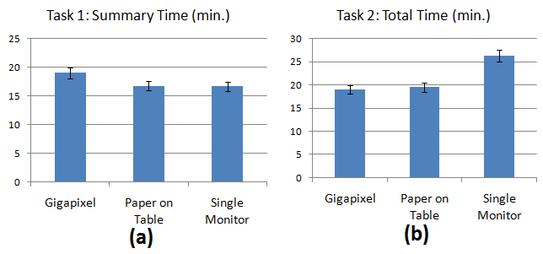
Group Average Time of Task 1&2
Notes:
Participants from Paper on Table (4 out of 4) and Single Monitor (3 out of 4) groups used the notepad often, whereas only one participant from Gigapixel group wrote short outlines on a note and the other Gigapixel participants didn’t use it at all.
It was possibly because Paper on Table and Single Monitor settings were configured on top of a desk, on which participants could write a note comfortably sitting on a chair. Whereas, only a small rolling desk was provided for Gigapixel setting and the discomfort of using it for writing while standing up holding the handheld interface might have resulted in low frequency of writing a note.
The participants, who wrote the notes, actively used them and it reduced writing time for their task 1. Since Gigapixel participants did not write a note except for one participant, their average time for task 1 took more than that of the other groups although the difference was not statistically significant (See Figure (a)).
The fact that the average writing time for three participants in the Gigapixel group, who did not use notes, is longer (18.3 min.) than that of either Paper on Table (16.75 min.) or Single Monitor (16.63 min.) groups might support the conjecture mentioned above.
In Figure (b), the average performance time of the Gigapixel group’s task 2 was found to be lower than that of the Single Monitor group and slightly lower than that of the Paper on Table group. However, these differences were not statistically significant from ANOVA at the p = 0.05 level; thus we could not confirm Hypothesis 2.
In Single Monitor setting, pages are accessed sequentially; thus users have to use page down/up buttons or scrolling frequently to access information. But in Gigapixel, information on pages are distributed on the display surface with visual cues such as images, tables or structure of paragraphs; thus users have an opportunity to access information directly.
Paper on Table setting also resembles Gigapixel setting with pages organized by the chapter. But, pages in each chapter are piled and accessed linearly by flipping over them. Compared to sequential access of Single Monitor and semi-direct access of Paper on Table, Gigapixel has benefits of utilizing direct access as well as visual cues on the pages to enhance performance in information finding tasks.

Slide 27
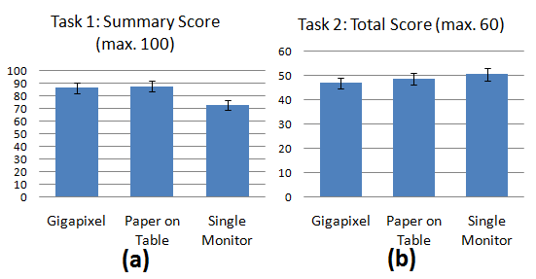
Group Average Score of Task 1&2
Notes:
To measure accuracy of task performance, thesis summaries (task 1) and six questions in task 2 were graded by two researchers. Those scores were averaged to reduce subjective factors in grading.
In Figure (a), the Gigapixel group’s average score was higher than that of the Single Monitor group; however, we could not confirm Hypothesis 1 since the differences were not statistically significant.
The average scores of the Gigapixel and Paper on Table groups were similar. This might mean that added spatial information in the Gigapixel and Paper on Table settings might have contributed to the better quality of the summary.
The average total scores of the three groups are shown in Figure (b). We expected that the score of the Gigapixel group would surpass those of the other two groups, but it turned out that the average scores were similar to each other.

Slide 28
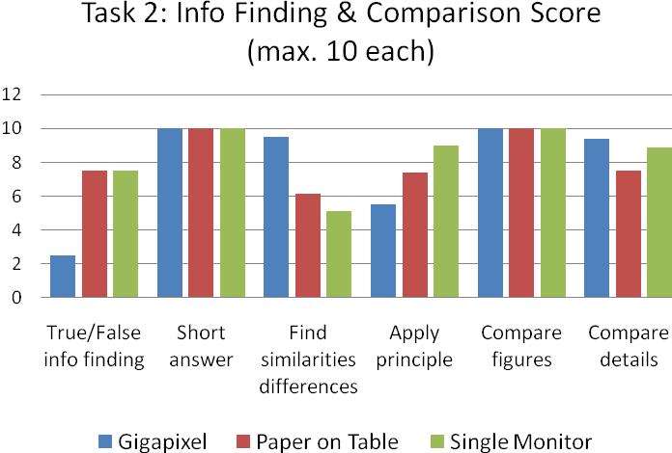
Group Average Score of Questions in Task 2
Significant
difference
Notes:
To see if we could find significant improvement of Gigapixel group’s performance from sub-tasks in task 2, we compared average scores of each question for the three groups in the figure above.
The Gigapixel group’s average performance for question 3, ‘Find similarities and differences’, showed a significant improvement in its accuracy with p=0.04 compared to that of the Single Monitor group (marked with red arrows in the red box). Based on this, Hypothesis 3 has been partially confirmed.
For question 1, ‘True/False info finding’, and 4, ‘Apply principle’, Gigixel group’s performance was lower than that of the other groups, but the differences were not statistically significant from Tukey-HSD analysis.

Slide 29
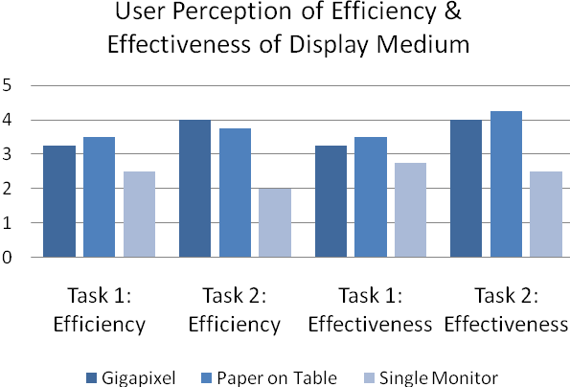
User Perception of Efficiency & Effectiveness
Significant
difference
Notes:
Users’ perceived efficiency and effectiveness, of the display medium that they used during the experiment, were collected using post-questionnaires. The group average ratings (1: not helpful at all – 5: very helpful) are displayed in the figure above.
Average user perception for efficiency and effectiveness of both the Gigapixel and Paper on Table groups was higher than that of the Single Monitor group. However, we could find a statistically significant difference only in the users’ perception of effectiveness in performing task 2 between Paper on Table and Single Monitor groups.
This partially confirmed Hypothesis 4.

Slide 30
List of Significant Results
Group average score for task 2, question 3:
Gigapixel group >> Single Monitor group
Partially confirming Hypothesis 3
User perception of effectiveness for task 2
Paper on Table group >> Single Monitor group
Partially confirming Hypothesis 4
Notes:
Hypothesis 3. The Gigapixel group will answer more accurately in finding/ comparing information (Task 2), when compared to either the Single Monitor or Paper on Table group.
➔ but the Gigapixel’s improvement was found in only one question from task 2.
Hypothesis 4. Participants in the Gigapixel group and Paper on Table group will perceive a higher level of efficiency and effectiveness for using their display medium compared to the Single Monitor group.
➔ but only the Paper on Table group’s perception was significantly higher than that of Single Monitor group.

Slide 31
User Behaviors
Four common behaviors identified from observations and post-questionnaire analysis
Physical Navigation
Reading and Page Switching Strategies
Arrangement of Pages
Comparing Pages
Notes:
Physical navigation.
They stepped backward if they wanted to see the structure of the thesis and an overview of pages on the Gigiapixel display. For more detailed view of an interesting one, they walked closer to a certain pages and read it. They also walked back and forth between pages during the task sessions.
One participant commented:
”On Gigapixel, I could see the whole content with just one single view, so I can easily navigate and figure out where I should go without thinking that much. And, I could intuitively use physical navigation and see interested images and also view how it is related to the overall content of the thesis.”
Participants in Paper on Table group picked the pages that they want to read from the chapter pile and brought them to their side. They used some physical navigation partially, such as head rotation or eye gaze, but nobody stood up or walked to read the thesis actively while running the study. This may be because they started doing the task sitting on a chair.
In the Single Monitor group, as we expected, there was no any meaning physical navigation.
Reading strategies and page switching strategies.
They first looked at the table of contents, introductions, or conclusions, and look through the details in each page by moving back and forth the pages frequently. Interestingly, some participants in Gigapixel group first remind that page’s figure or snapshot to re-find some information and move to the page. A couple of participants sat down on a chair and moved pages to closer to themselves with a handheld device for reading.
The Paper on Table group shared reading and page switching strategies used in both Gigapixel and Singel Monitor groups. Like the Gigapixel user, the participant moved to the related chapter directly after reading the problem, but in each chapter pile, all participants tried to maintain the page order and used sequencial ways to flip over each page until they find information on a certain page.
For the singe screen group, participants have to use completely a sequencial approach to turn over and scroll up and down the pages until they find the page or information with page up and down keys or the mouse wheel.
Arrangement of pages.
Each Gigapixel participant used a different strategy for arranging the pages on the Gigapixel display. Two participants looked for free space available on the display, and dragged and dropped pages to those spaces.
They used mostly the middle three rows of monitors. The Gigapixel participants often moved pages to a space where the participants can read more comfortably. Participants moved several pages because it was hard to read those pages on the top row of the screen due to light glare caused by the fluorescent light.
Also, people move some pages off the bezels because it was hard for them to read some pages crossing bezels. We observed one participant tend to get groups of the section laid out horizontally, and split them into different section in the left and right sections on the screen.
Like the Gigapixel group, the Paper on Table participants didn’t group the pages based on some information and just used the original grouping as given in the beginning. However, they divided the chapters into two or three in horizontal/vertical/diagonal ways to utilize space upper/lower desk, but did not disrupt the original layout.
Comparing the pages or information.
All Gigapixel and paper participants juxtaposed the two relevant pages together. As compared to the task 1, participants didn’t use much time to read each page and switch back and forth between pages faster to searched for specific information or keywords.
However, as we expected, comparing more than two figures or information on different pages was not easy for the Single Monitor environment. One Single Monitor participant reported:
”It was really hard to compare if related description and figure are place in separate pages. In this case, I needed to go back and forth often. It is very inconvenient and sometimes hinder me from understanding the contents. I often meet this situation.”
Some participant switch back and forth of the related pages and tried to memorize information on the first one and then check in the other page based on their memory, but some student failed to remember everything and went back to the first page again. Those participants ended up taking a note of the information on the first page and compare it with the other page.

Slide 32
Design Implications
Introduction
Hypotheses
Experiment
Results and Discussions
Design Implications
Additional Features
Conclusion and Future Works

Slide 33
Additional Features
Annotation, searching, and highlighting
Connecting related pages visually
Changing page size
Multiple document/reference support
Supporting different page layouts
Aligning pages with bezels
Temporary move
Notes:
Identified seven additional features
• Annotation, searching, and highlighting: Most participants wanted to use these features when they were reading an ETD using LHRD. Touchscreen interface or touch-enabled interface devices such as smart phones or iPads might be used to enter or draw annotations instead of using conventional interfaces such as mice or keyboards. Users may use their fingers to highlight text directly or draw circles for important information on the display.
• Connecting related pages visually: While reading an ETD, users may need to link between related pages using persistent lines or color codes. It will enable users to access related information to the current page and help understand information by visualizing the connections.
• Changing the page size: Changing the page size will allow users to have more space and hide less relevant pages by making them smaller. Magnifying figures and graphics would be useful in collaborative work such as discussing about a figure detail, etc.
• Multiple document or reference supports: Participants wanted to make use of LHRD’s large space and resolution to open multiple references. E.g., compare methodologies in several theses or related references.
• Supporting different page layouts: Depending on users’ preferences, forcing a single page organization makes it inefficient to read papers. Providing different initial layouts might help users understand and navigate the paper better.
• Aligning pages with bezels: A digital page that was divided by bezels made it hard for participants to read it on the Gigapixel. Those divided pages affected user experience of using the Gigapixel. Therefore, pages should be aligned within bezels, rather than across them.
• Temporary move: LHRD users will be allowed to drag-and-drop pages. Since the page layout is preserved, users can restore the original layout of a thesis after changes.

Slide 34
Conclusion and Future Works
Introduction
Hypotheses
Experiment
Results and Discussions
Design Implications
Conclusion and Future Works
Summary
Future Plans

Slide 35
Summary (1/4)
Hypotheses 1 and 2 have not been confirmed.
In general, compared to the other two groups, people in Gigapixel group could
Summarize the document with better quality
Find/compare information faster
But, we did not find a statistically significant effect.
Notes:
Although the average performances of Gigapixel group showed improvements in general, we found that only some of them were partially statistically significant and the others were not significant.
Hypotheses 1 and 2 could not be confirmed. One of the potential reasons for this result might be explained that the small number of study participants (e.g., 4 people for each group, for a total of 12) restricted the power of our analysis test. This remained as a limitation of the study.

Slide 36
Summary (2/4)
Hypotheses 3 have been partially confirmed.
A significant performance improvement by the Gigapixel group was found:
Could answer more accurately only for question 3 in task 2, which is to find similarities and differences of two systems, compared to Single Monitor group.
Notes:
Although the average performances of Gigapixel group showed improvements in general, we found that only some of them were statistically significant.
This led to a partial confirmation of Hypotheses 3 and 4.
Again, one of the potential reasons for this result might be explained that the small number of study participants (e.g., 4 people for each group, for a total of 12) restricted the power of our analysis test (restricted the rejection power for null hypotheses). This remained as a limitation of the study.

Slide 37
Summary (3/4)
Hypotheses 4 have been partially confirmed.
A significant performance improvement by the Paper on Table group was found:
Paper on Table group’s perception of their performance effectiveness for task 2 was significantly higher than that of Single Monitor group.
But, the perceptions of efficiency for task 1,2 and effectiveness for task 1 were not found to be significant.
Notes:
Although the average performances of Gigapixel group showed improvements in general, we found that only some of them were statistically significant.
This led to a partial confirmation of Hypotheses 3 and 4.
Again, one of the potential reasons for this result might be explained that the small number of study participants (e.g., 4 people for each group, for a total of 12) restricted the power of our analysis test (restricted the rejection power for null hypotheses). This remained as a limitation of the study.

Slide 38
Summary (4/4)
Large field of view and physical navigation helped people recognize the structure of the thesis and quickly navigate it to re-find information.
Physically navigating to nearby pages is almost instantaneous (eye glance, head rotation); scanning multiple pages or comparing 2 pages is faster.
Notes:
Although the average performances of Gigapixel group showed improvements in general, we found that only some of them were statistically significant.
This led to a partial confirmation of Hypotheses 3 and 4.
Again, one of the potential reasons for this result might be explained that the small number of study participants (e.g., 4 people for each group, for a total of 12) restricted the power of our analysis test (restricted the rejection power for null hypotheses). This remained as a limitation of the study.

Slide 39
Future Plans
Incorporate new features from Design Implications section
Study collaborative work using Gigapixel
E.g., Two people review scholarly publication together on a Gigapixel
Use many more participants
Notes:
As future works, we plan to incorporate one or multiple features mentioned in the Design Implications section. It will naturally be connected to our next study, which will involve many more participants.
Another venue for extending this study is to apply the Gigapixel display in collaborative work. It inherently supports collaborative work from its large field of views with high resolution. It might also offer benefits to group collaboration in reviewing scholarly publications. For example, multiple collaborators view and read different sections of a thesis at the same time and discuss about their findings to share opinions.

Slide 40
Thank you!
Questions?

