Slide 1
ETD-db: Today, Tomorrow, and the Future CaR
Edward A. Fox (fox@vt.edu) and Gail McMillan (gailmac@vt.edu)
Virginia Tech, Blacksburg, VA 24061 USA
ETDs for Rookies Workshop @ ETD 2010
University of Texas at Austin, June 16, 2010
Acknowledgments: Sung Hee Park, Paul Mather
Notes:
Virginia Tech and the NDLTD will help you jump start your ETD initiative. We provide open source ETD-db, software for processing ETDs from Student submissions through Approval and access. It is available FREE of charge to members of NDLTD.

Slide 2
About ETD-db from VT/NDTLD
Today
  HTML pages, Perl scripts interact with MySQL database
Tomorrow
  Ruby on Rails open source Web applications
Future option
  VT IT CaR (Collaboratory and Repository)

Slide 3
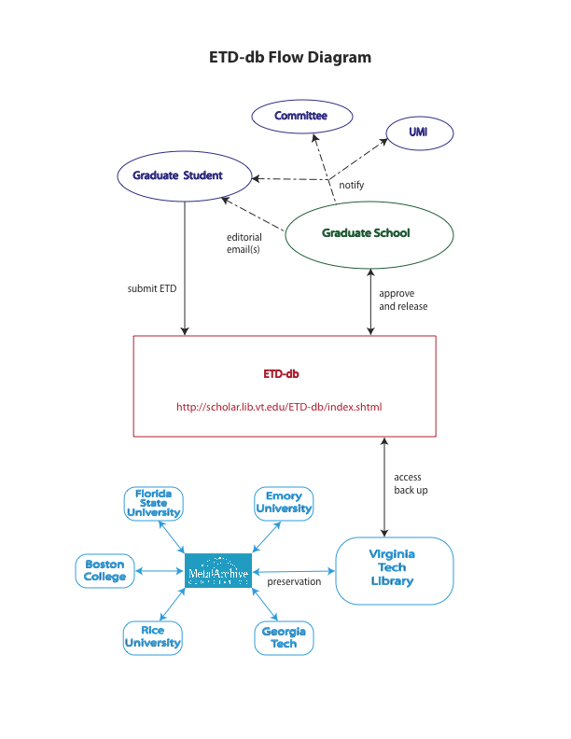
Notes:
Your institution could become part of the ETD Preservation Network, whether you use ETD-db or another system.

Slide 4
ETD-db: Student Authors
Login with university PID, password
Metadata
  Derived from university records (e.g., Banner and Plan of Study) (new)
  Entered by authors (e.g., copyright, keywords)
Set access level for the ETD
  Worldwide (open) access (all eventually)
  Restricted access (host university community-only temporarily)
  Embargoed access (inaccessible to everybody temporarily)
Faculty: online approval (new)
Notes:
ETD-db is run by the library. ETDs are submitted to the DLA/library server.

Slide 5
ETD-db: Graduate School
Processes submitted ETDs
  stored on ETD-db server
Graduate School personnel login
  Access list of submitted ETDs
  Email with authors as needed (tracked)
  Approve ETDs

Slide 6
ETD-db: Graduate School
Approving an ETD automatically generates
  Emails
    Notifications to author and committee w/URL
    Notification to UMI/ProQuest, includes author, title, institution, URL
  List of ETDs for Library Cataloging
  Access
    Author selected 1 of 3 levels: public, university-only, no one
    Automatically available to the public after temporary period of restricted access expires (new)

Slide 7
Notes:
This is what it looks like after the ETD was submitted and approved.

Slide 8
ETD-db software is free to NDLTD http://scholar.lib.vt.edu/ETD-db
Today
  ETD database: workflow, processing
  ETD server: provides access
    Cataloging
    Backups
    Preservation
Tomorrow: New and improved ETD-db
Notes:
Features such as open source and OAI harvestable metadata won’t change.
Next slide for design info about new and improved ETD-db

Slide 9
Current Efforts for ETD-db Redesign
Collect requirements
  Reviewing current ETD workflows
  Interviewing Users (e.g., reviewers, administrators)
  Investigating candidates
  Rewriting a pilot system in Ruby on Rails
    Using Agile Web Development Technology
  DSpace
    Commonly used institutional repository
  CONTENTdm
    Supported by OCLC (Online Computer Library Center)
  D-Net
    Important outcome from the DRIVER (Digital Repository Infrastructure Vision for European Research) project
Notes:
At 12:19 PM -0400 6/10/10, Sung Hee Park wrote:
Dear Dr. Fox,
I just summarized current efforts for ETD-db system redesign in a single slide.
Paul already mentioned about most portion of the current steps.
I am reviewing current ETD -db work flows, analyzing source codes to preserve current requirements.
And, Paul and I interviewed ETD-db system users for collecting current and new requirements.
I am writing the system requirements using UML(Unified Modeling Language) & Rational Rose diagrams.
In parallel, I am investigating several candidates to implement the improved ETD-db system.
I am rewriting a pilot system in Ruby on Rails, an agile web development technology, which is expected to help manage and upgrade the system.
I am still investigating other digital library applications (e.g., DSpace, D-Net, CONTENTdm), mostly with project reports which applied each application to a ETD repository.
Short-term goals are to write up a requirement specification for a redesigned ETD-db system and build a pilot sysetm in Ruby on Rails.
If you need more detail, please let me know it.

Slide 10
Future CaR:
Collaboratory & Repository
Develop an ETD within this system
  Author controls access
  Standards are more easily enforced
  Processing functions continue
  More reusable data
Updates: http://scholar.lib.vt.edu/theses
Email: ETD-db@scholar.lib.vt.edu
Notes:
CaR: Collaboratory & Repository
The Collaboratory (plus repository) is VT Grad School Dean Karen DePauw’s particular interest and has the support of VP for Research Bob Walters and VP for IT, Erv Blythe.Grad School Associate Dean and faculty in Computer Science, Maneul Perez-Quinones is working on this and incorporating his interests in having adaptable data for visualizations.

