Slide 1
Libraries In the Digital Age (LIDA)
May 24-28, 2010 Zadar, Croatia
“Digital Libraries, Scholarship, and the Humanities” by Edward A. Fox
fox@vt.edu http://fox.cs.vt.edu/talks/2010/
Dept. of Computer Science, Virginia Tech
Blacksburg, VA 24061 USA

Slide 2
Acknowledgements
Mentors (Licklider, Kessler, Salton)
Virginia Tech, CS, Digital Library Research Laboratory
NSF and other sponsors
Students, colleagues, co-investigators:
Monika Akbar, Yinlin Chen, Spencer Lee, Venkat Srinivasan, Seungwon Yang, …
Boots Cassel, Gary Marchionini, Jeffrey Pomerantz, Barbara Wildemuth, Andrea Kavanaugh, Naren Ramakrishnan, Steve Sheetz, Don Shoemaker, …

Slide 3
Scholarship
Humans/
Humanities
DL curriculum
Ensemble
Living In the KnowlEdge
Society (LIKES): Book,
Part on Humanities
Needs
Areas
Approach
Supporting
Scholarship
About Humans
Through
Content &
Services
Content
Services
Digitized
ETDs
Born digital
(digital
natives)
DLs:
CTRnet
Ensemble
ETANA
NDLTD
Flattening
(cooperation,
collaboration)
Exploring
(search, browse)
Interoperability
Integration

Slide 4
Outline
Humanism, Humanities
Selected DL Projects
Basic DL Concepts, Scholarship
NDLTD
Services Centered

Slide 5
Part 1 – Humanism, Humanities
Humanism
  Need for
Humans
  Principles
Humanities
  Areas
  About

Slide 6
Humanism
Human, humanist, humanistic, humanism
Geographical Perspective
  Asian, Greek, Roman, European, …
Historical Perspective
  Ancient, Classical Period, Renaissance, …
Related
  Knowledge, Literature, Philosophy, Religion
  Education, Inclusion, Life Stance
  …

Slide 7
Need for Humanism
Global population, tipping point
Destruction of biodiversity, ecology, environment -> global weirding, extinctions
War, terrorism, poverty -> education, …
Mental health -> creativity, compassion
Tom Friedman: Hot, Flat and Crowded
Jared Diamond: Collapse: How Societies Choose to Fail or Succeed

Slide 8
Humans
Health care crisis: population, aging, cost, specialization; stress, mental health, …
ADHD, PTSD, “Negative emotions”, …
Wholistic: To nurture or treat the entire person - physical, emotional, mental, and spiritual. (East vs. West, “fusion”)
Reductionism -> Integration
Mental discipline, meditation, reflection
Individual, Group, Organization, Society, World: Collaboration, cooperation, peace, …

Slide 9
Usui Reiki Principles
Version a:
For today only
anger not,
worry not.
Be humble, and
With Gratitude work on yourself.
Be Compassionate.
Version b:
Just for today
do not worry,
do not anger.
Treat others with respect and forgiveness.
Work with integrity.
Be grateful.

Slide 10
Humanities – 1 (Areas?)
Anthropology, Archaeology?
Communication?
Performing arts?
  Music
  Theatre
  Dance
Visual arts?
  Painting
  Sculpture
  Media types, Multimedia, hypermedia

Slide 11
Humanities – 2 (Areas)
Classics
Culture
History
Languages, Linguistics, English
Law
Literature
Philosophy
Religion

Slide 12
Humanities – 3 (About)
Studying:
  Human condition
Approach:
  Analytical
  Critical
  Speculative

Slide 13
Part 2 – Selected DL Projects
Digital Library Curricular Resources
  NSF IIS-0535057 & 0535060
CTRnet (Crisis, Tragedy & Recovery Net)
  NSF IIS-0916733
Ensemble (Computer Science Education)
  NSF DUE-0840719
Digital Preserve
  NSF IIS-0910183 & 0910465
  http://slurl.com/secondlife/Digital%20Preserve/140/126/29

Slide 14
DL Curric. Project - 1
NSF awards to VT and UNC-CH
CS and LIS
Project server: http://curric.dlib.vt.edu/
Wikiversity: http://en.wikiversity.org/wiki/Curriculum_on_Digital_Libraries

Slide 15
DL Curric. Project - 2
Module 1-b: History of digital libraries and library automation
Module 2-c: File Formats, Transformation, and Migration
Module 3-b: Digitization
Module 4-b: Metadata
Module 5-a: Architecture overviews

Slide 16
DL Curric. Project - 2
Module 5-b: Application software
Module 5-d: Protocols
Module 6-a: Information needs/relevance
Module 6-b: Online information seeking behaviors and search strategies
Module 6-d: Interaction design and usability assessment

Slide 17
DL Curric. Project - 3
Module 7-b: Reference Services
Module 7-g: Personalization
Module 8-b: Web Archiving
Module 9-c: Digital library evaluation, user studies

Slide 18
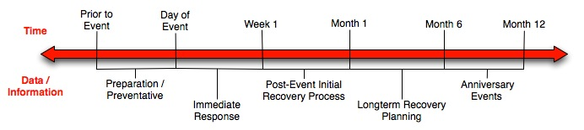
Crisis, Tragedy, and Recovery
Human tragedies that result from man-made and natural events affect humans and communities significantly.
During and after a tragic event, there are a series of needs that have to be addressed.
  Compounded by communication failures and a confusing plethora of data and information

Slide 19
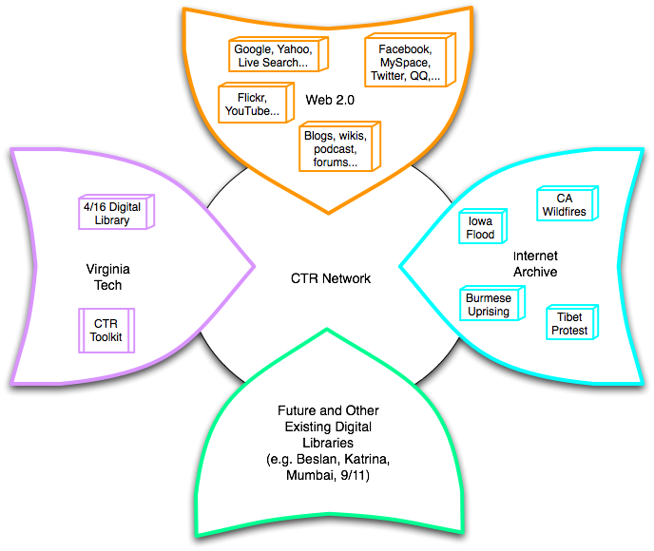
Build a networked digital library relating to CTR
www.citeulike.org group ctrnet
Citations
Papers, …
Integrate community, content, and services relating to CTR, making it accessible, and preserving it for long-term reuse
Support information exploration
Aided by an ontology
www.ctrnet.net

Slide 20

CTR stakeholders
Notes:
Help affected communities to recover more quickly and effectively
Provide global network with relevant information and resources
Support the research community, emergency personnel, decision makers, and the public in reacting to and recovering from crises

Slide 21
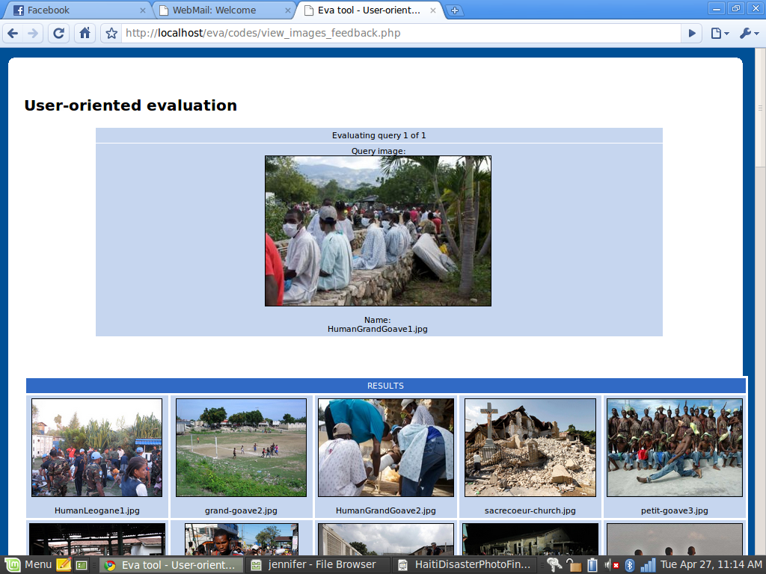
Haiti Photographs, Content Based Image Retrieval Evaluation

Slide 22
CTR Ontology
An ontology is
  Collection of words and phrases
  Graph of relationships, sometimes mostly hierarchical as in a taxonomy
  Covering the key concepts and terms in the discipline
  Supporting differing views on the field
Purposes
  Describes documents
    As tags, descriptors, keywords
  Supports navigation, learning, and research

Slide 23





Goals for Ontology for CTR
CTR literature
Browsing
sources
Searching
  Query
  expansion
Focus groups
CTR Ontology
Individual
Organizational
Community
Political
…
Tagging
Websites,
Internet Archive
Recommending
Social network
applications
Summarizing
uses
Multicultural/ linguistic input
Visualizing

Slide 24
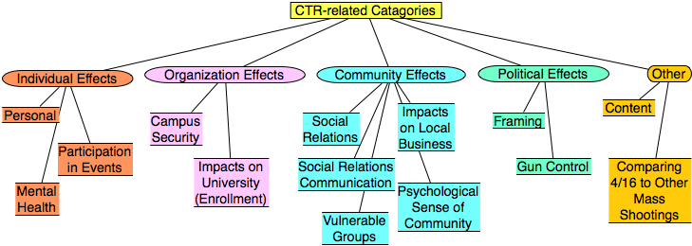
Categories from focus group study
Results from focus group interviews following the April 16, 2007 tragedy at Virginia Tech

Slide 25
CTR keyword pairs
Extracted top keyword pairs from ISCRAM proceedings using the N-gram statistics package
emergency response | decision support | information systems | teams participants
decision making | data models | disaster monitoring | teams maps
command teams | disaster plan | crisis management | sms text-message
flood alerts | information seeking | situational awareness | disaster registry
physical communication | human disaster | teams access | decision preference
Notes:
International Conference on Information Systems for Crisis Response and Management

Slide 26
Preliminary Web Data Analysis
Revise seeds if poor preliminary data
Crawl
Index Data
Index crawl data from Heritrix
Use NutchWax to preliminarily analyze seed quality
Pass Along
Collect Seeds
Send ARC files on for Story-telling

Slide 27
Data Cleaning, Extracting, Filtering, Storytelling
Classifying
Related files
Storytelling
Stories
Visualizing
Graph of stories
Analyzing
results
Goal: Discover relationships between tragic events.
  Examples: Shooting, study pressure, and mental disorders
formatting
Start and end docs

Slide 28
Hypothesis of school shooting
Immigration
Socially Different
Victim of Bullying
Isolation
Psychological Impact
School Impact
Out come
Keywords
Migration Geographical movement
Relocation
Keywords
Social Outsider
Social Stranger
Keywords
Homophobia Gay Taunts
Keywords
Rejection Seclusion
Keywords
Depression Frustration Anxiety Anger Aggression Stress Loneliness Low Self-esteem
Keywords
Truancy Poor Academic Performance
Low Grades School Drop-out
E.g., Any relations between
Violence and Migration?
Male
Female
Keywords
Delinquency Violence Fighting Masculinity Assault School Shooting
Keywords
Suicide Ideation Suicide Attempt Suicide

Slide 29
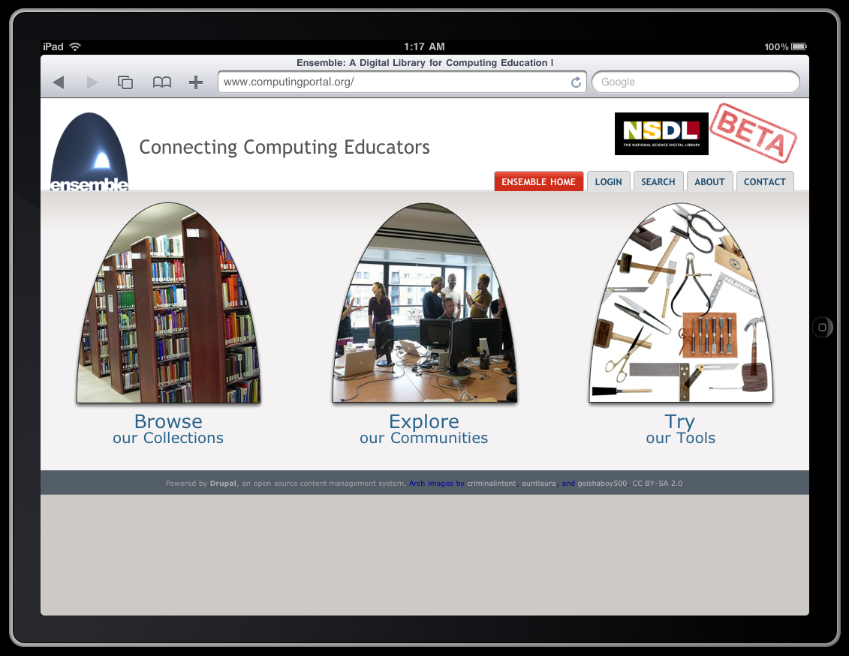
Ensemble Portal
Edward A. Fox, Yinlin Chen, Monika Akbar
Virginia Tech
www.computingportal.org

Slide 30



Social network services
Computing Communities
WebCAT
TECH
FOCES
CATSpace
CS1
Ensemble Portal
Drupal
Blog
Browse
Search
Tools
Walden’s Path/VKB
Forum
Submit
RSS
Walden’s Path
VKB
SI
Storage
Fedora
Computing Resources
Syllabus
SWENET
AlgoViz
CSTC
CITIDEL
CSTA

Slide 31
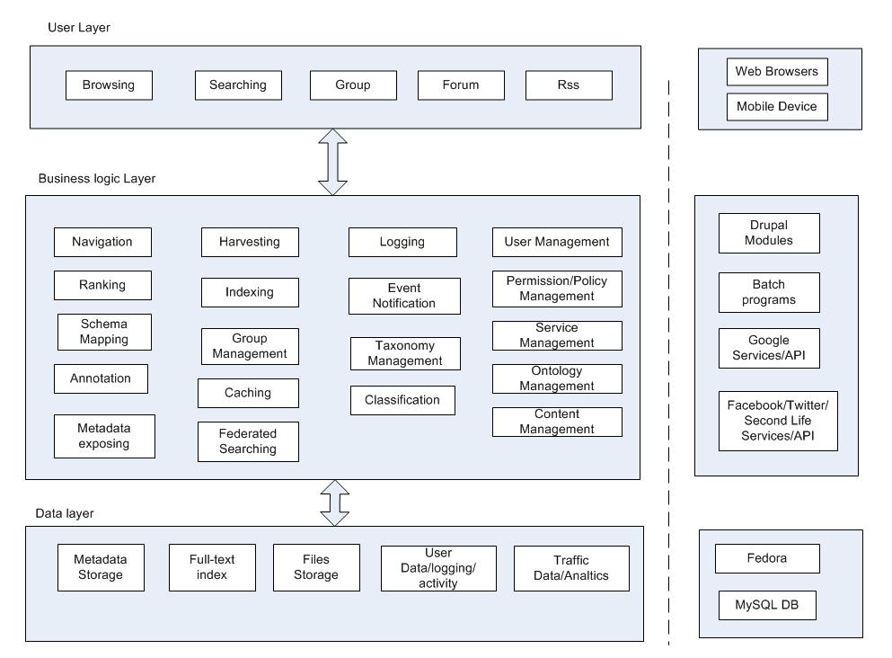
Ensemble Portal Architecture

Slide 32

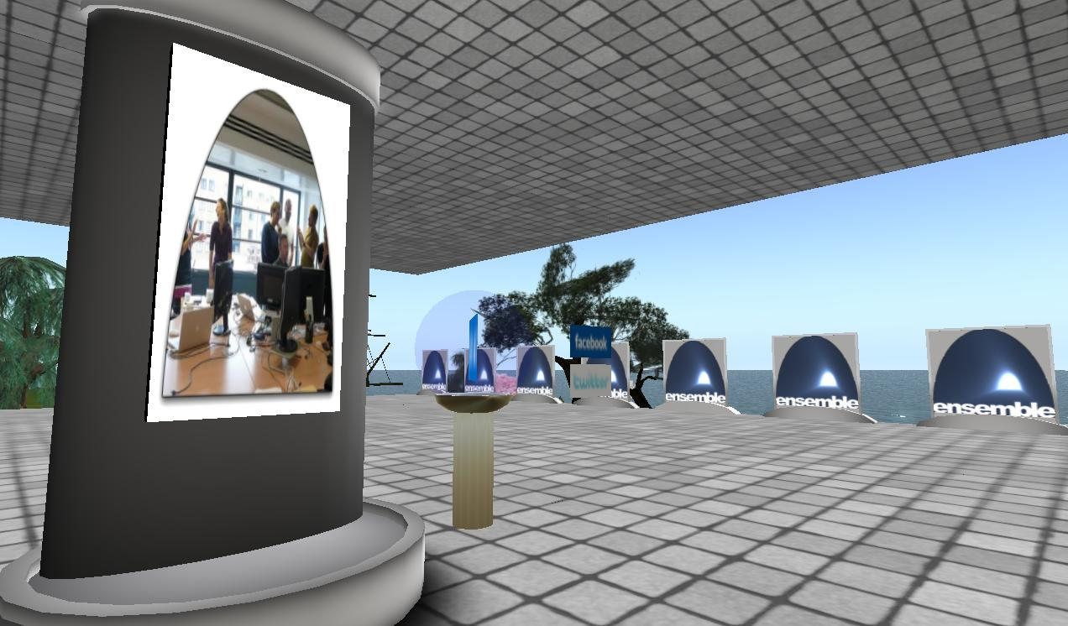
Ensemble in Second Life
http://slurl.com/secondlife/Educators%20Coop%204/66/236/28
The Ensemble Pavilion offers:
• teleports to other computing sites in Second Life like the Digital Preserve
• hyperlinks to related computing websites
• RSS readers with feeds from computing and computing education blogs
• membership in the Ensemble Computing group in Second Life, Facebook, and Twitter

Slide 33
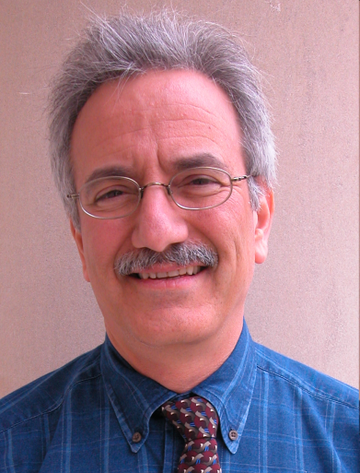
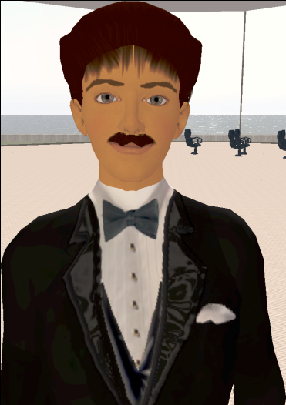
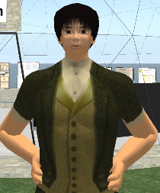
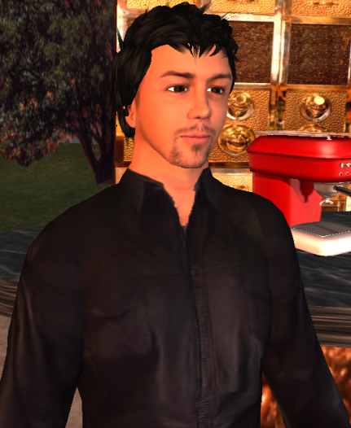
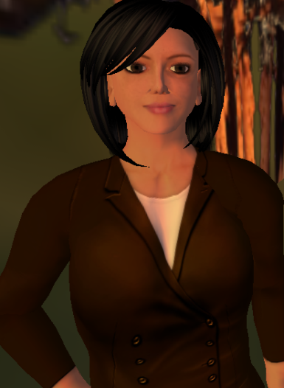
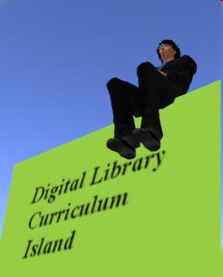
Selected Digital Preserve Personnel
Gary Octagon
Gary Marchionini
EdFox Rieko
Edward Fox
zamfir Paule
Spencer Lee
Uma Aldrin
Uma Murthy
Krad Proto
Seungwon Yang
mantruc Martian
Javier Velasco-Martin

Slide 34
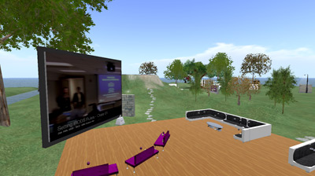
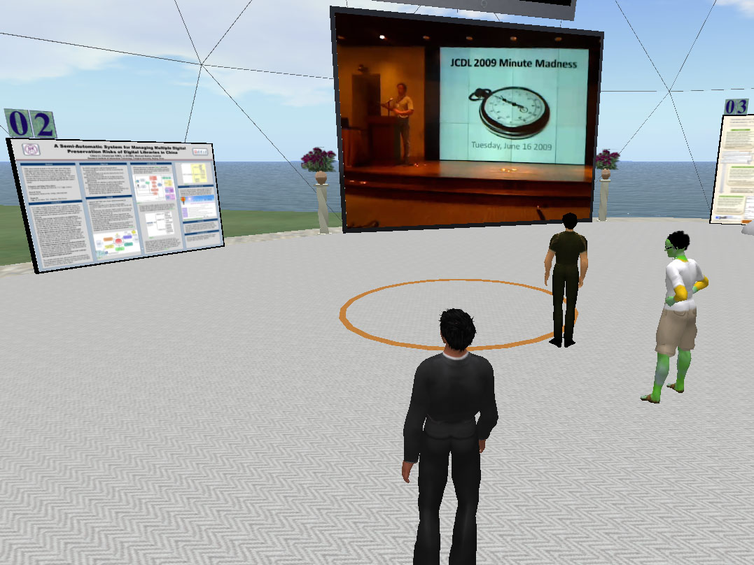
DP areas
Poster Building
18 posters on display
Poster view tips
Video screen
Cafe
Beverages
Screens
Discussion areas

Slide 35
Part 3 – Basic DL Concepts
Digital Library Scope
OAI
  Harvesting
  Repositories
Space-related Perspectives of Computing
  Distributed
  Cloud …
5S -> Content + Society

Slide 36
DL Scope
Institutional repositories
Open archives
Electronic/virtual libraries
Content management systems
Courseware management systems
Personal information management systems
Cloud/ubiquitous/… computing

Slide 37
Synchronous
Scholarly Communication
Same time, Same or different place

Slide 38

Asynchronous, Digital Library Mediated Scholarly Communication
Different time and/or place

Slide 39


Slide 40
Information Life Cycle
Creation
Active
Authoring
Modifying
Social Context
Using
Creating
Organizing
Indexing
Retention
/ Mining
Accessing
Filtering
Storing
Retrieving
Semi-
Active
Utilization
Distributing
Networking
Inactive
Searching
Notes:
This is a simplification of the previous slide.

Slide 41
Quality and the Information Life Cycle

Slide 42
DLs Shorten the Chain to
Roles
Digital
Library
Author
Teacher
User
Reader
Editor
Learner
Reviewer
Librarian

Slide 43
Degree of Structure
Web
DLs
DBs
Chaotic
Organized
Structured

Slide 44
Example of Granularity of Information Structure
Example of Structural Level
of Text Information
Word level
Phrase level
Sentence level
Passage level
Document level

Slide 45
ETD Logical Hierarchy
ETD
Cover
Page n
…
Section 1
…
Line n
Paragraph 1
…
Token 2
Character 1
Character n
…
Abstract
Acknowledgement
Table of contents
List of tables
List of figures
Chapter 1
Part I
Sentence 1
Phrase 1
Word 1
..

Slide 46
OAI = Technical Umbrella for
Practical Interoperability…
Metadata Harvesting
Reference
Libraries
Museums
Publishers
E-Print
Archives
…that can be exploited by different communities

Slide 47
OAI – Repository Perspective
Glossary:
DC=Dublin Core
MDO=Metadata Object
DO=Digital Object
Required: Protocol
Set Structure
URI Scheme
MDO
MDO
MDO
MDO
Required: DC
MDO
MDO
MDO
MDO
DO
DO
DO
DO

Slide 48
The World According to OAI
Service Providers
Discovery
Current
Awareness
Preservation
Metadata
harvesting
Data Providers

Slide 49
Space-related Computing
Mobile Computing
Ubiquitous Computing
Social Computing
Information
Green Computing
Cloud Computing

Slide 50
5S Layers
Societies
Scenarios
Spaces
Structures
Streams

Slide 51
5S Contextualized
Societies/communities/users served
Scenarios/services supported
Management of physical/conceptual/ feature spaces
Use of structures/organizational devices
Streams of content and communication

Slide 52
5S and DL formal definitions and compositions (April 2004 TOIS)

Slide 53
Content / People

Slide 54
Extending 5S
Higher DL Constructs
  Collections
  Catalogs
  Repositories and Archives
  Systems
  Case Studies
Specialized views and services

Slide 55
Streams
Structures
Spaces
Scenarios
Societies
community
services
user role
structured stream
structural metadata specification
descriptive metadata specification
user model
user
digital object
metadata catalog
hypertext
indexing
searching
browsing
personalization
collection
repository
collaboration
Minimal DL
base document
superimposed document
image stream
feature vector
mark
superimposed structure
image descriptor
composite image descriptor
structured feature vector
subdocument
presentation channel
view in context
image content description
image object
image descriptor metadata catalog
image collection
image digital object
complex object structure
complex object
visualization
CBIR service

Slide 56
Tools/Applications

Slide 57
Content Centered
Genre
  Gray literature
  Report, courseware
  Posters, demos, tutorials, panels, debates
Format (Humanities needed TEI)
Presentation (Enhanced expressivity)
Preservation (Rationalizing digitization)

Slide 58
Society Centered
Society, community, group, user
Web 2.0, Social networking
Computer-supported cooperative work
User modeling
  Authors, committee/peers, readers
Economics / culture
  Free: but who actually pays, how, implications
  Low cost: prepaid, but what of preservation
  Repository hierarchy: group, institution, nation

Slide 59
Part 4 – NDLTD
Roles
Member Support
Workflow
Content
Support for
Union Catalog

Slide 60
The Networked Digital Library of Theses and Dissertations
www.NDLTD.org
Advocate:
Training Authors
Expanding Access
Preserving Knowledge
Improving Graduate Education
Enhancing Scholarly Communication
Empowering Students & Universities
Leader of the Worldwide ETD
(Electronic Thesis and Dissertation) Initiative

Slide 61
Member Support
Advocacy for ETD activities
Annual conference
ETD-L – listserv for discussion
Union catalog: improving local data
Best X ETDs in Y lists
Services for access
Information for ETD projects
  Standards, documentation, best practices
Connect with: institutional repositories, …

Slide 62
Student Gets Committee
Signatures and Submits ETD
Approval
form
Signed
Grad School
Notes:
10

Slide 63
Library Catalogs ETD, Access is
Opened to the New Research
WWW
NDLTD
Digital library access control
Notes:
12

Slide 64
Support For Students
Learn about
  Electronic publishing
    Concepts, computational thinking
    Tools and services
  Intellectual property rights
  Digital libraries
More visibility
  Discover (potential) collaborators
  More citations

Slide 65
Support For Universities
Improve graduate education
Save time, space, and money
Increase visibility of research
  Through open access
Expand capabilities with digital libraries
  Including institutional repositories
Collaborate in region, nation, and internationally through the ETD movement

Slide 66
Union catalog statistics 5/2010
WorldCat has 13.4M records w. 502 MARC field indicating “thesis”
915K records are ETDs (MARC 502, 856)
630K ETDs added to WorldCat in 21 months
Uncertainty
  ETDs in Union Catalog not in WorldCat
  Union Catalog duplicates
OCLC data provider; services provided by Scirus, VTLS, …

Slide 67
Part 5 – Services Centered
Taxonomy
Interoperability, integration, packaging
  HTML5
Collaboration, annotation, recommending
Indexing, CBIR
Categorizing, browsing
Roles of librarians

Slide 69
DL.Org Functionality WG
Dagobert Soergel – Sci. Lead:
Functions where Interoperability is important
Behind the scene | For users
Feature extraction Classification / clustering Sharing authority files Log file analysis Sharing user profiles Harvesting , aggregating Shared storage and backup | Federated search Incorporating content from other places on the fly Display and visualization Timelines Maps Playing videos Same look-and-feel browse

Slide 70
Sub-functions of search
Quick Search | Advanced Search
Enter a query and click search Enter keywords or phrases for selected field Limit results to Search subscribed titels Clear | Enter a query and click search Enter keywords or phrases for selected fields Select keyword from a list Select Boolean operator (explicit) Define phrase match (explicit) Clear Search within results Limit results to (preselection) Sort by (preselection) Select display options Display X results per page Display search history

Slide 71
Sub-functions of annotate
Select object to be annotated (need to indicate selection method) Mark region in the object (many different methods depending on the object) Select type of annotation (highlight, mark with special meaning, text, image, sound) If text, image, sound Specify relationship to object to be annotated Select or create the annotating object (possibly specifying a region Annotating within one system Annotating across systems

Slide 72
Digital library architecture for local
and interoperable CITIDEL services

Slide 73
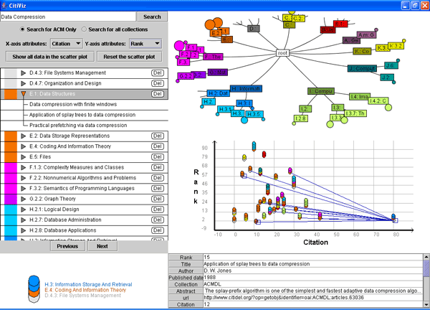
Example of Union Service: CitiViz

Slide 74
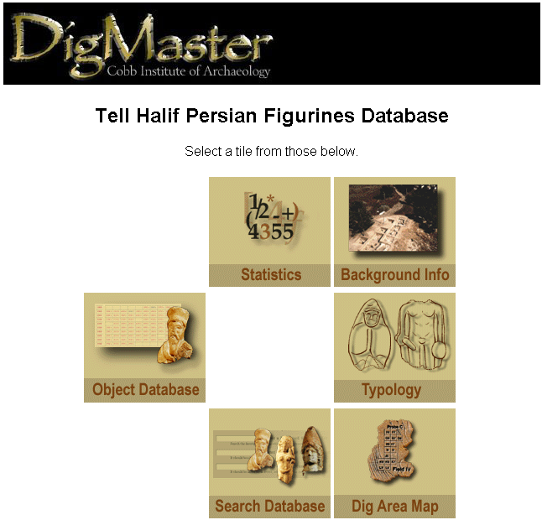
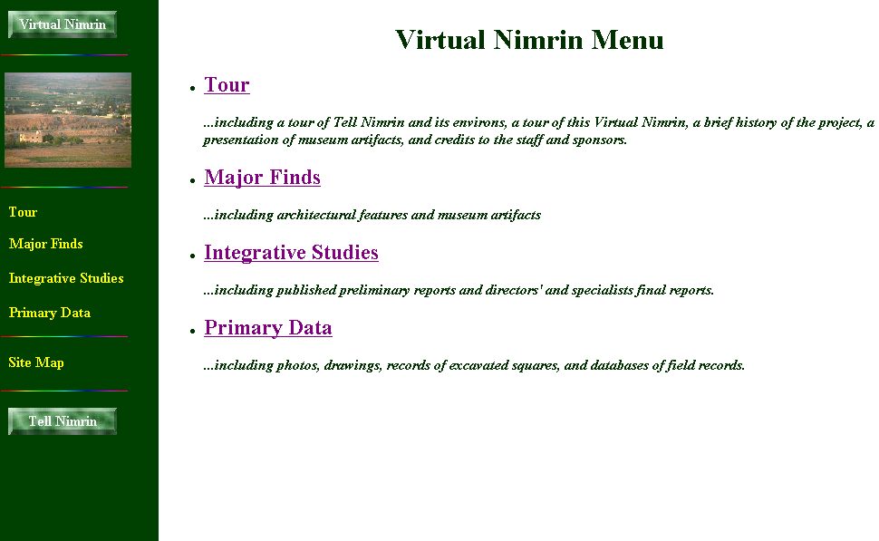
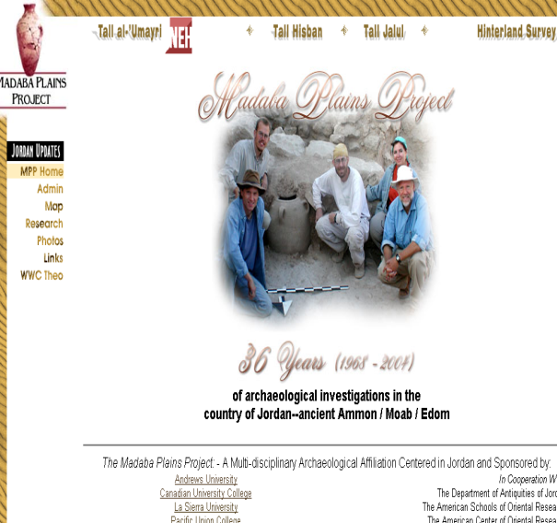
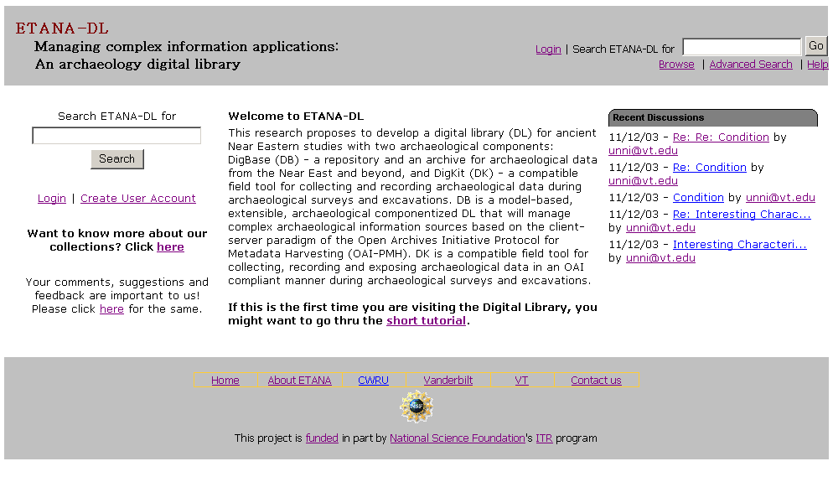
ETANA.org

Slide 75
Architecture of a Union DL (ETANA.org)
DL1
Union DL
DL2
Union Society
Society
☺ ☺ ☺ ☺
Society
☺ ☺
☺ ☺
archaeologists
Archaeologists
General Public
General Public
Union Service
Service
Service
Searching
Harvesting, Mapping,
Searching, Browsing,
Clustering, Visualization
Browsing
Catalog1
Union
Catalog
Catalog2
Union
Repository
Repository1
Repository2

Slide 76
Union Catalog Integration
Mapping
Tool
Virtual Nimrin
(VN)
VN Metadata
Format
Union ArchDL
Union
Catalog
VN
Catalog
Wrapper
Global Metadata
Format
Halif DigMaster
(HD)
HD
Catalog
Wrapper
HD Metadata
Format
Mapping
Tool

Slide 77

HTML5 Structuring Flowchart
HTML5
tag set
TXT/ HTML
ETD
structure
analyzer
Tagged TXT
PDFETD
Text/ Grammar
PDF2Text/HTML converter
HTML5
Converter
Multimedia file link extractor
Tagged TXT
HTML5ETD
TXT/ HTML
Tagged MM Source
HTML
Multimedia file source extractor

Slide 78
ETD Classification:
Algorithm Pipeline
ETDs categorized into a node of the category tree (after classification)
Category
Tree
ETD Collection
Category label for each node used as query
ETD metadata used for categorization
Categorized
ETDs
Google
Naïve Bayes Classifiers
Level-wise categorization
Top 50 webpages (for each node in the tree)
Training
Browsing
Web
Interface
Document
Sets
Training
Sets
Cleanup
(stemming,
stopword removal,
etc.)

Slide 79
Digital Librarians
Community oriented
Collection management
Customized services
Principles:
  Openness
  Expansion
    Interoperation, integration, communitization

Slide 80
Scholarship
Humans/
Humanities
DL curriculum
Ensemble
Living In the KnowlEdge
Society (LIKES): Book,
Part on Humanities
Needs
Areas
Approach
Supporting
Scholarship
About Humans
Through
Content &
Services
Content
Services
Digitized
ETDs
Born digital
(digital
natives)
DLs:
CTRnet
Ensemble
ETANA
NDLTD
Flattening
(cooperation,
collaboration)
Exploring
(search, browse)
Interoperability
Integration

Slide 81
Summary
Humanism, Humanities
Selected DL Projects
Basic DL Concepts, Scholarship
NDLTD
Services Centered
Questions and Comments?
http://fox.cs.vt.edu/talks/2010/
Remember: (ACM) JOCCH !!

