Slide 1
1st Canadian ETD & Open Repositories Workshop May 10-11, 2010 Carleton University, Ottawa “NDLTD: Past, Present, and Future” by Edward A. Fox
fox@vt.edu http://fox.cs.vt.edu
Dept. of Computer Science, Virginia Tech
Blacksburg, VA 24061 USA

Slide 2
Outline
Acknowledgements
NDLTD
Union Catalog
Recent and Future Work
Summary

Slide 3
Acknowledgements
All those working with ETDs
NDLTD, including Board, Committees, and Members
ETD & OR Workshop Team
Sponsors
Presenters, Attendees

Slide 4
Acknowledgements: Future Conferences
2010 – 13th symposium
University of Texas at Austin, 16-19 June
2011 – 14th symposium
Cape Town, S. Africa, in Sept.-Oct. time frame
2012 – 15th symposium
Bidding still open … ☺
Notes:
3
3

Slide 5
Outline
Acknowledgements
NDLTD
Union Catalog
Recent and Future Work
Summary

Slide 6
The Networked Digital Library of Theses and Dissertations
www.NDLTD.org
Advocate:
Training Authors
Expanding Access
Preserving Knowledge
Improving Graduate Education
Enhancing Scholarly Communication
Empowering Students & Universities
Leader of the Worldwide ETD
(Electronic Thesis and Dissertation) Initiative

Slide 9
NDLTD Incorporation
Networked Digital Library of Theses and Dissertations
incorporated May 20, 2003 in Virginia, USA
Charitable and educational purposes (501 c 3)

Slide 10
Board of Directors
Suzie Allard (ETD 2004, U. Kentucky)
Julia C. Blixrud (ARL)
Tony Cargnelutti
Vinod Chachra (VTLS)
Birte Christensen-Dalsgaard (Royal Library, Denmark)
William Clark (Ohio State U.)
Bruce Cochrane (Miami U. Ohio)
Susan Copeland (RGU, UK)
Jude Edminster (Bowling Green St. U.)
Edward A. Fox (Executive Director, Virginia Tech)
John H. Hagen (West Virginia U.)
Thomas B. Hickey (OCLC)
Christine Jewell (U. Waterloo, Canada)
Joan K. Lippincott (CNI)
Austin McLean (Treasurer, Proquest)
Gail McMillan (Secretary, Virginia Tech)
Eva Müller (EBSCO, Sweden)
Ana Pavani (PUC Rio, Brazil)
Max Read (U. British Columbia)
Sharon Reeves (Library and Archives of Canada)
Peter Schirmbacher (ETD 2003, Humboldt)
Nancy Seamans, Georgia State U.
Hussein Suleman (U.Cape Town, S. Africa)
Shalini R. Urs (U. Mysore, India)
Eric F. Van de Velde (ETD 2001)
Xiaolin Zhang (National Science Library, China)

Slide 11
NDLTD Committees (Chairs)
Awards (Christine Jewell, John Hagen)
Communications (Suzie Allard)
Conferences (Sharon Reeves)
Development (Suzie Allard, John Hagen)
Executive (Ed Fox)
Finance (Austin McLean)
Membership (Eric Van de Velde)
Nominating (Joan Lippincott)
Working Groups
International Activities, Strategic Planning, Website Revision, ETD Guide Revision

Slide 12
Member Support
Advocacy for ETD activities
Annual conference
ETD-L – listserv for discussion
Union catalog: improving local data
Best X ETDs in Y lists
Services for access
Information for ETD projects
Standards, documentation, best practices
Connect with: institutional repositories, …

Slide 13
Focused Needs/Opportunities
DART-Europe
Internationalization
Marketing
Member Benefits
Mentoring
Students
Visibility
Website, Guide (in Wikibooks)

Slide 14
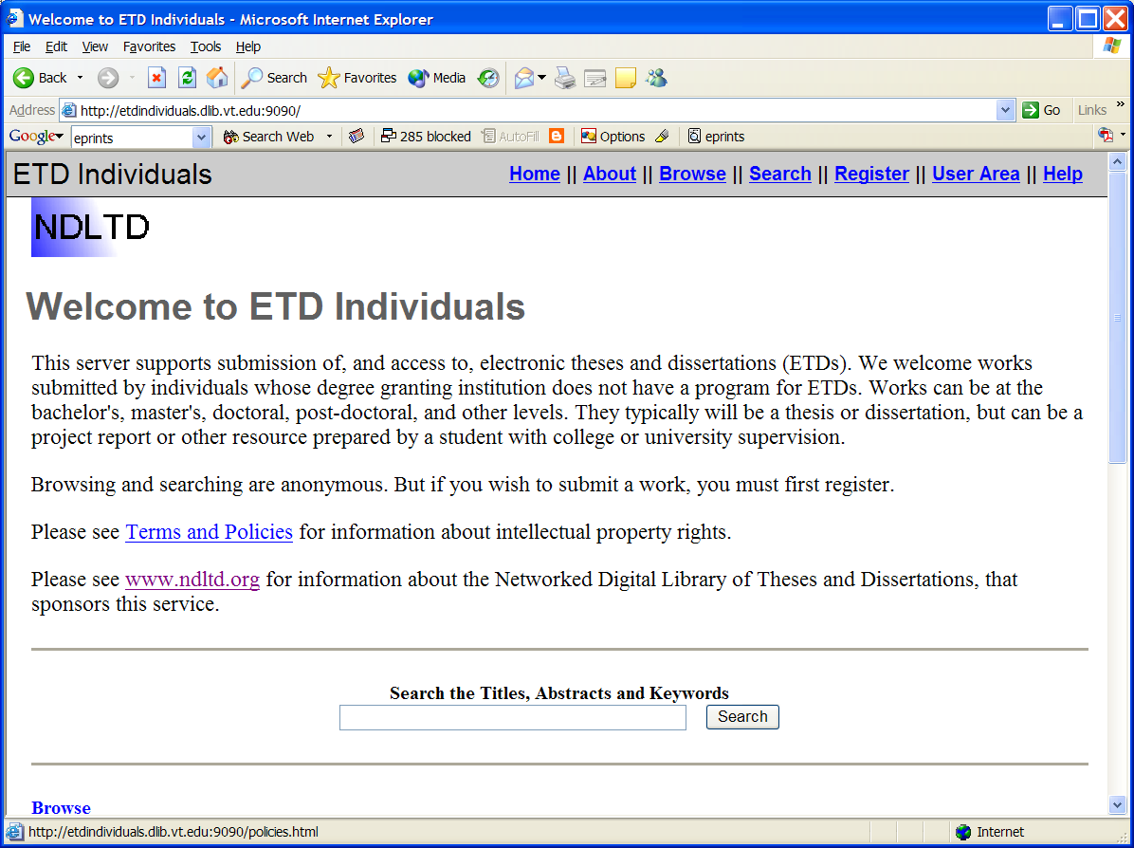

Slide 15
Members, Community
Individuals
Universities
Consortia
Investigate the Possibility
Pilot
Richer ETDs
Backfile conversion
Help other sites

Slide 16
For Students
Learn about
Electronic publishing
Concepts, computational thinking
Tools and services
Intellectual property rights
Digital libraries
More visibility
Discover (potential) collaborators
More citations

Slide 17
For Universities
Improve graduate education
Save time, space, and money
Increase visibility of research
Through open access
Expand capabilities with digital libraries
Including institutional repositories
Collaborate in region, nation, and internationally through the ETD movement

Slide 18
Outline
Acknowledgements
NDLTD
Union Catalog
Recent and Future Work
Summary

Slide 19
Union catalog
OCLC runs OAI data provider on TDs, getting data from WorldCat (many sites!).
Harvests from all others who contact them (see Thom Hickey, hickey@oclc.org).
Need DC and either ETD-MS or MARC.
Need a set for ETDs, or separate data provider.
Supports services by VTLS, Scirus, …

Slide 20
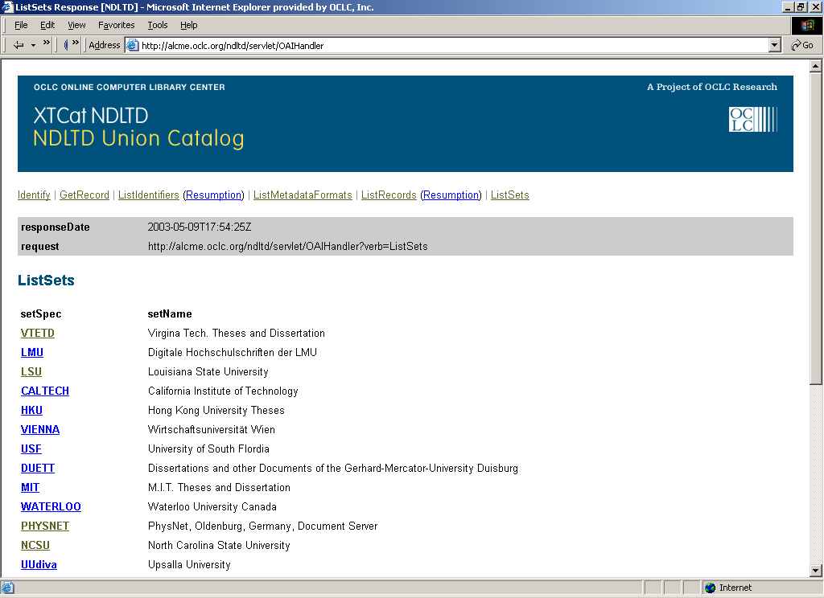

Slide 21
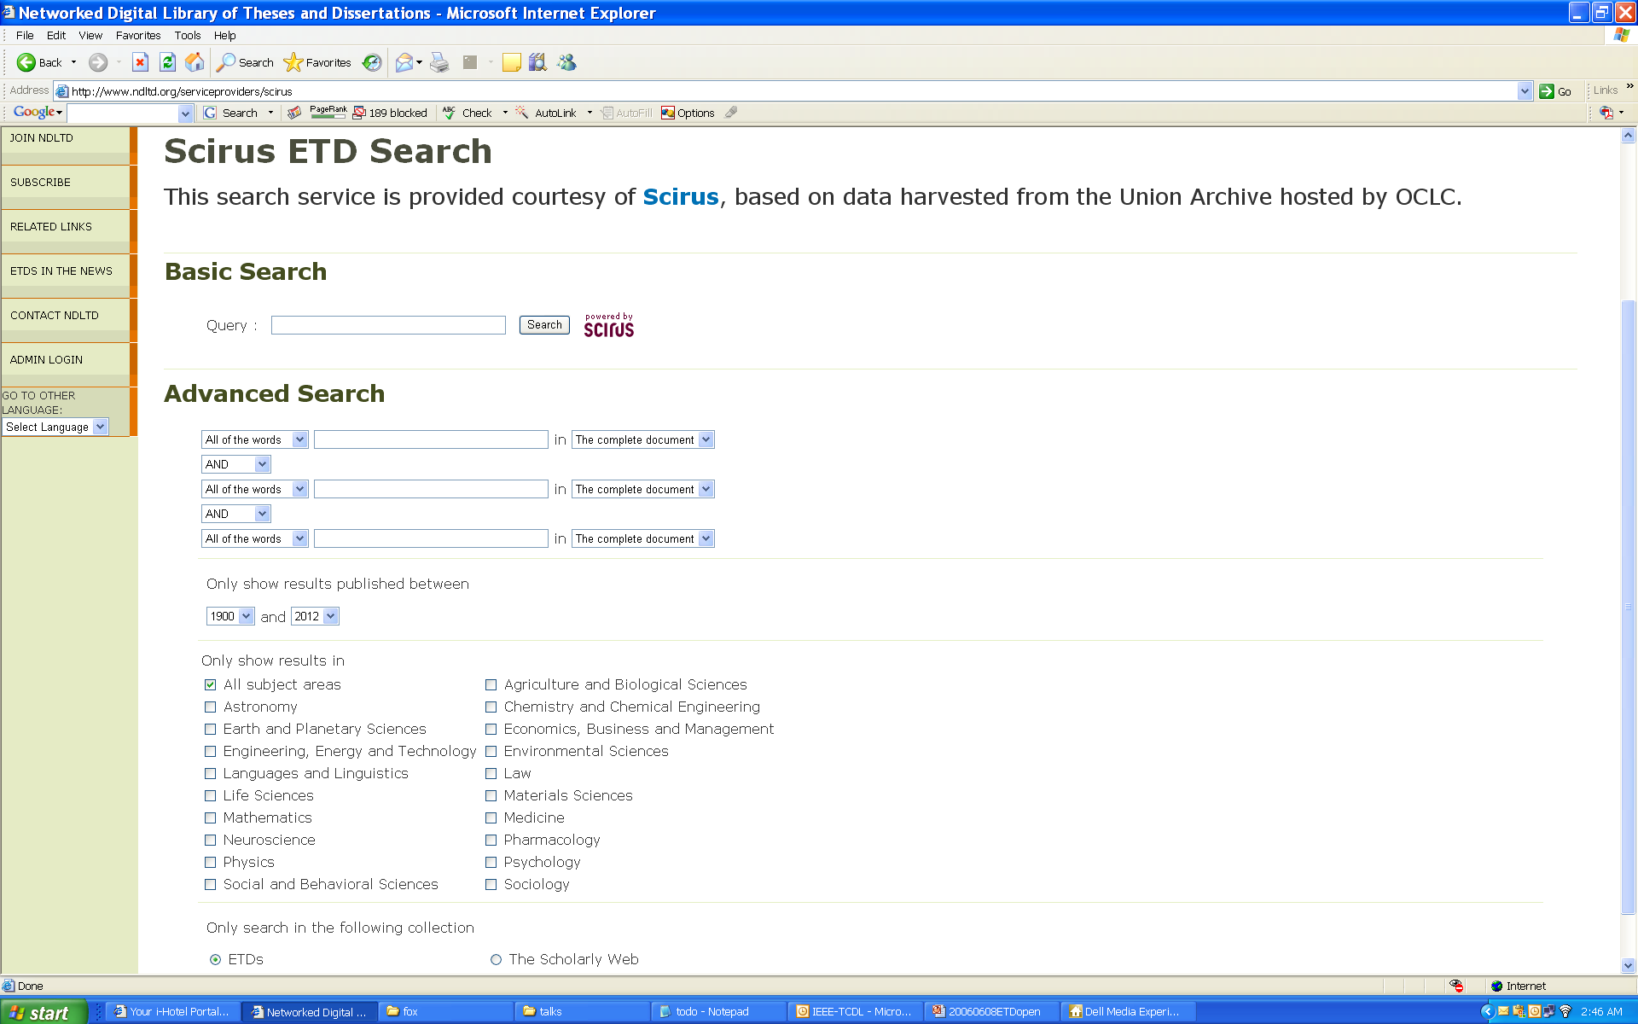

Slide 22
Union catalog statistics 5/2010
WorldCat has 13.4M records w. 502 MARC field indicating “thesis”
915K records are ETDs
502 and 856 MARC fields
ETDs added to WorldCat over the last 21 months = 630K
Uncertainty
ETDs in Union Catalog not in WorldCat
Union Catalog duplicates

Slide 23
Outline
Acknowledgements
NDLTD
Union Catalog
Recent and Future Work
Summary

Slide 24
Recent and Future Work
OAI
Preservation (LOCKSS)
Metadata: Update ETD-MS
Seungwon Yang
Venkat Srinivasan
Sung Hee Park
Other Future Services and Enhancements

Slide 25
OAI - Open Archives Initiative
Advocacy for interoperability
Standard for transferring metadata among digital libraries
Protocol for Metadata Harvesting (PMH)
Simplicity
Generality
Extensibility
Support for PMH => Open Archive (OA)

Slide 26
LOCKSS, MetaArchive
Lots of copies keep stuff safe
Stanford (Vicky Reich)
Initial content: journals
Set of publisher manifests (information providers)
Set of storage systems (archival storage)
2005 proof of concept inside USA
2006 proof of concept for international members
Who wants to join to extend (w. MetaArchive)?
Preservation Initiative: Gail McMillan

Slide 27
ETD-MS
ETD Metadata Standard
XML-encoded metadata standard (content and encoding) for Electronic Theses and Dissertations (ETDs)
in part conforming to Dublin Core (DC)
using RDF
using UNICODE
With specified relationship to MARC
Reworking and updating …

Slide 28
Seungwon Yang
Gigapixel display
Many computers and monitors in display wall
5 high x 10 wide
Showing many pages simultaneously
Sections of display for different purposes
Structure tree, sections as leaves
Comparing 2 ETDs

Slide 29
Venkat Srinivasan
DMOZ: OK if use highest levels
LCSH: over 4000 entries
OCLC data for training
MARC records: for ETDs, for comparable set of books
Build classifiers
Data to use
Title + Abstract vs. Adding Fulltext
New categorization and derived services
One ETD, ranked list of categories
Categories for each chapter

Slide 30
Sung Hee Park
ETD Table of Contents
Identify Structure according to ToC
Relate to Structure of Chapters, Sections, …
Extract citations and references
Related work by C. Lee Giles, etc.
Extract tables
Extract figures

Slide 31
Vision for a Research Project
ETD repository
zzzzzzz
Metadata Extraction
Finding the evidence between interdisciplinary
Structured ETD repository
Citation Extraction
Semantic Educational repository
Semantic search for large size document
chapterizing
Structured Syllabus repository
Categorization, searching, retrieval
TOC extraction
ETD structuring
Syllabus repository

Slide 32
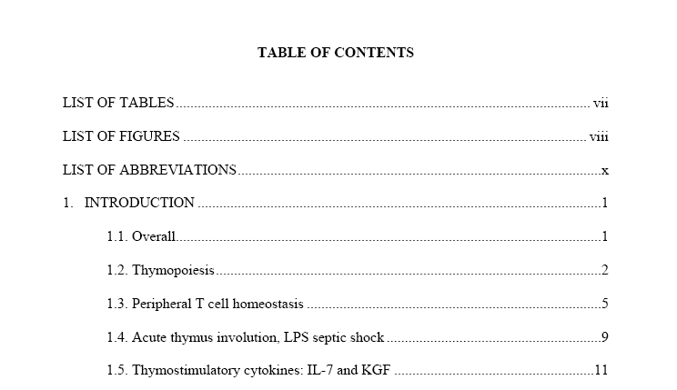
Logical structure
Logical location
ToC entry
Numbering scheme
Separator
Indentation
heading
Delimiter
Logical page

Slide 33
Physical Hierarchy
ETD
Page 1
Page n
…
Line 1
…
Line n
Token 1
…
Token 2
Character 1
Character n
…

Slide 34
Future Work – 1 of 3
Build Collection
Add in page images of back files or at least bib records (retrospective)
Expand from dissertations to theses to undergrad theses (to reports to e-portfolios)
Cover all universities in every region, every country
Build Community: local, national, regional

Slide 35
Future Work – 2 of 3
Promote richer use of ETDs
Collaborate with Google, Microsoft, …
Support students so have DOIs, resolved references, citing passages, separate CVs
Support cross language, multilingual, image & multimedia search/browse
Cross-lingual summarization and support for discovery
Browsing after classifying

Slide 36
Future Work – 3 of 3
Enhance services for students
Help students with electronic submission, e-pub, multimedia, hypermedia, electronic data sets, electronic lab notebooks
Support students with annotations, threaded discussions, recommenders
Support work with early versions of ETDs for collaboration, with limited access and chat groups, mentoring, external committee members
Encourage submission of PPT, video of defense (or a rerun)

Slide 37
Other Conferences
JCDL
ICADL
ECDL
CIKM
SIGIR
Multimedia
…
www.dlib.org

Slide 38
Spirit of NDLTD
Help make a better (smaller) world
Win-win-win (everyone can benefit)
Have fun helping others
Helpers/teachers learn more than those they work with
Build on standards
ETDs are preservable, popular, expressive, “better”
Doable, feasible, learnable, affordable, sharable
Please join/support NDLTD!

Slide 39
Summary
Acknowledgements
NDLTD
Union Catalog
Recent and Future Work
Questions and Comments?
http://fox.cs.vt.edu/talks/2010/

