Slide 1
1st Canadian ETD &
Open Repositories Workshop
May 10-11, 2010 Carleton University, Ottawa
“Opening and Expanding
Digital Library Services” by Edward A. Fox
fox@vt.edu http://fox.cs.vt.edu
Dept. of Computer Science, Virginia Tech
Blacksburg, VA 24061 USA

Slide 2
Acknowledgements
Mentors (Licklider, Kessler, Salton)
Virginia Tech, CS, Digital Library Research Laboratory
NSF and other sponsors
Students, colleagues, co-investigators
Monika Akbar, Yinlin Chen, Spencer Lee, Venkat Srinivasan, Seungwon Yang, …
Boots Cassel, Gary Marchionini, Jeffrey Pomerantz, Barbara Wildemuth, Andrea Kavanaugh, Naren Ramakrishnan, Steve Sheetz, Don Shoemaker, …

Slide 3
Part 1 – Selected DL Projects
Digital Library Curricular Resources
  NSF IIS-0535057 & 0535060
CTRnet (Crisis, Tragedy & Recovery Net)
  NSF IIS-0916733
Ensemble (Computer Science Education)
  NSF DUE-0840719
Digital Preserve
  NSF IIS-0910183 & 0910465
  http://slurl.com/secondlife/Digital%20Preserve/140/126/29

Slide 4
DL Curric. Project - 1
NSF awards to VT and UNC-CH
CS and LIS
Project server: http://curric.dlib.vt.edu/
Wikiversity: http://en.wikiversity.org/wiki/Curriculum_on_Digital_Libraries

Slide 5
DL Curric. Project - 2
Module 1-b: History of digital libraries and library automation
Module 2-c: File Formats, Transformation, and Migration
Module 3-b: Digitization
Module 4-b: Metadata
Module 5-a: Architecture overviews

Slide 6
DL Curric. Project - 2
Module 5-b: Application software
Module 5-d: Protocols
Module 6-a: Information needs/relevance
Module 6-b: Online information seeking behaviors and search strategies
Module 6-d: Interaction design and usability assessment

Slide 7
DL Curric. Project - 3
Module 7-b: Reference Services
Module 7-g: Personalization
Module 8-b: Web Archiving
Module 9-c: Digital library evaluation, user studies

Slide 8

CTR stakeholders
Notes:
Help affected communities to recover more quickly and effectively
Provide global network with relevant information and resources
Support the research community, emergency personnel, decision makers, and the public in reacting to and recovering from crises

Slide 9
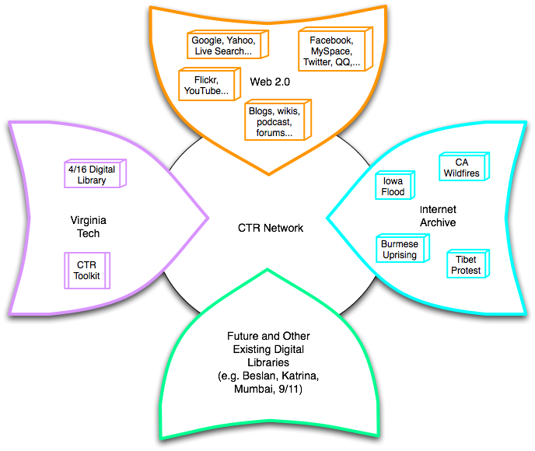
Build a networked digital library relating to CTR
www.citeulike.org group ctrnet
Citations
Papers, …
Integrate community, content, and services relating to CTR, making it accessible, and preserving it for long-term reuse
Support information exploration
Aided by an ontology

Slide 10
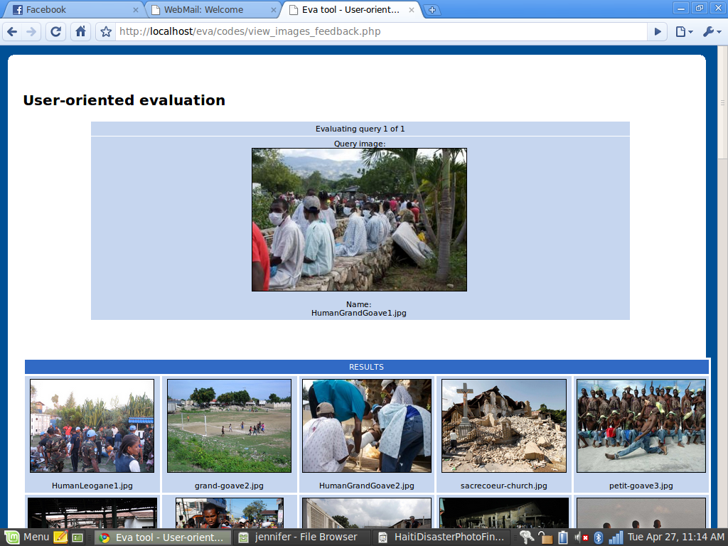
Haiti Photographs, Content Based Image Retrieval Evaluation

Slide 11





Goals for Ontology for CTR
CTR literature
Browsing
sources
Searching
  Query
  expansion
Focus groups
CTR Ontology
Individual
Organizational
Community
Political
…
Tagging
Websites,
Internet Archive
Recommending
Social network
applications
Summarizing
uses
Multicultural/ linguistic input
Visualizing

Slide 12
Preliminary Data Analysis
Revise seeds if poor preliminary data
Crawl
Index Data
Index crawl data from Heritrix
Use NutchWax to preliminarily analyze seed quality
Pass Along
Collect Seeds
Send ARC files on for Story-telling

Slide 13
Data Filtering and Storytelling
Crawling
Basic Text Cleanup
Classification
Storytelling
Preprocessing
Extracting Text
Supervised learning methods
Generating stories
Visualization
Story analysis
Evaluation
Classifying new data

Slide 14



Social network services
Computing Communities
WebCAT
TECH
FOCES
CATSpace
CS1
Ensemble Portal
Drupal
Blog
Browse
Search
Tools
Walden’s Path/VKB
Forum
Submit
RSS
Walden’s Path
VKB
SI
Storage
Fedora
Computing Resources
Syllabus
SWENET
AlgoViz
CSTC
CITIDEL
CSTA

Slide 15

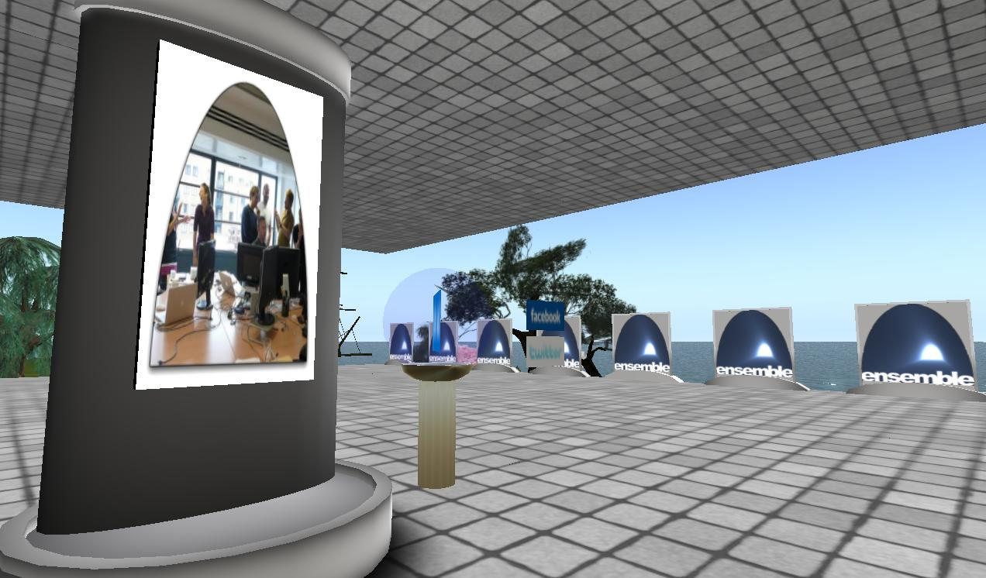
Ensemble in Second Life
http://slurl.com/secondlife/Educators%20Coop%204/66/236/28
The Ensemble Pavilion offers:
• teleports to other computing sites in Second Life like the Digital Preserve
• hyperlinks to related computing websites
• RSS readers with feeds from computing and computing education blogs
• membership in the Ensemble Computing group in Second Life, Facebook, and Twitter
www.computingportal.org

Slide 16
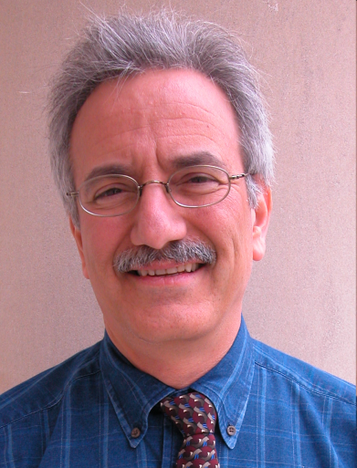
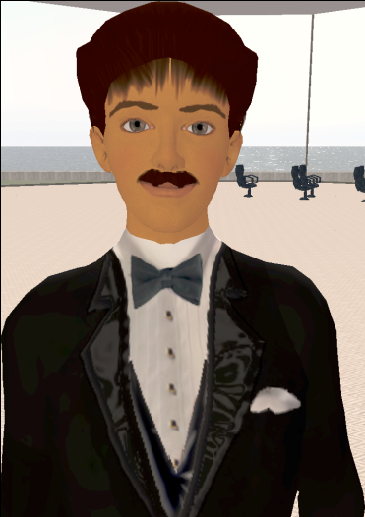
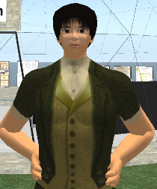
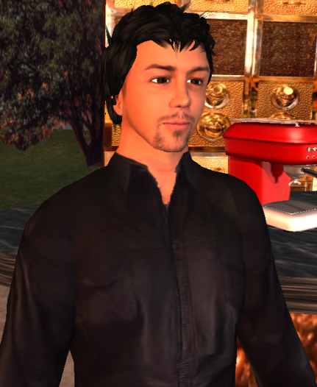
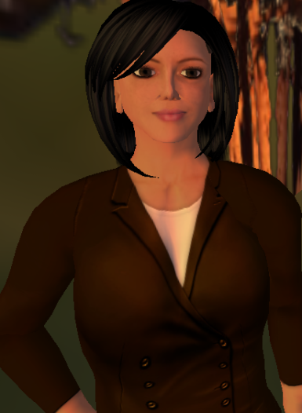
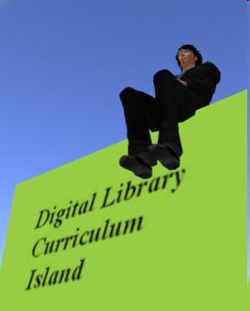
Selected Digital Preserve Personnel
Gary Octagon
Gary Marchionini
EdFox Rieko
Edward Fox
zamfir Paule
Spencer Lee
Uma Aldrin
Uma Murthy
Krad Proto
Seungwon Yang
mantruc Martian
Javier Velasco-Martin

Slide 17
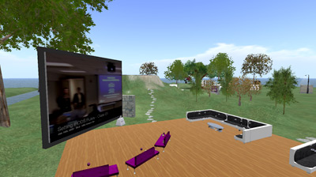
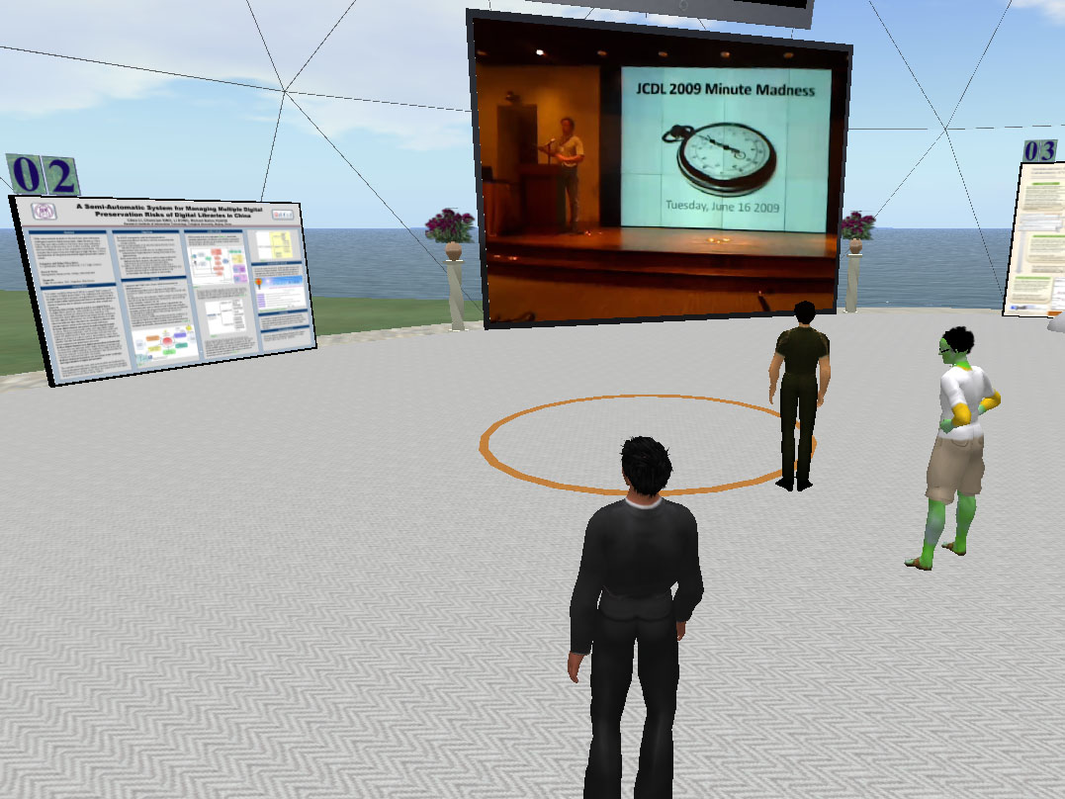
DP areas
Poster Building
18 posters on display
Poster view tips
Video screen
Cafe
Beverages
Screens
Discussion areas

Slide 18
Part 2 – Basic DL Concepts
Digital Library Scope
OAI
  Harvesting
  Repositories
Space-related Perspectives of Computing
  Distributed
  Cloud …
5S

Slide 19
DL Scope
Institutional repositories
Open archives
Electronic/virtual libraries
Content management systems
Courseware management systems
Personal information management systems
Cloud/ubiquitous/… computing

Slide 20
Synchronous
Scholarly Communication
Same time, Same or different place

Slide 21

Asynchronous, Digital Library Mediated Scholarly Communication
Different time and/or place

Slide 22


Slide 23
Information Life Cycle
Creation
Active
Authoring
Modifying
Social Context
Using
Creating
Organizing
Indexing
Retention
/ Mining
Accessing
Filtering
Storing
Retrieving
Semi-
Active
Utilization
Distributing
Networking
Inactive
Searching
Notes:
This is a simplification of the previous slide.

Slide 24
Quality and the Information Life Cycle

Slide 25
DLs Shorten the Chain to
Roles
Digital
Library
Author
Teacher
User
Reader
Editor
Learner
Reviewer
Librarian

Slide 26
Degree of Structure
Web
DLs
DBs
Chaotic
Organized
Structured

Slide 27
Example of Granularity of Information Structure
Example of Structural Level
of Text Information
Word level
Phrase level
Sentence level
Passage level
Document level

Slide 28
ETD Logical Hierarchy
ETD
Cover
Page n
…
Section 1
…
Line n
Paragraph 1
…
Token 2
Character 1
Character n
…
Abstract
Acknowledgement
Table of contents
List of tables
List of figures
Chapter 1
Part I
Sentence 1
Phrase 1
Word 1
..

Slide 29
OAI = Technical Umbrella for
Practical Interoperability…
Metadata Harvesting
Reference
Libraries
Museums
Publishers
E-Print
Archives
…that can be exploited by different communities

Slide 30
OAI – Repository Perspective
Glossary:
DC=Dublin Core
MDO=Metadata Object
DO=Digital Object
Required: Protocol
Set Structure
URI Scheme
MDO
MDO
MDO
MDO
Required: DC
MDO
MDO
MDO
MDO
DO
DO
DO
DO

Slide 31
The World According to OAI
Service Providers
Discovery
Current
Awareness
Preservation
Metadata
harvesting
Data Providers

Slide 32
Space-related Computing
Mobile Computing
Ubiquitous Computing
Social Computing
Information
Green Computing
Cloud Computing

Slide 33
5S Layers
Societies
Scenarios
Spaces
Structures
Streams

Slide 34
5Ss
Ss | Examples | Objectives
Streams | Text; video; audio; image | Describes properties of the DL content such as encoding and language for textual material or particular forms of multimedia data
Structures | Collection; catalog; hypertext; document; metadata | Specifies organizational aspects of the DL content
Spaces | Measure; measurable, topological, vector, probabilistic | Defines logical and presentational views of several DL components
Scenarios | Searching, browsing, recommending | Details the behavior of DL services
Societies | Service managers, learners, teachers, etc. | Defines managers, responsible for running DL services; actors, that use those services; and relationships among them

Slide 35
5S Contextualized
Societies/communities/users served
Scenarios/services supported
Management of physical/conceptual/ feature spaces
Use of structures/organizational devices
Streams of content and communication

Slide 36
5S and DL formal definitions and compositions (April 2004 TOIS)

Slide 37
Content / People

Slide 38
Extending 5S
Higher DL Constructs
  Collections
  Catalogs
  Repositories and Archives
  Systems
  Case Studies
Specialized views and services

Slide 39
Streams
Structures
Spaces
Scenarios
Societies
community
services
user role
structured stream
structural metadata specification
descriptive metadata specification
user model
user
digital object
metadata catalog
hypertext
indexing
searching
browsing
personalization
collection
repository
collaboration
Minimal DL
base document
superimposed document
image stream
feature vector
mark
superimposed structure
image descriptor
composite image descriptor
structured feature vector
subdocument
presentation channel
view in context
image content description
image object
image descriptor metadata catalog
image collection
image digital object
complex object structure
complex object
visualization
CBIR service

Slide 41
Tools/Applications

Slide 42
Society Centered
Society, community, group, user
Web 2.0, Social networking
Computer-supported cooperative work
User modeling
  Authors, committee/peers, readers
Economics / culture
  Free: but who actually pays, how, implications
  Low cost: prepaid, but what of preservation
  Repository hierarchy: group, institution, nation

Slide 43
Student Gets Committee
Signatures and Submits ETD
Approval
form
Signed
Grad School
Notes:
10

Slide 44
Library Catalogs ETD, Access is
Opened to the New Research
WWW
NDLTD
Digital library access control
Notes:
12

Slide 45
Content Centered
Genre
  Gray literature
  Report, courseware
  Posters, demos, tutorials, panels, debates
Format
Presentation
Preservation

Slide 46
Part 3 – Services Centered
Taxonomy
Interoperability, integration, packaging
  HTML5
Collaboration, annotation, recommending
Indexing, CBIR
Categorizing, browsing
Roles of librarians

Slide 48
DL.Org Functionality WG
Dagobert Soergel – Sci. Lead:
Functions where Interoperability is important
Behind the scene | For users
Feature extraction Classification / clustering Sharing authority files Log file analysis Sharing user profiles Harvesting , aggregating Shared storage and backup | Federated search Incorporating content from other places on the fly Display and visualization Timelines Maps Playing videos Same look-and-feel browse

Slide 49
Sub-functions of search
Quick Search | Advanced Search
Enter a query and click search Enter keywords or phrases for selected field Limit results to Search subscribed titels Clear | Enter a query and click search Enter keywords or phrases for selected fields Select keyword from a list Select Boolean operator (explicit) Define phrase match (explicit) Clear Search within results Limit results to (preselection) Sort by (preselection) Select display options Display X results per page Display search history

Slide 50
Sub-functions of annotate
Select object to be annotated (need to indicate selection method) Mark region in the object (many different methods depending on the object) Select type of annotation (highlight, mark with special meaning, text, image, sound) If text, image, sound Specify relationship to object to be annotated Select or create the annotating object (possibly specifying a region Annotating within one system Annotating across systems

Slide 51
Digital library architecture for local
and interoperable CITIDEL services

Slide 52
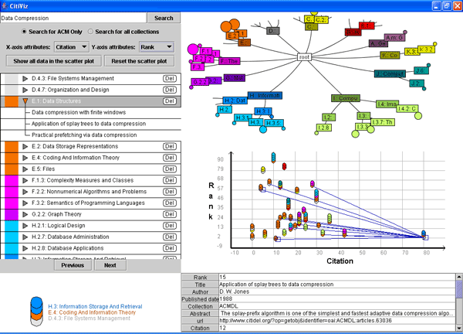
Example of Union Service: CitiViz

Slide 53
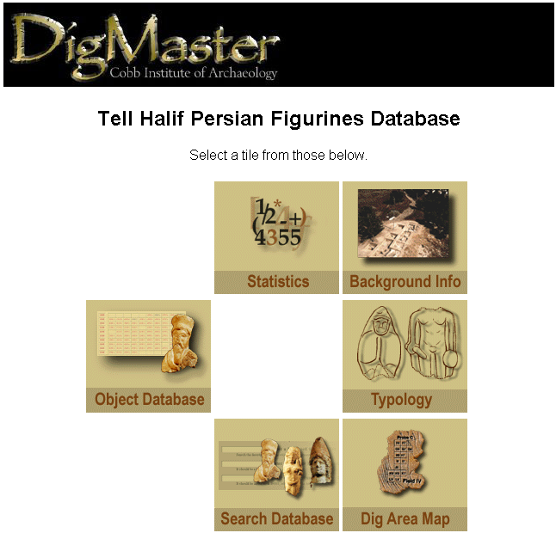
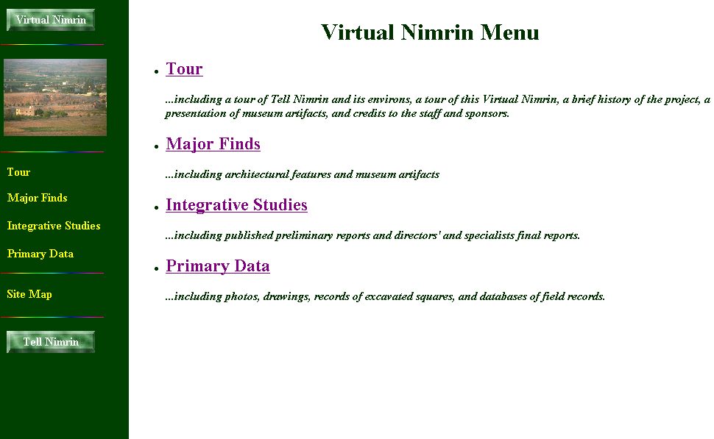
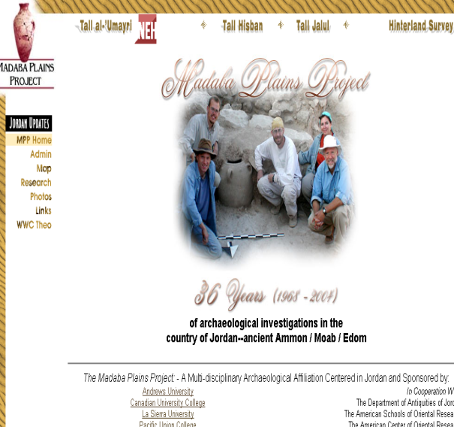
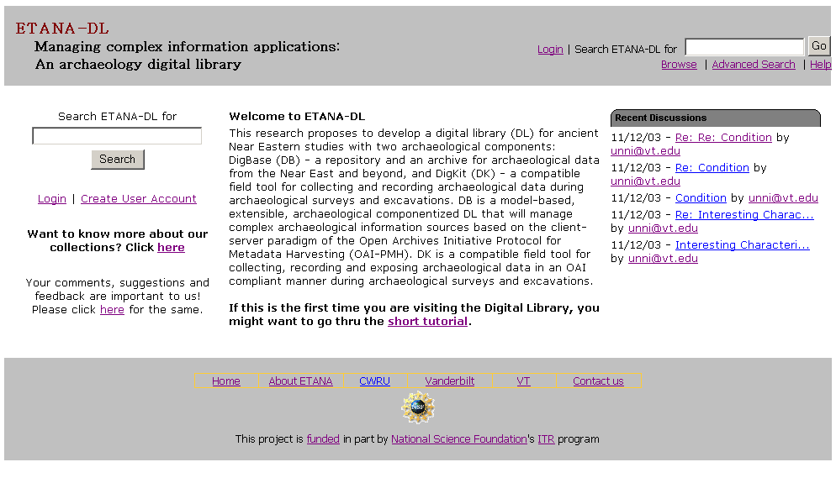
ETANA.org

Slide 54
Architecture of a Union DL (ETANA.org)
DL1
Union DL
DL2
Union Society
Society
☺ ☺ ☺ ☺
Society
☺ ☺
☺ ☺
archaeologists
Archaeologists
General Public
General Public
Union Service
Service
Service
Searching
Harvesting, Mapping,
Searching, Browsing,
Clustering, Visualization
Browsing
Catalog1
Union
Catalog
Catalog2
Union
Repository
Repository1
Repository2

Slide 55
Union Catalog Integration
Mapping
Tool
Virtual Nimrin
(VN)
VN Metadata
Format
Union ArchDL
Union
Catalog
VN
Catalog
Wrapper
Global Metadata
Format
Halif DigMaster
(HD)
HD
Catalog
Wrapper
HD Metadata
Format
Mapping
Tool

Slide 56

HTML5 Structuring Flowchart
HTML5
tag set
TXT/ HTML
ETD
structure
analyzer
Tagged TXT
PDFETD
Text/ Grammar
PDF2Text/HTML converter
HTML5
Converter
Multimedia file link extractor
Tagged TXT
HTML5ETD
TXT/ HTML
Tagged MM Source
HTML
Multimedia file source extractor

Slide 57
ETD Classification:
Algorithm Pipeline
ETDs categorized into a node of the category tree (after classification)
Category
Tree
ETD Collection
Category label for each node used as query
ETD metadata used for categorization
Categorized
ETDs
Google
Naïve Bayes Classifiers
Level-wise categorization
Top 50 webpages (for each node in the tree)
Training
Browsing
Web
Interface
Document
Sets
Training
Sets
Cleanup
(stemming,
stopword removal,
etc.)

Slide 58
Digital Librarians
Community oriented
Collection management
Customized services
Principles:
  Openness
  Expansion
    Interoperation, integration, communitization

Slide 59
Summary
Selected DL Projects
Basic DL Concepts
Services Centered
Openness
Expansion
Questions and Comments?
http://fox.cs.vt.edu/talks/2010/

