Slide 1
CNI 2009 Fall Meeting
Washington, D.C., 12/14
Crisis, Tragedy, and Recovery Network
(CTRnet)
Edward A. Fox
Virginia Tech, CS, Digital Library Research Laboratory
fox@vt.edu http://fox.cs.vt.edu www.dlib.vt.edu
www.ctrnet.net www.dl-vt-416.org
http://fox.cs.vt.edu/talks/2009/20091214CNI09CTR.pdf

Slide 2
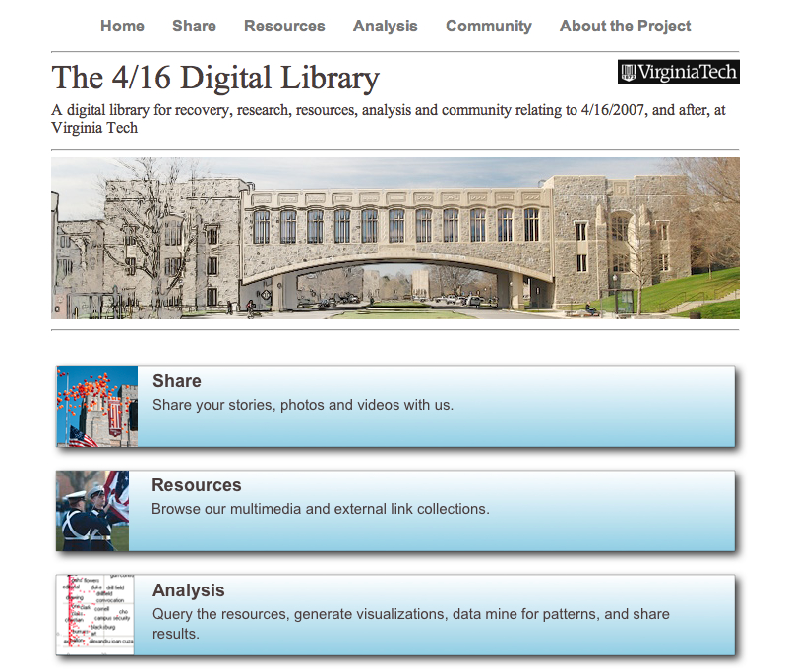
Thanks to: NSF IIS-0736055

Slide 3
Broader Interest
School Shootings and other Tragedies (>260)
  University of Texas clock tower shooting (1966)
  Columbine (1999), Beslan school massacre (2004)
  Northern Illinois U. & Kauhajoki Finland school (2008)
  Bath, MI school bombing (1927, 45 dead, 58 injured)
  Texas A&M Bonfire disaster (1999, Project BEAM)
Unfolding CTR Events
  Typhoon Ketsana, …
Interest: counseling, psychology, sociology, history, oral history, technology use, …
Idea: distributed digital library network, with world-wide collaborating community

Slide 4
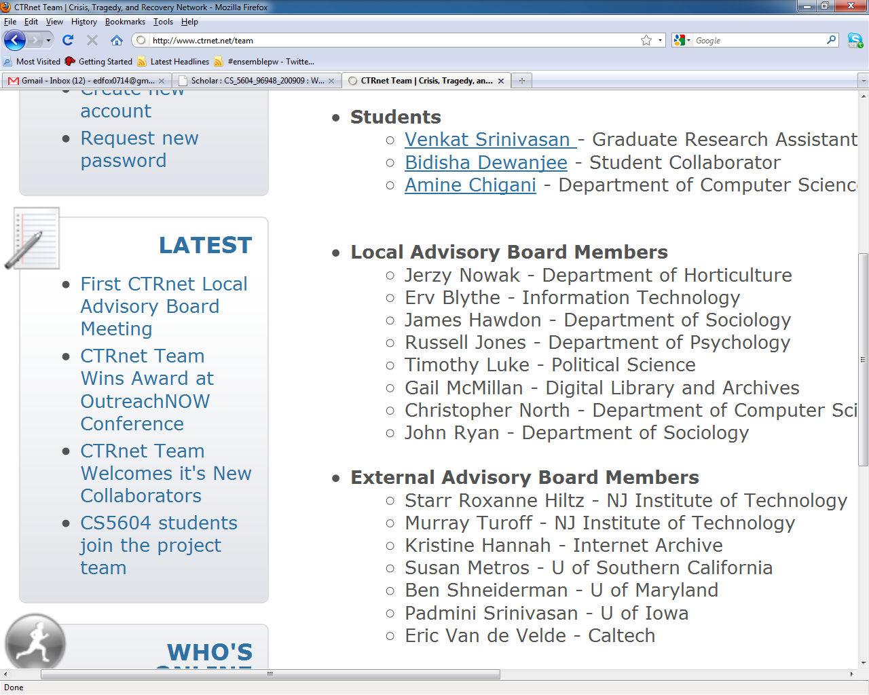
www.ctrnet.net

Slide 5


Acknowledgments
Co-PIs: Andrea Kavanaugh, Naren Ramakrishnan, Steven Sheetz, Donald Shoemaker
GRAs: Bidisha Dewanjee,
Venkataraghavan Srinivasan
CS5604 Team: Tristram Bethea, Yipan Deng, Seth Fox, Min Li, Chao Peng
Departments:
Accounting Information Systems
Computer Science
Sociology
Grant:
IIS-0916733

Slide 6
Intro: CTR
Difficulties faced:
  information not collected or else scattered;
  stove-piped communities ->survey contamination;
  few facing long-term issues/preservation;
  wide varieties of culture, content/genre, …
Scope: Human tragedies (loss of life) that results from
  natural or manmade events, where
  communities are effected (especially, larger communities)

Slide 7
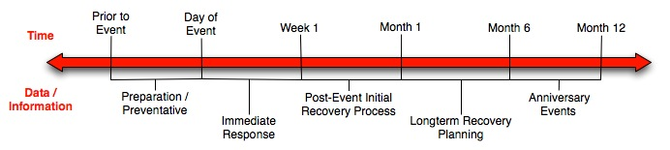
Intro: CTR Timeline
Notes:
Prior-day of: look at details, find patterns, learn (ex. 4/16 prevent people from being chained in buildings, evacuation plans)
Day 1-week 1: CTR toolkit distributed so others can use preservation tools
Week 1-month 1: researchers can begin analyzing data, publics service workers will know enough to help people
Month 1-month 6: research should know how and why the tragedy occurred and how community is dealing with it, tragedy can be compared to similar events to develop a working recovery plan
Month 6-month 12: people can reflect on events and policy makers can make laws to help prevent a similar tragedy from occurring or protect the people involved

Slide 8
Broader Goals: Technical:
Integrating heterogeneous information in a specific domain, making it accessible, and preserving it for long-term reuse
Extend the scope of intelligent digital libraries with ontology
Support information exploration with Storytelling & SSP
Notes:
Integrating heterogeneous information in a specific domain, making it accessible, and preserving it for long-term reuse
Extending the scope of digital libraries so they are closely but flexibly coupled with a wide variety of services to support diverse communities
Supporting information exploration with advanced and integrated methods (SSP, PathRank, and Storytelling) that facilitate searching, browsing, and discovery

Slide 9





Goals for Ontology for CTR
CTR literature
Browsing
sources
Searching
  Query
  expansion
Focus groups
CTR Ontology
Individual
Organizational
Community
Political
…
Tagging
Websites,
Internet Archive
Recommending
Social network
applications
Summarizing
uses
Multicultural/ linguistic input
Visualizing

Slide 10
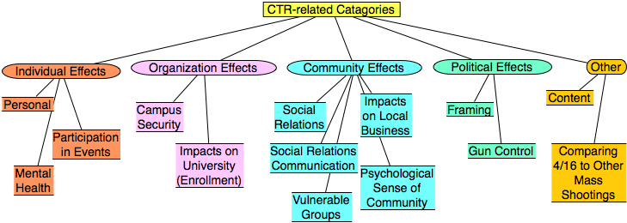
Categories from focus group study
Results from focus group interviews following the April 16, 2007 tragedy at Virginia Tech

Slide 11
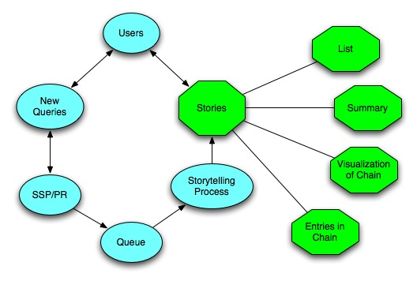
SSP¹ and Storytelling
1 Stepping Stones and Pathways, http://fox.cs.vt.edu/SSP
Notes:
When the users use the CTR DL, the system can record the queries automatically, and these queries can be some people’s name, some events’ name, or any other information, like articles, webpages. Then given two queries, we treat them as endpoints, such as two events, two topics, two articles, or any other two simple queries, the SSP and Storytelling can identify the chain of intermediate information carriers from one to other, satisfying any neighboring intermediate points have a relatively high similarity value. The SSP can return the chain immediately, so it is an online service. The storytelling can mine deeper relationships, but needs more time. All the result can be visulized in the same chain format, and the result can also be offered in the format of text summarization.

Slide 12
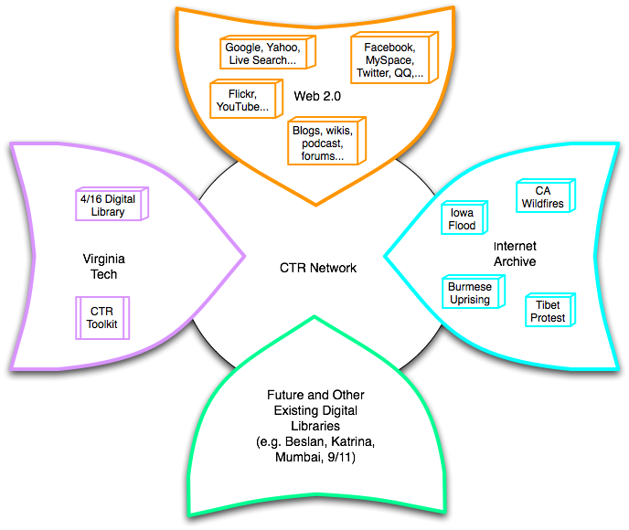
Build a networked digital library relating to CTR
www.citeulike.org group ctrnet
Citations
Papers, …
Integrate community, content, and services relating to CTR, making it accessible, and preserving it for long-term reuse
Support information exploration
Aided by an ontology

Slide 13

CTR stakeholders
Notes:
Help affected communities to recover more quickly and effectively
Provide global network with relevant information and resources
Support the research community, emergency personnel, decision makers, and the public in reacting to and recovering from crises

Slide 14




CS5604 Team Project Objectives
Build data collections on national tragedies and disasters by crawling the web for data.
Filter and classify the crawled web data to eliminate junk within the collection.
Perform Storytelling upon the filtered data to unveil relationships among the tragedies.
Index the data collections to allow for searching and document retrieval.

Slide 15
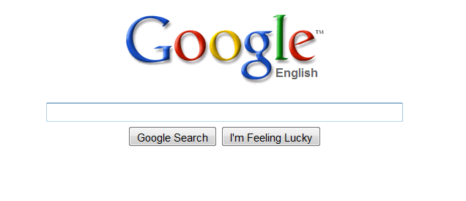
Automatic Generation of Seeds
“Pathfinder” is a new automated utility designed to find seeds relating to a certain topic.
  Uses Google to find the top 5 related queries for a topic.
  Retrieves information from Google’s categorical search engines.
    Google Blogs, Google Images, etc…
  Locates approximately 500 seeds per category and is executed on the original and related queries.

Slide 16
Manual vs. Generated Seeds
Manual Seeds
Generated Seeds
Cover Range of Material
Rapid Production
Large Quantity
Results Require Heavy Filtering
Results Require Moderate Filtering
Relatively Small in Quantity
Time Intensive to Produce
Accurate
Notes:
We want to be in the middle with the good qualities

Slide 17
Preliminary Data Analysis
Revise seeds if poor preliminary data
Crawl
Index Data
Index crawl data from Heritrix
Use NutchWax to prelimi-narily analyze seed quality
Pass Along
Collect Seeds
Send ARC files on for Story-telling

Slide 18
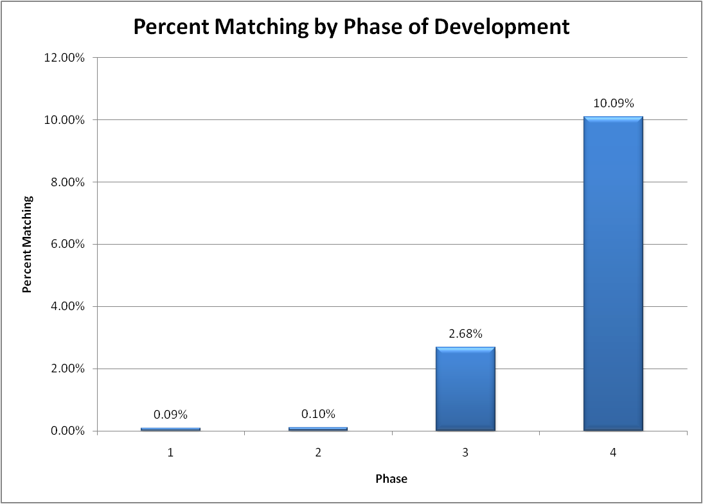
Results

Slide 19
Data Filtering and Storytelling
Crawling
Basic Text Cleanup
Classification
Storytelling
Preprocessing
Extracting Text
Supervised learning methods
Generating stories
Visualization
Story analysis
Evaluation
Classifying new data

Slide 20
Experimental Results
 | Precision |  |  |  | Recall |  |  |  | Accuracy
 | NB |  | SVM |  | NB |  | SVM |  | NB | SVM
 | R | N | R | N | R | N | R | N
VT-416 | 0.993 | 0.974 | 1.000 | 1.000 | 0.973 | 0.993 | 1.000 | 1.000 | 98.3% | 100.0%
 | 0.979 |  | 1.000 |  | 0.983 |  | 1.000
Amish | 0.881 | 0.992 | 0.985 | 0.961 | 0.993 | 0.873 | 0.957 | 0.987 | 93.1% | 97.3%
 | 0.937 |  | 0.973 |  | 0.933 |  | 0.972
Columbine | 0.810 | 1.000 | 0.961 | 0.980 | 1.000 | 0.767 | 0.980 | 0.960 | 88.3% | 97.0%
 | 0.905 |  | 0.971 |  | 0.884 |  | 0.970
R : relevant class N : non-relevant class
“Accuracy” is computed from Confusion Matrix.

Slide 21
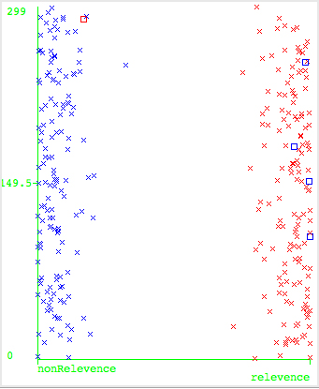
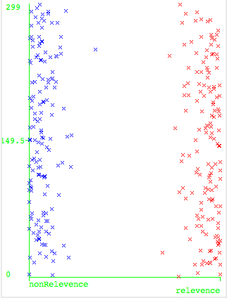
Experimental Results (contd.)
VT-416 with NB
VT-416 with SVM

Slide 22
Storytelling
Classifying
Related files
Storytelling
Stories
Visualizing
Graph of stories
Analyzing
results
Goal: Discover relationships between tragic events.
  Examples: Shooting, study pressure, and mental disorders
formatting
Start and end docs

Slide 23
Hypothesis of school shooting
Immigration
Socially Different
Victim of Bullying
Isolation
Psychological Impact
School Impact
Out come
Keywords
Migration Geographical movement
Relocation
Keywords
Social Outsider
Social Stranger
Keywords
Homophobia Gay Taunts
Keywords
Rejection Seclusion
Keywords
Depression Frustration Anxiety Anger Aggression Stress Loneliness Low Self-esteem
Keywords
Truancy Poor Academic Performance
Low Grades School Drop-out
E.g., Any relations between
Violence and Migration?
Male
Female
Keywords
Delinquency Violence Fighting Masculinity Assault School Shooting
Keywords
Suicide Ideation Suicide Attempt Suicide

Slide 24
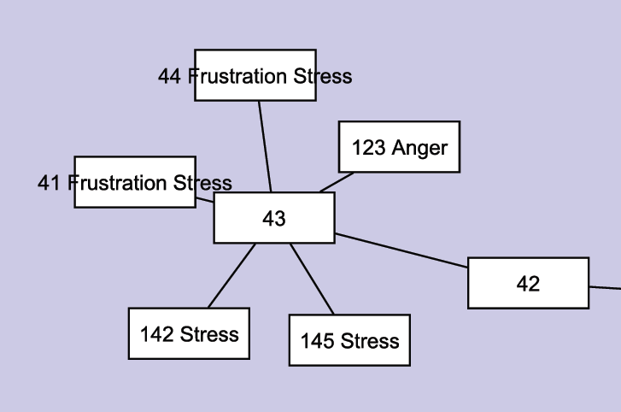
Result
Suicide has relations
with anger, stress,
and frustration.
PDF

Slide 25
CNI for CTR – Please join!
Social Networks | Information Content | Services (Automated)
Organizations Schools Gov agencies Relief agencies | Purposes Assist Plan Recover Understand | Information Analyze Collect Explore Preserve
People Counseling Emergency Assistance Preparedness Police Public relations Victims, families | Genre Web News Public Info Intranets Official reports Scholarship Articles | Collaboration Add to CTRnet Connect/contact Build lists Research Ontology building Spot events Seed identification

Slide 26
Please guide & help with CTRnet!
Thank you!
http://www.ctrnet.net
Ed Fox, fox@vt.edu, http://fox.cs.vt.edu
http://fox.cs.vt.edu/talks/2009/20091214CNI09CTR.pdf

