Slide 1
11/20/09 Seminar -- Virginia Tech
Department of Computer Science
“Digital Libraries” by Edward A. Fox
fox@vt.edu http://fox.cs.vt.edu
Director, Digital Library Research
Laboratory, http://www.dlib.vt.edu

Slide 2
Acknowledgements
Mentors (Licklider, Kessler, Salton)
Virginia Tech, CS, Digital Library Research Laboratory (DLRL: 2030 Torg.)
NSF and other sponsors
Students, colleagues, co-investigators

Slide 3
Faculty Collaborators (selected)
Robert Beck | Edward Carr | Lillian Cassel | Hsinchun Chen | Wingyan Chung
Lois Delcambre | Stephen Edward | Carlos Evia | Weiguo Fan | C. Lee Giles
Eric Hallerman | John Impagliazzo | Andrea Kavanaugh | John Lee | David Maier
Gary Marchionini | Manuel Perez-Quinones | Jeffrey Pomerantz | Naren Ramakrishnan | Steven Sheetz
Donald Shoemaker | Ricardo da Silva Torres | Barbara Wildemuth | Royce Zia | Christopher Zobel

Slide 4
Student Collaborators (selected)
Yinlin Chen | Noha ElSherbiny | Marcos Andre Goncalves | Doug Gorton
Jian Jiao | Tarek Kanan | Spencer Lee | Jonathan Leidig
Ming Luo | Yi Ma | Kunal Mudgal | Uma Murthy
Fernando Das Neves | Sung Hee Park | Rao Shen | Ohm Sornil
Venkat Srinivasan | Hussein Suleman | Seungwon Yang | Xiaoyan Yu

Slide 5


Slide 6

Asynchronous, Digital Library Mediated Scholarly Communication
Different time and/or place

Slide 7
Libraries of the Future
JCR Licklider, 1965, MIT Press
World
Nation
State
City
Community

Slide 8
Institutional Repositories
“Institutional repositories are digital collections that capture and preserve the intellectual output of a single university or a multiple institution community of colleges and universities.”
Crow, R. “Institutional repository checklist and resource guide”, SPARC, Washington, D.C., USA
www.arl.org/sparc/IR/IR_Guide_v1.pdf

Slide 9
Locating Digital Libraries in Computing and
Communications Technology Space
Digital Libraries technology
trajectory: intellectual
access to globally distributed information
Communications
(bandwidth, connectivity)
Computing (flops)
Digital content
Note: we should consider 4 dimensions: computing, communications,
content, and community (people)
less
more

Slide 11
Information Life Cycle
Creation
Active
Authoring
Modifying
Social Context
Using
Creating
Organizing
Indexing
Retention
/ Mining
Accessing
Filtering
Storing
Retrieving
Semi-
Active
Utilization
Distributing
Networking
Inactive
Searching
Notes:
This is a simplification of the previous slide.

Slide 12
Quality and the Information Life Cycle

Slide 13
Digital Libraries
Shorten the Chain from
Author
Editor
Reviewer
Publisher
A&I
Consolidator
Library
Reader

Slide 14
DLs Shorten the Chain to
Roles
Digital
Library
Author
Teacher
User
Reader
Editor
Learner
Reviewer
Librarian

Slide 15
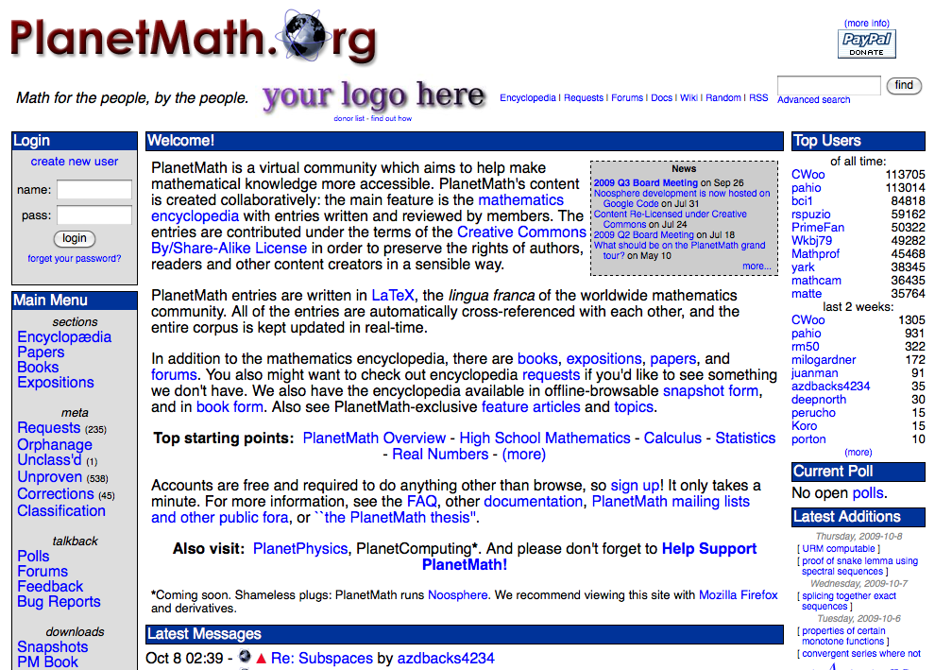
Example : planetmath.org

Slide 16
Digital Libraries --- Objectives
World Lit.: 24hr / 7day / from desktop
Integrated “super” information systems: 5S: Table of related areas and their coverage
Ubiquitous, Higher Quality, Lower Cost
Education, Knowledge Sharing, Discovery
Disintermediation -> Collaboration
Universities Reclaim Property
Interactive Courseware, Student Works
Scalable, Sustainable, Usable, Useful

Slide 17
Degree of Structure
Web
DLs
DBs
Chaotic
Organized
Structured

Slide 18
Digital Object (DO) Types
Born digital
Digitized version of “real” object
  Is the DO version the same, better, or worse?
  Decision for ETDs: structured + rendered
Surrogate for “real” object
  Not covered explicitly in metamodel for a minimal DL
  Crucial in metamodel for archaeology DL

Slide 19
Metadata Objects (MDOs)
MARC (library catalog records)
Dublin Core (web cataloging)
LOMS (learning objects)
RDF (Semantic Web)
ORE (packages)
Crosswalks, Mappings
Ontologies
Topic maps, Concept maps

Slide 20
Open Archives Initiative (OAI) = Technical Umbrella for
Practical Interoperability…
Metadata Harvesting
Reference
Libraries
Museums
Publishers
E-Print
Archives
…that can be exploited by different communities

Slide 21
OAI – Repository Perspective
Required: Protocol
Set Structure
URI Scheme
MDO
MDO
MDO
MDO
Required: DC
MDO
MDO
MDO
MDO
DO
DO
DO
DO

Slide 22
The World According to OAI
Service Providers
Discovery
Current
Awareness
Preservation
Metadata
harvesting
Data Providers

Slide 23
Contexts / Application Domains
Archaeology (ETANA-DL)
  http://www.etana.org
Computing education (Ensemble)
  http://www.computing portal.org
Crises/tragedies/recovery (CTR)
  http://www.ctrnet.net
Electronic theses and dissertations (ETDs)
  http://www.ndltd.org
Fish identification: http://si.dlib.vt.edu/

Slide 24
A Digital Library Case Study
Domain: graduate education, research
Genre:ETDs=electronic theses & dissertations
Ryan Richardson: Spanish Cmaps
Venkat Srinivasan: Classify, Browse, Analyze
Project:
Networked Digital
Library of Theses
& Dissertations
(NDLTD)
http://www.ndltd.org

Slide 25
Student Gets Committee
Signatures and Submits ETD
Approval
form
Signed
Grad School
Notes:
10

Slide 26
Library Catalogs ETD, Access is
Opened to the New Research
WWW
NDLTD
Digital library workflow -> access control
Notes:
12

Slide 27
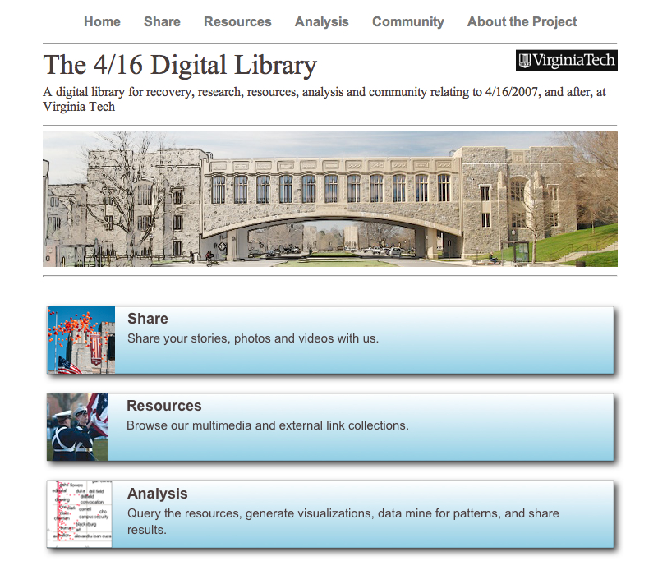
Thanks to: NSF IIS-0736055

Slide 28

CTR stakeholders
Notes:
Help affected communities to recover more quickly and effectively
Provide global network with relevant information and resources
Support the research community, emergency personnel, decision makers, and the public in reacting to and recovering from crises

Slide 29
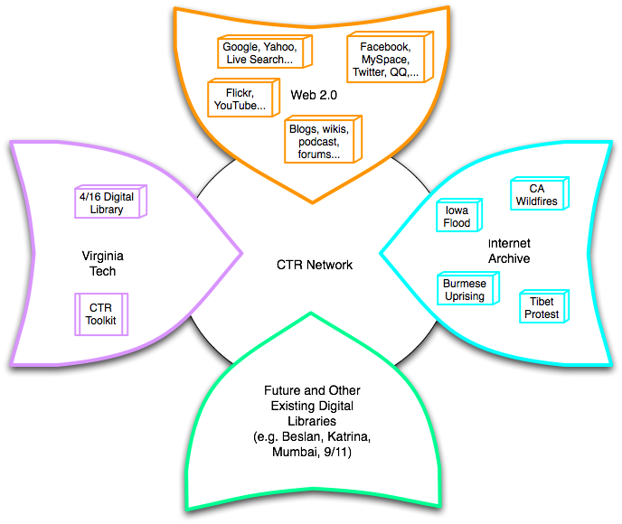
Build a networked digital library relating to CTR
Integrate community, content, and services relating to CTR, making it accessible, and preserving it for long-term reuse
Support information exploration
Aided by an ontology

Slide 30





Goals for Ontology for CTR
CTR literature
Browsing
sources
Searching
  Query
  expansion
Focus groups
CTR Ontology
Individual
Organizational
Community
Political
…
Tagging
Websites,
Internet Archive
Recommending
Social network
applications
Summarizing
uses
Multicultural/ linguistic input
Visualizing

Slide 31
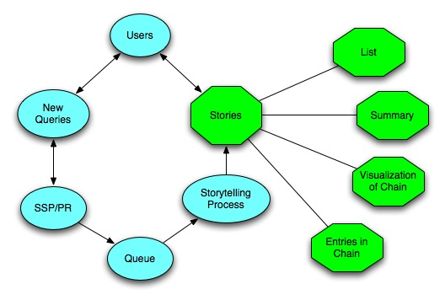
SSP¹ and Storytelling
1 Stepping Stones and Pathways, http://fox.cs.vt.edu/SSP
Notes:
When the users use the CTR DL, the system can record the queries automatically, and these queries can be some people’s name, some events’ name, or any other information, like articles, webpages. Then given two queries, we treat them as endpoints, such as two events, two topics, two articles, or any other two simple queries, the SSP and Storytelling can identify the chain of intermediate information carriers from one to other, satisfying any neighboring intermediate points have a relatively high similarity value. The SSP can return the chain immediately, so it is an online service. The storytelling can mine deeper relationships, but needs more time. All the result can be visulized in the same chain format, and the result can also be offered in the format of text summarization.

Slide 32
DL Curriculum Project
NSF award to VT and UNC-CH
CS and LIS
http://curric.dlib.vt.edu
http://en.wikiversity.org/wiki/Curriculum_on_Digital_Libraries

Slide 33
DL Curriculum Framework

Slide 34
Curatorial Work and Learning in Virtual Environments
Explore how Second Life (SL) can be leveraged in the digital curation community for purposes of improving work practices and training
  Explore and understand collaboration related to preservation using virtual environments
  Develop and assess SL services that support collaboration and training related to digital preservation

Slide 35
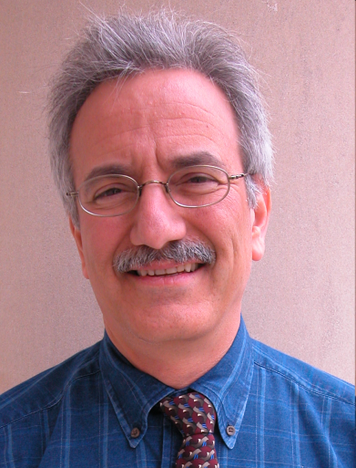
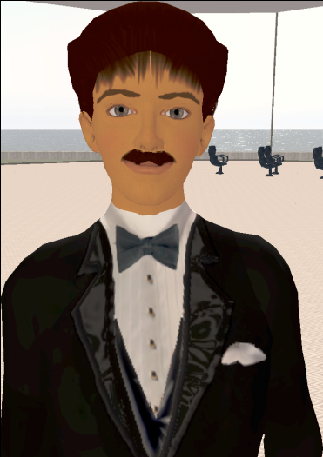
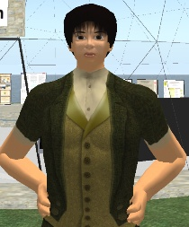
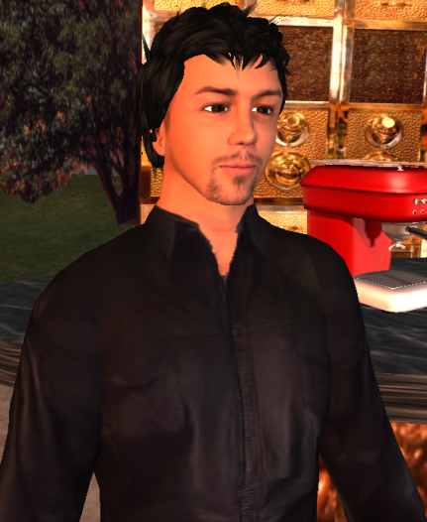
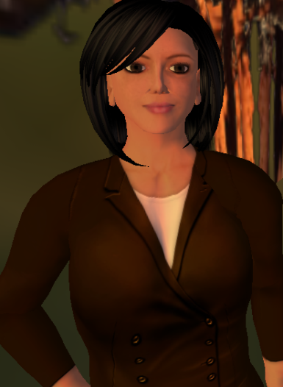


Digital Preserve Personnel / Avatars
http://slurl.com/secondlife/Digital%20Preserve/140/126/29
Gary Octagon
Gary Octagon
Gary Marchionini
EdFox Rieko
Edward Fox
zamfir Paule
Spencer Lee
mantruc Martian
Javier Velasco-Martin
Uma Aldrin
Uma Murthy

Slide 36
DL Definitions - 1
“A digital library is an organized and focused collection of digital objects, including text, images, video, and audio, along with methods of access and retrieval, and for selection, creation, organization, maintenance, and sharing of the collection.”
Witten & Bainbridge – “How to Build a Digital Library” – Morgan Kaufmann 2003

Slide 37
DL Definitions - 2
“Digital libraries are organizations that provide the resources, including the specialized staff, to select, structure, offer intellectual access to, interpret, distribute, preserve the integrity of, and ensure the persistence over time of collections of digital works so that they are readily and economically available for use by a defined community or set of communities”
Waters,D.J. CLIR Issues, July/August 1998
www.clir.org/pubs/issues/issues04.html

Slide 38
DL Definitions - 3
Issues and Spectra
  Collection vs. Institution
  Content vs. System
  Access vs. Preservation
  “Free” vs. Quality
  Managed vs. Comprehensive
  Centralized vs. Distributed

Slide 39
DL Definitions - 4
NOT a “digitized library”
NOT a “deconstruction” of existing systems and institutions, moving them to an electronic box in a Library
IS a new way to deal with knowledge
  Authoring, Self-archiving, Collecting,
  Organizing, Preserving,
  Accessing, Propagating, Re-using

Slide 40
5S Layers
Societies
Scenarios
Spaces
Structures
Streams

Slide 41
Informal 5S & DL Definitions
DLs are complex systems that
help satisfy info needs of users (societies)
provide info services (scenarios)
organize info in usable ways (structures)
present info in usable ways (spaces)
communicate info with users (streams)

Slide 42
Hypotheses
A formal theory for DLs can be built based on 5S.
The formalization can serve as a basis for modeling and building high-quality DLs.

Slide 43
5Ss
Ss | Examples | Objectives
Streams | Text; video; audio; image | Describes properties of the DL content such as encoding and language for textual material or particular forms of multimedia data
Structures | Collection; catalog; hypertext; document; metadata | Specifies organizational aspects of the DL content
Spaces | Measure; measurable, topological, vector, probabilistic | Defines logical and presentational views of several DL components
Scenarios | Searching, browsing, recommending | Details the behavior of DL services
Societies | Service managers, learners, teachers, etc. | Defines managers, responsible for running DL services; actors, that use those services; and relationships among them

Slide 44
5S and DL formal definitions and compositions (April 2004 TOIS)

Slide 45
A Minimal DL in the 5S Framework
Streams
Structures
Spaces
Scenarios
Societies
Structured Stream
Structural Metadata Specification
services
Descriptive Metadata Specification
indexing
browsing
searching
hypertext
Digital Object
Metadata Catalog
Collection
Repository
Minimal DL

Slide 48
Ontology: Applications

Slide 49
VT Research on Services
Browsing | Classifying | Clustering
Collecting | Filtering | Harvesting
Mining | Personalizing | Preserving
Recommending | Re-finding | Searching
Sharing | Submitting | Visualizing

Slide 50
DL Modeling and Software Engineering

Slide 51
Requirements (1)
Analysis (2)
5S
DL
Meta
5SGraph
Designer
DL
Model
Expert
Practitioner
5SL
Teacher
DL
Model
c
omponent
pool
Design (3)
ODLSearch,
Researcher
ODLBrowse,
Tailored
ODLRate,
5SLGen
DL
ODLReview,
…….
Services
Implementation (4)
5SSuite
5SGraph
5SGen
Mapping Tool

Slide 52
5SL: a DL design language
Domain specific languages
  Address a particular class of problems by offering specific abstractions and notations for the domain at hand
  Advantages: domain-specific analysis, program management, visualization, testing, maintenance, modeling, and rapid prototyping.
XML-based realization of 5S
  Interoperability
  Use of many sub-languages (e.g., MIME types, XML Schemas, UML notations)

Slide 53
5SGraph: A DL Modeling Tool
Help users model their own instances of a digital library (DL) in the 5S language (5SL).
A simple modeling process which enables rapid generation of digital libraries
Features
  5SGraph loads and displays a metamodel in a structured toolbox.
  The structured editor of 5SGraph provides a top-down visual building environment for the DL designer.
  5SGraph produces syntactically correct 5SL files according to the visual model built by the designer.

Slide 54
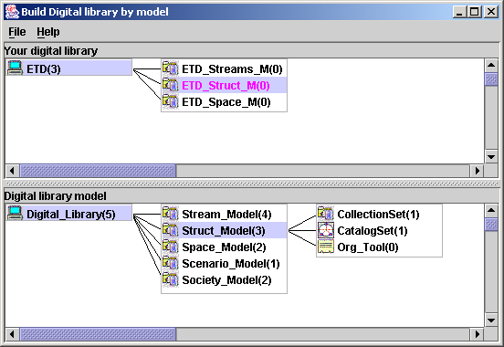
Overview of 5SGraph
Workspace
(instance model)
Structured
toolbox
(metamodel)

Slide 55
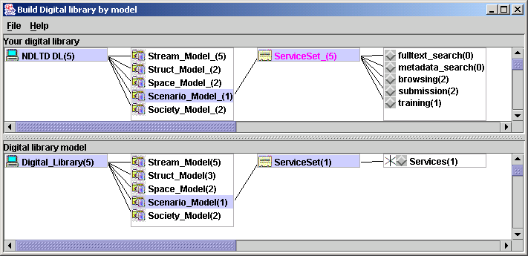

Slide 57
Integration of Domain Focused DLs
Union archaeological metadata catalog generation
Modeling archaeological DLs (ArchDLs) in the 5S framework
ArchDL integration case study:
ETANA-DL

Slide 58
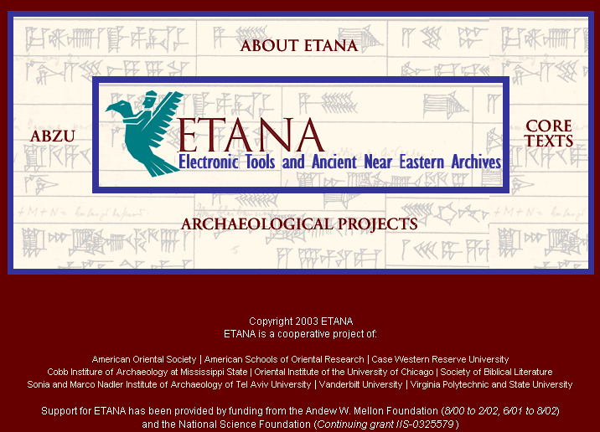

Slide 59
ETANA-DL Architecture
DigBase and DigKit
Lahav
D
A
T
A
B
A
S
E
W
R
A
P
P
E
R
S
Search
U
S
E
R
I
N
T
E
R
F
A
C
E
Browse
Nimrin
Recommend
Umayri
ETANA-DL
UNION
CATALOG
Note
Hisban
Personalize
Megiddo
Review
Jalul
Visualizations
Archaeology
Specific
…
New Sites
Work in progress

Slide 60
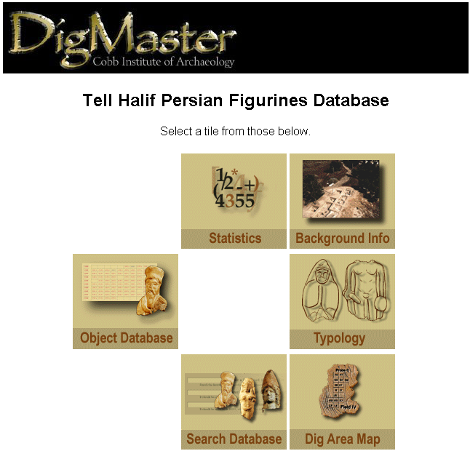
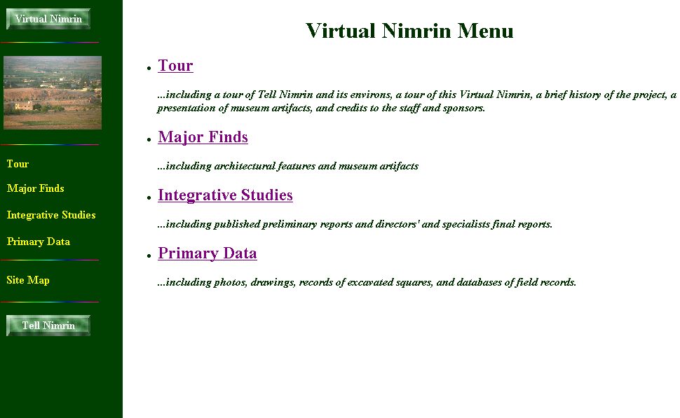
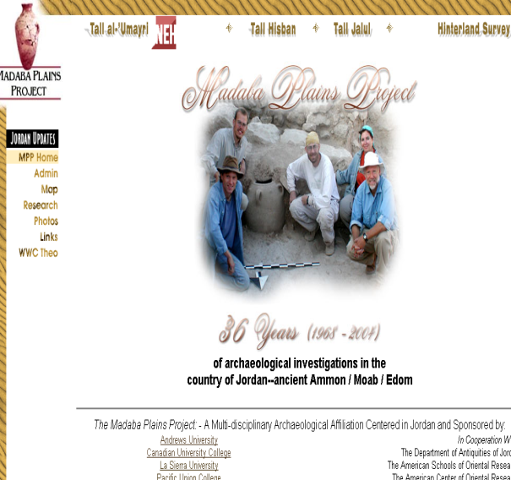
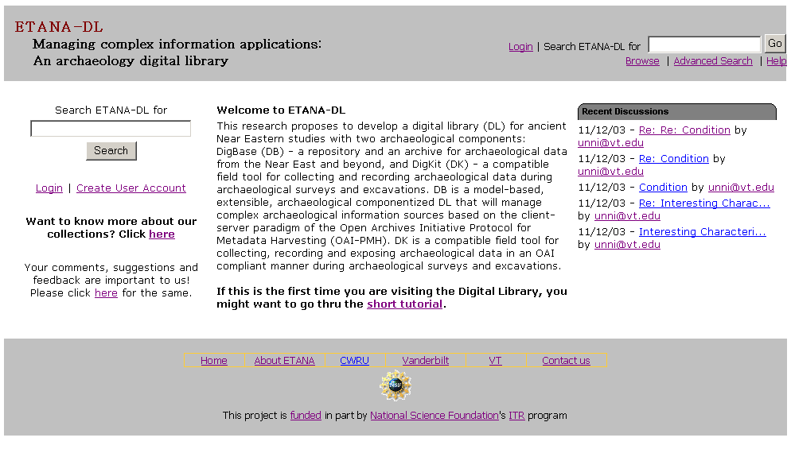

Slide 61
ETANA-DL Multi-dimensional Browsing
3 new sites
2 new types of artifacts

Slide 62
ETANA Societies
Historic and pre-historic societies (being studied)
Archaeologists (in academic institutes, fieldwork settings, or local and national governmental bodies)
Project directors
Technical staff (consisting of photographers, technical illustrators, and their assistants)
Field staff (responsible for the actual work of excavation)
Camp staff (e.g., camp managers, registrars, tool stewards)
General public (e.g., educators, learners, citizens)

Slide 63
ETANA Scenarios
Life in the site in former times
Digital recording: the planning stage and the excavation stage
Planning stage: remote sensing, fieldwalking, field surveys, building surveys, consulting historical and other documentary sources, and managing the sites and monuments
Excavation
  Detailed information is recorded, including for each layer of soil, and for features such as pole holes, pits, and ditches.
  Data about each artifact is recorded together with information about its exact find spot.
  Numerous environmental and other samples are taken for laboratory analysis, and the location and purpose of each is carefully recorded.
  Large numbers of photographs are taken, both general views of the progress of excavation and detailed shots showing the contexts of finds.
Organization and storage of material
Analysis and hypotheses generation and testing
Publications, museum displays
Information services for the general public

Slide 64
Minimal archaeological DL in the
5S framework
(A.i is from minimal DL, j is new)

Slide 65
SI: Knowledge Work Support
Torres at UNICAMP, Brazil
Hallerman in Fisheries at VT
Funding by Microsoft Research
Search in collections of fish images
using combination of
image properties (CBIR) and
textual descriptions (annotations)
With superimposed information (SI --Murthy, Delcambre, Cassel, …)

Slide 66
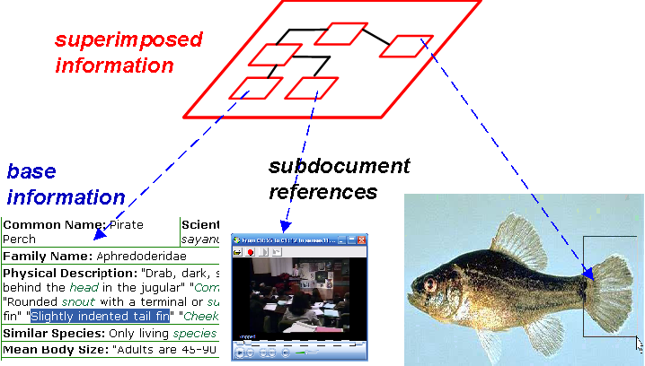
Working with information in situ

Slide 67
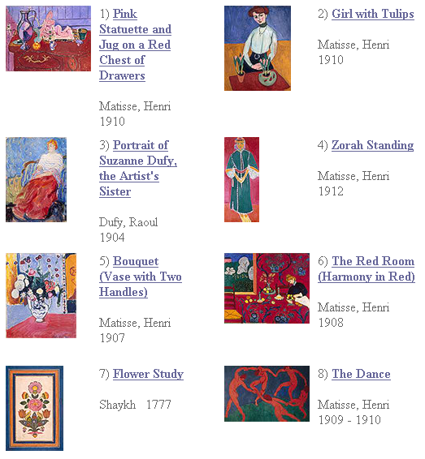
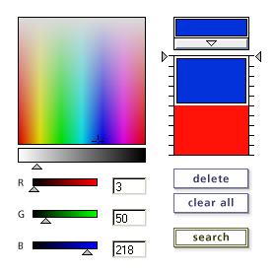
Content Based
Information
Retrieval

Slide 68
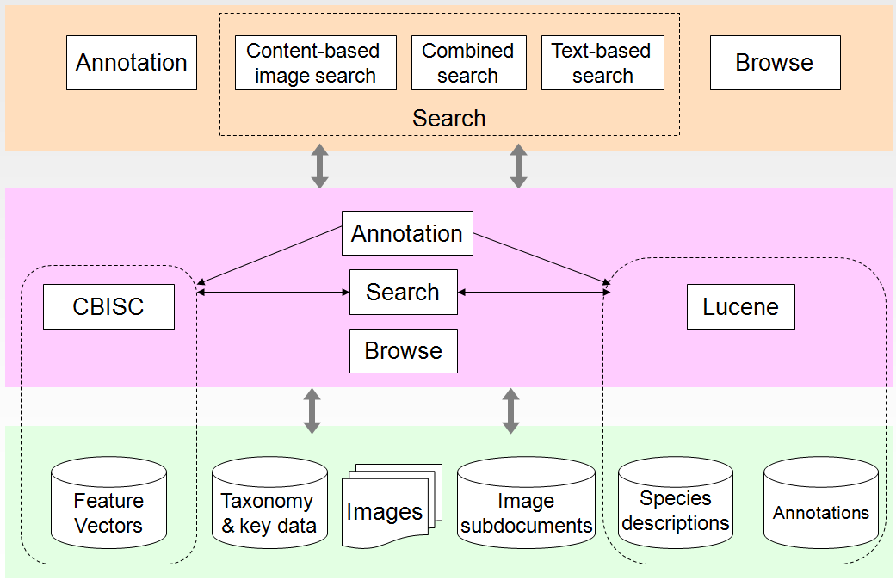
SuperIDR architecture

Slide 69
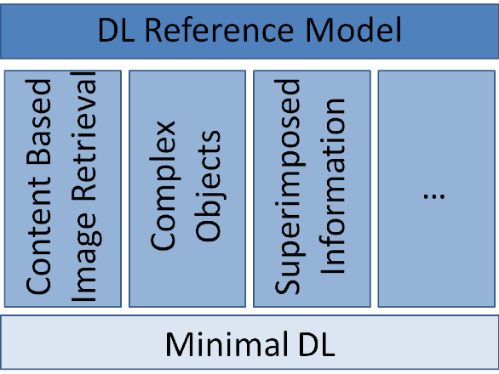
Minimal DL to Reference Model

Slide 70
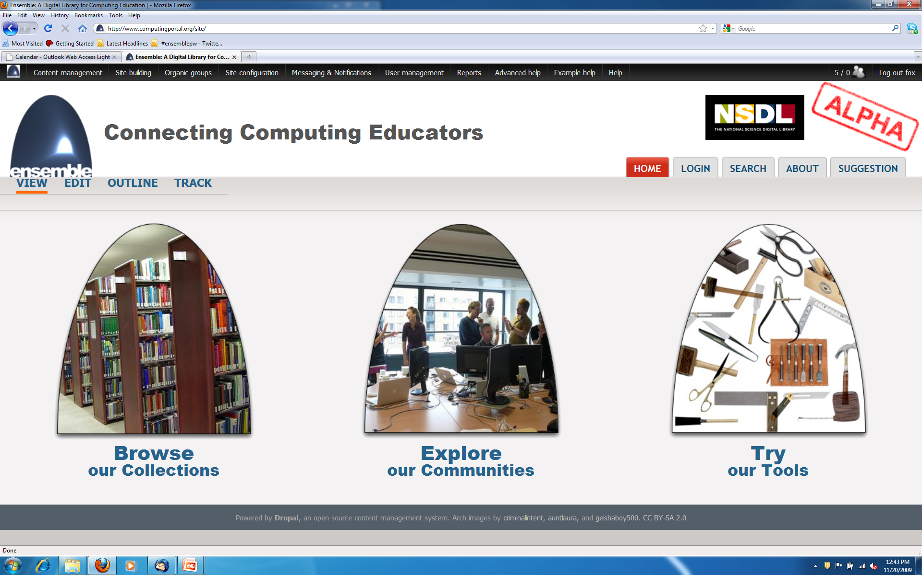
www.computingportal.org

Slide 71
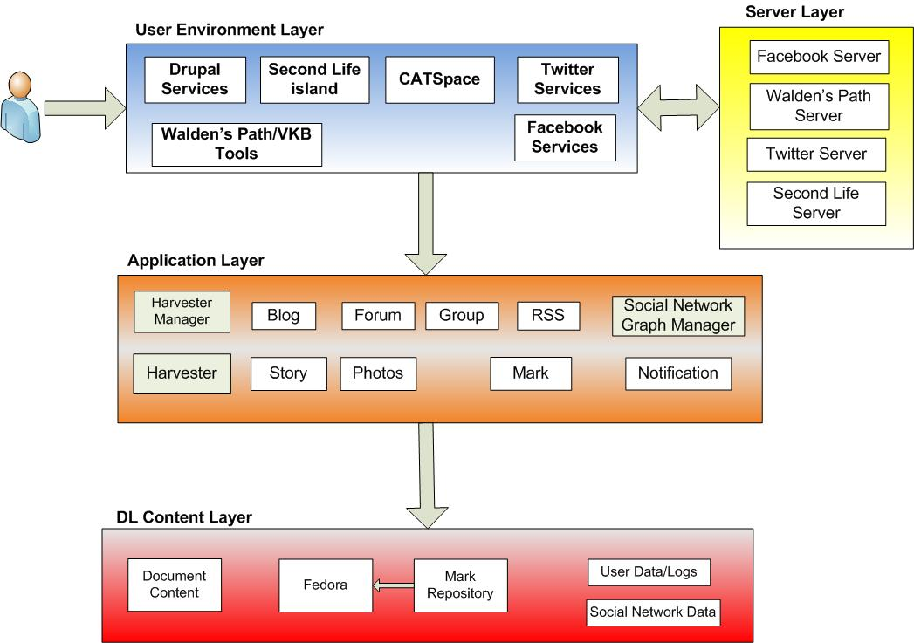
Ensemble Portal Logical Architecture

Slide 72
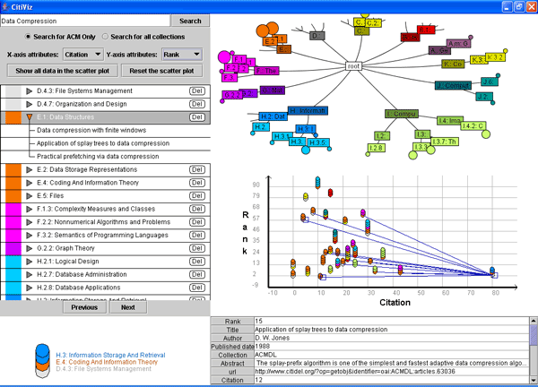
Example of Union Service: CitiViz

Slide 73
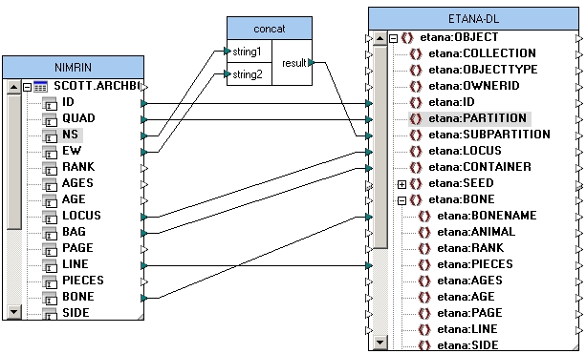
Data Mapping (state-of-the-art)

Slide 74
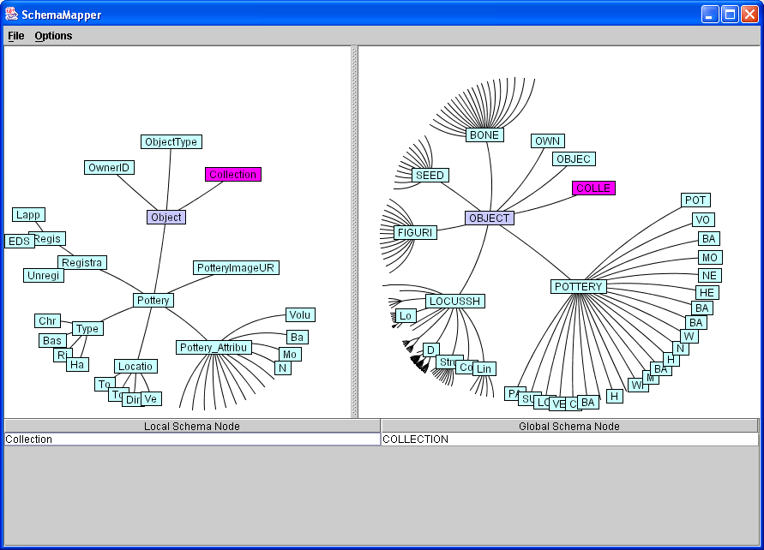
Mapping confirmation
Mapping history
Notes:
left click the suggested element on the global schema to confirm the mapping, then two mapped elements will display in the same color (pink?)
A mapping history will display at the bottom of the window
remove mapping: you can right click the element on the local schema, right click then click “Removing Mapping”

Slide 75
ArchDL Expert
5S Archaeology
MetaModel
ArchDL Designer
5SGraph
VN Metadata Format
HD Metadata Format
Scenario
Sub-model
ETANA-DL Metadata Format
ETANA-DL
Union Services
Descriptions
Harvesting
Mapping
Searching
Browsing
…
VN
Catalog
HD
Catalog
Mapping Tool
Wrapper4VN
Wrapper4HD
Structure
Sub-model
Inverted Files
XOAI
Search
Service
Web Interface
Index
Union
Catalog
Browse DB
Index
Browse
Service
Component
Pool
5SGen
Services DB
Other
ETANA-DL
Services
Browsing
XOAI
…

Slide 76
Conclusions
We have answered the >40-year-old challenge of Licklider to build a unified CS / LIS theory by
  Proposing and formalizing the first comprehensive formal framework for digital libraries
Showed how to move from theory to practice by
  Applying the framework to the problems of
  Materializing these applications into languages, tools, formats, systems, etc.
  Explaining and evaluating in a variety of contexts
You are invited to engage and innovate!

Slide 77
Choosing your contribution
How to innovate?
How to prove the improvement?
What group of stakeholders?
What type of content?
What approach to improving services?
What broader impact?

Slide 78
Questions?
Discussion?
Thank You!

