Slide 1
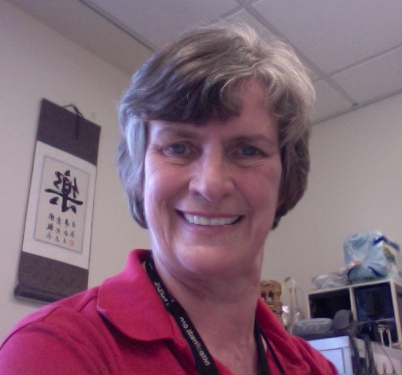

The community and the goals
Ensemble
Project Overview
Boots Cassel
Villanova
University
The computing portal in NSDL as a unifying force for the computing education community

Slide 2
The Team
Here today
  Boots Cassel, project lead, Villanova University
  Ed Fox, portal lead, Virginia Tech
  Lois Delcambre, Portland State University
  Rick Furuta, Texas A & M
  Dan Garcia, U. California, Berkeley
  Frank Shipman, Texas A & M
  Greg Hislop, Drexel University
  Monika Akbar, Virginia Tech
Virtually here
  Peter Brusilovsky, University of Pittsburg
  Steve Carpenter, Texas A & M
Here in spirit: the team (see our poster, #20)

Slide 3
Serving a community
Computing education spans many sub- disciplines and many separate groups.
Like a musical ensemble, the individuals make beautiful results when they work together in harmony.
The Ensemble project serves all of the computing education community.

Slide 4
Ensemble: A Community Center
Many sources of content
Many active entities
No sense in duplicating or trying to move all of them
Provide a place for connections to be made and synergies to be realized
Three essential elements:
  Content
  Communities
  Tools

Slide 5
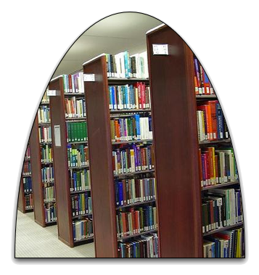
Content
Resources stored
  Locally created
  Stored in our own repositories
Meta-data for resources stored elsewhere
  Active, well-managed collections under the control of others, but known to Ensemble
  Regular harvesting for incremental indexing
Search tools that extend to resources that we cannot yet index, as well as for local information

Slide 6
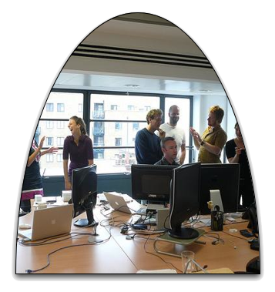
Communities
Support for groups doing shared
work
  ACM Education Board and Council
  Future of Computing Education Summit Action Groups
  CS1 Community Site
  TECH Developers
  Our own Development effort
A meeting place, a work place --independent of parent organizations.

Slide 7

Tools
Visual Knowledge Builder
Walden’s Paths
Ensemble in Second Life
More, “Coming Soon…”
Tools that can be used now, many adaptable to other Pathways, to enhance the teaching and learning endeavor

Slide 8
Active involvement
Comment, Review, Tag (CRT)
  Drupal provides facilities
  Enabled to allow easy participation
Support of relevant group activities
  Work spaces
  Posting of documents for review and comment
  Photo gallery to provide a social environment

Slide 9
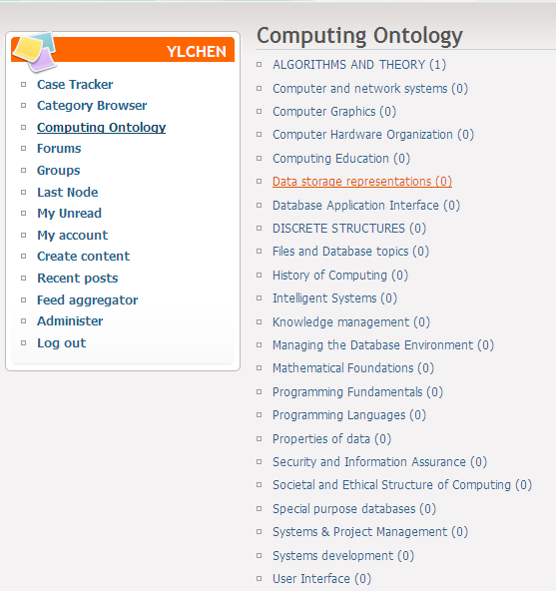
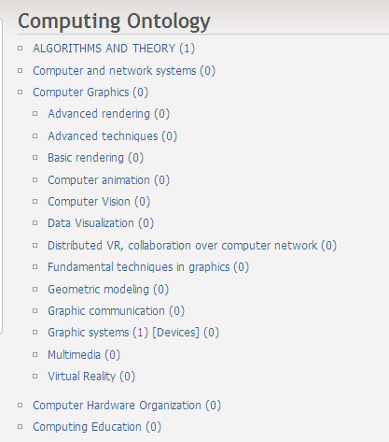
Computing Ontology

Slide 10
Coming next
Ed Fox and Steve Carpenter on Ensemble in Second Life (SL)
Peter Brusilovsky on Social Intelligence
  Delivered by way of Second Life
Dan Garcia on Rewards
Lois Delcambre on the CS1 Community site
Back to me for wrap-up, questions, and discussion

Slide 11
Ed Fox and Steve Carpenter
Ensemble in Second Life

Slide 12



Social network services
Computing Communities
WebCAT
TECH
FOCES
CATSpace
CS1
Ensemble Portal
Drupal
Blog
Browse
Search
Tools
Walden’s Path/VKB
Forum
Submit
RSS
Walden’s Path
VKB
SI
Storage
Fedora
Computing Resources
Syllabus
SWENET
AlgoViz
CSTC
CITIDEL
CSTA

Slide 13
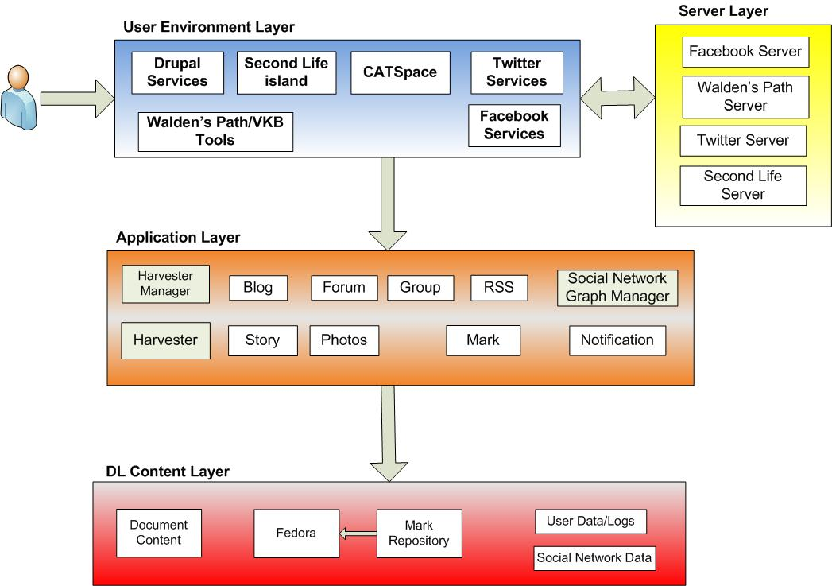
Ensemble Portal Logical Architecture

Slide 14

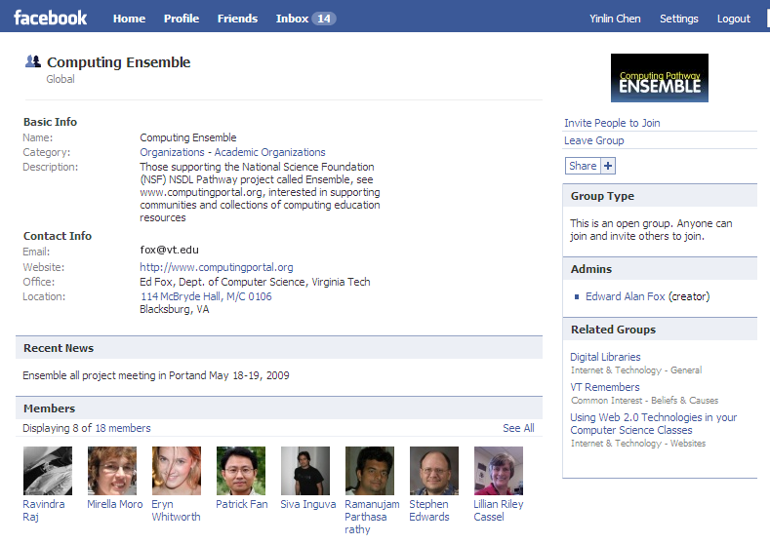
Facebook Integration
Facebook group – Computing Ensemble
  please join & contribute
Facebook Application – CATSpace
  a social repository of Computer Science assignments designed for use by CS instructors and students.

Slide 15

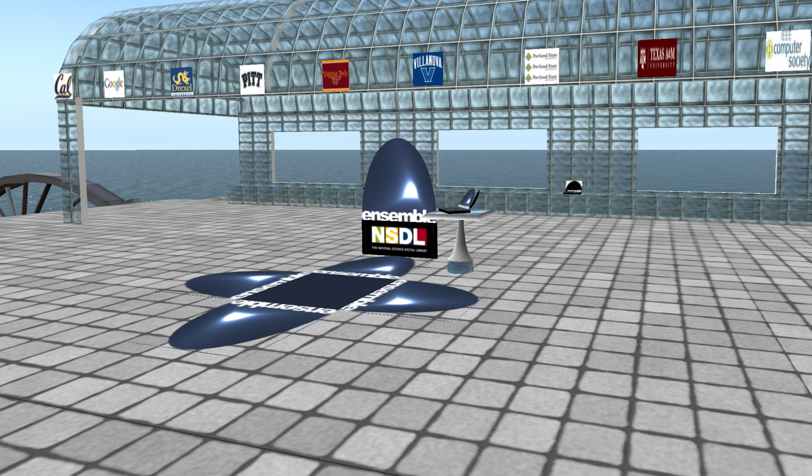
Ensemble in Second Life
http://slurl.com/secondlife/Educators%20Coop%204/66/236/28
The Ensemble Pavilion is located in the online virtual world Second Life.
The Ensemble Pavilion is conceived as a flexible, multi-use space that will evolve as the project develops.

Slide 16
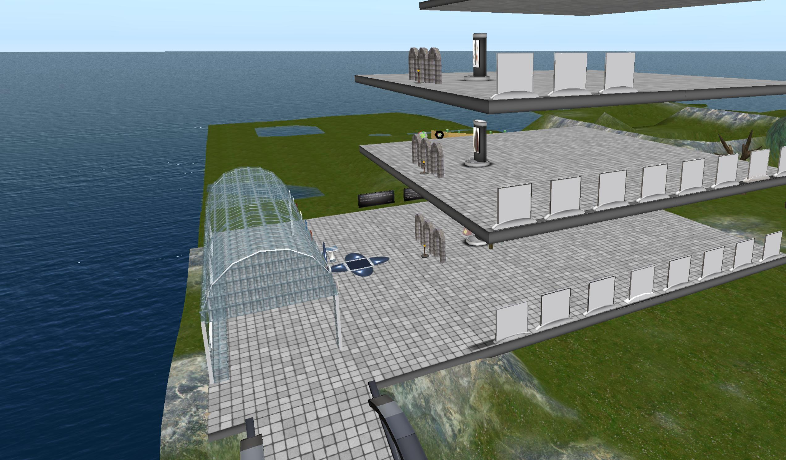
Ensemble in Second Life
http://slurl.com/secondlife/Educators%20Coop%204/66/236/28
Adjacent to the Pavilion is a four-storey virtual library that parallels the structure of the Ensemble Computing Portal.
The first floor houses communities, the second floor contains collections and the third floor offers tools. The fourth floor is designated for in-world lectures and seminars on computing.

Slide 17
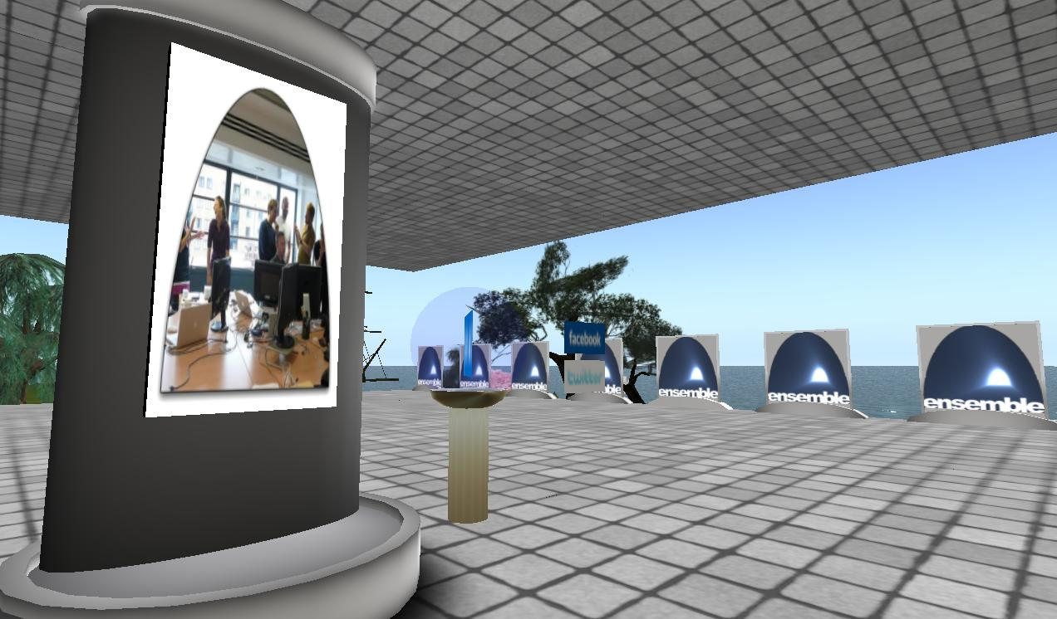
Ensemble in Second Life
http://slurl.com/secondlife/Educators%20Coop%204/66/236/28
The Ensemble Pavilion offers:
• teleports to other computing sites in Second Life like the Digital Preserve
• hyperlinks to related computing websites
• RSS readers with feeds from computing and computing education blogs
• membership in the Ensemble Computing group in Second Life, Facebook, and Twitter

Slide 18
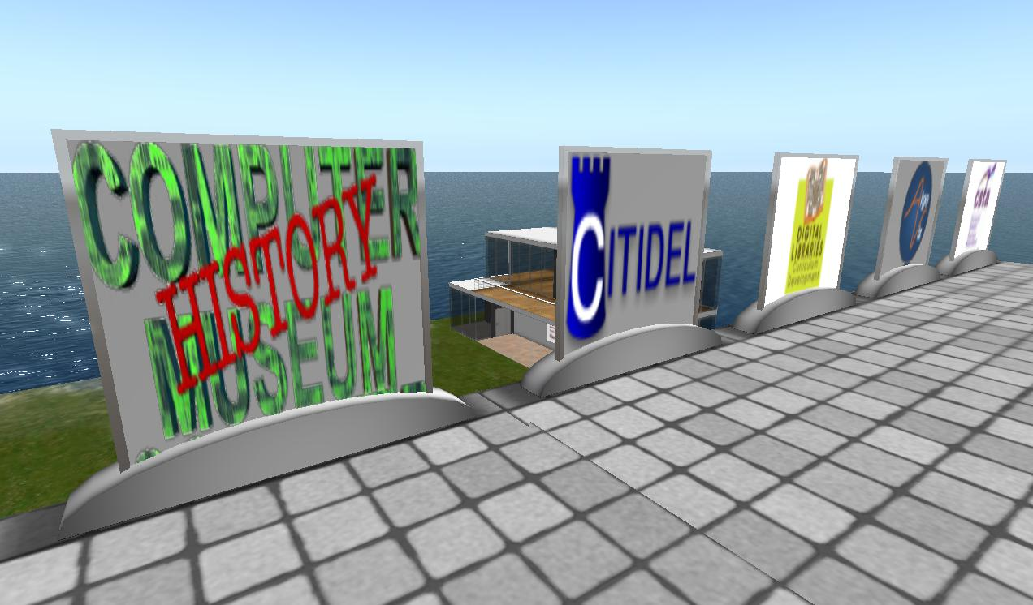
Ensemble in Second Life
http://slurl.com/secondlife/Educators%20Coop%204/66/236/28
The Ensemble Pavilion takes advantage of social networking and academic affordances of Second Life that are absent from traditional web-based formats.
The interactivity made possible by Second Life and other virtual worlds poses challenges and possibilities for current and future computing education, research, and development.

Slide 19
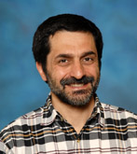

How TO
Social Intelligence
or, “Using Community Wisdom to guide learners to the right content …”
Peter Brusilovsky
University of Pittsburgh
use the cumulative actions of portal users to guide future users?

Slide 20


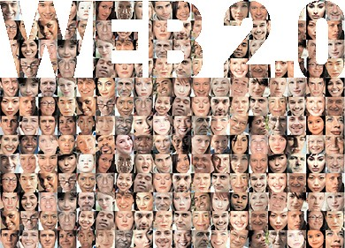


The New Web: the Web of People
http://www.veryweb.it/?page_id=27

Slide 21

Social Information Access
What kinds of user traces can be used?
  Browsing
  Tagging
  Ratings
  Comments
What kind of social
guidance can be provided?
  Social navigation support
  Social search
  Collaborative recommendations

Slide 22
Ratings and Reviews

Slide 23


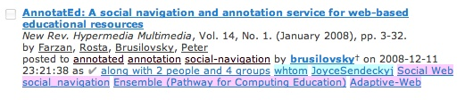
Bookmarking and Tagging
Bookmarking of a resource indicates users’ interests.
Tags indicate aspects of resources, which are interesting to the user.
  Tagging in del.icio.us
  Tagging in CiteULike

Slide 24
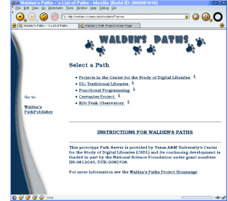
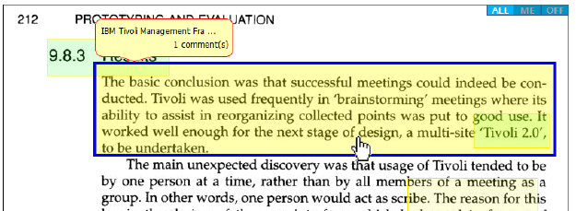
Extraction and Composition
More sophisticated tools in the Computing Portal allow collecting unique social wisdom.
  Composing a path
  from resources
  Extracting a fragment
  of an existing resource

Slide 25
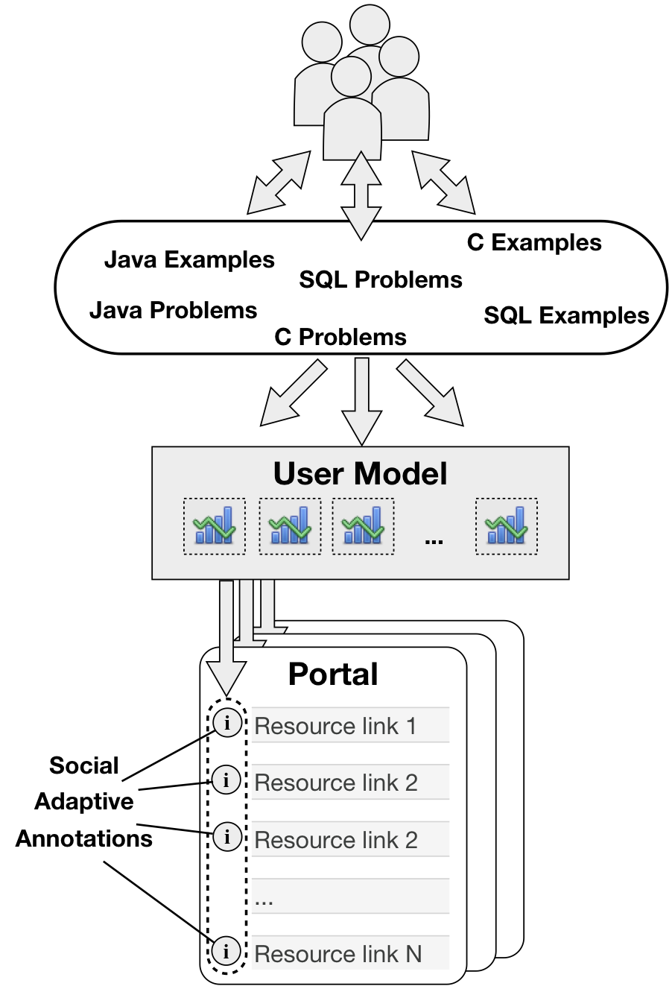
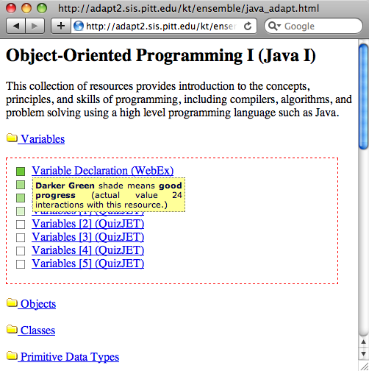
Social Navigation in Ensemble
PAWS Tools accessed through ENSEMBLE:
Darker bullets indicate resources that community users explored more frequently.

Slide 26
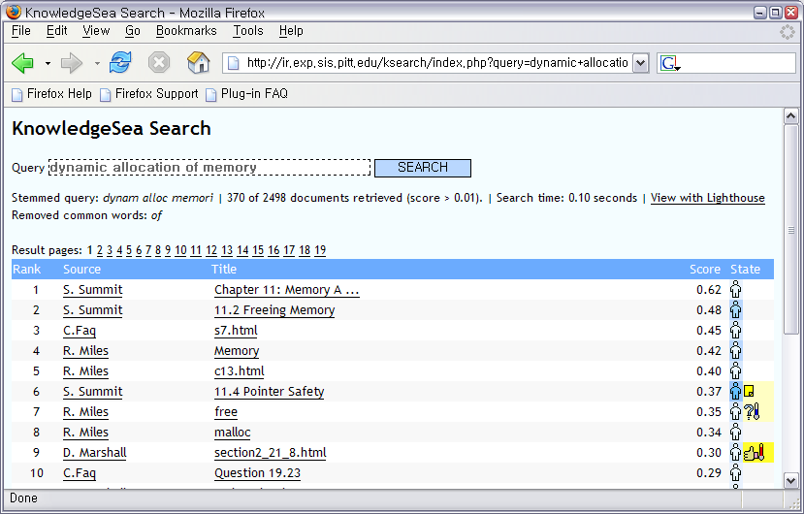
Social Search with Visual Cues
Using collective intelligence in search context
Annotation color
indicates popularity
Note indicates
user comments
Social Search in
Knowledge Sea
(University of
Pittsburgh)
Document with high traffic (higher rank)
Problems
with resource
Document with positive annotation
(higher rank)
Positively
evaluated
Resource

Slide 27
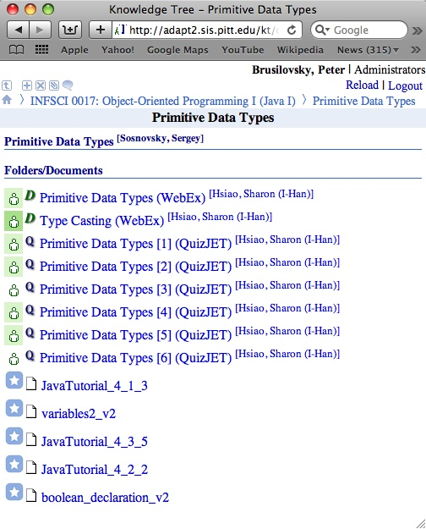
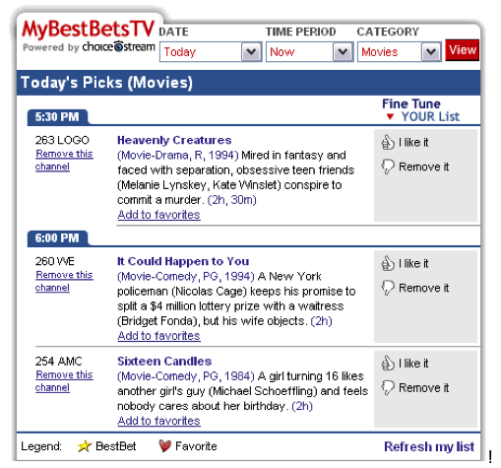
Collaborative Recommendation
This technology allows us to recommend content proactively based on ratings and work of past users
Recommended
Content in
Personalized TV
Recommended
Content in
ENSEMBLE

Slide 28
Current State
Implemented
  Group modeling framework (CUMULATE)
  Tracking of browsing/problem solving
  Group-level Social Navigation in one collection
Work in Progress
  Tracking comments, ratings, annotations, tags
  Social search
  Recommendations

Slide 29
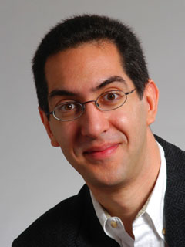
If you build it…
Rewards
or, “How to architect the right carrot…”
Dan Garcia
UC Berkeley
They will come…
(and return again and again, forming an active, thriving community)

Slide 30
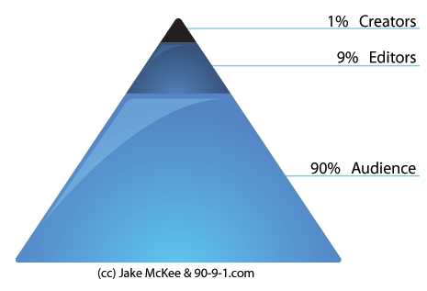
Challenge: 90-9-1 principle
90% of users are “audience”, or lurkers
  They tend to read, observe, don’t actively contribute
9% of users are “editors”
  Sometimes modifying content, rarely from scratch
1% of users are “creators”
  Driving large amounts of social group’s activity
Not representative!
$64k question
  What can we do about this?
“Participation Inequality”
Source: www.90-9-1.com

Slide 31
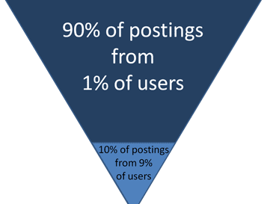
How to Overcome it…
Make it easier to contribute
  Clicking stars for a rating vs. writing natural language review
Promote quality contributions
  Reputation rankings
Reward participants
  Examples follow…
Source: www.useit.com/alertbox/participation_inequality.html
No postings from 90% of users

Slide 32
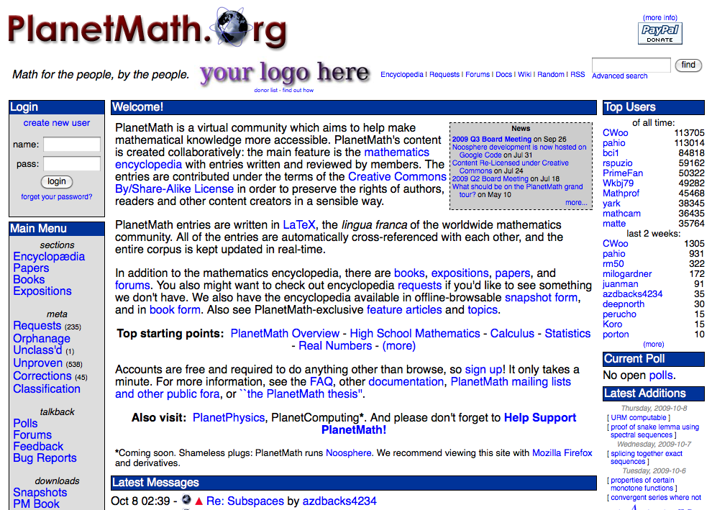
Example : planetmath.org

Slide 33
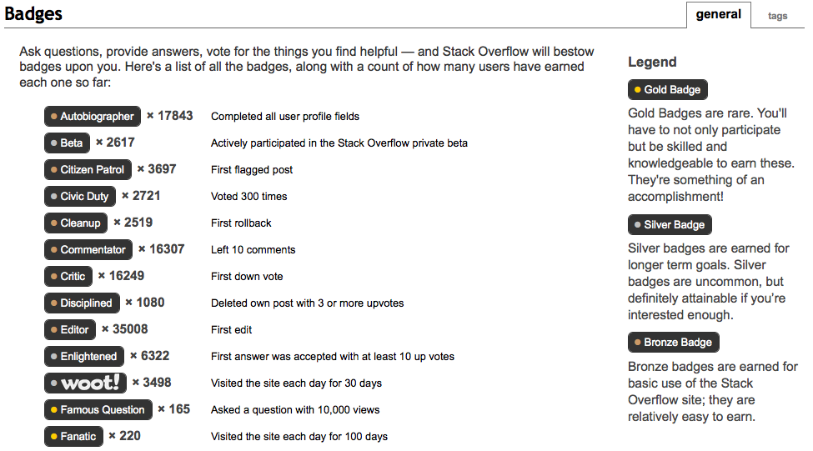
Example : stackoverflow.com (1)

Slide 34
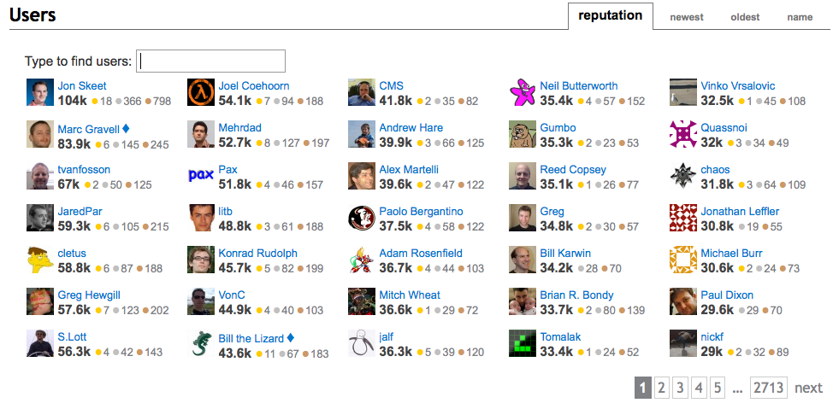
Example : stackoverflow.com (2)

Slide 35
Building a Rewards System
Top N users
  + Easy to see who is the top earner, recent top user
  – Hard to boil down the categories into a single #
Badges
  + Allows for lots of topics, gold / silver / bronze clustering allows easy categorization
  Xbox, runescape, WoW achievements, Spore similar
  What would be appropriate badges (open question)
  …for both curators and users
We have to fight gamers of the system
  Rewards “moderators” can monitor health

Slide 36
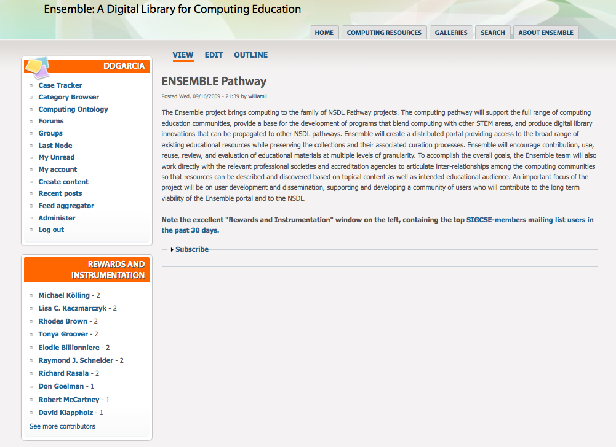
Ensemble Rewards Demo
www.computingportal.org/site/node/264

Slide 37
Lois delcambre
CS1 Community Site

Slide 38
The CS1 Community Site
There is much debate about how to teach CS1 – the first computer science course.
Site allows user to post views and opinions.
Site has initial content:
  Scott Fletcher - taught high school computer science teacher for 6 years
  Lois Delcambre – offered a new, pilot class

Slide 39
CS1 Content Types
Express your views and opinions about:
  Textbook Post
  Software/Other Resources
  Language Post
  Syllabus
  Teaching Strategy
Plus a generic forum for suggestions/feedback

Slide 40
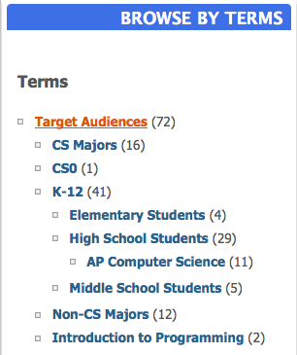
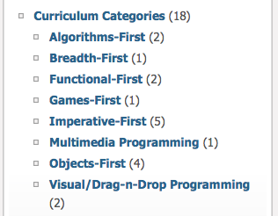
Categories and terms for CS1

Slide 41
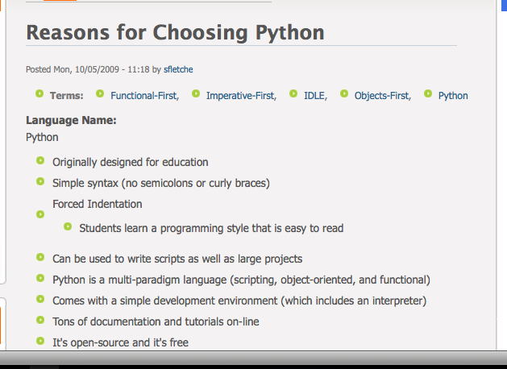
Sample Content: a Language Post

Slide 42
CS1 – the first in a family …
Similar sites can be created for;
  the first database course,
  the compilers course,
  …
Some of the CS1 infrastructure can be used; some new infrastructure can be created.
A “clone” button can be implemented.

Slide 43
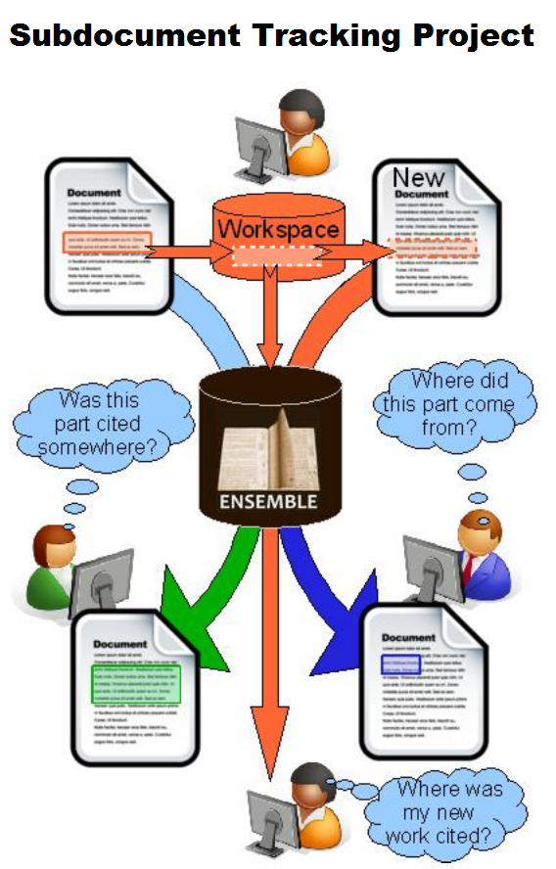
Fine-grained
Pieces of Digital
Content

Slide 44
Wrap up, questions and discussion

Slide 45
Ensemble: Computing Community Center
Our goal
  To support joint work, a strengthened sense of community among all computing educators
  To provide resources, tools, and meeting places
Our tool: Drupal
  We started Spring 2009 and have learned a lot, though there is much more to come.
Efforts
  Develop our site and support mechanisms
  Spread the word

Slide 46
Thank you for coming !!
Open for
Questions
And
Discussion

