Slide 1


CTRnet: A Crisis, Tragedy, & Recovery Network (www.ctrnet.net)
Oct .16, 2009
VCOM Research Day
Blacksburg, VA 24061 USA
Edward Fox (fox@vt.edu), Bidisha Dewanjee, Andrea Kavanaugh, Uma Murthy, Naren Ramakrishnan,
Steven Sheetz, Donald Shoemaker, and
Venkataraghavan Srinivasan
Departments:
Accounting Information Systems
Computer Science
Sociology
Grant:
IIS-0916733

Slide 2
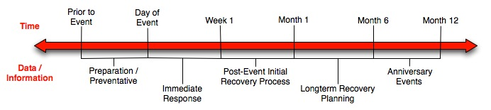
Crisis, Tragedy, and Recovery
Human tragedies that result from man-made and natural events affect communities significantly.
During and after a tragic event, there are a series of needs that have to be addressed.
  Usually centered around communication and a confusing plethora of data and information

Slide 3
Limited Data & Information on CTR
Year | Event | IA Collection # | Wikipedia suffix, other URLs
2004 | Asian Tsunami | 2004 | Indian_Ocean_earthquake , tsunami.archive.org
2007 | Burmese Uprising | 937 | 2007_Burmese_anti-government_protests
2007 | California Wildfires | 877 | California_wildfires_of_October_2007
2008 | Georgia and Russia Conflict | 1120 | 2008_Georgia–Russia_crisis
2005 | Hurricane Katrina | 174 | Hurricane_katrina, www.hurricanearchive.org, hellicane.blogspot.com, everythingandnothing.typepad.com katrinapoetry
2008 | Iowa Flood | 1092 | Iowa_flood_of_2008
1998 | Matthew Shepard murder | 1075 | Matthew_Shepard
2008 | N. Illinois U. Shooting | 970 | Northern_Illinois_University_shooting
2008 | Tibet protests | 1044 | Tibet_protests
2007 | VT April 16 Shooting | 694 | Virginia_Tech_massacre, www.april16archive.org
2008 | Zimbabwean crisis | 1048 | Zimbabwe, www.crisiszimbabwe.org
Staging: school shootings, school events, then to full set of natural / man-made

Slide 4
Data Collection
Expand coverage at Internet Archive
    Can crawl about 17million URLs a year
    Can get data back from them twice yearly
    Now crawling re Typhoons in Asia-Pacific (e.g., Ketsana)
Archive-It tool (http://archive-it.org)
    Can select seeds (starting URLs)
    Various parameters to adjust coverage
Seek volunteers to spot events, give seeds
Notes:
4

Slide 5
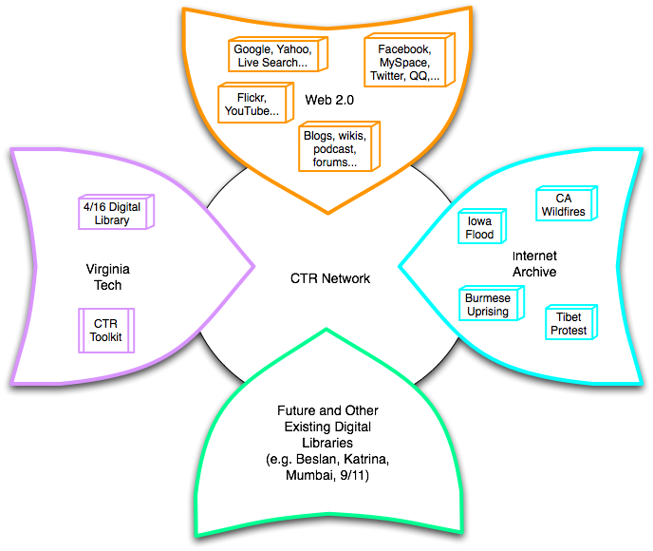
Build a networked digital library relating to CTR
Integrate community, content, and services relating to CTR, making it accessible, and preserving it for long-term reuse
Support information exploration
Aided by an ontology

Slide 6





An ontology for CTR
CTR literature
Browsing
sources
Searching
  Query
  expansion
Focus groups
CTR Ontology
Individual
Organizational
Community
Political
…
Tagging
Websites,
Internet Archive
Recommending
Social network
applications
Summarizing
uses
Multicultural/ linguistic input
Visualizing

Slide 7
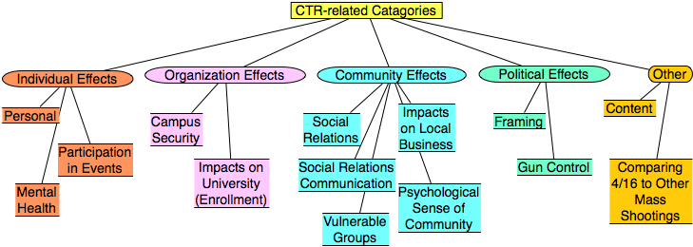
Categories from focus group study
Results from focus group interviews following the April 16, 2007 tragedy at Virginia Tech

Slide 8

CTR stakeholders
Notes:
Help affected communities to recover more quickly and effectively
Provide global network with relevant information and resources
Support the research community, emergency personnel, decision makers, and the public in reacting to and recovering from crises

Slide 9
Services
Infrastructure Services |  | Information Satisfaction Services
Repository-Building | Add Value
Acquiring | Classifying | Browsing
Cataloging and Annotating | Clustering | Collaborating
Crawling | Entity Extraction, and Integration through URM | Customizing
Digitizing | Evaluating | Filtering
Federating | Auto Tagging | Providing access
Harvesting | Publicizing | Recommending
Submitting | Rating | Searching
Indexing | Ontology building | Visualizing
Notes:
For service slidesThere are two types of services involved in CTR
Acquiring is taking Digital objects that are not there in Digital library and incorporating into this.
Acquiring adds ability to classify the objects
Annotating incorporates annotation into already existing set of annotations.
Catalogue is list of digital objects available in the digital library“
Crawling is an automated program that browses through the world wide web in methodical and automated manner to collect the information needed.
Crawler is an important component in the search engine.”
There are two types of services involved in CTR infrastructure services and information services
Acquiring is taking Digital objects that are not there in Digital library and incorporating into this.
Acquiring adds ability to classify the objects. Information from data sources, Integrator will be used to integrate data from different sources
Annotating incorporates annotation into already existing set of annotations. Done by user
Catalogue is list of digital objects available in the digital library . Done by user“
Crawling is an automated program that browses through the world wide web in methodical and automated manner to collect the information needed. Crawler is an important component in the search engine.” Done by Integrator
Digitizing (Done by user)
Federating is simultaneous search in mutiple databases (Integrator)
Submitting (Done by user on Website and Faceboook application)
These are not the exhaustive list of services services such as filtering could be addedEach service provides adds a value or produces a distinct output to the DL
Publicizing – sharing information on facebook application and website
Output of infrastructure is input to the information service . Some other services such as binding can be used. Binding is nothing but collection of digital objects into personal folder of a user

Slide 10
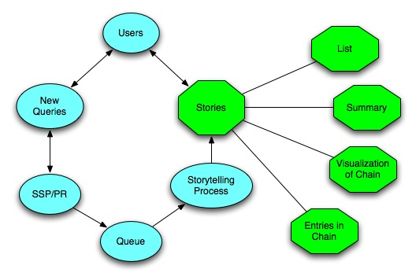
SSP and Storytelling
Notes:
When the users use the CTR DL, the system can record the queries automatically, and these queries can be some people’s name, some events’ name, or any other information, like articles, webpages. Then given two queries, we treat them as endpoints, such as two events, two topics, two articles, or any other two simple queries, the SSP and Storytelling can identify the chain of intermediate information carriers from one to other, satisfying any neighboring intermediate points have a relatively high similarity value. The SSP can return the chain immediately, so it is an online service. The storytelling can mine deeper relationships, but needs more time. All the result can be visulized in the same chain format, and the result can also be offered in the format of text summarization.

Slide 11
Potential impact
Help affected communities to recover more quickly and effectively
  Global network
  Easy accessibility
  Relevant information and resources
  INCLUDING FROM VCOM (e.g., aid worker diaries)
Support classes of stakeholders in reacting to and recovering from crises
  Researchers
  Scholars
  Emergency personnel
  Decision makers
  Public

Slide 12
Priorities
Find more partners (including internationally – Finland, Mexico, Russia, …)
Text mining & stories re: VT, NIU
  Supporting sociology research
Collect key information especially related to school shootings worldwide
Plan CTR computer: key tools & content
Initial release – of interest to general public

Slide 13
Please login, guide, & help us!
Thank you!
http://www.ctrnet.net
fox@vt.edu

