Slide 1
Local Advisory Board Meeting
Blacksburg, VA – 9/29/2009
Crisis, Tragedy, and Recovery network (CTRnet)
Edward A. Fox
Virginia Tech, Digital Library Research Laboratory
fox@vt.edu http://fox.cs.vt.edu www.dlib.vt.edu
www.dl-vt-416.org
www.ctrnet.net

Slide 2
Outline
Introductions
Overview of proposal and project
Reports from co-PIs and students
Discussion of priorities
Advice/recommendations

Slide 3
Attendees (plus CS5604 team)
Co-PIs: | Advisory Board:
Fox, Ed | Blythe, Erv
Kavanaugh, Andrea | Guilbaud, Patrick
Ramakrishnan, Naren | Hawdon, James
Sheetz, Steve | Jones, Russell
Shoemaker, Don | Luke, Tim
GRAs: | McMillan, Gail
Dewanjee, Bidisha | North, Chris
Srinivasan, Venkat | Nowak, Jerzy
Chigani, Amine | Powers, Jim

Slide 4
External Advisory Board
Starr Roxanne Hiltz - NJ Institute of Technology
Murray Turroff - NJ Institute of Technology
Kristine Hannah - Internet Archive
Susan Metros - U of Southern California
Ben Shneiderman - U of Maryland
Padmini Srinivasan - U of Iowa
Eric Van de Velde - Caltech
OTHERS????

Slide 5
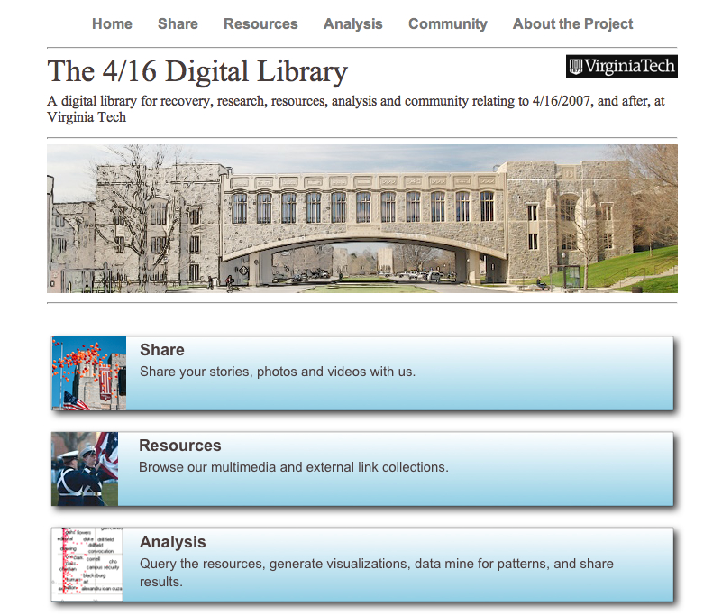
Thanks to: NSF IIS-0736055

Slide 6
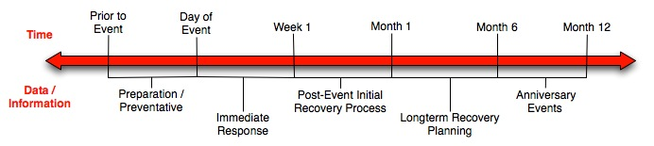
Crisis, Tragedy, and Recovery
Human tragedies that result from man-made and natural events affect communities significantly.
During and after a tragic event, there are a series of needs that have to be addressed.
  Usually centered around communication and a confusing plethora of data and information

Slide 7
Intro: Broader Interest
Kauhajoki Finland shooting
Northern Illinois U. shooting
Texas A&M Bonfire disaster (Project BEAM)
Beslan school massacre
Monterrey Tech, Mexico (esp. re Spanish)
MoU with eIFL.net (Iryna Kuchma)?
Proposal to Google Research?
Support by Regroup?
Interest: counseling, documentaries, psychol-ogy, sociology, (oral)history, technology use, …
Idea: distributed digital library network, with world-wide collaborating community

Slide 8
Intro: Crisis, Tragedy, and Recovery (CTR) Interest
Year | Event | IA Collection | Wikipedia suffix, other URLs
2004 | Asian Tsunami | 2004 | Indian_Ocean_earthquake , tsunami.archive.org
2007 | Burmese Uprising | 937 | 2007_Burmese_anti-government_protests
2007 | California Wildfires | 877 | California_wildfires_of_October_2007
2008 | Georgia and Russia Conflict | 1120 | 2008_Georgia–Russia_crisis
2005 | Hurricane Katrina | 174 | Hurricane_katrina, www.hurricanearchive.org, hellicane.blogspot.com, everythingandnothing.typepad.com katrinapoetry
2008 | Iowa Flood | 1092 | Iowa_flood_of_2008
1998 | Matthew Shepard murder | 1075 | Matthew_Shepard
2008 | N. Illinois U. Shooting | 970 | Northern_Illinois_University_shooting
2008 | Tibet protests | 1044 | Tibet_protests
2007 | VT April 16 Shooting | 694 | Virginia_Tech_massacre, www.april16archive.org
2008 | Zimbabwean crisis | 1048 | Zimbabwe, www.crisiszimbabwe.org
Plan: school shootings, school events, then to full set of natural / man-made

Slide 9
Broad Project Research Questions
How can a portion of the CTR Network be built semi-automatically, drawing upon related digital libraries, web pages, query logs, Web 2.0 applications, and other readily available Internet resources?
How can this CTR Network be utilized, efficient-ly and effectively, for a wide variety of tasks?
What kind of (usable) user interfaces can facili-tate building and utilizing the CTR Network?
How can our solution be evaluated and validated, leading to a widely used methodology?

Slide 10

System Stakeholders

Slide 11
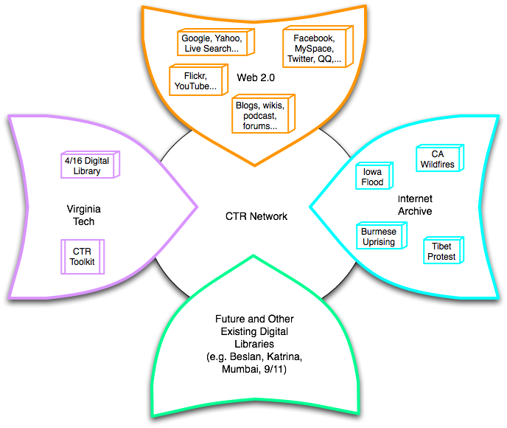
Crisis, Tragedy, and Recovery Network (CTRnet)
Build a networked digital library relating to CTR
Integrate community, content, and services relating to CTR, making it accessible, and preserving it for long-term reuse
Support information exploration
Aided by an ontology

Slide 12
CTR Ontology
An ontology is
  Collection of words and phrases
  Graph of relationships, sometimes mostly hierarchical as in a taxonomy
  Covering the key concepts and terms in the discipline
  Supporting differing views on the field
Purposes
  Describes documents
    As tags, descriptors, keywords
  Supports navigation, learning, and research

Slide 13
Development Approach
Interactions with Users
  Stakeholders
  Focus Groups
  Survey
  Ontology Evaluation
Automated Discovery
  N-Gram evaluation of ISCRAM Proceedings
  Related research from other disciplines
Review of Literature and Existing Systems
  Incident Report Database Schema
  Integration of multiple literatures

Slide 14





An ontology for CTR
CTR literature
Browsing
sources
Searching
  Query
  expansion
Focus groups
CTR Ontology
Individual
Organizational
Community
Political
…
Tagging
Websites,
Internet Archive
Recommending
Social network
applications
Summarizing
uses
Multicultural/ linguistic input
Visualizing

Slide 15
Focus Group Question
Thinking of your research interests and of the interests of other researchers in your discipline: 1) What are the most important research questions, issues, and/or concepts that are relevant to the events of April 16th? 2) What data are needed to address these research questions and issues? 3) What are ideal visualizations that would be most useful for understanding the key issues in your discipline.

Slide 16
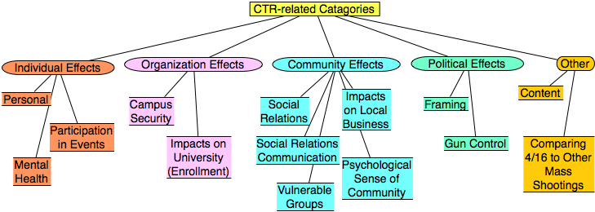
Categories from focus group study
Results from focus group interviews following the April 16, 2007 tragedy at Virginia Tech

Slide 17
CTR keyword pairs
Extracted top keyword pairs from ISCRAM proceedings using the N-gram statistics package
emergency response | decision support | information systems | teams participants
decision making | data models | disaster monitoring | teams maps
command teams | disaster plan | crisis management | sms text-message
flood alerts | information seeking | situational awareness | disaster registry
physical communication | human disaster | teams access | decision preference
Notes:
International Conference on Information Systems for Crisis Response and Management

Slide 18
Why social networking websites on 416?
If you used a social networking website to communicate to others that you were safe or OK, which website did you use first? (identify the website, then briefly - 1 or 2 sentences/phrases - explain why you selected this website)
  426 responses
  Content Analysis
  Results
Notes:
Facebook analysis is part of the Technology and Stress Project related to the April 16 tragedy here at Virginia Tech.

Slide 19
Why use Facebook?
Keyword | Definition
Belong | Only social networking website respondent belongs to or they say that they had an account at the time.
Easy | Easy (and quick) way to contact people or saying I know how to use Facebook.
Friends | Friends and other peers use this particular social networking website, must have thought that friends are on this site, everyone means their friends.
GetInfo | Went to the site to get information or best information.
Groups | Joined groups to connect with others.
Mass Comm | Wanted to reach many people at once, must have the intent to contact many people. Not make direct connections with individuals.
Networks | Means that the site is the most popular or has the most people.
OK | Idea that they went to the site for the purpose of letting others know they were OK or checking if others were OK.
Only Way | For some lost touch friends, this was the only method of communication available
Personal | Personal messages to or from individuals were utilized.
Reliability | Cell phone or other services were unreliable, however, social networking, websites were online the entire time allowing for faster response time
Status | Indicates that they used the public status feature to provide or receive updates about who was OK faster
Wall | A general post could be left on one’s own “wall” indicating they were OK. Ability to post single message for all friends to see. Anytime posting is mentioned.

Slide 20
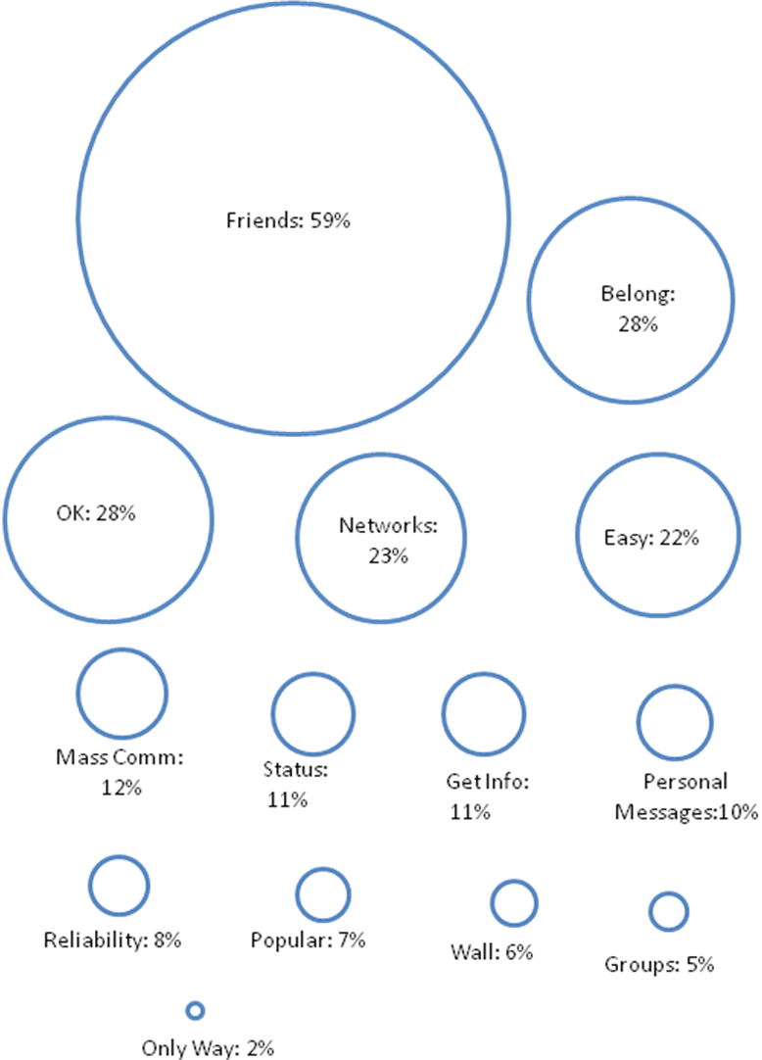
Frequency of Keyword Occurrence
Notes:
Students went to Facebook mainly because their friends were there and this can be seen from the experiment which shows that majority of the responders included this in their explanation
Facebook is the only social networking site in which they are part or they had a page in Facebook was another major reason why they went to Facebook
The most important reason quoted was that they want to communicate that they are ”ok”
this was supported by the actions like “changing their status messages and sending messages to say they were ok” that they performed when they visited that site Most of the responders said they used Facebook social networking site . Only 10% choose Myspace

Slide 21
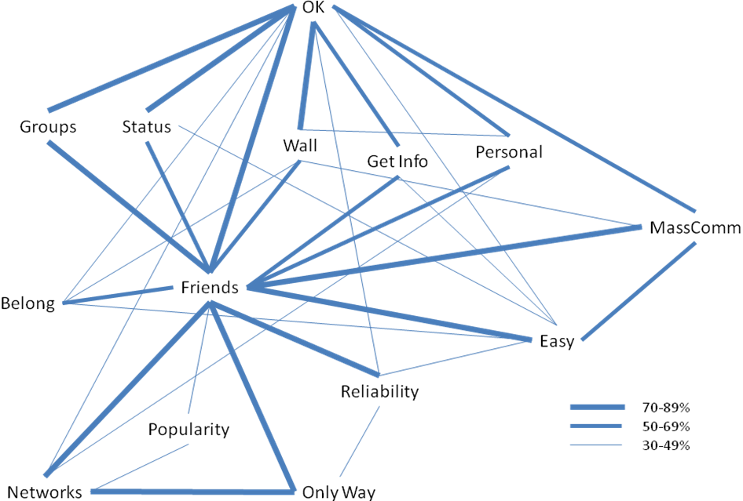
Keyword co-Occurrence
Notes:
Students went to Facebook mainly because their friends were there and this can be seen from the experiment which shows that majority of the responders included this in their explanation
Facebook is the only social networking site in which they are part or they had a page in Facebook was another major reason why they went to Facebook
The most important reason quoted was that they want to communicate that they are ”ok”
this was supported by the actions like “changing their status messages and sending messages to say they were ok” that they performed when they visited that site Most of the responders said they used Facebook social networking site . Only 10% choose Myspace

Slide 22
Next Steps
Users
  Select Next Stakeholder Group
  Focus Groups
Automated Discovery
  Apply N-Gram evaluation to Sociology Research
Revise Ontology
  Examine multiple arrangements
  Evaluate usefulness with crawl results

Slide 23
Approach: Services
Infrastructure Services |  | Information Satisfaction Services
Repository-Building | Add Value
Acquiring | Classifying | Browsing
Cataloging and Annotating | Clustering | Collaborating
Crawling | Entity Extraction, and Integration through URM | Customizing
Digitizing | Evaluating | Filtering
Federating | Auto Tagging | Providing access
Harvesting | Publicizing | Recommending
Submitting | Rating | Searching
Indexing | Ontology building | Visualizing
Notes:
For service slidesThere are two types of services involved in CTR
Acquiring is taking Digital objects that are not there in Digital library and incorporating into this.
Acquiring adds ability to classify the objects
Annotating incorporates annotation into already existing set of annotations.
Catalogue is list of digital objects available in the digital library“
Crawling is an automated program that browses through the world wide web in methodical and automated manner to collect the information needed.
Crawler is an important component in the search engine.”
There are two types of services involved in CTR infrastructure services and information services
Acquiring is taking Digital objects that are not there in Digital library and incorporating into this.
Acquiring adds ability to classify the objects. Information from data sources, Integrator will be used to integrate data from different sources
Annotating incorporates annotation into already existing set of annotations. Done by user
Catalogue is list of digital objects available in the digital library . Done by user“
Crawling is an automated program that browses through the world wide web in methodical and automated manner to collect the information needed. Crawler is an important component in the search engine.” Done by Integrator
Digitizing (Done by user)
Federating is simultaneous search in mutiple databases (Integrator)
Submitting (Done by user on Website and Faceboook application)
These are not the exhaustive list of services services such as filtering could be addedEach service provides adds a value or produces a distinct output to the DL
Publicizing – sharing information on facebook application and website
Output of infrastructure is input to the information service . Some other services such as binding can be used. Binding is nothing but collection of digital objects into personal folder of a user

Slide 24
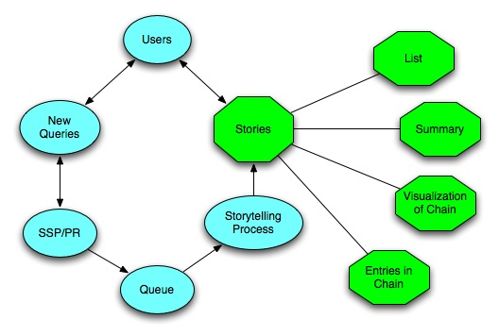
Approach: SSP and Storytelling
Notes:
When the users use the CTR DL, the system can record the queries automatically, and these queries can be some people’s name, some events’ name, or any other information, like articles, webpages. Then given two queries, we treat them as endpoints, such as two events, two topics, two articles, or any other two simple queries, the SSP and Storytelling can identify the chain of intermediate information carriers from one to other, satisfying any neighboring intermediate points have a relatively high similarity value. The SSP can return the chain immediately, so it is an online service. The storytelling can mine deeper relationships, but needs more time. All the result can be visulized in the same chain format, and the result can also be offered in the format of text summarization.

Slide 25
Data Collection
Tie-up with Internet Archive
    Can crawl about 17million URLs a year
    Can get data from them twice a year
    Done some test crawls at our local set-up
Archive-It tool (http://archive-it.org)
    Can select seeds (starting URLs)
    Various parameters to adjust the scope of the crawl
Demo
Notes:
25

Slide 26
Outreach
CTRnet website
    Forums, user uploads etc.
    Feedback/Feature requests ?
CiteULike (http://www.citeulike.org)
    Group called “ctrnet”
    Please join, and post pointers to papers, books and other scholarly material of interest
Notes:
26

Slide 27
Research Questions - sample
An important goal of the CTRnet project is to provide assistance to researchers, especially from social / behavioral science fields. Listed below are a few research questions which are connected with school shootings and similar tragedies.
1. What are the social parameters of social networking (such as Facebook and Myspace) in reaction to school tragedies? For example, do women use social networking more often than men? Is social networking more common among students than faculty or staff? Is social networking more common among university personnel than within the community?
(cont’d)

Slide 28
Research Questions - continued
2. How do school structures affect responses to tragedies? What is the impact of tragedies on community structures and school-community relationships?
3. Are there stages of grieving within a community? We know people go through several stages of grief in reaction to the loss of loved ones. Do communities also go through stages of grief in reaction to tragedies?
4. What are the characteristics of school administrations in reaction to tragedies? For example, do schools vary in initial reactions to tragedies, such as communication and class schedules? Are there differences with regards to long-term effects of tragedies, in terms of organization and communication systems?
5. Are there international differences in response to school shootings? Are these differences evident in school and community settings?

Slide 29
CS5604 CTRnet Project Report
Group 1: Develop a CTRnet methodology for finding proper seeds in crawling and perform basic filtering after crawling. (Tristram Bethea, Seth Fox)
  Choosing links, setting depth to crawl in a site
  Use ontology and machine learning
Group 2: Further filter the data which prepares for Storytelling to build meaningful connections and apply other potential techniques (Timeline analysis, etc.) to gain extra insight. (Chao Peng, Min Li, Yipan Deng)
  Transform data for use with StoryTelling and SSP
  Start with questions from researchers to prime our first investigation of developing useful stories

Slide 30
Questions
Other VT people, partners, collaborators, sponsors, members of external board?
Should we run more focus groups?
Pointers to
  papers, classes, case studies, publications?
Ontology
  what should it contain?

Slide 31
Priorities
Find key partners
Work with data in hand re VT, NIU
Prepare to crawl with IA; practice, train others
Collect key information especially related to school shootings worldwide
Demonstrate storytelling & SSP integration
  Using social/behavioral science research questions
Plan CTR computer
  Key tools
  Key content
Initial release – of interest to general public

Slide 32

Thank you
http://www.ctrnet.net

