Slide 1
Two Approaches to Enhance the Education for ETDs: Developing Educational Modules and Migrating the ETD Guide into a Community Wiki
Seungwon Yang, Jean Levy, Kevin Miller, Jeffrey Pomerantz, Sanghee Oh, Barbara Wildemuth, Edward A. Fox (fox@vt.edu)
11th International Symposium on Electronic Theses & Dissertations (June 4-7, 2008)
The Robert Gordon University, Aberdeen, Scotland, UK

Slide 2
Acknowledgement
This material is based upon work supported by the National Science Foundation under Grant Numbers IIS-0535057 (VT) and IIS-0535060 (UNC-CH).

Slide 3
Overview
1. Introduction
2. Selected DL modules for scholars
2.1. Draft DL modules
3. The ETD Guide update and migration
3.1. Contributing to The ETD Guide
4. Summary
5. Invitation

Slide 4
Introduction
Two efforts to help ETD/NDLTD community
Educational module development
Enhance understanding of ETDs for research
scholars
The ETD Guide
Content update
Migration to local MediaWiki server

Slide 5
Overview
1. Introduction
2. Selected DL modules for scholars
2.1. Draft DL modules
3. The ETD Guide update and migration
3.1. Contributing to The ETD Guide
4. Summary
5. Invitation

Slide 6
Selected DL educational modules (1/2)
DL Curriculum Project Group has been developing educational modules since 2006 (curric.dlib.vt.edu)
Plan for 41 modules
Presented in the DL Framework (next 2 slides)

Slide 7
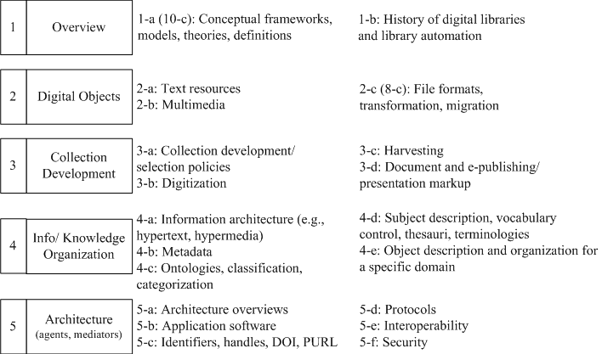
DL Framework (1/2)

Slide 8
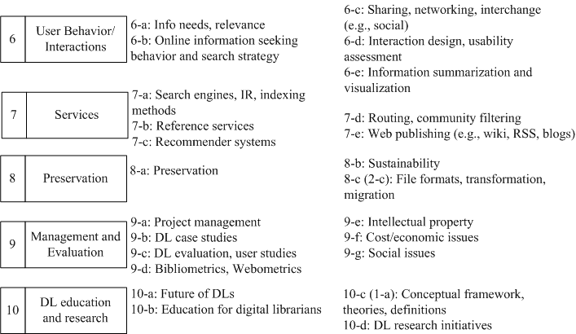
DL Framework (2/2)

Slide 9
Selected DL educational modules (2/2)
11 modules selected (from 41)
Might be most useful and relevant for scholars doing research
By studying those modules, scholars might be able to more fully use ETDs and DL systems
Details are in our ETD ‘07 paper
“Improving Education and Understanding of NDLTD”

Slide 10
11 modules (1/2)
Module No. | Name
1-a (10-c) | Conceptual frameworks, theories, definitions
2-c (8-c) | File formats, transformation, migration
3-b | Digitization
3-d | Document and e-publishing/presentation markup
4-b | Metadata

Slide 11
11 modules (2/2)
Module No. | Name
4-d | Subject description, vocabulary control, thesauri, terminologies
5-c | Identifiers, handles, DOI, PURL
6-b | Online information seeking behaviors and search strategies
7-e | Web publishing (e.g., wiki, RSS, blogs)
9-b | DL case studies
9-e | Intellectual property

Slide 12
Effectively using 11 modules (1/6)
1-a(10-c): Conceptual framework, theories, definitions
Introduce fundamental DL concepts
Basics for deductive learning
2-c(8-c): File formats, transformation, migration
Introduce the different digital formats we face everyday
E.g., transforming .doc file into a PDF document

Slide 13
Effectively using 11 modules (2/6)
3-b: Digitization
One of basic modules for ETDs
Most documents are created digitally nowadays
Equally important is to digitize valuable paper-based theses and dissertations
These digitized documents are easily accessible
3-d: Document and e-publishing/ presentation markup
Could be combined with 7-e: Web publishing

Slide 14
Effectively using 11 modules (3/6)
4-b: Metadata
Important step in submitting ETDs
Allows searching/browsing using categories
4-d: Subject description, vocabulary control, thesauri, terminologies
Assist the authors of ETDs with keyword selection
Particularly useful when organizing large collections of digital objects

Slide 15
Effectively using 11 modules (4/6)
5-c: Identifiers, handles, DOI, PURL
Assigning a unique ID to a digital object is important to distinguish it from others
ID should be persistent to allow long-term access
6-b: Online information seeking behaviors and search strategies
DL system studies should go hand-in-hand with the studies about their users to better support user needs. Theories and practices are explained.

Slide 16
Effectively using 11 modules (5/6)
7-e: Web publishing (e.g., wiki, RSS, blogs)
Introduces technologies that allow
Easy creation (e.g., wikis and blogs)
Easy sharing (e.g., RSS)
A group of scholars having same interests can communicate and collaborate through these media
9-b: DL case studies
Might be used as a reference when developing a digital library

Slide 17
Effectively using 11 modules (6/6)
9-e: Intellectual property
Presents issues such as:
copyright protection
fair use
Technologies to support those issues
E.g., Digital Rights Management (DRM)

Slide 18
Overview
1. Introduction
2. Selected DL modules for scholars
2.1. Draft DL modules
3. The ETD Guide update and migration
3.1. Contributing to The ETD Guide
4. Summary
5. Invitation

Slide 19
DL module template (1/2)
1. Module name
2. Scope
3. Learning objectives
4. 5S characteristics of the module
5. Level of effort required (in-class and out-
of-class time required for students)
6. Relationships with other modules
7. Prerequisite knowledge/skills required (completion optional)
8. Introductory remedial instruction

Slide 20
DL module template (2/2)
9. Body of knowledge
10. Resources (textbooks, required and
optional readings for instructors and
students)
11. Concept map (created by students)
12. Exercises / Learning activities
13. Evaluation of learning objective
achievement
14. Glossary
15. Additional useful links
16. Contributors

Slide 21
Five draft DL modules (1/2)
Name | Description | Review status
3-b: Digitization | Approaches for selecting material, process, challenges are covered. Practical considerations are evaluated. | Draft done, expert review done, field testing begun
4-b: Metadata | Approaches to create, maintain and update metadata are described. History and issues for standards are introduced. Metadata generation methods are discussed and provided as an exercise. | Draft done, expert review begun
6-b: Online information seeking behaviors and search strategies | Theories, models and practices in different settings are covered. Methods of collecting user data are practiced as exercises. | Draft done, expert review done, field testing begun

Slide 22
Five draft DL modules (2/2)
Name | Description | Review status
7-e:Web publishing (e.g., wiki, RSS and blogs) | Various tools/technologies that support publishing/sharing on the internet will be presented. Their features will be discussed and the design concepts will be compared. | Draft done, under internal review
9-e:Intellectual property | Defines the purpose of copyright and copyright protection of DL resources. Discusses the controversial issues related to privacy. It also will deal with technical methods to protect the author of resources. | Draft done, under internal review

Slide 23
Example module
Only 5 sections are displayed in a module
(out of original 16, for simplicity)
Sections have close relationships with one another
Example module 3-b: Digitization

Slide 24
Major 5 sections in a module
Section | Content
Learning objectives | Includes 3-4 learning objectives Illustrates expected performance and achievements
Level of effort required | Both in-class (1.5-3 hours, e.g., lectures) and out-of-class (e.g., homework, reading papers, group assignments) hours are considered
Body of knowledge | Lists the core topics to learn Covers basic concepts, definitions, theoretical models and practices
Readings for students | 3-5 assigned for students (& advanced students, instructors) Representative papers within the scope
Learning activities | Mostly group activities (project or discussions) to effectively use team-based learning approach

Slide 25
Module 3-b: Digitization (1/3)
Learning objectives | Students will be able to: a. Explain the standard process of digitization projects, from initiating the project, to selecting and creating materials, making them accessible to users, and maintaining the collection of digitized materials. b. Demonstrate the critical issues and challenges of the digitization project (e.g., the potential uses, legal and financial considerations, preservation, and technical feasibility). Practice, by creating a small-scale collection of digital objects.
Level of effort required | a. Class time: 1 1/2 hour b. Student time outside class: 4 hours • Reading before the class starts: 2 hours • Homework assignment: 2 hours

Slide 26
Module 3-b: Digitization (2/3)
Body of knowledge | Definitions Digitization Digital conversion Digitization Process Potential and intended uses Considering issues before digitization Selecting materials for digitization Actions for digitizing Processing for use Digitization Projects Google Book Library Projects Open Content Alliance (OCA) The Library of Congress: American Memory

Slide 27
Module 3-b: Digitization (3/3)
(Selected) Readings for students | Chowdhury, G.G., & Chowdhury, S. (2003). Chapter 6, Digitization. In Introduction to Digital Libraries. London: Facet Publishing, 103-119. Cornell University Library. (2000). Moving theory into practice: Digital imaging tutorial. Retrieved October 29, 2005, from http://www.library.cornell.edu/ preservation/tutorial/contents.html Smith, A. (1999). Why Digitize? Washington, DC: Council on Library & Information Resources. Retrieved November 2, 2007, from http://www.clir.org/pubs/abstract/pub80.html
Learning activities | Group assignment: Building a digital image collection. This assignment provides an opportunity for the students to create digital objects and process the objects to be used as a part of an art image collection of a hypothetical digital library that the class members will build together.

Slide 28
Module 4-a: Metadata (1/4)
Learning objectives | Students will be able to: Explain the basic principles of metadata creation. Explain the issues associated with the design of metadata schema for digital materials, and the assignment of metadata values for specific digital materials. Design a metadata schema and assign the values appropriate to materials in a particular digital library.
Level of effort required | a. In class: 3 hours b. Student time outside class: • Reading before the class starts: 2-3 hours • Homework assignment (optional): 1 hour

Slide 29
Module 4-a: Metadata (2/4)
Body of knowledge | Definitions Dublin Core (DC) DC principles Data model Problems with DC DC extensions Namespaces and repositories Types of interoperability (federation, harvesting, crosswalks) Administrative metadata Designates information related to the administration of digital objects Enable verification of the integrity, ownership and authorship Examples of elements (Rights, Handling, Affiliation)

Slide 30
Module 4-a: Metadata (3/4)
(Continued…) Body of knowledge | Preservation metadata Data necessary to maintain the viability, renderability and understandability of digital objects over the long term Examples of elements (PreservationLevel, Fixity, Environment) Harvesting Facilities (reuse, services, sharing among the community members) Open Archive Initiative Protocol for Metadata Harvesting (OAI-PMH) Educational metadata Sharable Content Object Reference Model (SCORM) Semantic Web Necessitates the widespread use of ontology Cyber-infrastructure: goal of ubiquitous information infrastructure

Slide 31
Module 4-a: Metadata (4/4)
(Selected) Readings for students | Weibel, S. (1995). Metadata: The foundations of resource description. D-Lib Magazine, 1(1). http://www.dlib.org/dlib/July95/07weibel.html Duval, E., Hodgins, W., Sutton, S., & Weibel, S. L. (2002). Metadata principles and practicalities. D-Lib Magazine, 8(4). http://www.dlib.org/dlib/april02/weibel/04weibel.html
Learning activities | Group exercise (15-20 min): Invent object description The instructor provides various objects to student groups and each group describes them as much detail as possible so that a user could locate the objects in a library/archive/museum. Then discuss about the limitations and differences among the descriptions.

Slide 32
Survey item (1/3) (1:strongly disagree – 5:strongly agree)
No. | Survey item
1 | Clearly outlined objectives and outcomes were provided
2 | The module was well-organized
3 | The amount of work required for this module was appropriate
4 | The assigned readings helped me better understand the subject matter
5 | Given the module’s objectives, the learning activities and/or assignments were appropriate
6 | The learning activities and/or assignments required thinking and understanding.

Slide 33
Survey item (2/3) (1:strongly disagree – 5:strongly agree)
No. | Survey item
7 | The learning activities and/or assignments were stimulating.
8 | Assignments for this module helped me understand what will be expected of me as a professional.
9 | I learned useful professional skills from this module.
10 | I know significantly more about this subject than before I took this module.
11 | Class lectures added to my understanding of the subject.
12 | I gained a good understanding of the basic concepts related to this subject.

Slide 34
Survey item (3/3) (1:strongly disagree – 5:strongly agree)
No. | Survey item
13 | I learned to interrelate important issues related to this subject.
14 | This module stimulated me to think critically about the subject matter.
15 | I feel that this learning module served my needs well.
16 | I was very satisfied with this learning module.
17 | Overall, considering its content, design, and structure, this module was effective.

Slide 35
Overview
1. Introduction
2. Selected DL modules for scholars
2.1. Draft DL modules
3. The ETD Guide update and migration
3.1. Contributing to The ETD Guide
4. Summary
5. Invitation

Slide 36
The ETD Guide - Introduction -
Originally published by UNESCO online in 2001 (etdguide.org), 420 pages
More than 20 authors internationally
Intended to help academic researchers (writing ETDs), faculty (mentoring ETD writing) and graduate deans (initiating ETD program)

Slide 37
The ETD Guide - Problems -
Problem 1:
Outdated information (no update since 2001)
E.g., instructions for MS Office 2000, non-working URLs (www.vtls.com/ndltd)
Problem 2:
PDF document
Not manageable to quickly update the content

Slide 38
The ETD Guide - Approach for Problem 1 -
Update the outdated content !
SUCCESSFUL…
1
2
3
Read
entire 420 pages
Flagged sections to be updated
Corrected typos & grammatical errors, software versions & features

Slide 39
The ETD Guide - Approach for Problem 2 (1/2) -
Utilize the flexibility of wiki !
Wikibooks.org
Wikiversity.org BUT…
Wikisource.org
Local wiki server…
1
2
3
Found
candidate wiki communities
Selected wikibooks.org
Attempted to migrate to it

Slide 40
The ETD Guide - Approach for Problem 2 (2/2) -
Obstacles…
We faced copyright issues
So, contacted UNESCO for permission
In the mean time, we decided to change the host to local MediaWiki server
→ Better control over content by allowing only specified users to alter it

Slide 41
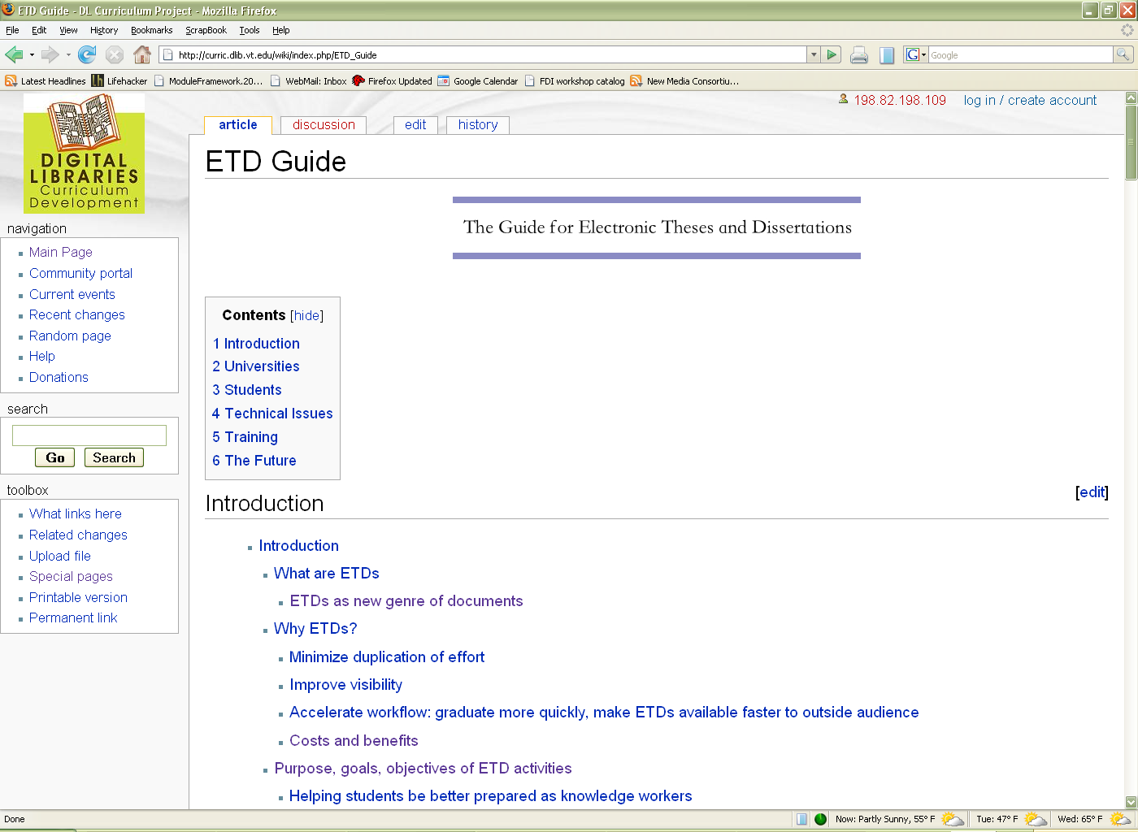
Wiki-based ETD Guide curric.dlib.vt.edu/wiki/index.php/ETD_Guide
Notes:
Another difference from the original is that all the section numbers are removed so that a section can be added, removed or reorganized flexibly.
There were some dead links in the old document. Because providing the dead links in the document would degrade the quality and integrity of the revised version, we decided not to include those links, but still keep the name of the web site to which the links referred.

Slide 42
Overview
1. Introduction
2. Selected DL modules for scholars
2.1. Draft DL modules
3. The ETD Guide update and migration
3.1. Contributing to The ETD Guide
4. Summary
5. Invitation

Slide 43
Contributing to The ETD Guide
Steps | To do
1 | Email seungwon@vt.edu or shoh@email.unc.edu and get an account
2 | Login to the wiki-based ETD Guide
3 | Modify / create content as needed
* For details of wiki programming, please refer to the project report or MediaWiki manual
Notes:
For details on wiki manipulation, please refer to:
Project report: http://pubs.dlib.vt.edu:9090/183/01/The_Guide_for_Electronic_Theses_and_Dissertations.pdf
MediaWiki manual:
http://www.mediawiki.org/wiki/Help:Editing_pages

Slide 44
Overview
1. Introduction
2. Selected DL modules for scholars
2.1. Draft DL modules
3. The ETD Guide update and migration
3.1. Contributing to The ETD Guide
4. Summary
5. Invitation

Slide 45
Summary
Educational modules for research scholars
41 DL curriculum modules
11 selected for research scholars
5 drafts are introduced in the paper
Some of them can be accessed at http://curric.dlib.vt.edu/wiki
The ETD Guide is updated and migrated to the flexible wiki server at
http://curric.dlib.vt.edu/wiki/index.php/ETD_Guide

Slide 46
Overview
1. Introduction
2. Selected DL modules for scholars
2.1. Draft DL modules
3. The ETD Guide update and migration
3.1. Contributing to The ETD Guide
4. Summary
5. Invitation

Slide 47
Invitation (1/2)
DL Curriculum Project:
http://curric.dlib.vt.edu
Would you like to join our effort ☺ ?
You can participate in two ways:
Module development
Module evaluation/field test
Notes:
DL curriculum group have been developing educational modules together with our collaborators…

Slide 48
Invitation (2/2)
1
2
3
Email
project PIs:
fox@vt.edu
wildem@
ils.unc.edu
Receive:
Resources for module development or evaluation
Build, evaluate:
Your module will be used by scholars internationally
And your name will remain forever with the module!

Slide 49
Thank you!
Questions?

