Slide 1
Big Data Processing of School Shooting Archives
PRANAV NAKATE
Independent Study (CS 5974)
Virginia Tech
Dr. Edward fox
Computer Science
Blacksburg, Virginia 24060
This material is based upon work supported by the National Science Foundation under Grant No. NSF - IIS1319578: SMALL: ideal

Slide 2
Goals
Help Dr. Shoemaker (Professor, Sociology, and co-PI on IDEAL) in his research on school shootings
Collect, clean, and organize existing webpage and tweet collections to make them searchable for researchers
Remove unnecessary and unrelated content from each collection
Remove stop words and profane words from the content of each collection

Slide 3
Collections
News articles about past school shootings
Tweets about school shootings
The collections contain:
  Noise in the webpages / tweets
    Stop words
    Profane words
  Broken pages
  Duplicate pages
  Useful webpages and tweets
WARC file format

Slide 4
Task Pipeline
WARC
Positive Samples
Negative Samples
Extract Webpage Locations
Clean Page Content
Create Sample Sets
Train Classifier
Classify Collection
Remove Duplicates
Remove Stop Words, Profanity
Word Lemmatization
SVM
Naïve Bayes
SOLR

Slide 5
Collection Statistics
Collection | HTML | non-HTML | non-English | Duplicates | non-English | Duplicates
Northern Illinois University | 73307 | 33175 | 766 | 31619 | 1.04% | 43.13%
Alabama University | 30970 | 4807 | 76 | 11659 | 0.25% | 37.65%
Youngstown Shooting | 11697 | 13609 | 210 | 4549 | 1.80% | 38.89%
Brazilian School Shooting | 3995 | 12298 | 209 | 1813 | 5.23% | 45.38%
Norway Shooting | 10321 | 36093 | -- | 3724 | -- | 36.08%
Connecticut School Shooting | 11710 | 32315 | 698 | 5657 | 5.96% | 48.31%

Slide 6
Webpage Cleaning
Readability
Beautiful Soup
NLTK LancasterStemmer
Regular Expressions (Python)
  Stop Words
  Profane Words
Cleaned Content
Raw Page
Extract HTML
Extract Main Body
Word Lemmatization
Regular Expressions

Slide 7
Create Training Data
Automated Script
  Input: Collection of pages
  Output: Positive sample file and negative sample file
  Take a sample of pages from the collection
  Display the content of the sample to the user
  Label a sample: positive or negative (manually by the user)
  Store in positive and negative sample files

Slide 8
Sample sets size
What should be the size of positive and negative sample sets?
  Number of unique documents in the collection
  Average length of relevant, non-relevant pages
  Classifier training and accuracy with existing size of the sample sets
  If accuracy is lower (below 70%) for all values of parameter K, then add more positive and negative samples

Slide 9
Classifier Training
Input: positive and negative sample files
75% positive samples + 75% negative samples for training
25% as test data
Feature Selection
  CountVectorizer
  TfidfTransformer
  SelectKBest
SVM Classifier
Naïve Bayes Classifier
Calculate accuracy on training data and test data
List of Documents
Count Vectorizer
Tfidf Transformer
SelectKBest

Slide 10
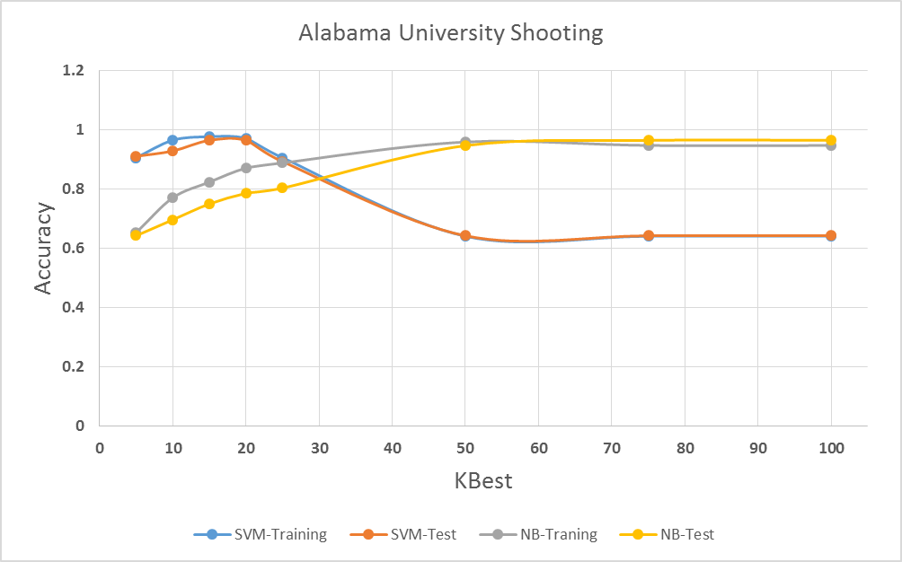
Results - 1

Slide 11
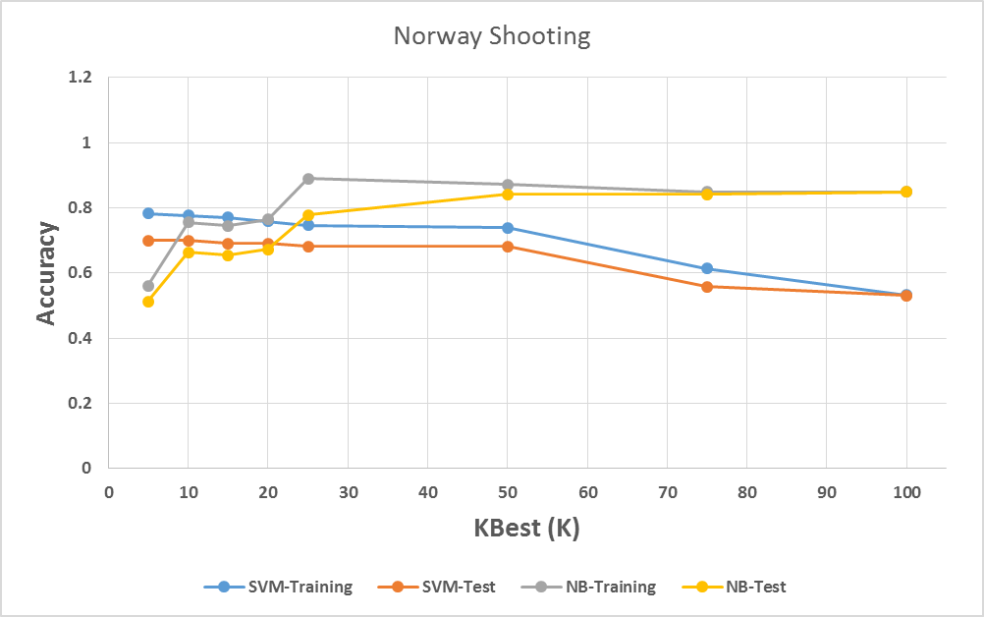
Results - 2

Slide 12
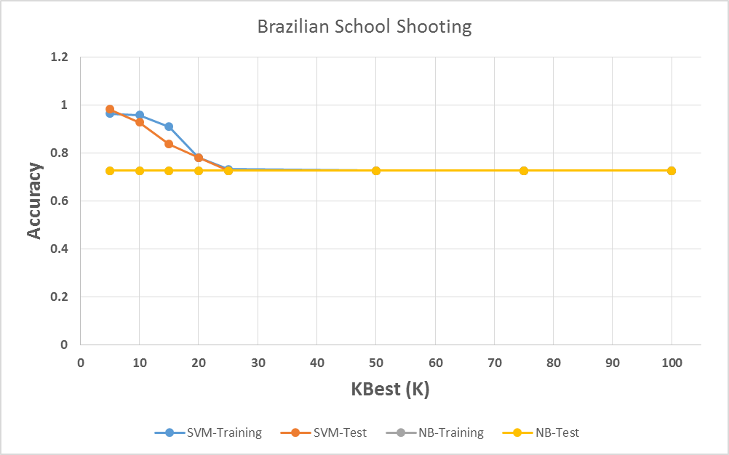
Results - 3

Slide 13
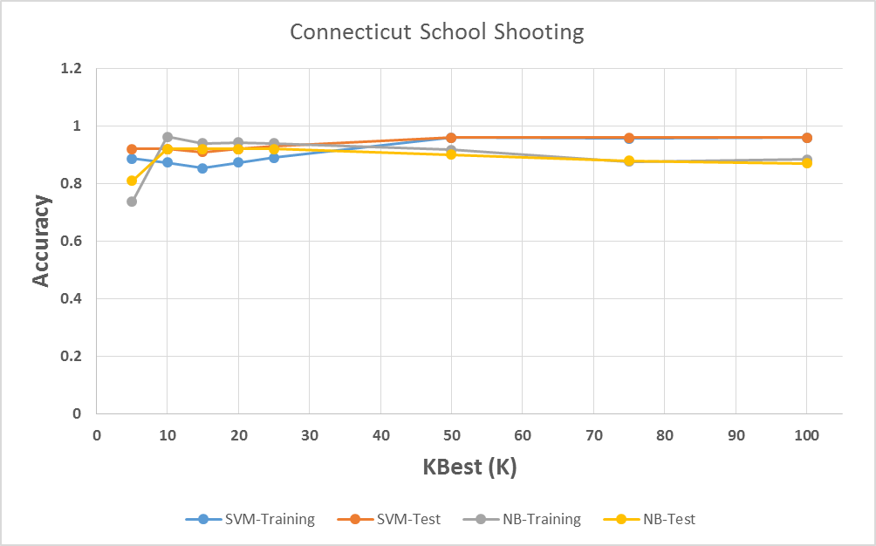
Results - 4

Slide 14
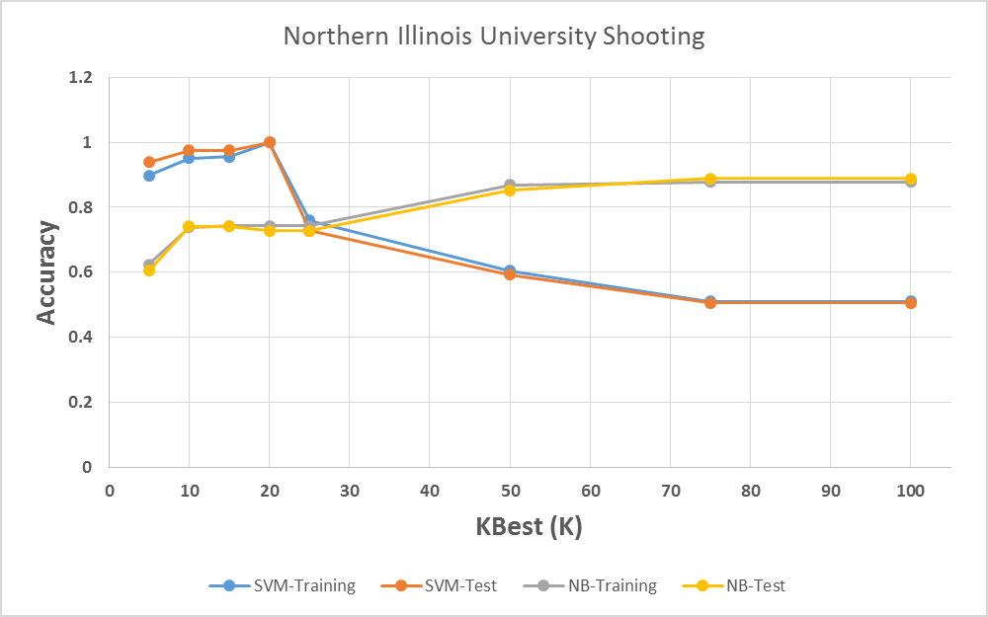
Results - 5

Slide 15
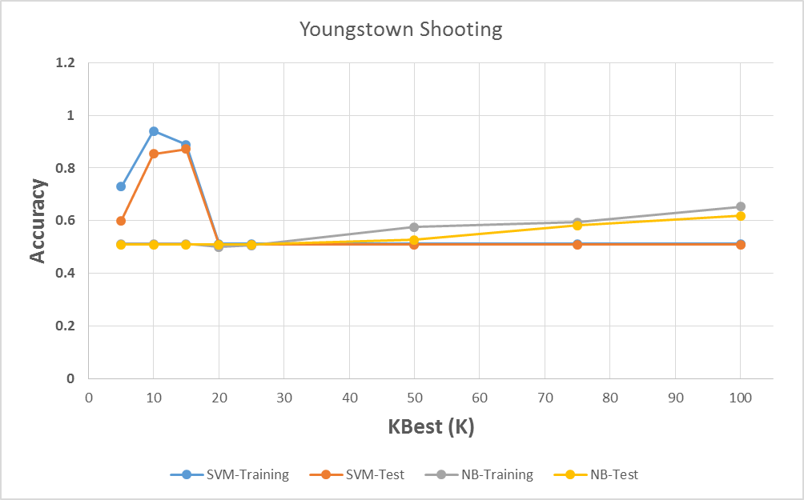
Results - 6

Slide 16
F1 Measure – with SVM Classifier average precision, recall and F1-score with total support values
Collection | Precision | Recall | F1-score | Support
Northern Illinois University | 0.98 | 0.98 | 0.98 | 81
Alabama University | 0.96 | 0.96 | 0.96 | 56
Youngstown Shooting | 0.88 | 0.87 | 0.87 | 55
Brazilian School Shooting | 0.87 | 0.84 | 0.81 | 55
Norway Shooting | 0.79 | 0.69 | 0.66 | 113
Connecticut School Shooting | 0.92 | 0.91 | 0.91 | 100

Slide 17
F1 Measure – Naïve Bayes Classifier average precision, recall and F1-score with total support values
Collection | Precision | Recall | F1-score | Support
Northern Illinois University | 0.83 | 0.74 | 0.72 | 81
Alabama University | 0.82 | 0.75 | 0.7 | 56
Youngstown Shooting | 0.26 | 0.51 | 0.34 | 55
Brazilian School Shooting | 0.53 | 0.73 | 0.61 | 55
Norway Shooting | 0.73 | 0.65 | 0.62 | 113
Connecticut School Shooting | 0.83 | 0.74 | 0.72 | 81

Slide 18
In the pipeline…
Upload the final classified pages to Solr
Histogram of word count vs. page count in each collection
Stop words, Profane words statistics

Slide 19
Future Work
New classification features
  Page title
  Word count of the page
K fold cross validation
Display top K features
Process other file types such as PDF, Txt
Paragraph extraction and classification
Moving deduplication to the start of process pipeline

Slide 20
Thank you!
Questions?

