Slide 1

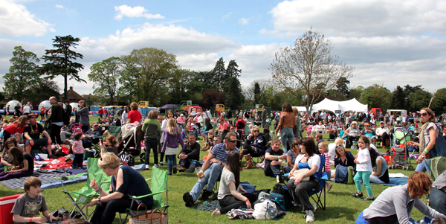
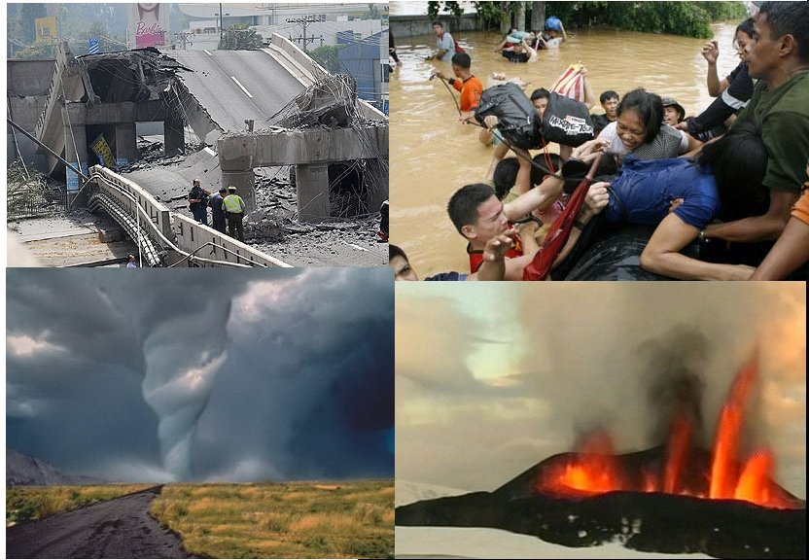
Integrated Digital Event Archiving & Library (IDEAL)
http://www.eventsarchive.org
(includes proposal and 1 year report to NSF)
Internal Advisory Board Meeting
October 16, 2014

Slide 2
Outline / Agenda
Prior work (CTRnet)
Current status
Discussion
Please help us:
Prioritize and focus on important topics
Make connections with related efforts
Extend our dissemination
Please comment / ask questions throughout.

Slide 3
Acknowledgments - 1
External Advisory Board
David Chaiken, CTO, Altiscale
Kristine Hanna, Director Archiving Services, Internet Archive
Geoff Harder, Associate University Librarian, Univ. Alberta
Grant Ingersoll, CTO, LucidWorks
Kris Kasianovitz, International, State, and Local Government Documents Librarian, Stanford University
Patrick Meier, iRevolution.net, Director of Social Innovation at Qatar Computing Research Institute (QCRI)
Susan Metros, Interim CIO & Associate Dean, USC
Michael Nelson, Associate Prof., Old Dominion University
Eric Van de Velde, Owner, EVdV Consulting

Slide 4
Acknowledgments - 2
Internal Advisory Board (please introduce yourselves!)
James Hawdon, Sociology & Director of Center for Peace Studies & Violence Prevention (CPSVP)
Russell Jones, Psychology
Timothy Luke, Chair, Political Science
Madhav Marathe, CS & Director Network Dynamics and Simulation Science Laboratory (NDSSL)
Gail McMillan, Director, Digital Library and Archives
Scott Midkiff, VP, Information Technology
Chris North, Computer Science
John Ryan, Chair, Sociology
Tyler Walters, Dean, University Libraries

Slide 5
Acknowledgments - 3
Related Funding:
  2007-2008: NSF IIS-0736055, DL-VT416: A Digital Library Testbed for Research Related to 4/16/2007 at Virginia Tech
  2009-2013: NSF IIS-0916733, Crisis, Tragedy, and Recovery network (CTRnet)
  2013-2016: NSF IIS-1319578, Integrated Digital Event Archive & Library (IDEAL)
  2012-2014: Villanova University (NSF DUE-1141209): Computing in Context
  2012-2015: Qatar NPRP 4-029-1-007, Establishing a Qatari Arabic-English Library Institute
  2014: Mellon/Columbia, Archiving Transactions Towards Uninterruptible Web Service (UPS – building on Memento and SiteStory)
The Internet Archive (Kristine Hanna, co-PI):
  Heritrix crawler and other tools and support
  Hosting the crawls and resulting archives
  Jefferson Bailey, Program Manager, on the call today
Support letters from Internet Archive, LucidWorks, Qatar Computing Research Institute (QCRI), and Virginia Tech (Library, NDSSL, CPSVP)

Slide 6
Acknowledgments - 4
IDEAL: VT: PI: Fox (CS), co-PIs: Andrea Kavanaugh (CS, CHCI), Steve Sheetz (ACIS), Don Shoemaker (Sociology); GRAs: Mohamed Magdy, Sunshin Lee
CTRnet: also Naren Ramakrishnan (CS, co-PI); GRAs Seungwon Yang (now GMU) and Venkat Srinivasan
  DL-VT416: also Christopher North (CS) and Weiguo Fan (ACIS)
  Computing in Context: Villanova PI Robert Beck; VT PI Fox, GRAs: Xuan Zhang, Tarek Kanan: CS4984 class on Computational Linguistics, summarizing Web collections (extract words/POS/sentences, find topics, fill/use event templates)
Qatar: PI Fox, Co-PIs Mohammed Samaka (Qatar U.), Somaya Al-maadeed (QU), Krishna RoyChowdhury (Qatar National Library), C. Lee Giles (Penn State), Rick Furuta (Texas A&M); consultant John Impagliazzo (Hofstra), VT GRA Tarek Kanan
Mellon: PI Zhiwu Xie, co-PI Fox, GRA Prashant Chandrasekar
Other students: Kiran Chitturi, Rachel Coston, Alex Cummins, Ishita Ganotra, S.M.Shamimul Hasan, So Hyun Jo, Christopher Jones, Rohan Kaul, Jun Kim, Lin Tzi Li, Ying Ni, Nikhil Plassmann, Braeden Sebastian & teams in CS4624, 5604, 6604
Collaborators in: Egypt, Tunisia, Mexico, Philippines, … – others are welcome!

Slide 7
CTRnet
  Collect, analyze, and visualize disaster information with a DL

Slide 8
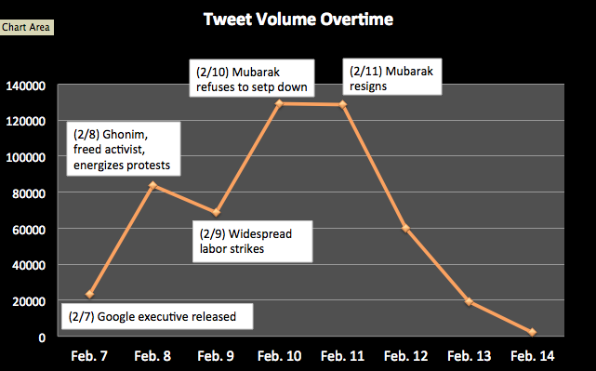
Social Media Use in Political Crisis (1/2)(2/7 - 2/14, 2011)
No. Tweets
Total 514,782 tweets

Slide 9
Social Media Use in Political Crisis (2/2)
Opinion Leadership in Egypt Uprising 2011
  514,782 tweets (one week around Mubarak’s resignation)
  Total 79,000 unique users
    Presumably posting from Egypt → 4,710
    Individuals excluding organizations → 3,675
  Opinion leaders
    500-27,000 followers in top 10% (365) individuals
    Bios: blogger/activist, writer/reporter, lawyer/executive director, social media consultant,… → ‘elite’ type actors
This has led to other studies, surveys, publications

Slide 10
Visualizing Emergency Phases in Tweets (ISCRAM 2013) (1/2)
Four phases of emergency management model

Slide 11
Visualizing Emergency Phases in Tweets (2/2)

Slide 12
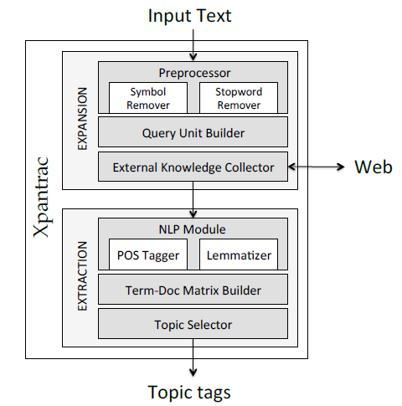
Topic Tagging of Webpages: Xpantrac
Seungwon Yang dissertation
Input: text file
Build query
  Every 5 words, 1 word overlap
Send query to search API
  Web search (Seungwon)
  Wikipedia, our collection(s): CS4624 Spring 2014: Sloane Neidig, Samantha Johnson, David Cabrera, Erika Hoffman
Find topics in retrieved documents
  Frequency of words
Select most frequent as “topics”
Output: topics
Notes:
Sloane

Slide 13
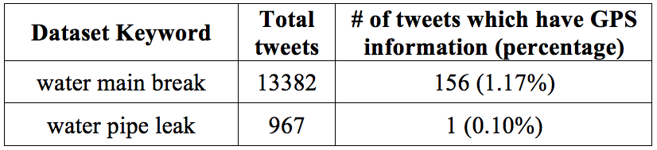
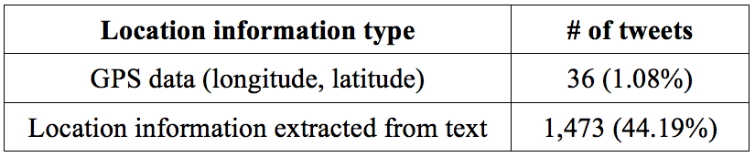
Water Main Break Visualization
Sunshin Lee: leading to current tweet geo-location research
Tweets collected with keywords
Selected tweets with location information
Event locations displayed with
details
Notes:
SNER extracts location information from each tweet message, and then it returns a set of geonames as location information. The selected dataset has 3333 tweets. Table 10 shows that we get 1,473 relevant tweets by extracting location information from text. In contrast, we only get 36 tweets using GPS data.

Slide 14
Web Archives
13 TB of IA Collections, e.g., Boston Marathon blast, Global Emergency Overview, April 16 Shooting, and Ebola.
Category | No. of Archives
Accidents (plane crash, building collapse, ferry sinking) | 11
Bombings | 4
Earthquakes (Japan) | 12
Fires | 2
Floods | 5
Hurricanes (Sandy), Tsunami, Cyclones, Typhoons | 8
Shootings | 17
Community | 3
Disease Outbreak | 2

Slide 15
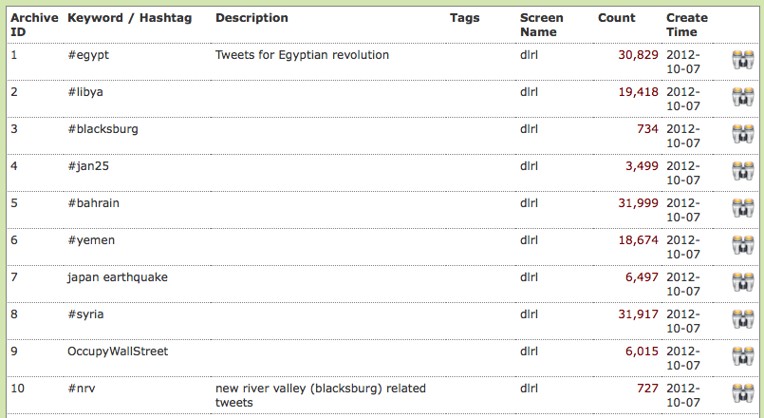
Tweet Collections
442 Event-specific and general collections
  Accident, shooting, bombing, earthquake, fire, flood, hurricane, community, political, and etc.
Total of 942 million tweets (Oct. 14, 2014)
  YourTwapperKeeper using keywords and hashtags

Slide 16
Integrated Digital Event Archive and Library (IDEAL) Project http://www.eventsarchive.org/
Extension of CTRnet with broadened scope:
  Event detection
  Event data archiving & processing
    Multimedia (images, videos) shared in social media
Digital government research
  Community issue detection
  Public opinion mining, mood perception, information flow
Technologies:
  Focused crawling, analysis/visualization services, integration of archive and DL capabilities

Slide 17
IDEAL Proposal Architecture

Slide 18
Ontology
Taxonomy for events, with upper levels used in website and for browsing collections
What to do with additional ontology details?
How to automatically extract values from collections for the key attributes of events in the ontology?
Most importantly, for summarization and focused crawling, how can we automatically find details on:
Who: Organizations/entities participating in the event
What: Topics of the Event
When: Event time frame (and later times of interest, e.g., anniversaries)
Where: Event location (eventually: lat/long)

Slide 19
IDEAL System Architecture
Sunshin Lee (built low-cost 11 node Hadoop cluster)
Notes:
IDEAL Project System Architecture
Highlights are my research-related components
Collect Source
Provide Services
Use Framework

Slide 20
IDEAL Data Architecture
Sunshin Lee
Notes:
나중에 관련있는 부분을 highlight 한다고 말할 것

Slide 21
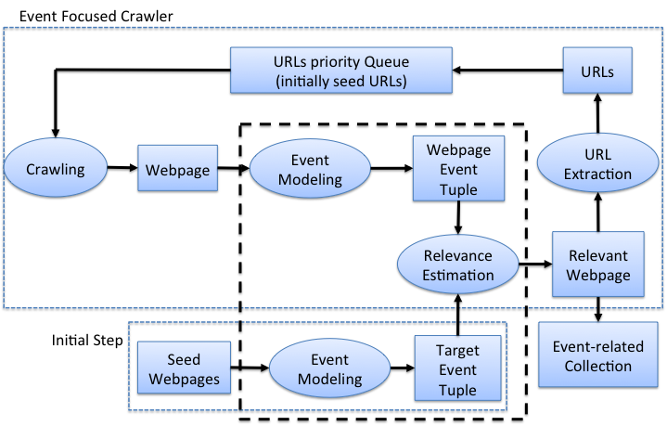
Event Focused Crawler
Mohamed Magdy
Focus of research

Slide 22
Baseline vs. Event Focused Crawler
Mohamed Magdy
Harvest ratio: relevant crawled webpages vs. cumulative set of crawled webpages

Slide 23
Extracted News Events on a Time Line
CS6604 Spring 2014: Tianyu Geng, Wei Huang, Ji Wang, Xuan Zhang
russia, bank, sanctions, ukraine, crisis, crimea
ukraine, tensions, data, rise, shares, china, stocks
ukraine, russia, talks, aid, crisis, sanctions, deal
ukraine, yanukovich, crisis, minister, sign, russian
gas, ukraine, russian, russia, europe, talks, energy
02/28
03/08
03/12
03/16
03/23
04/12
03/01
03/09
03/14
03/20
03/26
04/16
ukraine, crimea, crisis, putin, russia, minister
ukraine, house, imf, u.s, bill, white, aid
ukraine, aid, support, government, talks, house, russian
History:
3/7 referendum
annulled
3/14: UN draft
resolution
crimea, ukraine, russia, minister, referendum, vote
crimea, ukraine, russian, troops, border

Slide 24





News-Tweet Architecture
CS6604 Spring 2014: Tianyu Geng, Wei Huang, Ji Wang, Xuan Zhang
Event 3
Event 3
Event 2
Who
Event 2
Who
Topic
Topic
Event 1
Event 1
Who
Topic
Who
Topic
When
When
Topic
Who
Who
When
Topic
When
Where
Where
Event Extraction Sys.
When
When
Event Extraction Sys.
Where
Where
Pre-processor
Where
Where
Pre-processor
LDA
LDA
NER
Correlation
NER

Slide 25
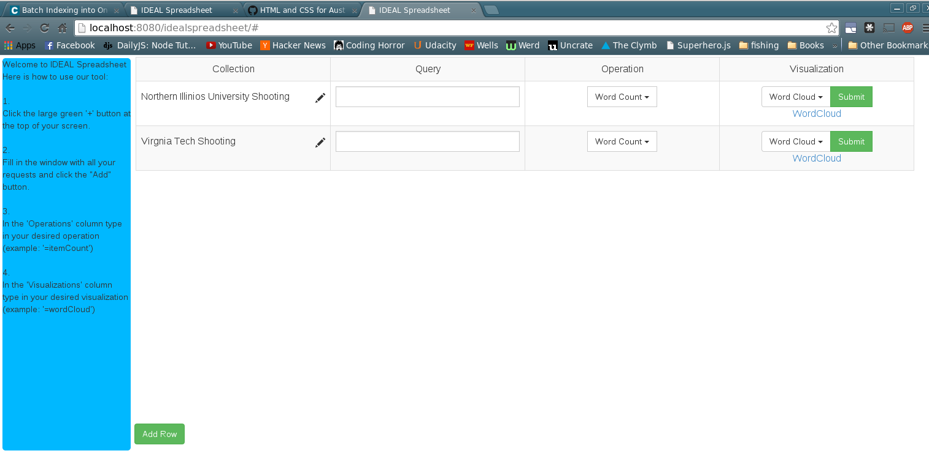
IDEAL Spreadsheet
CS4624 Spring 2014: Tony Ardura, Austin Burnett, Rex Lacy, Shawn Neumann
(based on ArcSpread by Andreas Paepcke et al.)

Slide 26
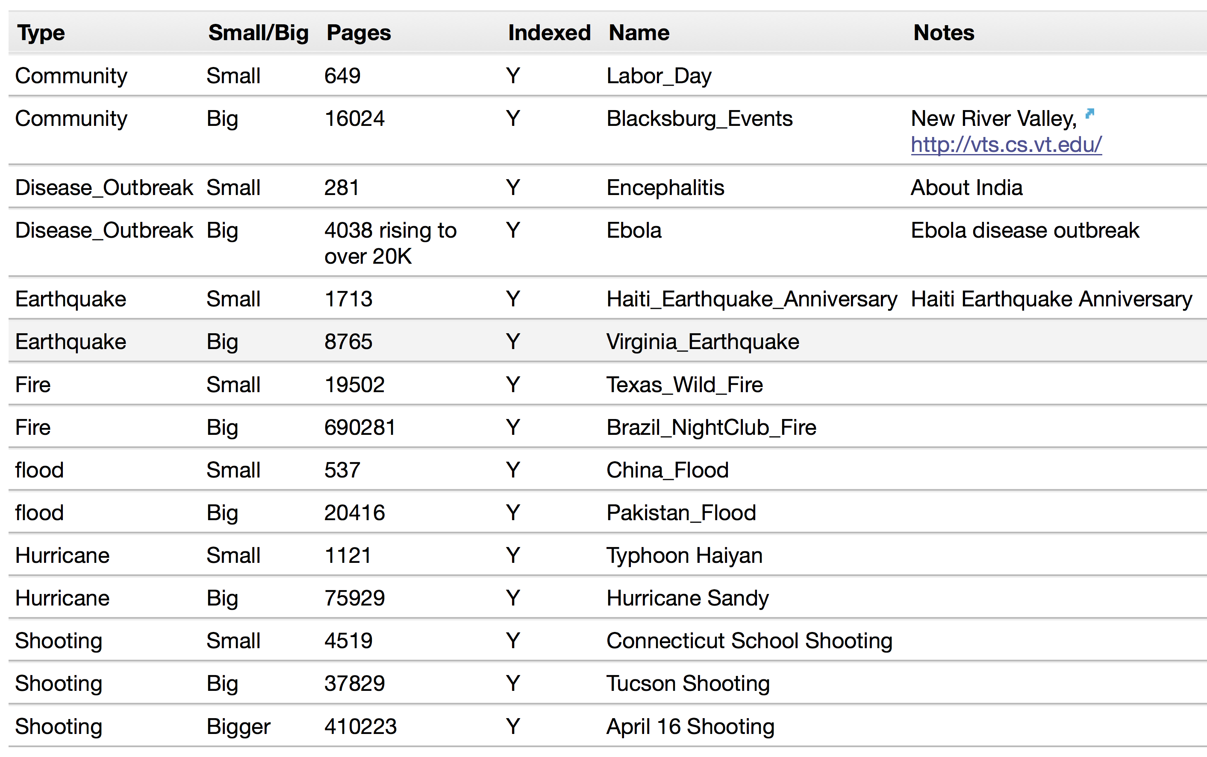
CS4984 Computational Linguistics: Corpora Available

Slide 27
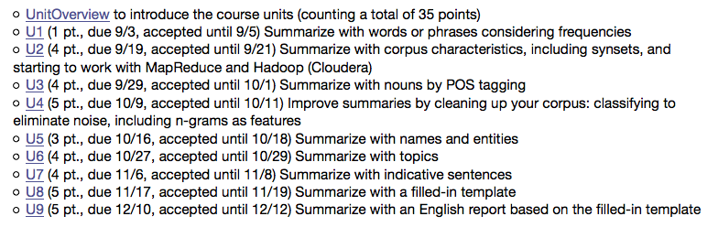
CS4984 Computational Linguistics: Units / Ways to Summarize

Slide 28
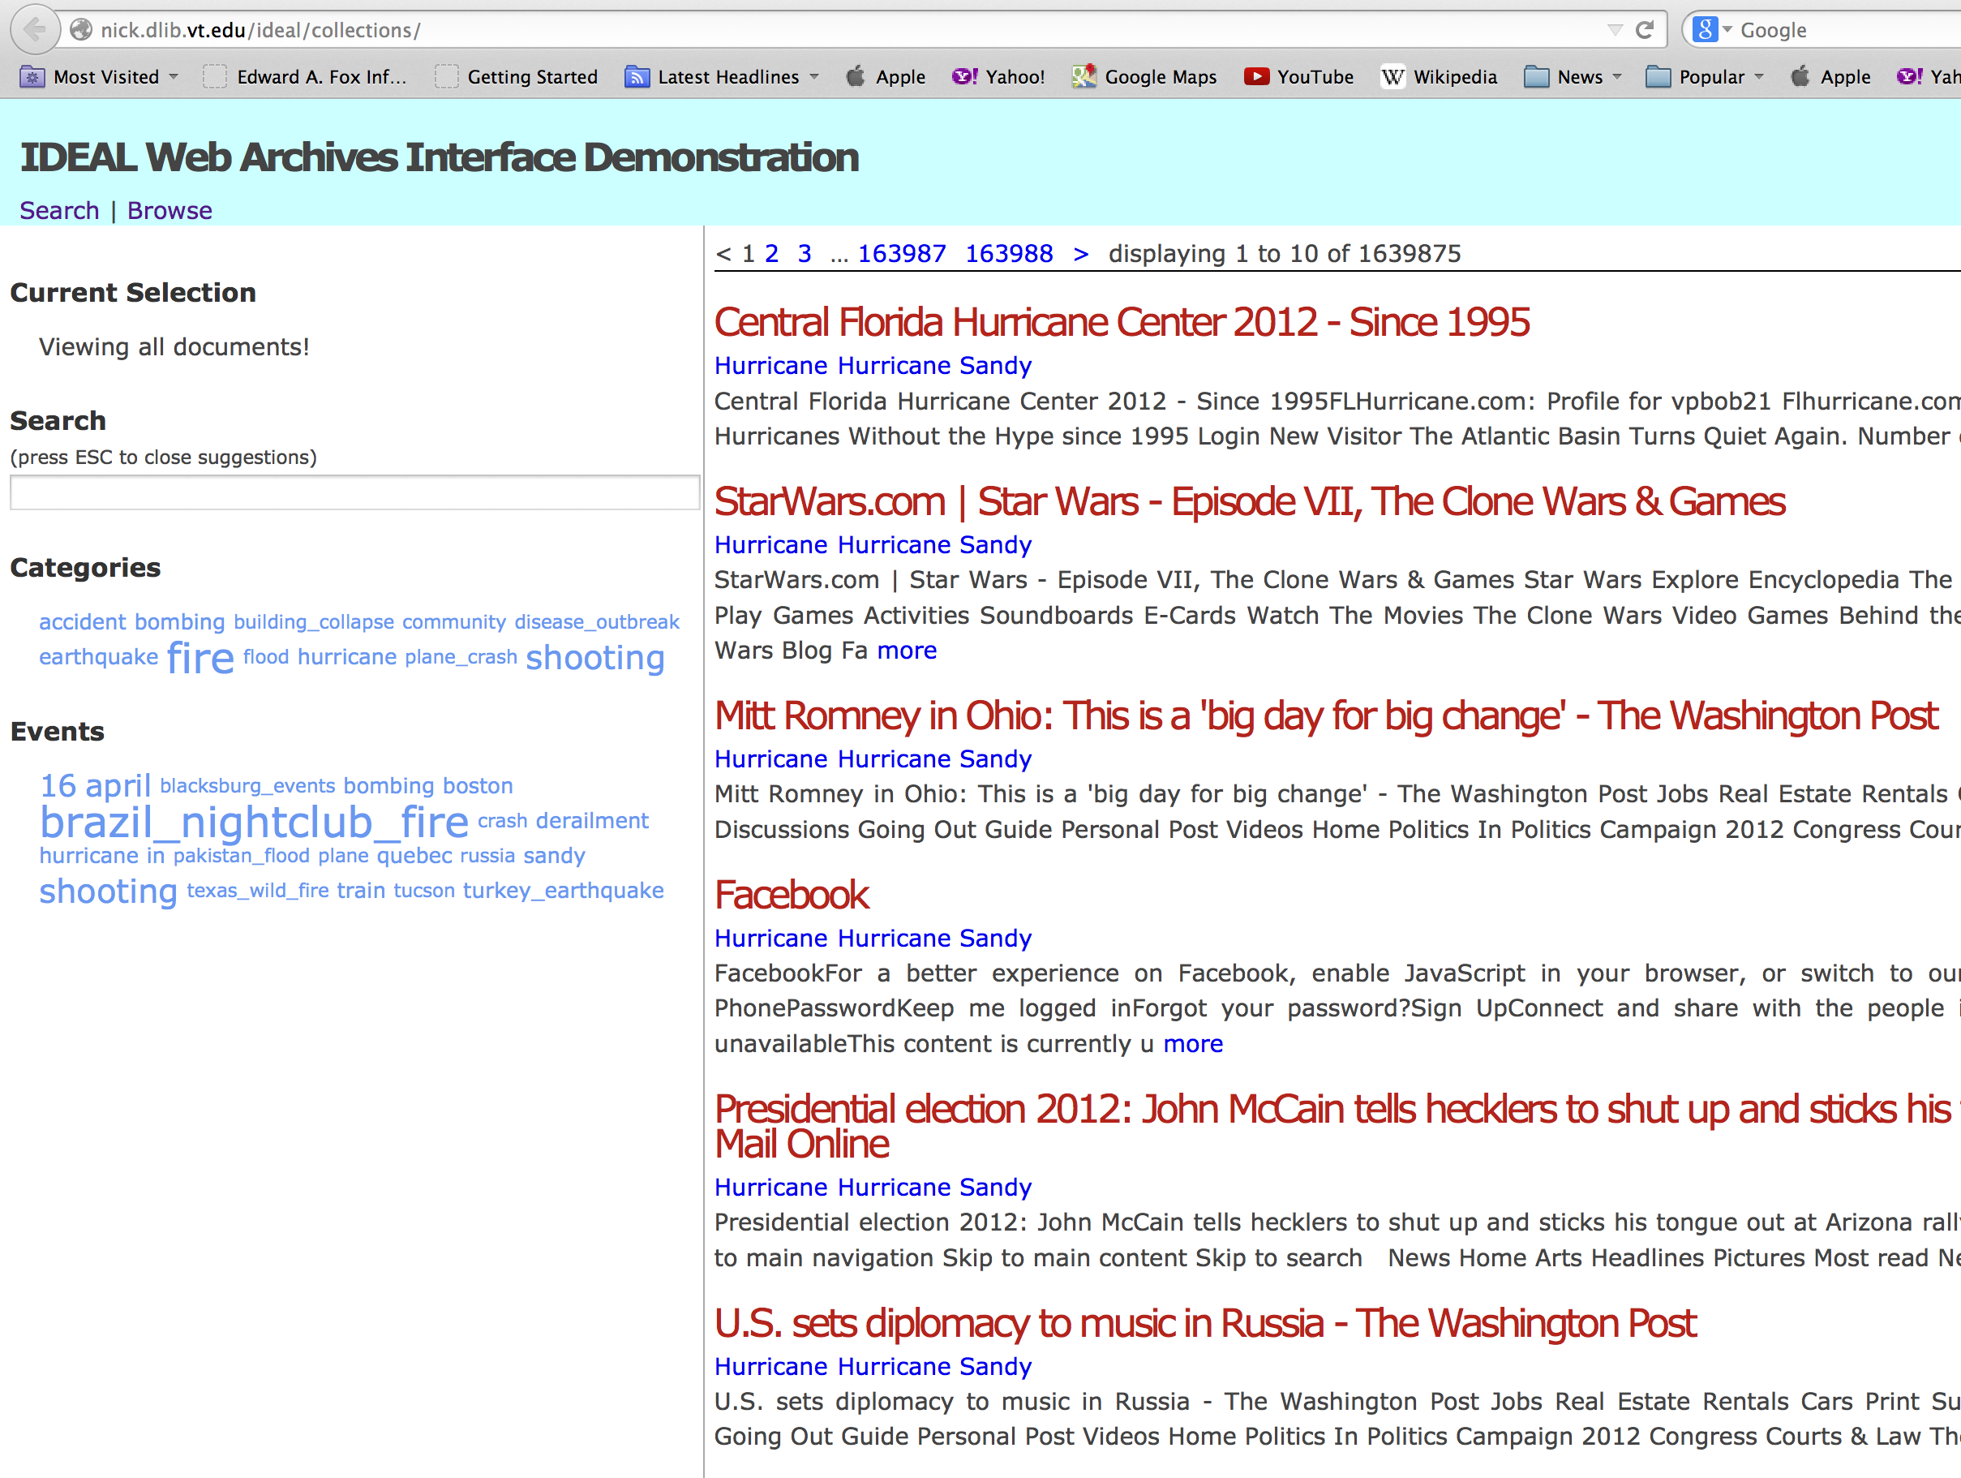

Slide 29
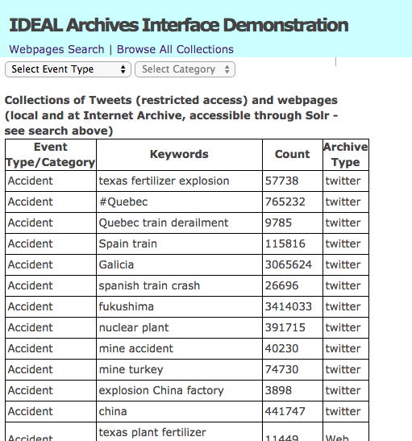

Slide 30
Local Collaborations
Please guide us to more!
Center for Peace Studies & Violence Prevention (CPSVP) – how can we help?
Digital Humanities – aided by Tom Ewing
English
  Katie Carmichael: Katrina oral histories
  Abby Walker: dialects and tweet geolocation

Slide 31
Website and School Shootings
Please try out browsing and searching on this topic using http://nick.dlib.vt.edu/ideal/collections/
Please also see our page http://www.eventsarchive.org/?q=node/38
Regarding that, can you comment:
1. What suggestions would you make with regards to the visibility of this collection on the website?
2. What kinds of information would be useful for us to provide for unique entries in the collection? Is what we have adequate?
3. What sources of information would you suggest to consider in future efforts to develop the collection?

Slide 32
Some Discussion Topics; Priorities?
Facilities
  Webserver: website, …
  Hadoop cluster
  Research systems: tweet collecting, etc.
Collections
  Twitter
  Internet Archive
  Focused crawled webpages
  User requested + Auto-spotting
Services
  Demo for searching and browsing
  Support for CL course
  Analysis & visualization
Website
  Inherits from CTRnet
  Evolving organization and coverage
  Suggestions welcome!
Education/Research
  Mohamed: focused crawling
  Sunshin: tweet geo-location
  Courses
  Supporting outside user groups
Publications
  Related to doctoral work
  Related to surveys
  From classes, projects

Slide 33
Thank you!
Questions/Comments? fox@vt.edu, 540-231-5113
IDEAL-BOARDS@LISTSERV.VT.EDU
IDEAL-CORE@LISTSERV.VT.EDU

Slide 34
Backup slides in case questions arise:
CS6604 project for sharing tweet collections
Earthquakes taxonomy, terminology - details

Slide 35
Recommended Collection-Level Metadata
CS6604 Spring 2014: Michael Shuffett
Dublin Core
  Title, Description
PROV-O
  Starting Point Classes
  Collection process, organization, hadMember, atLocation
ISO 3166-2 for locations
W3/XMLSchema#dateTime
PLUS: TweetID tool for tweet collections
  Extracts tweet and collection level metadata
  Compares / combines tweet collections

Slide 36
Earthquakes taxonomy and terminology
Undergraduate Research, Virginia Tech CS2994
Rohan Kaul and Ishita Ganotra, 8/16/2014
Earthquake.accelerogram
Earthquake.accelerogram.peakAcceleration
Earthquake.accelerogram.acceleration
Earthquake.accelerogram.velocity
Earthquake.accelerogram.displacement
Earthquake.accelerogram.accelerograph
Earthquake.tectonic.accretionaryWedge
Earthquake.tectonic.fault..activefault
Earthquake.aftershocks
Earthquake.alluvium
Earthquake.amplification
Earthquake.amplification.softnessOfRocks
Earthquake.amplification.thicknessOfSediments
Earthquake.amplitude
Earthquake.amplitude.highAmplitude
Earthquake.amplitude.mediumAmplitude
Earthquake.amplitude.lowAmplitude
Earthquake.tectonic.arc
Earthquake.tectonic.fault.aseismic
Earthquake.tectonic.asperity
Earthquake.earth.asthenosphere
Earthquake.attenuation
Earthquake.tectonic.backarc
Earthquake.earth.basement
Earthquake.earth.basement.bedrock
Earthquake.tectonic.benioffZone
Earthquake.tectonic.fault.blindThrustfault
Earthquake.seismicWave.bodyWave
Earthquake.seismicWave.bodyWave.pWave
Earthquake.seismicWave.bodyWave.sWave
Earthquake.earth.crust.brittleDuctileBoundary
Earthquake.dating.carbon14Age
Earthquake.stress.normalStress.tensionalStress
Earthquake.stress.normalStress.compressionalStress
Earthquake.stress.searStress
Earthquake.earth.core
Earthquake.tectonic.fault.creep
Earthquake.earth.crust
Earthquake.stress.deformation
Earthquake.tectonic.fault.dip
Earthquake.tectonic.fault.dipSlip
Earthquake.tectonic.fault.directivity
Earthquake.earthquakeHazard
Earthquake.earthquakeHazard.surfacefault
Earthquake.earthquakeHazard.groundShake
Earthquake.earthquakeHazard.landslide
Earthquake.earthquakeHazard.liquefaction
Earthquake.earthquakeHazard.tectonicDeformation
Earthquake.earthquakeHazard.tsunami
Earthquake.earthquakeHazard.seiches
Earthquake.damage.earthquakeRisk
Earthquake.location.epicenter
Earthquake.tectonic.fault.faultGouge
Earthquake.tectonic.fault.faultPlane
Earthquake.tectonic.fault.faultScarp
Earthquake.tectonic.fault.faultTrace
Earthquake.tectonic.fault.faultPlaneSolution
Earthquake.tectonic.fault.focalMechanismSolution
Earthquake.seismogram.firstMotion
Eartquake.location.hypocenter
Earthquake.location.hypocenter.focalDepth
Earthquake.tectonic.forearc
Earthquake.foreshock
. . .

