Slide 1
Blacksburg Breakfast Lions Club April 4, 2024 “Artificial Intelligence” Edward A. Fox, Ph.D., Professor
fox@vt.edu http://fox.cs.vt.edu
Dept of Computer Science (& ECE by courtesy)
Virginia Tech, Blacksburg, VA 24061 USA
http://fox.cs.vt.edu/talks/2024/20240403FoxLionsBreakfast.pptx

Slide 2
Outline
Acknowledgements
Introduction
Definitions, History
Computers, Technology
Benefits, Concerns
GPT Examples
VT Center and My Examples
Q&A

Slide 3
Acknowledgements
Mentors (Licklider, Kessler, Salton); IMLS, NSF, and other sponsors
Students, colleagues, co-investigators (selected): Lynn Abbott, Eman Abdelrahman, Aman Ahuja, Monika Akbar, Hamed Alhoori, Pranav Angara, Ashish Baghudana, Bipasha Banerjee, Elinor Benami, Warren Bickel, Boots Cassel, Saurabh Chakravarty, Prashant Chandrasekar, Satvik Chekuri, Yinlin Chen, Kiran Chitturi, Luis Escobar, Alexandre Falcao, Weiguo Fan, Francesco Ferretti, Eric Fouh, Chris Franck, Rick Furuta, Lee Giles, Marcos André Gonçalves, Doug Gorton, Islam Harb, S.M.Shamimul Hasan, Chongyu He, Michael Hsiao, Bill Ingram, Jeremy Jenrette, Palakh Jude, Adheesh Juvekar, Sampanna Kahu, Tarek Kanan, Ola Karajeh, Andrea Kavanaugh, Martin Klein, Harinni Kumar, Spencer Lee, Sunshin Lee, Jonathan Leidig, Lin Tzy Li, Liuqing Li, Yi Ma, Yufeng Ma, Mohamed Magdy, Shivam Maharshi, Madhav Marathe, Gary Marchionini, Paul Mather, Maanav Mehrotra, Uma Murthy, Pranav Nakate, Michael Nelson, Sanghee Oh, Sung Hee Park, Supritha Patil, Denilson Pereira, Jeff Pomerantz, Naren Ramakrishnan, Sagnik Ray-Choudhury, Chandan Reddy, Aditya Shah, Rao Shen, Ziqian Song, Venkat Srinivasan, Jeff Stein, Hussein Suleman, Allison Tegge, Ricardo Torres, Adithya Upadhya, Saket Vishwasrao, Xinyue Wang, Barbara Wildemuth, Jian Wu, Zhiwu Xie, Seungwon Yang, Xuan Zhang, ...

Slide 4
JCR Licklider
Grandfather of Internet
Director, Project MAC: CTSS, Multics, AI Lab
M. M. Waldrop’s 2001 biography
“The Dream Machine: J.C.R. Licklider and the Revolution That Made Computing Personal”:
“He is almost alone in his conviction that computers can become not just superfast calculating machines, but joyful machines: tools that will serve as a new media of expression, inspirations to creativity, and gateways to a vast world of online information.”

Slide 5
Gerard Salton
Preeminent figure in modern information retrieval
SMART information retrieval system
Among founders of Cornell Computer Science department
Vector space model
TF*IDF weighting

Slide 6
Early AI Activities, Student Works
1965: Wrote program to play chess
1978-81: Graduate work: CS, Linguistics: Clustering, Relevance feedback, Query expansion
Sheila G. Winett, "FOCES: An experimental expert system to select appropriate foster care homes for children", 1987, MS thesis
R. C. Wohlwend, "Creation of a Prolog Fact Base from the Collins English Dictionary", 1988, MS
Richard Dee Barnhart, "The naval message analyzer", 1992, MS
Robert Karl France, "Effective, Efficient Retrieval in a Network of Digital Information Objects", 2001, PhD
Baoping Zhang, "Intelligent Fusion of Evidence from Multiple Sources for Text Classification", 2006, PhD
Sung Hee Park, "Discipline-Independent Text Information Extraction from Heterogeneous Styled References Using Knowledge from the Web", 2013, Ph.D.
Tarek Ghaze Kanan, "Arabic News Text Classification and Summarization: A Case of the Electronic Library Institute SeerQ (ELISQ)", 2015, Ph.D.
Mohamed Magdy Gharib Farag, "Intelligent Event Focused Crawling", 2016, PhD
Sunshin Lee, "Geo-Locating Tweets with Latent Location Information", 2016, PhD
Xuan Zhang, "Product Defect Discovery and Summarization from Online User Reviews", 2018, PhD
Yufeng Ma, "Going Deeper with Images and Natural Language", 2019, PhD
Liuqing Li, "Event-related Collections Understanding and Services", 2020, PhD
John H. Geissinger, "On Natural Motion Processing using Inertial Motion Capture and Deep Learning", 2020, MS
Ziqian Song, "The Impact of Operational Crisis on Firm Equity Value: An Event-driven Approach", 2020, PhD
Amirsina Torfi, "Privacy-Preserving Deep Learning to Generate Synthetic Healthcare Records", 2020, PhD
Sampanna Yashwant Kahu, "Figure extraction from scanned electronic theses and dissertations", 2020, MS
Amr Ahmed Aboelnaga, "USV Classifications: An Adaptation from DeepSqueak", 2020, MEng
Saurabh Chakravarty, "Summarizing Legal Depositions," 2020 PhD
Aditya Ashishkumar Shah, "Leveraging Transformer Models and Elasticsearch to Help Prevent and Manage Diabetes through EFT Cues", 2023, MS
Nila Masrourisaadat. "Quantitative and Qualitative Analysis of Text to Image Models", 2023, MS
Chongyu He. "Deep Learning Approach for Cell Nuclear Pore Detection and Quantification over High Resolution 3D Data," 2023, MS

Slide 7
Reading List (Audiobooks)
The Deep Learning Revolution (8:05) 2019: Terrence Sejnowski
Talk to Me: How Voice Computing Will Transform the Way We Live, Work, and Think (10:29) 2019: James Vlahos
Artificial Intelligence: Learning about Chatbots, Robotics, and Other Business Applications (1:49) 2020: John Adamssen
Intelligent Automation: Learn how to harness artificial intelligence to boost business & make our world more human (5:53) 2021: Pascal Bornet, Ian Barkin, Jochen Wirtz
The Age of AI: And Our Human Future (7:13) 2021: Henry A. Kissinger, Eric Schmidt, Daniel Huttenlocher

Slide 8
Definitions
John McCarthy (1955, Stanford, coined): the science and engineering of making intelligent machines
IBM: Artificial intelligence, or AI, is technology that enables computers and machines to simulate human intelligence and problem-solving capabilities.
Coursera: Artificial intelligence (AI) refers to computer systems capable of performing complex tasks that historically only a human could do, such as reasoning, making decisions, or solving problems.
According to 15 U.S. Code § 9401 artificial intelligence is defined as “a machine-based system that can, for a given set of human-defined objectives, make predictions, recommendations or decisions influencing real or virtual environments.” The notes in 10 U.S. Code § 2358 define artificial intelligence as:
“Any artificial system that performs tasks under varying and unpredictable circumstances without significant human oversight, or that can learn from experience and improve performance when exposed to data sets.
An artificial system developed in computer software, physical hardware, or other context that solves tasks requiring human-like perception, cognition, planning, learning, communication, or physical action.
An artificial system designed to think or act like a human, including cognitive architectures and neural networks.
A set of techniques, including machine learning, that is designed to approximate a cognitive task.
An artificial system designed to act rationally, including an intelligent software agent or embodied robot that achieves goals using perception, planning, reasoning, learning, communicating, decision making, and acting.”

Slide 9
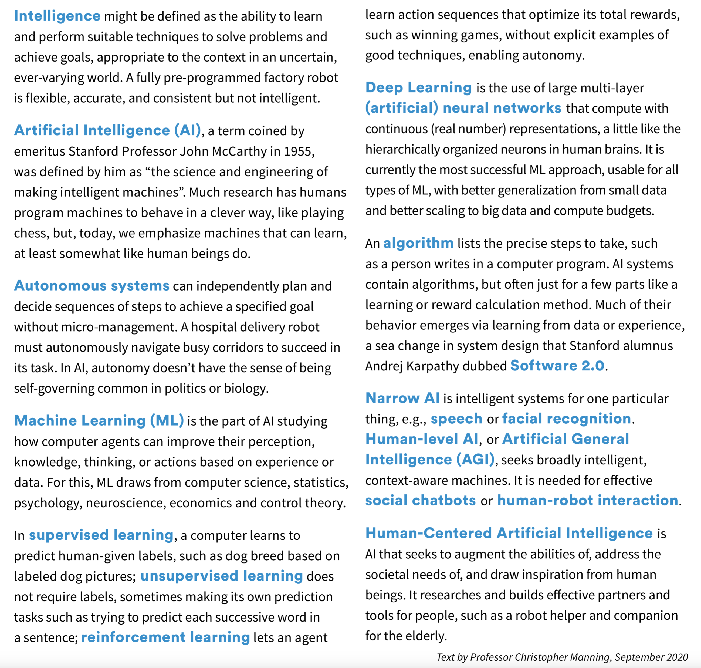

Slide 10
Intelligent Information Systems
Search engines
Recommenders
Smart homes, smart cities
Robots
Chatbots
Bots
Autonomous vehicles
Land: Cars, Trucks
Air: Planes, Drones
Sea: Boats, Underwater

Slide 11
Rules/Symbols, Neural Networks
1950s – 1990s
1950 “Computing Machinery and Intelligence”: Alan Turing (Turing test)
A rule-based AI system uses pre-written rules to make decisions and solve problems. Domain-specific rules are based on human expert knowledge.
Symbolic AI uses logic programming, production rules, semantic nets and frames. Applications/methods: knowledge-based systems, symbolic mathematics, automated theorem provers, ontologies, semantic web, search, automated planning / scheduling systems, (multi-)agent systems.
2000 –
Inspired by study of brains and neurons
Parallel processing, connectionism
Enabled by increases in data, and computer speed / memory / connectivity
Deep neural networks, methods from physics and optimization (back prop)

Slide 12
AI Milestones / Accomplishments
1997: chess: IBM Deep Blue vs. Kasparov
2005: 5 autonomous vehicles: DARPA Grand Challenge
2011: Siri; Jeopardy: IBM’s Watson
2012: cat identification: 10M unlabeled YouTube pictures
2014: Alexa: shopping assistance
2015: ImageNet challenge: 1000 images
2016: Go: AlphaGo defeated world champion
2019: lung cancer detection: GoogleAI > radiologists
2020: antibiotic discovery: Halicin: MIT’s James Collins
2020: self-driving public taxi: Waymo, Phoenix
2020: protein folding: AlphaFold
See also https://achievements.ai/

Slide 13
Computers / Companies
WWW 2
Early Computers: Univac, IBM, Digital Equipment, Intel, …
Current Largest AI Companies: Microsoft, Alphabet, NVIDIA, Meta, Tesla, IBM, Palantir, Mobileye, …
Moore’s Law
speed and capability of computers can be expected to double every two years

Slide 14
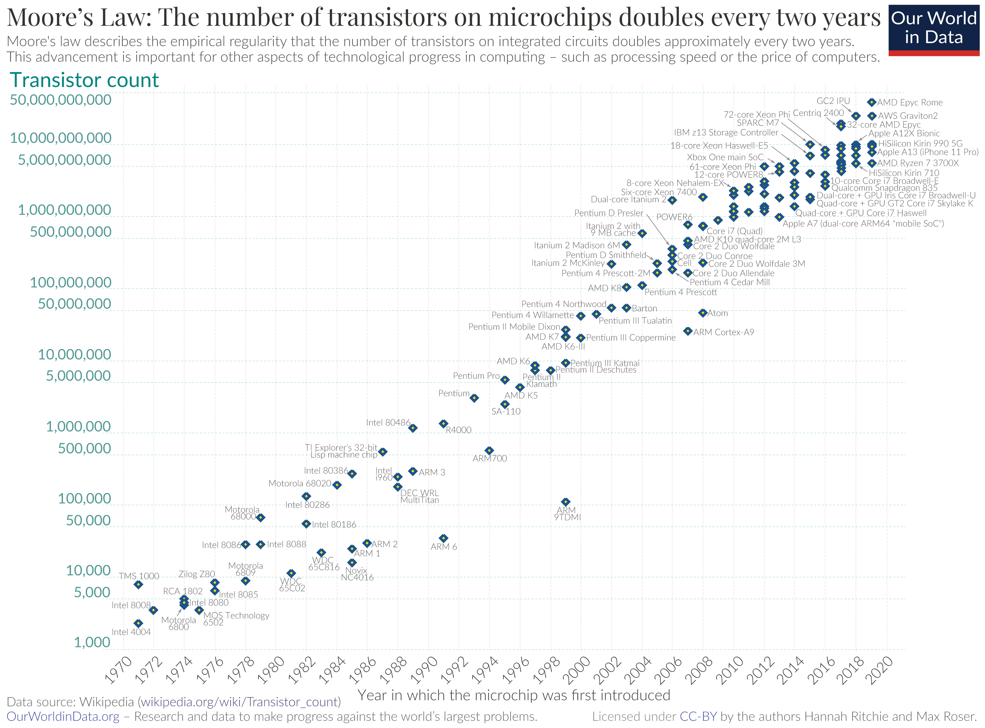

Slide 15
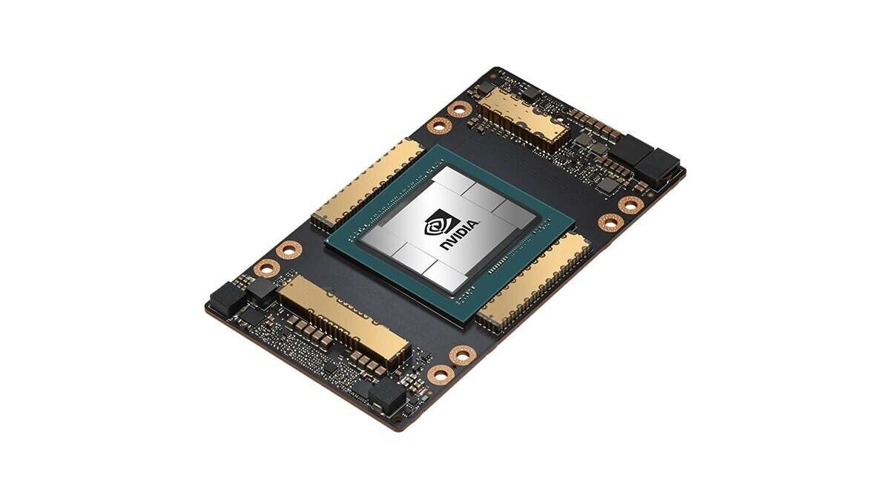
NVIDIA A100 Tensor Core GPU SXM4 80GB
Graphics Card For AI Data Centers
Up to 249X Higher AI Inference Performance Over CPUs
CDW price: over $17K

Slide 16
Benefits
Solve hard problems
Health, food, energy, environment, …
Real-time decisions for urgent situations
Reduce drudgery
85% of people hate their jobs
Augmented humans
Pacemakers, insulin dispensers, prosthetics, hearing-aids, XR glasses, vision aids
Data / evidence-based solutions

Slide 17
Concerns
Privacy and copyright
Misinformation
Algorithmic bias and fairness
Opacity / lack of transparency
Bad actors, weaponized AI
Technological unemployment
Existential risk
Center for AI and Digital Policy https://www.caidp.org/

Slide 18
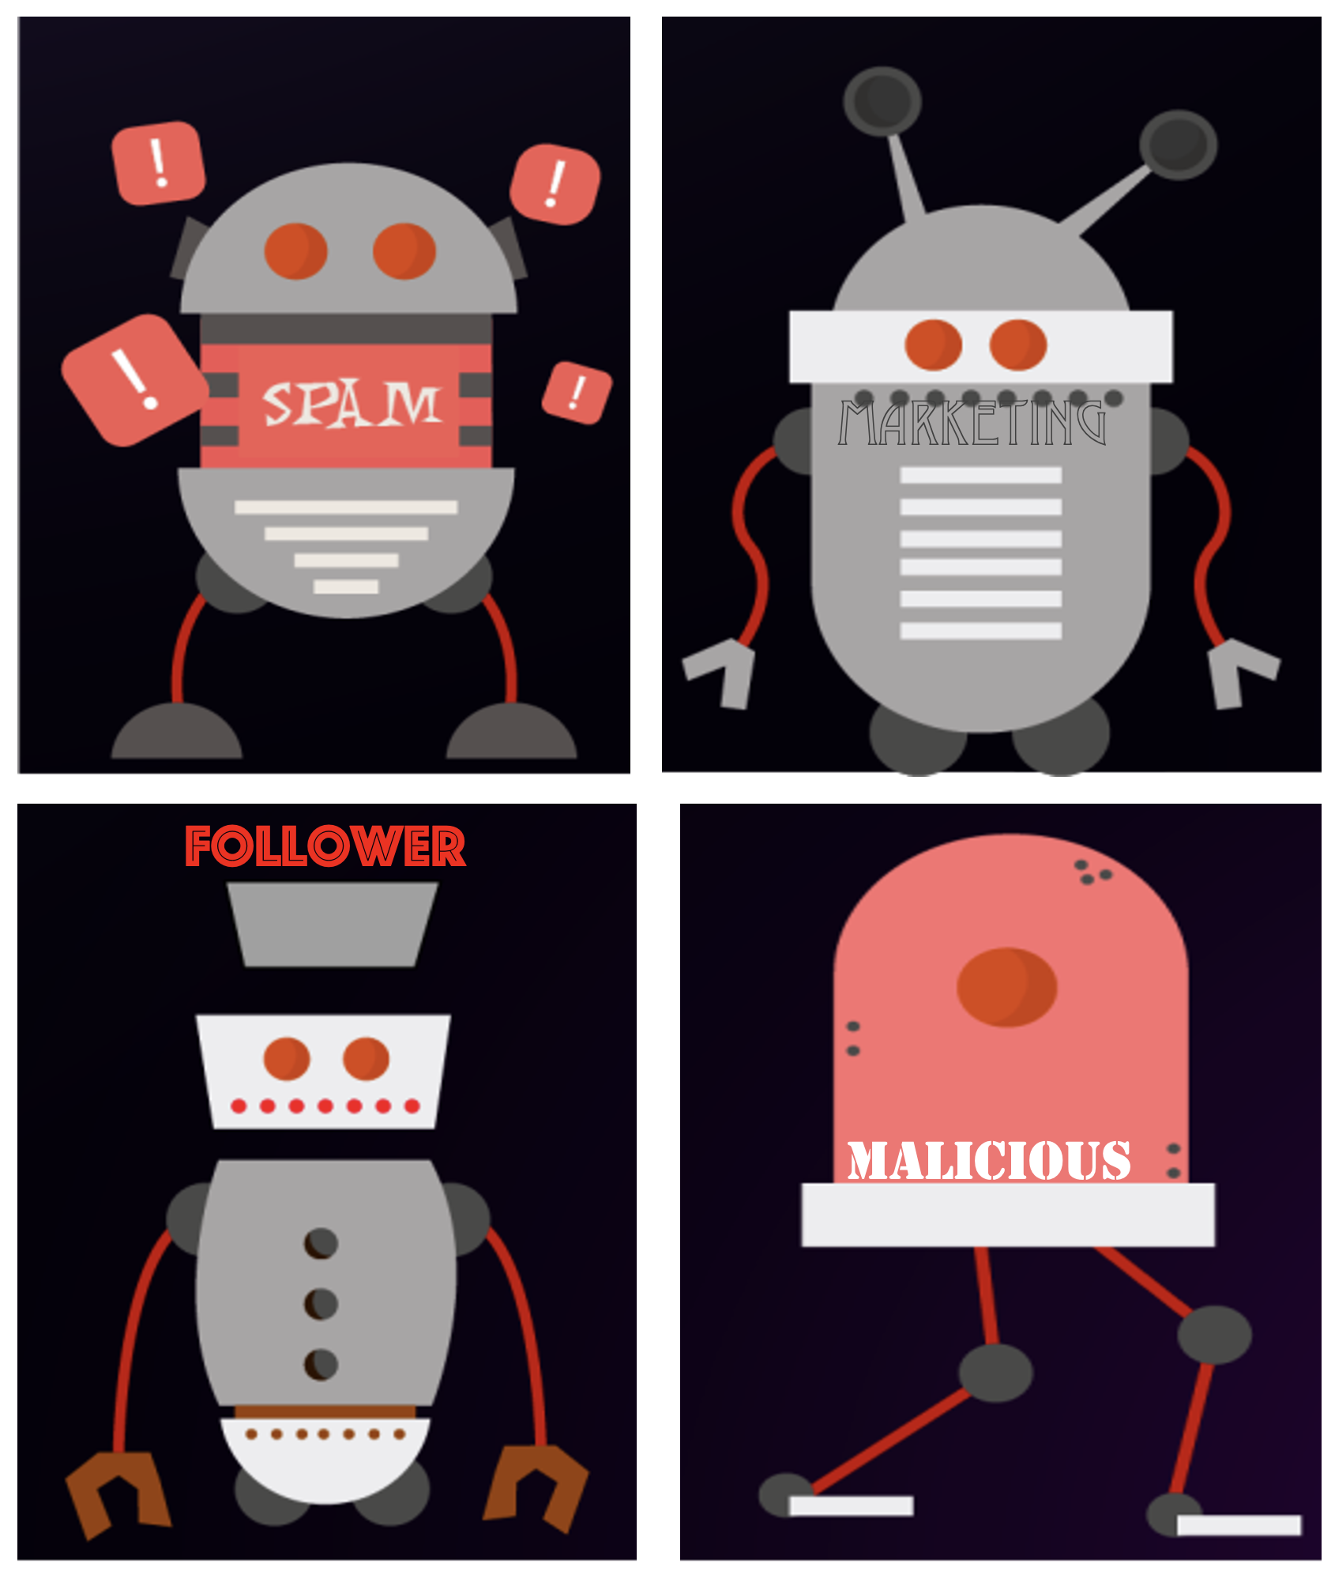
Lulwah AlKulaib Ph.D. Final Defense 2/16/2024

Slide 19
GPT Examples
Grant: Virginia Tech Center for Health Behaviors Research (CHBR) pilot and feasibility funding: Ubiquitous Health Monitoring for Obesity-Related Diseases and Disorders; July 1, 2023 - June 30, 2024; PI A. Lynn Abbott, co-PIs Abhijit Sarkar, John W. Epling, Jr., Julia M. Gohlke, and Edward A. Fox.
Examples by Abhijit Sarkar (VTTI)

Slide 20
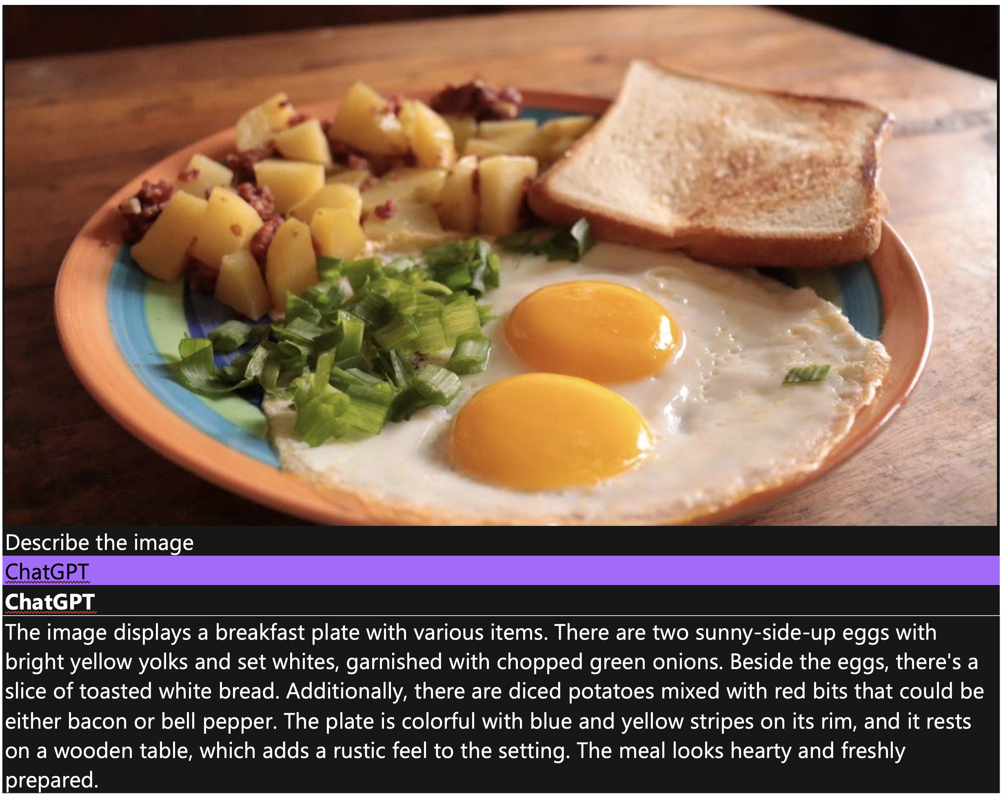

Slide 21
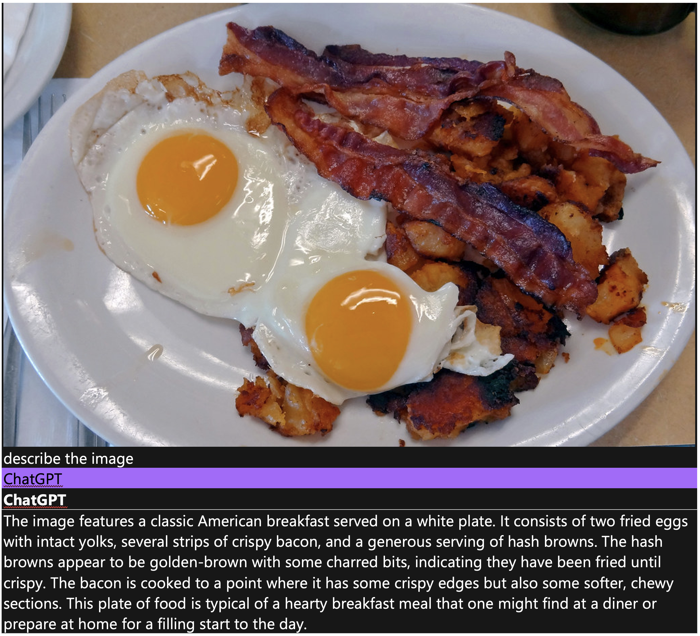

Slide 22
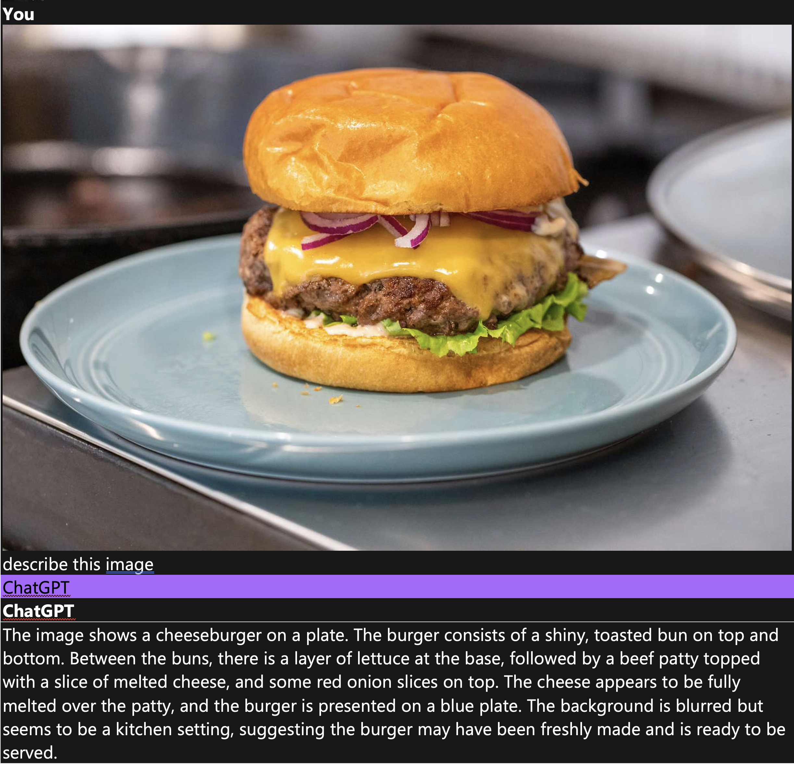

Slide 25
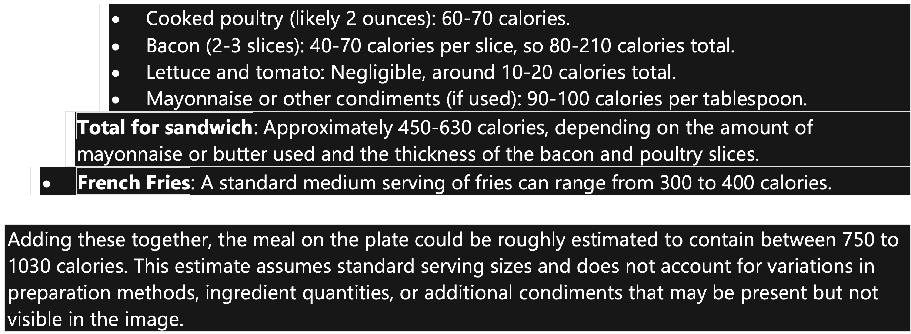

Slide 26
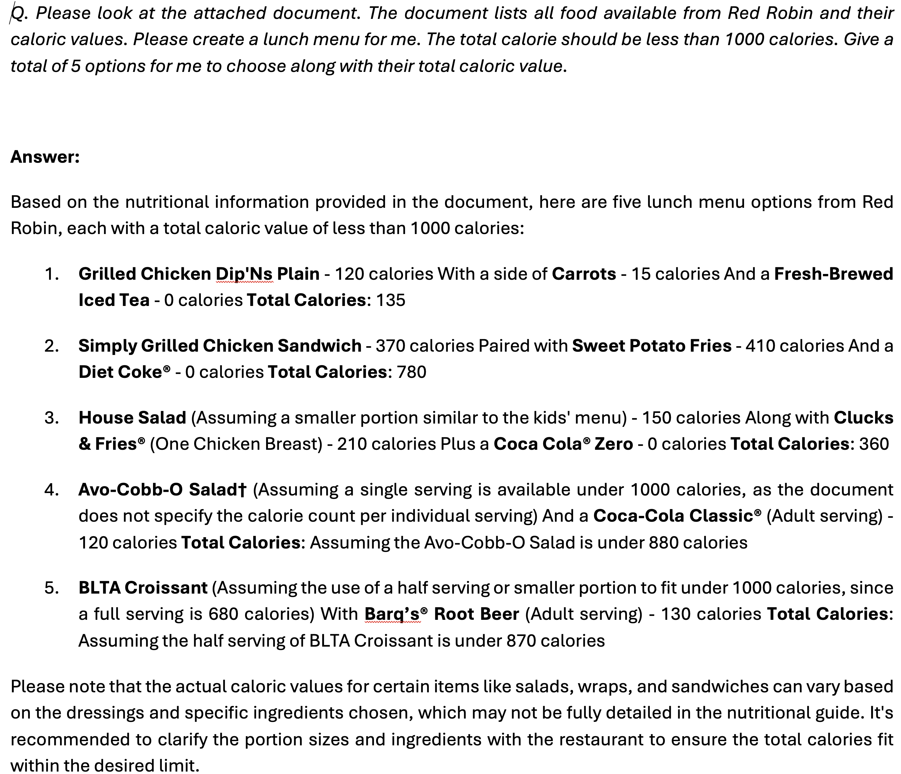

Slide 27
VT / Sanghani Center
Sanghani Center for Artificial Intelligence and Data Analytics https://sanghani.cs.vt.edu/
Almost 200 people
Some areas: computer vision, forecasting, social media analytics, visual analytics, urban computing
Applications: Computational Epidemiology, Health informatics, Intelligence analysis, Urban informatics, Cyber-security, Cyber-physical systems, Internet of Things, Military and defense applications

Slide 28
Liuqing Li: TwiRole
http://hdl.handle.net/10919/97365

Slide 29
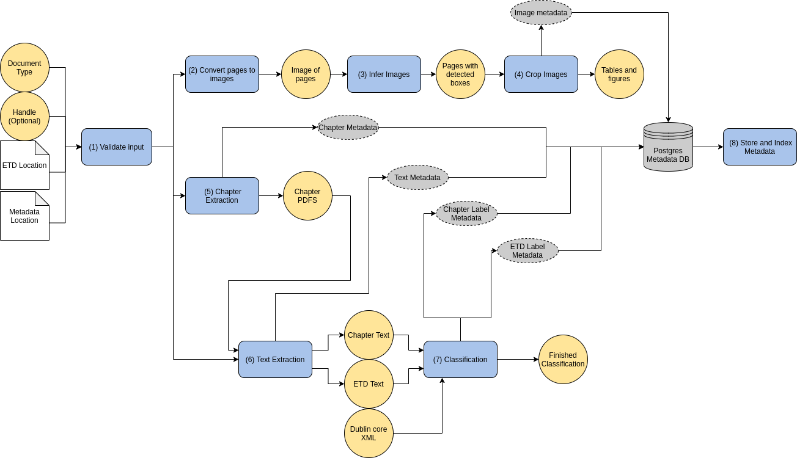
CS5604 ETD Team: Architecture

Slide 30
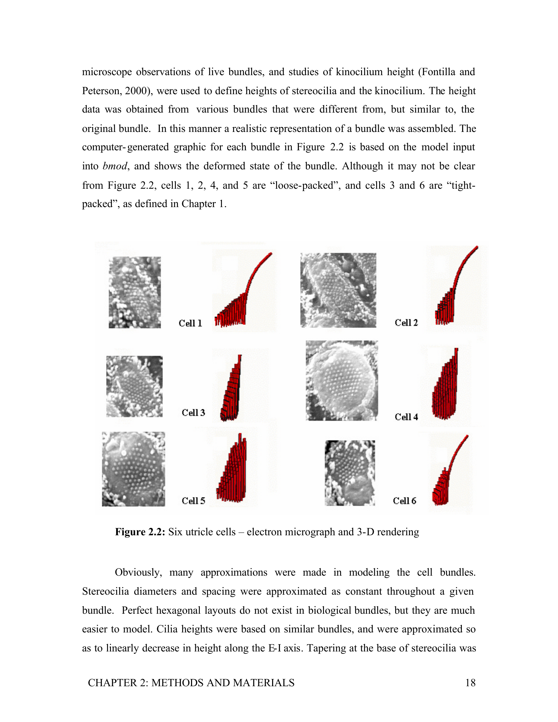
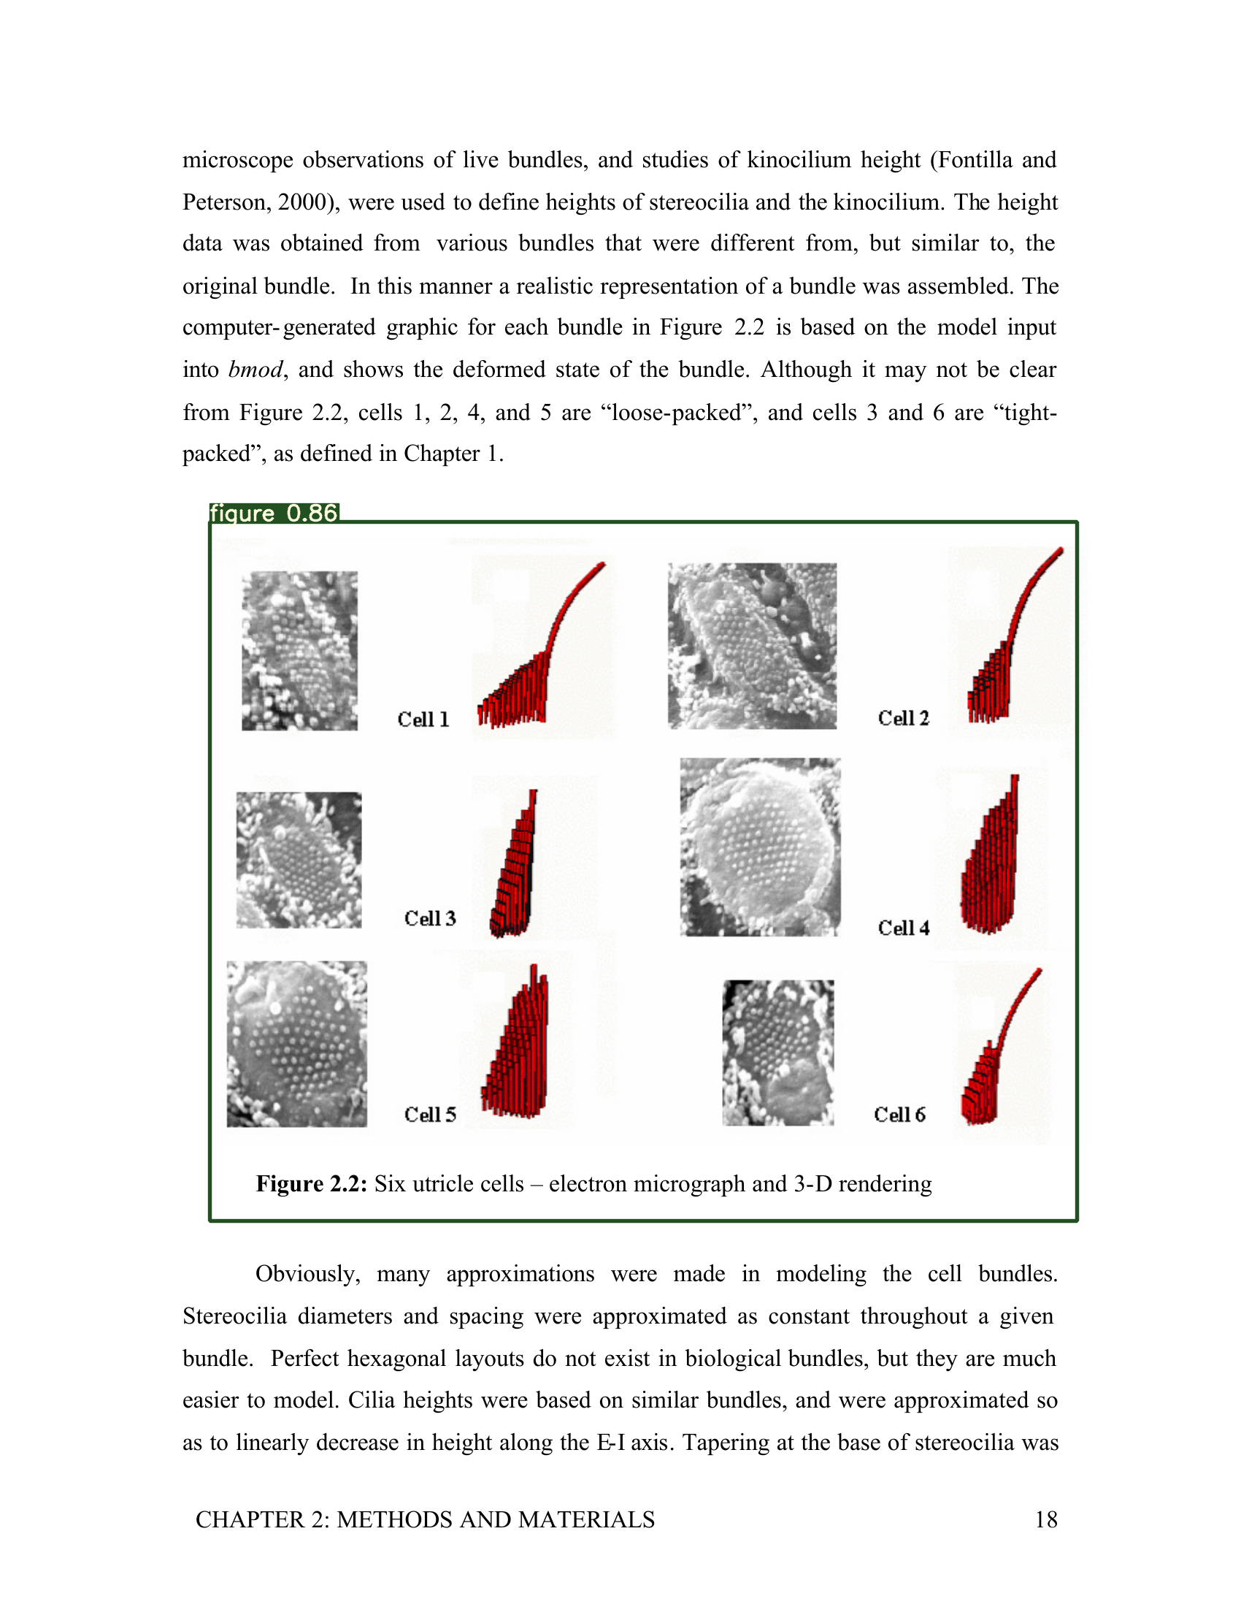
CS5604 ETD Team: Figure Extraction
Inference is accomplished via the best performing model trained by Sampanna and others
Page image(s)
Page image(s) with image bound information

Slide 31
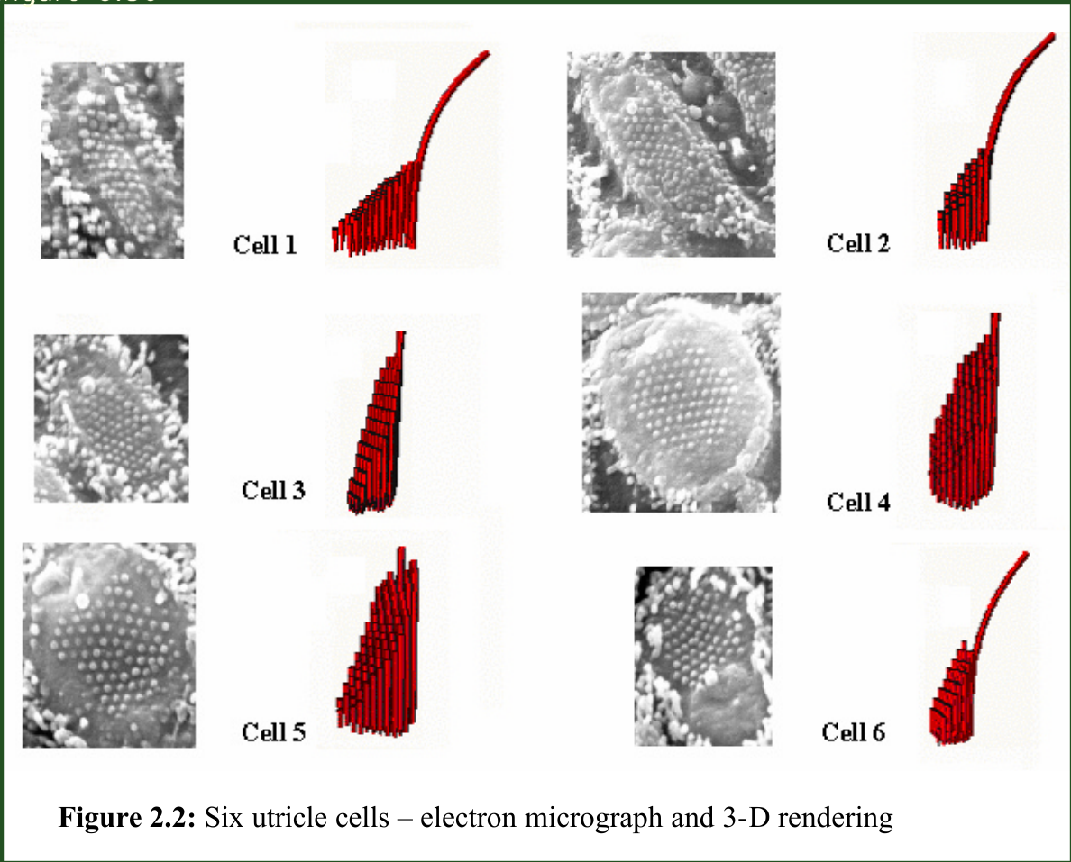
CS5604 ETD Team: Cropping
Cropped images
Page image(s) with
image bound information

Slide 32
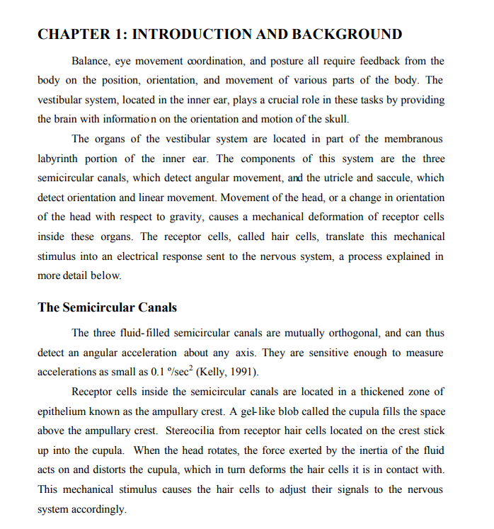
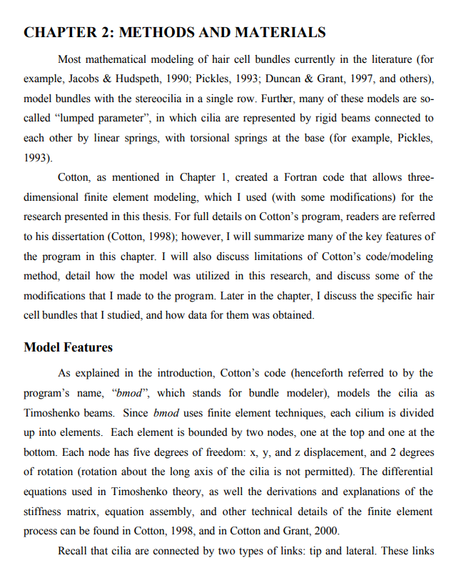
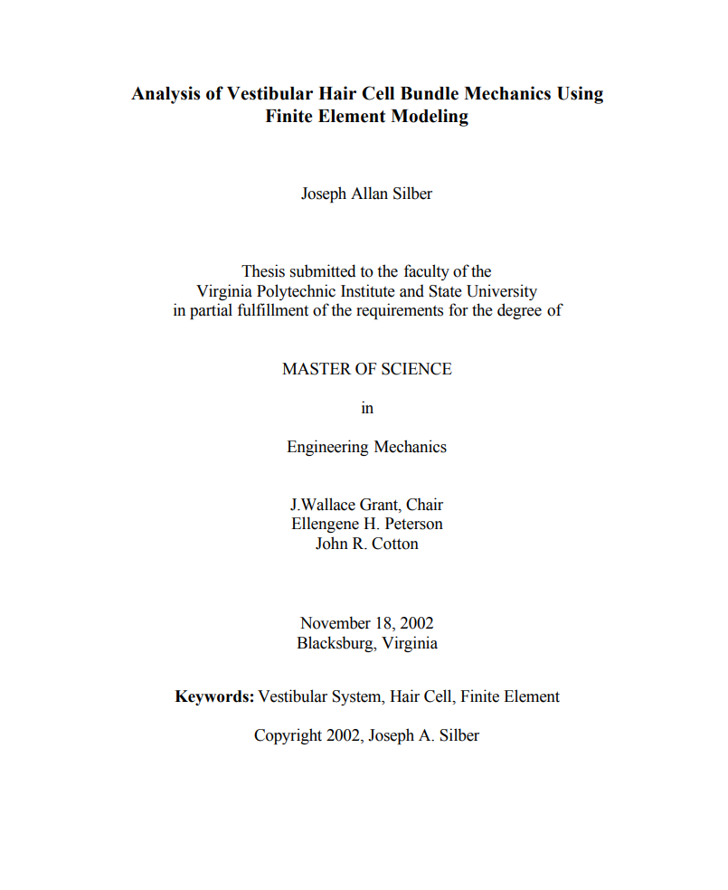
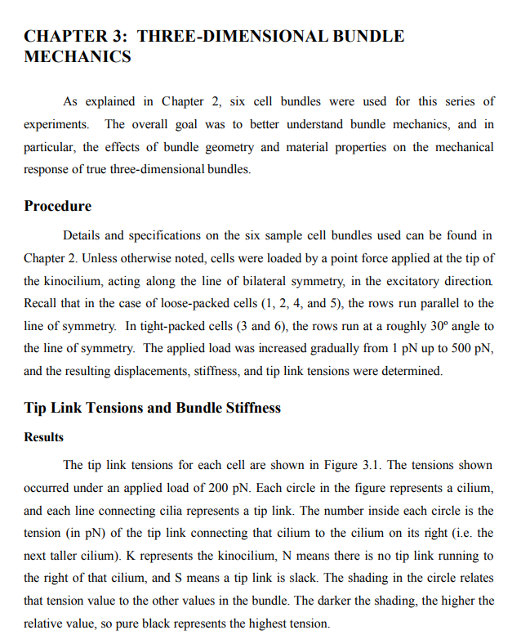
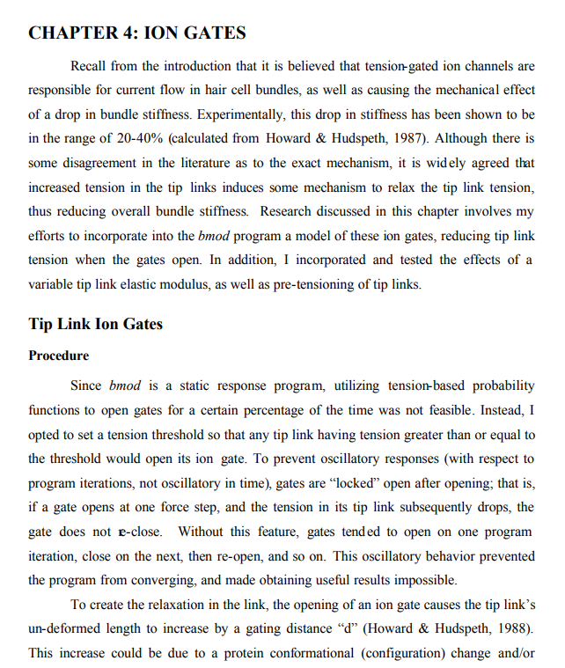
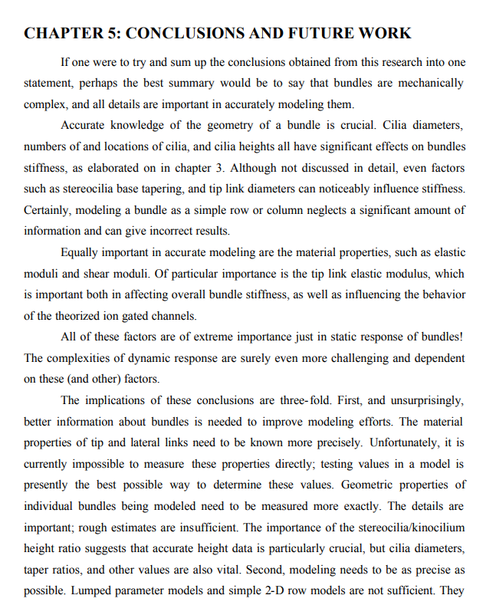
CS5604 ETD Team: Ch. Segmentation
Chapter fulltext

Slide 33
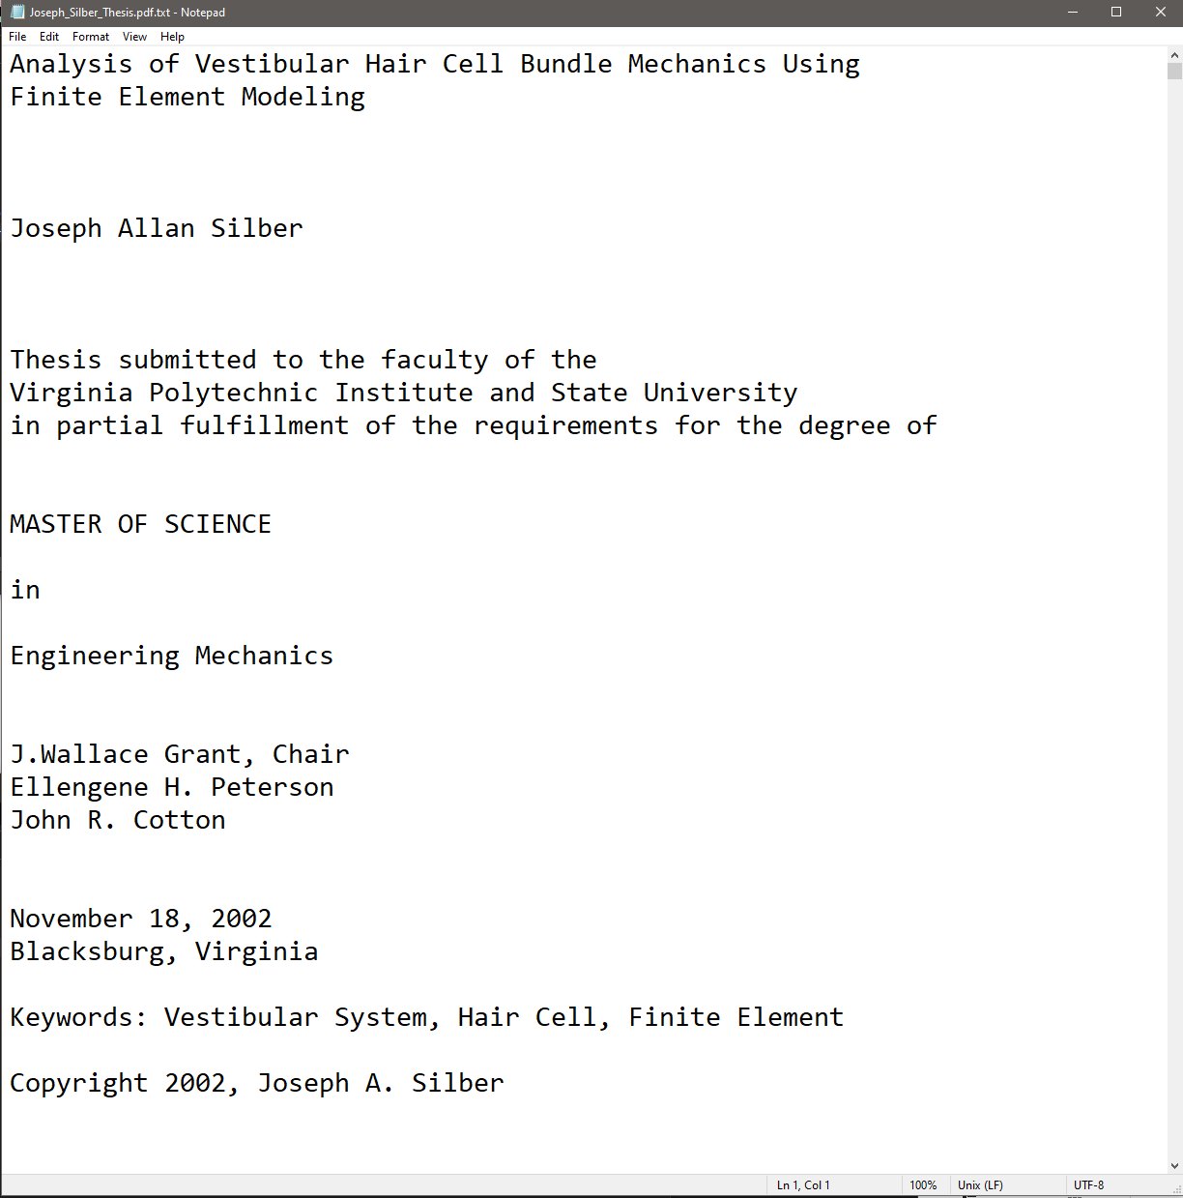
CS5604 ETD Team: Text Extraction
Extract text from PDF page. Write the text into a .txt file. Repeat until finish all PDF pages.
Extracted Text

Slide 34
CS5604 ETD Team: Classification
Classifier
Labels for ETD
Extracted Text
Dublin Core XML

Slide 35
Questions? Discussion?
Thank You!
fox@vt.edu
http://fox.cs.vt.edu/talks/2024/20240403FoxLionsBreakfast.pptx

