Slide 1
Exploration with Intelligent Information Systems
Edward A. Fox, Professor
Department of Computer Science
(and by courtesy, Electrical and Computer Engineering)
Centers: AI and Data Analytics, Autism Research, Global Change, Human-Computer Interaction (HCI)
Intro to Scieneering, ENGR 2164
190 Goodwin Hall, Virginia Tech, Blacksburg, VA 24061 -- 17 September 2021

Slide 2
Outline
Career path
Article shared
Exploration as a basic human activity
Information life cycle
Digital libraries
Building intelligent information systems
Workflows: AI reasoning and knowledge representation: goals -> services
Case study 1: Tweets, Web pages, ETDs
Case study 2: summarize depositions (law, linguistics and AI / deep learning)
Summary

Slide 3
Career path
Summers at MIT: automating: newspapers, stock market
After college: steel joist manufacturing: civil engineering, inventory, sales, finances
Summer at Cornell: IBM FSD: applying the first relational database (System R)
IITA, Ibadan, Nigeria: supporting agricultural research, automating the library
Virginia Tech: applications of intelligent information systems to
Addiction recovery, agriculture, archaeology, archives, autism/neuroscience, business, CD-ROM, chemistry, disease, documents, education, fingerprints, fish, geography, global change, history, libraries, memory care, multimedia, physics, publishing, searching, sociology, tourism, video, WWW, …
Networked Digital Library of Theses and Dissertations (theses.org) - ETDs Mayfair/ClaimEdge.co: automating handling of litigated claims (law, insurance)

Slide 4
Article shared
“How Should One Explore the Digital Library of the Future?”
Edward A. Fox and Prashant Chandrasekar
Now at Mary Washington University
Thanks for slides related to his doctoral research!
https://doi.org/10.2478/dim-2021-0003, from February 2021

Slide 5
Exploration as a basic human activity
See also: Sapiens: A Brief History of Humankind, by Yuval Noah Harari, 2015

Slide 6
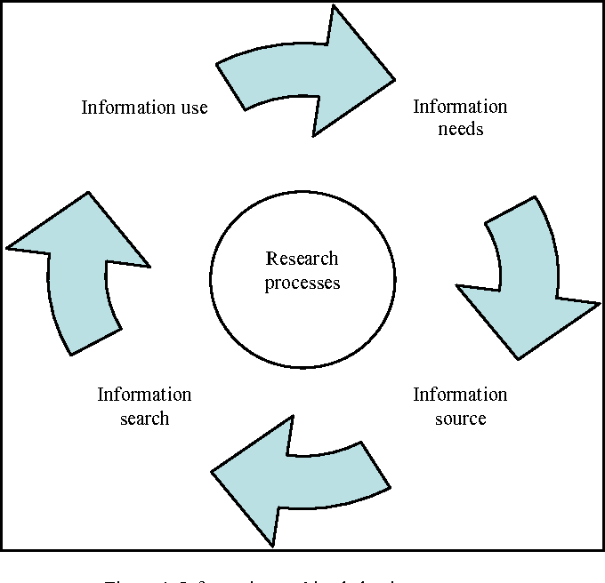
Exploration includes:
See also:
Exploratory
Search: Beyond
the Query-
Response
Paradigm, by
Ryen W. White,
Resa A. Roth,
Morgan &
Claypool, 2009
See also works on: HCIR,
Information
Seeking
Behavior, Info-
Visualization, Probing, Delving, Investigation, Discovery, Data Analysis/Science

Slide 7
Information
Life
Cycle
Adapted
from:
Social
aspects of digital libraries,
UCLA 1996,
eds. Christine L.
Borgman et al., https://
works.bepress.com/borgman/183/
Exploring

Slide 8
Definition: Digital Libraries are complex systems that
help satisfy info needs of users (societies)
provide info services (scenarios)
organize info in usable ways (structures)
present info in usable ways (spaces)
communicate info with users (streams)

Slide 9
DL Services/Activities Taxonomy
Infrastructure Services
Information
Satisfaction
Services
Repository-Building
Add
Value
Creational
Preservational
Acquiring
Cataloging
Crawling (focused)
Describing
Digitizing
Federating
Harvesting
Purchasing
Submitting
Conserving
Converting
Copying/Replicating
Emulating
Renewing
Translating (format)
Annotating
Classifying
Clustering
Evaluating
Extracting
Indexing
Measuring
Publicizing
Rating
Reviewing (peer)
Surveying
Translating (language)
Browsing
Collaborating
Customizing
Filtering
Providing access
Recommending
Requesting
Searching
Visualizing

Slide 10
Prashant Chandrasekar’s Architecture of DL for SME Exploration
CS1 - Information System
Digital Library of SME System Req. Descriptions
UXR
CS2 - Information System
SME
Conduct UX Research
CS1 - Information System
Service x
Service y
Service z
Capture User Requirements
Results
Catalog of system req. descriptions
Case UX ARTIFACTS
Query
Case1
Case2
Case3
. . .
-- ----- ---- ---- -
---- --- ----- ----
--- --- --- ------- -
. . .
PRODUCE
GRAPH INTERFACE
UXR
Developer
WORKFLOW MANAGER
ARTIFACT MANAGER
Analyst
SERVICES REGISTRY

Slide 11
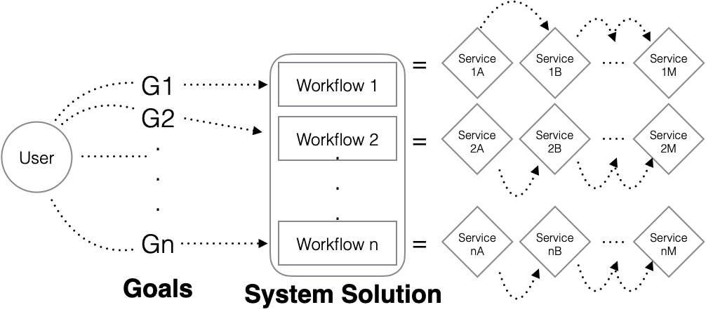
Workflow-defining systems

Slide 12
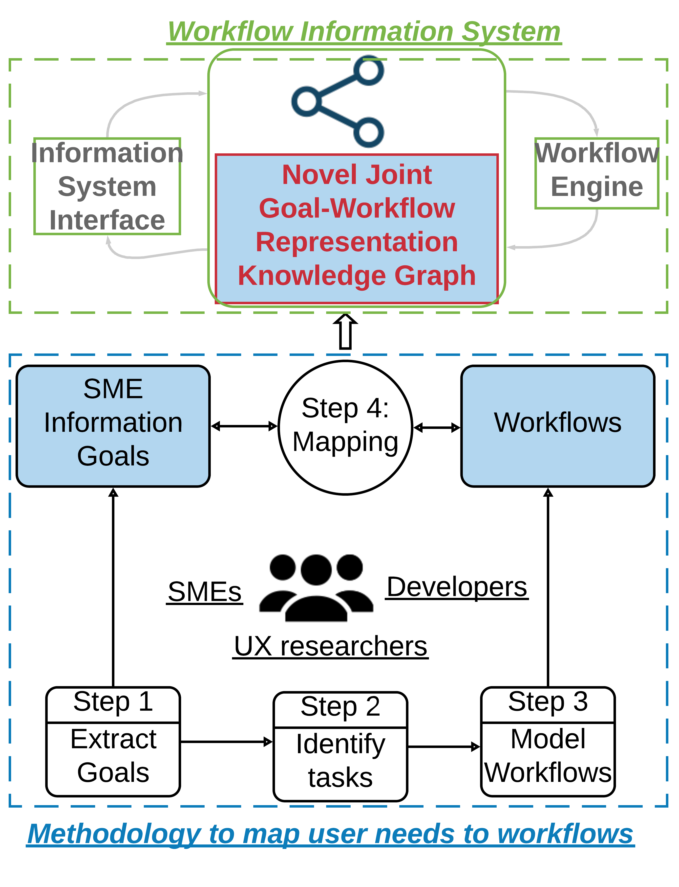
Workflow definition process
Collaboration between users (SMEs), UX researchers, and developers
Step 1: Extract goals
Step 2: Identify tasks
Breakdown of tasks determines workflow steps
Step 3: Model workflows
Identify functions/services to support each task
Step 4: Represent goal-workflow knowledge graph

Slide 13
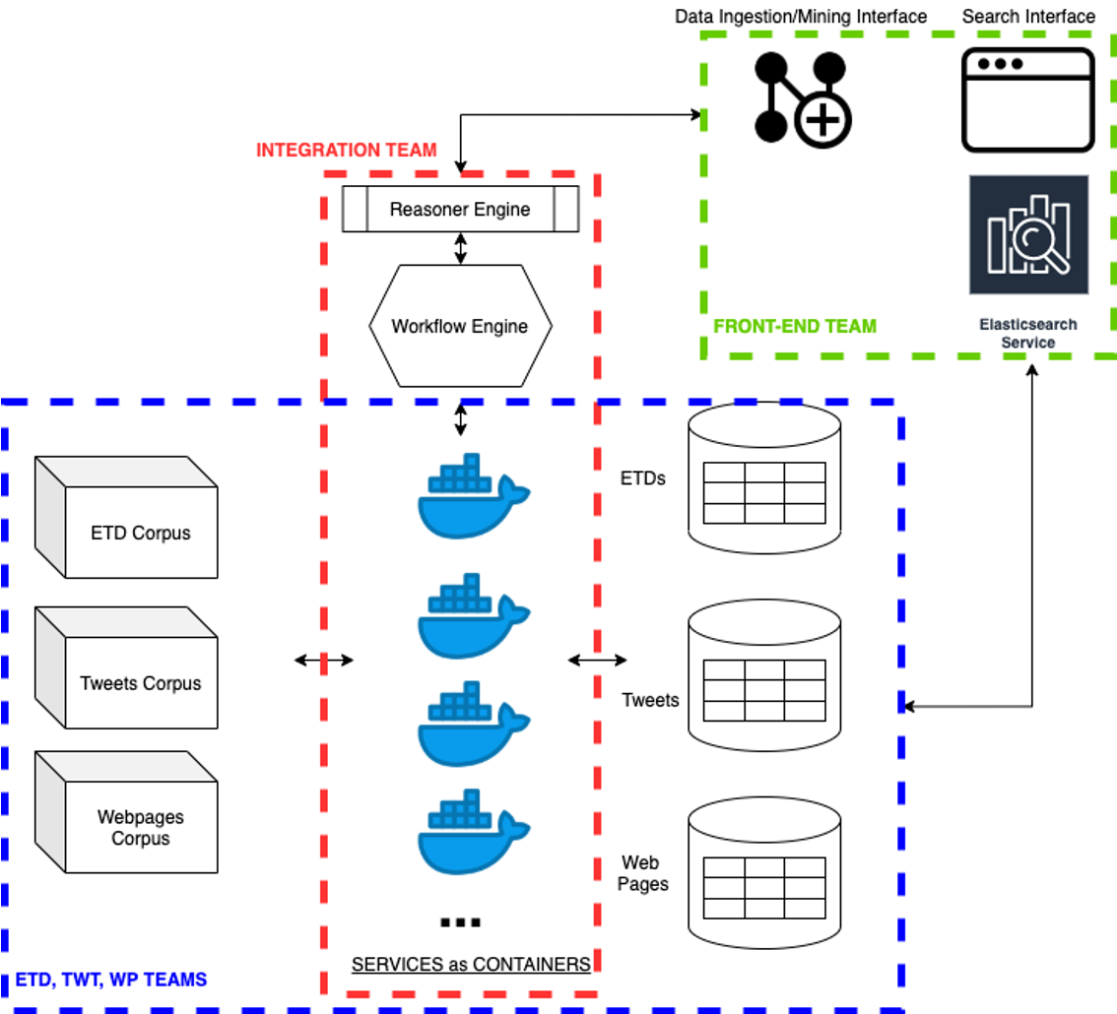
CASE STUDY 1: CS5604 (Information Retrieval)
Problem-based learning:
Build novel intelligent system
Approach: co-designed
architecture -> CI/CD

Slide 14
CASE STUDY 2: Law, Linguistics: LEGAL DEPOSITIONS
A deposition is a witness's sworn out-of-court testimony.
Used by lawyers and paralegals to ascertain facts pertaining to a case
Conversation = sequence of question-answer (QA) groups
Notes:
Show a deposition document as example

Slide 15
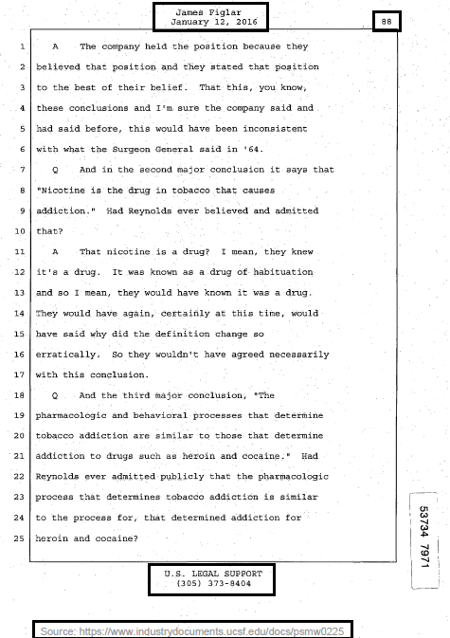
A Deposition Sample

Slide 16
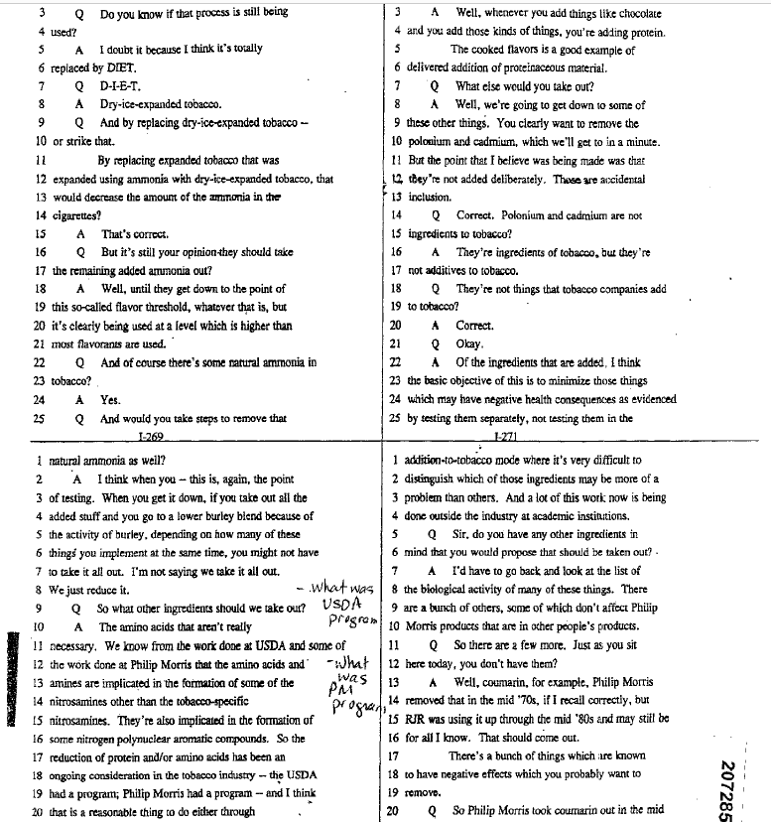
PARSING
CHALLENGES FACED
Varying number of columns per page
Annotations: handwriting, stamps
Conversation of questions & answers

Slide 17
Parsed Deposition

Slide 18
Comprehending Depositions - Challenges
Documents are noisy and only loosely follow grammatical rules.
Incomplete or abandoned sentences
Context spread across multiple QA pairs
Traditional natural language processing (NLP) methods, like syntax parsing into dependency trees, struggle to find the root of the sentences.
➔ Dialog Acts …

Slide 19
Dialog Act (DA) - Definition
Dialog act represents the communicative intent behind a speaker’s utterance in a conversation.

Slide 20
Dialog Act - Types
Questions
wh-* and wh-*-declarative- Which hip did you break?
binary and binary-declarative - Do you have a California driver's license?
open question - Do you currently or just in general do you have any hobbies?
or question - And were you working out for fun or were you into bodybuilding?
Answers
Yes and yes-declarative - definitely it is, yes sir.
No and no-declarative - I am afraid not
Statement opinion and non-opinion - I would say in July, I went to Los Angeles.
Acknowledge - Um-hum, Okay
Don’t know/recall - I can't remember which year it was.
Notes:
show the excel file for more examples if needed

Slide 21
Dialog Act Classification
Manually annotated sentences to their Dialog Acts (about 2500 QA’s total).
Train, validation, test split of 70:20:10
Deep Learning based classifiers.
CNN with Word2Vec embeddings
Bi-LSTM with attention
BERT embeddings with a final neural network (NN) layer

Slide 22
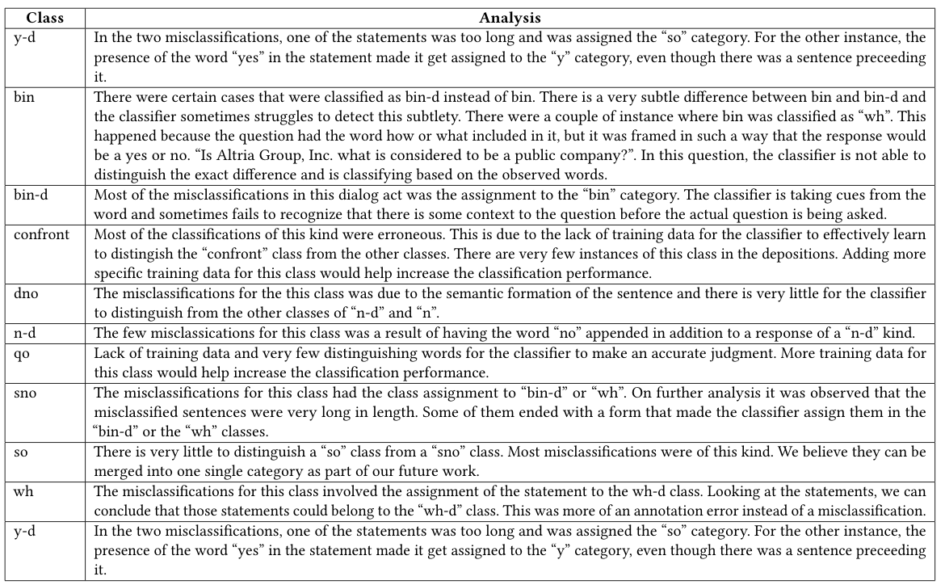
Misclassifications

Slide 23
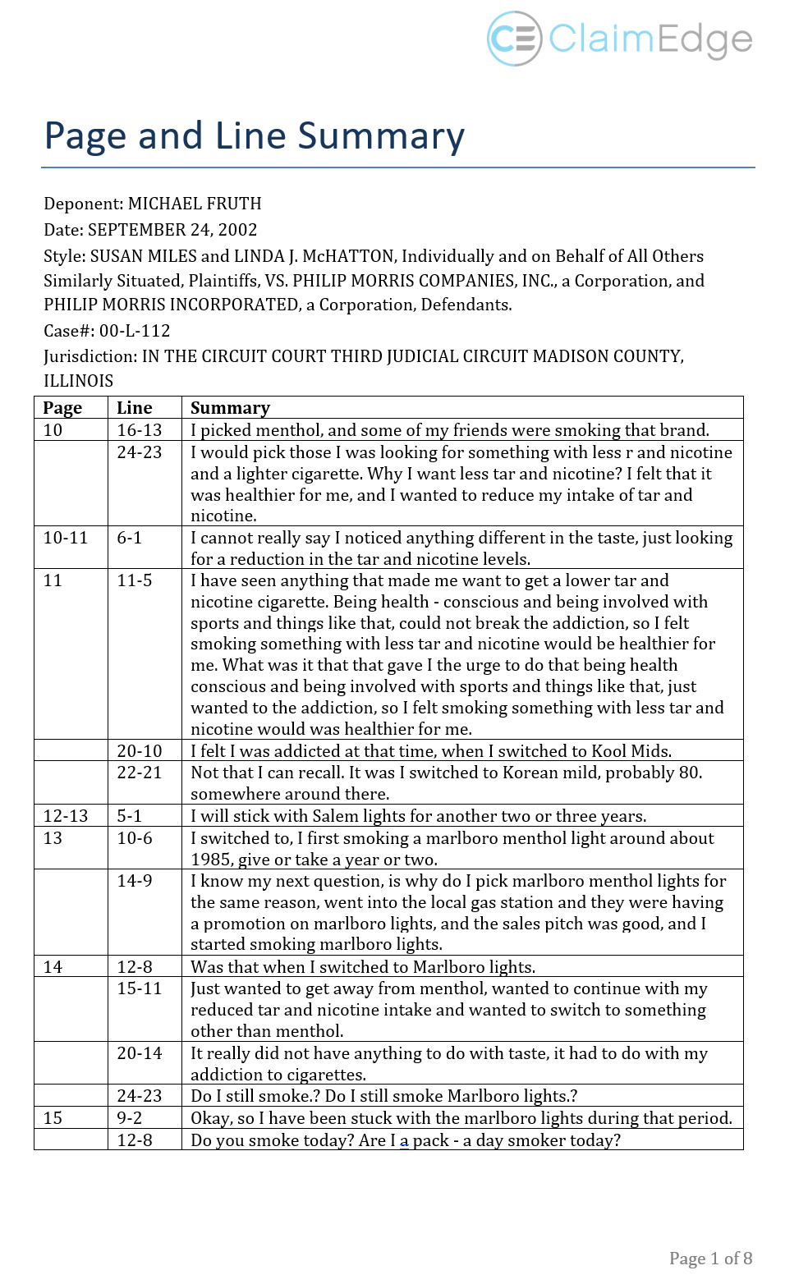
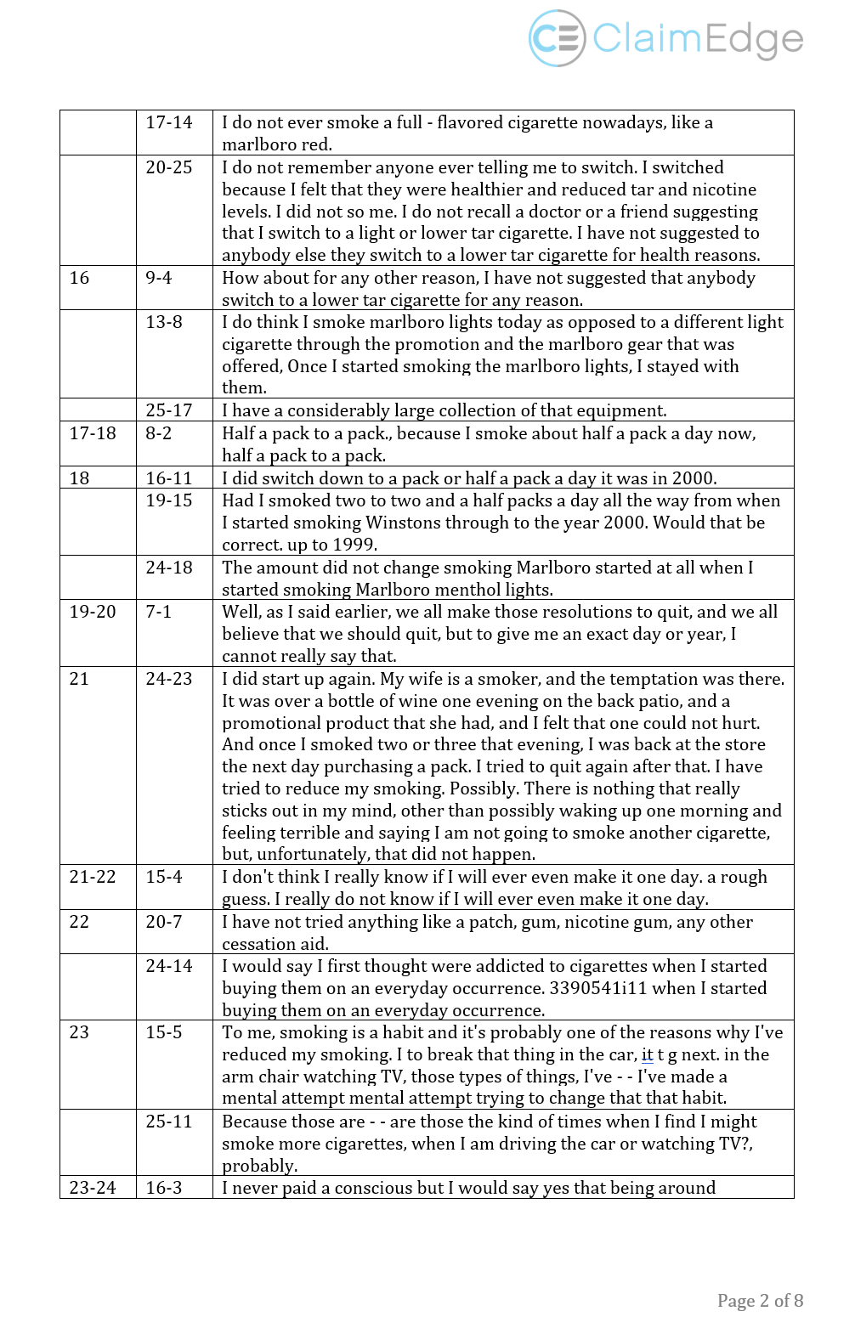
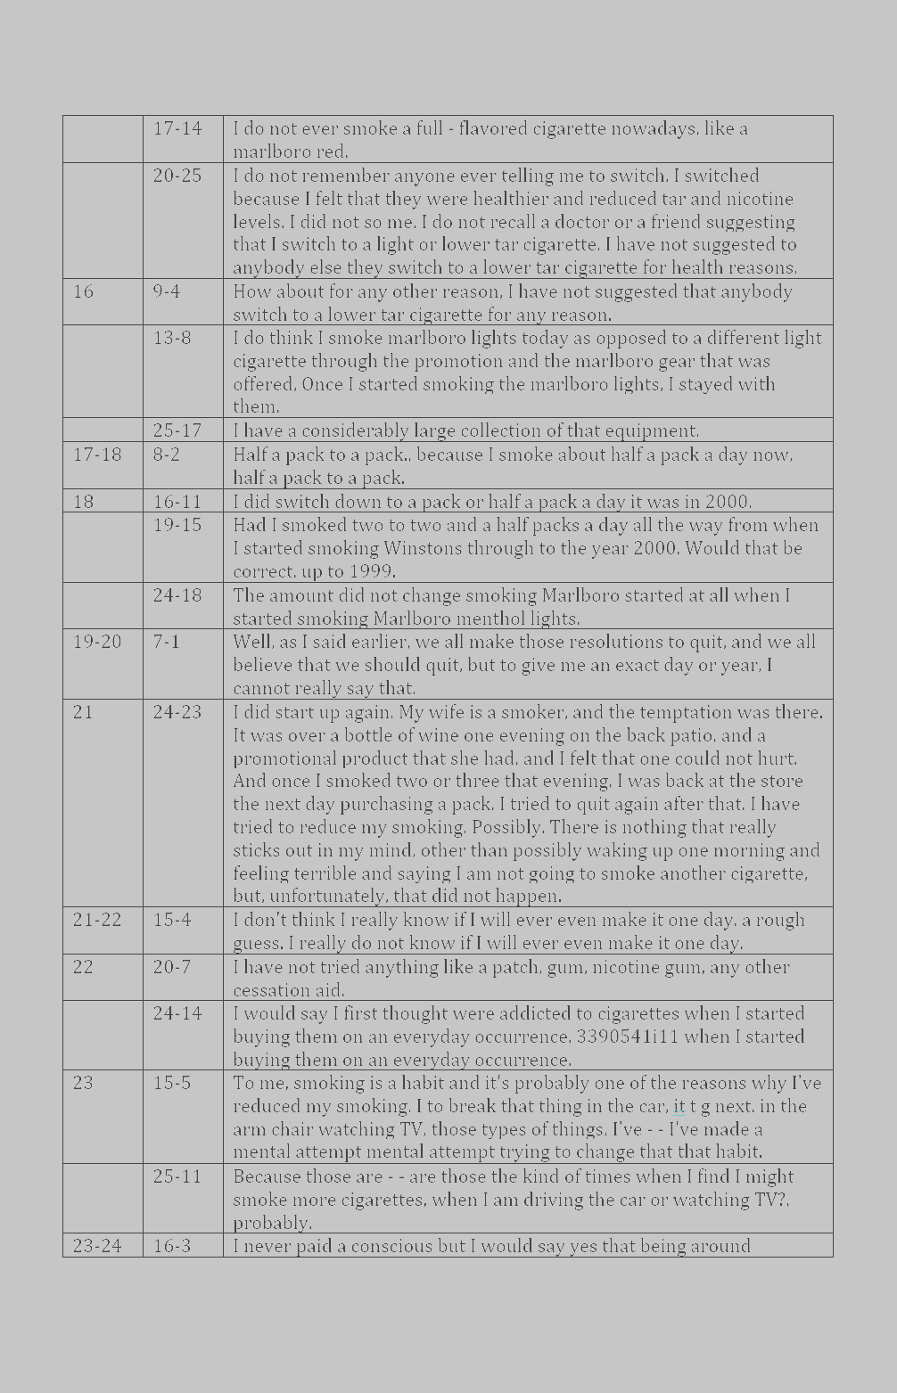
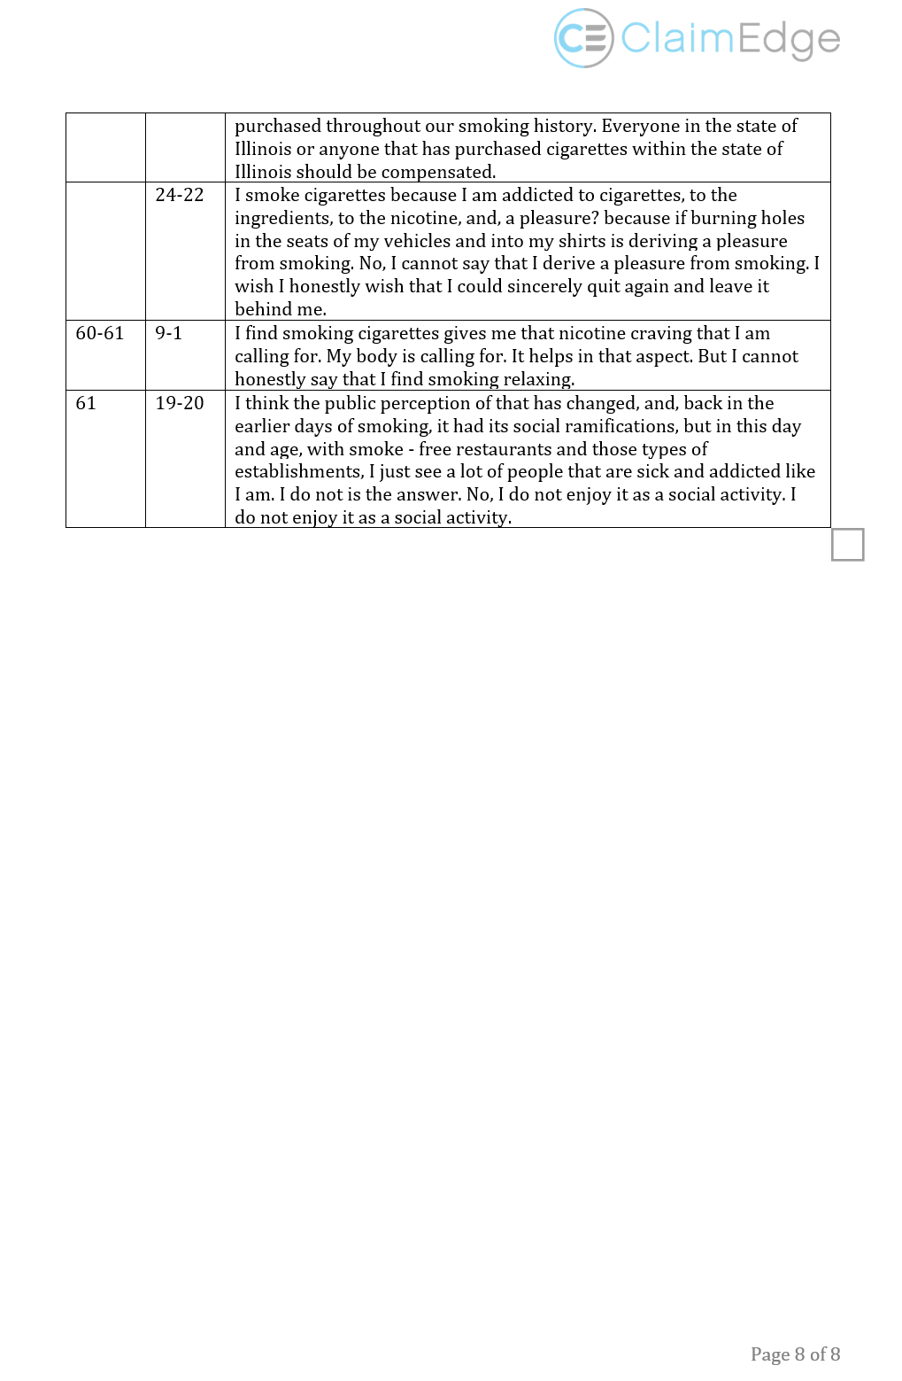
Abstractive Summary (replacing QA
pairs with
declarative
statements)

Slide 24
SUMMARY
Career path
Article shared
Exploration as a basic human activity
Information life cycle
Digital libraries
Building intelligent information systems
Workflows: AI reasoning and knowledge representation: goals -> services
Case study 1: Tweets, Web pages, ETDs
Case study 2: summarize depositions (law, linguistics and AI / deep learning)

Slide 25
fox@vt.edu

