Slide 1
BIRDS 2021 Invited
(with CHIIR 2021, online)
User Discovery and Exploration in Future Digital Libraries by Edward A. Fox
ORCiD: 0000-0003-1447-6870
http://fox.cs.vt.edu/talks/2021/20210319FoxBIRDS.pptx
fox@vt.edu http://fox.cs.vt.edu
Dept. of Computer Science, Virginia Tech
Blacksburg, VA 24061 USA

Slide 2
Acknowledgements
Mentors (Licklider, Kessler, Salton)
Virginia Tech, CS, Digital Library Research Laboratory (DLRL)
NSF, IMLS, and many other sponsors (see http://fox.cs.vt.edu/cv.htm)
Students, colleagues, co-investigators (selected): Eman Abdelrahman, Monika Akbar, Hamed Alhoori, Pranav Angara, Ashish Baghudana, Jefferson Bailey, Bipasha Banerjee, Abigail Bartolome, Warren Bickel, Matt Bock, Boots Cassel, Prashant Chandrasekar, Saurabh Chakravarty, Prashant Chandrasekar, Raja Chava, Satvik Chekuri, Yinlin Chen, Kiran Chitturi, Lois Delcambre, Noha ElSherbiny, Alexandre Falcao, Weiguo Fan, Eric Fouh, Chris Franck, Rick Furuta, Jack Geissinger, Lee Giles, Marcos André Gonçalves, Doug Gorton, Seth Guikema, Islam Harb, S.M.Shamimul Hasan, Michael Hsiao, Bill Ingram, Palakh Jude, Adheesh Juvekar, Sampanna Kahu, Tarek Kanan, Ola Karajeh, Andrea Kavanaugh, Farnaz Khaghani, Martin Klein, Nadia Kozievitch, Abhinav Kumar, Harinni Kumar, Spencer Lee, Sunshin Lee, Jonathan Leidig, Lin Tzy Li, Liuqing Li, Yi Ma, Yufeng Ma, Mohamed Magdy, Shivam Maharshi, Ashish Malpani, Madhav Marathe, Gary Marchionini, Paul Mather, Maanav Mehrotra, Pamela Murray-Tuite, Uma Murthy, Pranav Nakate, Michael Nelson, Sanghee Oh, Sung Hee Park, Supritha Patil, Denilson Pereira, Jeff Pomerantz, Naren Ramakrishnan, Pranavi Rambhakta, Sagnik Ray-Choudhury, Chandan Reddy, Rao Shen, Cliff Shaffer, Steve Sheetz, Don Shoemaker, Ziqian Song, Venkat Srinivasan, Hussein Suleman, Amirsina Torfi, Ricardo Torres, Adithya Upadhya, Saket Vishwasrao, Xinyue Wang, Kris Wernstedt, Barbara Wildemuth, Jian Wu, Zhiwu Xie, Seungwon Yang, Xiaoyan Yu, Xuan Zhang, ...

Slide 3
Perspectives
Member of ACM (1967-), IEEE (2004-)
Professor of CS (cs.vt.edu, 1983-)
Digital libraries (dlib.vt.edu, 1991-)
Event archiving (eventsarchive.org: web, social media, 2007-)
CTO of startup (claimedge.co, 2018-) working to connect law and insurance firms with summarization, extensible workflows, and AI support of guidance; NSF I-Corps customer discovery

Slide 4
Short Version
Exploration is a fundamental need, and so should be well supported in future DLs:
for all Societies: Humans and/with Computers;
through diverse Scenarios, aided by Spaces and Structures, covering all types of Streams.
Theory-> Design-> Implementation-> DevOps
Integrating Sciences: computing, library, infor.; AI, Archiving, DB, DS, HCI, HPC, Hypermedia, IR, Networking, NLP, Psychology, Sociology,...

Slide 5
See also: Sapiens: A Brief History of Humankind, by Yuval Noah Harari, 2015

Slide 6
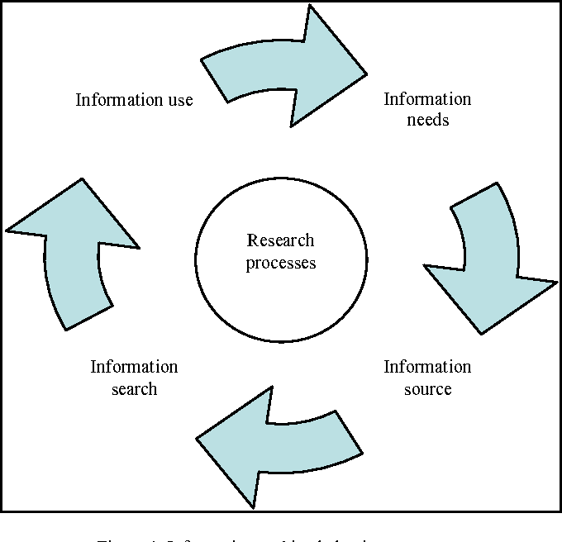
Exploration includes:
See also:
Exploratory
Search: Beyond
the Query-
Response
Paradigm, by
Ryen W. White,
Resa A. Roth,
Morgan &
Claypool, 2009
See also works on: HCIR,
Information
Seeking
Behavior, Info-
Visualization, Probing, Delving, Investigation, Discovery, Data Analysis/Science

Slide 7
Outline
JCR Licklider
Libraries of the Future
5S
Building Digital Libraries
Exploring (incl. from JCDL 2006)
Future

Slide 8
For: ARPA’s Information Processing Techniques Office

Slide 9
JCR Licklider
Grandfather of Internet
Director, Project MAC: CTSS, Multics, AI Lab
M. M. Waldrop’s 2001 biography “The Dream Machine: J.C.R. Licklider and the Revolution That Made Computing Personal”:
  “He is almost alone in his conviction that computers can become not just superfast calculating machines, but joyful machines: tools that will serve as a new media of expression, inspirations to creativity, and gateways to a vast world of online information.”

Slide 10
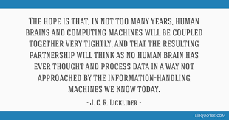

Slide 11
Overview
As JCR Licklider forecast in 1965 in his “Libraries of the Future” (report for CLR)
Highly effective human-computer symbiosis in procognitive systems that mediate online interactions with knowledge
Knowledge: acquisition, organization, use
Analysis: files, documents, texts, words
Marry information retrieval, question-answering, NLP
Adaptive self-organization, associative chaining
Leverage: set theory, spaces, functions, relations, predicate calculus, higher-order knowledge representations

Slide 12
Closing Challenge
(4) A sympathetic, cooperative, verbal, community is a fundamental essential for the development of a sophisticated verbal mechanism. To develop complex language behavior . . .
(5) no one seems likely to design or invent a formal system capable of automating sophisticated language behavior. The best approach … to call for a formal base plus an overlay of experience gained in interaction with the cooperative verbal community.

Slide 13
Outline
JCR Licklider
Libraries of the Future
5S
Building Digital Libraries
Exploring (incl. from JCDL 2006)
Future

Slide 14
5S Motivation
DLs are not benefiting from formal theories as have other CS fields: DB, IR, PL, etc.
DL construction: difficult, ad-hoc, lacking support for tailoring/customization
Conceptual modeling, requirements analysis, and methodological approaches are rarely supported in DL development.
See my 9/2004 invited talk in Beijing “Digital Libraries for Education: Foundations to Case Studies” http://fox.cs.vt.edu/talks/2004/200409BeijingDL.ppt

Slide 15
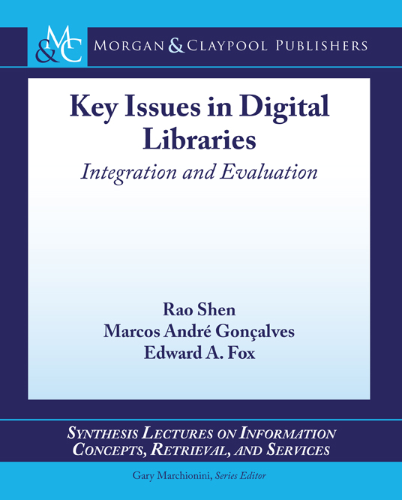
Ch. 2: Exploration;
App. D2 pp. 91-100

Slide 17
Definition: Digital Libraries are complex systems that
help satisfy info needs of users (societies)
provide info services (scenarios)
organize info in usable ways (structures)
present info in usable ways (spaces)
communicate info with users (streams)

Slide 18
5S Model: Definitions
5S | Definition
Streams | Sequences of elements of an arbitrary type
Structures | Labeled directed graphs
Spatial | Sets and operations on those sets
Scenarios | Sequences of events that modify states of a computation in order to accomplish some functional requirement.
Societies | Sets of communities and relationships among them

Slide 19

5S for DLs
Compare:
5 elements
(China)
Ss | Examples | Objectives
Streams | Text; video; audio; image | Describes properties of the DL content such as encoding and language for textual material or particular forms of multimedia data
Structures | Collection; catalog; hypertext; document; metadata | Specifies organizational aspects of the DL content
Spaces | Measure; measurable, topological, vector, probabilistic | Defines logical and presentational views of several DL components
Scenarios | Searching, browsing, recommending | Details the behavior of DL services
Societies | Service managers, learners, teachers, etc. | Defines managers, responsible for running DL services; actors, that use those services; and relationships among them
Notes:
Do not read
Pick example: structure, scenario

Slide 21
Overview of 5S and DL formal definitions and compositions

Slide 24
Outline
JCR Licklider
Libraries of the Future
5S
Building Digital Libraries
Exploring (incl. from JCDL 2006)
Future

Slide 25
DL Services/Activities Taxonomy
Infrastructure Services
Information Satisfaction
Services
Repository-Building
Add
Value
Creational
Preservational
Acquiring
Cataloging
Crawling (focused)
Describing
Digitizing
Federating
Harvesting
Purchasing
Submitting
Conserving
Converting
Copying/Replicating
Emulating
Renewing
Translating (format)
Annotating
Classifying
Clustering
Evaluating
Extracting
Indexing
Measuring
Publicizing
Rating
Reviewing (peer)
Surveying
Translating (language)
Browsing
Collaborating
Customizing
Filtering
Providing access
Recommending
Requesting
Searching
Visualizing

Slide 26
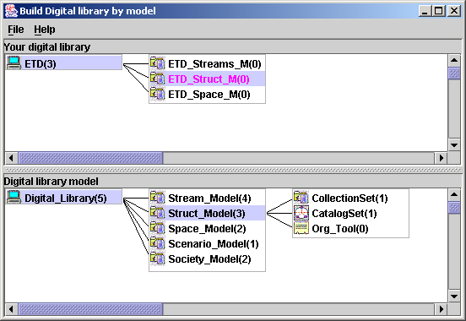
5SGraph: No Code DL
Workspace
(instance model)
Structured
toolbox
(metamodel)
See https://www.gartner.com/en/documents/3956079/magic-quadrant-for-enterprise-low-code-application-platf from August 2019: "By 2024, low-code application development will be responsible for more than 65% of application development activity."

Slide 27
5S-based Architecture for
DL Modeling and Generation
5S
Meta
Model
DL
Designer
5SGraph
DL
Expert
Practitioner
5SL
DL
Models
Teacher
component
pool
Researcher
ODLSearch,
ODLBrowse,
ODLRate,
ODLReview,
…….
Tailored
DL Services
5SLGen
Notes:
The process of building a DL:
The role of the DL expert is to design a metamodel for DLs which will be used for modeling the DL. We already have defined the 5S metamodel for DLs. The DL expert may either create a new metamodel, use the 5S metamodel or extend the 5S metamodel for digital libraries.
The 5SGraph modeling tool processes the metamodel, allowing the DL designer to visualize the components of the metamodel. The DL designer must be aware of the functional requirements . The designer uses those visualized graphical components of the metamodel to put together the final model of his own digital library. The DL requirements acquired with 5SGraph are captured with user-level 5SL models.
The 5SL DL models are input to the 5SLGen DL generator, along with a pool of reusable DL components (a component implements a specific service such as search, browse, rate, etc.,) to generate classes for the 5SFramework. The 5SFramework is a reusable design, expressed as a set of classes, that implements the modeled DL and supports reuse at a larger granularity than classes. This transformation from 5SL models to object-oriented classes involves scenario analysis, scenario-synthesis, component pool utilization and mapping of 5SL modeling elements to programming language concepts.
The DL designer completes the modeling and generation process by modifying the generated 5SFramework classes and coupling them with the user-interface provided by the web developer.

Slide 28
Outline
JCR Licklider
Libraries of the Future
5S
Building Digital Libraries
Exploring (incl. from JCDL 2006)
Future

Slide 29
Information
Life
Cycle
Adapted
from:
Social
aspects of
digital libraries,
UCLA 1996,
eds. Christine L.
Borgman et al., https://
works.bepress.com/borgman/183/
Exploring

Slide 30
Exploring Digital Libraries: Integrating Browsing, Searching, and Visualization
JCDL 2006, Chapel Hill, NC, June 12, 2006
Rao Shen, Naga Srinivas Vemuri, Weiguo Fan,
Ricardo da S. Torres, and Edward A. Fox
DOI 10.1145/1141753.1141755
http://fox.cs.vt.edu/talks/2006/20060612JCDL06exploring.ppt

Slide 31
Introduction
What’s exploring?
  searching, browsing, investigating, studying, or analyzing
  for purposes of discovery,
  pursuing truth or facts about something
Notes:
Reflecting upon the current state and different types of exploring services for DLs has led us to the following research questions:
Though many research projects have developed different interaction strategies allowing smooth transition between browsing and searching, to the best of our knowledge, none of them generalize these two predominant exploring services in DLs.

Slide 32
Introduction (Cont.)
Are browsing and searching duals or can they be converted to each other when certain conditions are met?
Can we generalize these DL exploring services within a formal DL framework?
Can the formal generalization guide development of exploring services for domain focused DLs?
Notes:
To answer these question, we again turn to 5S.

Slide 33
Exploring Services Formalization
Within the 5S Framework
Generalize DL exploring services such as browsing, searching, clustering, and visualization.
Prove theorems and lemmas based on the generalization
  searching browsing

Slide 34
Theorems & Lemmas related to Operations
Theorems and Lemmas | Searching Op_{s} | Browsing Op_{b} | Clustering Op_{clu} | Visualization Op_{viz}
Theorem 1 | √
Theorem 2 |  | √
Theorem 3 (Op_{s} followed by Op_{clu} ) | √ |  | √
Theorem 4 (Op_{s} followed by Op_{viz}) | √ |  |  | √
Lemma 1 | √ | √
Lemma 2 | √ | √
Lemma 3 (Op_{b} followed by Op_{s}) | √ | √
Lemma 4 (Op_{s} followed by Op_{b}) | √ | √ | √

Slide 35
Theory-based approach to describing DL Exploring Services
— guides us to design and implement exploring services for ETANA-DL
Multi-dimensional browsing
Searching and browsing integration
Visualization
Usability evaluation

Slide 36
Evaluation of ETANA-DL services (N=28, Scale 0-5)
Browse | Search | EtanaViz | Save navigation path (SNP) | Search within browsing context (SWBC)
4.0 | 4.0 | 4.0 | 4.5 | 4.5

Slide 37
Conclusions
Approach DL exploring services based on a DL theory.
Develop theorems indicating browsing and searching can be converted and switched to each other under certain conditions.
Provide a systematic and functional method to design and implement DL exploring services in an integrated archaeological DL, ETANA-DL, which was used as a case study.
Made contributions to aid both users and developers of DLs.

Slide 38
Outline
JCR Licklider
Libraries of the Future
5S
Building Digital Libraries
Exploring (incl. from JCDL 2006)
Future

Slide 39
Working toward the Future
Collecting information for DS
Curating and archiving content (IS)
Text and data analysis (DS)
Discovering personas, customers (HCI)
Mapping goals to tasks to services (UX, SMEs, DevOps) -> knowledge representation
Dynamically solving information needs (IR)
Semi-automatically continuously improving the information system (DS, IR, IS, HCI)

Slide 40
Future: Prashant Chandrasekar’s Architecture of DL for SME Exploration
CS1 - Information System
Digital Library of SME System Req. Descriptions
UXR
CS2 - Information System
SME
Conduct
UX Research
CS1 - Information System
Service x
Service y
Service z
Capture User
Requirements
Results
Catalog of system req. descriptions
Case UX ARTIFACTS
Query
Case1
Case2
Case3
. . .
-- ----- ---- ---- -
---- --- ----- ----
--- --- --- ------- -
. . .
PRODUCE
GRAPH INTERFACE
UXR
Developer
WORKFLOW MANAGER
ARTIFACT MANAGER
Analyst
SERVICES REGISTRY

Slide 41
Future
Facilitate curiosity and wonder
Aid learning, discovery, and leveraging
Promote truth and understanding
Enable collaboration in the small and large
Support specialization and synthesis
Meet short and long term goals, with history
Tailor to groups, personalize to individuals
Cover the full information life cycle

Slide 42
Summary
JCR Licklider
Libraries of the Future
5S
Building Digital Libraries
Exploring (incl. from JCDL 2006)
Future

Slide 43
Questions?
Discussion?
Thank You!
fox@vt.edu
Upcoming related publications:
Edward A. Fox and Prashant Chandrasekar. 2021. How Should One Explore the Digital Library of the Future? Data and Information Management, Volume 5, in press, https://sciendo.com/journal/DIM
Edward A. Fox. 2021. Building and Using Digital Libraries for Electronic Theses and Dissertations. Journal of Electronic Theses and Dissertations (J-ETD), Volume 1, in press, http://j-etd.org

