Slide 1
Dialog Act Classification for Question Answer Corpora
Saurabh Chakravarty, Raja Venkata Satya Phanindra, and Edward A. Fox. In: Proceedings of the Third Workshop on Automated Semantic Analysis of Information in Legal Text (ASAIL 2019), June 21, 2019, Montreal, QC, Canada
Presented in Montreal by Saurabh Chakravarty.
Edited & presented 12/6/2019 by Edward A. Fox for
Intro to Scieneering, 3100 Torgersen Hall, Virginia Tech, Blacksburg, VA 24061

Slide 2
LEGAL DEPOSITIONS
A deposition is a witness's sworn out-of-court testimony.
Used by lawyers and paralegals to ascertain facts pertaining to a case
Conversation = sequence of QA pairs
Notes:
Show a deposition document as example

Slide 3
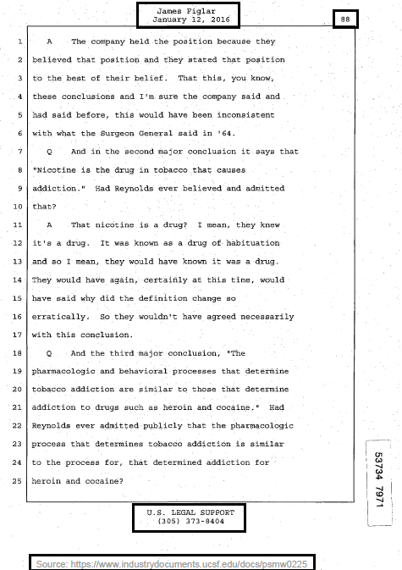
A Deposition Sample

Slide 4
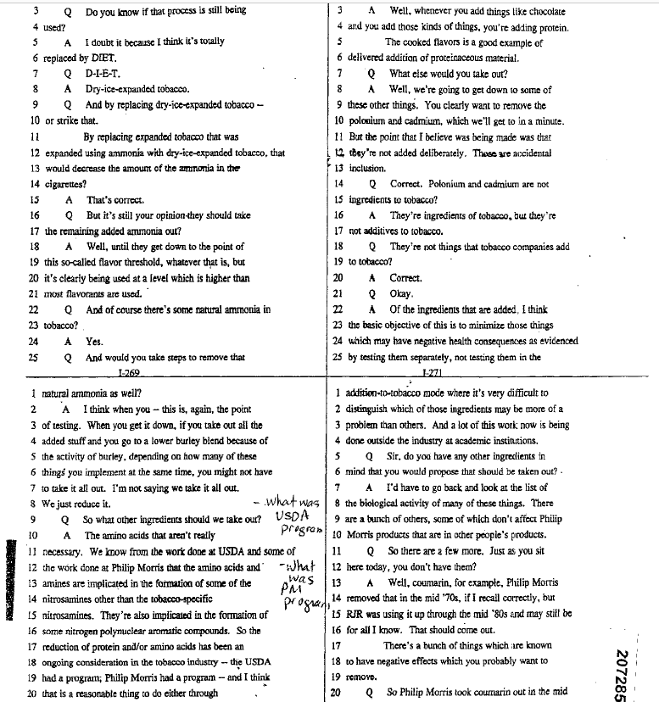
PARSING
CHALLENGES FACED
Varying number of columns per page

Slide 5
PARSING
CHALLENGES FACED
Header and footer elimination
“sourcehttpswww.industrydocuments.ucsf.edudocspsmw"
“January"
“Jamesfiglar"
“u.s.legalsupport"

Slide 6
Parsing
Legal depositions occur in:
txt ✅
doc/docx ✅
pdf ✅
rtf ✅
ptx ❌
Need a generalized way to read all file formats.
APACHE TIKA

Slide 7
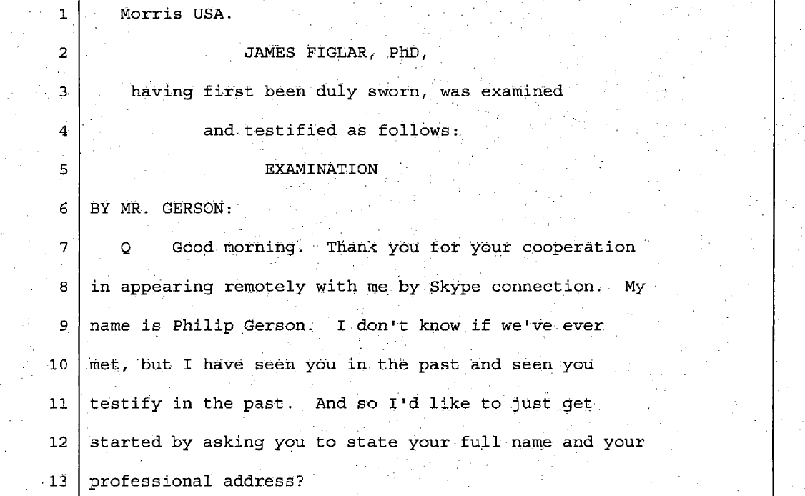
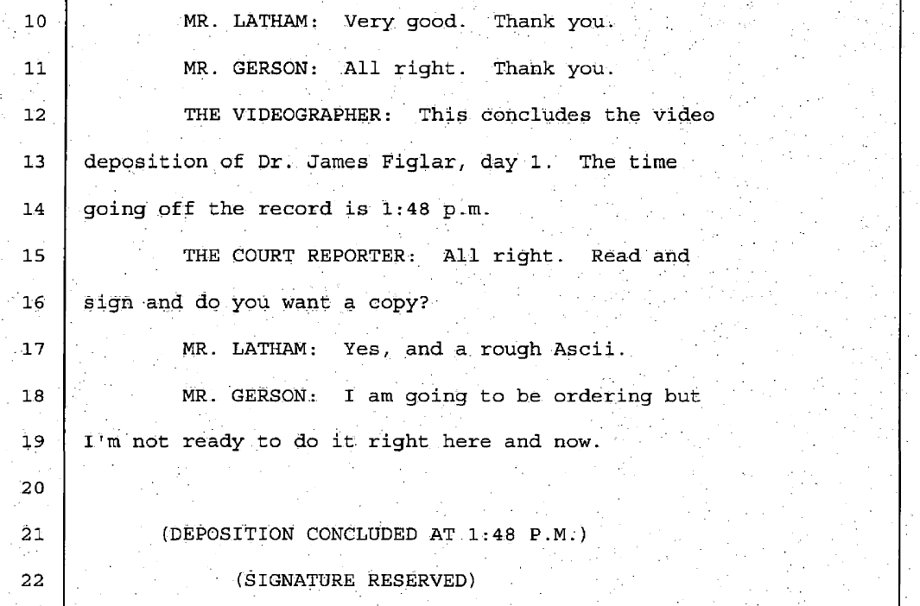
Parsing
Extract only the “EXAMINATION” segment
Remove
Headers and Footer
Timestamps
Page and line numbers
Retain
Question & answer tags
Speaker names
Intermittent speakers and what they spoke

Slide 8
Parsed Deposition

Slide 9
Comprehending Depositions - Challenges
Documents are noisy and only loosely follow grammatical rules.
Incomplete or abandoned sentences
Context spread across multiple QA pairs
Traditional NLP methods, like syntax parsing into dependency trees, struggle to find the root of the sentences.
➔ Dialog Acts …

Slide 10
Dialog Act (DA) - Definition
Dialog act represents the communicative intent behind a speaker’s utterance in a conversation.

Slide 11
Related Work
DA classification work for meeting transcripts and telephone exchange conversations
Used classical Machine Learning techniques like SVM, DBN, HMM, and CRF
➔ Tailor to depositions, with tailored ontology
➔ Use state-of-the-art Deep Learning methods: CNN, LSTM, BERT.
Notes:
Condense this to short sentences.

Slide 12
Dialog Act - Types
Questions
wh-* and wh-*-declarative- Which hip did you break?
binary and binary-declarative - Do you have a California driver's license?
open question - Do you currently or just in general do you have any hobbies?
or question - And were you working out for fun or were you into bodybuilding?
Answers
Yes and yes-declarative - definitely it is, yes sir.
No and no-declarative - I am afraid not
Statement opinion and non-opinion - I would say in July, I went to Los Angeles.
Acknowledge - Um-hum, Okay
Don’t know/recall - I can't remember which year it was.
Notes:
show the excel file for more examples if needed

Slide 13
Dialog Act Classification
Manually annotated sentences to their Dialog Acts (about 2500 QA’s total).
Train, validation, test split of 70:20:10
Deep Learning based classifiers.
CNN with Word2Vec embeddings
Bi-LSTM with attention
BERT embeddings with a final NN layer

Slide 14
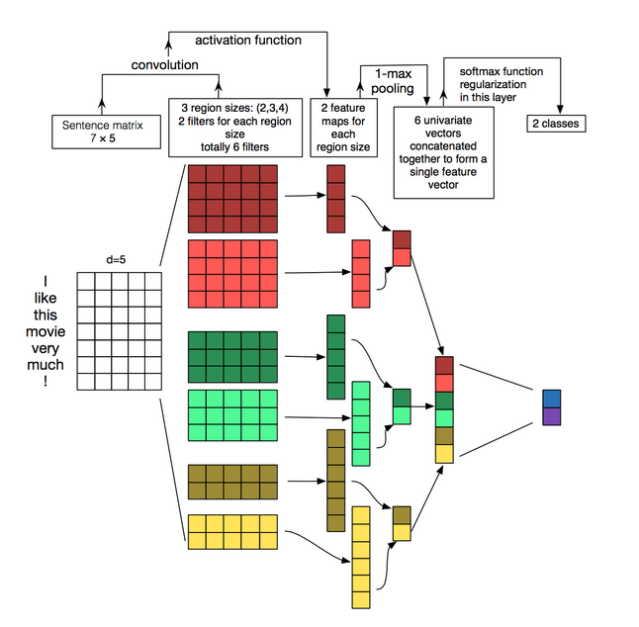
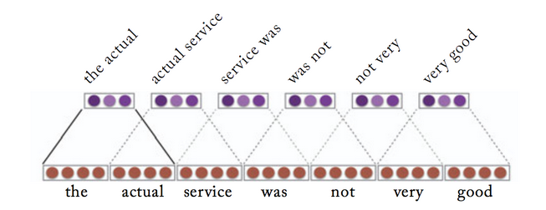
CNN-word2vec
Pre-trained word2vec → sentence matrix
unigram, bigram and trigram filter sizes → feature maps
Max-pooling → maximum feature
Feed-forward NN → classification

Slide 15
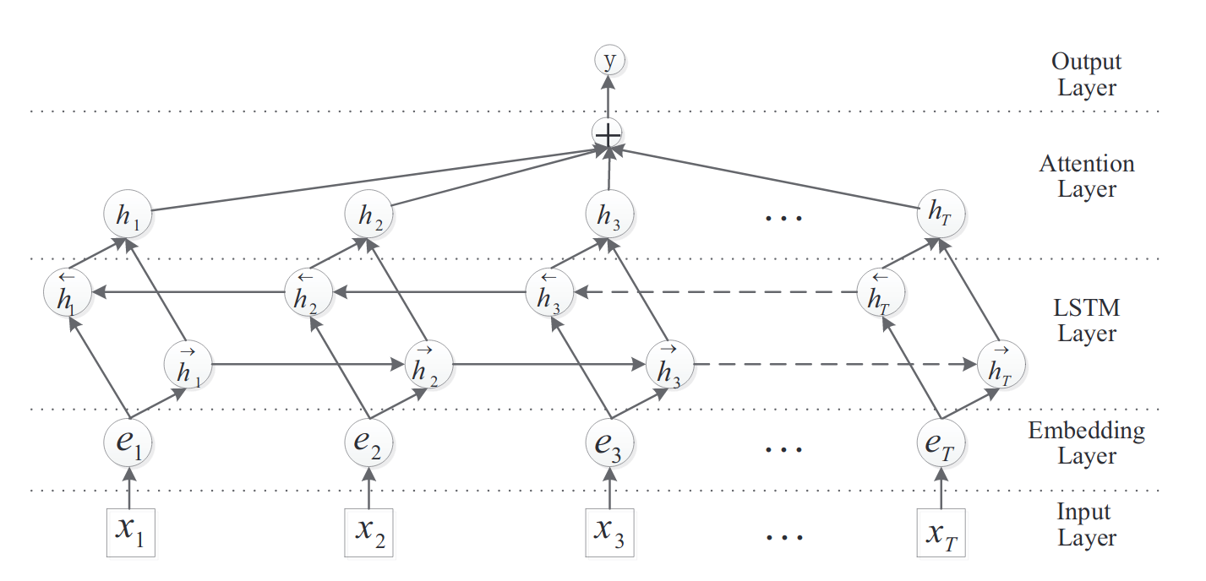
Bi-LSTM with Attention
Input layer → input sentence to tokens
Embedding layer → map each word to vector
Bi-LSTM layer → get high-level feature maps → capture long term semantic dependencies
Attention → merge word-level features from each time step into sentence-level feature
Output layer → softmax classifier → predict probabilities

Slide 16
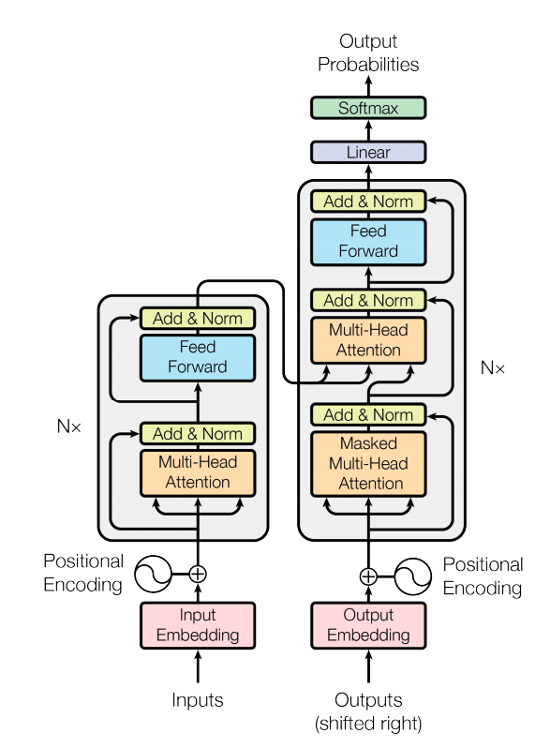
Transformer (BERT)
Encoder-decoder attention
Attention: word-level features → sentence-level feature (bi-directional)
Masked attention: word-level features → sentence-level feature (uni-directional)
Encoder: input sequence → sequence of continuous vectors
Decoder: generate output sequence one at a time
Notes:
WMT 2014 English-to-German and WMT 2014 English-to-French translation tasks

Slide 17
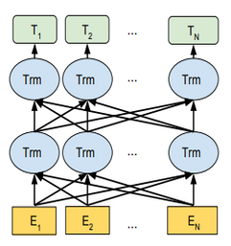
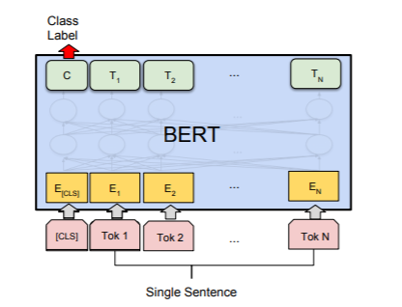
Pre-trained BERT
Bi-directional transformer layers
Uses bi-directional self-attention
Feed-forward NN layer on the top of pre-trained BERT
Standard softmax function computes the probability of the class label
Notes:
The first task was to guess a masked word in a sentence, where each sentence was from a large corpus. The authors removed a word randomly from a sentence and trained the model to predict the right word. The second task was predict the following sentence for a given sentence, from a choice of 4 sentences. The training was performed using BooksCorpus(800M words)[??] and English Wikipedia(2,500M words)[??].
We used the BERT-Base, Cased pre-trained model for our classification experiments.

Slide 18
DIALOG ACTS CLASSIFICATION
LSTM
Parameters | Values
hidden layer size | 64
Embedding size | 32
Learning late | 0.01
max-sequence length | 32
batch-size | 100
epochs | 30
Best fine-tuned parameters for the classifiers
CNN
Parameters | Values
hidden layer size | 100
dropout | 0.1
activation function | sigmoid
n-gram | Unigram (1)
max-sequence length | 32
batch-size | 100
epochs | 30
BERT
Parameters | Values
Learning late | 0.0005
max-sequence length | 32
batch-size | 100
epochs | 30

Slide 19
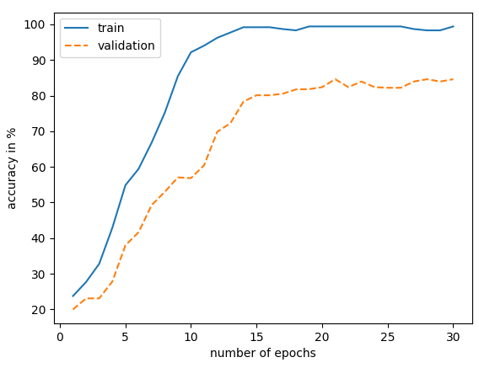
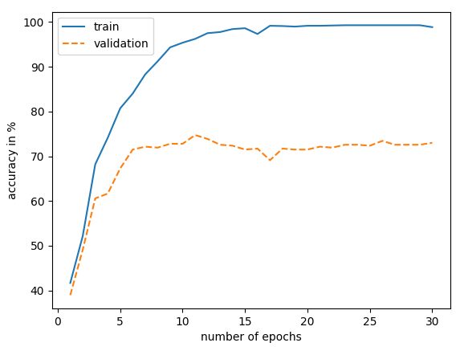
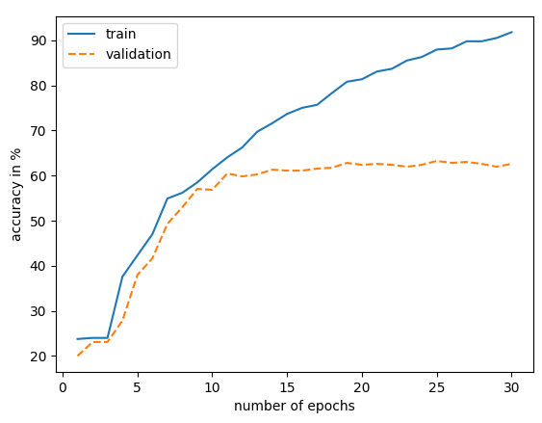
DIALOG ACTS CLASSIFICATION
Test accuracy and train accuracy across number of epochs
BERT
LSTM
CNN

Slide 20
Results – Tobacco Dataset
Classifier | F1 score
BERT | 0.84
CNN | 0.57
LSTM | 0.71

Slide 21
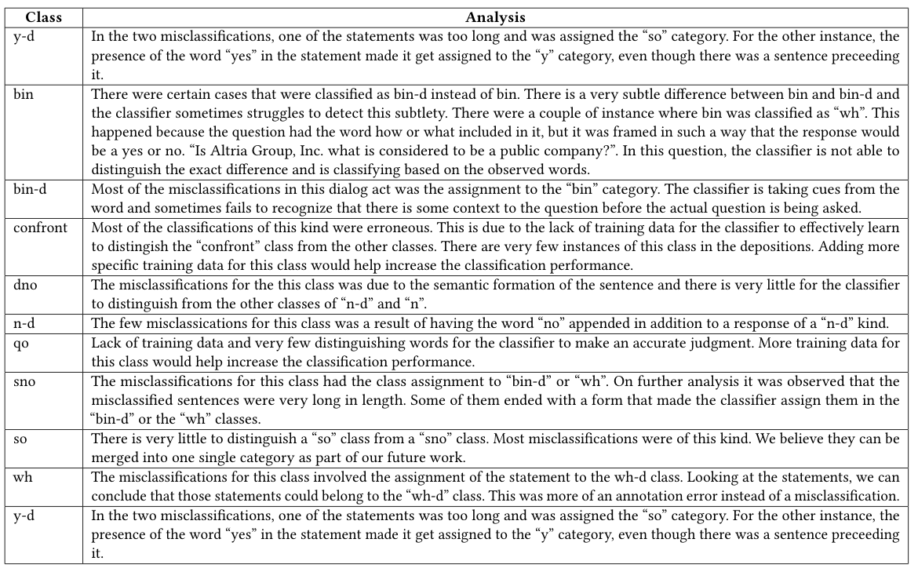
Misclassifications

Slide 22
Error Analysis Summary
Certain words like “yes” or “no” present in non-binary classes made the classifier assign binary labels.
Very little to distinguish between some classes like bin or bin-d
Classifier is unable to detect the presence of a context in the sentence; is just focusing on words.
Lack of training data for certain classes
Long sentences containing certain words induce bias during classification.

Slide 23
Conclusion
Defined dialog acts enriched based on legal domain (20 DA’s).
Created a dataset with 2500 manually annotated QA’s.
Designed three deep learning classifiers using reference implementations, and fine-tuned for classification of Dialog Acts.
Achieved 0.84 F1 with BERT, outperforming the CNN and LSTM based classifiers.
Dialog Acts classification could be useful in other downstream tasks like transformation and summarization.

Slide 24
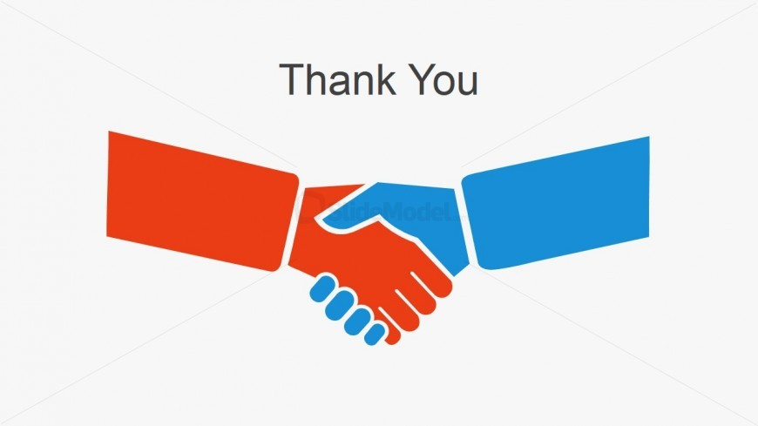
fox@vt.edu
http://fox.cs.vt.edu/talks/2019/20191206ScieneeringFoxASAIL.pptx

