Slide 1
“Information Friendly” Edward A. Fox, fox@vt.edu ENGE 1014, 11/15/2019
http://fox.cs.vt.edu/talks/2019/20191115ENGE1014Fox.pptx

Slide 2
Acknowledgements
Mentors: MIT– J.C.R. Licklider, M. Kessler; Cornell– G. Salton
Virginia Tech: CS, ECE; Digital Library Research Laboratory
NSF and many other sponsors
Students, colleagues, co-investigators (hundreds)

Slide 3
Working in CS Areas with Less Gender Imbalance
Information retrieval / digital libraries (closely related to library and information science, move toward iSchools)
Human-computer interaction (including social networks and informatics)
Collaboration with health, medical, biological and bio-informatics areas (+Reiki)
Collaboration with humanities and social/ behavioral sciences (e.g., NLP / computational linguistics)

Slide 4
Current Funded Grants (1 of 2)
IMLS LG: Opening Books and the National Corpus of Graduate Research, PI Bill Ingram
IMLS RE: Continuing Education to Advance Web Archiving, PI Zhiwu Xie
NIH: The Social Interactome of Recovery: Social Media as Therapy Development, PI Warren K. Bickel (VTCRI)
NSF CRISP : Coordinated, Behaviorally-Aware Recovery for Transportation and Power Disruptions (CBAR-tpd), PI Pamela Murray-Tuite
NSF I-Corps: Automated Summarization Technology, PI E. A. Fox
NSF IIS: Global Event and Trend Archive Research (GETAR), PI E. A. Fox
NSF OAC: CINES: A Scalable Cyberinfrastructure for Sustained Innovation in Network Engineering and Science, PI Madhav Marathe

Slide 5
Current Funded Grants (2 of 2)
NSF I-Corps: Automated Summarization Technology, PI E. A. Fox
NSF IIS: Global Event and Trend Archive Research (GETAR), PI E. A. Fox
NSF OAC: CINES: A Scalable Cyberinfrastructure for Sustained Innovation in Network Engineering and Science, PI Madhav Marathe

Slide 6
Word Cloud from Resume
Design of
INFORMATION
Access
Extraction
Representation
Retrieval
Systems
Technology
Theory
Viz
Libraries
Archives
Multimedia
Hypermedia
Text
WWW
Hypertext
Images
Search Engine
Crawling
Webpage
Links
Videos
Machine Learning
Mining
Analytics
Deep Learning
Relational
NLP
AI
Statistics
Database
Tables
Data
Knowledge
5

Slide 7
Information Life Cycle
Creation
Active
Authoring
Modifying
Social Context
Using
Creating
Organizing
Indexing
Retention
/ Mining
Accessing
Filtering
Storing
Retrieving
Semi-
Active
Utilization
Distributing
Networking
Inactive
Searching
6

Slide 8
Taxonomy of Services

Slide 9
Informal 5S and Digital Library Definitions
Digital libraries are complex systems that
help satisfy info needs of users (societies)
provide info services (scenarios)
organize info in usable ways (structures)
present info in usable ways (spaces)
communicate info with users (streams)

Slide 10
Information Systems

Slide 11
Digital Library Curriculum Framework

Slide 12
ETANA Digital Library for Archaeology
Lahav
D
A
T
A
B
A
S
E
W
R
A
P
P
E
R
S
Search
U
S
E
R
I
N
T
E
R
F
A
C
E
Browse
Nimrin
Recommend
Umayri
ETANA-DL
UNION
CATALOG
Note
Hisban
Personalize
Megiddo
Review
Jalul
Visualizations
Archaeology
Specific
…

Slide 13
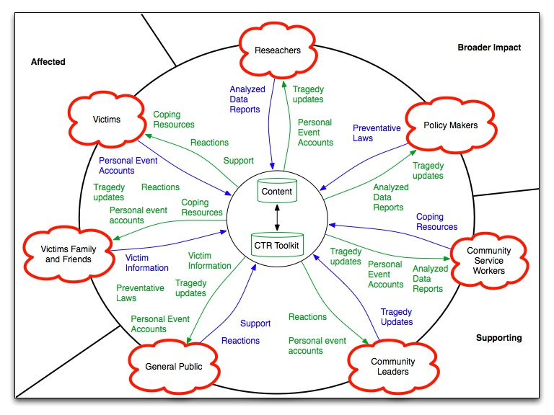
Event Archive and Library Stakeholders

Slide 14
Where Can You Fit in Computer Science?
CS – Looking Out:
Interaction: Games, Graphics, HCI, VR/AR
Programming: Algorithms, Languages, Problem Solving, Workflows
Simulation: Agents, Modeling: Epidemiology
KID: Knowledge, Information, Data: AI, Machine Learning
CS – Looking In:
HPC <-> PC <-> GPU
Networking
Programming
Algorithms,
Languages,
Problem Solving
Workflows
Systems
Theory

Slide 15
Conclusion; Questions?
At least learn: Computational Thinking
Volunteers and students from high school to Ph.D.
http://fox.cs.vt.edu
Feel free to contact: fox@vt.edu

