Slide 1
Big Data and Hadoop and DLRL
Introduction to the DLRL Hadoop Cluster
Sunshin Lee and Edward A. Fox
DLRL, CS, Virginia Tech
21 May 2015 presentation for QNL
Notes:
DLRL; digital library research lab

Slide 2
Google vs. Hadoop
Category | Google’s Papers | Hadoop solutions
File System | 2003 Google File System (GFS) | Hadoop File System (HDFS) | Distributed File System
 | 2010 Colossus | - | Improved GFS
Data Processing | 2004 MapReduce | Open Source MapReduce(MRv1), YARN (MRv2) | Distributed Processing
 | 2005 Google Big Table(Sawzall) | Hbase, Pig, Hive | Bigdata Query (Batch)
 | 2009 Pregel | Giraph | Graph processing
 | 2010 Dremel | Drill, Impala | Bigdata Query(Real time)
Notes:
After Google published papers, Hadoop also started to work on or released similar solutions.
Now it’s time to see Google’s Clusters

Slide 3
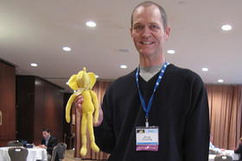
What is Big Data and Hadoop
Definition
  Big data
    a collection of data sets so large and complex that it becomes difficult to process using on-hand database management tools or traditional data processing applications.¹⁾
  Apache Hadoop
    a framework for distributed processing of large data sets across clusters of computers using simple programming models.²⁾
1) Big data definition: wikipedia.org
2) Hadoop definition: hadoop.apache.org
Notes:
Doug Cutting created open-source Hadoop Framework.
BigData
Hadoop
So, Apache Hadoop is one of the best solution for BigData
Let’s look at main two components in Hadoop

Slide 4

Hadoop solutions
Hadoop
  MapReduce (YARN: MapReduce V2)
    a programming model for processing large data sets with a parallel, distributed algorithm on a cluster.
  HDFS
    a distributed, scalable, and portable file-system written in Java for the Hadoop framework
Notes:
Main Two Component
MapReduce
HDFS
But this Hadoop is inspired by Google’s papers

Slide 5
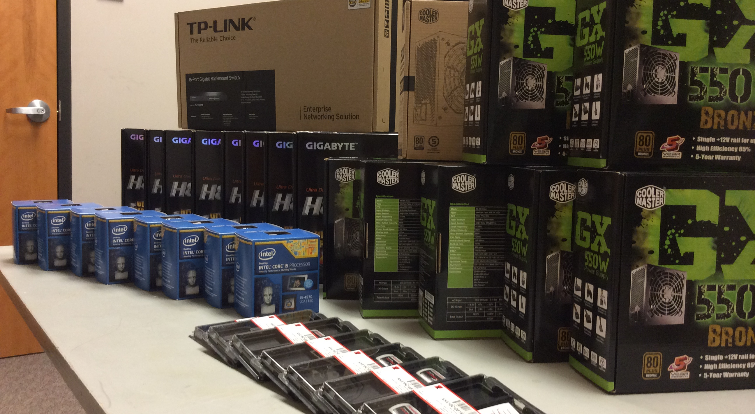
DLRL Cluster – Order Parts
Notes:
We ordered commodity parts like Google
But we also ordered Cases unlike Google.
Move: Mohamed

Slide 6
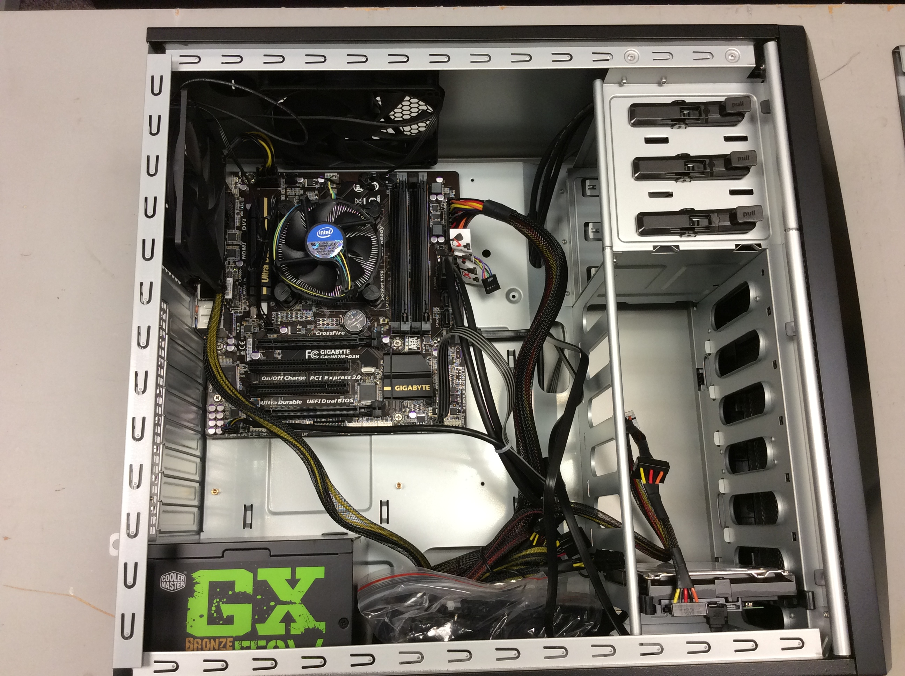
DLRL Cluster – Assemble
No-ODD such as DVD or CD-ROM
Notes:
We have case, so we don’t need to use wood or Velcro's

Slide 7
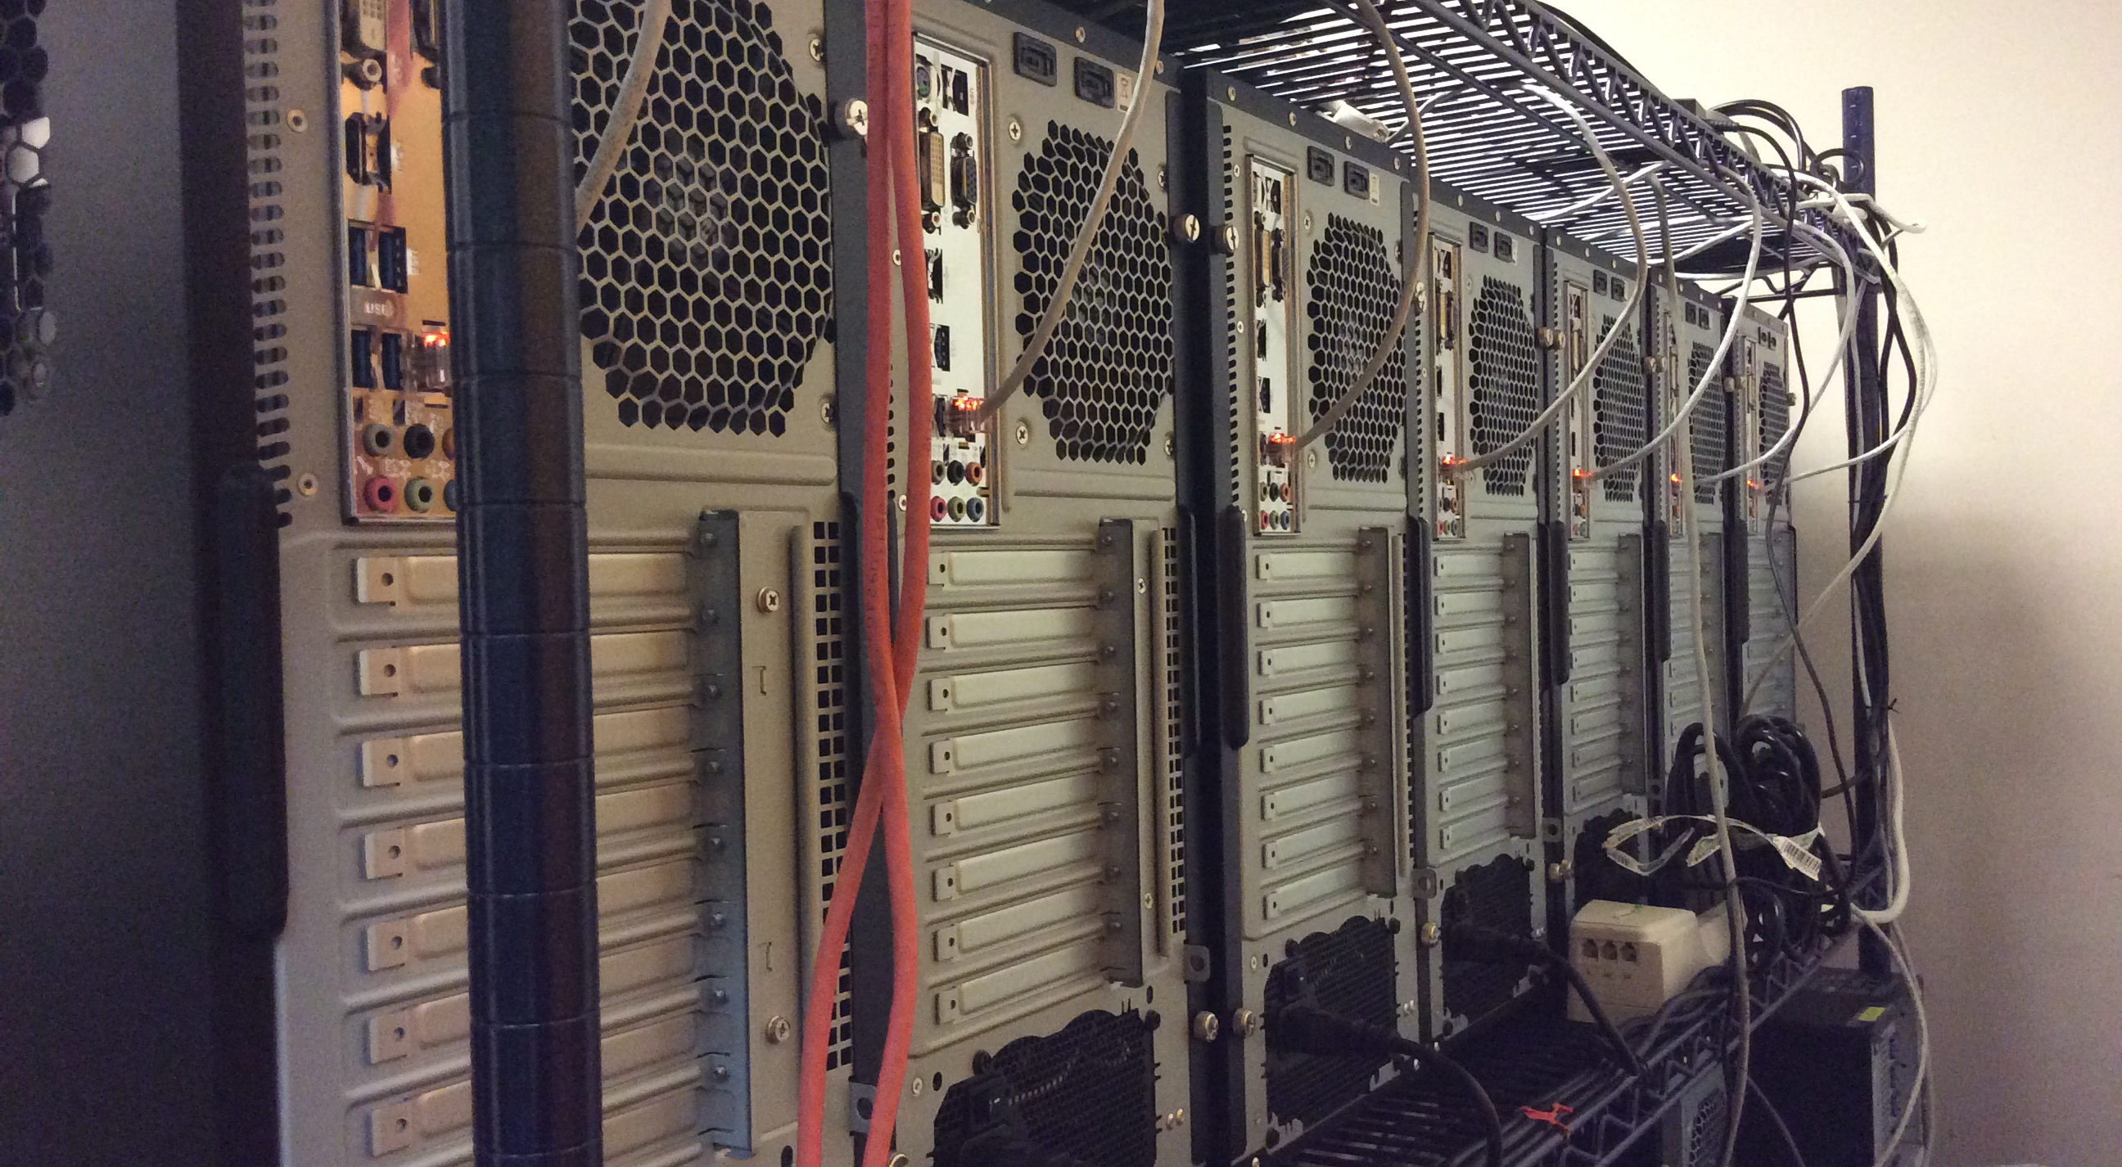
DLRL Cluster – Configure Network
Difficult things: configuring gateway(NAT) and Firewall

Slide 8
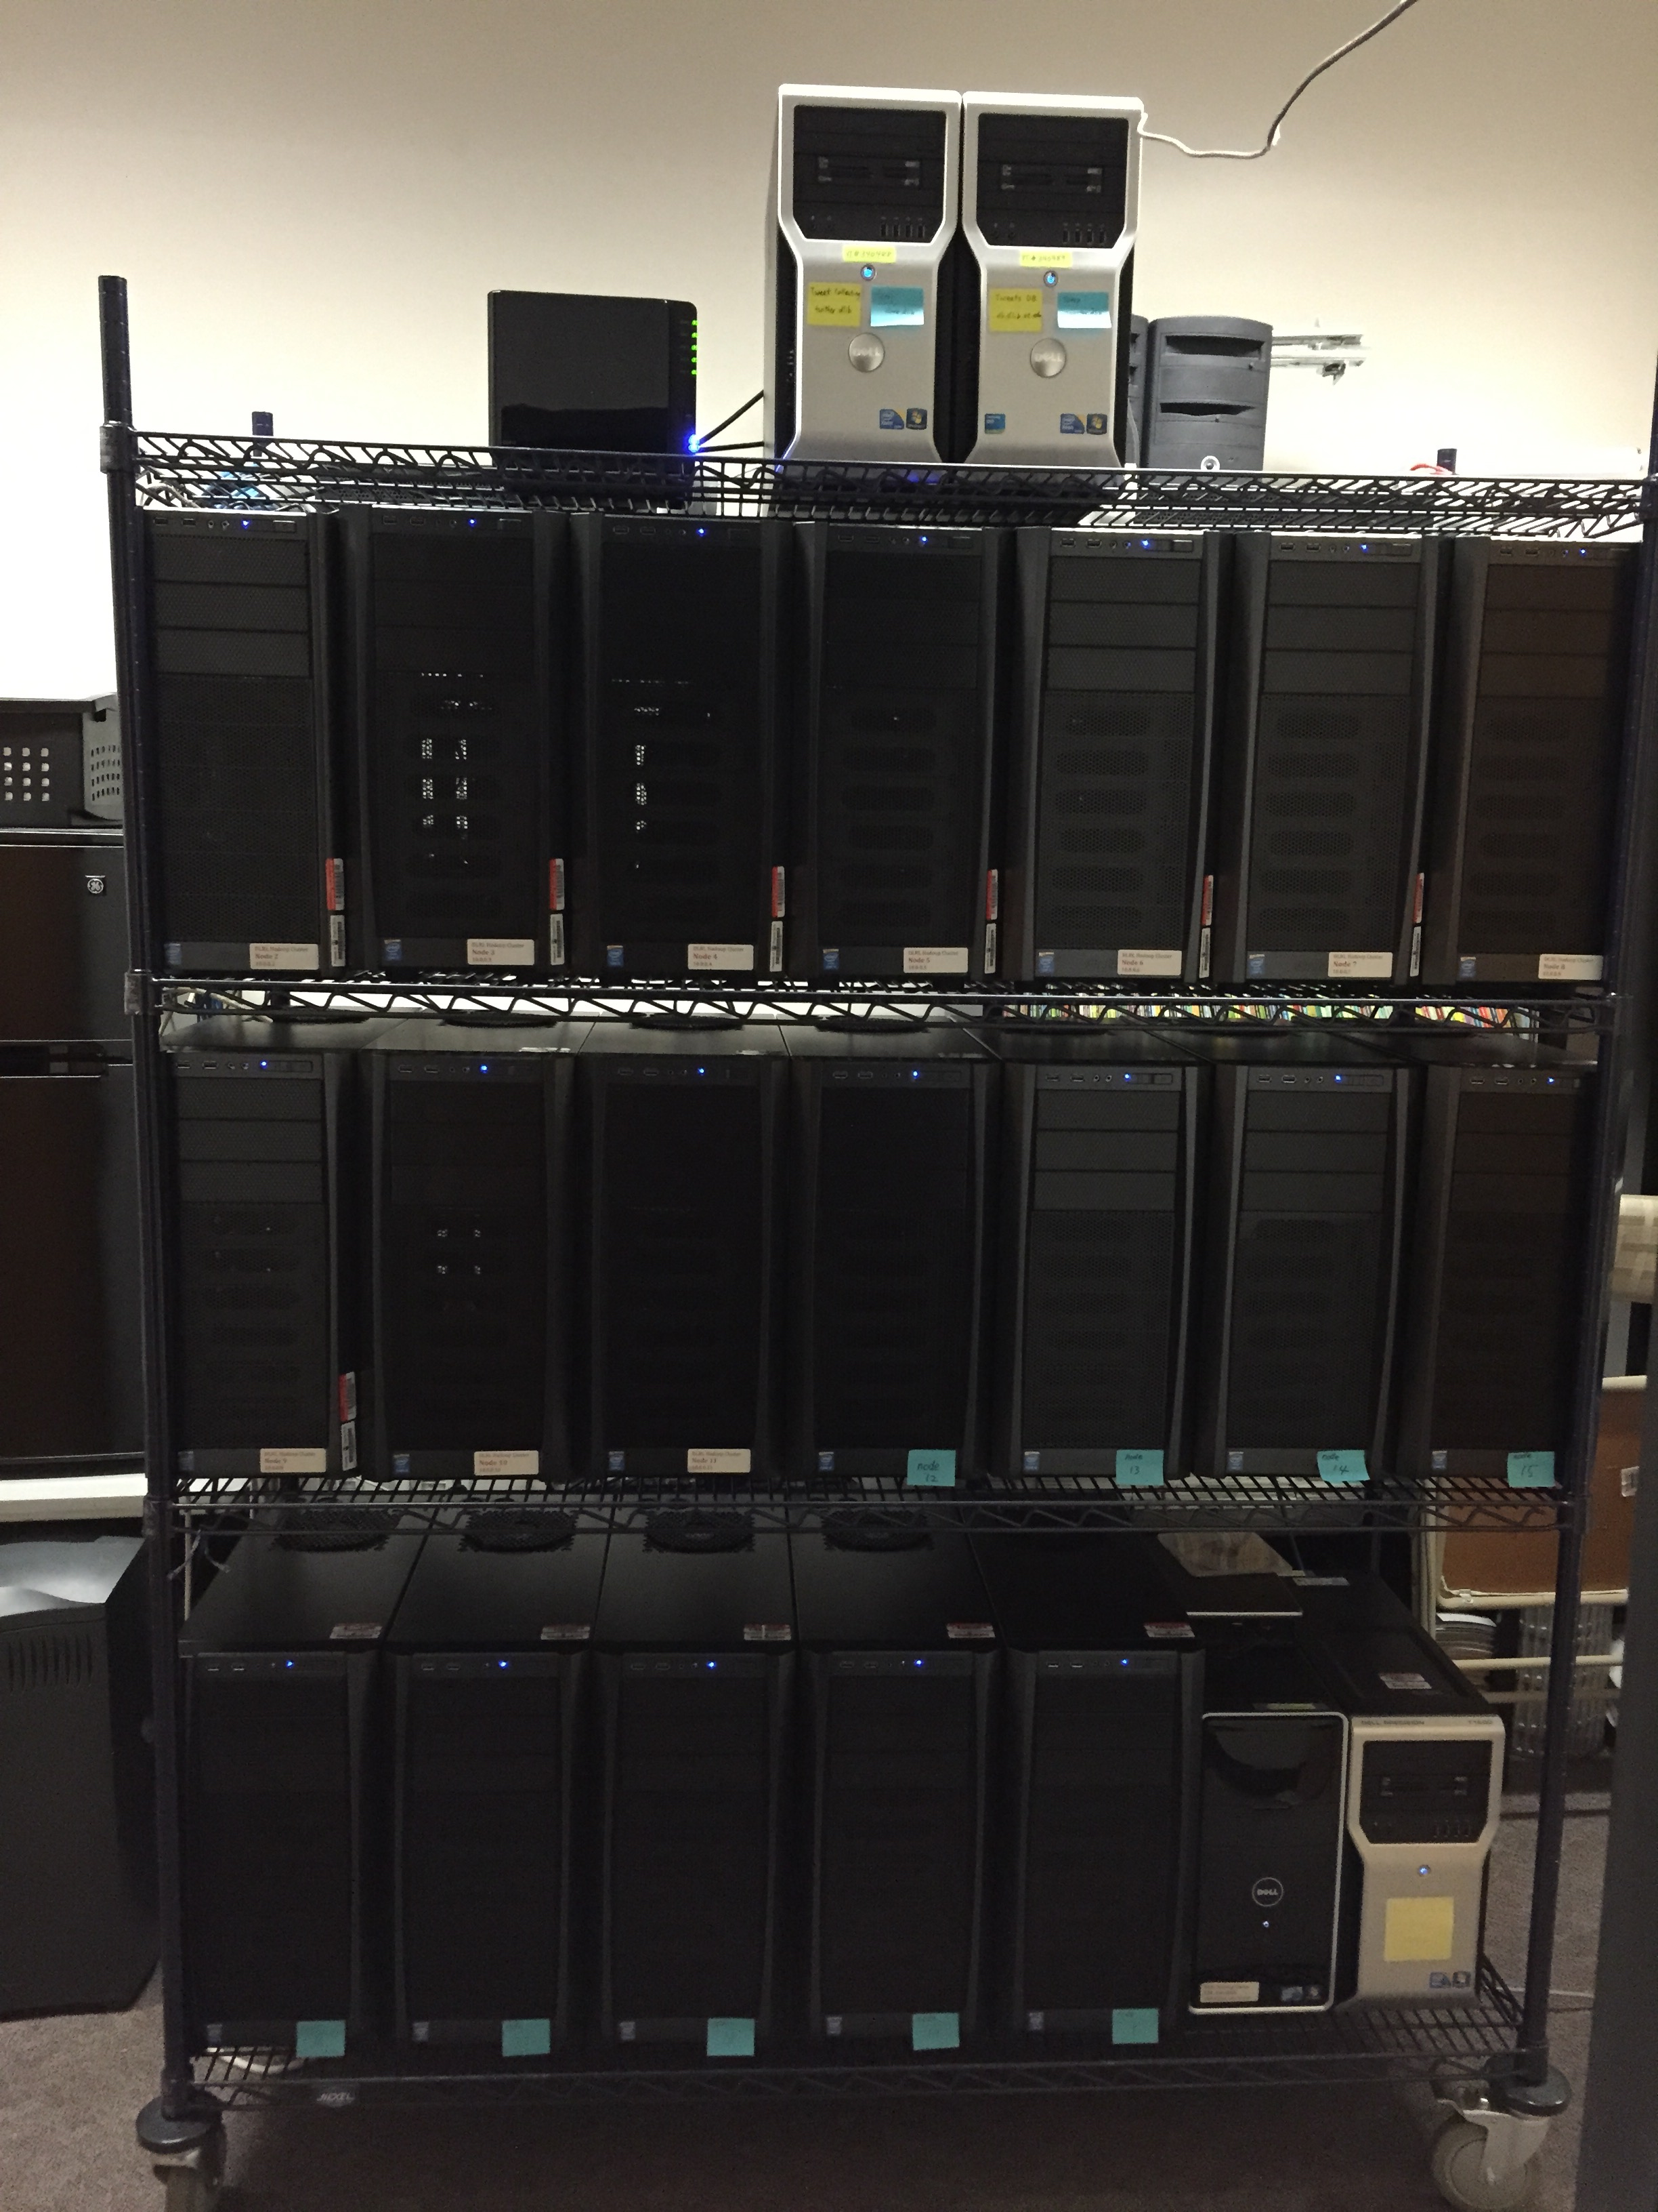
DLRL Cluster
Notes:
Looks Good?
We have case!!

Slide 9
DLRL Cluster Spec. – May 2015
# of Nodes: 20 + 4
  20 (Hadoop nodes) + 1 (manager node)
  1 (HDFS backup) + 2 (tweet DB nodes)
CPU: Intel i5 Haswell Quad core 3.3Ghz, Xeon
RAM: 692 GB
  32GB * 20 (Hadoop nodes) + 4GB * 1 (manger node)
  16GB * 1 (HDFS backup) + 16GB * 2 (tweet DB nodes)
HDD: 63 TB + 11.3TB (backup) + 1.256TB SSD
  3TB * 20 (Hadoop nodes, head node:6TB )
  3TB (HDFS backup), 1TB + 256GB SSD (Tweet DB nodes)
  8.3TB NAS Backup
Notes:
We need lots of RAM and HDD for Hadoop

Slide 10
DLRL Cluster - Architecture
Notes:
OS, Cloudera Manager, and CDH 5.0
Two networks
To build this system,

Slide 11
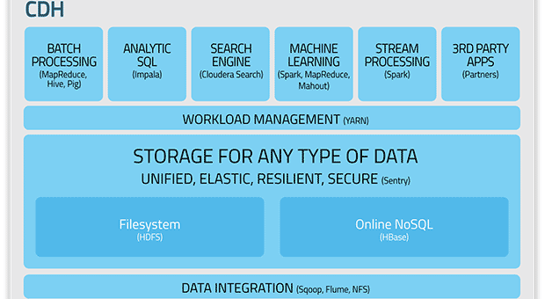
DLRL Cluster – Install Cloudera Hadoop

Slide 12
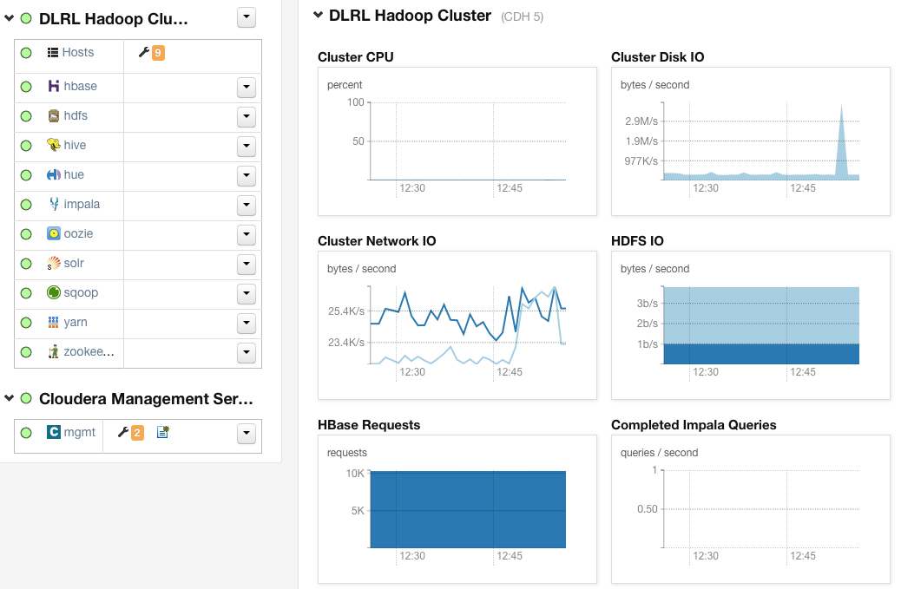
DLRL cluster - Services

Slide 13
Tools for research
Mahout: Classification, clustering, topic analysis (LDA), frequent patterns mining
Solr/Lucene: Search/(Faceted) Browse
Natural Language Processing and Named Entity Recognition
  Hadoop Streaming
  NLTK (Python) and SNER (Stanford NER)
Notes:
Hadoop Streaming
: The utility allows you to create and run Map/Reduce jobs with any executable or script as the mapper and/or the reducer

Slide 14
Hadoop Roles in IDEAL Project

Slide 15
CS4984 Projects in IDEAL Project

