Slide 1
ETD-db: Original
ETD-db 2.0: Enhanced
Gail McMillan
Director, Digital Library and Archives, Virginia Tech
and
Edward A. Fox, Executive Director, NDLTD
Newcomers’ Workshop @ ETD 2014
Leicester, England
July 23, 2014
Notes:
Virginia Tech and the NDLTD will help you jump start your ETD initiative. We provide open source ETD-db, software for processing ETDs from student submissions through approval and access. It is available FREE of charge to members of NDLTD.

Slide 2
Overview
ETD submission systems
ETD-db 1.0
Steps to extend ETD-db
ETD-db 2.0
Contact information

Slide 3
ETD Submission Systems
Earliest was ETD-db
  Adapted in many sites, e.g., TEDE in Brazil
Many now are integrated into an institutional repository, e.g., Dspace
ETD Drop: http://etd-drop.readthedocs.org
2013 poster by Stephanie Larrison
  https://conferences.tdl.org/tcdl/index.php/TCDL/TCDL2013/paper/viewFile/572/264
  also lists: Vireo, ETD Admin, EPrints, Digital Commons, and Jarrow

Slide 4
ETD-db is free to NDLTD members http://scholar.lib.vt.edu/ETD-db
Original version
  Authors enter their own metadata
  ETD database: workflow, processing
  ETD server: provides access
    Cataloging
    Backups
    Preservation
Extension: ETD-db 2.0
Notes:
Features such as open source and OAI harvestable metadata won’t change.
Next slide for design info about new and improved ETD-db

Slide 5
Notes:
This is where you can find ETD-db. Feel free to download it and look it over.

Slide 6
Notes:
This is what it looks like after the ETD was submitted and approved.

Slide 7
ETD-db 1.0
Workflow: submit, manage, search, browse
1995/97: James Powell, 1998/2001 Tony Atkins
  Technical Directors, VT Digital Library and Archives
Web applications, Perl, MySQL
Improvements suggested by
  Stakeholders (e.g., system admins, managers, authors)
  R. Jones 2004 article compares DSpace, ETD-db
Notes:
The ETD-db system is a digital repository system for submitting, searching, browsing, and managing ETD collections. It was originally developed by James Powell, the first technical Director of Virginia Tech’s precursor to DLA, the Scholarly Communications Project. In 1998 the Digital Library and Archives 2nd Technical Director, Tony Atkins, upgraded Powell’s work, which has been functioning beautifully for over a decade with patches and band aids by our subsequent Technical Directors and Systems Administrators, including, currently, Paul Mather.
Virginia Tech has been using ETD-db system as its main repository since we required the first ETD in Jan. 1997. In addition to born digital ETDs, paper versions of theses and dissertation have been scanned and integrated into the ETD-db system. Currently, the VT-ETD db hosts over 19,000 ETDs.
In Oct. 2010 Virginia Tech was honored by OCLC when the one millionth ETD harvested into WorldCat via the Digital Collection Gateway was by Xingwei Wang, who completed her doctorate at Virginia Tech in electrical and computer engineering. Her dissertation was titled "Label-free DNA Sequence Detection …” and can be viewed at http://scholar.lib.vt.edu/theses/available/etd-08142006-211154/.
Over the years since ETD-db has been in production, stakeholders (e.g., system administrators, managers, reviewers, authors) have suggested various improvements. Moreover, a researcher compared DSpace ("DSpace home page,") to the ETD-db system when choosing software to manage ETDs and pointed out some advantages of ETD-db compared to DSpace. ETD db 1.7c and DSpace v1.1.1 had already been compared by Jones (Jones, 2004).

Slide 8
ETD-db 2.0
Rewrite of VT’s ETD processing software
  Collin Brittle, Kimberli Weeks, Sung Hee Park
Major objectives
  Improve the original, powerful functionalities
  More reliable and safer system:
    Role management, Finer-grained permissions
Ruby on Rails
  Open source web application framework
  Any database, Any server supported by Ruby on Rails
http://dl.cs.uct.ac.za/conferences/etd2011/papers/etd2011_park.pdf
Notes:
A new version of Virginia Tech’s ETD digital library system, which is still based on free, open-source software.
Among the requirements, we focused on (1) improving the single password per role and (2) supporting fine-grained access control as new features for administration and security.
Improving one single password per role: In ETD-db, one password per role exists even though more than two users have the same role (e.g., there are multiple Graduate School reviewers). ETD-db 2.0 is a more reliable and safer system; role management functionalities with finer-grained permissions need to be extended to multiple admin users.
Supporting fine-grained access control: Currently, ETD-db provides different access permissions to different databases. For example, ETD-db 1.0 has submitted, available, and withheld ETD databases. System administrators, managers, or reviewers have access to all ETD databases while authors have access permission only to the submitted ETD database. Different roles should not have only database-level access permission, but also digital object-level and action-level access permission for more secure access control.
ETD-db 2.0 is a Web application using Ruby on Rails that continues to work with any database (e.g., MySQL, PostgreSQL, Oracle, etc.) and is hosted by any Web server supported by Ruby on Rails (e.g., Apache). The major objectives of rewriting ETD-db were to (1) to improve the original powerful functionalities of the current ETD-db, and, (2) to handle ETD collections more reliably and securely.

Slide 9
Use Cases
Notes:
To provide new, reliable, and secure features, we conducted interviews. We talked to current ETD-db users, including system administrators, managers, and authors, as well as catalogers and graduate school reviewers. Sung Hee analyzed their requirements using the Use Case Based Requirement Engineering approach.
This diagrams the use cases. Blue represents new features for ETD-db 2.0 and yellow indicates features of the existing ETD-db system.

Slide 10
Notes:
Your institution could become part of the ETD Preservation Network, whether you use ETD-db or another system. More discussion on preservation will occur in later talks.

Slide 11
ETD-db: Student Authors
Login with university PID and password
Metadata
  Derived from university records (e.g., Banner and Plan of Study) (2.0)
  Authors enter: keywords, copyright/permission
Author select access level
  Open access (unrestricted)
  Originating university community-only (restricted)
  No access (embargoed/withheld/inaccessible)
  Mix of the above (for different parts)
Faculty: online approval (2.0)
Notes:
ETD-db is run by the library. ETDs are submitted to the DLA/library server.

Slide 12
ETD-db: Graduate School
Processes ETDs submitted by authors
  Stored on library’s ETD server
Graduate School personnel login
  Access submitted ETDs
  Email with authors as needed (tracked/audited)
  Approve ETDs
Notes:
Graduate School staff login into library server to process ETDs.

Slide 13
ETD-db: Graduate School
Approving an ETD automatically generates
  3 email notifications
    Author – Congratulations!
    Committee w/URL
    UMI/ProQuest: author, title, institution, URL
  Directory/list of ETDs for Library Cataloging
  Accessible immediately
    Author selected 1 of 4 levels: everyone, university-only, no one, mix of these options
    Automatically publicly available when temporary period of restricted access expires (2.0)
Notes:
As soon as the Graduate School staff approve an ETD, it immediately becomes available at the level of access the author selected. Restrictions and embargoes usually last one year.

Slide 14
ETD-db 2.0
Requirements
  Reviewed current ETD workflows
  Interviewed users (e.g., reviewers, administrators, students)
  Chose Ruby on Rails
    Free, open source software
    Web applications
    Any database application, Any server
    More reliable and secure
    Enhanced ETD-db 1.0 features (e.g., workflow, automatic notifications, OAI-PMH, etc.)

Slide 15
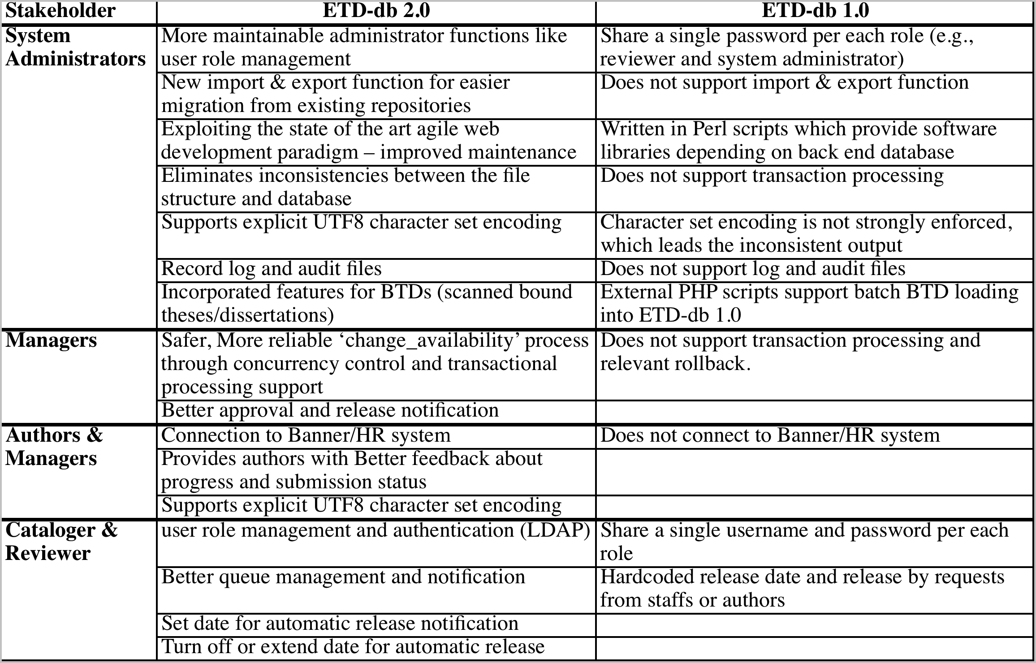
Discussion
Notes:
This table articulates the improvements of ETD-db 2.0, and compares it to the current ETD-db. The more technically-minded may want to refer to Sung Hee Park’s paper in the 2011 conference proceedings.

Slide 16
VT handling of ETDs now
Scanning old works: BTDs
Doctoral Dissertations: 8879
Masters' Theses: 13548
IR local: http://vtechworks.lib.vt.edu/handle/10919/5534
IR individuals: http://vtechworks.lib.vt.edu/handle/10919/18725
CS: http://dopey.cs.vt.edu/etd/about.php
Notes:
Graduate School staff login into library server to process ETDs.

Slide 17
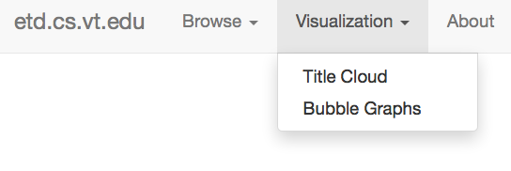
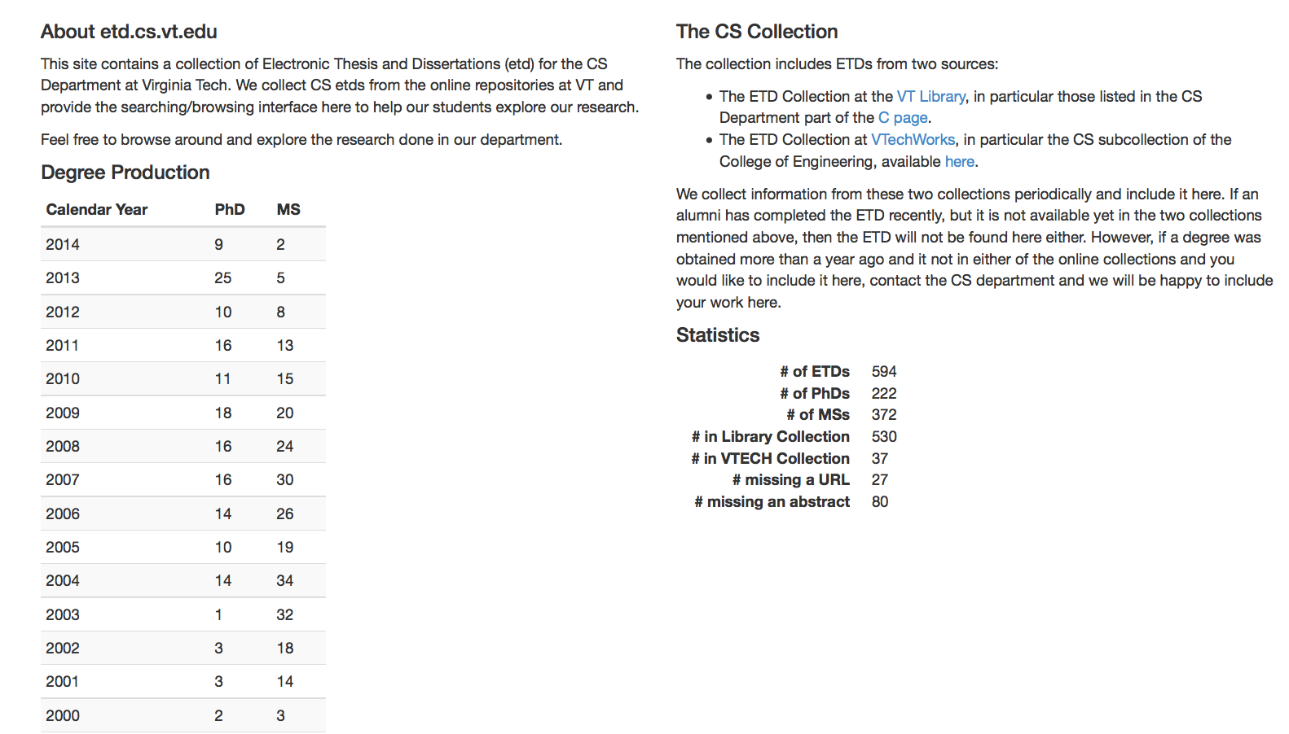

Slide 18
Conclusion & Future Work on ETD-db
Improved reliability and security
  Fine-grained access control, increased audit logging
  Eliminate inconsistencies between file structure and database, and between contents and metadata
  More reliable content management, content integrity, version control
Plans and Future Work
  Access and integrate Banner system
  Implement audit logging and provenance, import and export
Notes:
ETD-db 2.0 improves the current ETD-db system in terms of reliability and security benefiting to all stakeholders (e.g., libraries, graduate schools, and contributors) including users (e.g., system administrators, managers, reviewers, catalogers, authors, etc).
Security issues have been improved by fine-grained access control, increased audit logging, and maintenance eliminating inconsistencies between the file structure and the database. In addition, more reliable content management has been accomplished by increasing the consistency between contents and their metadata, ensuring content integrity, and implementing version control for each ETD.
We still have work to do to test and implement ETD-db 2.0. We have gotten permission to extract information from the online human resources system (VT Banner). We accomplished audit logging and provenance for seamless communication between author and reviewer, and the import/export function.

Slide 19
For More Information
Updates: http://scholar.lib.vt.edu/theses
Email: ETD-db@scholar.lib.vt.edu
Comment and/or Questions?
Collin Brittle, rotated8@vt.edu
Gail McMillan, gailmac@vt.edu
Ed Fox, fox@vt.edu

